Slide 1
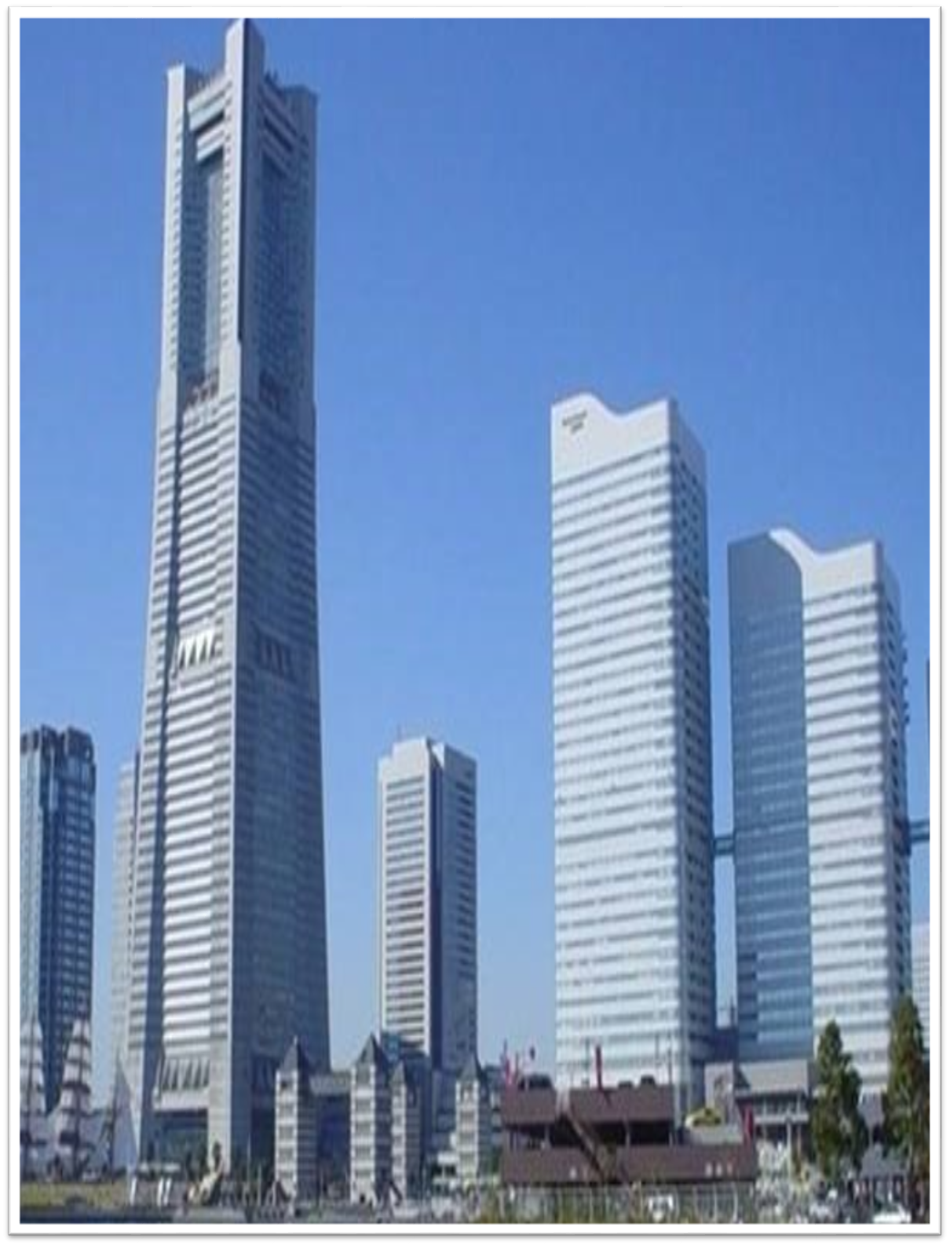

Faculty of Engineering & Information Technology
Department of Civil Engineer
Graduation Project II
Design & Analysis for AL-Sha`ar Building in Nabluse City
Prepared By:
Ammar Khader Amr
Linda Fares Bsharat
Qusai Khaled Khalifa
Rami Omar Daraghmeh
Under supervision of: Dr. Mohammad Samaaneh

Slide 2
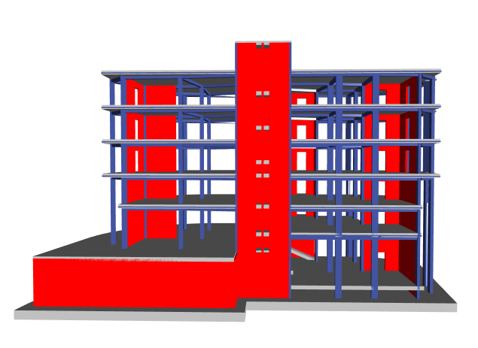
Contents
1
2
3
Introduction
Preliminary Dimensions
Modeling Using ETABs
4
5
6
Seismic Force Analysis
Design for Structural Elements
Design of Footing
7
Shear Wall

Slide 3
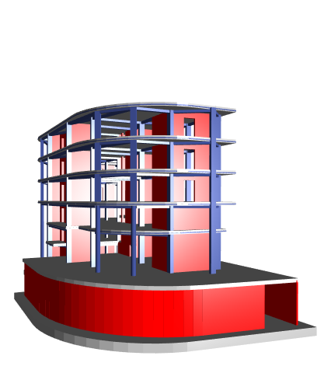
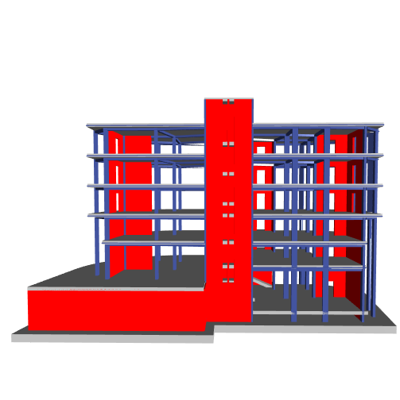
Side View
Front View

Slide 4
1
Introduction
1.1: Project Description
The project is a residential and commercial building, located in the city of Nablus in Palestine, and consists of 6 floors, ground floor and basement level and enchanted floor and three floors of a total area of 2636 square meters.
Consistence and use of floor | Area (m2) | Floor
commercial | 401 | Ground floor
Residential and commercial | 397.3 | First floor
Residential | 3*436.17 | Residential floors 2-4

Slide 5

1
Introduction
1.2: Codes & Materials
Codes:
ACI318-14
ASCE7-10
IBC-2015
Materials:
Concrete $f^{′}c=28MPa$
Reinforcing Steel Fy = 420 MPa

Slide 6
1
Introduction
1.3: Loads
1.3.1: Load Types
(1)Dead Load:
consist of the own weight of the structure.
•Main Beams(450*300) weight = 4045kN
•Columns weight = 3410 kN
•Shear wall weight = 8919kN
•Slab weight = 14619kN
Total weight due to dead loads = 30994 kN

Slide 7
1
Introduction
1.3: Loads
Usage | Live Load (KN/m²)
Residential buildings | 2
Commercial | 4
Roof | 10
Parking | 10
1.3.1: Load Types
(2)Live Load:
include any temporary or transient forces .
Total live load =12594.4 KN

Slide 8
1
Introduction
1.3: Loads
1.3.1: Load Types
(3)Superimposed Load:
come from the weight of all non-structural elements.
Item | Unit weight Ɣ (KN/m³) | Thickness (cm) | Calculations | Weight per m² (KN/m²)
Mortar | 23 | 3 | 0.03*23 | 0.69
Tiles | 26 | 1 | 0.01*26 | 0.26
Filling | 18 | 5 | 0.05*18 | 0.90
Plastering | 23 | 1 | 0.01*23 | 0.23
Total Super Dead Load |  |  |  | 2.08

Slide 9
1
Introduction
1.3: Loads
1.3.2: Load Combinations
ULTIMATE:
1.4 D.L.
1.2 D.L. + 1.6 L.L.

Slide 10
1
Introduction
1.3: Loads
1.3.2: Load Combinations
SEISMIC:
1.2 D + 1L +EX+EV
1.2 D + 1L - EX+EV
0.9 D + EX + EV
0.9 D - EX + EV
1.2D+L-Ey+Ev
1.2D+L+Ey+Ev
0.9+L+Ey+Ev
0.9+L-Ey+Ev

Slide 11
1
Introduction
1.3: Loads
1.3.2: Load Combinations
SERVICE:
1D + 1L
1D+0.7Ev+0.7Eh
1D+(0.75(.0.7Ev+0.7Eh))+0.25L
0.6D-0.7Ev+0.7Eh
Also the same of this load combinations in other direction.

Slide 12
Beams
Main Beams
Secondary Beam
Preliminary Dimensions
Slab
Columns
Circular
Square

Slide 13
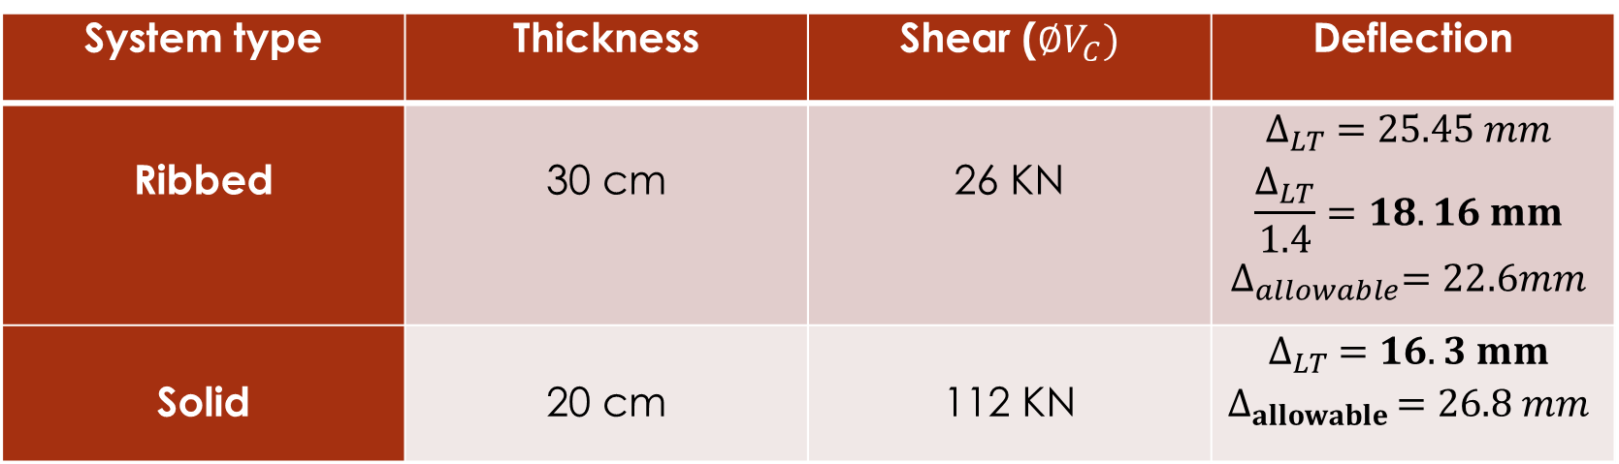
2
Preliminary Dimensions
2.1: Slab
After comparing between two systems (Two-Way Ribbed Slab and Two-Way Solid Slab)_as table bellow_
We decide to use Two-Way Solid Slab.
System type | Thickness | Shear ($∅V_{C})$ | Deflection
Ribbed | 30 cm | 26 KN | $$∆_{LT} =25.45 mm$$ $$\frac{∆_{LT}}{1.4}=18.16 mm$$ $$∆_{allowable}=22.6mm$$
Solid | 20 cm | 112 KN | $$∆_{LT} =16.3 mm$$ $$∆_{allowable }=26.8 mm$$

Slide 14
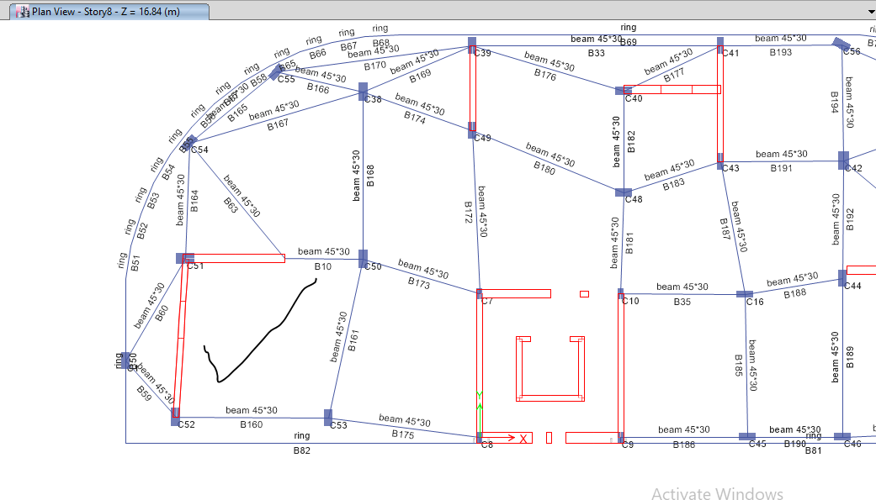

2
Preliminary Dimensions
2.1: Slab
Two-Way Solid Slab
we took critical panel
Slab thickness h = 20 cm
h = $\frac{Ln∗(0.8+\frac{Fy}{1400})}{36+9β}$ ; β= $\frac{5.756}{5.424}=1.061$
h = $\frac{7.256∗(0.8+\frac{420}{1400})}{36+9∗1,061}=175mm$

Slide 15
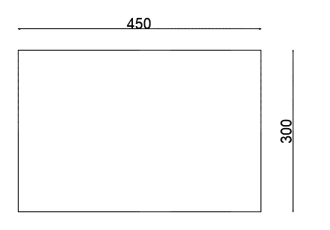
2
Preliminary Dimensions
2.2: Beams
Main Beams(drop)
= 450 * 300 mm
Secondary Beam(drop)
(around the structure)

Slide 16
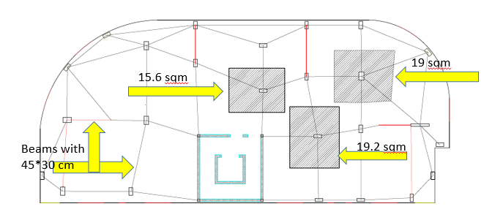
2
Preliminary Dimensions
2.2: Columns
Rectangular Column Dimensions
We used three dimensions for columns:
600*300 mm
600*250 mm
650*400 mm

Slide 17
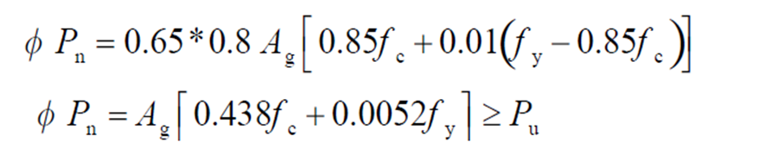

2
Preliminary Dimensions
2.2: Columns
Tributary area for the column = 3.44*5.79 = 19.92 $m^{2}$
Wu =1.2WD+1.6WL
=1.2(0.22*25+2.08) + 1.6*4=15.5 kN
Load on the column = Wu * tributary area
= 15.5* 19.92 = 308.76 KN= Pu
∅Pn = 1371 KN
∅Pn > Pu ➔ OK

Slide 18
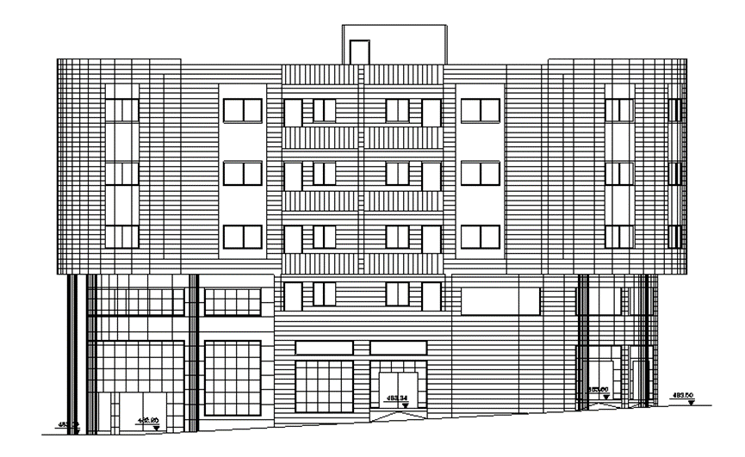
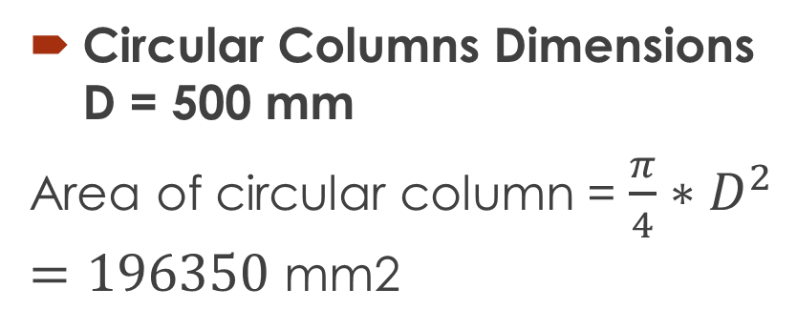
2
Preliminary Dimensions
2.2: Columns
Circular Columns Dimensions D = 500 mm
Area of circular column = $\frac{π}{4}∗D^{2}=196350$ mm2
Circular Column

Slide 19
3
Modeling Using ETABs
3.1: Model Checks
Compatibility check
Equilibrium check
Internal force check ( stress – srain check )
Deflection check

Slide 20
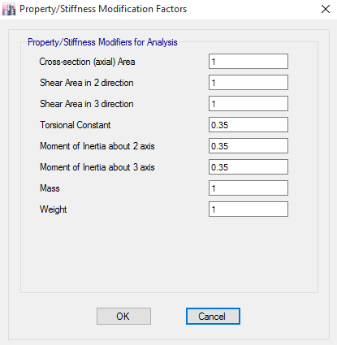
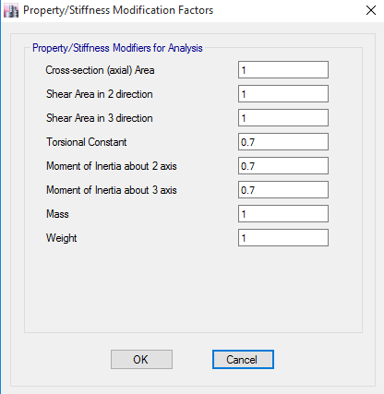
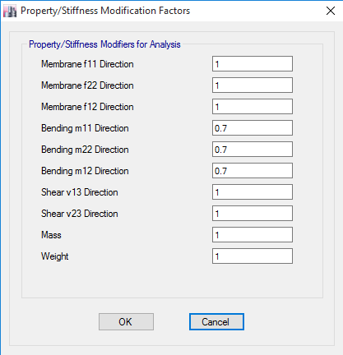
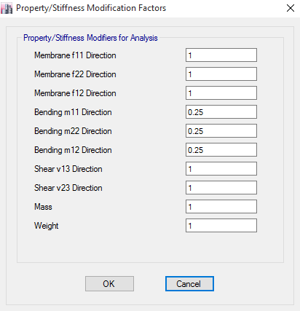
3
Modeling Using ETABs
3.2: Element modifiers

Slide 21
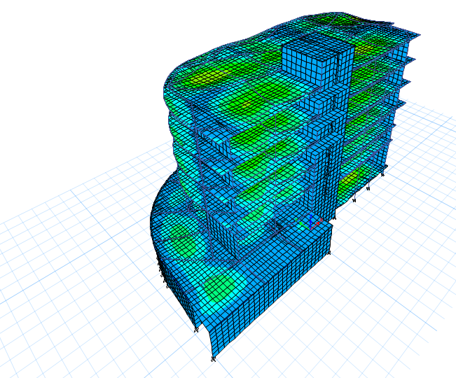
3
Modeling Using ETABs
3.1: Model Checks
3.1.1: Compatibility Check
As picture show
There is large
compatibility

Slide 22
3
Modeling Using ETABs
3.1: Model Checks
3.1.2: Equilibrium check
 | Manual | From ETAB’s | %Error
LIVE LOAD | 13272.2 | 13278 | 0.04%
DEAD LOAD | 30994 | 30080 | 2.9%
SD LOAD | 13215.375 | 13222 | 0.05%
All values less than 5 %, So it`s OK

Slide 23
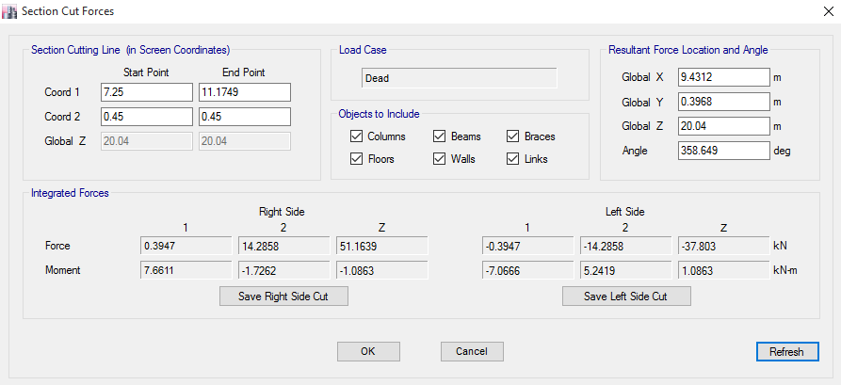
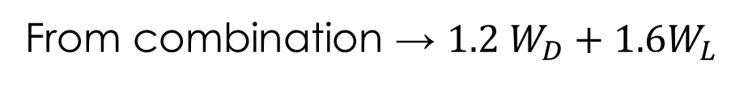
3
Modeling Using ETABs
3.1: Model Checks
3.1.3: Internal force check
From combination → ${1.2 W}_{D}+{1.6W}_{L}$

Slide 24
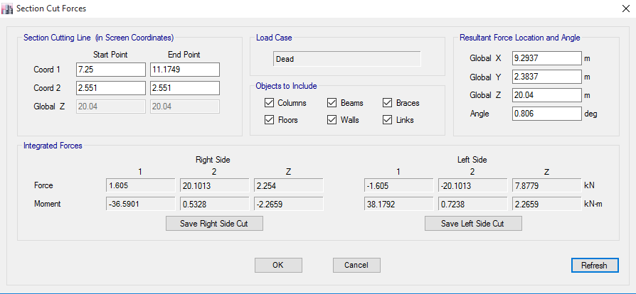
3
Modeling Using ETABs
3.1: Model Checks
3.1.3: Internal force check

Slide 25
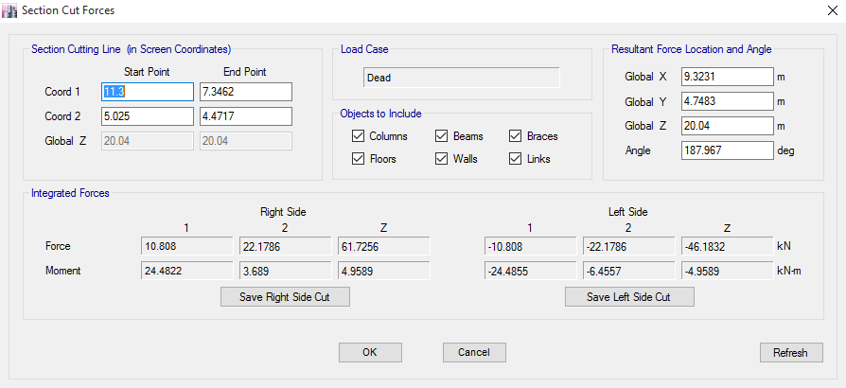
3
Modeling Using ETABs
3.1: Model Checks
3.1.3: Internal force check
Ln = 4.8 m
Q = 5kN/m2
M = Ln2 * L2 * Q/ 8
= 56.52 kN.m
From ETABs = 54.1 kN.m
% diff. = 3.7 % < 25%
It`s OK

Slide 26
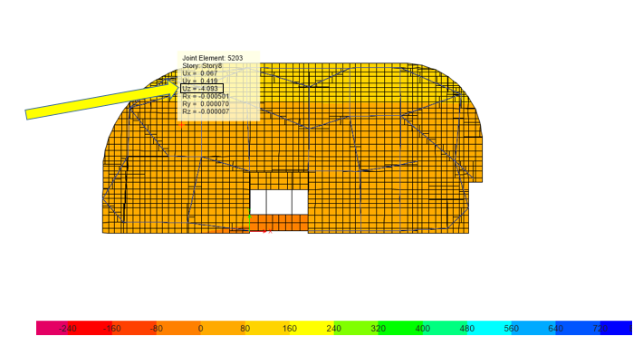

3
Modeling Using ETABs
3.1: Model Checks
3.1.4: Deflection check
Live: $∆$=4.03mm

Slide 27
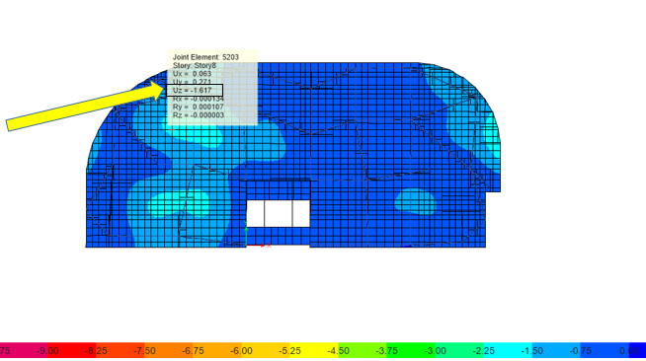
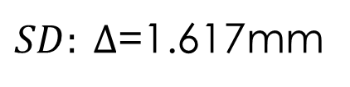
3
Modeling Using ETABs
3.1: Model Checks
3.1.4: Deflection check
$SD: ∆$=1.617mm

Slide 28
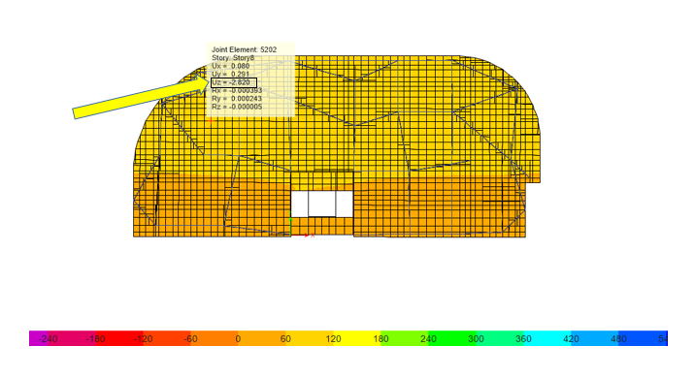
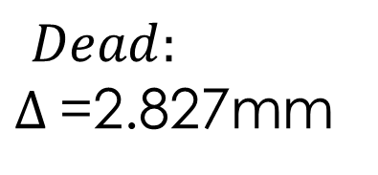
3
Modeling Using ETABs
3.1: Model Checks
3.1.4: Deflection check
$$Dead:$$
$∆$=2.827mm

Slide 29
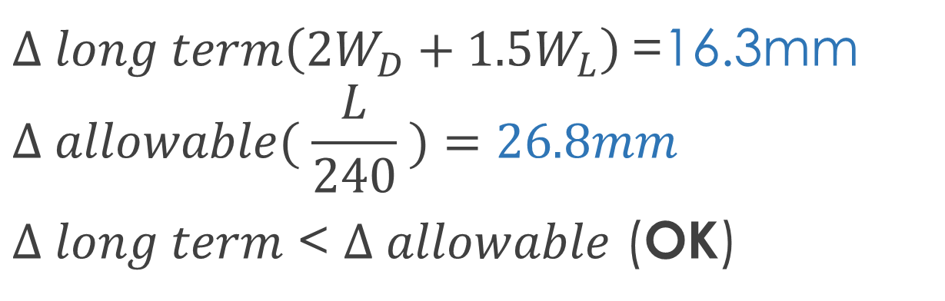
3
Modeling Using ETABs
3.1: Model Checks
3.1.4: Deflection check
$∆ long term\left({2W}_{D}+{1.5W}_{L}\right)$=16.3mm
$$∆ allowable( \frac{L}{240} )=26.8mm$$
$∆ long term$ < $∆ allowable$ (OK)

Slide 30
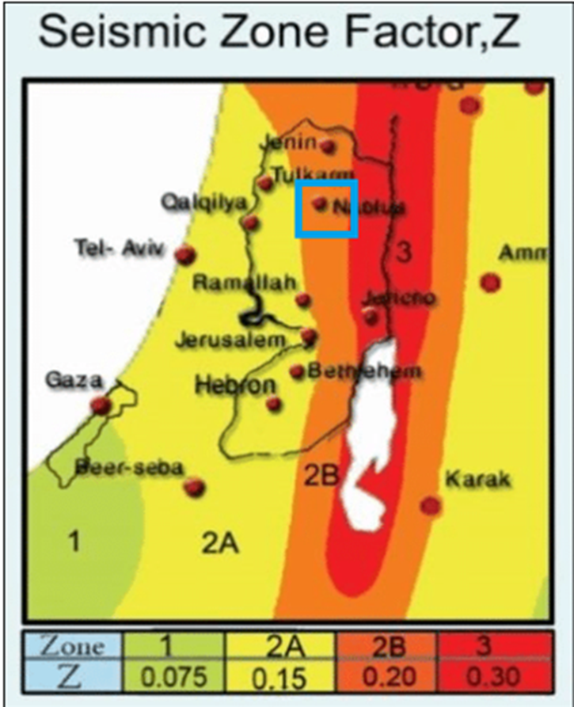
4
Seismic Force Analysis
4.1: seismic zone factor ‘Z’
The building is in Nablus City, Palestine. So according to figure 5-1, seismic zone factor ‘Z’ equals to 0.2g
Z value is used to calculate mapped acceleration parameters.

Slide 31
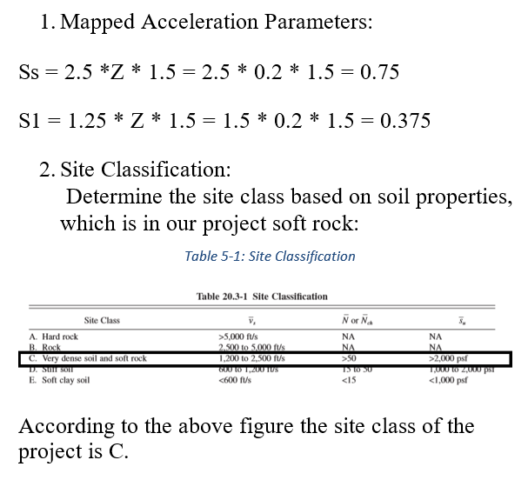
4
Seismic Force Analysis

Slide 32
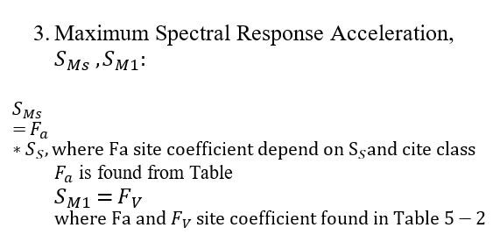
4
Seismic Force Analysis

Slide 33
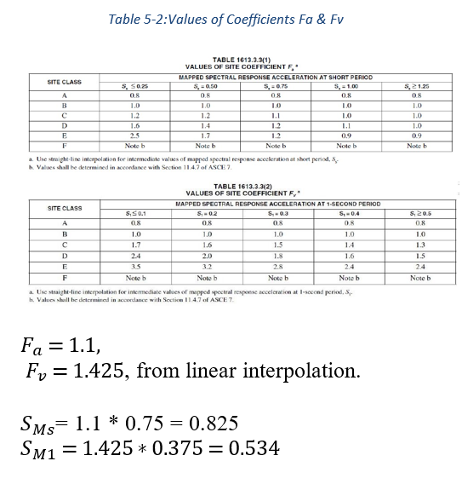
4
Seismic Force Analysis

Slide 34
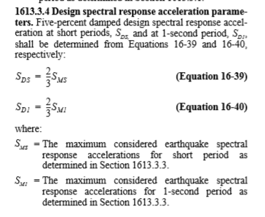
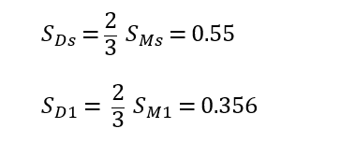
4
Seismic Force Analysis

Slide 35
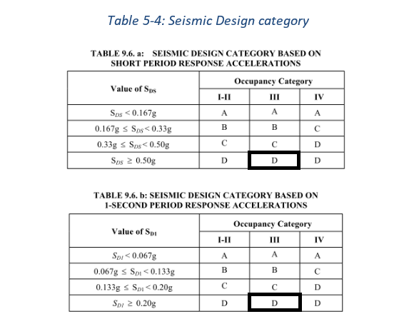
4
Seismic Force Analysis

Slide 36
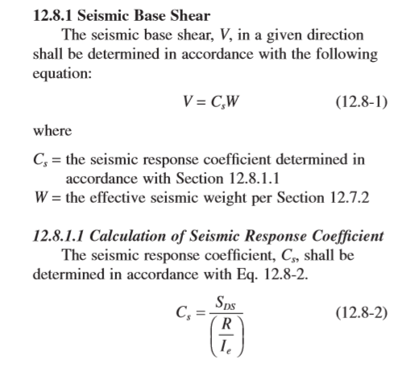
4
Seismic Force Analysis

Slide 37
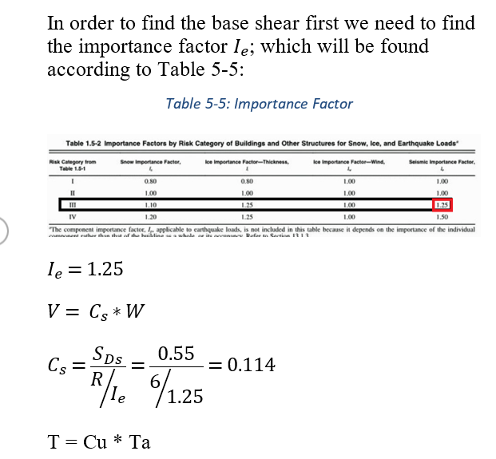
4
Seismic Force Analysis

Slide 38
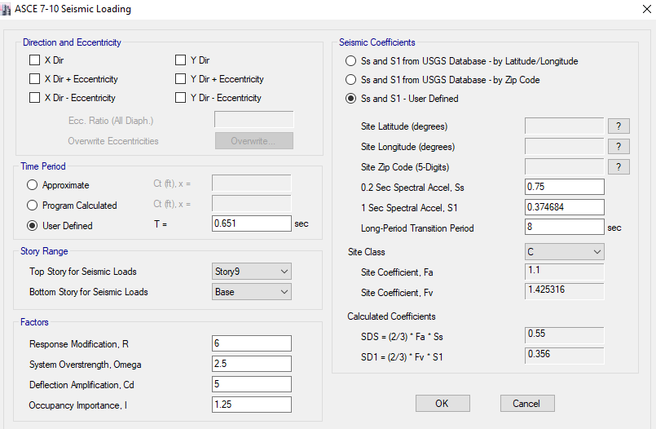
4
Seismic Force Analysis
Period Check
This picture shows stories that been considered

Slide 39

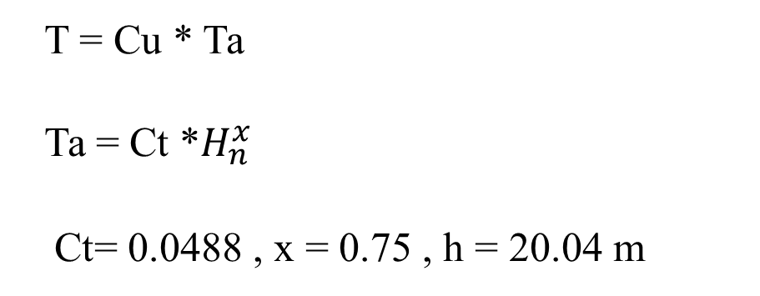
4
Seismic Force Analysis
Period Check
Ta = 0.0488 *${16.6}^{0.75}=0.4$63 sec.
Cu = 1.4 (from table)
T = Cu * Ta = 1.4 * 0.463 = 0.651 sec.
T = Cu * Ta
Ta = Ct *$H_{n}^{x}$
Ct= 0.0488 , x = 0.75 , h = 20.04 m

Slide 40
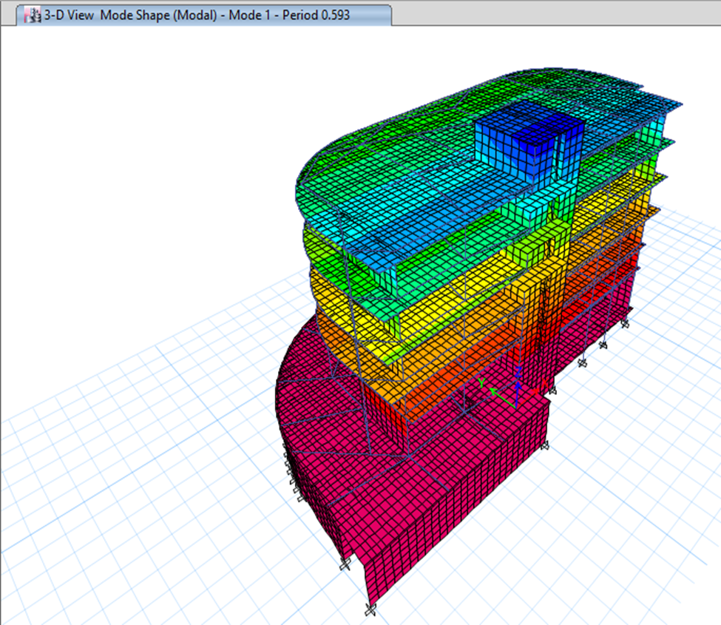
4
Seismic Force Analysis
Period Check
Fundamental mode period from ETABS ( T= 0.593 Sec.)
Manual ( T= 0.651 Sec.)
T= 0.651 Sec. > ETABS Period
It`s OK

Slide 41
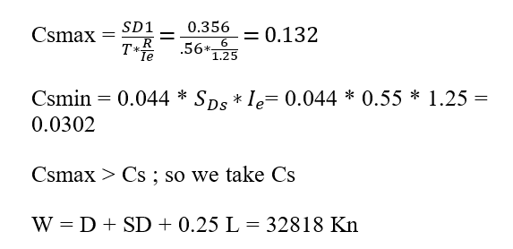
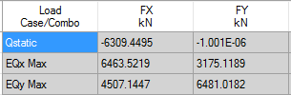
4
Seismic Force Analysis
W = 56362.71 kN
V = Cs * W = 56362.71 * 0.114 = 6425.35 kN
From ETABs = 6309.45 kN
%diff. = 1.8% < 5%

Slide 42
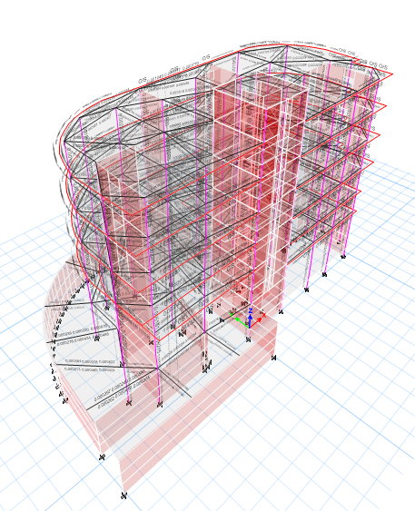
4
Seismic Force Analysis
4.2: After running the model

Slide 43
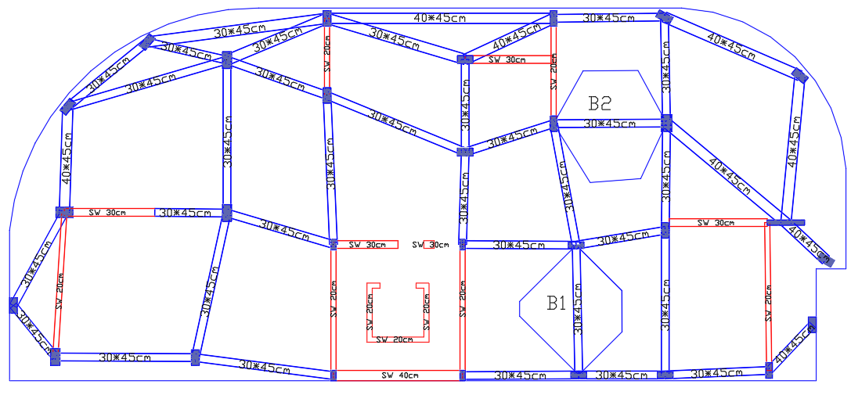
4
Seismic Force Analysis
4.3: Check moment on beams:
Weight of drop beam per meter length= 0.25*0.30*25*1= 1.875 kN/m
Tributary area = 12 m2
Wu = 36.7 kN/m
Moment for both fixed ends = WL2/12 = 79.55 kN.m
Total moment = Wl2/8 = 79.55 kN.m
Moment from ETABs:
Negative one = 62 kN.m
Negative two = 71 kN.m
Positive = 45 kN.m
So total value = 111.5 kN.m
% difference = 6.4 %

Slide 44

4
Seismic Force Analysis
$$δ_{x,y}=\frac{c_{d} δ_{xe}}{I_{e}}$$
4.3: Check story drift:
X- Direction:
Story | H (m) | Delta (mm) | Displacement | Story drift | Allowable | Check
1 | 4.94 | 1.842 | 7.368 | 7.368 | 34.58 | Ok
2 | 7.54 | 4.084 | 16.336 | 8.968 | 52.78 | Ok
3 | 10.44 | 7.117 | 28.468 | 12.132 | 73.08 | Ok
4 | 13.64 | 10.735 | 42.94 | 14.472 | 95.48 | Ok
5 | 16.84 | 14.460 | 57.84 | 14.9 | 118 | Ok
6 | 20.04 | 17.998 | 71.992 | 14.152 | 143 | Ok

Slide 45

4
Seismic Force Analysis
4.3: Check story drift:
$$δ_{x,y}=\frac{c_{d} δ_{xe}}{I_{e}}$$
Y- Direction:
Story | Height | Delta (mm) | Displacement | Story drift | Allowable | Check
1 | 4.94 | 2.157 | 8.628 | 8.628 | 34.58 | Ok
2 | 7.54 | 3.687 | 14.748 | 6.12 | 52.78 | Ok
3 | 10.44 | 6.119 | 24.476 | 9.728 | 73.08 | Ok
4 | 13.64 | 9.149 | 36.596 | 12.12 | 95.48 | Ok
5 | 16.84 | 12.278 | 49.112 | 12.52 | 118 | Ok
6 | 20.04 | 15.181 | 60.724 | 11.62 | 143 | Ok

Slide 46

4
Seismic Force Analysis
4.4: Check torsional irregularly:
$A_{X}={\left(\frac{δ_{max}}{1.2 δ_{avg}}\right)}^{2}$
X – Direction:
Story | Load Case/Combo | Item | Max Drift | Avg Drift | Ratio
Story10 | EQx Max | Diaph project X | 0.000242 | 0.000152 | 1.599
Story9 | EQx Max | Diaph project X | 0.000521 | 0.000346 | 1.506
Story8 | EQx Max | Diaph project X | 0.000578 | 0.000408 | 1.416
Story7 | EQx Max | Diaph project X | 0.000578 | 0.000419 | 1.379
Story6 | EQx Max | Diaph project X | 0.000565 | 0.00037 | 1.527
Story5 | EQx Max | Diaph project X | 0.000603 | 0.000432 | 1.395
Story4 | EQx Max | Diaph project X | 0.000509 | 0.00036 | 1.413
Story3 | EQx Max | Diaph project X | 0.000152 | 0.000106 | 1.436
Story2 | EQx Max | Diaph project X | 8E-05 | 6.5E-05 | 1.234
Story1 | EQx Max | Diaph project X | 6.7E-05 | 5.1E-05 | 1.314

Slide 47

4
Seismic Force Analysis
4.4: Check torsional irregularly:
$A_{X}={\left(\frac{δ_{max}}{1.2 δ_{avg}}\right)}^{2}$
Y – Direction:
Story | Load Case/Combo | Item | Max Drift | Avg Drift | Ratio
Story10 | EQy Max | Diaph project Y | 0.000192 | 0.000125 | 1.542
Story9 | EQy Max | Diaph project Y | 0.000497 | 0.000322 | 1.541
Story8 | EQy Max | Diaph project Y | 0.000551 | 0.000369 | 1.492
Story7 | EQy Max | Diaph project Y | 0.000565 | 0.000394 | 1.436
Story6 | EQy Max | Diaph project Y | 0.000587 | 0.000393 | 1.494
Story5 | EQy Max | Diaph project Y | 0.000534 | 0.000402 | 1.33
Story4 | EQy Max | Diaph project Y | 0.00038 | 0.000281 | 1.351
Story3 | EQy Max | Diaph project Y | 0.000189 | 0.000138 | 1.371
Story2 | EQy Max | Diaph project Y | 0.000131 | 0.000114 | 1.147
Story1 | EQy Max | Diaph project Y | 0.000132 | 9.5E-05 | 1.391
As we see almost all values more than the ratio 1.2 so there is Irregularity and must be taken in the design.

Slide 48


4
Seismic Force Analysis
$$∅=\frac{p∆I_{e}}{vhc_{d}}$$
4.5: Check P-delta
X – Direction:
Story | h | Delta$∆$ | p | V | Ø
1 | 4.9 | 1.842 | 46003.3219 | 6224.1291 | 0.000695
2 | 2.6 | 4.084 | 37768.6034 | 5752.7372 | 0.002578
3 | 2.9 | 7.117 | 29075.0635 | 4959 | 0.003597
4 | 3.2 | 10.735 | 20431.5021 | 3899.1568 | 0.004395
5 | 3.2 | 14.460 | 11825.182 | 2416.4529 | 0.005528
6 | 3.2 | 17.998 | 517.7992 | 226.5714 | 0.003213

Slide 49
4
Seismic Force Analysis
4.5: Check P-delta
$$∅=\frac{p∆I_{e}}{vhc_{d}}$$
Y- Direction:
Story | h | delta | p | v | Ø
1 | 4.9 | 1.675 | 46003.3219 | 4346.7907 | 0.000904
2 | 2.6 | 2.865 | 37768.6034 | 4023.4958 | 0.002586
3 | 2.9 | 4.320 | 29075.0635 | 3474.2099 | 0.003117
4 | 3.2 | 5.870 | 20431.5021 | 2703.9146 | 0.003465
5 | 3.2 | 7.480 | 11825.182 | 1672.3407 | 0.004132
6 | 3.2 | 8.976 | 517.7992 | 151.35 | 0.002399
All values less than 0.1, so it’s ok

Slide 50
Design of Beams
Design for Structural Elements
Design of Columns
Design of Slabs

Slide 51


5
Design for Structural Elements
5.1: Design of Beams
5.1.1: Flexural
$$M_{+}=170 KN.m$$
$$M_{−}=300 KN.m$$
For $M_{−}=300 KN.m$ $→ρ=\frac{0.85f_{c}}{f_{y}} \left(1−\sqrt{1−\frac{2.61M_{U}}{bd^{2}f_{c}} } \right)=ρ=\frac{0.85∗28}{420} \left(1−\sqrt{1−\frac{2.61∗300∗{10}^{6}}{400∗{390}^{2}∗28} } \right)= 0.015>ρ_{MIN} OK$
$$A_{S−}= ρbd=0.015∗400∗390=2340 {mm}^{2}$$
Assume $∅18mm with Ast= \frac{3.14∗{18}^{2}}{4}=254{mm}^{2}$
n = $\frac{2340}{254}=10∅18mm/m$ with Ast = 10*254 = 2540 ${mm}^{2}$

Slide 52


5
Design for Structural Elements
5.1: Design of Beams
V = $\frac{M_{P1}+M_{P2}}{L_{N}}+\frac{W_{u}l_{n}}{2}$
V = (1.2+0.4$S_{DS})D+L+2E$
V = 1.2D+1.6L
5.1.2: Shear
FOR As = 2111 ${mm}^{2}$ & As = 1137 ${mm}^{2}$
a = $\frac{1.25A_{s} f_{y}}{0.85f_{c} b}= \frac{1.25∗2111∗420}{0.85∗28∗400}=116.5 mm$
$M_{P1}=1.25$ $A_{s} f_{y} \left(d−\frac{a}{2} \right)=1.25∗2111∗420∗\left(390−\frac{116.5}{2} \right)=367.67 kN.m$
$M_{P2}=1.25$ $A_{s} f_{y} \left(d−\frac{a}{2} \right)=1.25∗1137∗420∗\left(390−\frac{116.5}{2} \right)=214 kN.m$

Slide 53





5
Design for Structural Elements
5.1: Design of Beams
5.1.2: Shear
$\frac{W_{u}l_{n}}{2}$ = $\frac{\left(1.2+0.2S_{DS} \right)D+L}{2}$
$$S_{DS}=0.55$$
Dead = 62.2 kN
Sd = 42.35 kN
Sd ring beam = 120 kN
Live = 37.6 kN

Slide 54



5
Design for Structural Elements
5.1: Design of Beams
5.1.2: Shear
V = $\frac{M_{P1}+M_{P2}}{L_{N}}+\frac{W_{u}l_{n}}{2}$ = $\frac{367.64+214}{8.2462}+165.881=236.42 kN$
V = (1.2+0.4$S_{DS})D+L+2E$= 356.461 +2*(12.4) = 381.261 kN
3. V = 1.2D+1.6L = 281.72 kN
$V_{P}=74.3 kN$= $\frac{M_{P1}+M_{P2}}{L_{N}}$
$$V_{factoried}=343.4 kn$$
$V_{g}=331.4 kN$= V = (1.2+0.4$S_{DS})D+L+2E$

Slide 55


5
Design for Structural Elements
5.1: Design of Beams
5.1.3: Torsion
Calculate the ultimate torsion $→T_{u}= \frac{∅λ}{3} \sqrt{f_{c} }{(\frac{A_{cp}}{P_{cp}})}^{2}$ = $\frac{0.75∗1}{3} \sqrt{28} {(\frac{400∗450}{2∗(400+450)})}^{2}= 14.83 kN.m$
From ETABs $T_{u}= 14.3 kN.m$

Slide 56

5
Design for Structural Elements
5.1: Design of Beams
5.1.3: Torsion
Calculate threshold torsion $→ T_{th}= ∅ λ \frac{\sqrt{f_{c} }}{12} {(\frac{A_{cp}}{P_{cp}})}^{2}$ = 0.75*1*$\frac{\sqrt{28}}{12}$ ${(\frac{400∗450}{2∗(400+450)})}^{2}$ = 3.7 kN
$P_{h}=2∗\left(x+y\right) →where x=width−2cover−ds=268 mm$& y = depth -2cover –ds = 318 mm so $P_{h}=2∗\left(268+318\right)=1172 mm$
Which is equal = x*y = 308 * 358 = 85224 ${mm}^{2} ………….$ $\sqrt{{(\frac{V_{u}}{b_{w}d})}^{2}+{(\frac{T_{u} P_{h}}{1.7 {A_{oh}}^{2}})}^{2}} ≤ \frac{∅5}{6} \sqrt{f_{c}}V_{u} from shear calculations=$381.261 kN
$\sqrt{{\left(\frac{381.261∗{10}^{3}}{400∗390}\right)}^{2}+{\left(\frac{14.83∗{10}^{6}∗1172}{1.7∗{85224}^{2}}\right)}^{2}} ≤ \frac{0.75∗5}{6} \sqrt{28}$
  2.8 mPa $≤3.31 mpa )$, so dimensions are ok

Slide 57

5
Design for Structural Elements
5.1: Design of Beams
5.1.3: Torsion
$$\frac{A_{t}}{S}= \frac{\frac{T_{u}}{∅}}{2 A_{o} f_{yt}}= \frac{\frac{14.83 {∗10}^{6}}{0.75}}{2\left( 0.85∗85224\right)∗420}=0.325 {mm}^{2}/mm$$
${(\frac{A_{V}}{S})}_{t}=\left(\frac{A_{V}}{S}\right)+2∗\left(\frac{A_{t}}{S}\right)$= 2.70 + (2*0.325) = 3.35 ${mm}^{2}/mm$
$${\left(\frac{A_{V}}{S}\right)}_{min}= \max\left(\begin{aligned}0.3125 \\ 0.334\end{aligned}\right)=0.334<3.35 so its ok$$

Slide 58

5
Design for Structural Elements
5.1: Design of Beams
5.1.3: Torsion
Assume stirrups with $∅=12 mm$so Ab = 113 ${mm}^{2}$
$\frac{A_{V}}{S}=3.35= \frac{2∗113}{S} so spacing=67.3 mm$
Check spacing:
$$S_{max}=min\left(\begin{aligned}\frac{P_{h}}{8} \\ 300\end{aligned}\right)=min\left(\begin{aligned}\frac{1172}{8}=146.5 \\ 300\end{aligned}\right)$$

Slide 59

5
Design for Structural Elements
5.1: Design of Beams
5.1.3: Torsion
Calculate the longitudinal torsion reinforcement:
$A_{L}= \left(\frac{A_{t}}{S}\right)P_{h}\left(\frac{f_{yt}}{f_{y}}\right)$= $0.325$ *$1172$ = 381 ${mm}^{2}$
$A_{L,min}= \frac{5\sqrt{f_{c}}}{12fy} A_{CP}− \left(\frac{A_{t}}{S}\right)P_{h}\left(\frac{f_{yt}}{f_{y}}\right)$= $\frac{5∗\sqrt{28}}{12∗420} \left(400∗450\right)−381=564 {mm}^{2}$ SO use $A_{L,min}$
Use $3∅18mm$

Slide 60

5.1: Design of Beams
5
Design for Structural Elements
5.1.4: Example of Beam Reinforcement

Slide 61


5
Design for Structural Elements
5.2: Design of Columns
5.2.1: Flexural
Pu = 2748.62 kN
0.1Ag fc = 0.1*28*600*250 = 420 kN
So 0.1Ag fc < Pu so design it Sa column
$$I_{C}= \frac{1}{12}∗bh^{3}= \frac{1}{12}∗250∗{600}^{3}=3.15∗{10}^{−3} m^{4}$$
$$I_{b}= \frac{1}{12}∗bh^{3}= \frac{1}{12}∗300∗{450}^{3}=7.97∗{10}^{−4} m^{4}$$

Slide 62


5
Design for Structural Elements
5.2: Design of Columns
5.2.1: Flexural
$$γ_{A}= \frac{\sum{EI/L_{C}}}{\sum{EI/L_{B}}}= \frac{2∗3.15{∗10}^{−3} }{\frac{7.97{∗10}^{−3}}{4.4}+\frac{7.97{∗10}^{−3}}{4.8} + \frac{7.97{∗10}^{−3}}{ 5.1}+ \frac{7.97{∗10}^{−3}}{4}}=2.8=γ_{B}$$
So the value of K =1.72
$$\frac{KL_{u}}{r}= \frac{1∗3.2}{0.3h}= \frac{1∗3.2}{0.3∗0.6}=31>22$$
$$p_{cr}= \frac{π^{2}EI}{{(KL)}^{2}}= \frac{{3.14}^{2}∗EI}{{(1.72∗3.2)}^{2}}$$

Slide 63

5
Design for Structural Elements
5.2: Design of Columns
5.2.1: Flexural
$$EI=0.25∗Es∗Ig=0.25∗2∗{10}^{8}∗\frac{1}{12}∗0.25∗{0.6}^{3}=157500 kN$$
$$\sum{pu=1.4D+L+Ex →38186.21 kN }$$
$$\sum{pcr}=29∗\left(\frac{{3.14}^{2}∗157500}{{\left(1.72∗3.2\right)}^{2}}\right)=1486555.1 kN$$
$$δ= \frac{1}{1−\frac{\sum{pu}}{∅\sum{pcr}}}= \frac{1}{1−\frac{38186.21}{0.75∗1486555.1}}=1.1$$

Slide 64

5
Design for Structural Elements
5.2: Design of Columns
5.2.1: Flexural
Calculate M2:
$$M_{2}=M_{2ns}+δM_{2s}$$
$$M_{2ns}=1.4D+L+Ex=1.4\left(5.3+4+0.3\right)+2.5+\left(1.1∗8.6\right)=25.4 kN.m$$
Compare this value with the value of moment from top steel of Beams:

Slide 65


5
Design for Structural Elements
5.2: Design of Columns
5.2.1: Flexural
So As = 497 ${mm}^{2}$
a = $\frac{As fy}{0.85 fc b }= \frac{497∗420}{0.85∗28∗300 }=29.24 mm$
$$M_{n}=1.25 fy As \left(d− \frac{a}{2} \right)=1.25∗420∗497\left(560−\frac{29.24}{2} \right)=142 .3 kN.m$$
1.2*$M_{n}$ = 170.77 kN.m, So 1.2*$M_{n}$ > $M_{2}$ so take 1.2*$M_{n}$

Slide 66

5
Design for Structural Elements
5.2: Design of Columns
5.2.1: Flexural
Calculate MIII:
$M_{2}=M_{2ns}+δM_{2s}$ = 1.4(5.6+4.3+0.7) + 2.11 + 1.1*41.23 = 62.3 kN.m
Now check the dimensions according to the Bresler equation:
$$\frac{1}{∅pn}= \frac{1}{∅px}+ \frac{1}{∅py}+ \frac{1}{∅p_{o}}$$

Slide 67

5
Design for Structural Elements
5.2: Design of Columns
5.2.1: Flexural

Slide 68

5
Design for Structural Elements
5.2: Design of Columns
5.2.1: Flexural
$$∅pn= ∅λ(0.85fc \left(Ag−As\right)+fyAg$$
Assume $ρ=1\%$so As = $ρAg$ = 0.01 Ag
$∅pn= ∅λ(0.85fc \left(Ag−As\right)+fyAs$ = 0.65*0.8 (0.85*28(Ag-0.01Ag) +420*0.01*Ag = 3284.245 kn
From interaction diagram determine the value of the px & py from M3, M2 respectively so
Px = 1852.2 kN Py = 1981.4 kN
$\frac{1}{∅pn}= \frac{1}{∅px}+ \frac{1}{∅py}+ \frac{1}{∅p_{o}}$ = $\frac{1}{0.65∗1852.2}+ \frac{1}{0.65∗1981.4}+ \frac{1}{3284.245}=1911 kN>$1076.2 kN so its ok

Slide 69


5
Design for Structural Elements
5.2: Design of Columns
5.2.2: Shear
Moment of As= 5$∅14$ = 5*$\frac{3.4∗{14}^{2}}{4}=769.3 {mm}^{2}$
$$M= \frac{As fy h }{2}= \frac{769.3∗420∗540}{2}=97 kN.m$$
V = $\frac{2M}{ln}= \frac{2∗97}{3.2}=61 KN$compare this value with the value from ultimate and take the large value so take the 61 kN

Slide 70

5
Design for Structural Elements
5.2: Design of Columns
5.2.2: Shear
$$∅vc=\frac{∅}{6} \sqrt{fc} bw d= \frac{0.75}{6} \sqrt{28} 250∗540= 89.3 kn$$
$Vs$ = $\frac{vu}{∅}−vc=\frac{97}{0.75}−89.3=40 kN$
$$Vs= \frac{Av∗fy∗d}{S}$$

Slide 71

5
Design for Structural Elements
5.2: Design of Columns
5.2.3: Sample of rectangular column reinforcement

Slide 72


5
Design for Structural Elements
5.3: Design of Slabs
5.3.1: Design of flexure
We check slab in story @ elevation = 16.84 m
Assume shrinkage steel ratio ($ρ_{shrinkage }=0.0018)$
so Ast = 0.0018 * 1000 * 200 = 360 ${mm}^{2}$
$$∅M_{n}= ∅A_{ST} f_{y} \left(d−\frac{a}{2} \right)$$
Assume $∅12mm with area of the bar=113 {mm}^{2}$ , n = $\frac{360}{113}=3.2$ use 4$∅12mm/m$
So Ast = 4*113 = 452 ${mm}^{2}$
Section in Slab

Slide 73


5
Design for Structural Elements
5.3: Design of Slabs
$$a=\frac{Ast fy }{0.85 fc b }= \frac{360∗452}{0.85∗28∗1000}=6.83 mm$$
$∅M_{n}= ∅A_{ST} f_{y} \left(d−\frac{a}{2} \right)$ = 0.9*452*420 ( 160 - $\frac{6.83}{2} ) =27 KN.m$
5.3.1: Design of flexure

Slide 74


5
Design for Structural Elements
5.3: Design of Slabs
5.3.1: Design of flexure
The regions in the dark color exceed the minimum steel ratio ($ρ_{shrinkage }=0.0018)$

Slide 75



5
Design for Structural Elements
5.3: Design of Slabs
5.3.1: Design of flexure
So we display the moment ($M_{11})$ range from ( -40 – 40 kn.m ) :

Slide 76

5
Design for Structural Elements
5.3: Design of Slabs
5.3.1: Design of flexure
$ρ= \frac{0.85f_{c}}{f_{y}} \left(1−\sqrt{1−\frac{2.61M_{11}∗{10}^{6}}{bd^{2}f_{c}}}\right)=\frac{0.85∗28}{420} (1−\sqrt{1−\frac{2.61∗40∗{10}^{6}}{1000∗{160}^{2}∗28} })$ = 0.0043
Ast = 0.0043 b*d = 0.0043 *1000*160 = 688 ${mm}^{2}$ , assume $∅=12 mm$
so number of bars n = $\frac{688}{113}=6.1$use 7$∅12mm/m$
with area of steel = 7 * 113 = 791 ${mm}^{2}$

Slide 77



5
Design for Structural Elements
5.3: Design of Slabs
5.3.1: Design of flexure
$$M_{22}=40 kn.m$$
$ρ= \frac{0.85f_{c}}{f_{y}} \left(1−\sqrt{1−\frac{2.61M_{11}∗{10}^{6}}{bd^{2}f_{c}}}\right)=\frac{0.85∗28}{420} (1−\sqrt{1−\frac{2.61∗40∗{10}^{6}}{1000∗{160}^{2}∗28} })$
= 0.0043
Ast = 0.0043 b*d = 0.0043 *1000*160 = 688 ${mm}^{2}$ ,
assume $∅=12 mm$so number of bars n = $\frac{688}{113}=6.1$use
7$∅12mm/m$ with area of steel = 7 * 113 = 791 ${mm}^{2}$ .

Slide 78

5.3: Design of Slabs
5
Design for Structural Elements
5.3.2: Example of slab reinforcement

Slide 79
6
Design of Footing
6.1: Introduction
Foundation is the element of a structure which connects it to the ground, and transfers loads from the structure to the ground. Foundations are generally considered either shallow or deep.

Slide 80


6
Design of Footing
6.1: Introduction

Slide 81
6
Design of Footing
6.2: Design
Depending on the calculation that will be shown later we saw that mat foundation is the appropriate type of footing to be used.

Slide 82

6
Design of Footing
6.2: Design
Distribution of columns and load value on each

Slide 83

6
Design of Footing
6.2: Design
Based on the ultimate loads on the columns from the whole structure we calculated the area of the foundation.
Total area of mat foundation = 749.23 $m^{2}$

Slide 84


6
Design of Footing
6.2: Design
Screenshots from ETABs for the building showing the foundation

Slide 85

6
Design of Footing
6.2: Design
6.2.1: Check if there is tensions under mat foundation
$q= −\frac{P}{A}∓\frac{M_{Y}X}{I_{Y}}∓\frac{M_{X}Y}{I_{X}}$
total service loads = 41852 kN = P
area of mat = 749.23 $m^{2}$
Find the moment in two directions:
$M_{Y}=P∗$ $e_{x}$ = 41582 * 3.264 = 136604.93 KN.m (with positive direction)
$M_{X}=P∗ey= 41852∗0.7962$ = 33322.562 KN.m (with positive direction)

Slide 86

6
Design of Footing
6.2: Design
6.2.1: Check if there is tensions under mat foundation
Tension area for the footing

Slide 87


6
Design of Footing
6.2: Design
6.2.1: Check if there is tensions under mat foundation
Now we find stress @ point A & B to check if there is tension @ foundation.
$$q= −\frac{P}{A}∓\frac{M_{Y}X}{I_{Y}}∓\frac{M_{X}Y}{I_{X}}$$
$q_{A}=− \frac{41852}{749.23}+\frac{136604.93∗5.5172}{85675.7703}+\frac{33322.562∗12.1613}{63318.9662}= −40.663 {kn}/{m^{2}}$
$q_{B}=− \frac{41852}{749.23}−\frac{136604.93∗0.4386}{85675.7703}−\frac{33322.562∗11.3085}{63318.9662}= −62.511{kn}/{m^{2}}$

Slide 88

6
Design of Footing
6.2: Design
6.2.1: Check if there is tensions under mat foundation
Bearing capacity of the foundation are 3.5 ${kg}/{{cm}^{2}}$ which is equal to 343.35 ${kn}/{m^{2}}$ .
Both values are less than Bearing capacity, so its ok
Select the design strip which is contains the maximum strip load:
Total load inside these strip = 11508.03 kN
Width of these strip = 6.33 m
Length of strip = 39.08 m

Slide 89
6
Design of Footing
6.2: Design
6.2.2: Select the design strip which is contains the maximum strip load
Total load inside these strip = 11508.03 kN
Width of these strip = 6.33 m
Length of strip = 39.08 m

Slide 90
6
Design of Footing
6.2: Design
6.2.2: Select the design strip which is contains the maximum strip load

Slide 91

6
Design of Footing
6.2: Design
6.2.2: Select the design strip which is contains the maximum strip load
Now we need to calculate the stress @ point (C + D):
$q_{C}=− \frac{41852}{749.23}+\frac{136604.93∗18.6135}{85675.7703}−\frac{33322.562∗5.2708}{63318.9662}= −28.96 {kN}/{m^{2}}$
$q_{D}=− \frac{41852}{749.23}−\frac{136604.93∗19.6954}{85675.7703}−\frac{33322.562∗5.4138}{63318.9662}= −90.11$ ${kN}/{m^{2}}$
$q_{avg}= \frac{90.11+28.96}{2}=59.54 {kN}/{m^{2}}$
Total soil reaction = 59.54 * 6.33 * 39.08 = 14728.791 KN

Slide 92

6
Design of Footing
6.2: Design
6.2.2: Select the design strip which is contains the maximum strip load
Total load inside these strip = $11508.03$ kn
$Q_{avg}=\frac{14728.791+11508.03}{2}=13118.411kn$
Average pressure in the strip = 59.54 * ($\frac{13118.411}{14728.791 } )$ = 53.03 ${kN}/{m^{2}}$
Column loads modification factor = $\frac{13118.41}{11508.03}=1.14$
So line load on the strip = 6.33 * 53.03 = 335.68 kN /m

Slide 93

6.2: Design
6
Design of Footing
6.2.2: Select the design strip which is contains the maximum strip load
we multiply the reactions on columns by factor = 1.14 and draw Shear Force Diagram ‘SFD’ to calculate preliminary thickness for foundations
SFD for the strip:

Slide 94

6
Design of Footing
6.2: Design
6.2.3: Thickness of footing
The maximum shear force value equal to 2394.91 Kn
Wide Beam shear = $∅V_{c}=∅∗\frac{1}{6}\sqrt{f_{c} } b_{w} d$= $\frac{0.75}{6}∗\sqrt{28}∗6330∗d$ = 4186.9 d
Maximum shear force @ distance d from face of column = 2394.91 – 335.68 ( $\frac{C}{2}+d$ )
2394.91 – 335.68*($\frac{0.2}{2}+d )$ = 2361.342 +335.68 d
So the value of depth (d) = 0.6 m , h = 0.80 m.

Slide 95

6
Design of Footing
6.2: Design
6.2.4: Punching shear check
Punching shear area:

Slide 96

6
Design of Footing
6.2: Design
6.2.4: Punching shear check
Ultimate load on column = 3252.96 kN
$∅V_{c}≤∅\frac{1}{6}\sqrt{fc} \left(1+\frac{2}{β} \right)b_{o}d=0.75∗\frac{1}{6}∗\sqrt{28}∗\left(1+\frac{2}{2.40}\right)∗6500∗600= 4729.28 kn$
$∅V_{c}≤∅\frac{\sqrt{fc}}{3}b_{o}d= \frac{0.75∗\sqrt{28}}{3}∗6500∗600=5159.215 kn$
$∅V_{c}≤0.083∗\left(\frac{α_{s}∗d}{b_{o}}+2 \right)\sqrt{fc} b_{o}d=0.083∗\left(\frac{40∗600}{6500}+2\right)∗\sqrt{28}∗6500∗600=9750.13 kn$
Minimum value from above = 4729.28 > 3252.96 so its ok (thickness of slab acceptable).
h = 0.80 m (OK)

Slide 97


6
Design of Footing
6.3: Design Foundation by ETABs
6.3.1: Check pressure under foundation by service loads:
Maximum value of stress under mat nearly equal to 70 ${kN}/{m^{2}}$ << 343.35 ${kN}/{m^{2}}$ so its ok .

Slide 98

6
Design of Footing
6.3: Design Foundation by ETABs
6.3.2: Punching Shear Check:
As picture shows there is no Punching shear in foundation
so its ok.
Punching Shear vales from ETABs

Slide 99


6
Design of Footing
6.3: Design Foundation by ETABs
6.3.2: Punching Shear Check:
Punching Shear vales from ETABs:
As picture shows there is no Punching shear in foundation so its ok.
Which the maximum value from circular column equal to 0.542
All of ratios less than one so its ok , which these ratios equal to $\frac{Design Shear }{Concrete Shear Capacity }$ .

Slide 100

6
Design of Footing
6.3: Design Foundation by ETABs
6.3.2: Punching Shear Check:
As picture shown maximum shear force in x-direction equal to 1659.741 kN < 2512.14 kN so the capacity of foundation to resist shear force are ok.

Slide 101

6
Design of Footing
6.3: Design Foundation by ETABs
6.3.2: Punching Shear Check:
Here maximum value equal to 2159.688 kN < 2512.14 kN so its ok, also we over conservative because we take the value @ the center of columns.

Slide 102

6
Design of Footing
6.4: Foundation Detailing
6.4.1: Rebar in Direction one:
Row Values in direction1
Top Rebar:
As figure shown the top steel is approximately minimum steel and this the general case.

Slide 103

6
Design of Footing
6.4: Foundation Detailing
6.4.1: Rebar in Direction one:
Bottom Rebar:
Here we note that the steel is too big than previous so its ok.

Slide 104

6
Design of Footing
6.4: Foundation Detailing
6.4.2: Rebar in Direction Two:
Top Rebar

Slide 105

6
Design of Footing
6.4: Foundation Detailing
6.4.2: Rebar in Direction Two:
Bottom Rebar:

Slide 106

6
Design of Footing
6.5: Mat foundation Reinforcement

Slide 107

7
Shear Wall
7.1: Design of Shear Wall
Location of Shear Wall:

Slide 108


7
Shear Wall
7.1: Design of Shear Wall
By using section designer program:
we got the following results:
ultimate forces in this table:
$p=1519.2739 KN$
$M_{u3}=9642.1441 KN.m$
$M_{u2}=31.4517 KN.m$
Required area of steel = 0.015263 $m^{2}=15263 {mm}^{2}$
$length=5.75 m$
$thickness=0.20 m$

Slide 109


7
Shear Wall
7.1: Design of Shear Wall
From Bresler equation:
$$\frac{1}{∅pn}= \frac{1}{∅px}+ \frac{1}{∅py} + \frac{1}{p_{o}}$$
From $M_{u3} determine px from interaction diagram , px=13900 kn .$
From $M_{u2} determine py from interaction diagram , py=14000 kn .$
Minimum steel ratio for walls ($ρ$ = 0.0025) , $A_{S}= ρ A_{g}=0.0025A_{g}$
$∅pn= ∅λ(0.85fc \left(Ag−As\right)+fyAs$ = 0.65*0.80* ( 0.85*28 ( $Ag−0.0025Ag$ ) + 420 * $0.0025 Ag )$
= 12.89 * 5750 * 200 = 14823.50 KN >>> 1519.2739KN so its ok

Slide 110


7
Shear Wall
7.1: Design of Shear Wall
Also ($∅pn=\text{14823.50 }\text{KN}$)more than ultimate load from envelope of all combinations so its OK.
Axial & Torsion values from ETABs:

Slide 111




7
Shear Wall
7.1: Design of Shear Wall
In our design we use Uniform Reinforcing method:
( $Pier 1 ,h_{w}=1.4 m , l=5.75 m ,b_{w}=0.20 m ) .$
According to the figure above shown the values of design loads:
ultimate load which is equal to 1519.3 $KN$
ultimate moment equal to 9642.2$KN.m$ .

Slide 112

7
Shear Wall
7.1: Design of Shear Wall
Now we need to calculate the tension and compression acting of the boundary element of the wall
Compression force (C):
$C=\frac{P_{u}l_{be}∗h}{A_{total}}+ \frac{M_{u}}{l_{w}−(l_{w}−l_{be})}= \frac{1519.3∗1.50∗0.20}{5.75∗0.20}+\frac{9642.2}{( 5.75−1.50 )}= 2665.1 KN$
2. Tension force (T):
$T=\frac{M_{u}}{l_{w}−(l_{w}−l_{be})}−\frac{P_{u}l_{be}∗h}{A_{total}}= \frac{9642.2}{5.75−1.50}−\frac{1519.3∗1.50∗0.2}{5.75∗0.20}=1872.42 KN$

Slide 113

7
Shear Wall
7.1: Design of Shear Wall
calculate area of steel for both compression and tension and take maximum value from both.
For compression calculate area of steel from capacity of column in axial.
$∅p_{n}=∅λ\left(0.85f_{c}\left(A_{g}−A_{s}\right)+f_{y}A_{s} \right)$
2665.1 * ${10}^{3}$ = 0.65 * 0.80 ( 0.85*28 ( 1500*200 - $A_{s}$ ) + 420 *$A_{s}$ )
2665.1 * ${10}^{3}$ = 3712800 + 206.024$A_{s}$
$A_{s}→ \frac{2665.1 ∗ {10}^{3} −3712800}{206.024}=$ $−5085.33 {mm}^{2}$,So no need to Reinforcement

Slide 114

7
Shear Wall
7.1: Design of Shear Wall
2. For tension side:
$A_{s}= \frac{T}{∅f_{y}}= \frac{1872.42∗{10}^{3}}{0.9∗420}=4953.5 {mm}^{2}$
So the value we take 4953.5 ${mm}^{2}$ , 25$∅16$
3. For the critical section in middle we calculate area of steel for it from the remaining of $P_{u} \& M_{u2} .$
Where the value of the moment in second direction is equal to $32 KN.m$ as shown from the previous figure.
$p_{u,remaining }=\frac{p_{u}∗(l_{w}−2∗l_{be})}{A_{total }}= \frac{1519.3∗( 5.75−2∗1.50)}{5.75∗0.20} =3633.11 KN$
So we represent the inner zone in SAP to get interaction diagram for it.

Slide 115


7.1: Design of Shear Wall
7
Shear Wall
So from the values in previous we note that the ratio of axial load to the second bending moment are huge, so we can calculate the area of steel from axial compression load only from capacity of column in axial.
$∅p_{n}=∅λ\left(0.85f_{c}\left(A_{g}−A_{s}\right)+f_{y}A_{s} \right)$
$3633.11∗{10}^{3}=0.65∗0.80∗\left(0.85∗28\left(2750∗200−A_{s}\right)+420A_{s} \right)$
$A_{s}=15404.5 {mm}^{2}$, (41$∅22) @ each face$

Slide 116

7
Shear Wall
7.2: Shear Reinforcement
For wall $→\frac{A_{V}}{S}=0.68 {{mm}^{2}}/{mm}$
Transverse Reinforcement for Boundary element:
max of these values $→\left[\begin{aligned}0.3\left(\frac{A_{g}}{A_{ch}}−1\right)\frac{f_{c}}{f_{y}} \\ 0.09\frac{f_{c}}{f_{y}}\end{aligned}\right]$
So take maximum ratio from above$ρ=$ 0.0077113
so $A_{v}=0.0077113∗200∗1400=2159.64 {mm}^{2 }, \left(20∅12\right)> A_{Vmin.} @ ρ=0.0025, OK$

Slide 117

7
Shear Wall
7.3: Shear wall layout
7.3.1:Shear wall layout for stories 6, 7 & 8

Slide 118

7
Shear Wall
7.3: Shear wall layout
7.3.2: Shear wall layout for story 5

Slide 119

7
Shear Wall
7.3: Shear wall layout
7.3.3: Shear wall layout for story 4

Slide 120

7
Shear Wall
7.3: Shear wall layout
7.3.4: Shear wall layout for story 3

Slide 121
7
Shear Wall
7.3: Shear wall layout
7.3.5: Shear wall layout for story 2

Slide 122

7
Shear Wall
7.3: Shear wall layout
7.3.6: Shear wall layout for story 1

Slide 123

7
Shear Wall
7.4: Detailing of Shear wall

Slide 124

7
Shear Wall
7.4: Detailing of Shear wall

Slide 125

7
Shear Wall

