Slide 1


Flamingo App
Presented by: Ameed Sayeh, Nizar Hattab
Anas Abu Zaitoun
Supervised by: Dr. Samer Arandi, Dr.Luai Malhis

Slide 2
Outline
What is Flamingo ?
Why Flamingo
Features
What is flamingo built on
Database
Server Side
Website
Mobile Application
Notes:
Today, we’re gonna talk about those things:

Slide 3

What is Flamingo ?
45 Sec
A cross-platform mobile app. that allows users’ to create scheduled events in groups that can be triggered by variety of triggers.
Notes:
Create events that get triggered by custom triggers of your choice
Flamingo is an enhanced notifying engine that helps users
and this is where Flamingo App shines.
Flamingo is a cross-platform mobile App to automate mobile interactions, helping you focus on
what matters. By allowing users to create scheduled events that can be triggered by
various number of triggers that the user can pick from, Flamingo user can rest assured
that they will be notified and informed of weather status and changes, currency daily
changes, or when their parents need them, allowing users to create groups, invite their
friends and relatives, and create group-wide triggered events chat, voice room and to take it one step further, users can
add their own triggered events for personal use.

Slide 4
Why flamingo
Flame n’ go
🔥
🏃

Slide 5



But for real:
45 Sec
People tend to fear of missing out and always need someone to remind them and organize their time
I'm lazy. But it's the lazy people who invented the wheel and the bicycle because they didn't like walking or carrying things.
Lech Wałęsa
Former President of Poland
Notes:
People have this fear of missing out, they tend to continuously check their phones to make sure they didn’t miss any notification, the thing that takes a lot of their time and disconnects them
From the real world, other people tend to forget doing stuff, thus, Flamingo allows them to create reminders that happens at certain time and at certain events.
Since lazy people invent new things, we organize their time to help them invent more.

Slide 6







Features
Enhanced Rich Notifications
Full Control
Scheduled Events
Privacy Ensured
In-Group Voice & Text Chat
Customized Themes
Scheduled Events for groups and individuals
Enhanced Rich Notification System
Privacy Ensured (Groups Cannot be accessed by outsiders)
Advanced settings and controls
In-Group Chat
In-Group Voice Channel
Customized In-App Themes
Notes:
Flamingo is packed with loads of features, scheduled events, notification system, settings and control, privacy, chat.. Etc etc
Rich: contains images
Privacy: groups cannot be joined by anyone, instead invitations are sent from groups’ admins

Slide 7

What is Flamingo built on

Slide 8
Flamingo Consists of
Native Android Application
Native iOS Application
Neversleeping Server
Database
Website to promote the app (http://www.flamingo-app.com/)
Admin Dashboard for managing users and groups.
Notes:
After mentioning the features, how do these features appear
As app, server, website
We used to go native, for two reasons, since the differences in the two OSes, at some point we will need to implement some features using native code, so we decided to stick with the native code for each OS.
We have previous experience in both Android and iOS development

Slide 9

Database
Notes:
After mentioning features and services, how did we do it? Starting with firebase
Flamingo relies heavily on Firebase, which is Google’s database solution, its realtime db connects between the mobile app and the server
Nothing much can be written here, we have to talk a bit about firebase and how useful it is

Slide 10
Why Firebase?
Real-time database is magical
Heavily supported with extra features:
Firebase Cloud Messaging.
Firebase Hosting.
Firebase ML Kit.
Authentication System.
Secured Encrypted Transactions.
Notes:
Because firebase is a fire of awesomeness
Observers firebase provides, speed of syncing

Slide 11

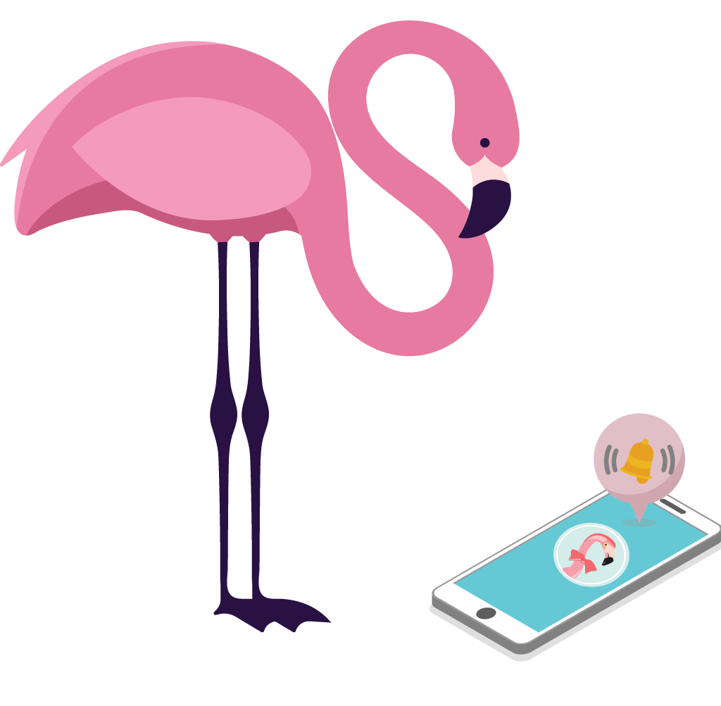

Messaging Techniques
NodeMailer
FCM
Notes:
Messaging is separated into two parts, delivering the message and pushing a notification
Notifications are handled using Firebase cloud messaging, and delivering the data uses firebase’s real time database

Slide 12
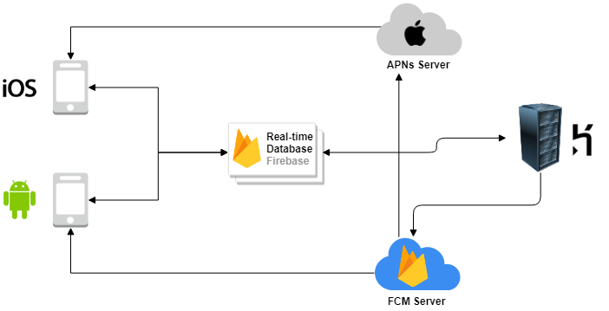
How Notification System works

Slide 13

Server Side:
Non-Blocking I/O Model
Uses Asynchronous JS coding technique
Well Documented & Community Friendly
Open-source fully documented packages
The Fast Suite
Built on V8 JS engine
Solved All NoSQL Databases Queries
JS enables Real-Time DBs to run with no obstacles
Notes:
As for the server, we used NodeJS to do that

Slide 14


Web Host
Notes:
Heroku was used to host the website

Slide 15

Flamingo Website

Slide 16

Domain Name:
www.flamingo-app.com

Slide 17
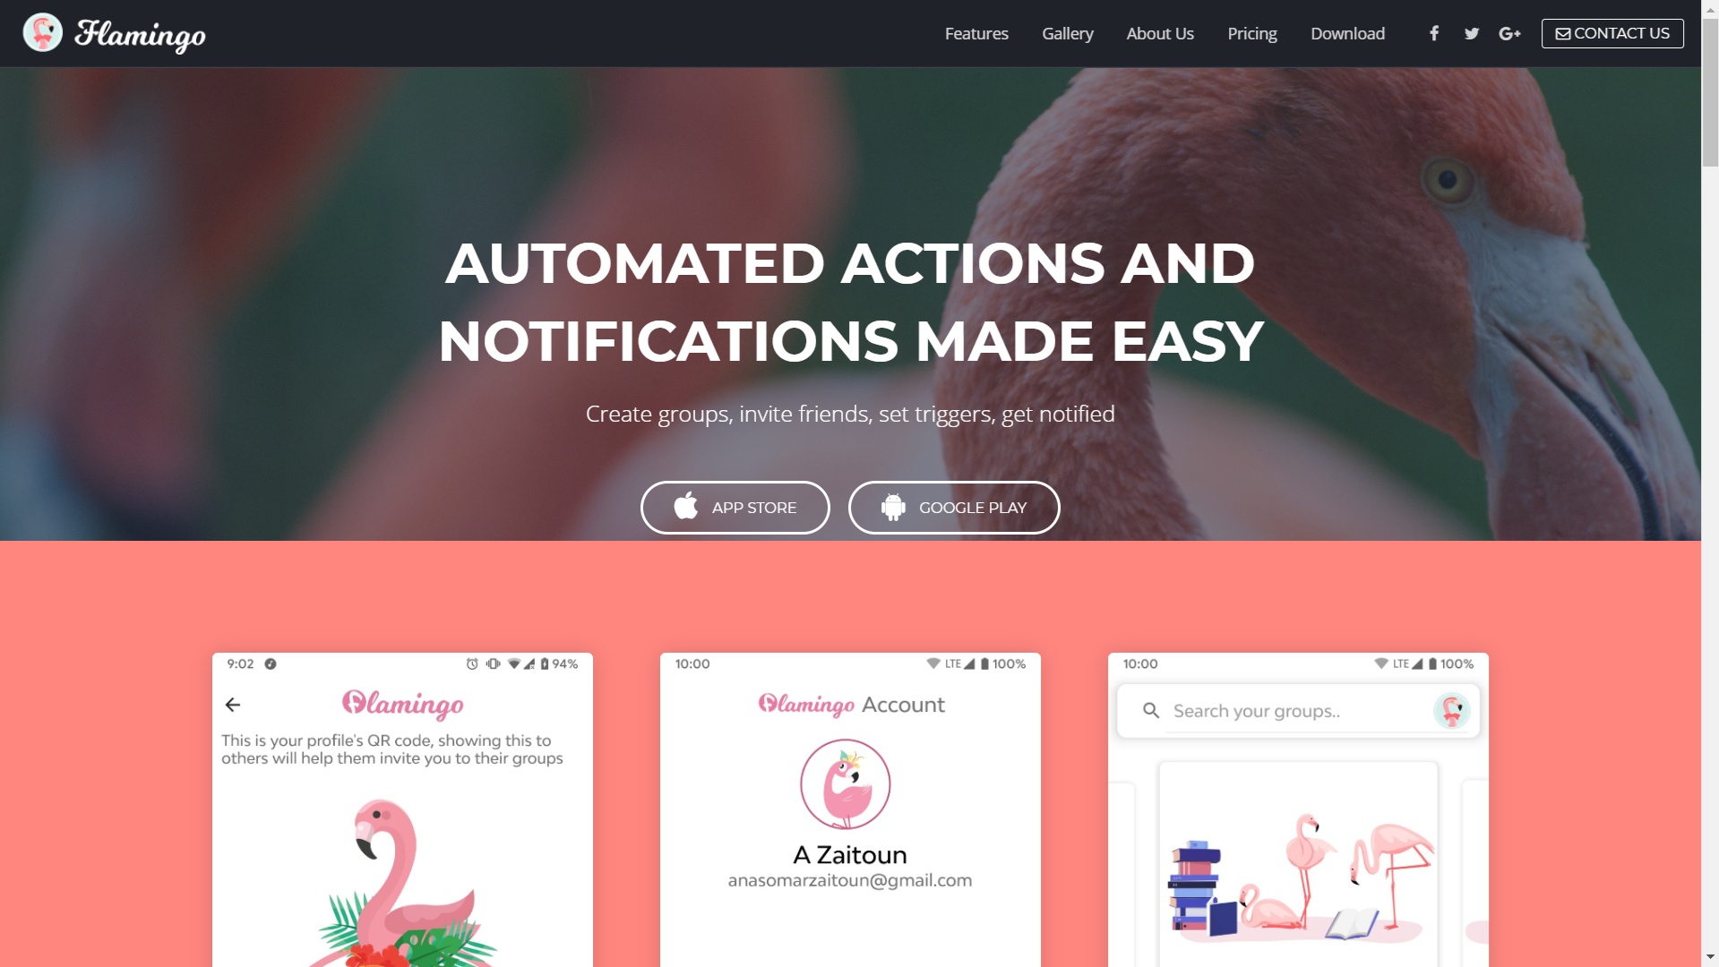

Slide 18



Admin Dashboard
Simple Admin portal to view and manage users and groups, send manual notifications, promotions and announcements to custom set of users, groups.
Dashboard was developed using AngularJS communicating with the Server that uses Firebase Admin SDK

Slide 19
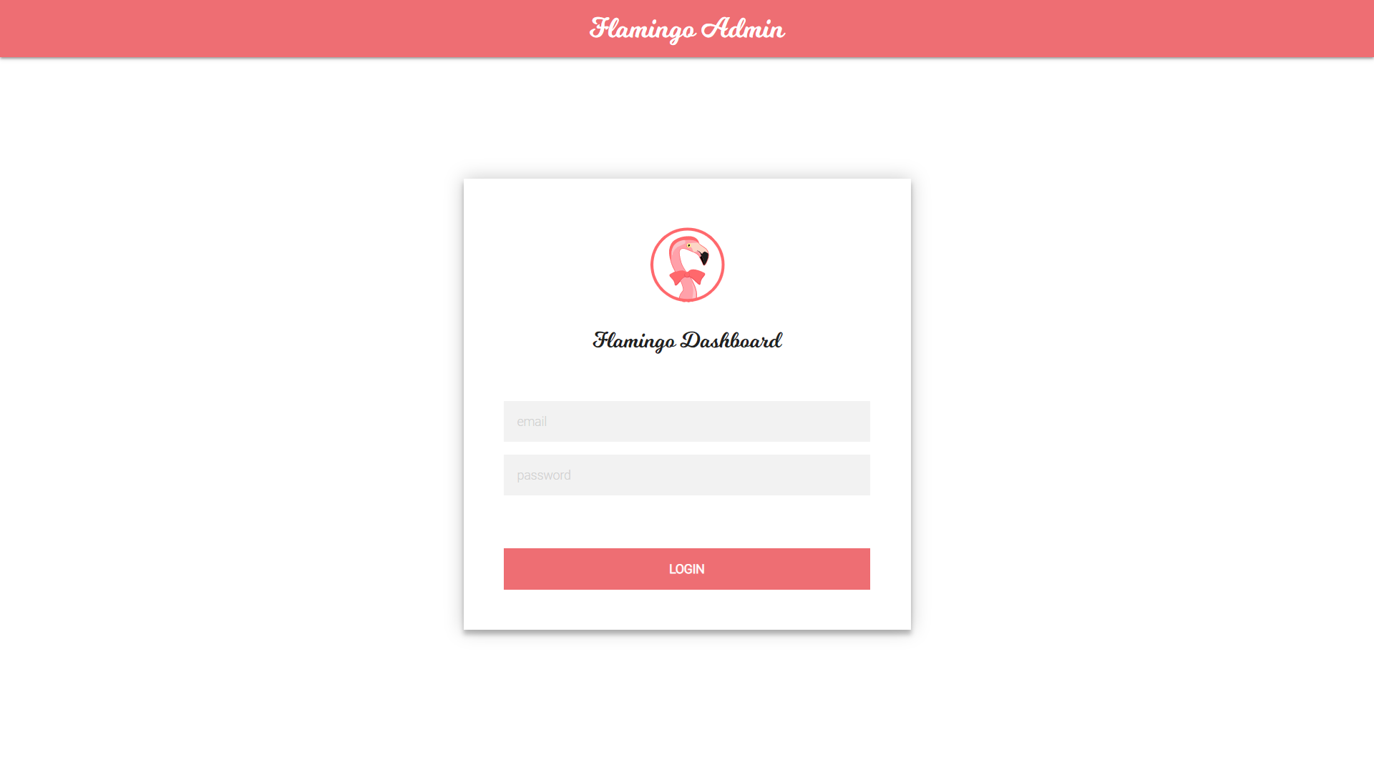

Slide 20
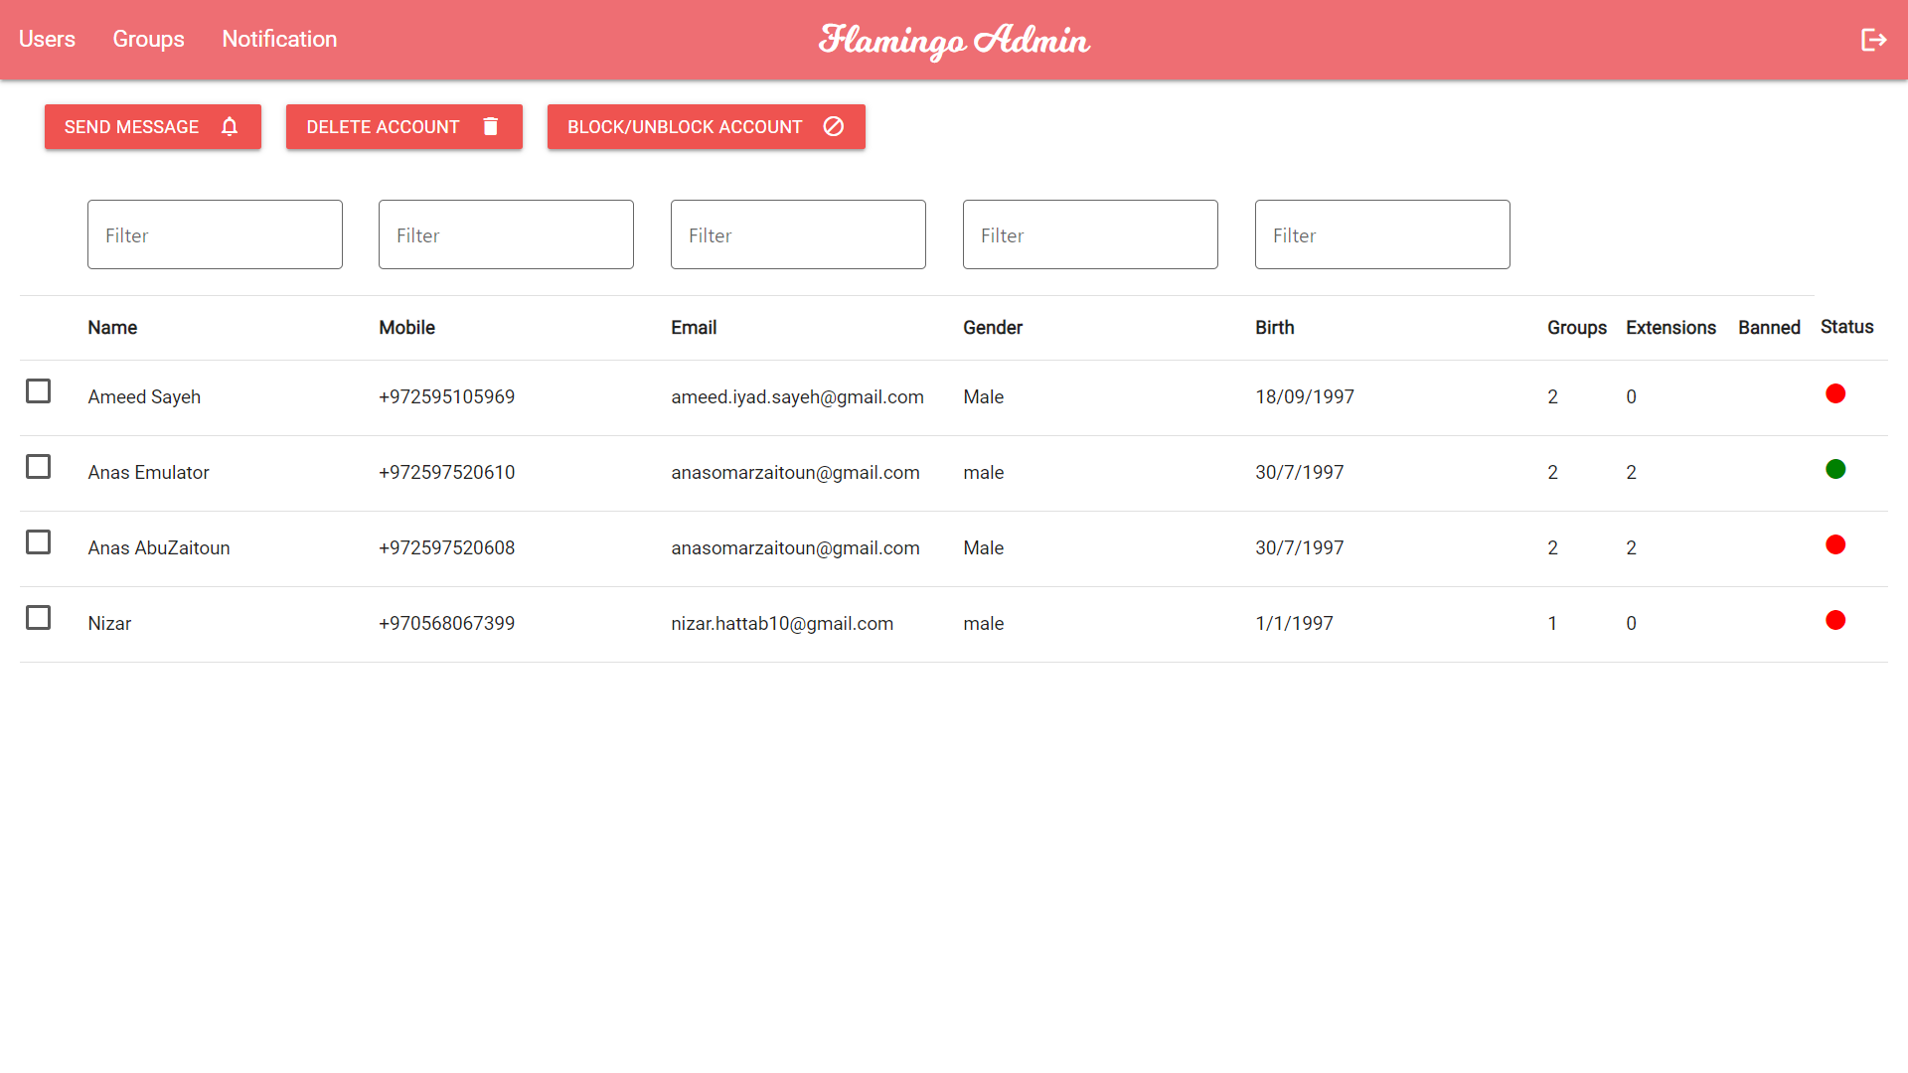

Slide 21
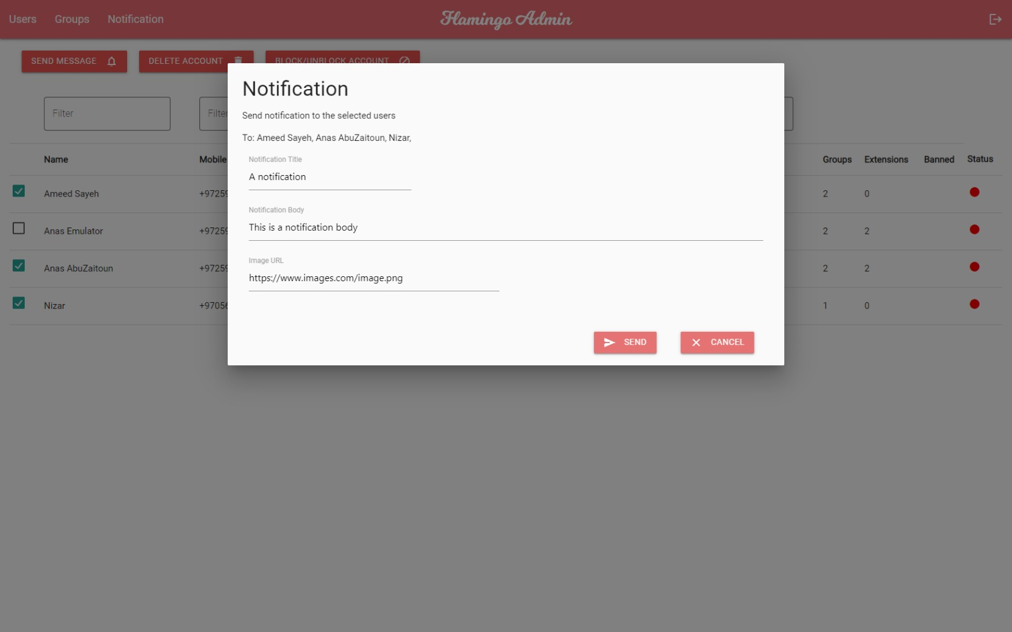

Slide 22


The Application
Notes:
The application, which is point of focus for this project is available on both Android and iOS

Slide 23
App hierarchy
Users
Groups
Group Triggers
Personal Triggers
Notes:
Talk about what we have, groups, users, notification tickets, jobs and personal jobs, alongside everything that the server updates periodically
How groups have lists of members and list of jobs, those jobs are connected to GroupJobs, same applies to users, they have jobs that are connected to personal jobs

Slide 24
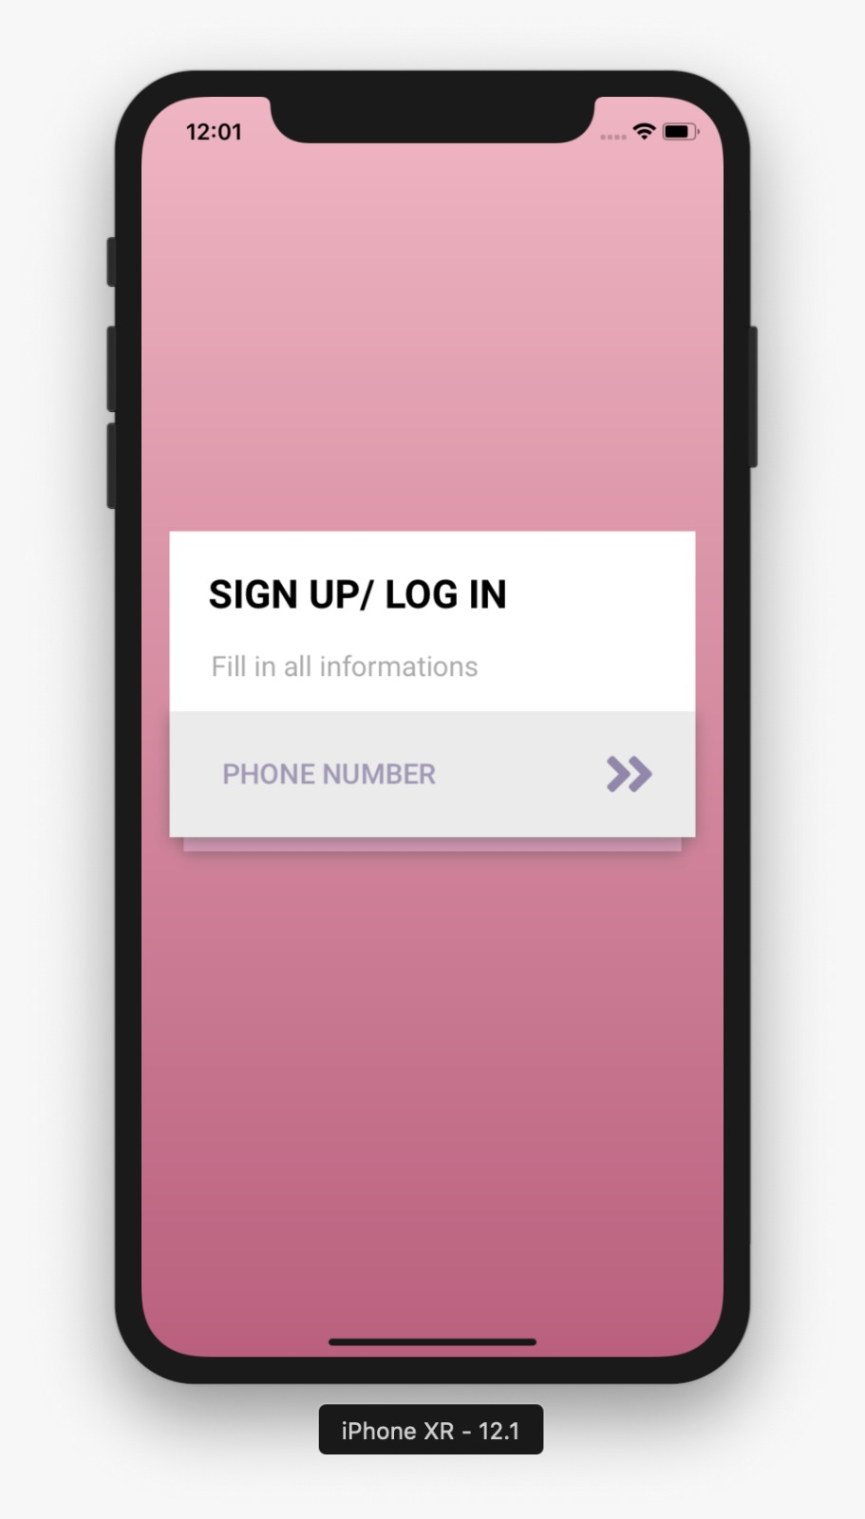
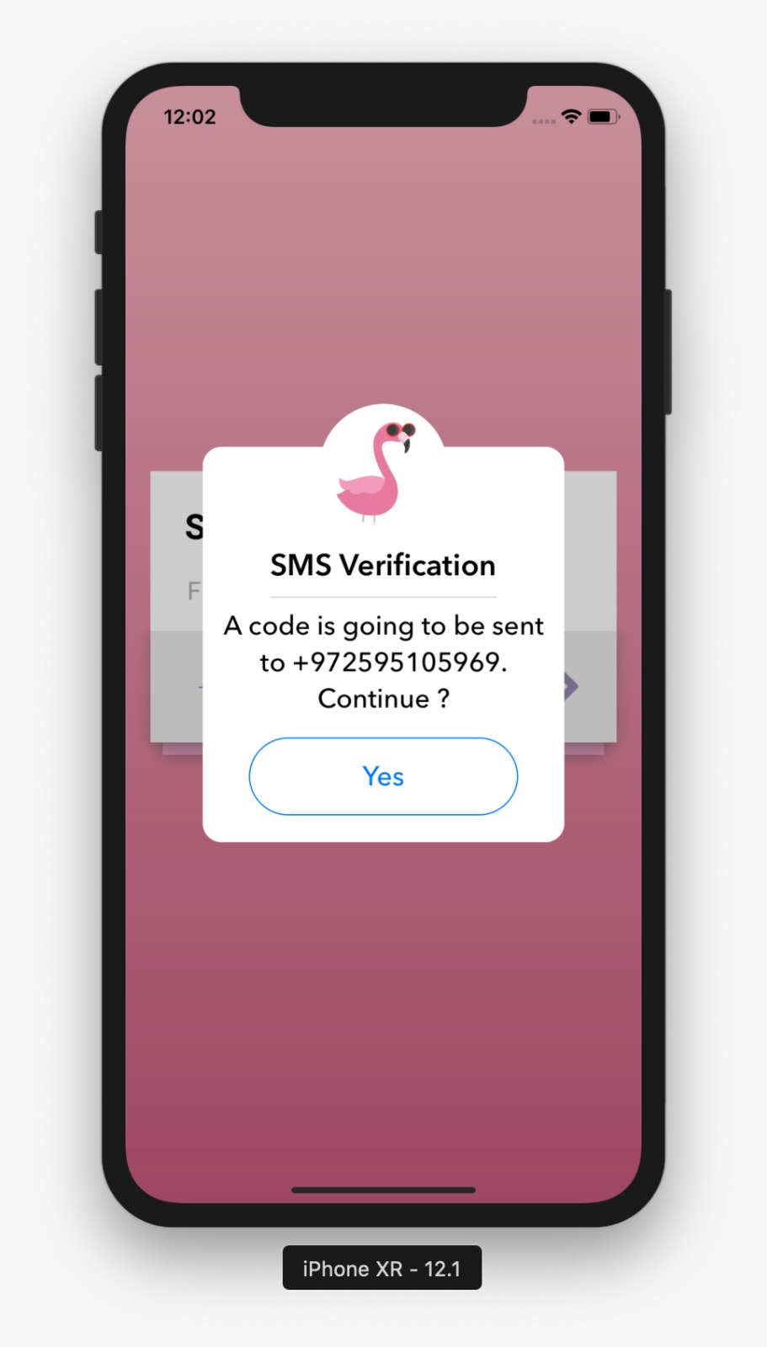
Creating An Account

Slide 25
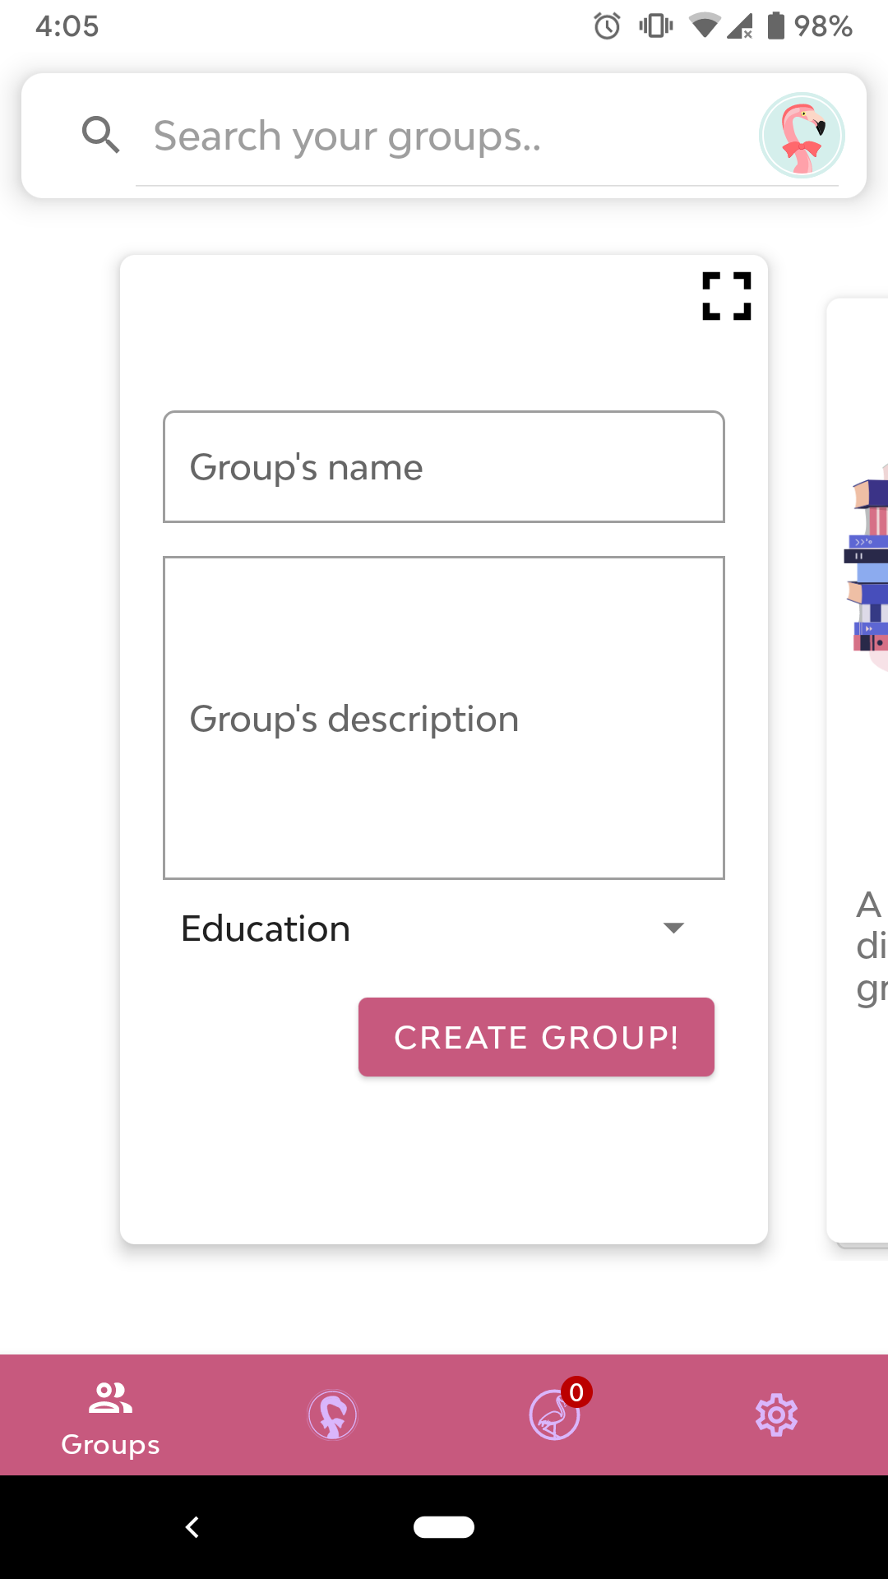
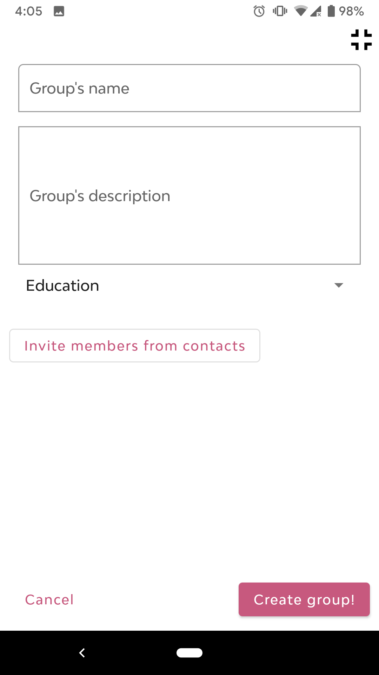
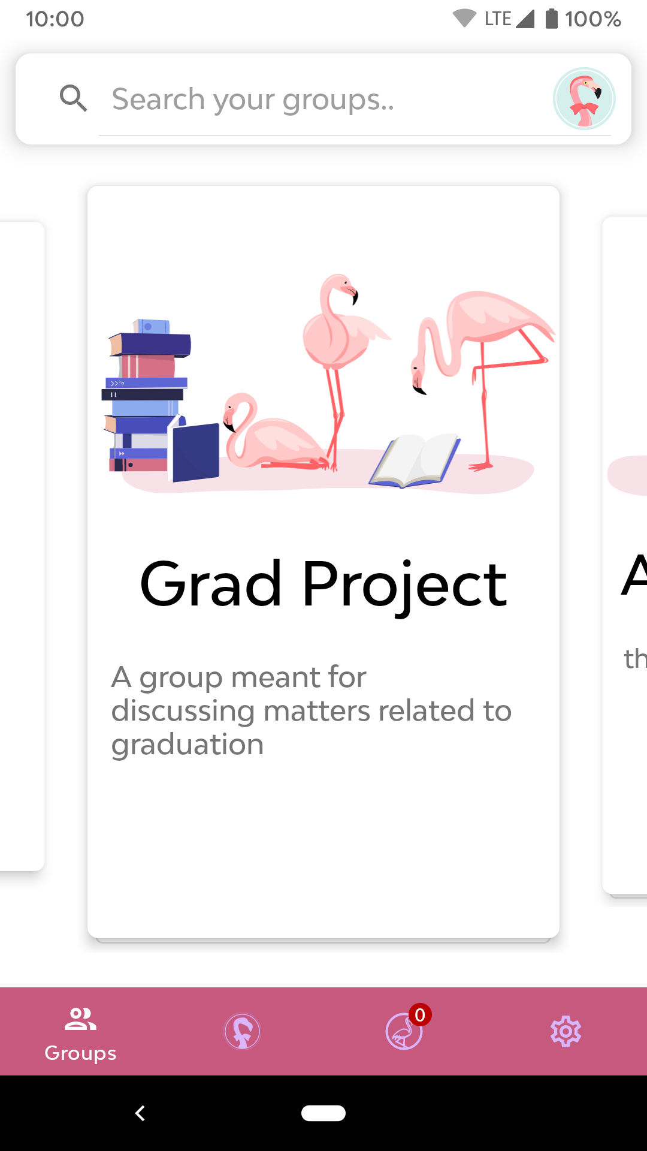
Creating a Group

Slide 26
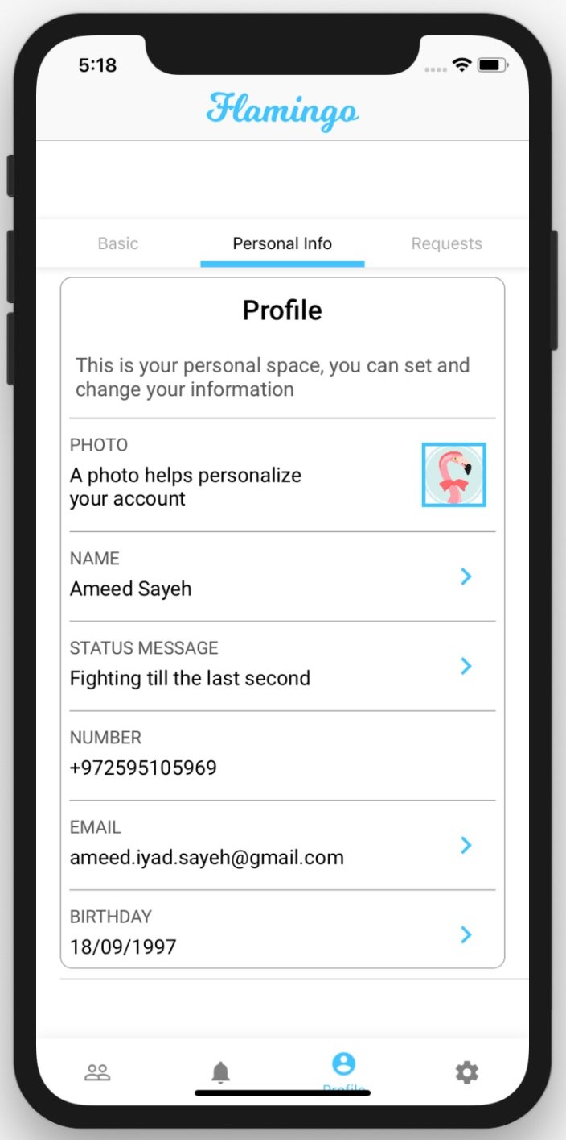
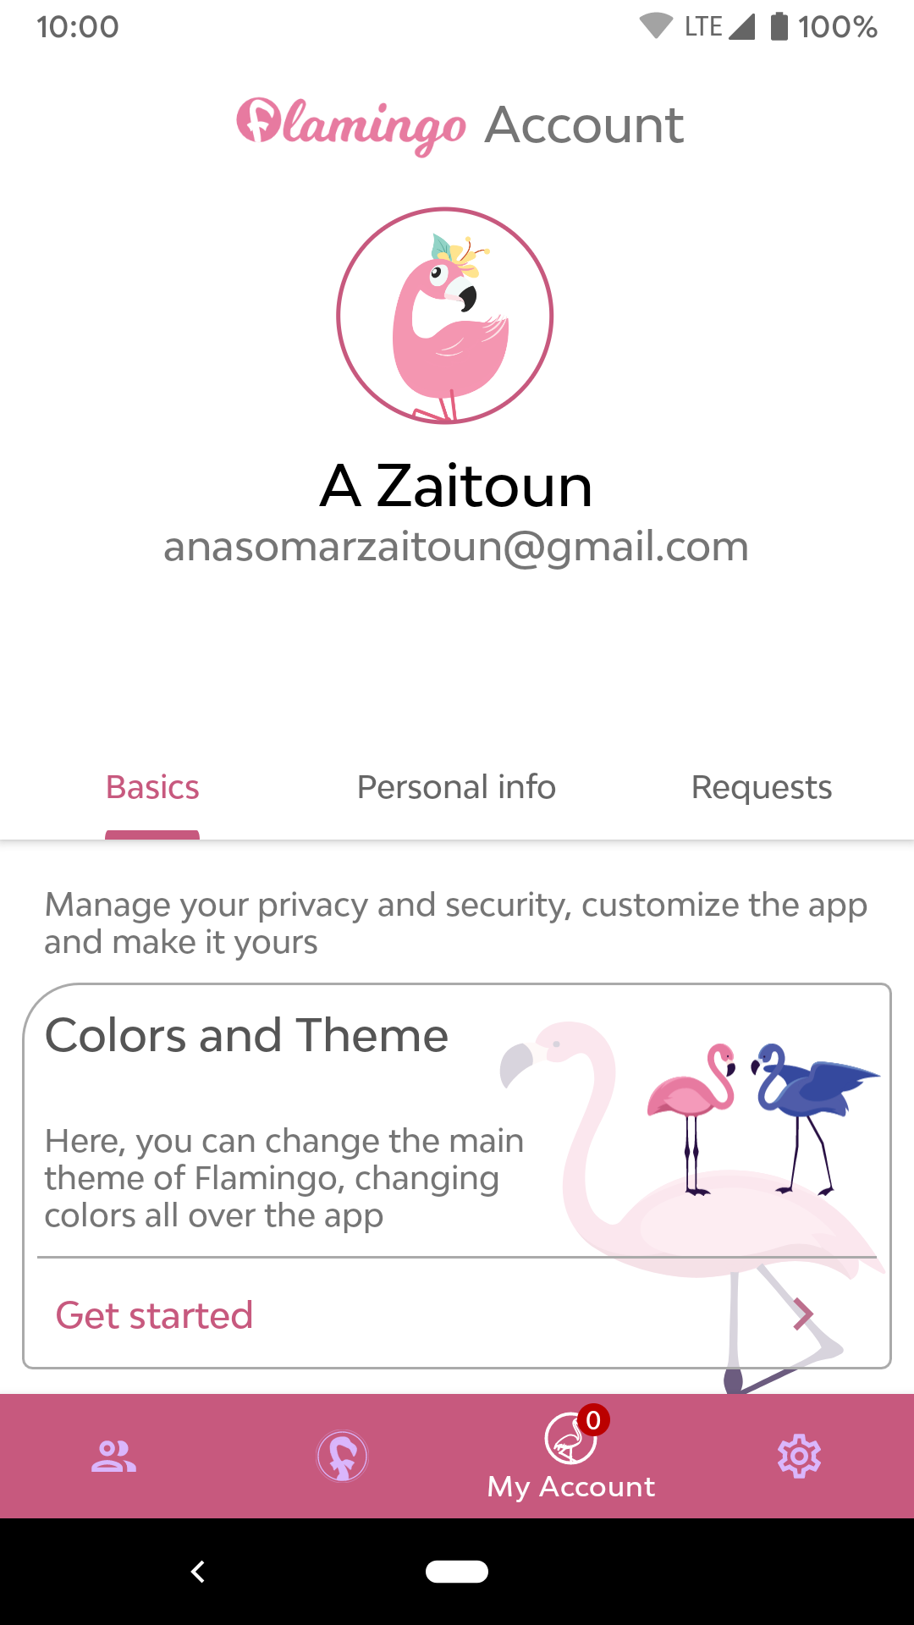
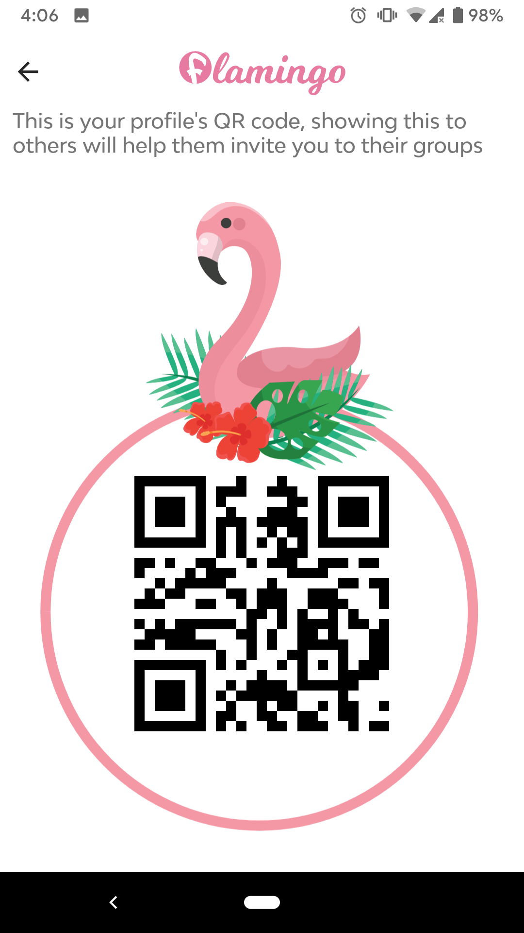
View Profile

Slide 27
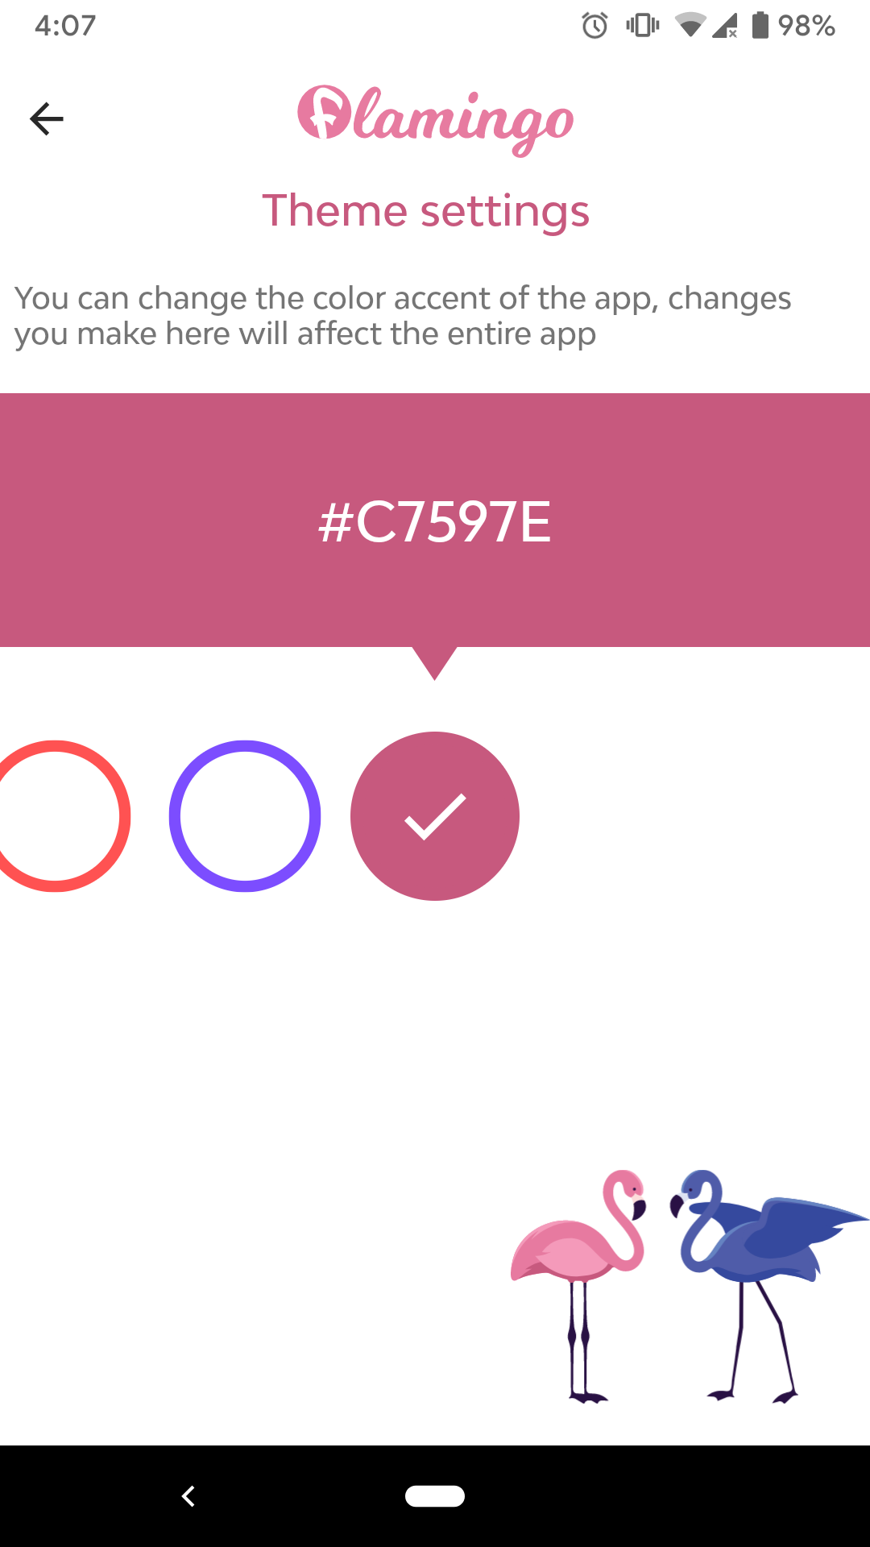
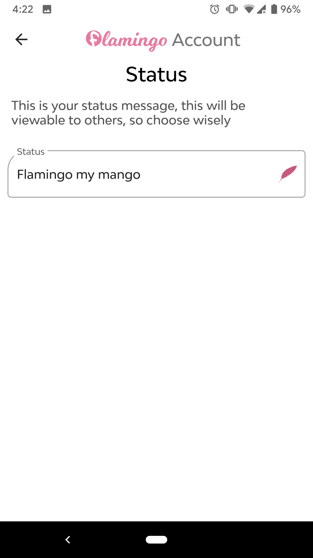
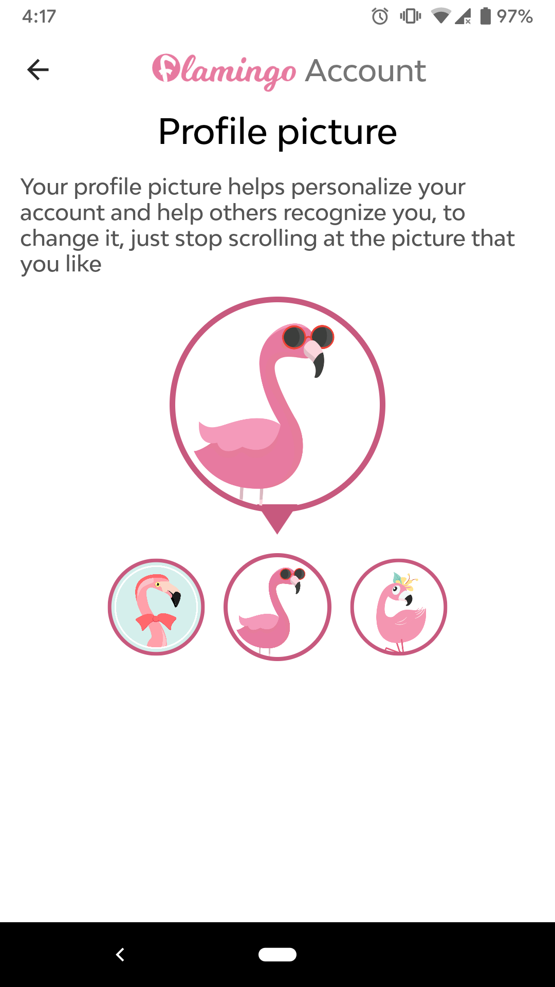
Customize Profile & Theme

Slide 28
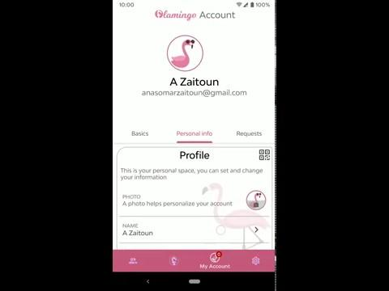

Slide 29
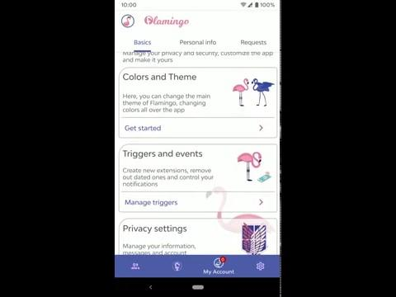

Slide 30
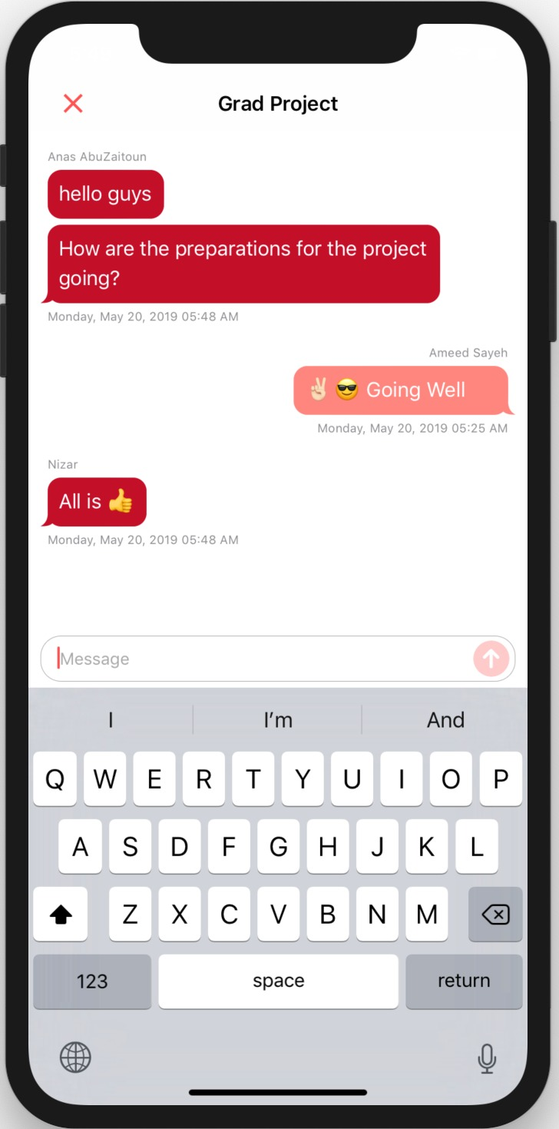
Chat With Group Members

Slide 31

Privacy Means

Slide 32


Privacy & Security
Users can control what of their info is visible
Users can download their data.
Users can delete all of their data.
Signing in can only be using one device

Slide 33
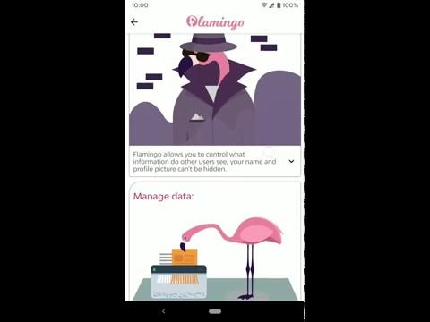

Slide 34
Extension Triggers
Time
Currency Exchange Rates
Weather
GPS ( to be implemented )

Slide 35
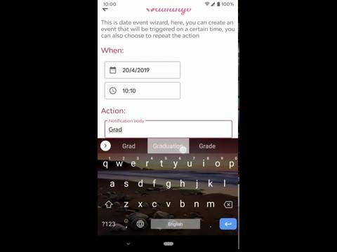

Slide 36

Time
Using node-schedule package
* * * * * *
┬ ┬ ┬ ┬ ┬ ┬
│ │ │ │ │ │
│ │ │ │ │ └ day of week (0 - 7) (0 or 7 is Sun)
│ │ │ │ └───── month (1 - 12)
│ │ │ └────────── day of month (1 - 31)
│ │ └─────────────── hour (0 - 23)
│ └──────────────────── minute (0 - 59)
└───────────────────────── second (0 - 59)

Slide 37


Currency
Using exchangerateapi
Time update
On Change

Slide 38


Weather
Using APIXU

Slide 39
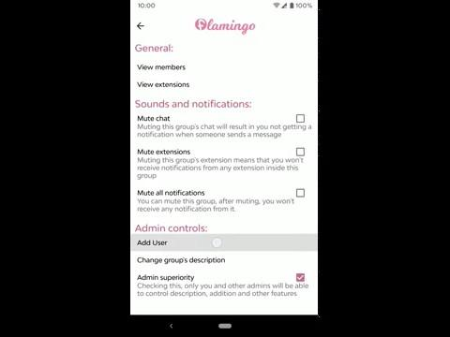

Slide 40
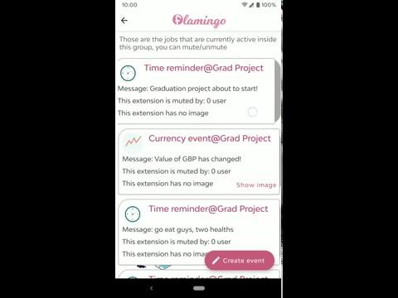

Slide 41
Future Work
More triggers
More actions
Add more features to chat
Finalizing details
Website App

Slide 42
Thank you!

Slide 45

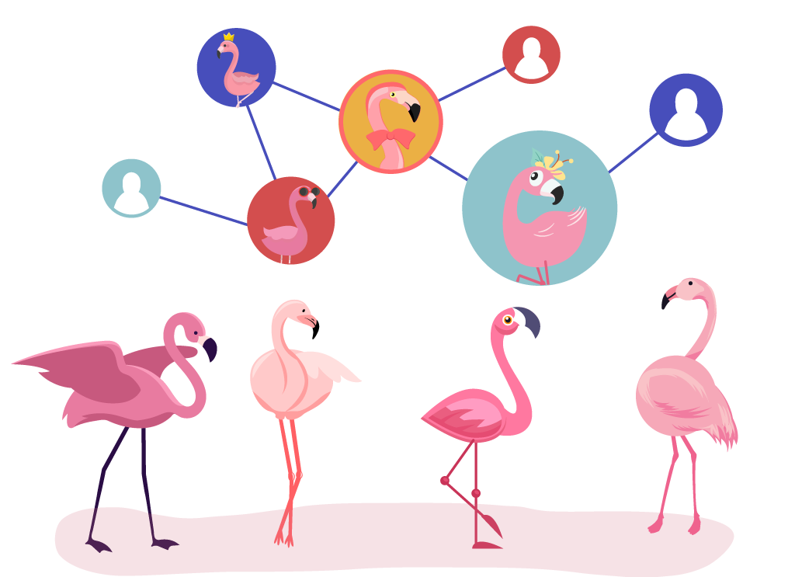



Slide 47
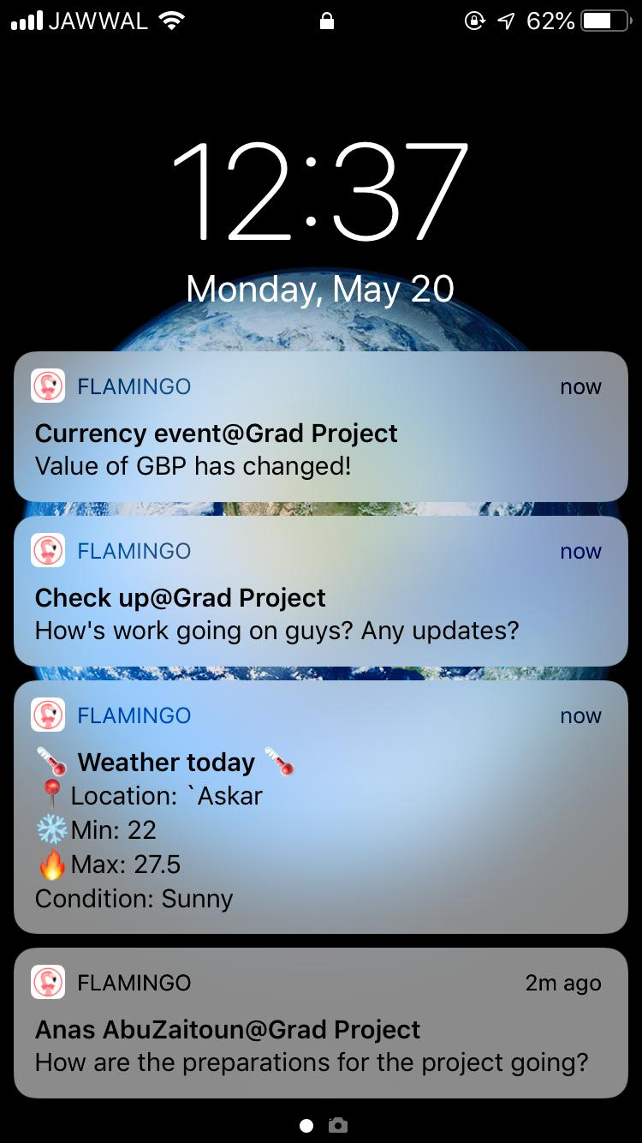
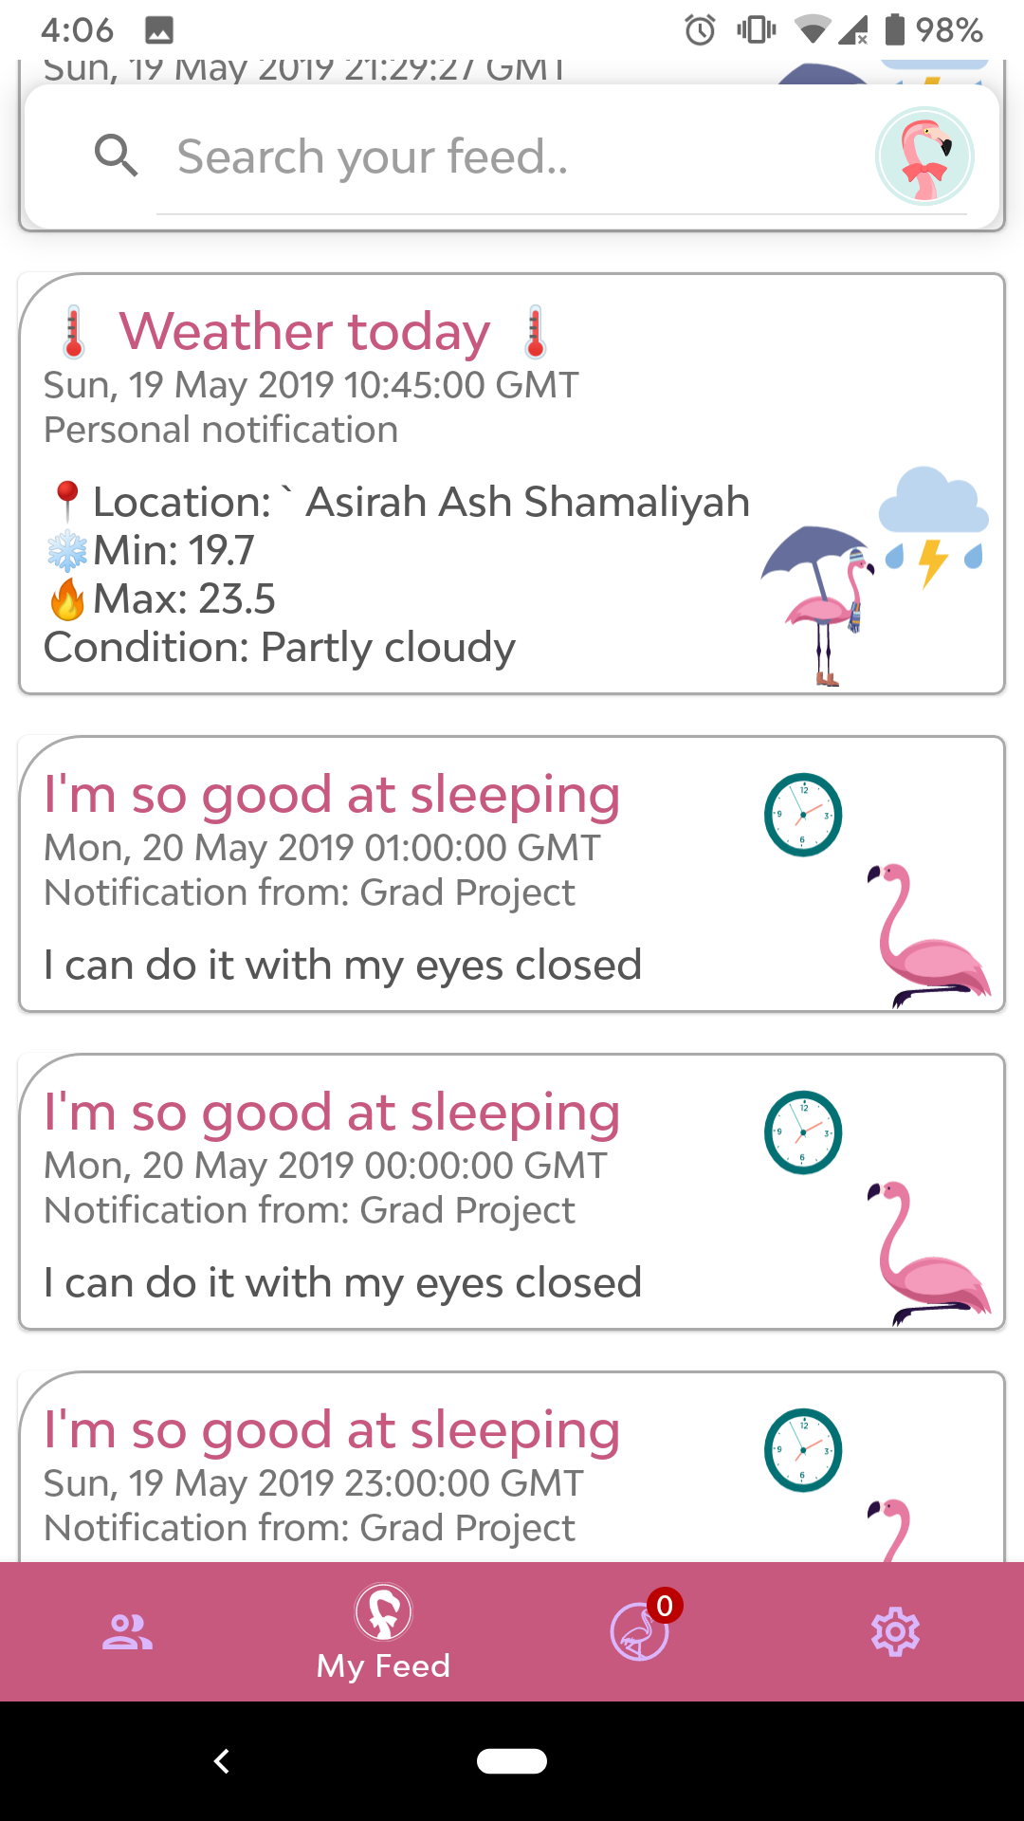

Slide 48
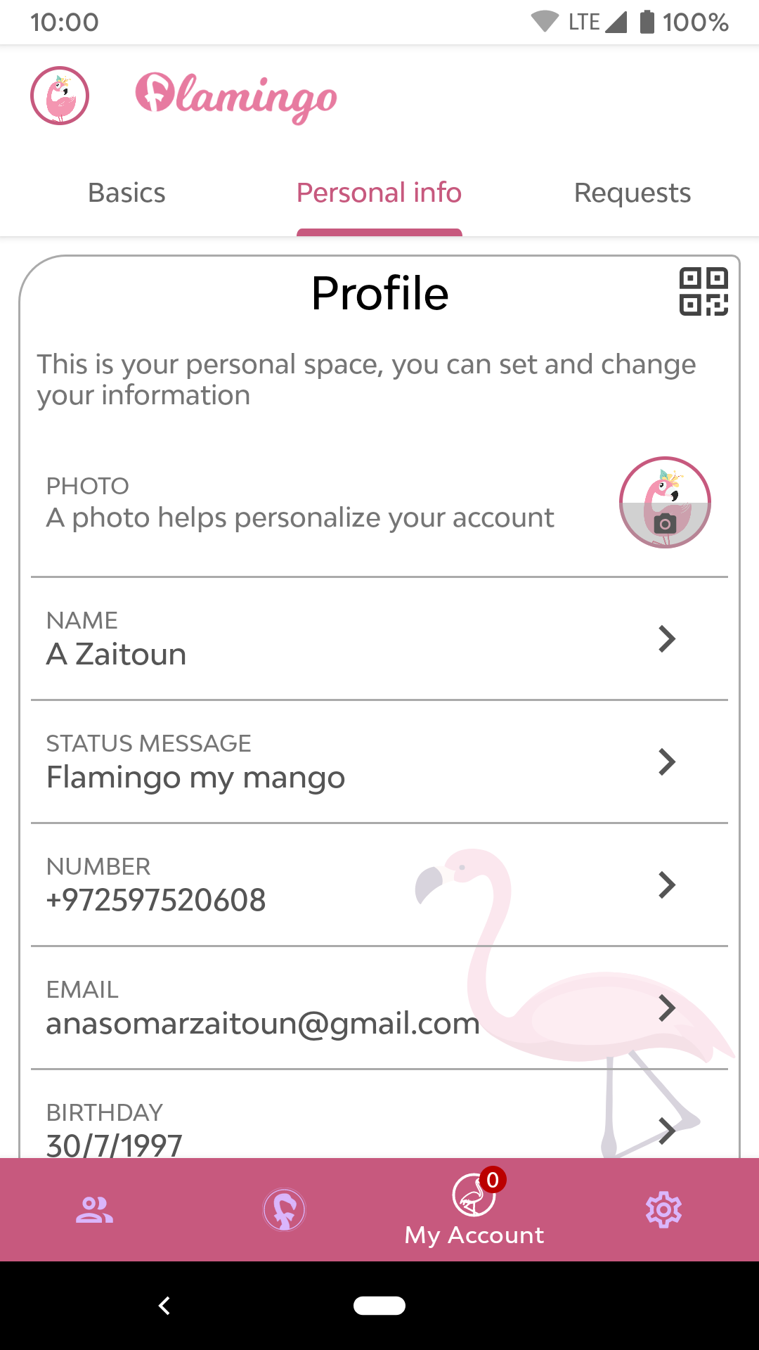

Slide 50
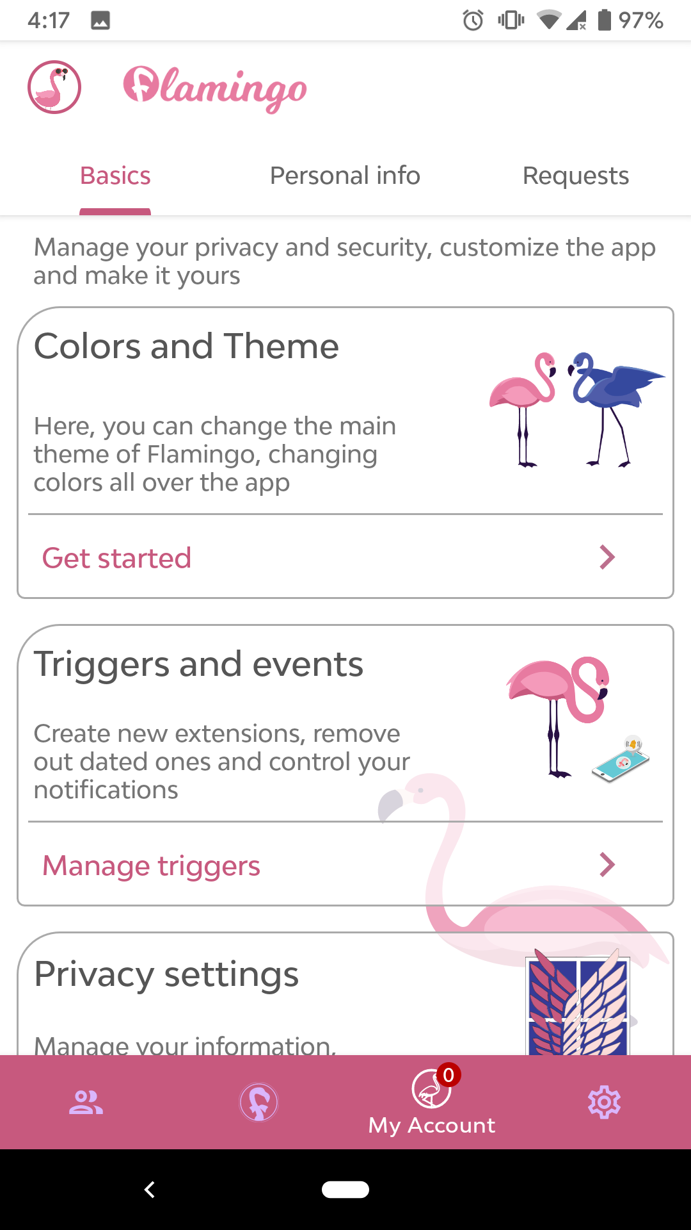
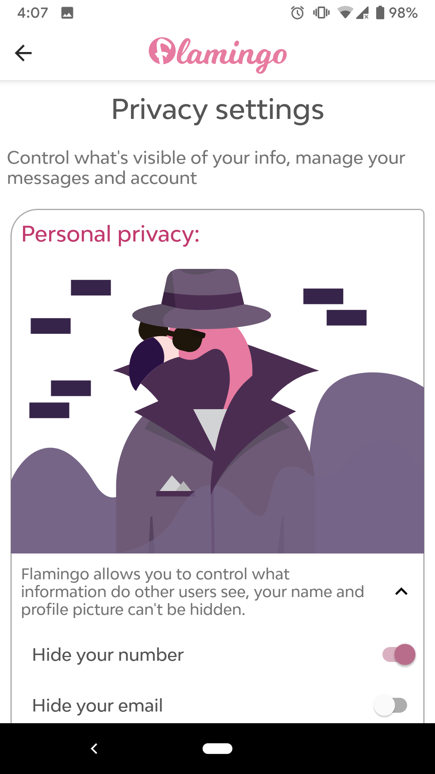
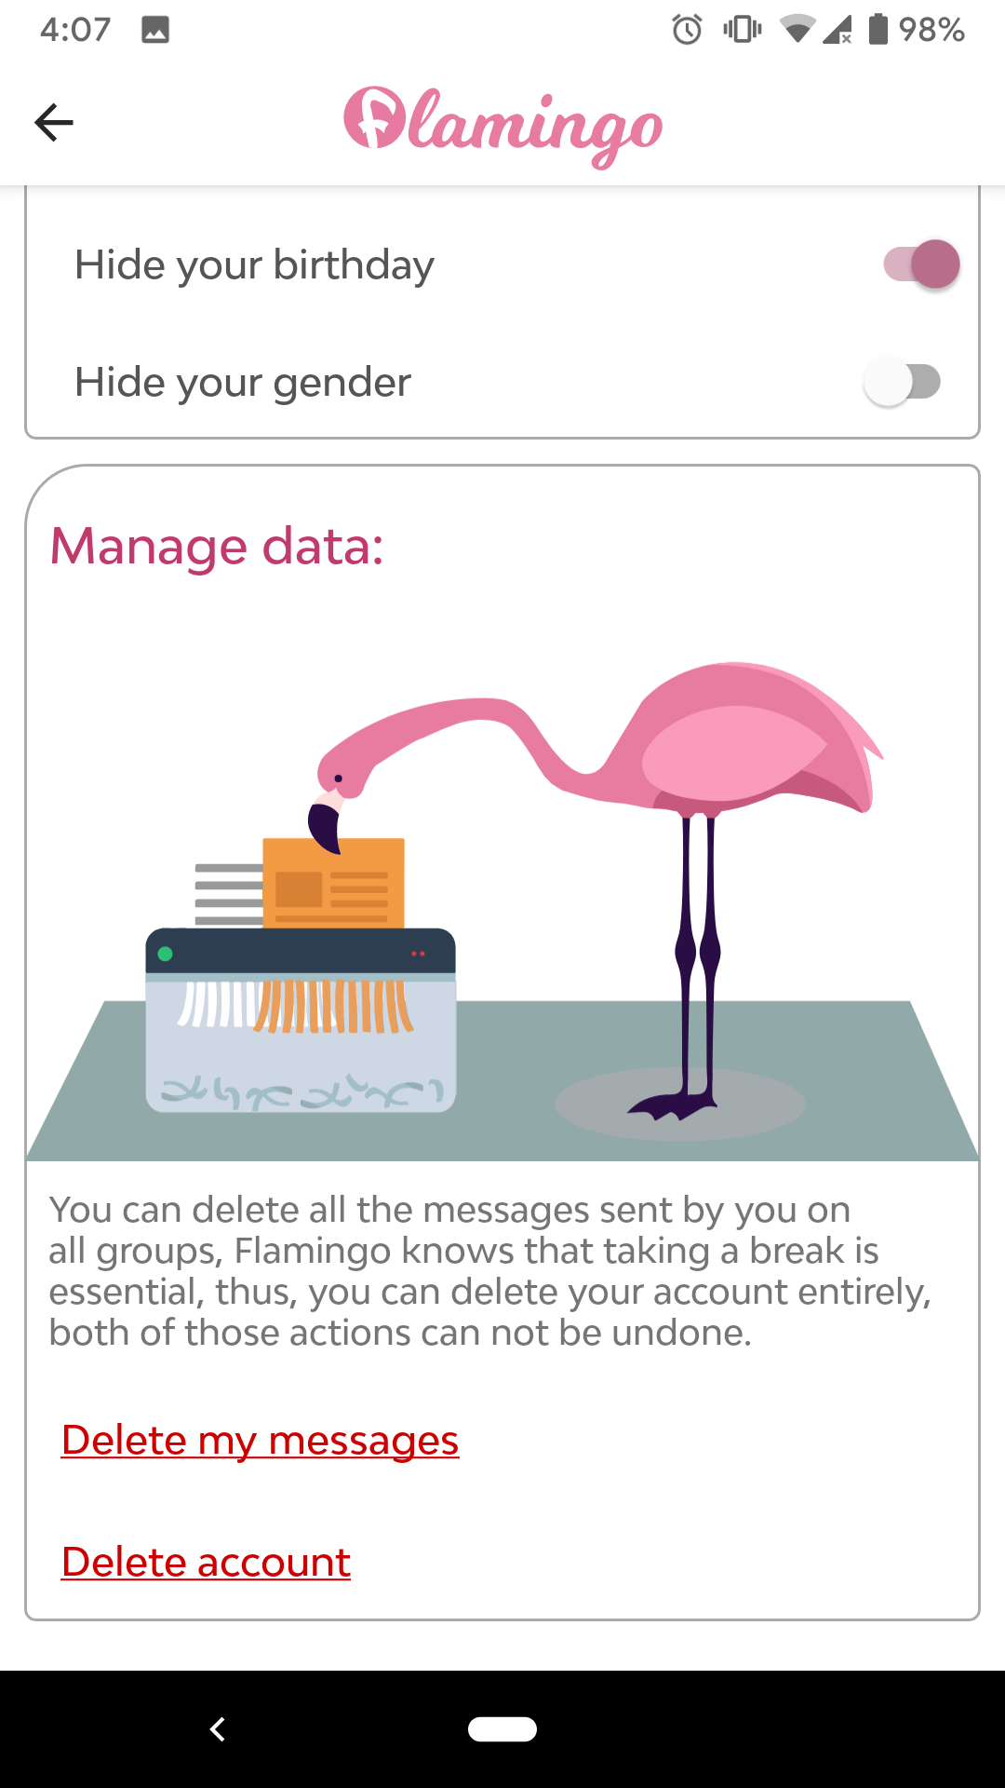

Slide 51
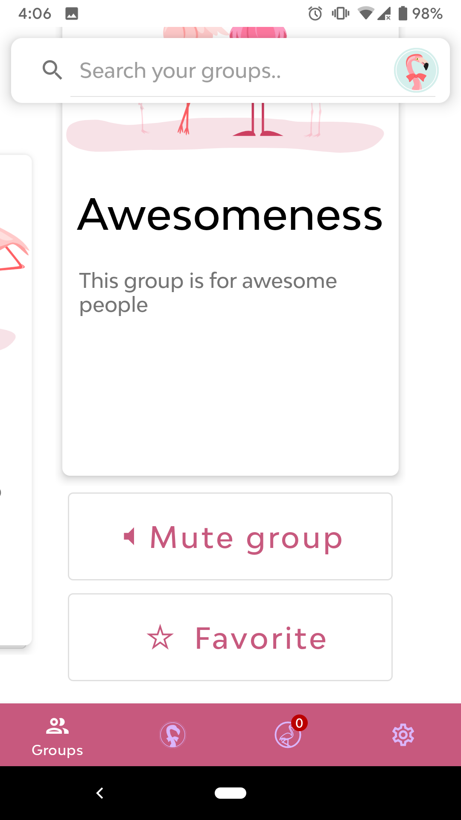
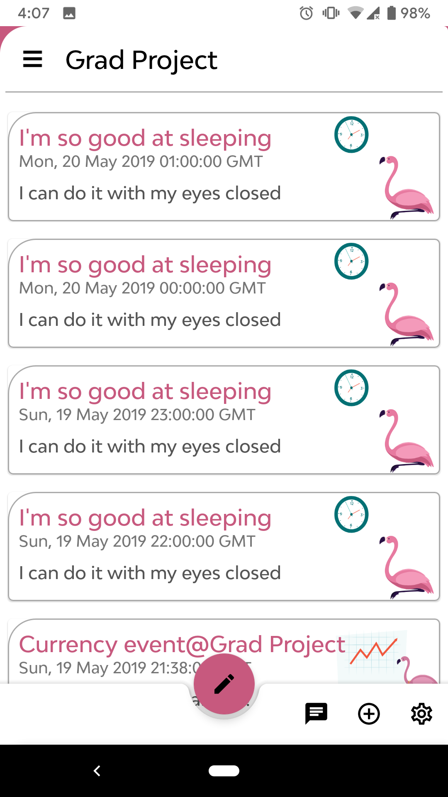
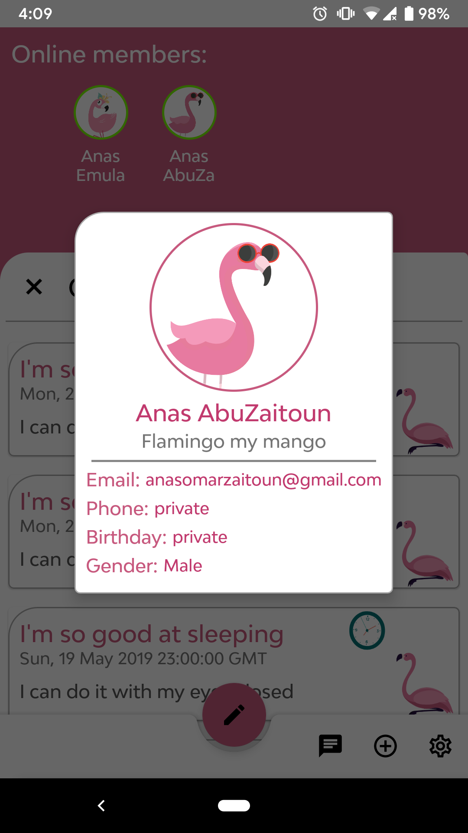

Slide 52
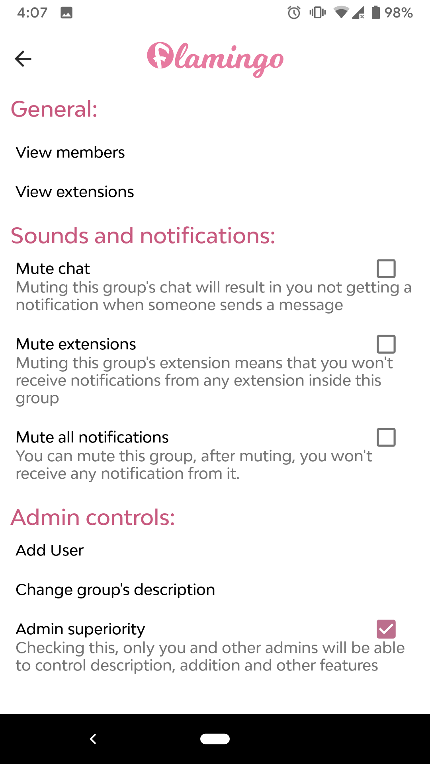
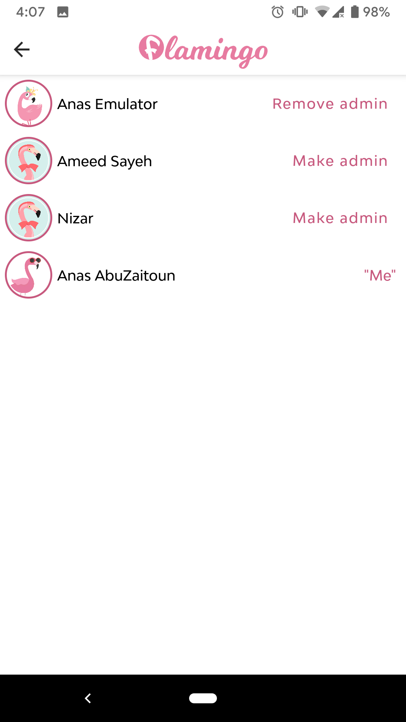
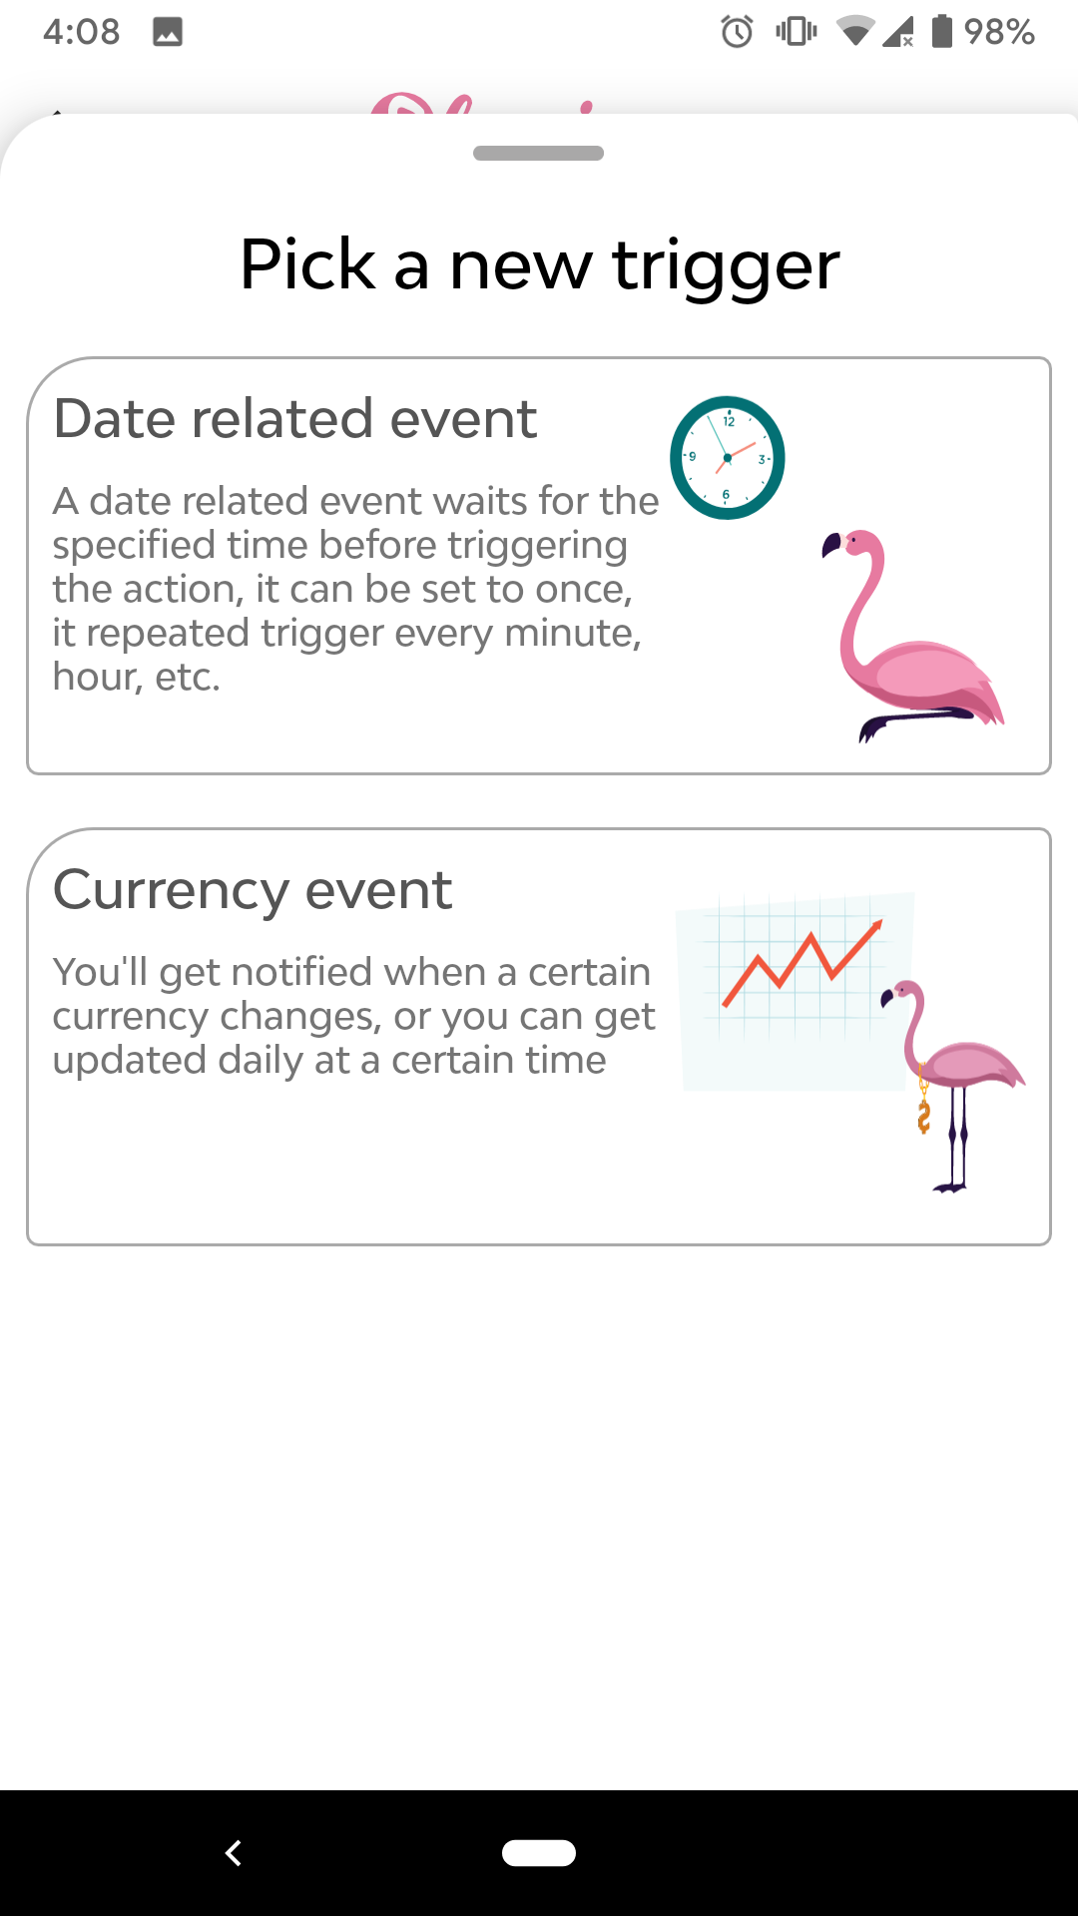

Slide 53
