Slide 1




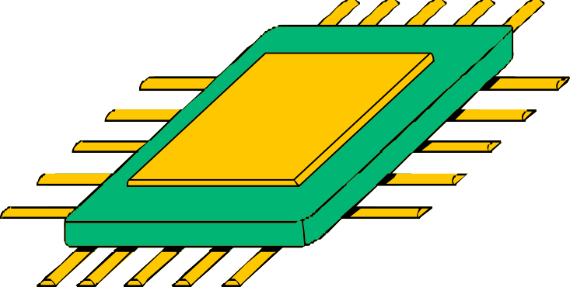
DRILL AND PLOW MACHINE
PRESENTED BY:
Presented By:
Fatima Zhraa Saidi ,Sama Abosair
SUPERVISED BY:
LUAI MALHIS

Slide 2



CONTENTS
Introduction
Primary Goals 3.Constraints 4.Features
5.Hardware Parts 6.Conclusion

Slide 3


INTRODUCTION
The Drill and Plow Machine is designed to automate plowing and digging tasks,
reducing physical effort for farmers. It
operates in two modes: autonomous, where it avoids obstacles and plows on its own,
and manual, where the farmer controls it
directly. The machine uses advanced sensors and efficient power management to improve productivity in the field.

Slide 4

PRIMARY GOALS
Autonomous Plowing
Precise Digging
Increased Productivity Tech Integration

Slide 5



Constraints
Soil and Terrain
Environmental Sensitivity
Power Consumption
Handling Small Electrical Parts
Damage from Rocks
Finding Suitable Motors

Slide 6

FEATURES
Dual Operation Modes
Obstacle Avoidance
Wireless Control
Efficient Power Management
Precise Plowing and Digging

Slide 7
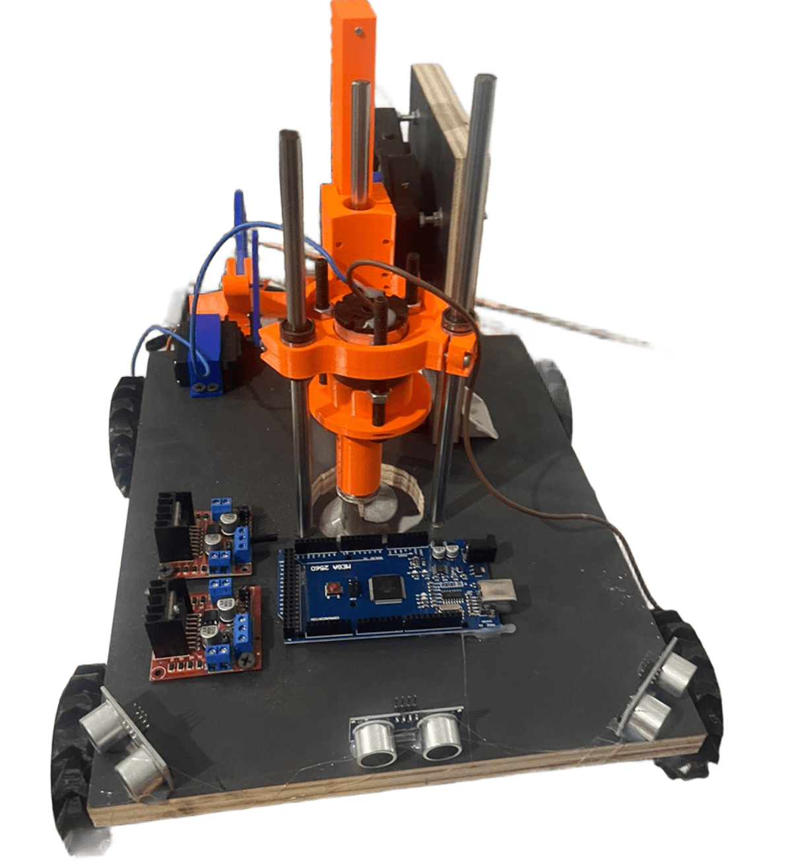

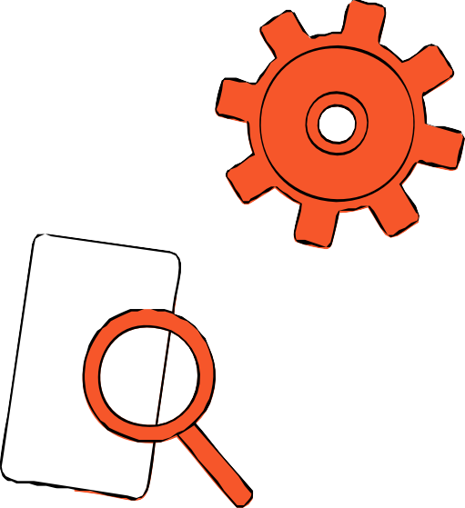
HARDWARE PARTS

Slide 8

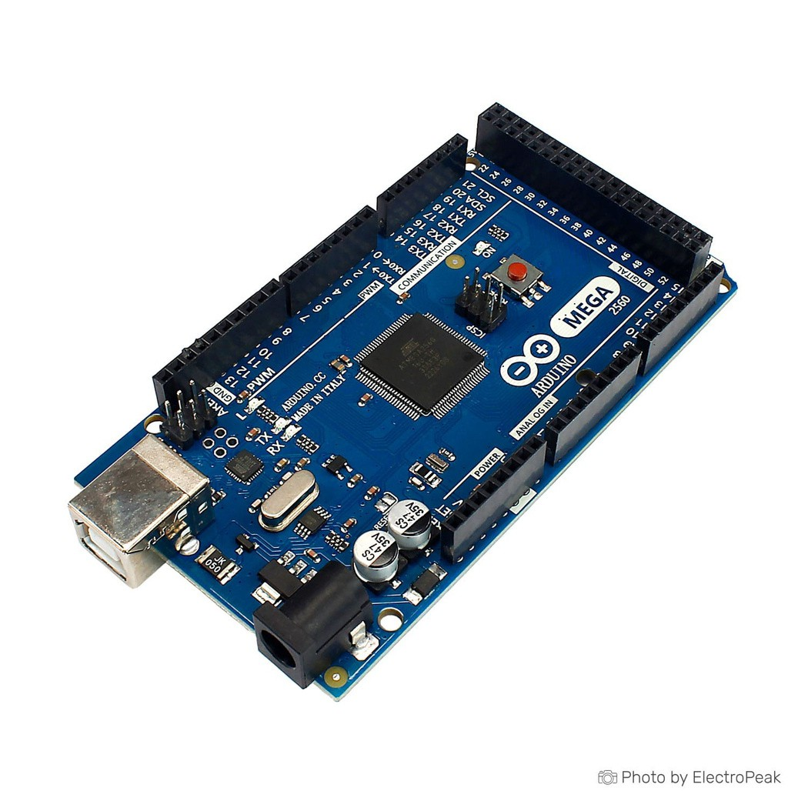
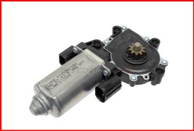


HARDWARE PARTS
Arduino Mega2560
DC MOTOR WITH GEARBOX
DC MOTOR

Slide 9

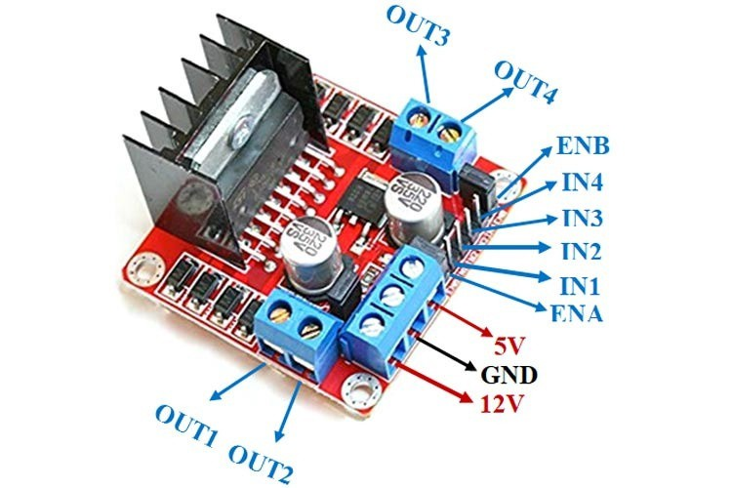
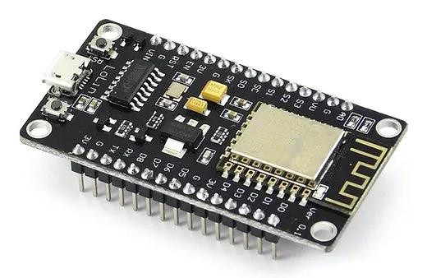
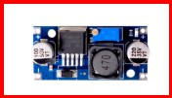
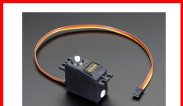

HARDWARE PARTS
L298N MOTOR DRIVERS
ESP8266
DC Converter
SERVO MOTOR

Slide 10
HARDWARE PARTS
Servo Motor
DC-DC Converter (6V)
Lithium Battery
HC-SR04 Ultrasonic

Slide 11



USING THE ESP MODULE TO CONNECT THE DRILL AND PLOW MACHINE WITH THE MOBILE
Starting the plowing process: The farmer uses the mobile application to activate the Drill and Plow Machine, which starts plowing the land while avoiding obstacles.
Status of the drilling tool: A green indicator in the app shows that the drilling tool is operational, while a red indicator means it is idle or stopped.

Slide 12













CONCLUSION
The Drill and Plow Machine efficiently automates plowing and digging tasks, with a reliable obstacle avoidance system and optimized energy use. It reduces farmers' physical effort and boosts productivity, offering a practical and sustainable solution for modern agricultural practices.

Slide 13

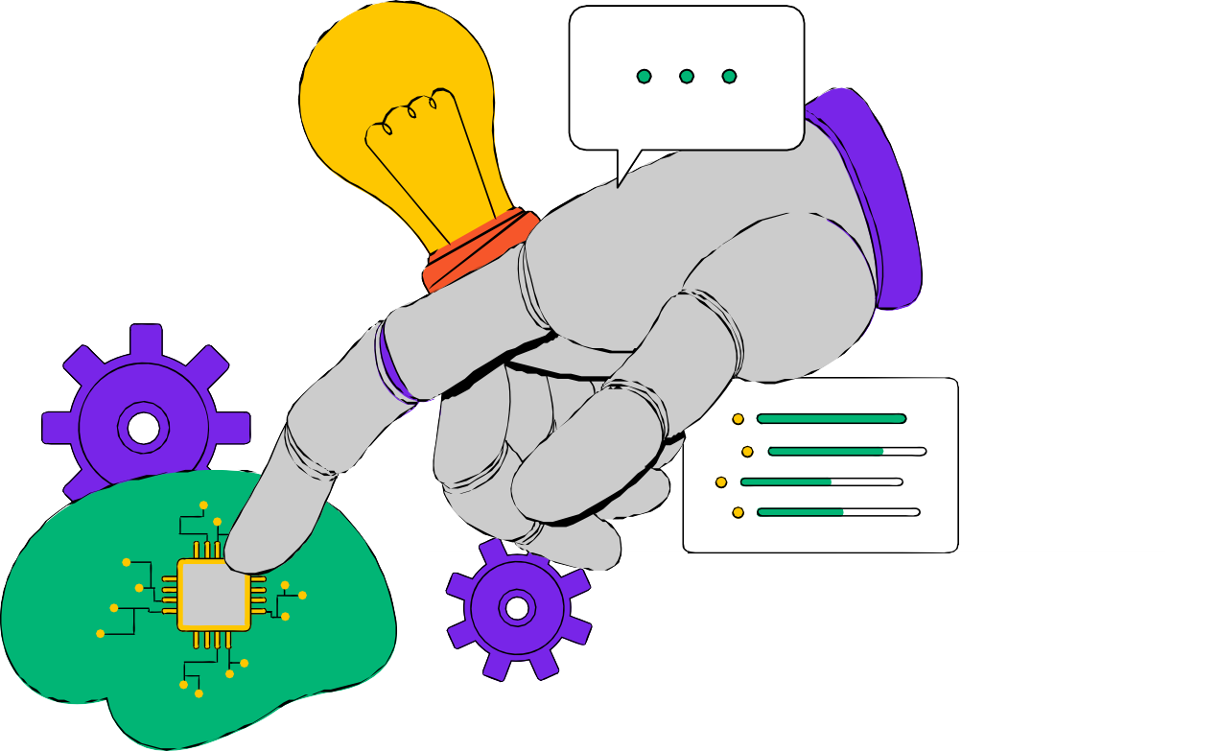



ANY QUESTIONS?

