Slide 1
BookWise

Slide 2
Project Idea.
Origins of the idea.
Planning the idea’s implementation.

Slide 3
Development Process:
Collecting data.
Designing the database.
UI decision making.

Slide 4






Frontend Development Tools:
React
JavaScript
Material-UI
Expo Go
Axios

Slide 5
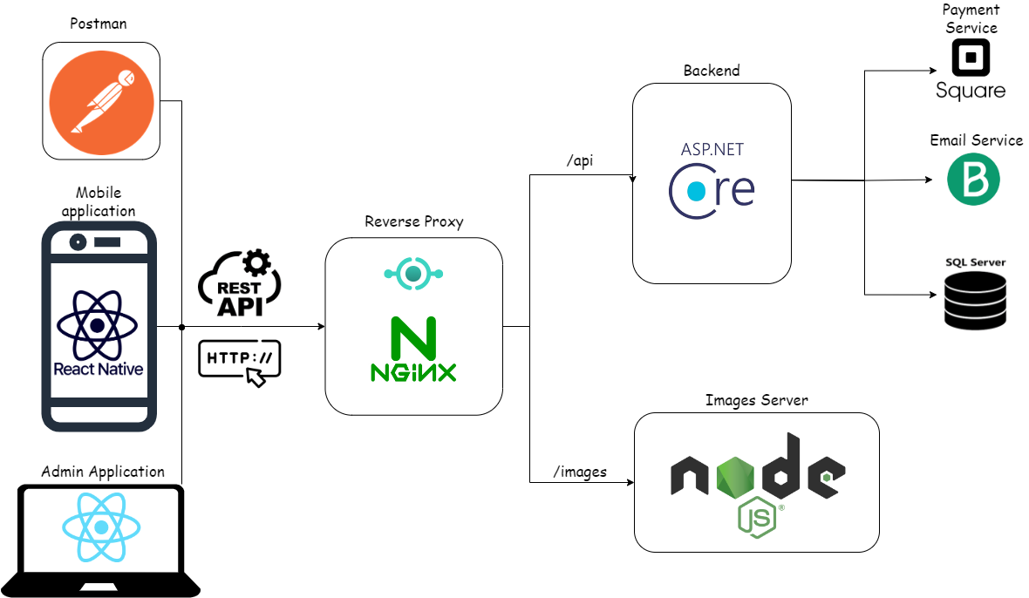




Application Flow

Slide 6
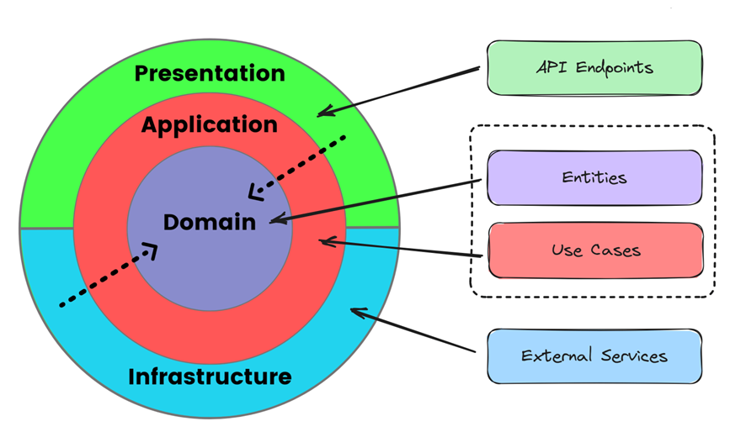


Backend Development Tools:
Unit Testing
Backend Architecture
JWT Bearer Token

Slide 7
Admin UI Pages.

Slide 8
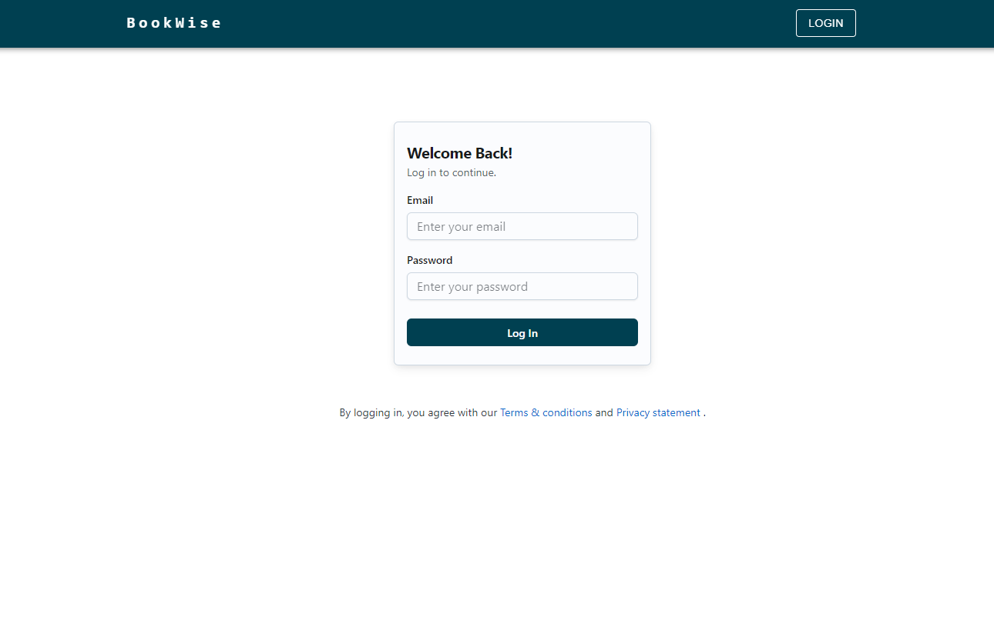
Admin login Page:

Slide 9
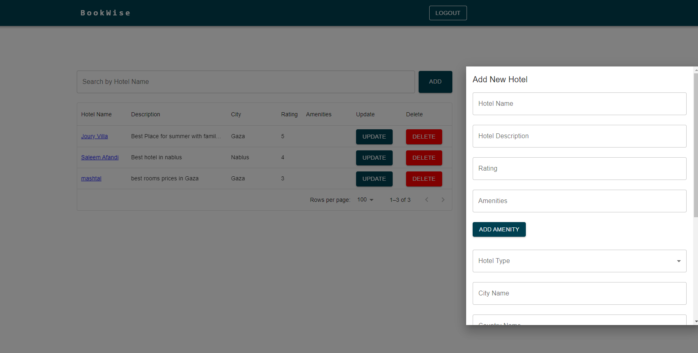
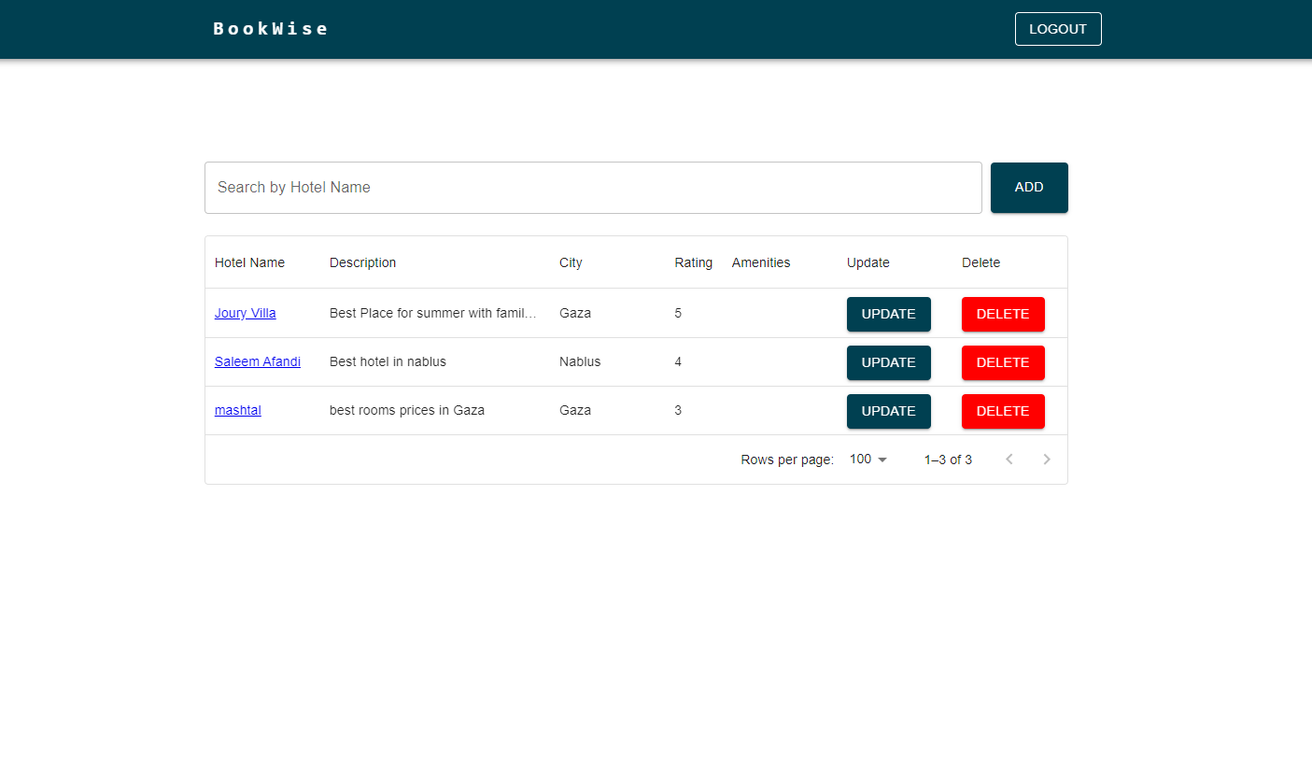
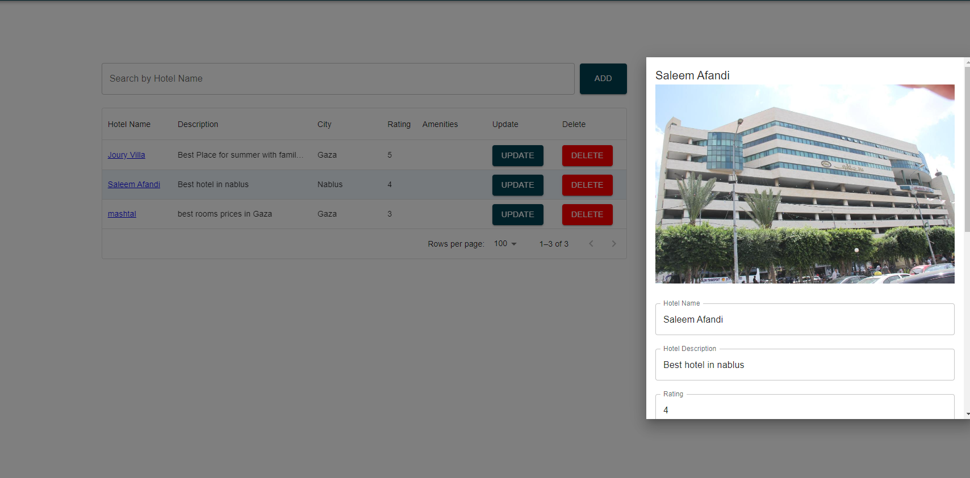
Admin Hotel Management Pages:

Slide 10
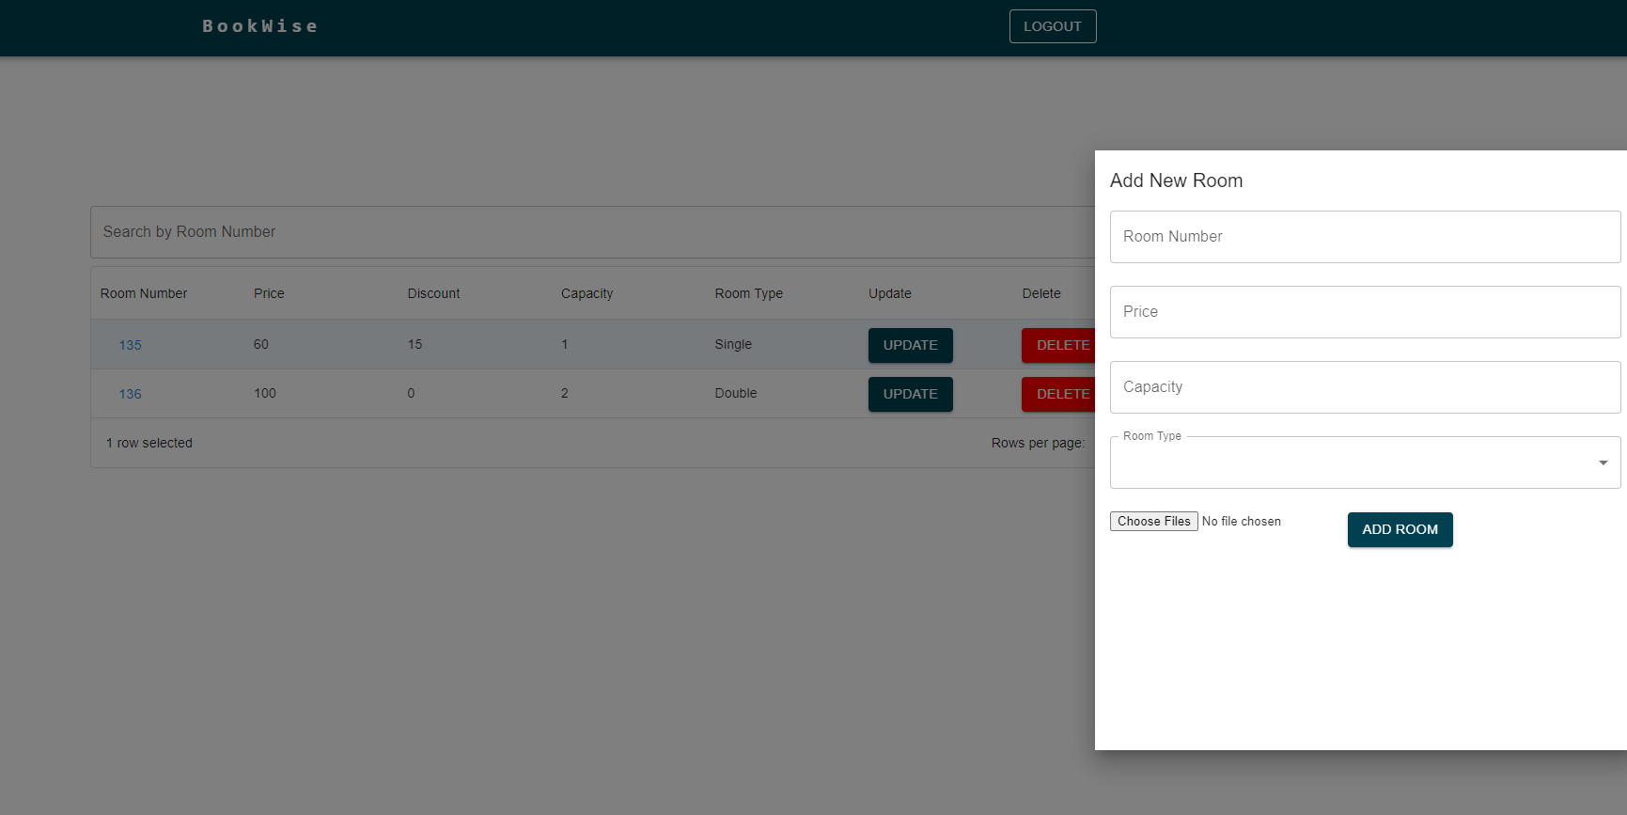
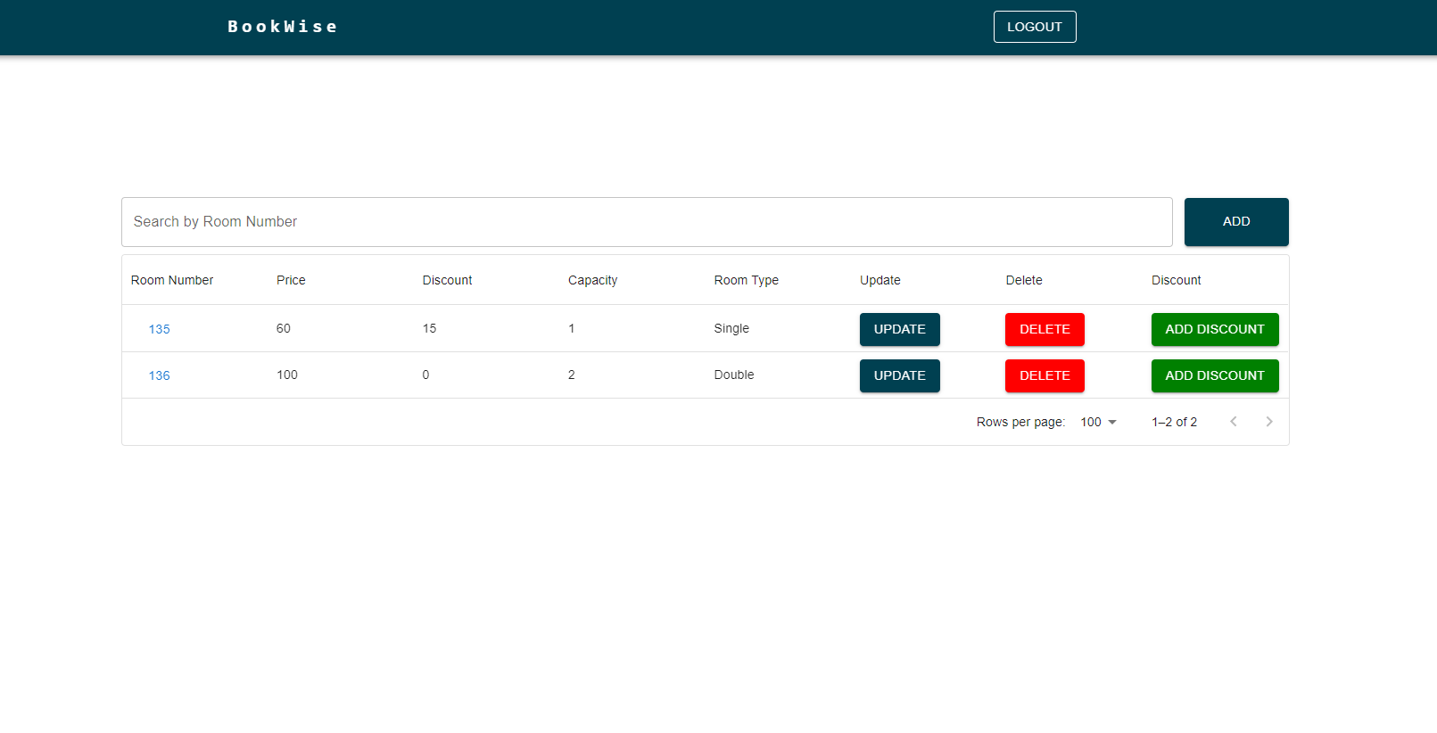
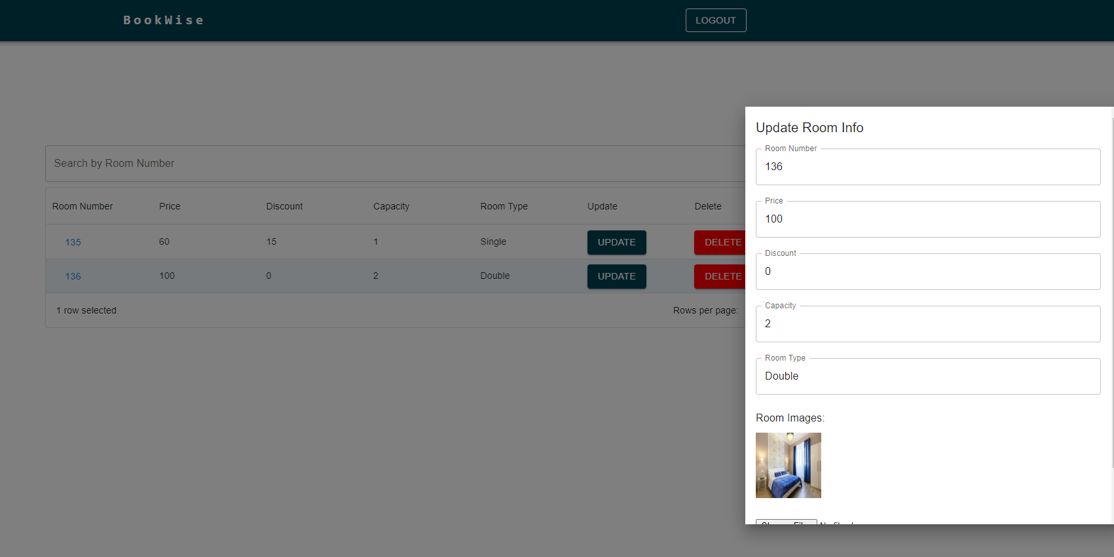
Admin room management pages:

Slide 11
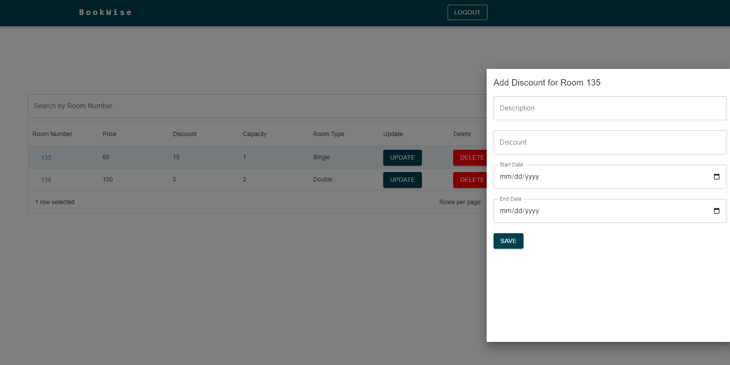
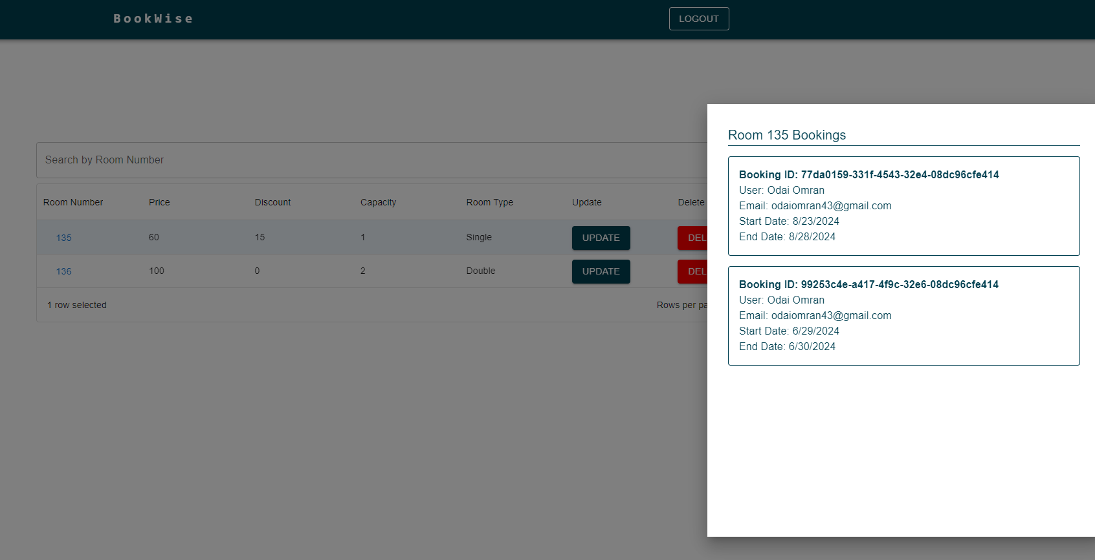
Admin Room Management Pages:

Slide 12
User UI Pages.

Slide 13
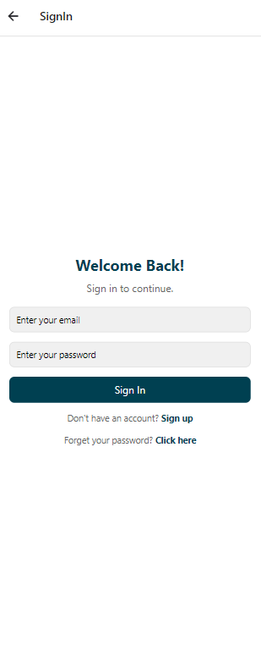
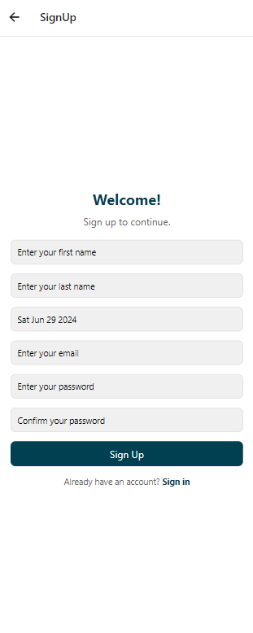
User Registration Pages:

Slide 14

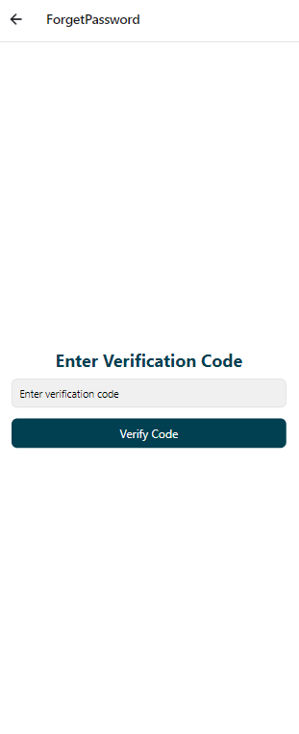
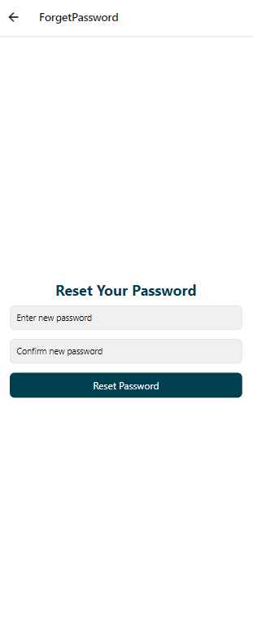
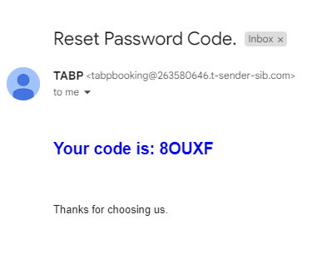
User Forget Password Pages:

Slide 15

Guest page:

Slide 16
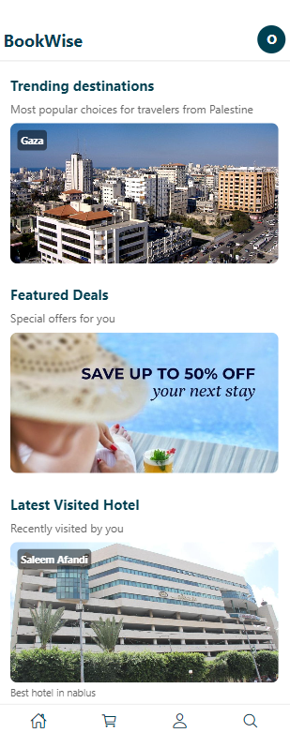
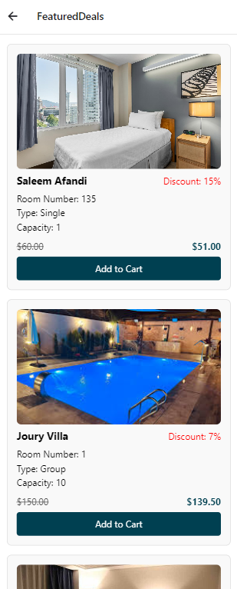
User Home Page:

Slide 17
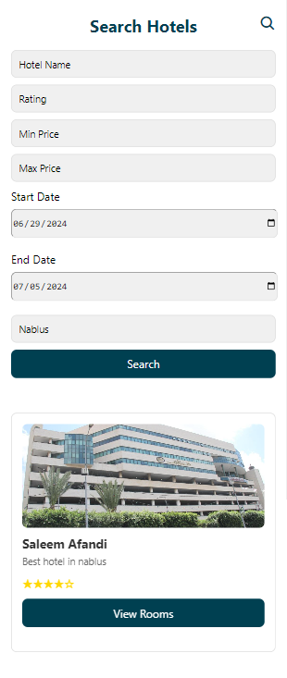
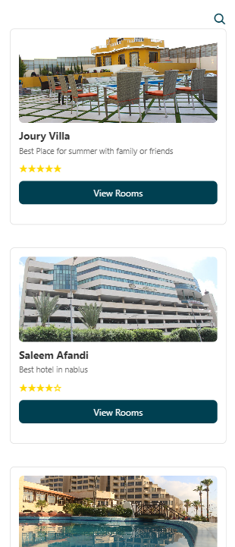
Search Page:

Slide 18
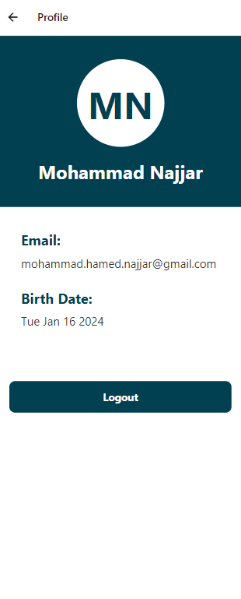
User Profile Page:

Slide 19
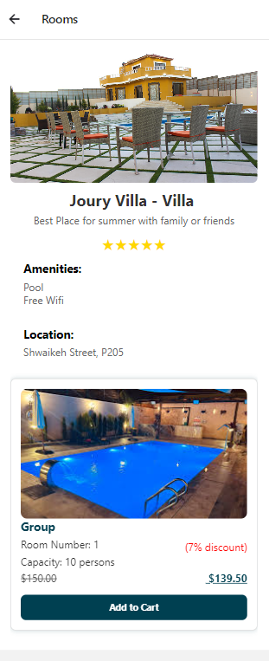
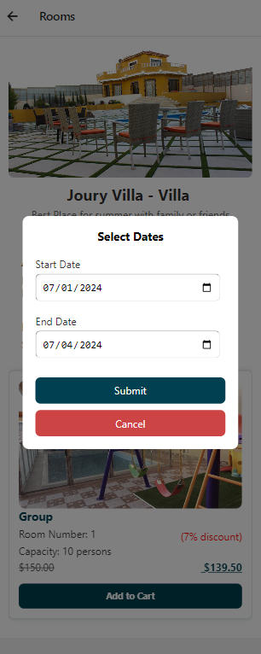
Booking:

Slide 20
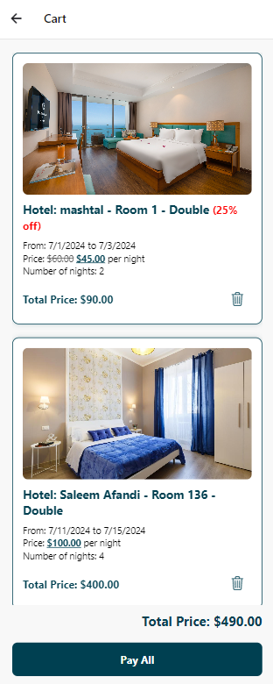
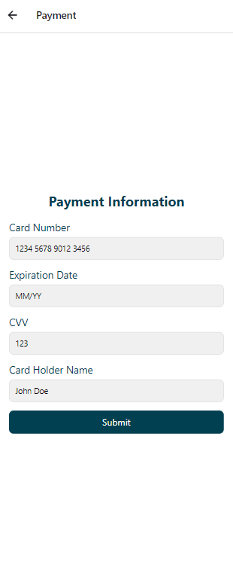
Payment Page:

Slide 21
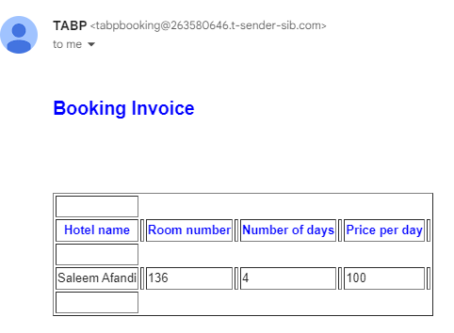
Invoice Email:

Slide 22
Project constraints:

Slide 23

Project constraints:
Technological Limitations:
Square payment.
Mobile application.
Time Constraints.

Slide 24
Future Work:
Fixing the inefficiency in the project:
Payment feature.
Working with all time zones.
Recommendation system.

Slide 25
Thank you
Made by:
Mohammad Isa Moghrabi.
Mohammad Hamed Najjar.
Supervised by:
Suleiman Naeem Abu Kharmeh.

