Slide 1

Graduation Project 2
2021
“The role of organizational citizenship behaviour is a mediator in the effect of green human resources management and corporate social responsibility on sustainable performance in the higher educational sector”
Group Members:
Hammam Rehan (11525782)
Malek Ishtaya (11108625)
Supervisor:
Dr. Mohammed Othman

Slide 2
Chapter 1: Introduction
1.1. General background
Worldwide, there is a rising consensus among decision makers, environmental professionals and scientists that human activities are profoundly embedded in the causes of environmental problems such as global warming, water depletion, climate change and loss of biodiversity
The role of Green Human Resource Management (HRM) in shaping green employee behavior in the workplace has emerged as a focus of research in response to these concerns
Organizational Citizenship Behavior towards Environment (OCBE) can be characterized as person and voluntary social activities that are not specifically acknowledged by the institutional incentive structure and that lead to organizations' more successful environmental management

Slide 3
1.2. Research objective
The goal of this research was to explore the mediating impact of OCBE between Green HRM and corporate social responsibility and sustainable performance. A survey was carried out among academics at Palestinian universities in order to achieve this objective.

Slide 4
Chapter 2: Literature review
2.1. An overview
Institutions of higher education, such as universities and colleges of applied sciences, which form the center of the science system, including its three fields of study, teaching and services, are also responsible, as institutions of society, for contributing to the future-oriented growth of society
However, in the sense of sustainable higher education institutions, which is an emerging field of study, there is a research gap in Green HRM research
Higher education institutions will, most notably, educate potential engineers, architects, scientists, policymakers, and people who will be expected to imagine, promote and enforce sustainable practices

Slide 5
The contributions to this present research are as follows:
To the best of our understanding, no research has so far examined the relationships considered here.
Exploring the role of the tertiary education sector in the development of the environment, an overlooked sector.
Analysis of the role of OCBE in enhancing the university's sustainable performance by academic staff.
Examination of the mediating influence of OCBE academic staff in introducing Green HRM practices to enhance the university's sustainable performance.
And providing Palestinian empirical data in this analysis of the AMO system and theoretical model.

Slide 6
2.2. Theoretical background and hypotheses development
The ability, motivation and opportunity AMO model is an outstanding and organized system that offers a deeper understanding of the HRM-performance relationship.
The ability factor is generally defined by the abbreviation KSA (knowledge, abilities and skills)
Motivation addresses the willingness of an employee to succeed, which may be strengthened by extrinsic or inherent motivation.
On the basis of work design theory and empowerment literature, the AMO paradigm also incorporates the opportunity factor

Slide 7
2.2.1. The link between green competence building practices and OCBE
H1. OCBE is positively linked to green competency building practices.
H2. Sustainable performance is positively linked to green competency building practices.

Slide 8
2.2.2. The link between green motivation improving practices and OCBE
H3. Green motivation improving practices are positively linked to OCBE.
H4. Green motivation improving practices are positively linked to Sustainable performance.

Slide 9
2.2.3. The relationship between green employee engagement practices and OCBE
H5. OCBE is positively linked to green employee engagement practices.
H6. Sustainable performance is positively linked to green employee engagement practices.

Slide 10
2.2.4. CSR and OCBE
H7. Corporate social responsibility has a positive effect on sustainable performance.
H.8 Corporate social responsibility has a positive effect on OCBE.

Slide 11
2.2.5. OCBE/sustainable performance relationship
H9. OCBE is linked to sustainable performance in a positive way.
2.2.5. OCBE's mediating role
H10. OCBE mediates the link between green competence building practices and sustainable performance.
H11. OCBE mediates the interaction between enhancing practices for green motivation and sustainable performance.
H12. The connection between green workforce engagement practices and sustainable performance is mediated by the OCBE.
H11. OCBE mediates the link between CSR and sustainable performance.

Slide 12
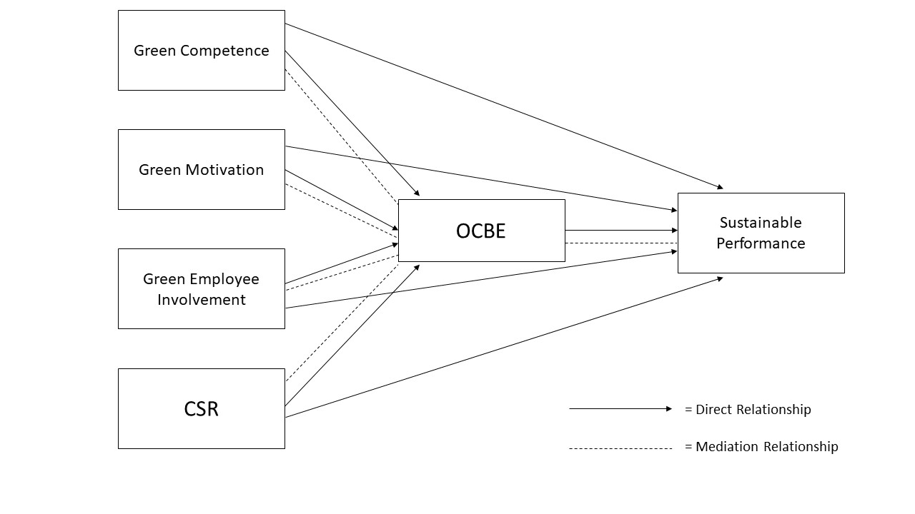

Slide 13
Chapter 3: Methodology
3.1. Collecting samples and data
A cross-sectional survey of Palestine Universities' academic staff was performed and a convenience sampling methodology was used.
The most recommended method in the PLS-SEM literature is power analysis to assess the sample size for structural equation modeling
Three hundred surveys were hand handed to academic personnel at their workplaces, yielding 160 usable replies.

Slide 14
3.2. Measurements
From the literature, the measuring objects for all structures were modified. The unit of research was at the person level, as the aim of this study is to define the relationship between Green HRM practices, CSR, OCBE, and sustainable performance based on the understanding of academic employees.
Two dimensions, including green recruitment and green preparation, shape the structure of green competency building practices. Similarly, two aspects, namely green performance and green incentives, are based on the principle of Green Motivation Improving Practices.

Slide 15
Tang et al. (2017) have modified all assessment elements for green recruiting, green preparation, green performance, green incentives, and green employee engagement practices. There were a total of 17 items taken from Tang et al (2017).
The 11-item scale of ethical CSR established by Podnar and Golob (2007), based on prior work by Aupperle et al. (1985) and Maignan (2001), was used to assess CSR.
The 10-item scale that Boiral and Paille (2012) developed was chosen to assess organizational citizenship behaviors towards the environment. Three dimensions of OCBE are covered by these ten items, including eco-initiatives, eco-civic involvement, and eco-support.
The triple bottom line principle, or sustainable performance (SP), has three dimensions: economic performance, environmental performance, and social performance, all of which are measured using a 15-item survey. Each build is made out of five items and is based on Yong et al. (2020).
The 5-point Likert scale was used for all measurements, varying from 1 (not at all) to 5 (to a very significant extent).

Slide 16
Chapter 4: Results
Construct | Item | Loadings | CR | AVE | Cronbach
Green recruitmrnt | GR 1 GR 2 GR 3 | 0.888 0.941 0.921 | 0.940 | 0.840 | 0.905
Green training | GT1 GT2 GT3 | 0.918 0.927 0.772 | 0.907 | 0.766 | 0.844
Green Performance | GP1 GP2 GP3 | 0.863 0.932 0.924 | 0.933 | 0.822 | 0.891
Green Rewards | GRW1 GRW2 GRW3 | 0.937 0.939 0.944 | 0.958 | 0.884 | 0.934
Green Employee Involvement Practices | GEIP1 GEIP2 GEIP3 GEIP4 GEIP5 | 0.842 0.886 0.886 0.927 0.903 | 0.948 | 0.784 | 0.931

Slide 17
Construct | Item | Loadings | CR | AVE | Cronbach
Corporate Social Responsibility | CSR1 CSR2 CSR3 CSR4 CSR5 CSR6 CSR7 CSR8 CSR9 CSR10 CSR11 | 0.701 0.810 0.828 0.880 0.865 0.859 0.893 0.880 0.878 0.869 0.703 | 0.961 | 0.695 | 0.955
Eco iNITIATIVES | EI1 EI2 EI3 | 0.766 0.917 0.856 | 0.885 | 0.720 | 0.804
eco CIVIC ENGAGEMENT | ECE1 ECE2 ECE3 ECE4 | 0.921 0.958 0.932 0.876 | 0.949 | 0.824 | 0.928
eco HELPING | EH1 EH2 EH3 | 0.944 0.937 0.949 | 0.960 | 0.890 | 0.938

Slide 18
Construct | Item | Loadings | CR | AVE | Cronbach
ECONOMIC PERFORMANCE | ECP1 ECP2 ECP3 ECP4 ECP5 | 0.846 0.857 0.873 0.913 0.880 | 0.942 | 0.764 | 0.923
eNVIRONMENTAL PERFORMANCE | ENP1 ENP2 ENP3 ENP4 ENP5 | 0.889 0.872 0.916 0.884 0.830 | 0.944 | 0.773 | 0.926
social performance | SCP1 SCP2 SCP3 SCP4 SCP5 | 0.909 0.922 0.903 0.912 0.923 | 0.962 | 0.835 | 0.951

Slide 19
 | 1 | 2 | 3 | 4 | 5 | 6
1. Green Competence
2. Corporate Social responsibility | 0.707
3. Green motivation | 0.738 | 0.665
4. green employee involvement | 0.738 | 0.745 | 0.818
5. OCBE | 0.649 | 0.576 | 0.635 | 0.687
6. sustinaple performannce | 0.677 | 0.643 | 0.594 | 0.630 | 0.626

Slide 20
 | Original Sample (O) | Standard Deviation (STDEV) | T Statistics (|O/STDEV|) | P Values
Competence -> OCBE | -0.082 | 0.032 | 2.604 | 0.009
competence -> SP | -0.223 | 0.103 | 2.165 | 0.030
motivation -> OCBE | -0.074 | 0.014 | 5.472 | 0.000
Motivation -> SP | 0.776 | 0.047 | 16.346 | 0.000
involvement -> OCBE | 0.033 | 0.010 | 3.356 | 0.001
involvement -> SP | 0.096 | 0.032 | 3.001 | 0.003
CSR -> OCBE | 1.106 | 0.031 | 35.280 | 0.000
CSR -> SP | 1.265 | 0.330 | 3.833 | 0.000
ocbe -> SP | -0.934 | 0.283 | 3.303 | 0.001

Slide 21
 | Original Sample (O) | Standard Deviation (STDEV) | T Statistics (|O/STDEV|) | P Values | BCI LL | BCI UL
CSR -> OCBE -> SP | -1.033 | 0.303 | 3.407 | 0.001 | -1.627 | -0.439
Motivaion -> OCBE -> SP | 0.070 | 0.024 | 2.949 | 0.003 | 0.022 | 0.116
involvement -> OCBE -> SP | -0.031 | 0.012 | 2.591 | 0.010 | -0.054 | -0.007
competence -> OCBE -> SP | 0.077 | 0.032 | 2.416 | 0.016 | 0.014 | 0.139

Slide 22
 | OCBE | SP
COMPETENCE | 3.198 | 3.848
CSR | 3.438 | 4.722
MOTIVAION | 2.627 | 3.158
INVOLVEMENT | 2.317 | 2.419
OCBE |  | 4.842

Slide 23
Chapter 5: Discussion
The impact of green HRM practices (green competence, green motivation, and green employee participation) and CSR on sustainable performance, as well as the mediating impact of OCBE, were investigated in this study.
The current study produced assumptions that green HRM practices and CSR are positively connected with sustainable performance, based on (AMO) and stakeholder theory.
CSR, OCBE, GHRM, and sustainability have all benefited from this research.
The mediating variable OCBE has mediated the relationship between GHRM practices, CSR, and sustainable performance in a significant and positive way. It also shows that implementing GHRM practices effectively can improve sustainable performance.

Slide 24
Conclusions
Higher education institutions have understood that failing to address human or behavioral variables in their environmental activities would result in inefficient sustainable performance as a result of increased environmental responsibility.
Universities, as information creators, should be examined not just on how much environmental awareness they generate, but also on how devoted they are to fostering environmental citizenship behavior on their campuses.
The study's findings were able to illustrate the favorable effects of Green HRM practices, as well as CSR and OCBE, on sustainable performance. The findings provide policymakers food for thought as they analyze academic staff's environmental citizenship behavior and what motivates them to do so.
The current study successfully utilized AMO and stakeholder theory. It was shown that higher education institutions may achieve sustainability by engaging in green activities and acting in a socially responsible manner.
Similarly, CSR contributes to sustainability. As a result, it is argued that GHRM, CSR, and OCBE may help higher education institutions gain a competitive edge sustainability.

