Slide 1
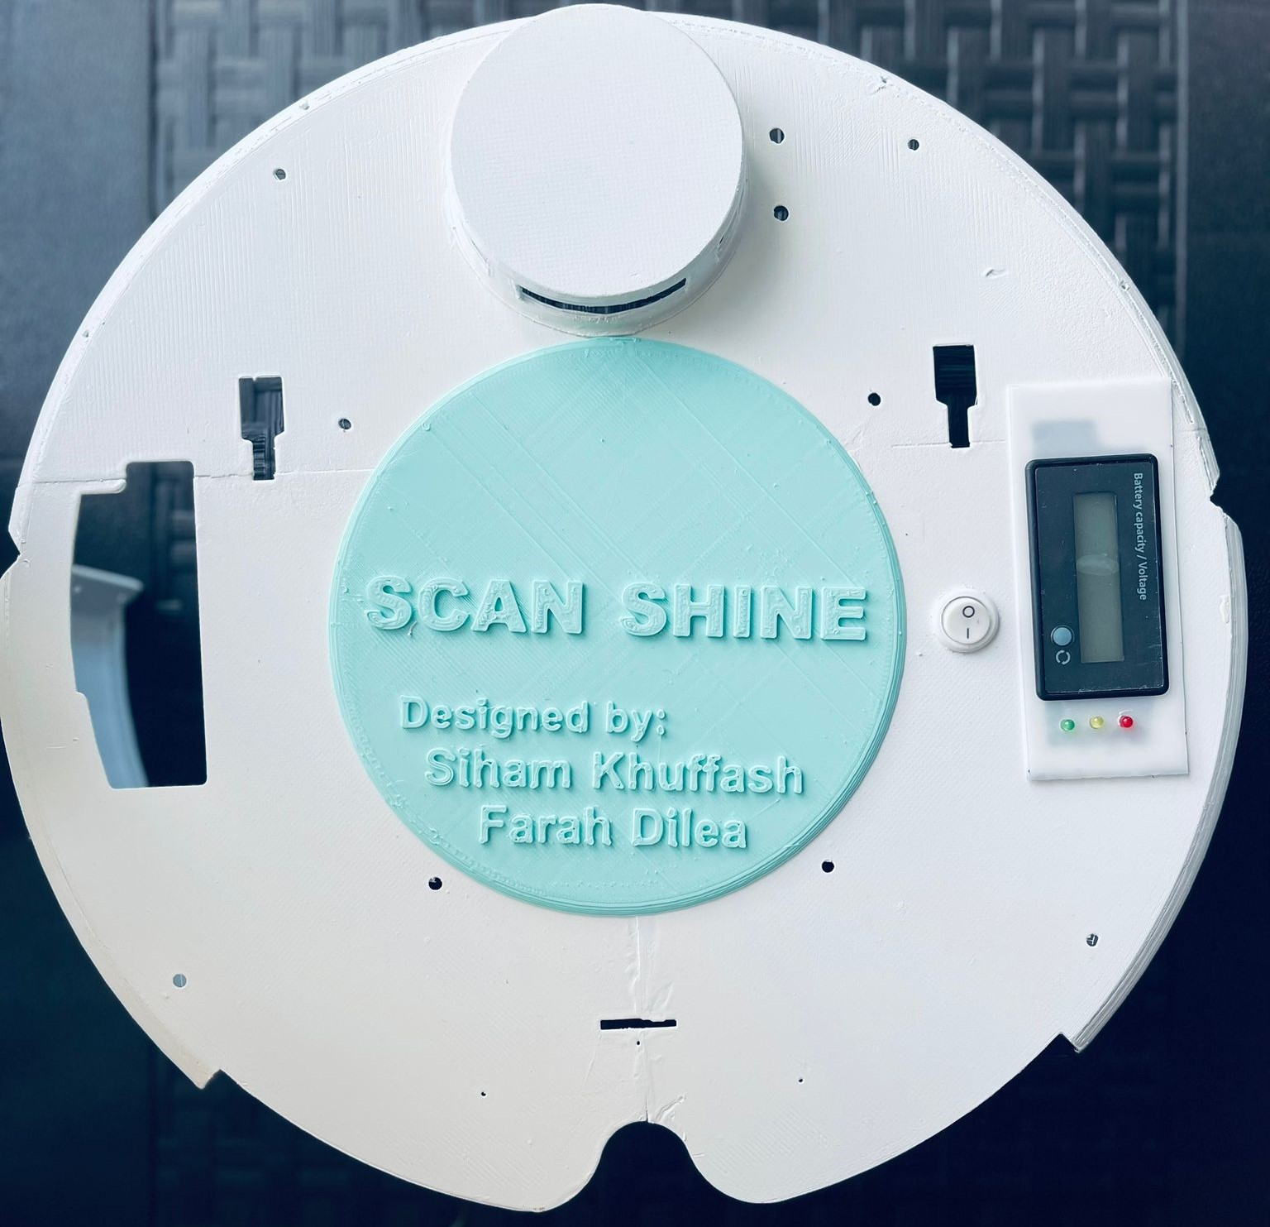
SCAN SHINE
Robot vacuum cleaner
Done By:
Farah Dilea
Siham Khuffash

Slide 2
Table of contents
1
2
3
The Idea
Goals
Implementations
4
5
Challenges
Future Work

Slide 3
Scan Shine Idea
It’s a vacuum cleaner robot, that have 3 cleaning modes, sweeping, mopping and perfuming, which cleaning the rooms without collide any obstacle near it.

Slide 4
Scan Shine Goal’s
01
03
02
Safe movement
WIFI control
Good obstacle detection and movement
Control robots modes using the web page, and setting specific times for working.
Cleaning modes
Sweeping, mopping and perfuming

Slide 5
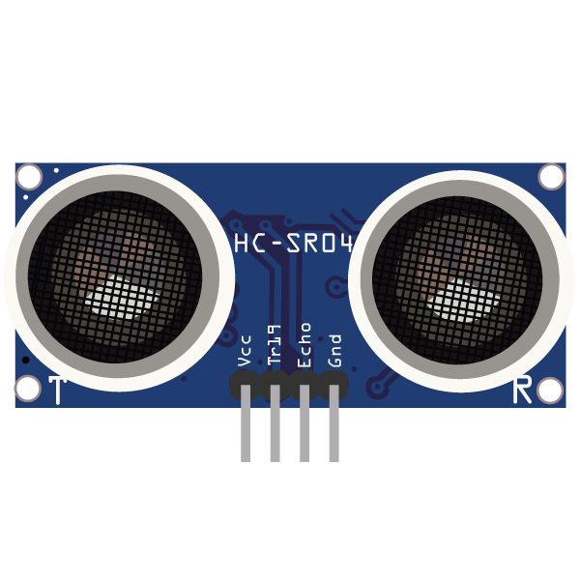
Hardware Environment
Ultrasonic
To detect the obstacles if there are near the robot or not.

Slide 6
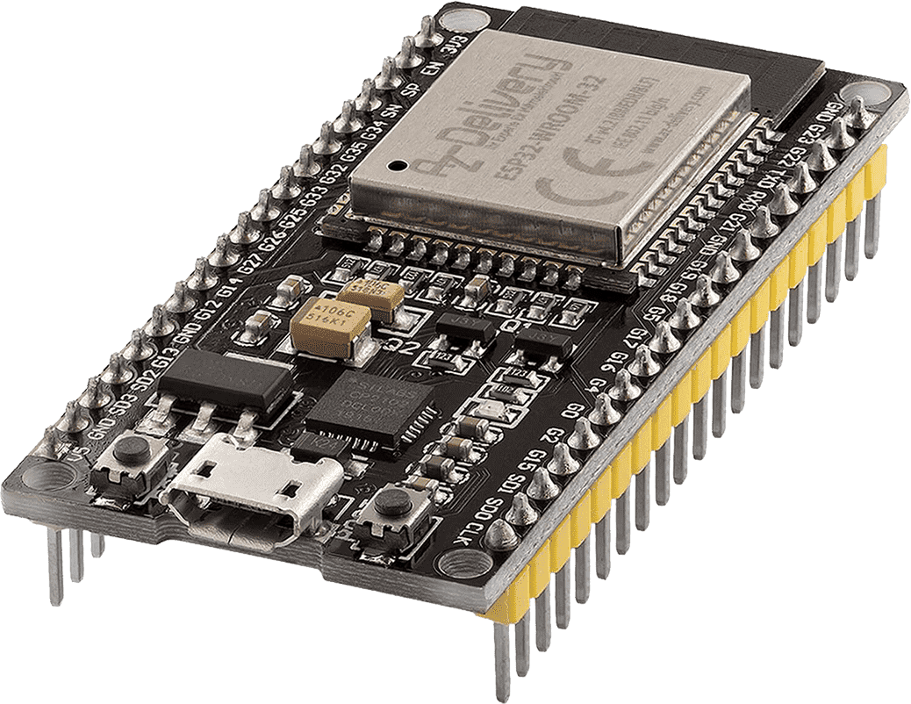
Hardware Environment
ESP32
To control the Wi-Fi page that control the robot.

Slide 7
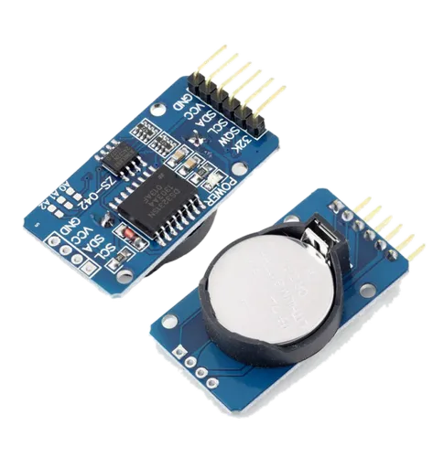
Hardware Environment
RTC
Real clock time, to set a specific control time.

Slide 8
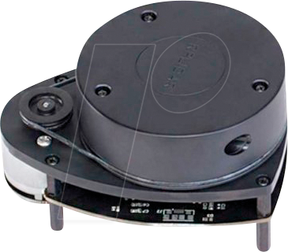
Hardware Environment
RPlidar A1
Detect all the obstecals around 4 meters from the robot.

Slide 9
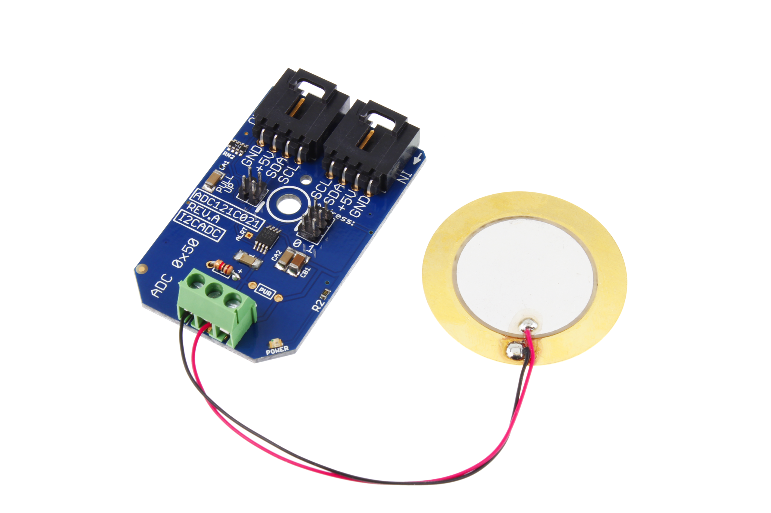
Hardware Environment
piezoelectric sensor
Detect if the dirt wrapped around the brushers.

Slide 10
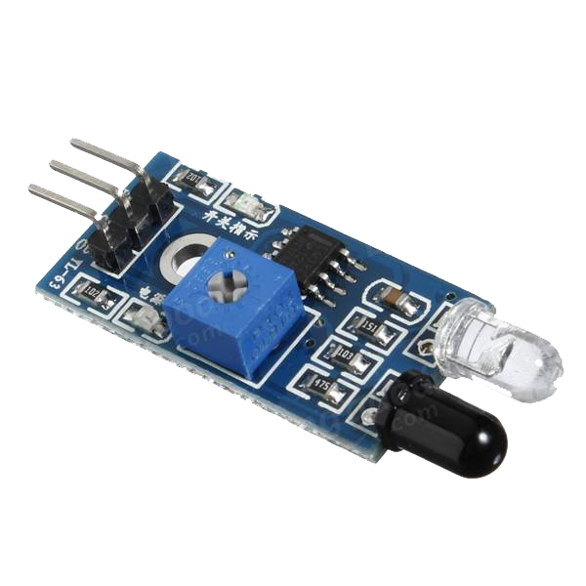
Hardware Environment
IR sensor
Detect base level, if the ground level change it will make a decision.

Slide 11
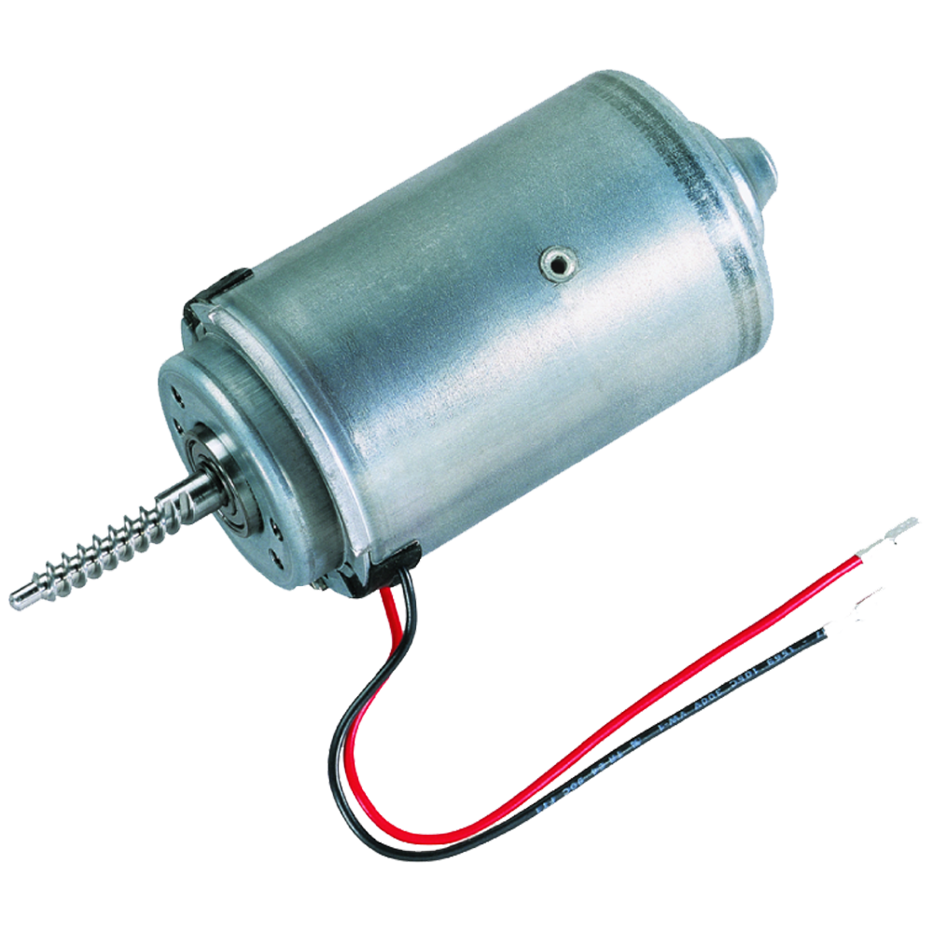
Hardware Environment
DC motor
Run the brushers of our vacuum.

Slide 12
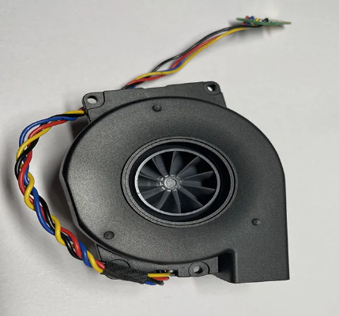
Hardware Environment
Fan suction
Help the brusher work for good sweeping .

Slide 13
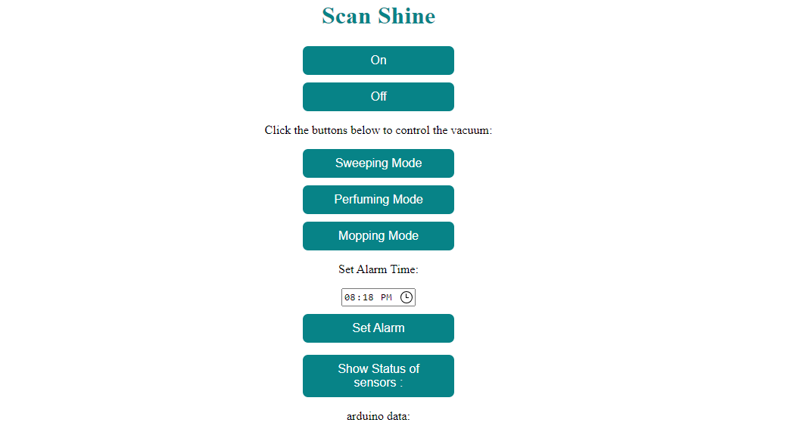
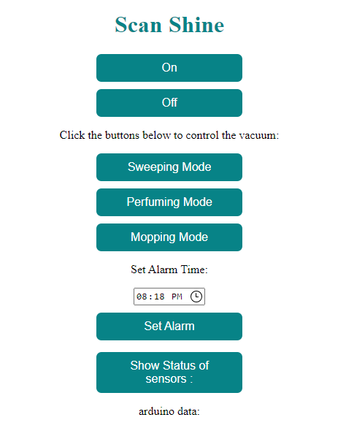
Web page
Software Environment
Control the vacuum.
Check sensors values.
Set specific control time.

Slide 14
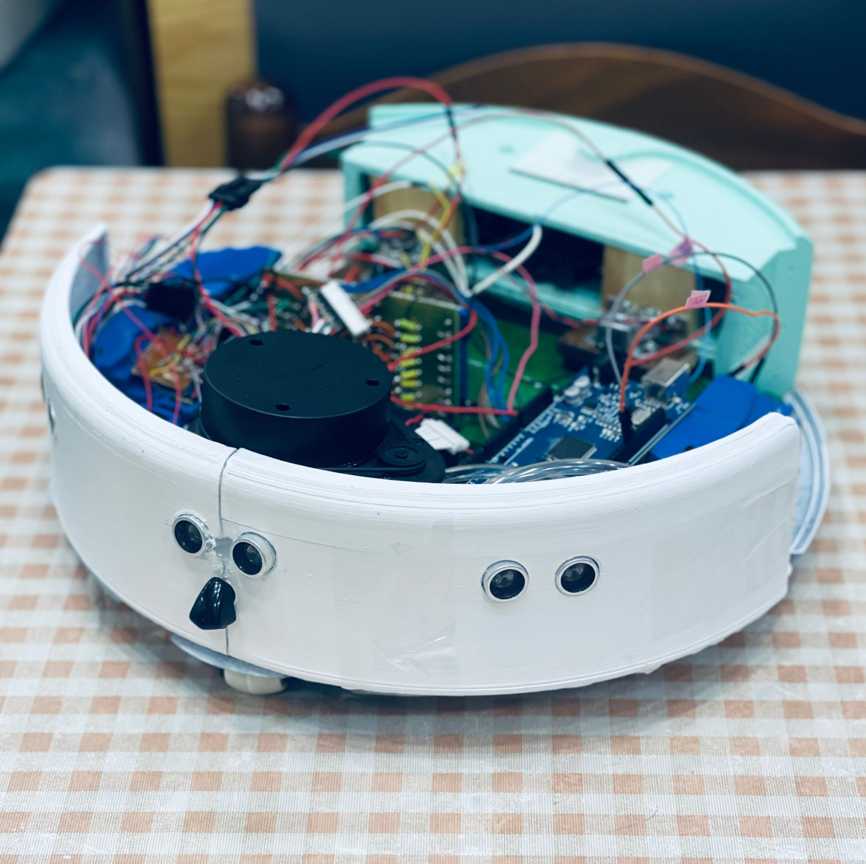
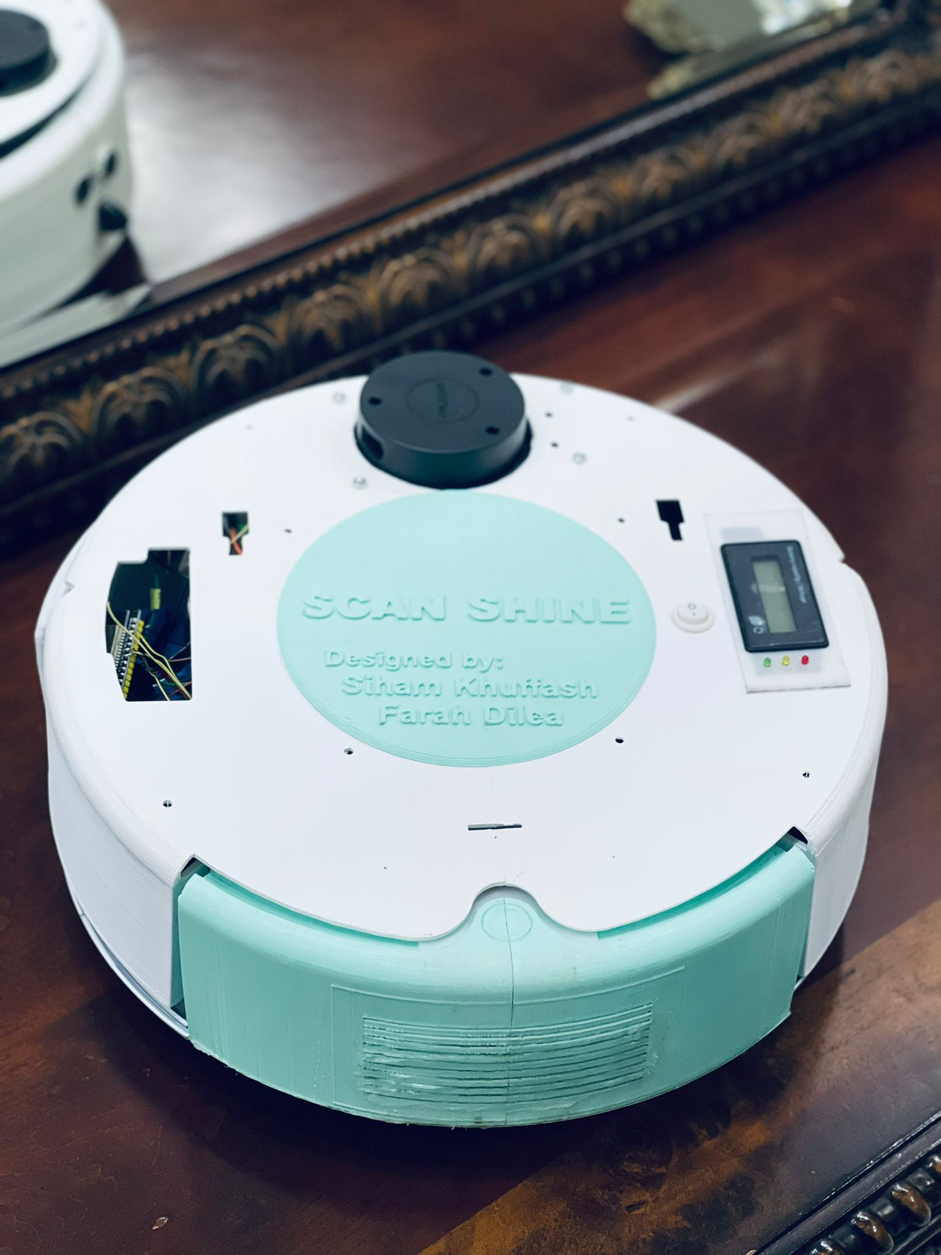
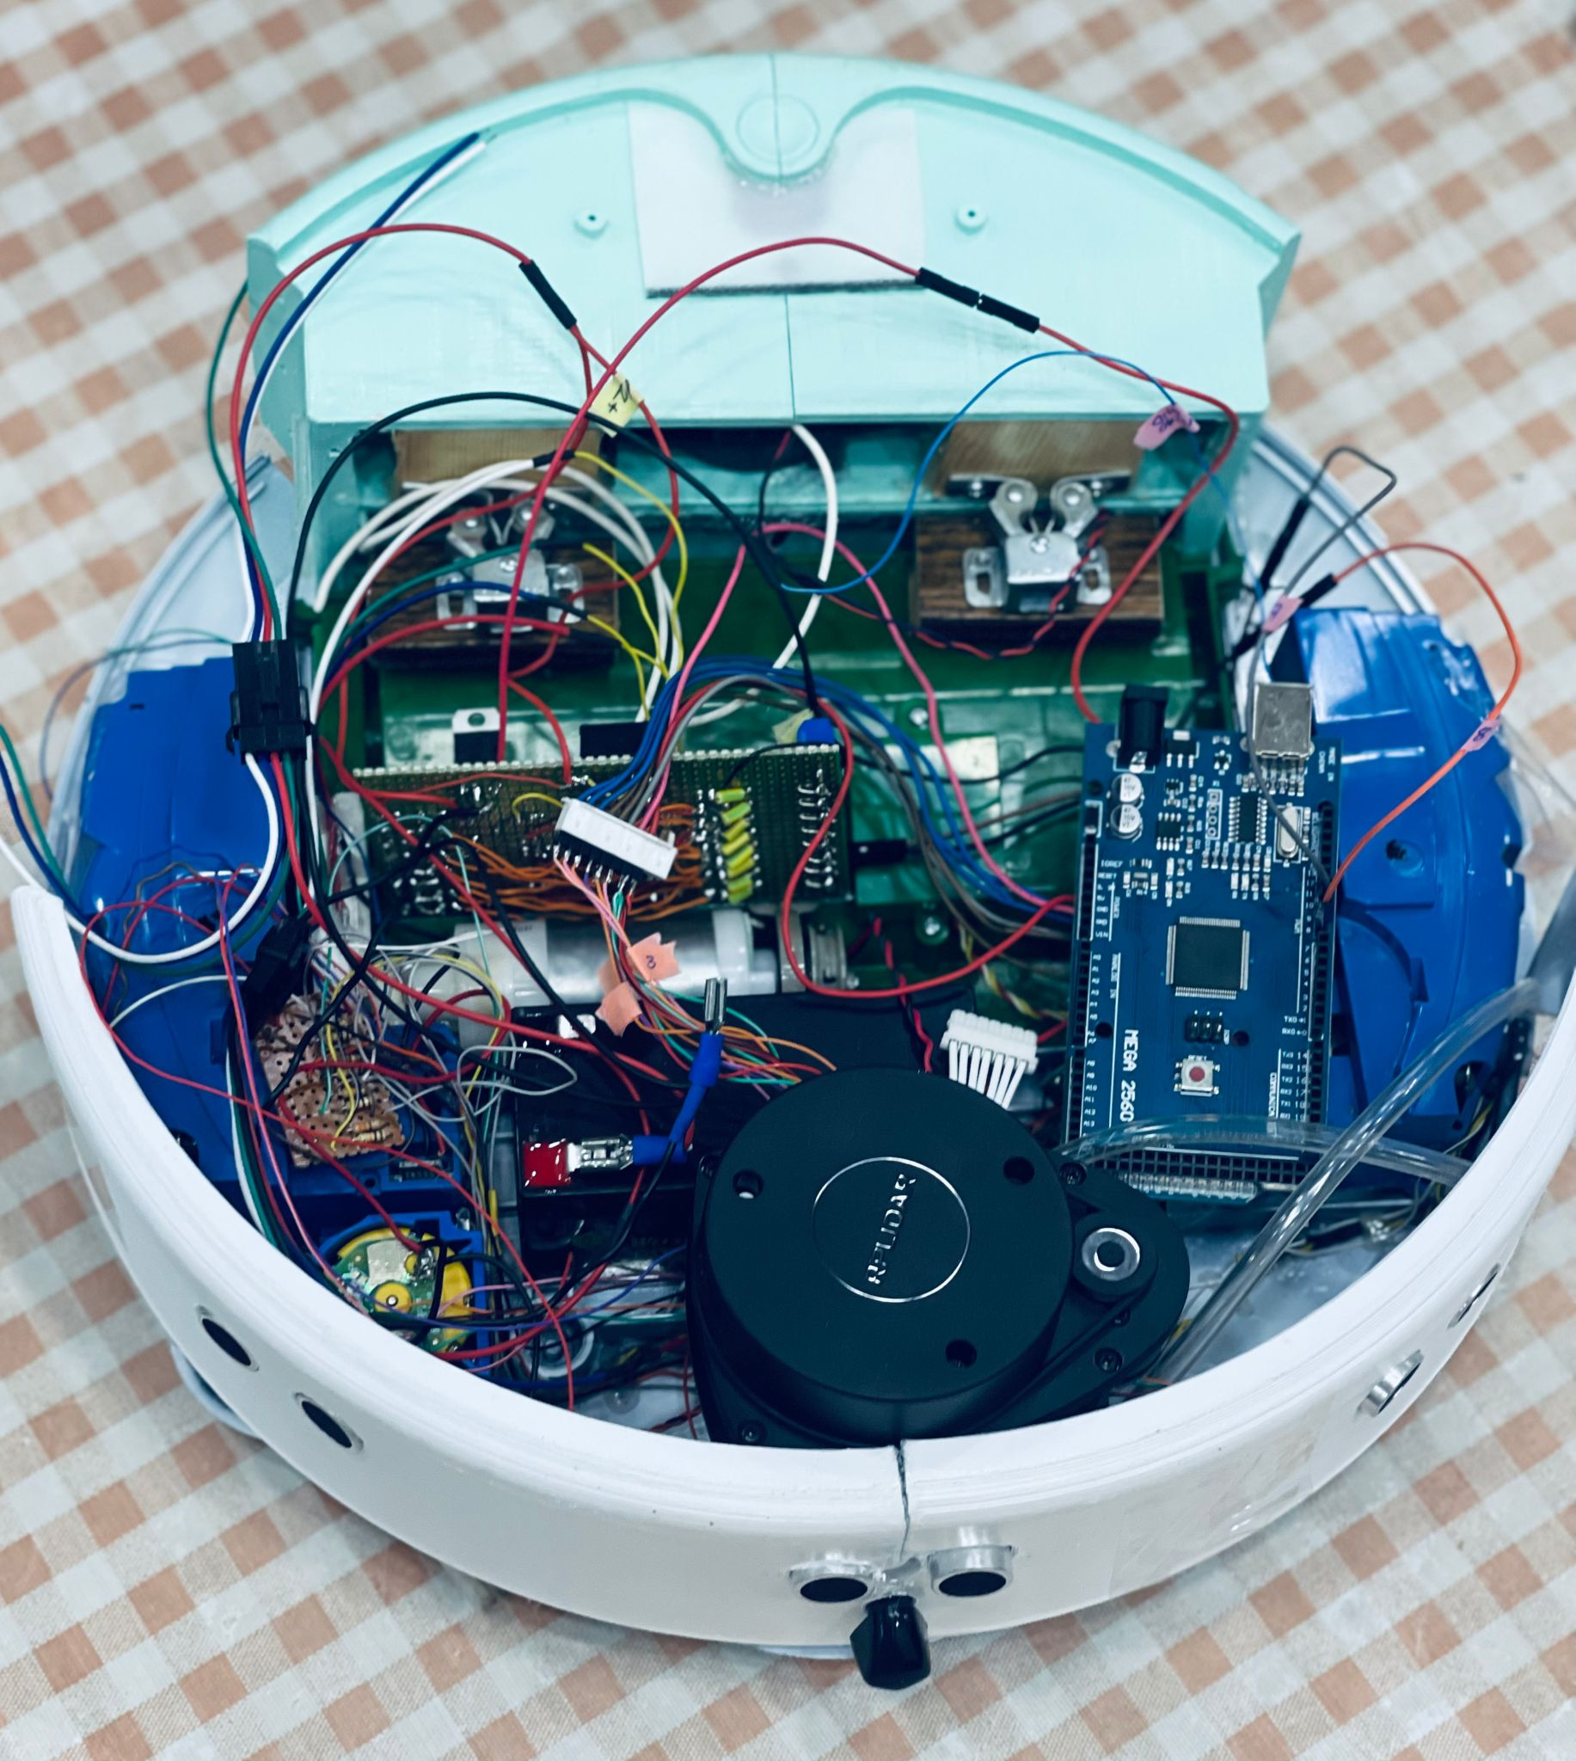
Real design

Slide 15
Product Development Process
01
02
Requirements
Design
03
04
implementation
Testing

Slide 16
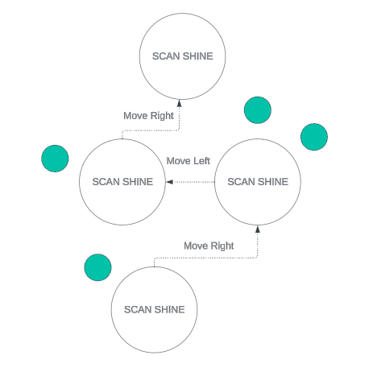
Product Development Process
Navigation robot example

Slide 17
Tools and Technology
ArduinoIDE, C
PHP
Network systems
To write an Arduino codes
To design web page
For Wi-Fi process

Slide 18
Challenges
1
Hardware components
3
Moveable parts
2
Small robot body
4
Pretty and suitable design

Slide 19
Future Work
1
2
3
Mapping system
PHP
Network systems

Slide 20
Thanks!
Do you have any questions?

