Slide 1
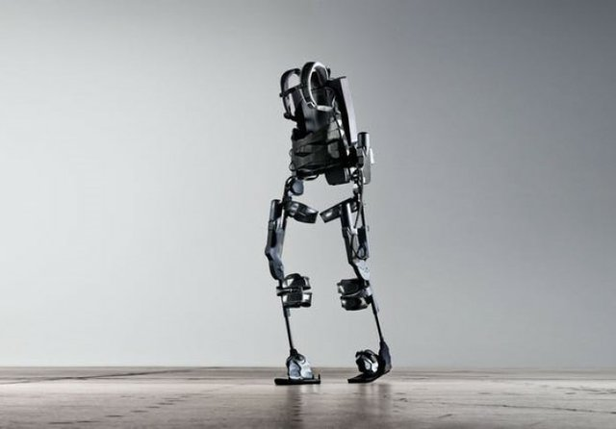
Abstract

Slide 2
Applications of Exoskeleton

Slide 3
Solidworks concept of this project

Slide 4

Material selection
The most important considerations in material selection are:
Strength to weight ratio of the material $$\left(M_{1}={σ_{y}}/P\right).$$
Stiffness $$\left(M_{2}={E^{0.5}}/P\right).$$
Fracture toughness $$\left(M_{3}={k_{1}C}/P\right).$$
$$Z=10M1+5M2+3M3$$
Depending on these factors, we found that carbon fiber is the best material that meets the required work.

Slide 5
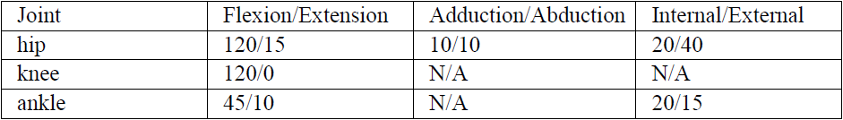
Biomechanical Consideration in the Design of Lower Limb Exoskeleton

Slide 6

Kinematic Analysis and Dynamic Analysis
Using Lagrangian calculations, torque was calculated in the Hip, Knee, and Ankle joints.
$$\frac{d}{dt}\left(\frac{∂L}{∂\dot{θn}}\right)−\frac{∂L}{∂θn}=fn$$
Torque in hip joint $$τ_{1}=140 N.m.$$
Torque in knee joint$${ τ}_{2}=109.5 N.m.$$
Torque in ankle joint $${ τ}_{3}=205 N.m.$$

Slide 7

Actuators
$$Output power=τ.ω$$
Hip joint motor$$→Output power=τ_{1}ω_{1}=140∗5=650w.$$
Knee joint motor $$→Output power=τ_{2}ω_{2}=110∗10=1100w.$$
The ankle joint motor was added just to help in Carrying the foot portion Weight so it doesn’t need high torque.
Hip joint motor Knee joint motor Ankle joint motor

Slide 8

Gear Design
Gear Design in hip joint:
The angular velocity of the motor in the hip joint is equal w1=1500rpm and the required angular velocity in hip joint =5rad/s=47.7rpm so the gear ratio equals:
$$i=\frac{ω_{1}}{ω_{2}}=\frac{1500}{47.7}=31.4$$
$$N_{p}=\frac{2k}{\left(1+2m\right)\sin^{2}{θ}}\left(m+\sqrt{m^{2}+\left(1+2m\right)\sin^{2}{θ}}\right)=17 teeth.$$
$$N_{G}=96 teeth.$$
$$d_{P}=1 in ,d_{G}=5.6 in.$$
Gear Design in knee joint:
The angular velocity of the motor in hip joint equals w1=2150rpm and the required angular velocity in hip joint =10rad/s=95.5rpm so the gear ratio is equal to:
$$i=\frac{ω_{1}}{ω_{2}}=\frac{2150}{95.5}=22.5$$
$$N_{P}=17 teeth.$$
$$N_{G}=76 teeth.$$
$$d_{P}=1 in ,d_{G}=4.7 in .$$

Slide 9
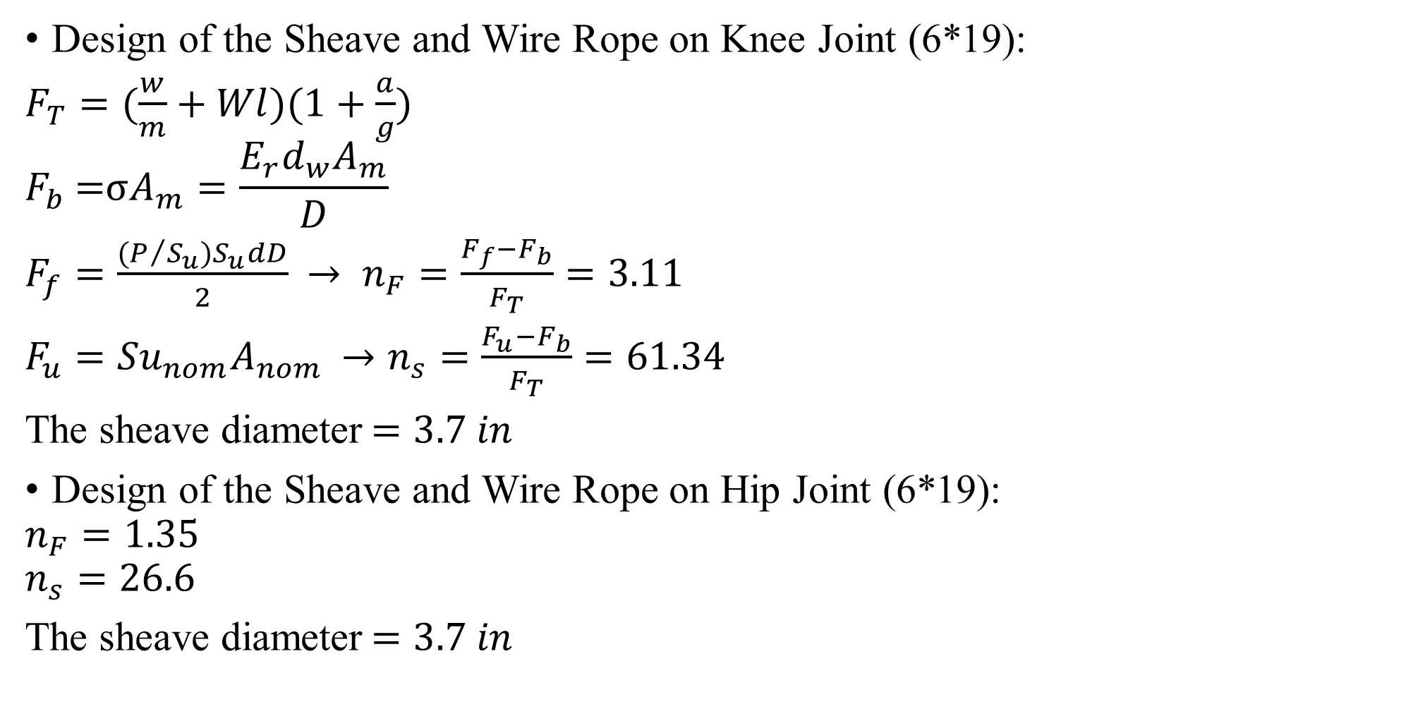
Design of the Sheave and Wire Rope
Design of the Sheave and Wire Rope on Knee Joint (6*19):
$$F_{T}=(\frac{w}{m}+Wl)(1+\frac{a}{g})$$
$$F_{b} =σA_{m}=\frac{E_{r}d_{w}A_{m}}{D}$$
$$F_{f}=\frac{(P/{S_{u}})S_{u}dD}{2}$$
$$F_{u}={Su}_{nom}A_{nom}$$
The sheave diameter$$=3.7 in$$
Design of the Sheave and Wire Rope on Hip Joint (6*19):
$$n_{F}=1.35$$
$$n_{s}=26.6$$
The sheave diameter$$=3.7 in$$

Slide 10
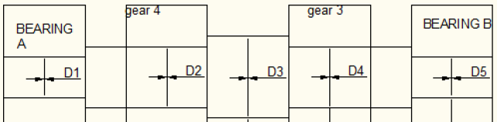
Shafts Design
A shafts on hip joint
Design for shaft #1(derived by gear placed on motor and driving a shaft #2)
𝐷1=𝐷5=0.5 𝑖𝑛
𝐷2=𝐷4=0.75 𝑖𝑛
𝐷3=1 𝑖𝑛

Slide 11
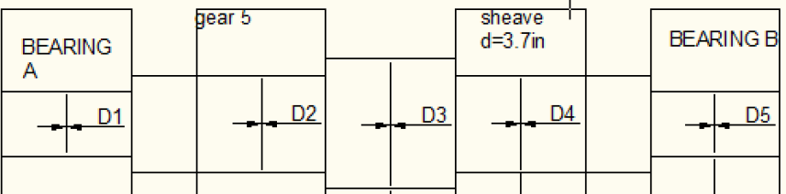

Design for shaft #2(derived by gear placed on shaft #1 and driving a sheave that driving the leg)
D1=D5=$$0.75in$$
D2=D4=$$1in$$
D3=$$1.25in$$

Slide 12
A shafts on knee joint
Design for shaft #1(derived by gear placed on motor and driving a shaft #2)
D1=D5=0.5in
D2=D4=1in
D3=1.25in
Design for shaft #2(derived by gear placed on shaft #1 and driving a sheave that driving the leg)
D1=D5=0.75in
D2=D4=1in
D3=1.25in

Slide 13
Bearing design
Bearing on the hip shafts

Slide 14

Shaft #1
$$C_{10}=a_{f}F_{D}{\left(\frac{X_{D}}{X_{0}+\left(∅−X_{0}\right){\left(\ln\left(\frac{1}{R}\right)\right)}^{\frac{1}{b}}}\right)}^{\frac{1}{a}}$$
Where:
𝐶10: catalog load rating(N)
𝑎𝑓:application factor (>1)(assume equal to 1.2)
𝐹𝐷: resultant force of radial force
𝑋`0=0.02 ɸ−𝑋0=4.439
𝑏=1.483 a=3 for ball bearing
For bearing A$$→ C_{10}=14.9 kN$$ for deep groove bearing
From table: OD(out diameter)=62mm
Width =16mm
Bore = 30mm

Slide 15

For bearing B$$→ C_{10}=1.95 kN$$ for deep groove bearing
From table: OD(out diameter)=32mm
Width =10mm
Bore = 12mm
Shaft #2
For bearing C$$→ C_{10}=14.8 kN$$for angular contact bearing
From table: OD(out diameter)=52mm
Width =15mm
Bore = 25mm
For bearing D$$→ C_{10}=8.4 kN$$for angular contact bearing
From table: OD(out diameter)=40mm
Width =12mm
Bore = 17mm

Slide 16
Bearing on the Knee shafts

Slide 17
By doing the same steps
For bearing A
The bore equal 17mm, OD=40mm and the width equal 22mm
For bearing B
The bore equal 30mm, OD=62mm and the width equal 16mm
For bearing C
The bore equal 15mm, OD=35mm and the width equal 11mm
For bearing D
The bore equal 20mm, OD=47mm and the width equal4mm

Slide 18
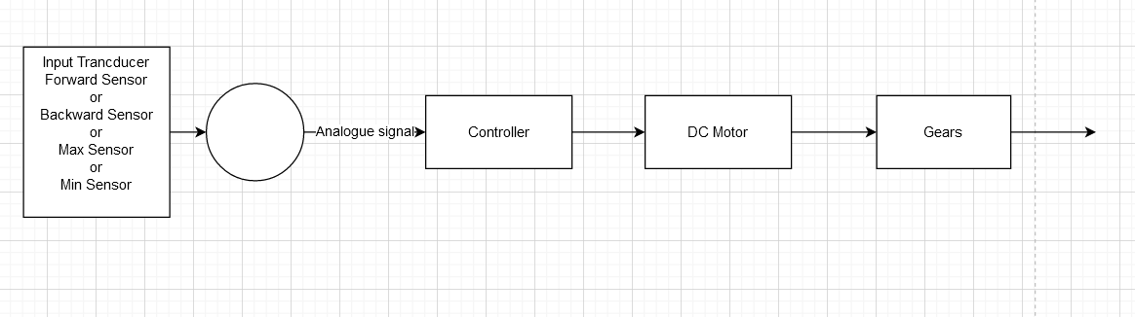
Block Diagram
Control System

Slide 19
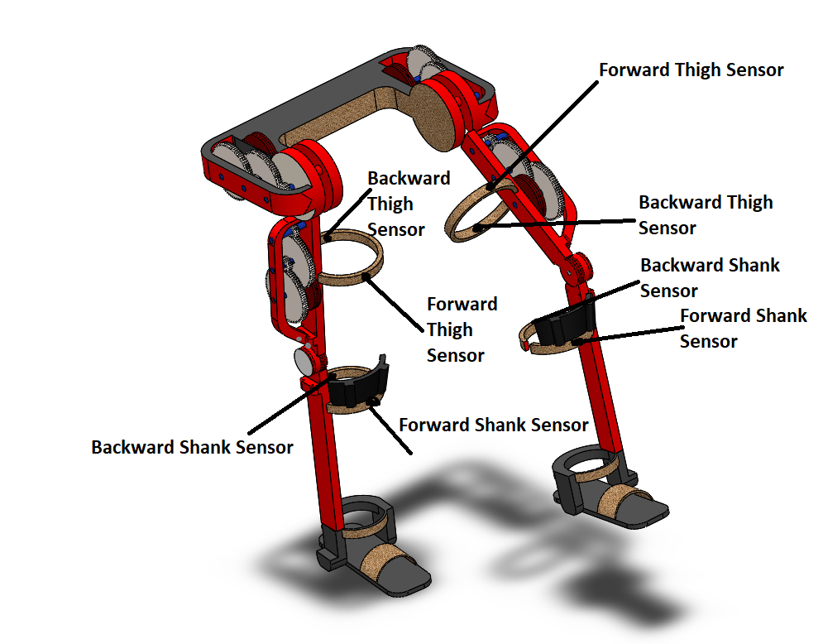
Sensors location

Slide 20
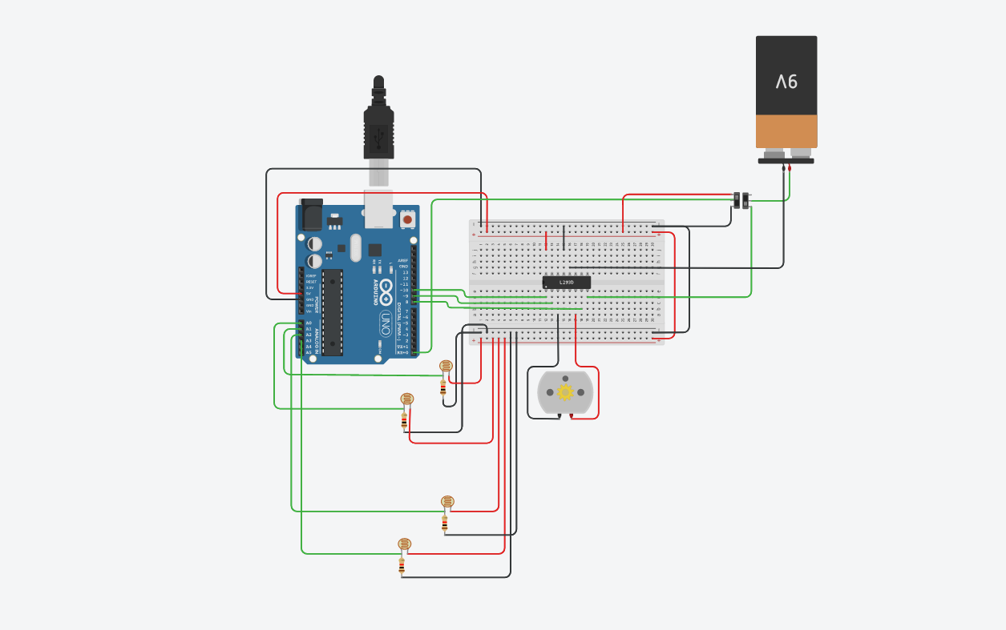
Arduino Circuit & Parts

Slide 21
Battery
It is hard to find a 12 v battery with 565 A.h with suitable Wight so in this project we chose a 36 v battery with 188 A.h
4LOAD Charge Box

Slide 22
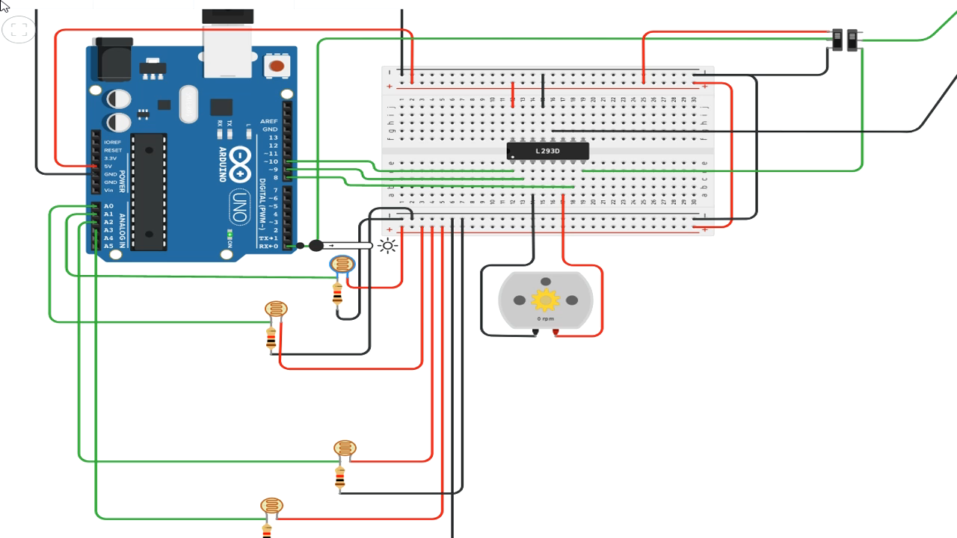

Slide 23
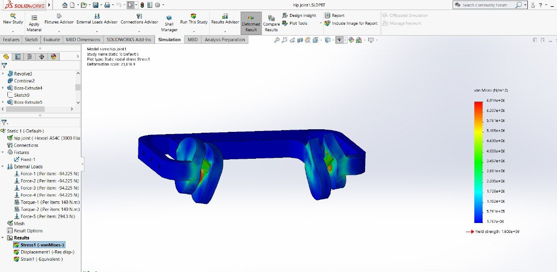
Solid work analysis
Stress analysis for waist part

Slide 24

Solid work analysis
Strain analysis for waist part

Slide 25
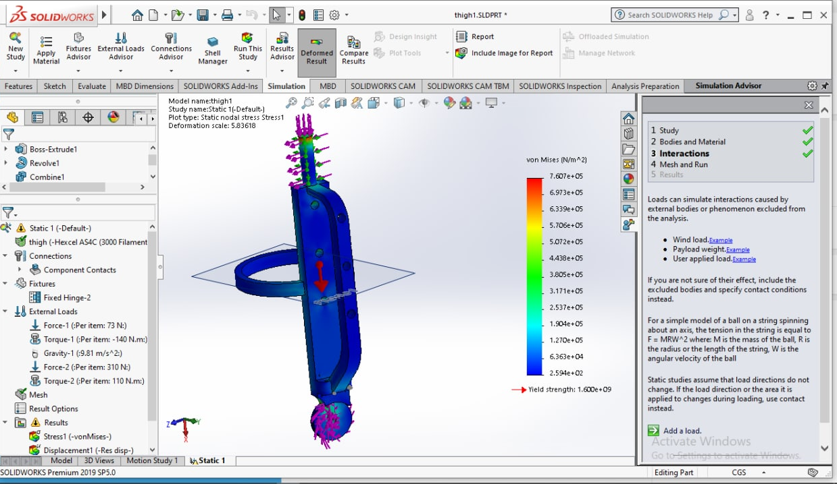
Solid work analysis
stress analysis for thigh part

Slide 26
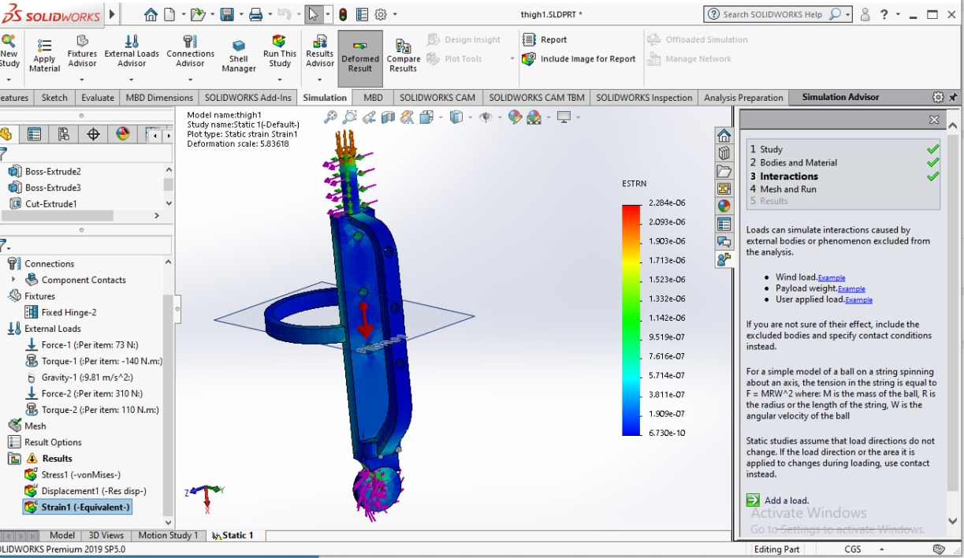
Solid work analysis
strain analysis for thigh part

Slide 27
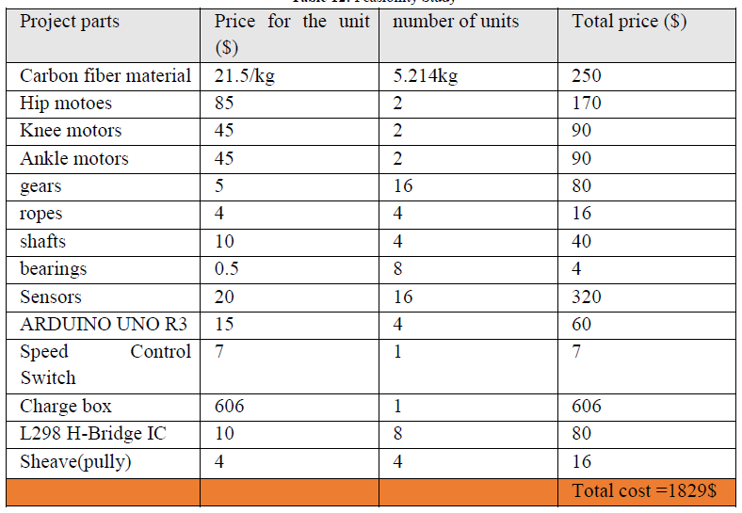
Feasibility study

