Slide 1

Development of the Kafr Rai electricity network and the cluster network
By: Eng. Abd-AlRahman Sbeah
Eng. Yazan Bni Jaber
Eng. Hani Helan
Supervisor: Dr. Raed Jaber

Slide 2
The project aims to study the performance of the electricity network of the town of Kafr Rai and add a new connection point that supports the connection point from the Israeli side in the eastern region of the town from the city of Tubas, with a maximum capacity of 2-3 megawatts from the Tubas Electricity Company.
.
A study and analysis of the load flow of the electricity network in the town of Kafr Ra’i was conducted using the ETAP program, and this will include the original state and determine the current voltage, power loss and power factor, to know the effect of adding a new connection point to the network, improving the power factor, improving the voltage level and reducing electrical losses in the network and suggesting A solution to add a capacitor, change a tap changer, add a new connection point and change the configuration (eg adding a loop) thus reducing penalties in the municipal total tariff and increasing network reliability.

Slide 3
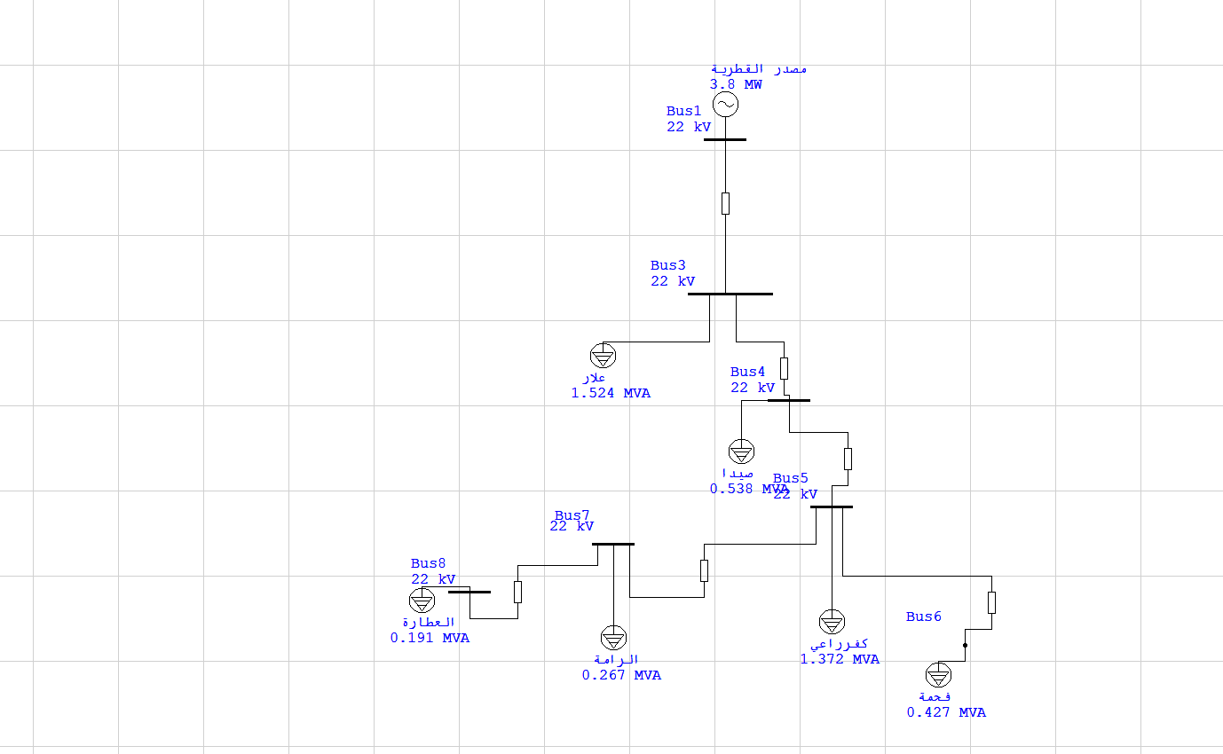
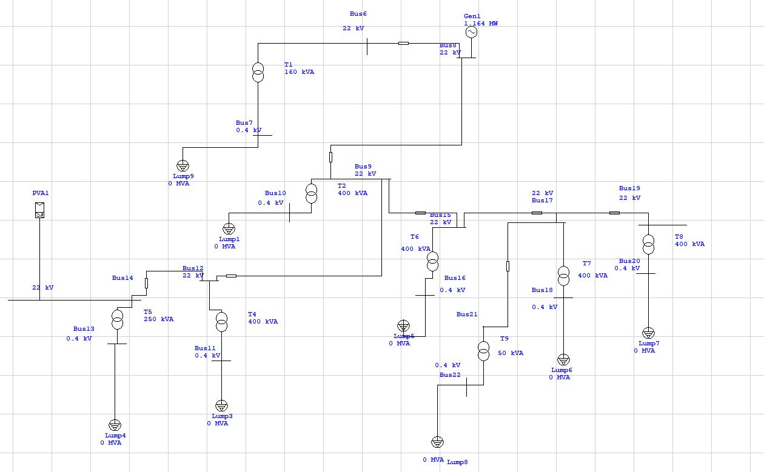
The cluster network
The Kafr Rai electricity network

Slide 4
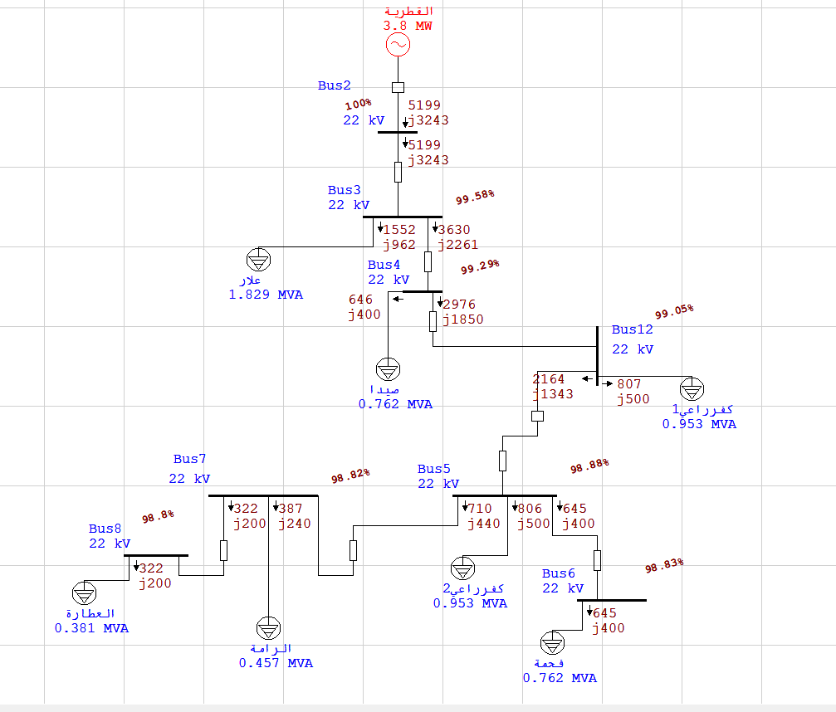
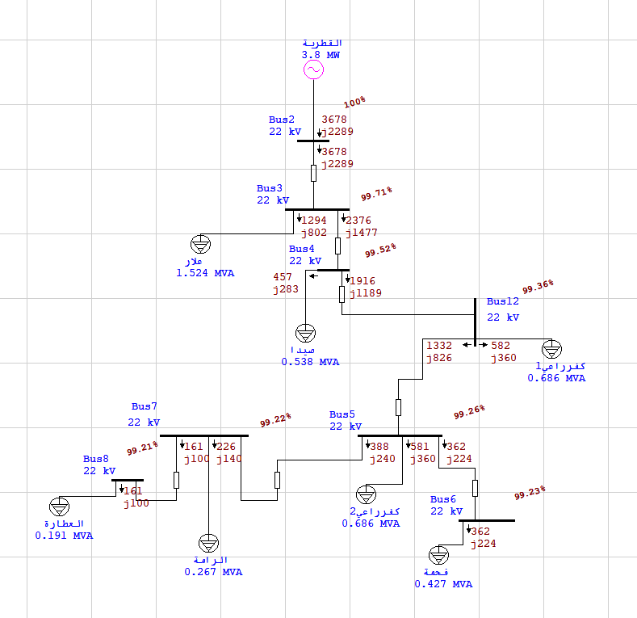
Results And Analysis for cluster network
The Maximum load Case
The original case

Slide 5
Our goal is to improve the voltages of these criteria by using the following three steps of improving the electrical network :
Increasing the turn’s ratio of Tap change under load to 5% of its original ratio.
Inserting capacitors in the nodes which suffer from depression of voltage in order to produce Q and increase V.
Adding Anew electrical connection point

Slide 6
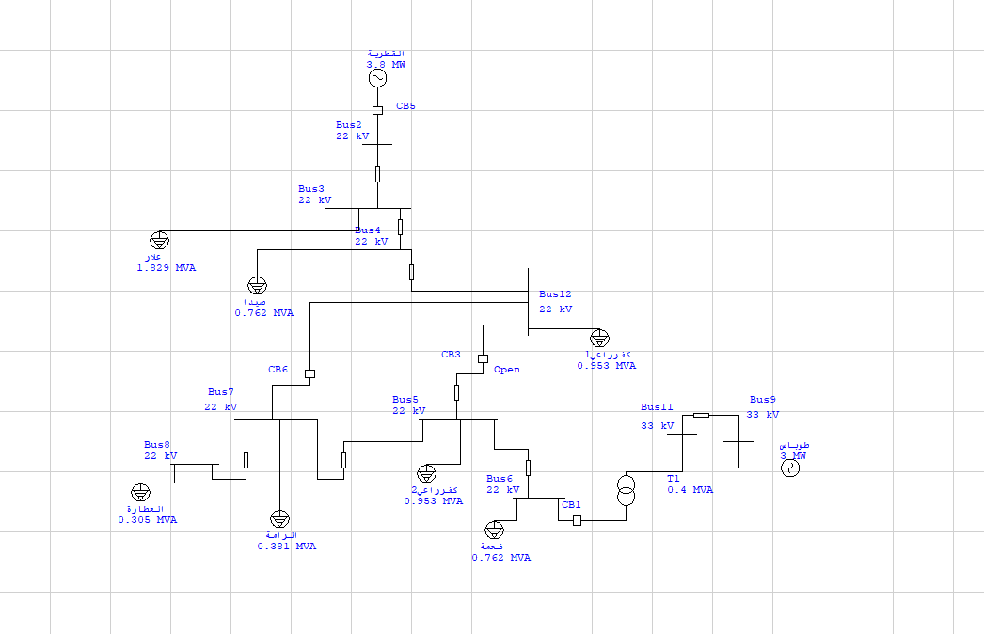
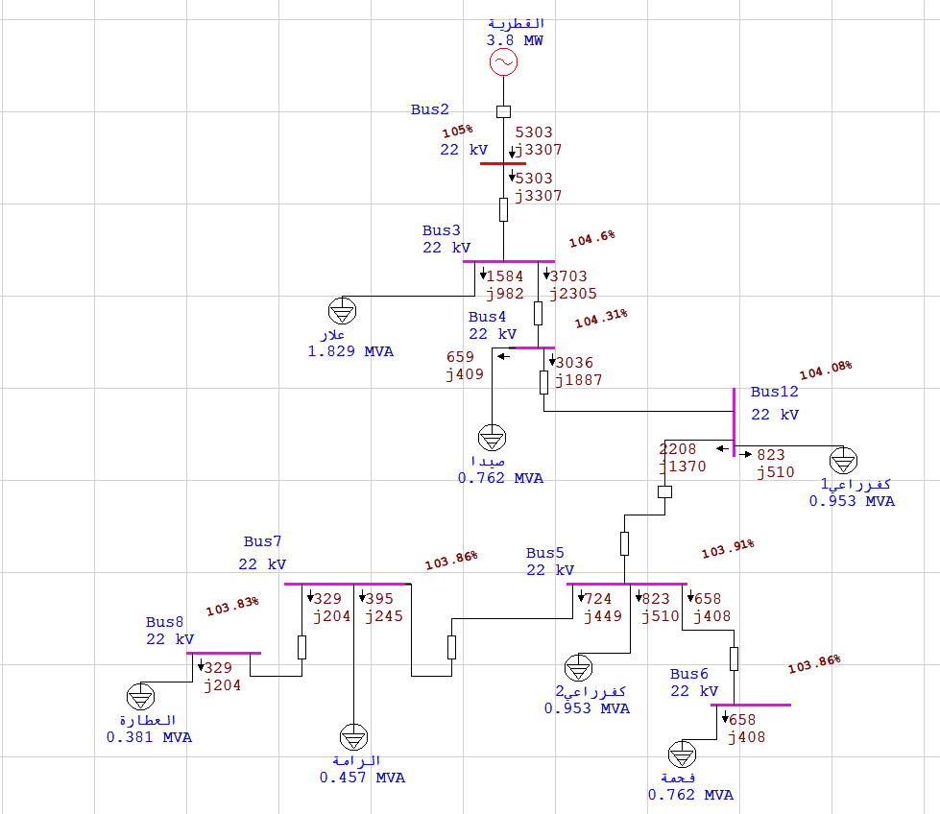
Old connection point
New connection point
Add a new connection point
Improvement the Maximum Load case using tap changing

Slide 7
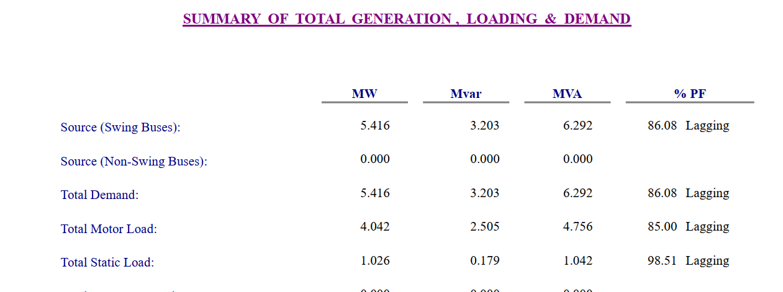
NO.OF BUS | Voltage in maximum load case(kV) | Voltage after adding connection point(kV)
2 | 22 | 22
3 | 21.909 | 21.955
4 | 21.845 | 21.93
12 | 21.792 | 21.92
5 | 21.745 | 21.935
6 | 21.742 | 21.964
7 | 21.741 | 21.92
8 | 21.735 | 21.916
VOLTAGE AFTER ADDING NEW CONNECTION POINT &COMPARING THE VOLTAGES WITH MAXIMUM LOAD CASE.
Summary of Total Generation at max load, Loading (add capacitor bank)

Slide 8
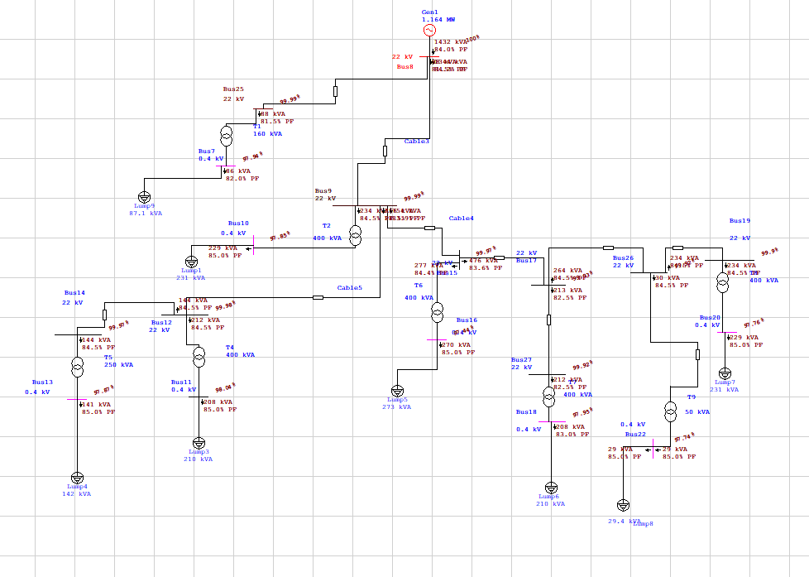
Results And Analysis for kufr’Rai network
NO.OF BUS | Voltage in maximum load case(%V) | Voltage after adding connection point and a new transformers (%V)
25 | 99.99 | 99.99
7 | 97.94 | 98.43
9 | 99.99 | 99.99
10 | 97.85 | 99.75
12 | 99.98 | 99.97
14 | 99.97 | 99.97
11 | 98.04 | 98.04
13 | 97.87 | 97.97
15 | 99.96 | 99.96
17 | 99.93 | 99.93
16 | 97.43 | 98.93
27 | 99.93 | 99.96
18 | 99.66 | 99.88
26 | 99.9 | 99.96
19 | 99.88 | 99.89
20 | 97.75 | 97.93
22 | 97.74 | 98.74
31 جديد | - | 97.39
جديد 29 | - | 97.99
bus voltages after adding new transformers and the connection point
The original case

Slide 9
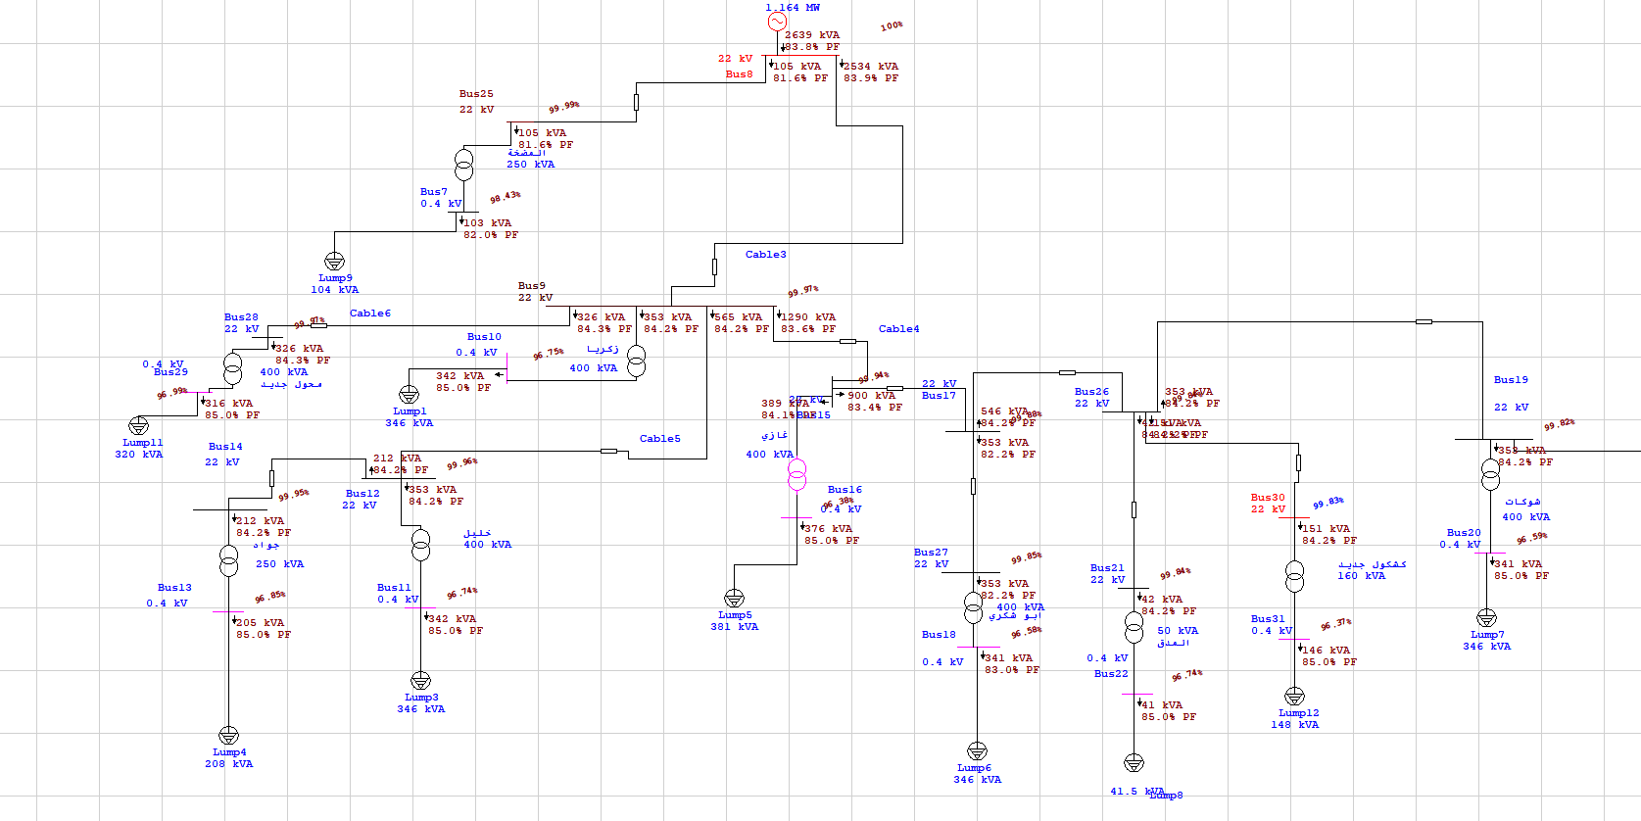
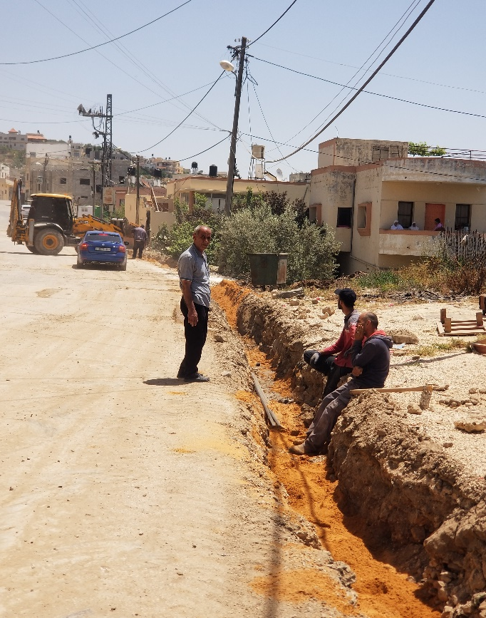
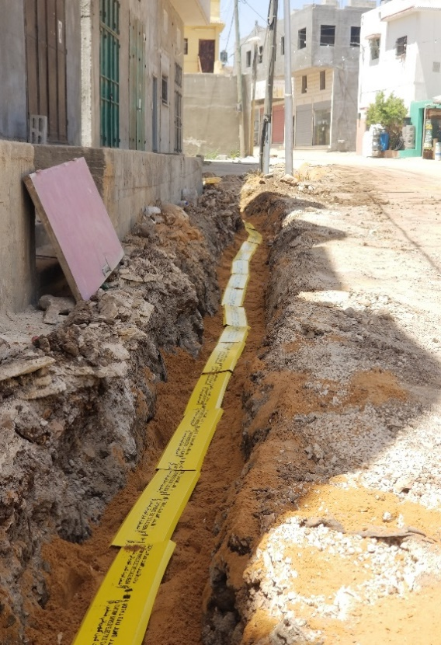
We have developed the internal electricity network for the town of Kafr Ray (Low Voltage) In conjunction with the improvement of the (High Voltage) network, where new electrical transformers were added to the internal network, which led to the improvement of electricity in remote areas and on the outskirts of the town. This was documented in pictures during work

Slide 10
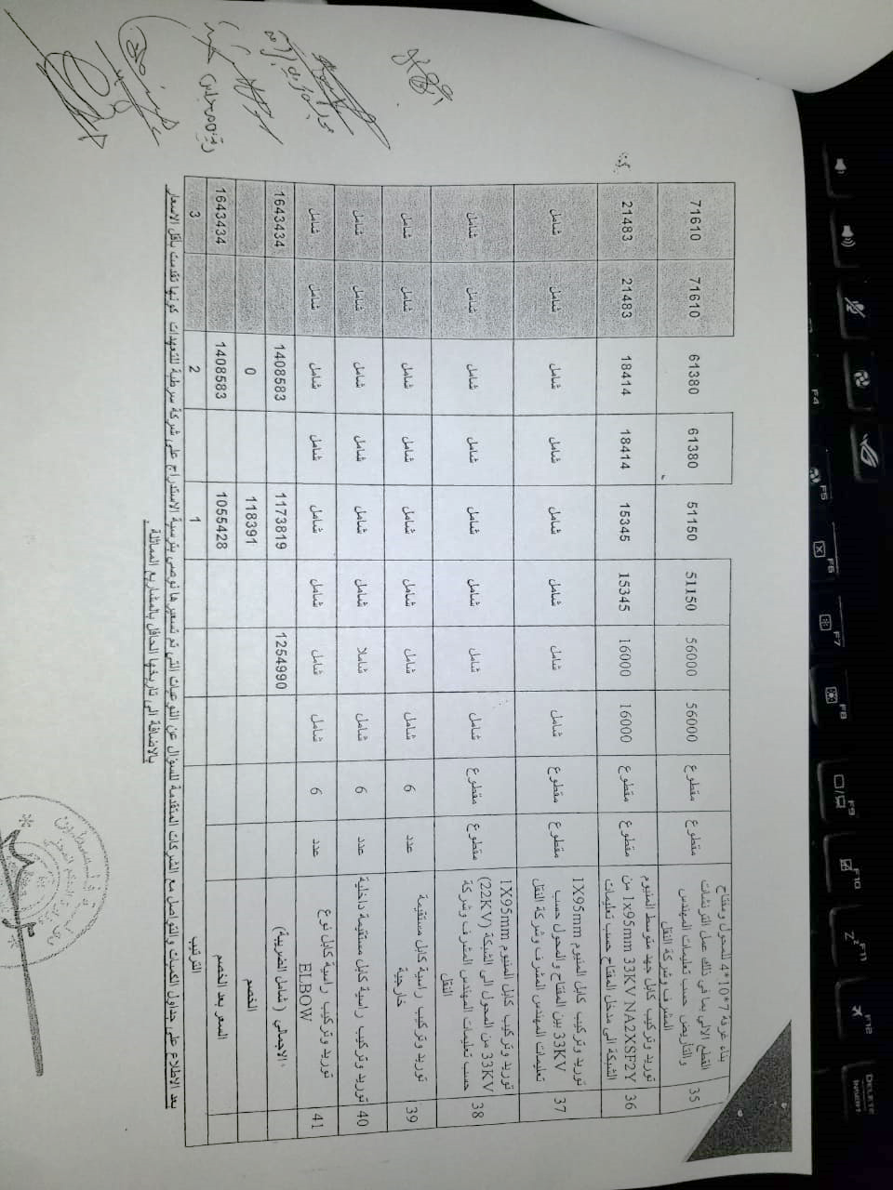
The Economical Study
In the beginning, the municipality of Kafr Rai offered a tender to add the new connection point with specific specifications and standards in partnership with the rest of the villages in the area, so many companies submitted offers at different prices.
SATCO was selected, which presented an offer that matches the required
specifications and at the lowest price compared to other companies.
Saving in penalties
= 42406.459 NIS/year.
Saving in losses :
=234154.8 NIS/year.
Capital Cost:
= 1063708 NIS
Total saving=saving in losses +saving in penalties
= 234154.8 + 42406.459
= 276561.259 NIS
S.P.B.P=Investment /Saving
= 1006337088/ 27656276561.25259 =3.84 years

Slide 11
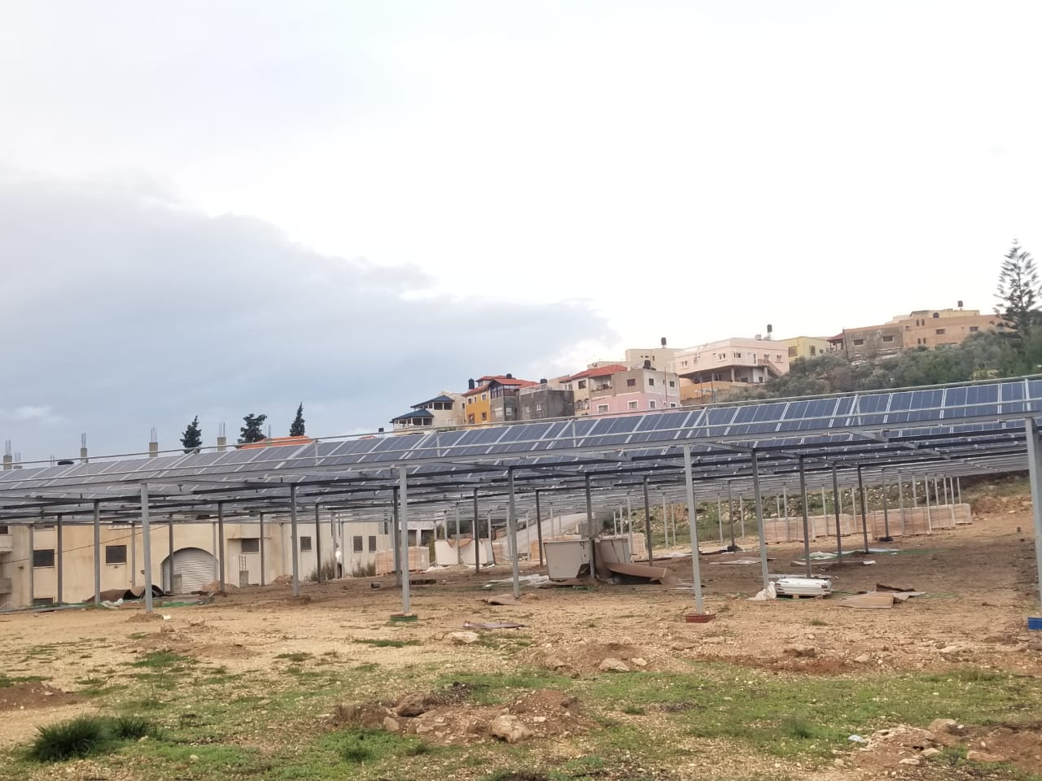
PV-system :
Work has started to install a 700 kilowatt project on the eastern cemetery in the town of Kafr Rai, and the first phase with a capacity of 350 kilowatts has begun by making umbrellas over the cemetery and investing them in solar panels.

Slide 12
Thank you

