Slide 1
An -Najah National University
Faculty of Engineering and Information Technology
Civil Engineering Department
Graduation Project II
“ The Assessment of the Faculty of Law “

Slide 2
Prepared By :
Sarah Halawa
Majd Ayyash.
Malak Asaad
Razan Uzrail
Sandi Daibes
Under supervision of:
Dr. Rema Nassar

Slide 3
Project management

Slide 4
Understanding Project & Management
INTRODUCTION
“A project is a temporary endeavor undertaken to create a unique product, service or result.

Slide 5
Project Resources
Manpower
Money
Machines
material

Slide 6
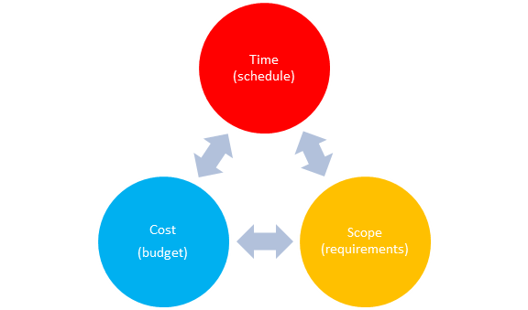
Project Constraints

Slide 7
Definition of Project Management
Project management is the planning, organizing, directing, and controlling of company resources for a relatively short-term objective that has been established to complete specific goals and objectives.

Slide 8

Management functions

Slide 9
Project life cycle
The project life cycle is “The sequence of phases through which the project will evolve.
these are the most common phases that many projects go through :
* Initiation phase
* Planning phase
* Executing phase
* Closing phase

Slide 10
Introduction of our project
* Project scope :
In any project that we will face, we have to consider the constraints of time, cost and quality. The most two important things is schedule of the activities that we have by using primavera and to compare between our calculations by hand and what it had done in reality and to estimate the cost

Slide 11
Building Description:
The building which is considered in this project is about the Assessment of the Faulty of Law in An-Najah National University, which was built in An- Najah National University last year, , it consists of six floors with a ground floor and the basement floor , wich has an area of 5,709 m2 , and we can said also that this area includes all mechanical works with elevators.

Slide 12
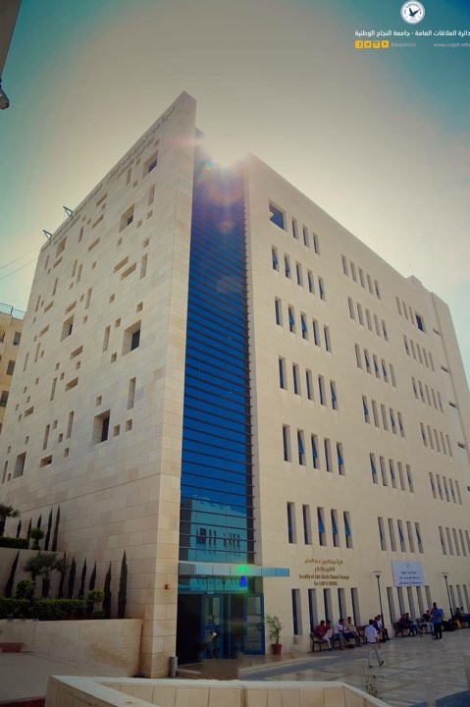

Slide 13
* Time line of the project
تاريخ المباشرة الفعلية واستلام الموقع | 7/6/2013
مدة العقد | 450 يوم تقويمي
تاريخ تسليم العمل حسب الاتفاقية | 25/8/2014
التمديدات الموافق عليها | يوم51
تاريخ التسليم بعد التمديد | 2014/11/6
التاريخ المتوقع لتسليم المشروع | 2014/11/6
التاريخ المتوقع لتسليم المشروع | سنة كاملة للأعمال المدنية وسنتين للأعمال الميكانيكية

Slide 14
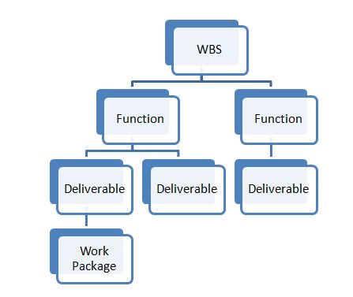
Work Breakdown Structure

Slide 15
WBS In Our Project
In Our Project we divided the WBS into three stages:
1- Sub-structure
2- Super-structure
3- Finishes(Architectural Works)
And each Stage includes several activities

Slide 16
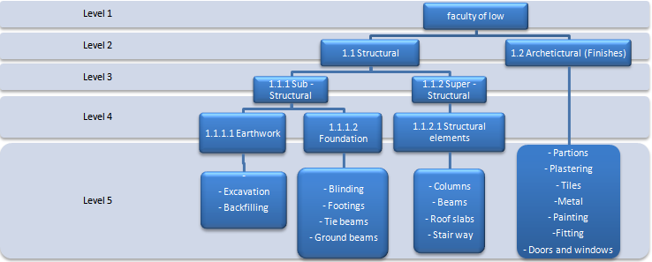

Slide 17
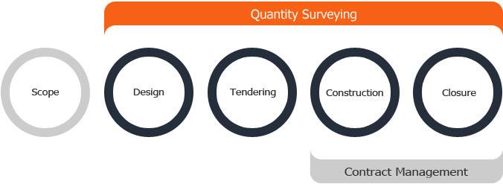
Quantity surveying
Quantity surveying and the estimated quantities of materials required on a project are normally determined by professional surveyor or engineer.

Slide 18

The Quantity Surveyor
The quantity surveyor is the person responsible for figuring out just what a construction project is going to cost. They have other roles too, especially making sure that construction costs and production are managed as efficiently as possible.

Slide 19
Sub – Structural works
Sub – structural works are divided into two work
:packages which are
→Earthwork.
→Foundation
→For Excavation works :
The item of Earthwork contains two types of
activities : Excavation & (filling or Backfilling)

Slide 20
Level Line | Area (m2) | construction level | Diff. |  | Volume (m3)
597.5 | 453.74 | 593.62 | 3.88 | Excavation | 1760.53
598.5 | 443.20 | 593.62 | 4.88 | Excavation | 2162.81
599.5 | 292.62 | 593.62 | 5.88 | Excavation | 1720.60
600.5 | 56.26 | 593.62 | 6.88 | Excavation | 387.04
601.5 | 76.13 | 593.62 | 7.88 | Excavation | 599.94
602.5 | 93.23 | 593.62 | 8.88 | Excavation | 827.90
603.5 | 105.82 | 593.62 | 9.88 | Excavation | 1045.50
 |  |  |  | total | 8504.32

Slide 21
→8504.32 – ( 9 + 120 +483 ) = 7892.32 m3
For Backfilling works :
The following equation: (2) was used to calculate the total backfilling for all wall footings that we have :
→8504.32 – ( 9 + 120 +483 ) = 7892.32 m3

Slide 22
For Foundation Works:
Blinding activity:
→Blinding for footings:
Area from AutoCAD=777
Depth of blinding =10 cm
The Volume of blinding= 777*10
=77.7 m3
Footing activity→
for footing type (1) :

Slide 23
Note: A waste factor of 2% was considered in calculating The concrete quantities.
Therefore, concrete volume the footings of type 1 after considering the waste factor
= 3.75* 1.02
3.825m3=

Slide 24
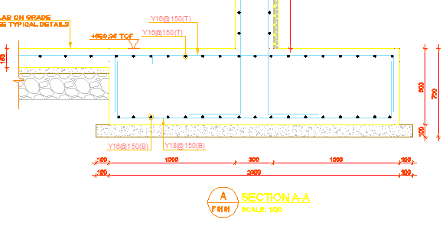
Also for footing in Section A-A, There is steel reinforcement of two types: longitudinal and stirrups steel

Slide 25



The weight of steel for one bar was calculated using the following equation:
Top steel :
Long direction =
Short direction =

Slide 26

Long direction =
Bottom steel :
Long direction =
Short direction =
By considering a waste factor of 10% to account only
for waste through using steel bars:
=1276.48*1.1
=1404.13 Kg
Total amount of Steel in Footing in Section A-A= 1276.48 kg

Slide 27
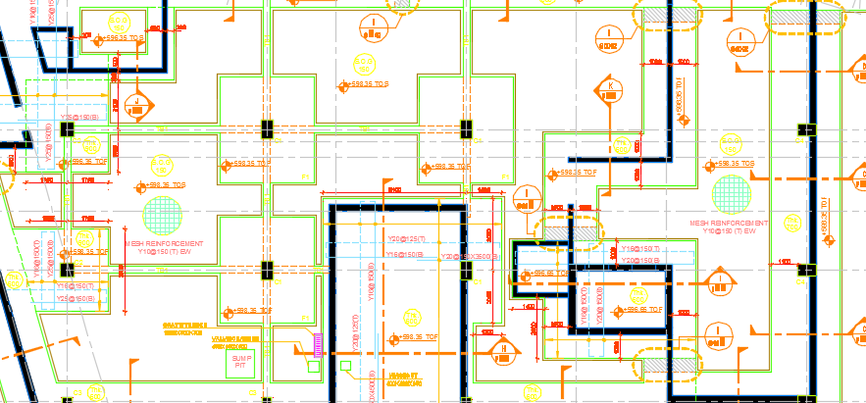
:Tie beams activity
53.75 * 0.45 * 0.30 = 7.30 m3 =

Slide 28



Note: A waste factor of 2% was considered in calculating final concrete quantities.
= 7.45
Therefore, concrete volume for inner TB(1) after considering the waste factor will be:
.3*1.027Considering waste factor= Concrete volume For TB1
For steel quantities of tie beams (1) , by applying this equation:
Top steel =
Bottom steel=

Slide 29
By considering a waste factor of 10% to account for waste through using steel bars and over lapping
796* 1.1 = 875.6 kg
the number of stirrups that we need :
53.75 / 0.20 = approximetly 269(this is the number of spaces ):
The number of stirrups = the number of spaces +1 , So the # of stirrups = 270
= 293.40 Kg( by considering waste factor of 10%)
Total amount of steel = 1.17 ton

Slide 30
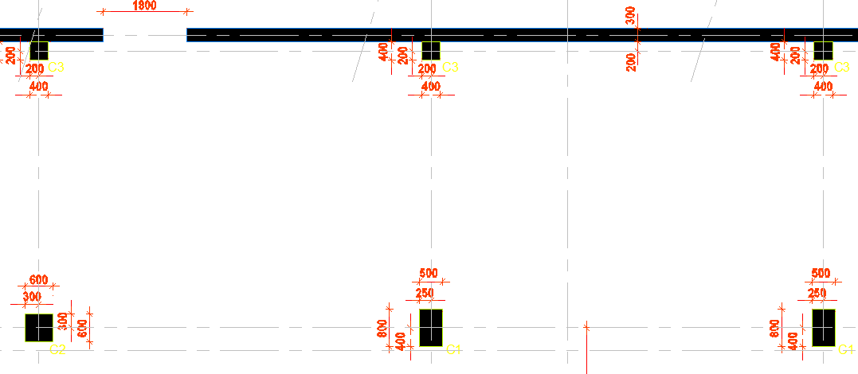
super – Structural works
Column activity :

Slide 31
Ground level column :
For columns type 1 in basement floor, concrete volume was calculated using equation:
For basement floor= number of column * concrete volume
=1.5*4
=6m3
Note: A waste factor of 2% was considered

Slide 32
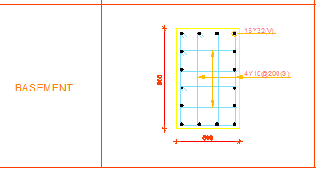

Steel for column:
Sample calculation:
For column type 1 in basement floor
Reinforcement of column type 1
Longitudinal steel

Slide 33


=4
=4
=4
=505.5 kg
column from type 1 in basement Floor=number of column*Weight for one column
4*505.5=
2022=
Stirrups:
Length of stirrups (m)= 2.8m
Diameter of stirrups=10
Number of stirrups=75

Slide 34
=4
For All column = number of column* weight of Column
= 4*129.6
=518.5 kg
Total weight of steel of column type 1 in basement floor=
Weight of longitudinal steel+ Weight of Stirrups
518.5+ 2022 =
=2540 kg
Note: A waste factor of 10% was considered in calculating steel quantities.
Therefore, steel weight for all column Type 1 after considering the waste factor will be:

Slide 35
Therefore, steel weight for all column Type 1 after
considering the waste factor will be:
2540*1.1=2794 kg.

Slide 36

Reinforced concrete walls activity
For section ( A-A) , concrete volume was taken off using parametric method and by applying equation:

Slide 37
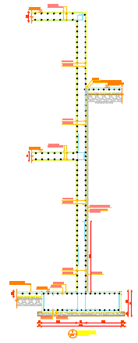
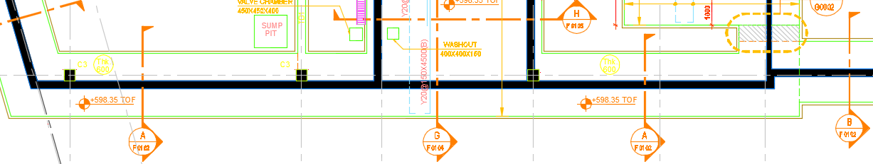

Slide 38

=length*width*depth
= 21 * 0.30 * 7.5 = 47.30
Note: A waste factor of 2% was considered in calculating final concrete quantities.
Therefore, concrete volume for ( A-A) after considering the waste factor will be:
= 47.30* 1.02 = 48.25
For steel quantities :

Slide 40



=
vertical steel for (outer side)
(1)
(2)
        vertical steel for ( inner side)
Horizontal steel for (outer side)

Slide 41
Horizontal steel for (inner side)
Note: A waste factor of 10% was considered in calculating final Steel quantitites
Therefore, steel quantities for wall footing (section A-A) after considering the waste factor will be:
= 5695.30* 1.10
= 6264.80 kg
= 6.264 ton

Slide 42
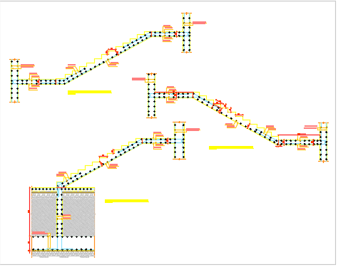
Stairs activity :

Slide 43
Concrete:
The amount of concrete = side area from AutoCAD *length of step from plane
Sample calculation :
Area = 1.096 m^2.
length of step = 1.2 m
The amount of concrete = 1.096 *1.2 = 1.3m^3
Stair case 1
# of floor | Volume
B | 4.126
G | 4.26
1 | 4.26
2 | 4.26
3 | 4.26
4 | 4.26
5 | 4.26
Total
29.686

Slide 44
Steel :
Weight of steel(kg) = # of bar * (diameter)^2 *length /162
# of bars = total distance /distance between 2 bars
Sample calculation:
# of bars = 3.77 /0.2 =18.82 = 19 bars
Weight of steel = 19 * 10 ^2 * 1.4 /162 = 16.42 kg
Stair case 1
# of floor | Weight of steel
B | 439.52
G | 512.77
1 | 512.77
2 | 512.77
3 | 512.77
4 | 512.77
5 | 512.77
Total | 3516.14

Slide 45
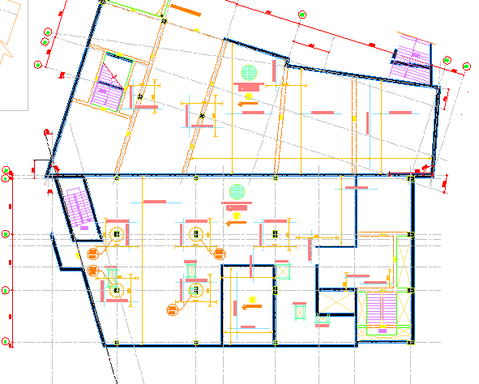
Basement floor slab:

Slide 46
Volume (m3) | Depth (m) | Area (m2) | Number of Floor
182.3 | 0.3 | 607.68 | Basement 1
150.33 | 0.25 | 601.32 | Basement
169.8 | 0.25 | 679.2 | Ground floor
158.76 | 0.25 | 635.03 | First Floor
158.76 | 0.25 | 635.03 | Second Floor
155.08 | 0.25 | 620.33 | Third Floor
155.08 | 0.25 | 620.33 | Fourth Floor
155.08 | 0.25 | 620.33 | Fifth Floor
8.19 | 0.25 | 32.75 | Roof floor
1239.38 |  |  | Total Volume

Slide 47
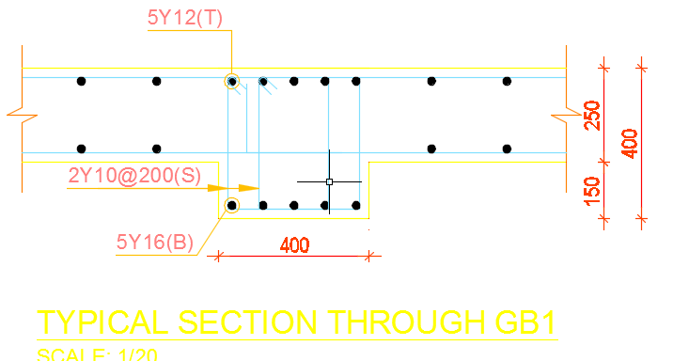

Beams activity :
concrete volume

Slide 48

= 5.35 * 0.40 * 0.150 = 0.321
Note: A waste factor of 2% was considered in calculating final concrete quantities.
Therefore, concrete volume for ( GB1) after considering the waste factor will be:
= 0.321 * 1.02 = 0.33
steel quantities

Slide 49
By considering a waste factor of 10% to account for waste through using steel bars and over lapping
66.10* 1.1 = 72.71 kg
the number of stirrups that we need :
(5.35 / 0.20) approximately = 27(this is the number of spaces ):
The number of stirrups = the number of spaces +1 , So the # of stirrups = 28
Note: here in this section every 20 cm , we have double stirrups , so the total number of stirrups = 56 stirrups.
= 53.24 kg ( by taking waste factor of 10%)
Total = 53.24 + 72.71 = 126 kg

Slide 50
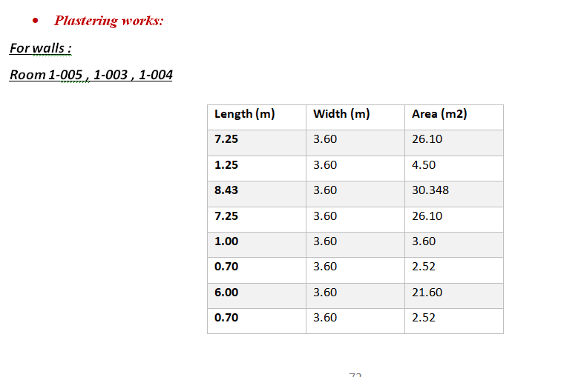
Finishing works:

Slide 51
Total area = 117.288(m2) , doors & windows openings = 8.30 (m2) , Net area = 108.988 (m2
Total area of plastering for walls & slabs = 6769.63 m2
To ceilings and stair's soffits, internally = 980 m2
Externally, for parapets and where required = 350 m2
Total area of painting for walls & slabs = 8075 m2 including :
Walls
Ceilings and stair’s soffits
Elevations &parpets

Slide 52
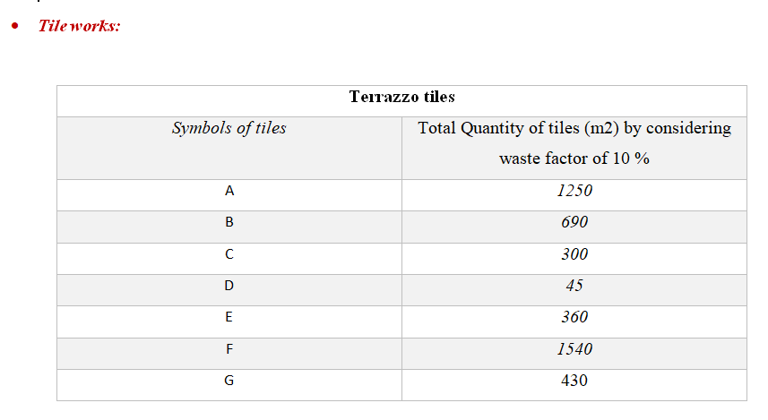

Slide 53
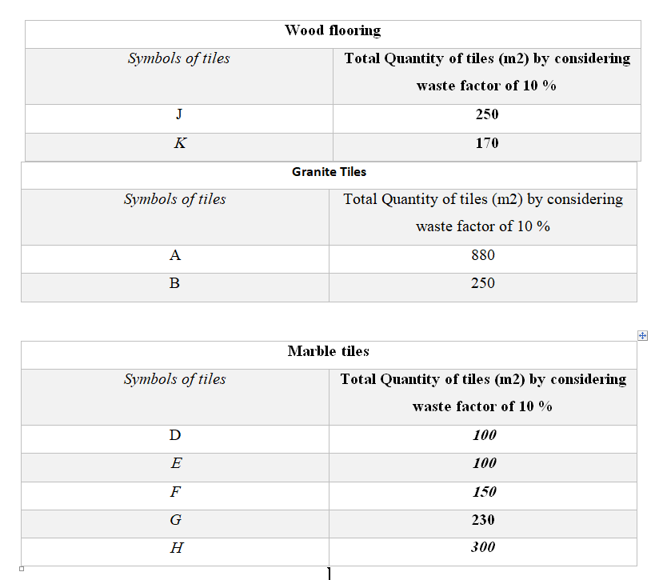

Slide 54
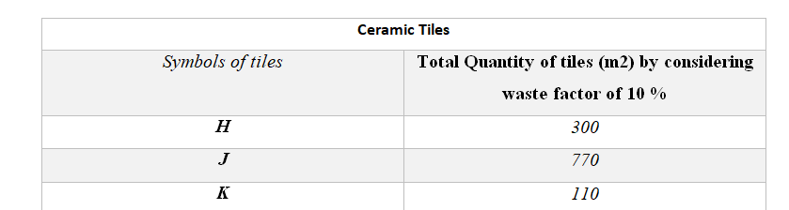

Slide 55
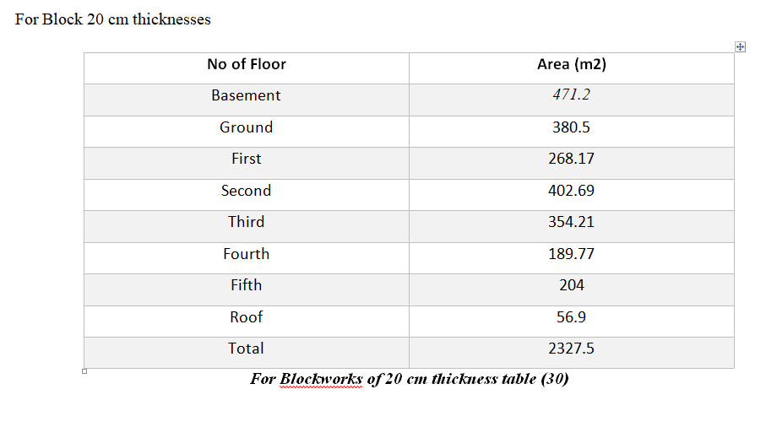
Block works

Slide 56
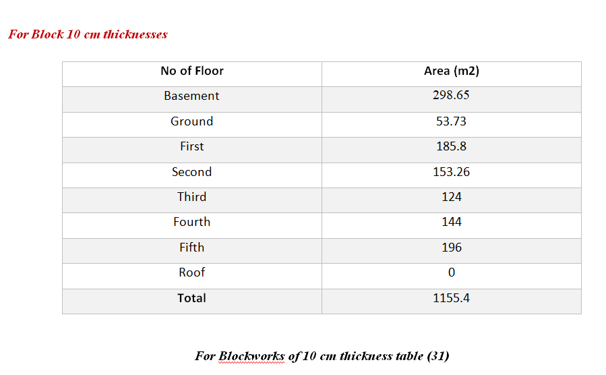

Slide 57
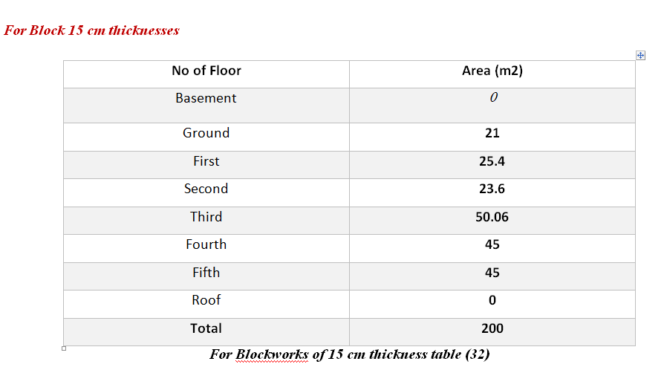

Slide 58
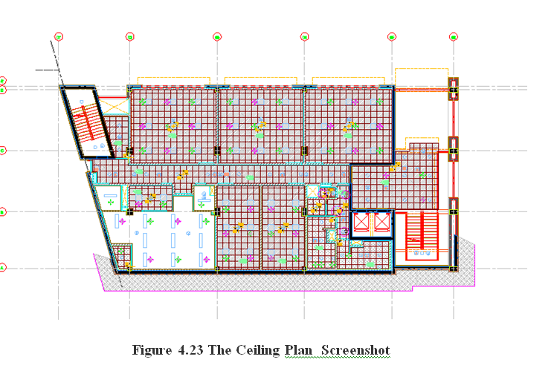
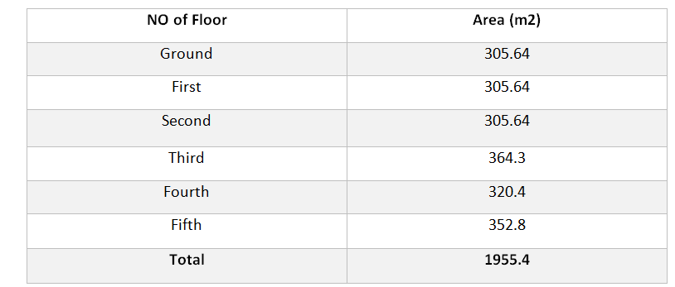
Ceiling:

Slide 59
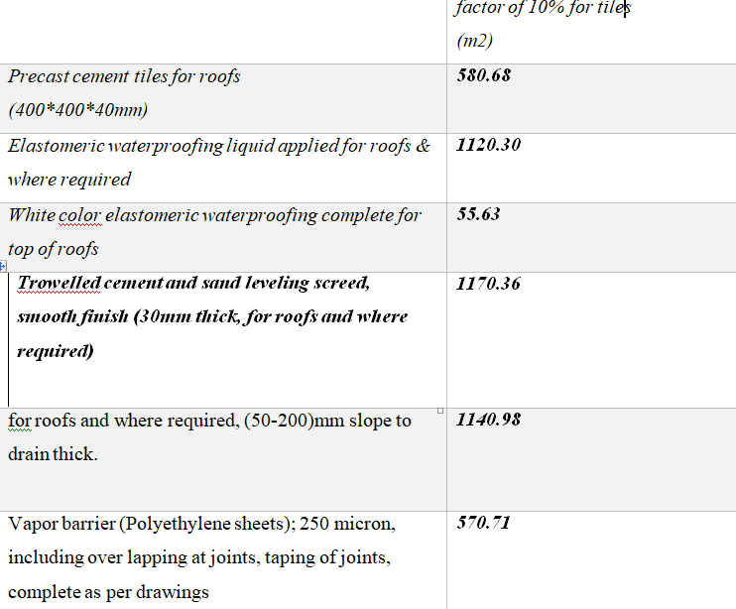
Roofing & Insulation Systems

Slide 60
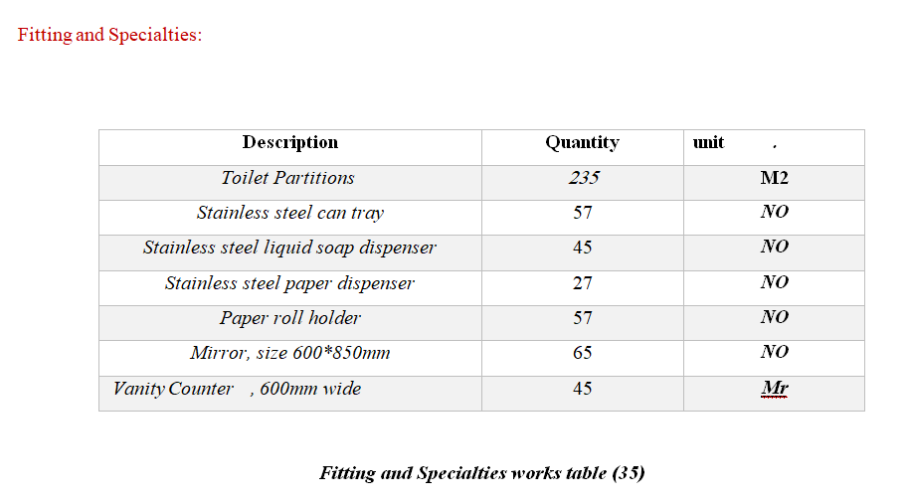

Slide 61
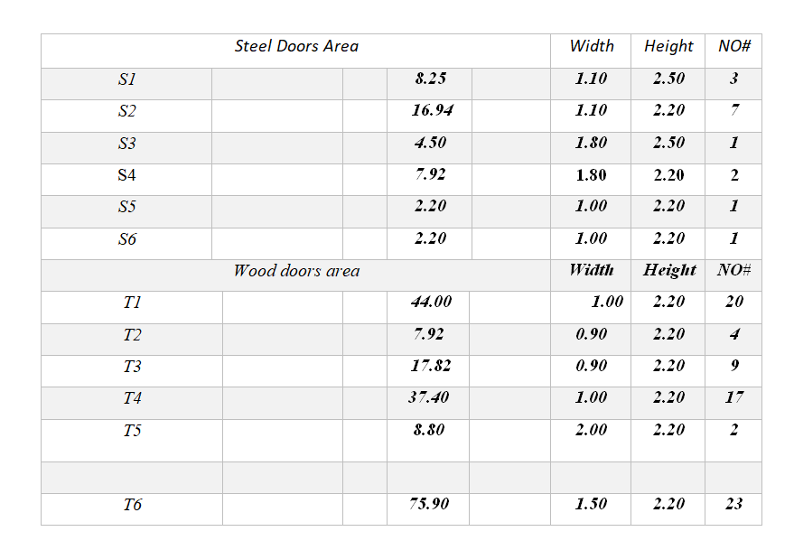
Doors and Windows works:

Slide 62
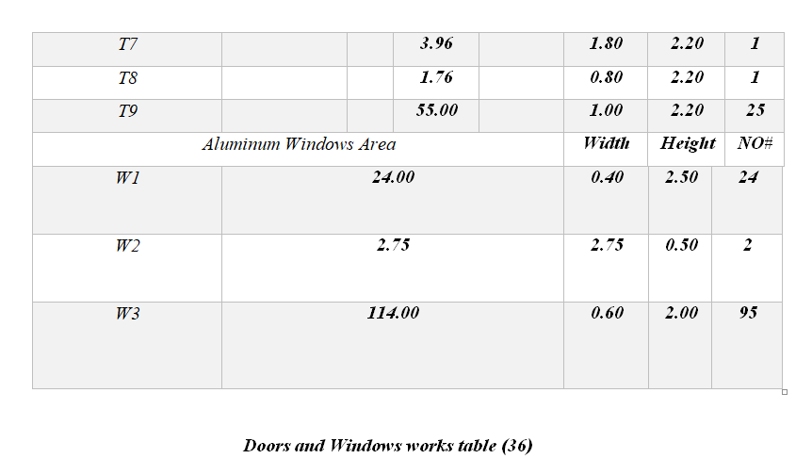

Slide 63

Cost Estimating

Slide 64

Definition of cost estimating
Cost estimation is the art of assigning value. It is also a science making use of a wide range of techniques to predict the costs of activities and assets.

Slide 65
principles of cost estimating
It is used to predict the quantity, cost and price of the resources required by the scope of a project.
to provide decision makers to make investment decisions, choose between alternatives and to set up the budget during the front end of projects

Slide 66
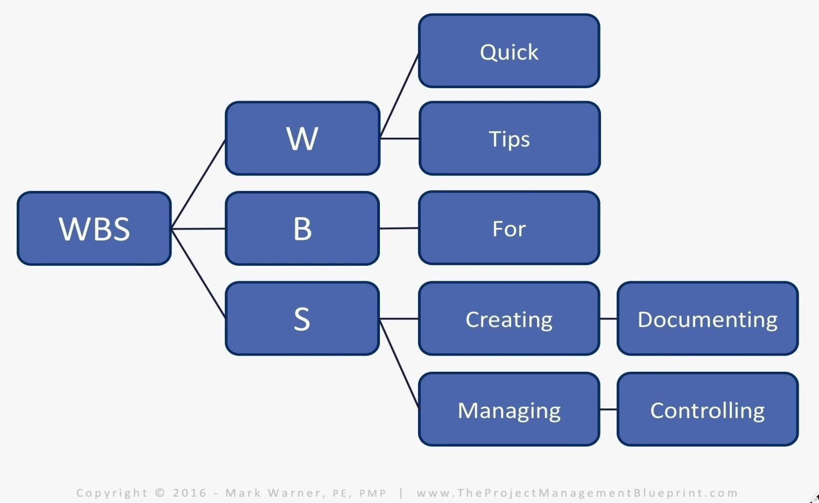
Estimating is done by breaking down the total scope of a project in manageable parts, to which resources can be assigned and costed.

Slide 67
A cost estimate is more than a list of costs. It also includes a detailed Basis of Estimate (BOE) report that describes the assumptions, inclusions, exclusions, accuracy and other aspects that are needed to interpret the total project cost. Otherwise, it would be a meaningless number.

Slide 68
In our project ,we made an estimation of the items that we have to compare between our calculations and what it had done in reality .
→ We asked for help of the contractor in order to price our activities and entered details for these items.

Slide 69
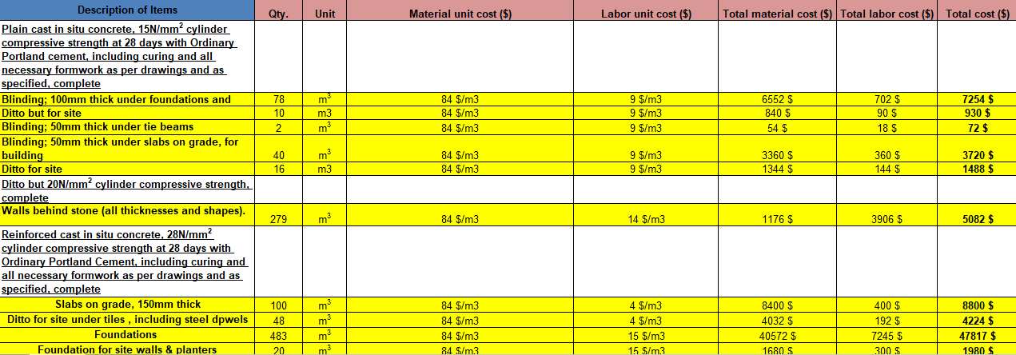

Slide 70
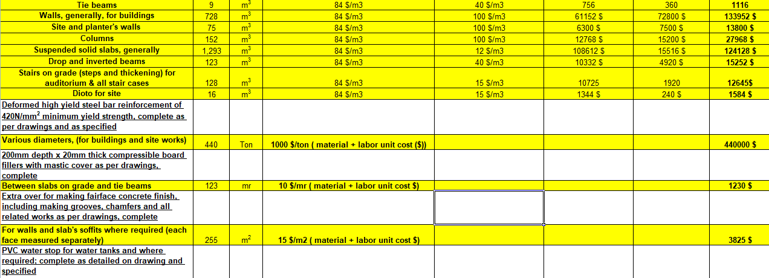

Slide 71
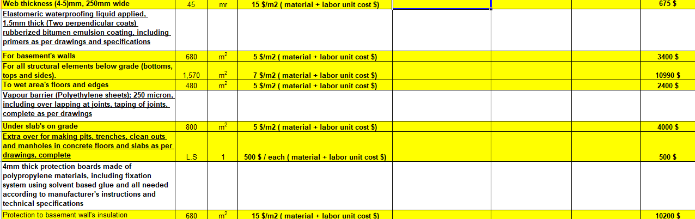

Slide 72
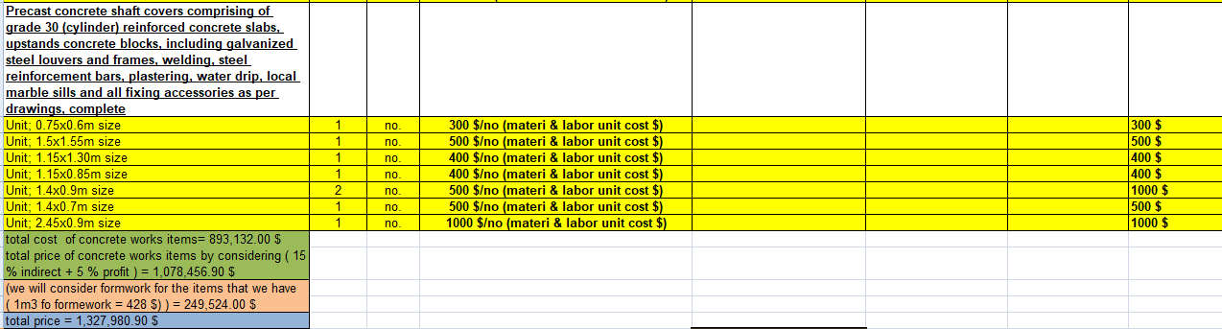

Slide 73
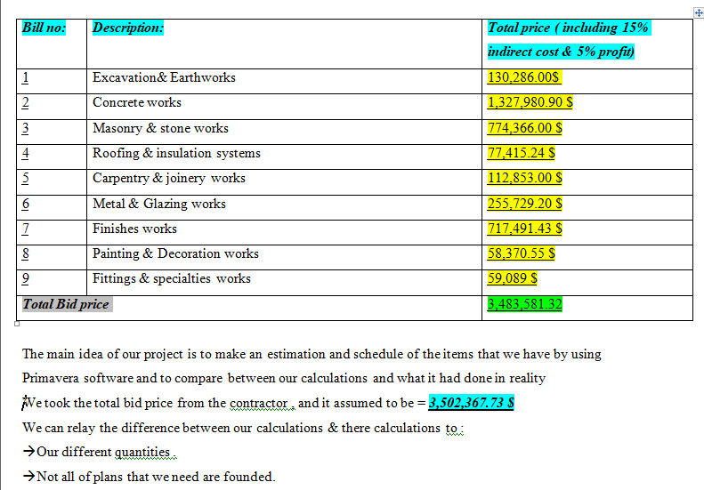

Slide 74
Scheduling
A schedule is known as a basic time-management tool , which consists of a list of times at which possible tasks, events, or actions are intended to take place.
Or known as : a sequence of events in the chronological order in which such things are intended to take place

Slide 75
Criteria of project schedule
1-The schedule must be constantly (weekly works best) updated.
2-The remaining effort must be appropriately distributed among team members (taking vacations into consideration)

Slide 76
Steps to Schedule a project
1)Break down the project into small activities
2)Estimate activity durations
3)Set up the schedule logic
4)Draw network & perform CPM Calculations .
5)Review and analyze the schedule

Slide 77
Methodology:
For the purpose of obtaining the final cost of the architectural and structural aspects of the building, the project was broken down into smaller manageable work packages which were, in turn, broken down into activities. These packages and activities are organized in a form called work breakdown structure by using primavera program.

Slide 78
Firstly, we will recognize each work package, we will measure the quantities of these activities to estimate the cost of them. Afterwards, activities costs’ were summed up to find the packages costs which were accordingly summed up to find the whole project and architectural costs.
We will use Excel to make some calculations & AutoCAD to get some geometric readings about our building.

Slide 79
Primavera Management Software
Is the most popular software used in construction scheduling, this new edition covers the latest version of Primavera Project Planner

Slide 80
Advantages of Primavera
1. It helps you easily plan and manage your project activities.
2. It helps you optimize your project plan, costs and resource utilization.
3. It gives you clear visibility of what is going on in the project , forecast costs and schedule .

Slide 81
Steps of this program:
In this program we must define three things before we put the
activities
1) EPS (Enterprise Project Schedule) : this is Hierarchal structure that identifies the company wide projects and enables organizing and management of those projects.
2) OBS (Organizational Breakdown Structure):- It represents management responsible at the EPS/ Project. Each Manager in the OBS is associated with our area of the EPS.
3) WBS (Work Breakdown Structure):- Each Project in the EPS has its own WBS. A WBS is a hierarchal arrangement of product and services produced during and by a project.

Slide 82
WBS of our project includes :
1)Mobilization
2)Excavation .
3)Blinding .
4)Foundation .
5)Tie beams .
6)Ground slab.
7)Concrete works .
8)Finishes .
* blocks
*stone
*plastering
*painting
*tiling
*ceiling
*carpentry works
*fitting & metal works

Slide 83
And we will identify the duration of each activity by asked for help from more than one contractor according to their experiences in work & our quantities that we calculated in order to make a schedule of time .

Slide 84
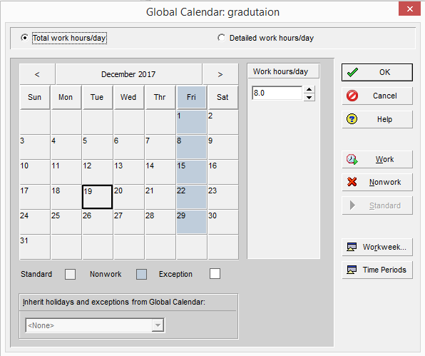
Step by step :
First of all, we will define a calendar for our project(5 days work with 8hr / day )
EPS > calendar > add > select the name for it and select it > then we modified everything we want.

Slide 85
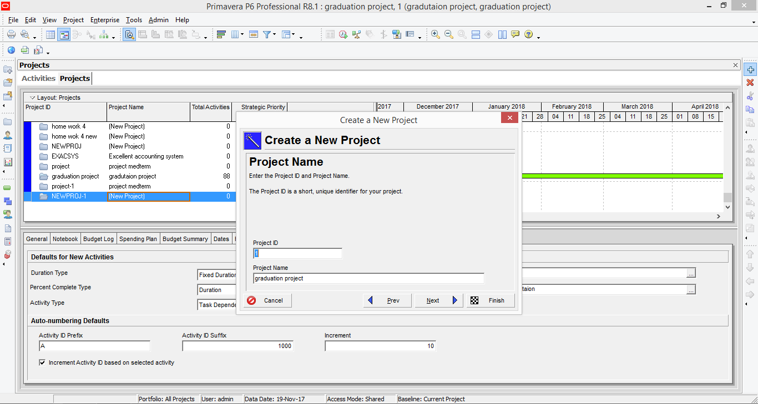
We will establish our new project EPS > projects > new > select our EPS > project name (Graduation Project) > Project forecast start date >7 /6 /2013

Slide 86
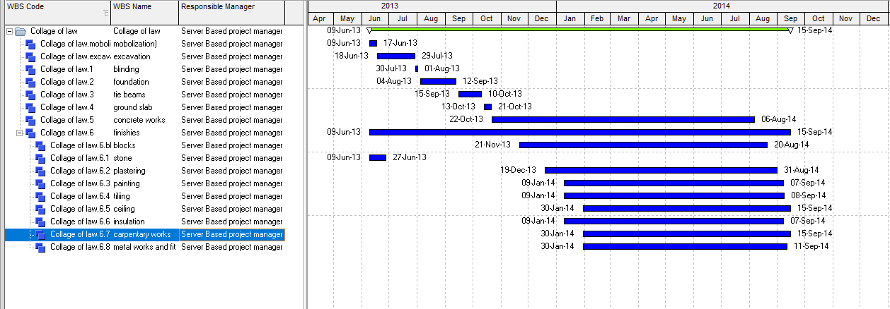
Establish our WBS
Project > Wbs > add

Slide 87
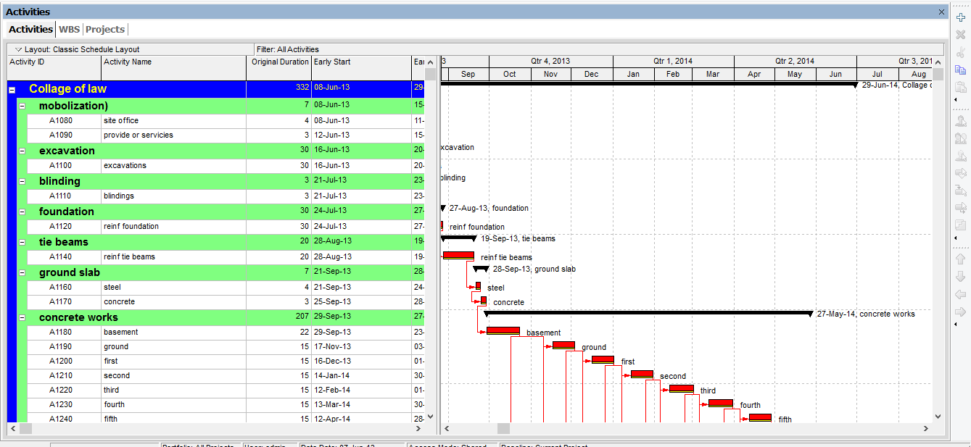
We will enter all activities under each WBS that we already established
*For each activity we added , we put the original duration according to our quantities that we calculated in chapter four .

Slide 88
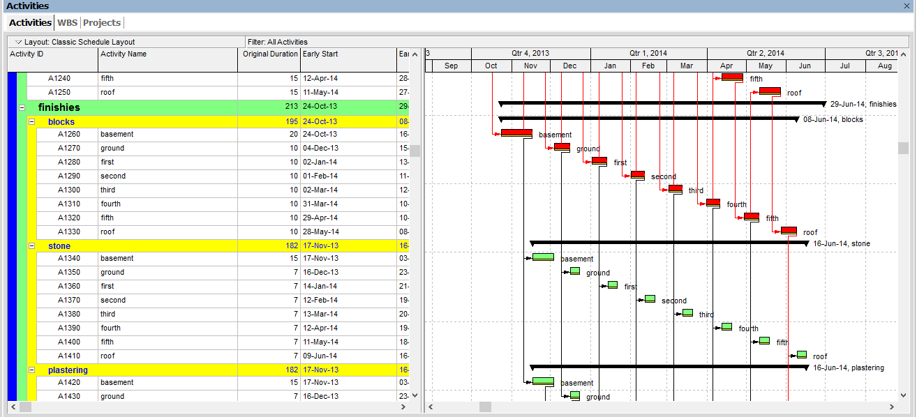

Slide 89
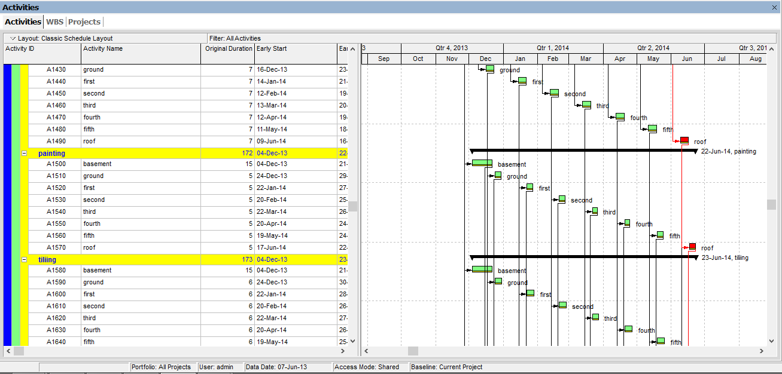

Slide 90
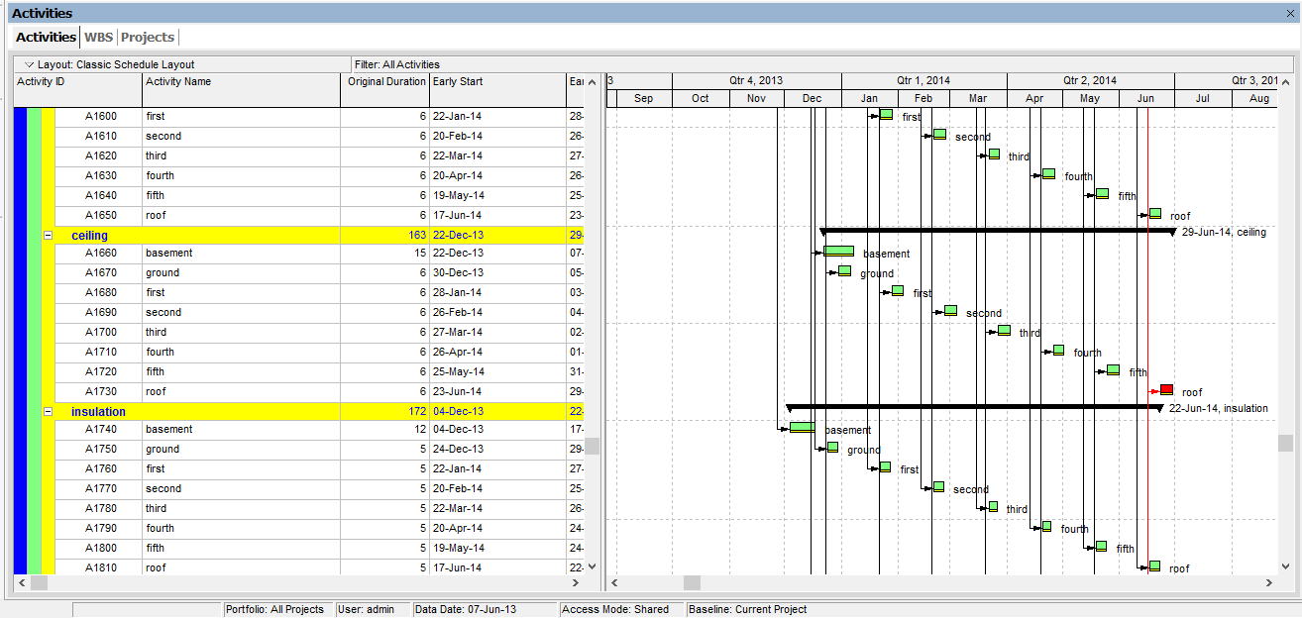

Slide 91
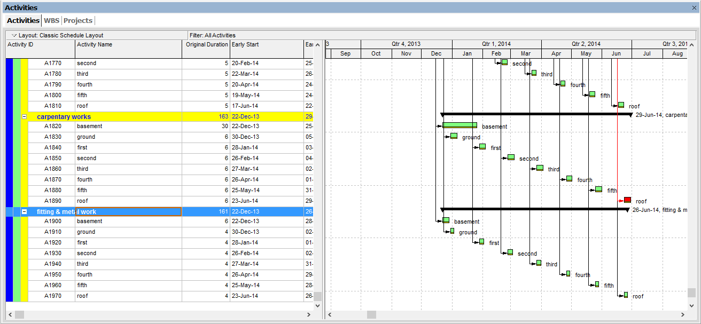

Slide 92
Final result :
* We took the total duration in terms of working days from the contractor and it assumed to be 395 days.

