Slide 1

An-Najah National University Faculty of Engineering and Information Technology
Building Engineering Department
Graduated Project -2
Integrated design of a bank building
Reported by:
Ali Zawawi
Mazen Abd Al Haq
Nasser Abu Baker
Instructor:
Dr. Luay Dwaikat
2022-2023

Slide 2
Contents
Introduction.
Site analysis.
Architectural aspects.
Environmental aspects.
Structure aspects.
Electro- Mechanical aspects.
Cost estimation.
Conclusion.

Slide 3
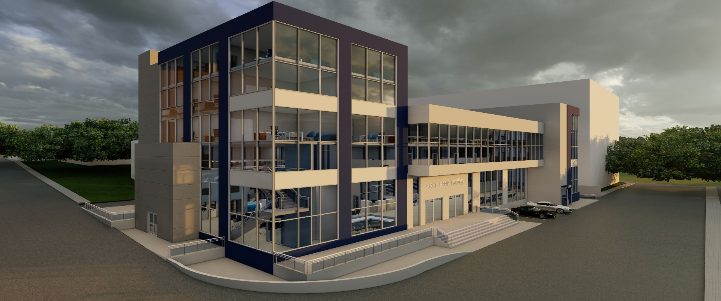
Introduction:
1- Quick reminder of the site analysis.
2- why this project?

Slide 4
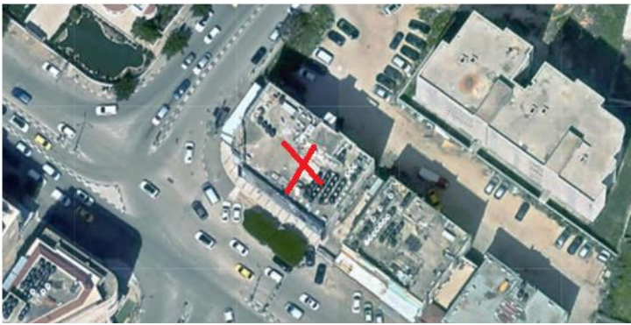
Site analysis.
its location:

Slide 5
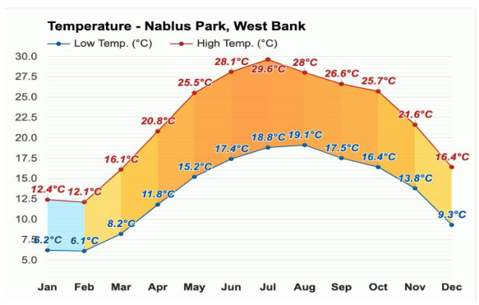
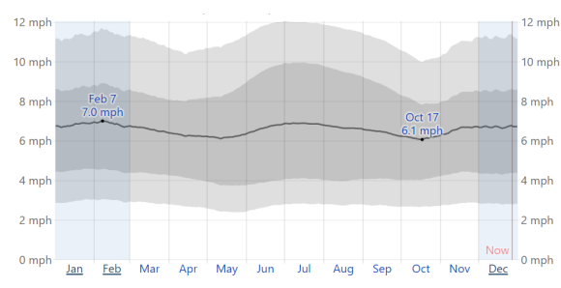
Temperature:
Wind:

Slide 6
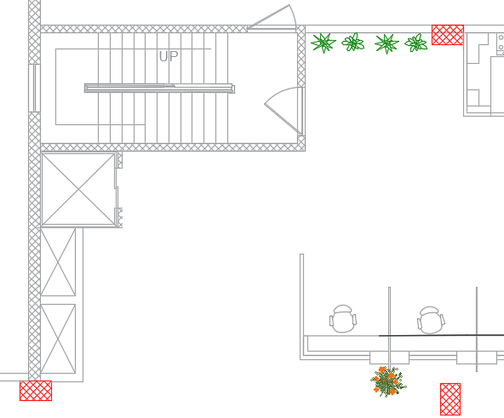
Architectural aspects and the improvements:
1- Emergency stairs & wide the corridors

Slide 7
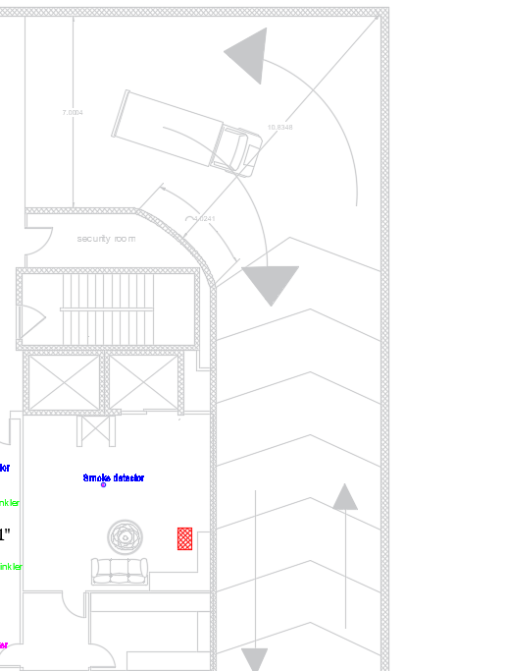
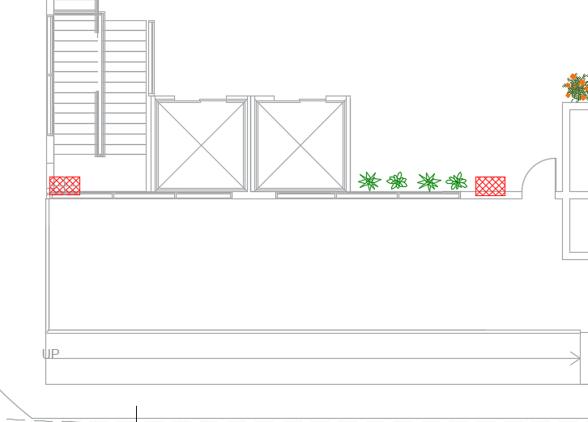
Ramps for disabled & cars:

Slide 8
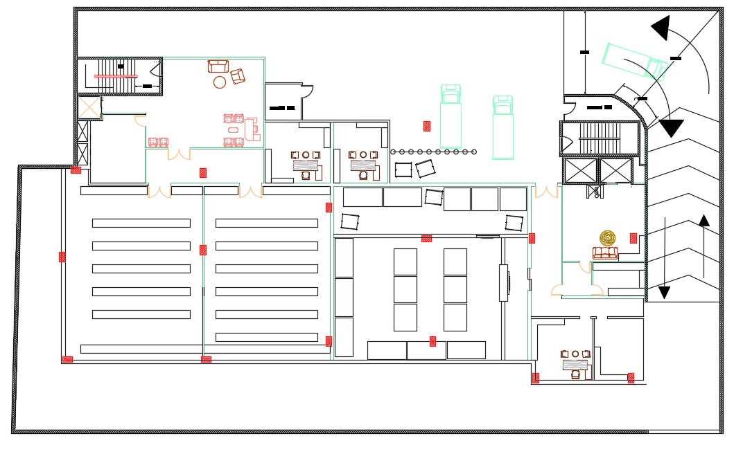
Add B1&B2&B3:

Slide 9
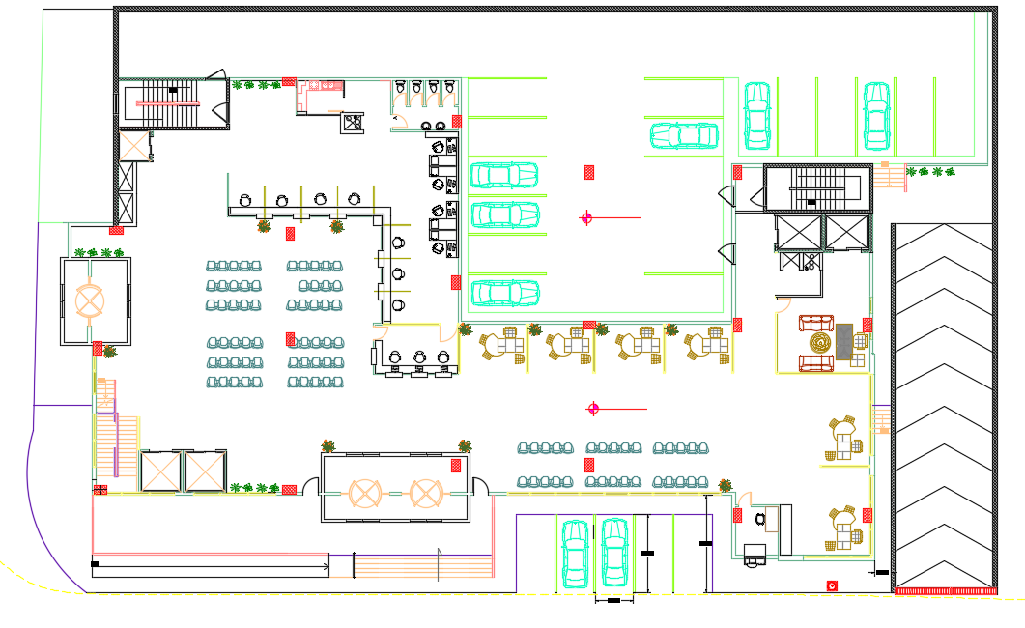
The ground floor after the modifications:

Slide 10
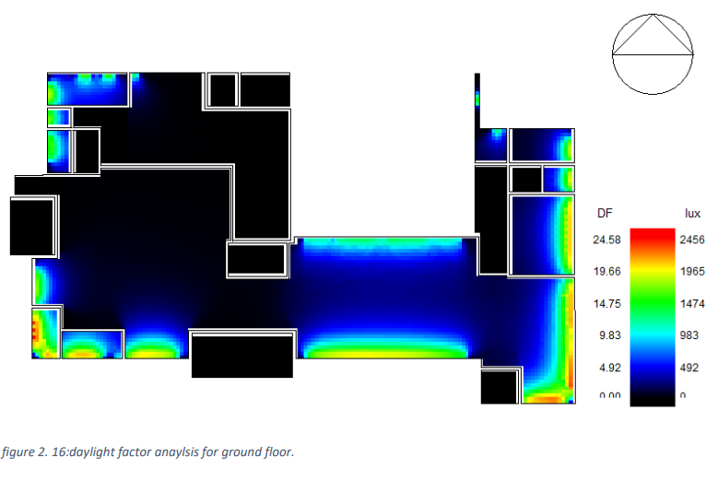
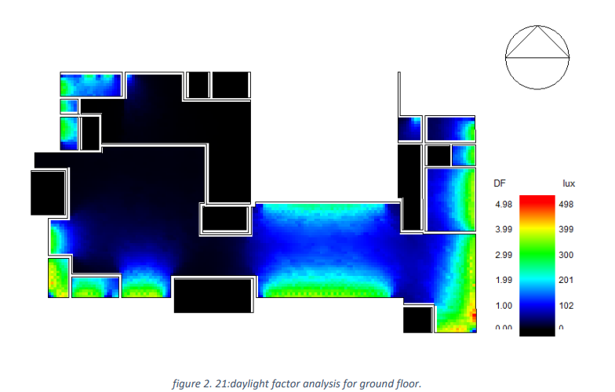
Environmental aspects.
(DAYLIGHT FACTOR)
G.F - Before modifications
GF – After modifications:

Slide 11
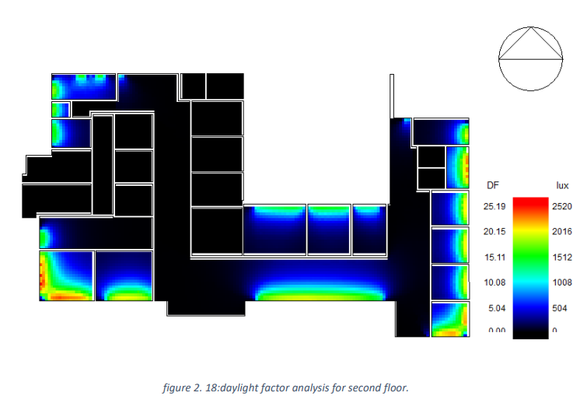
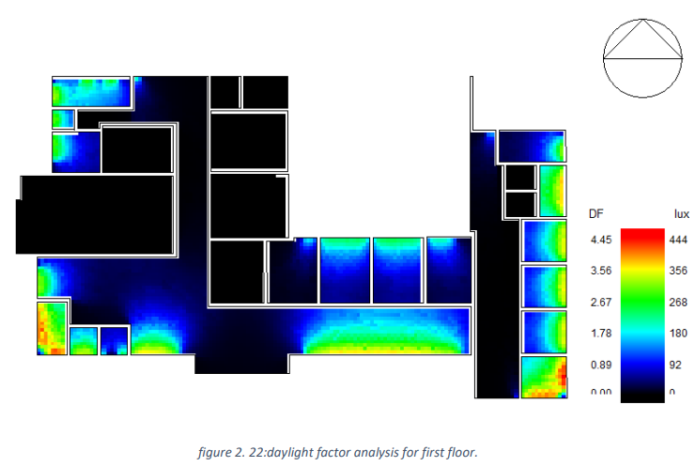
F.F - Before modifications
F.F – after modifications

Slide 12
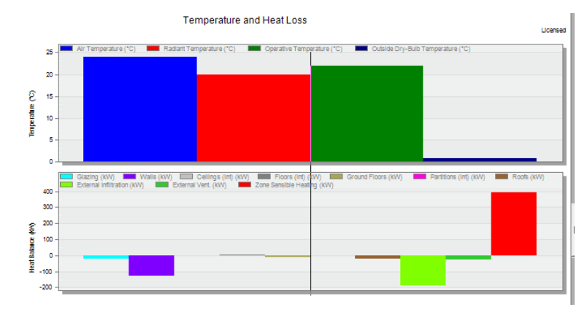
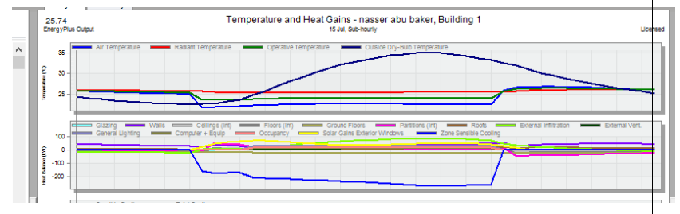
(HEATING &COOLING)
heating & cooling Before modifications

Slide 13
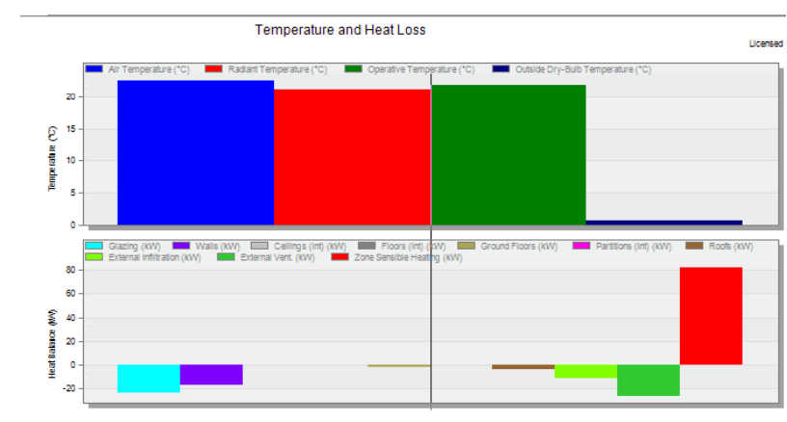
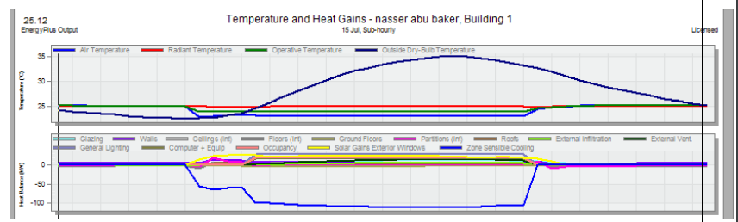
heating & cooling after modifications

Slide 14
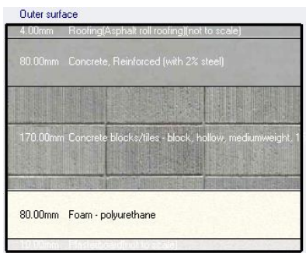
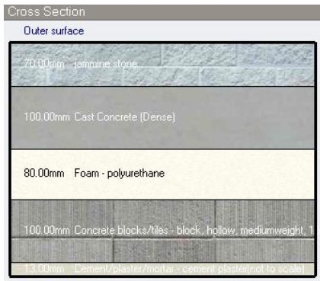
Modifications has done:
2- Roof after modifications
1- External walls after modifications
U- Value = 0.303
U- Value = 0.307

Slide 15
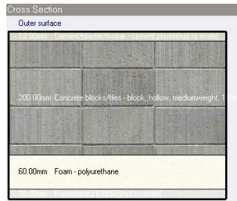
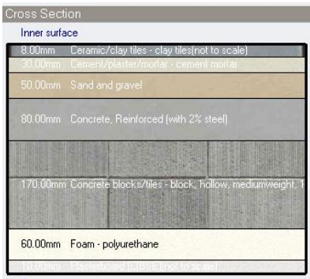
3- Internal walls after modifications
4- Floor after modifications
5- U-Value for glazing = 1.338 and this value is considered an acceptable value.

Slide 16
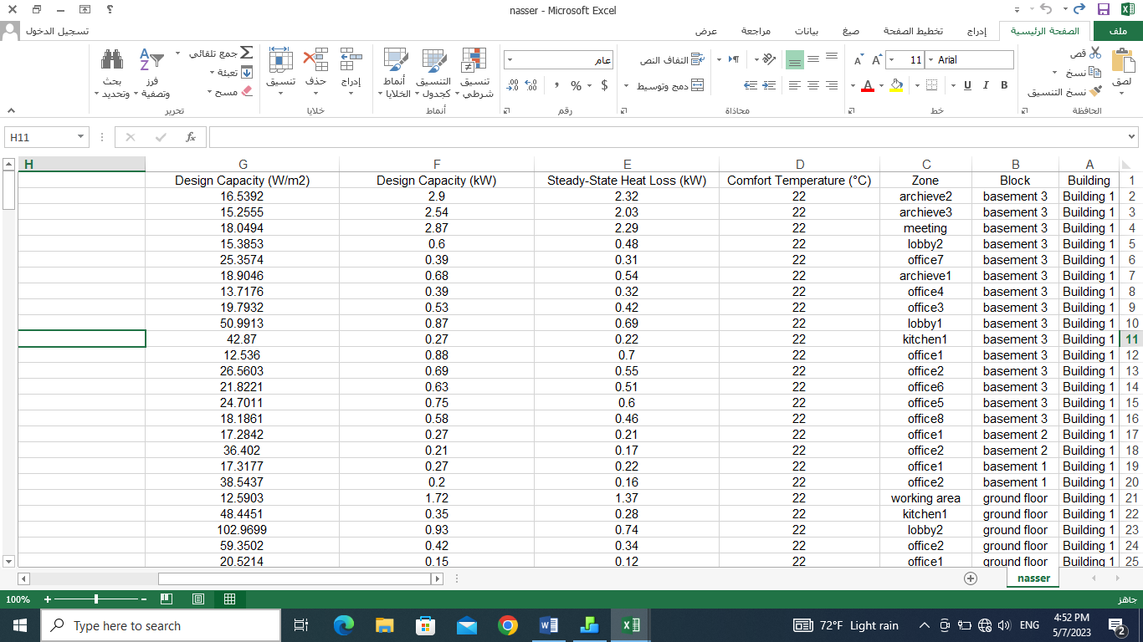
heating design for the building:

Slide 17
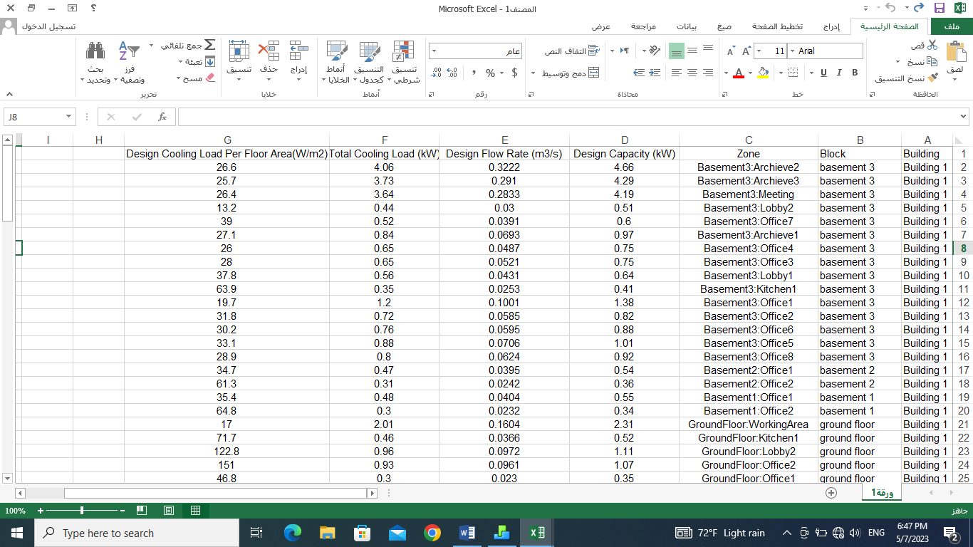
cooling design:

Slide 18
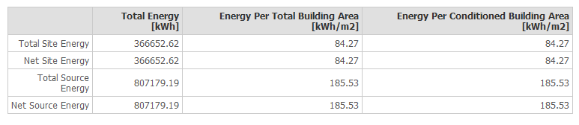
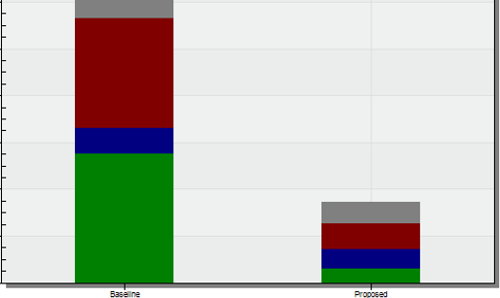
site and source energy:
    Comparison with baseline:

Slide 19
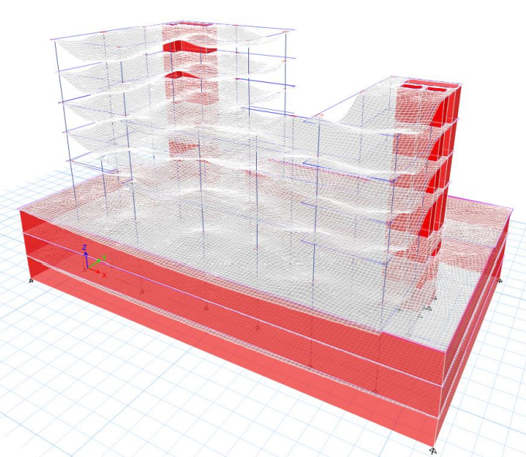
Structure aspects:
Compatibility check:

Slide 20
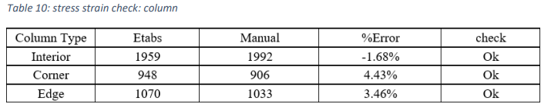

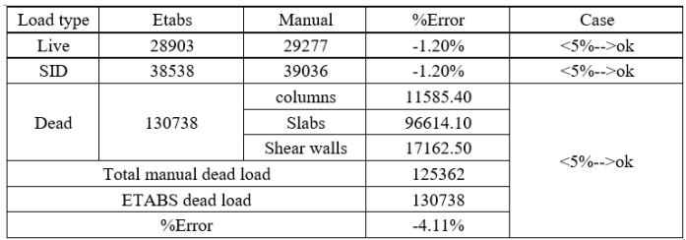
Stress strain check:
Equilibrium check:

Slide 21
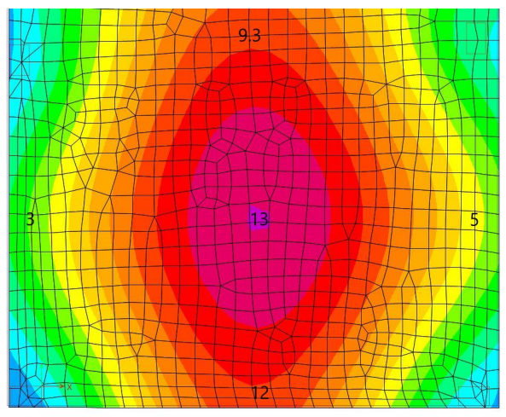
Deflection check:
Limit =12.64 /360 =35.11 mm
Etabs deflection = 5.70 mm<<35.11mm
From service loads: Limit =12.64/240=52.66mm
is ok

Slide 22
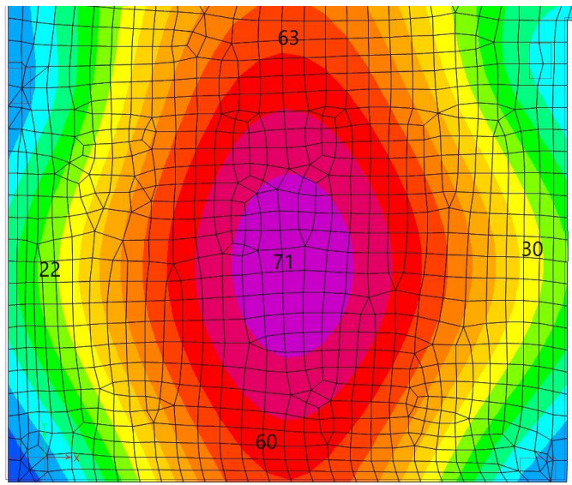
Etabs deflection = 27.25 mm<<52.66mm

Slide 23
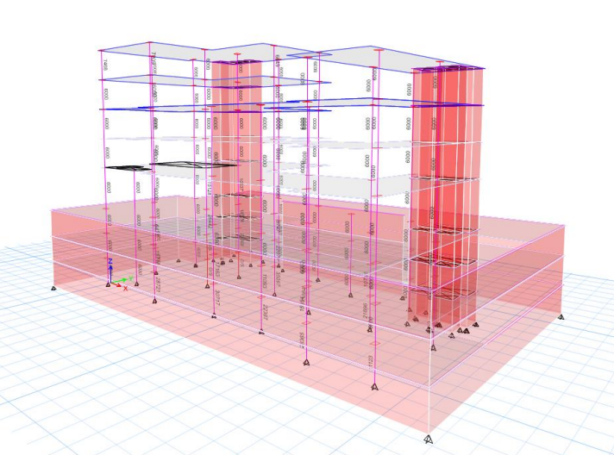
Design check:

Slide 24
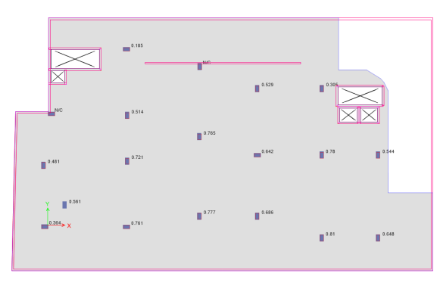
Punching shear check:

Slide 25
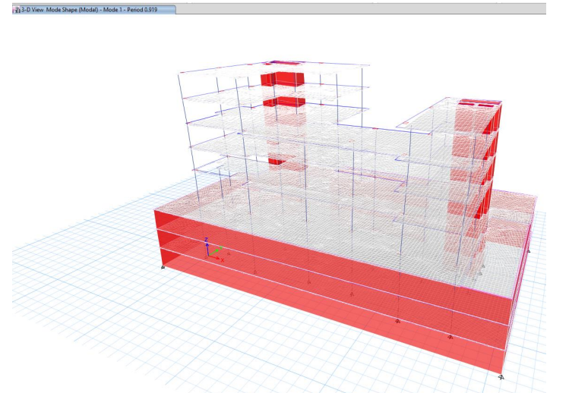
Period check:

Slide 26
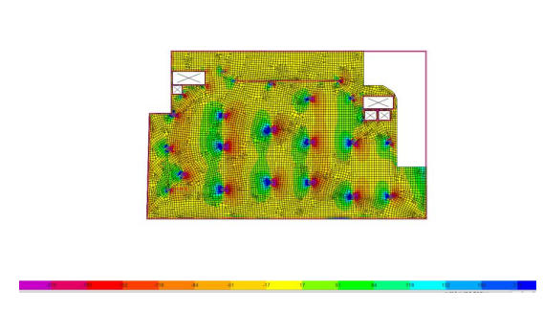
Slab shear check

Slide 27
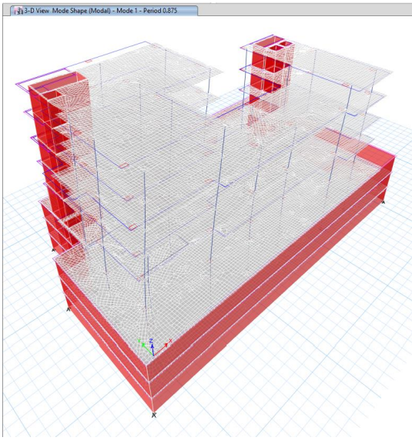
Seismic checks:
Period check:
1.4 * T (method A)= 1.43 > T period from etabs =0.875 Is ok

Slide 28
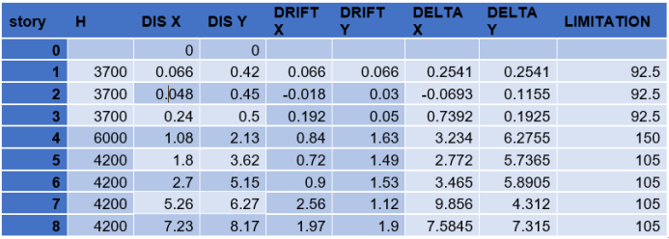
Draft check:

Slide 29
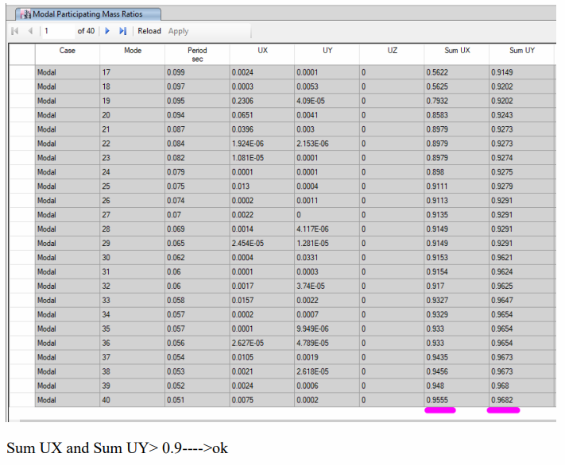
Model participant mass ratio check:

Slide 30
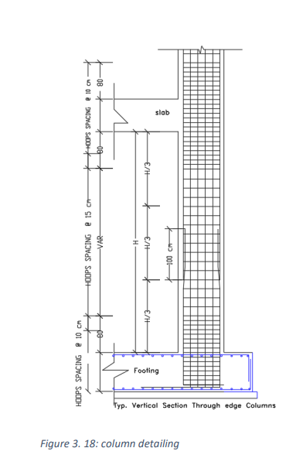
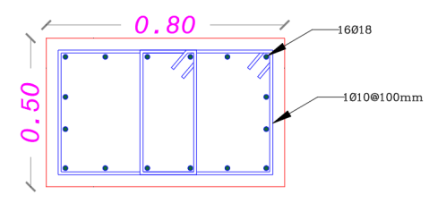
Column design detailing:

Slide 31
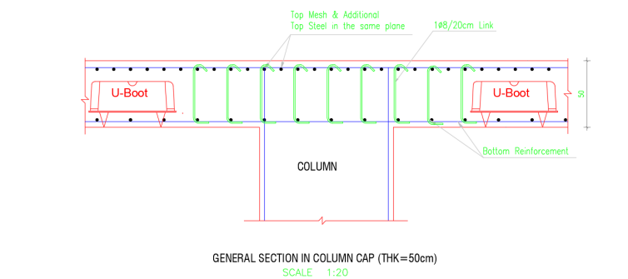
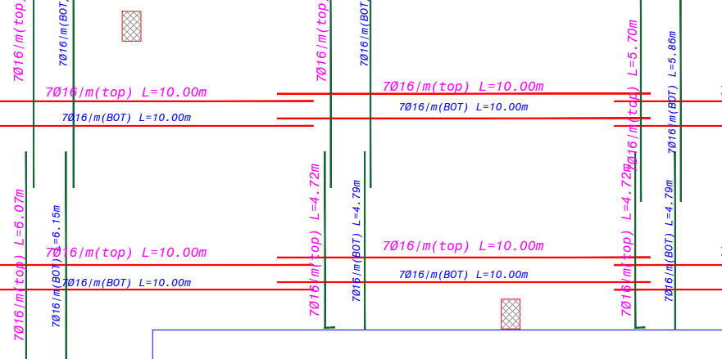
Slab design detailing:

Slide 32
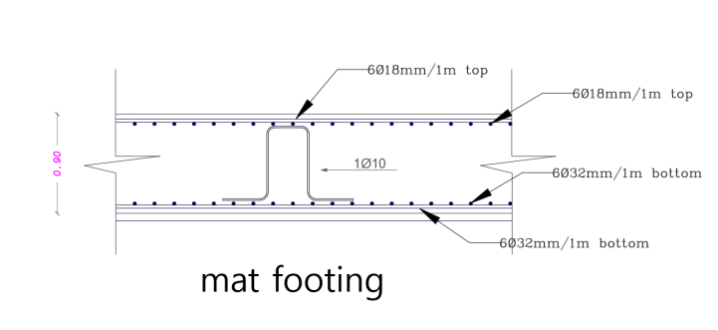
Footing detailing:

Slide 33
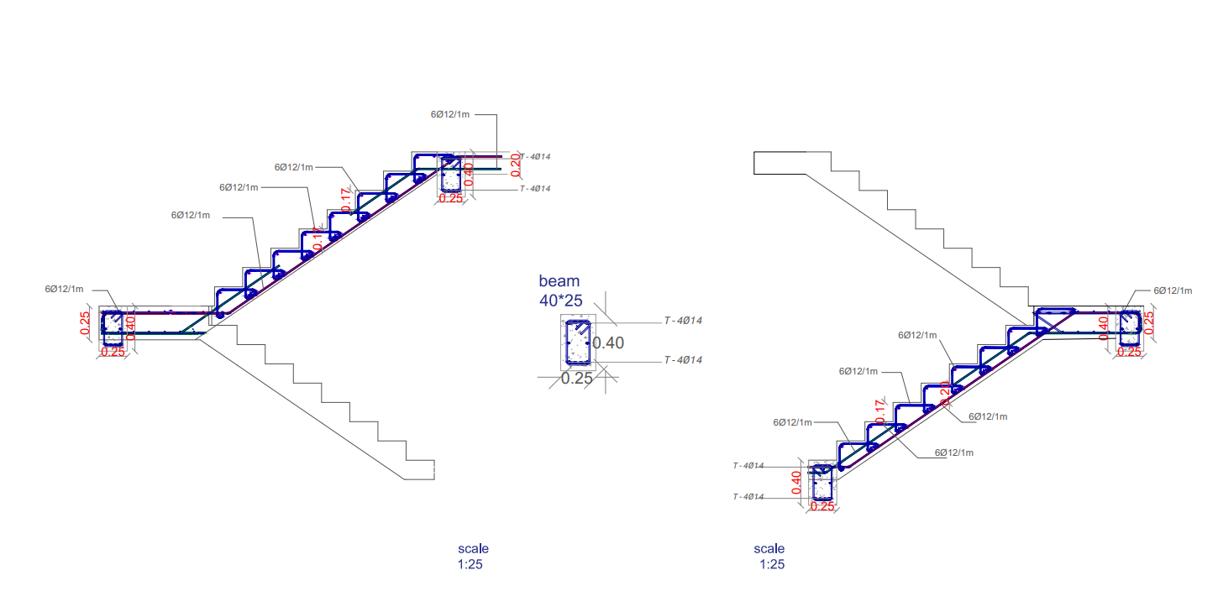
Stairs design and detail:

Slide 34
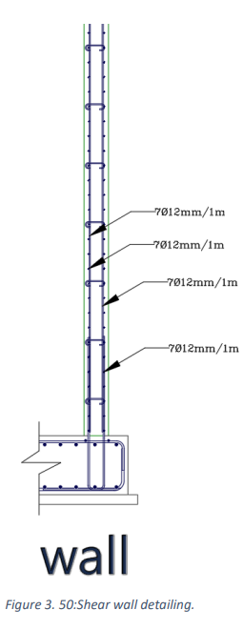
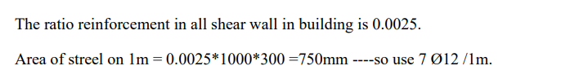
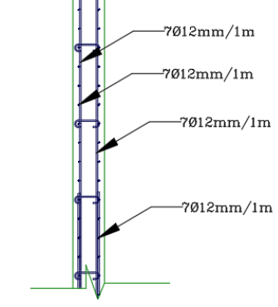
Design for shear wall:
Shear wall detailing:

Slide 35
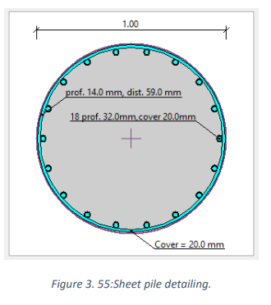
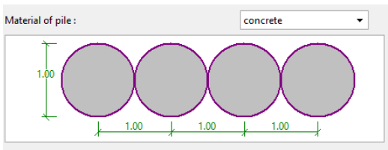
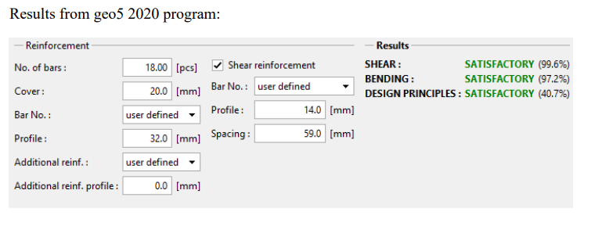
Sheet piles design:
Sheet pile geometry, Bending moment and shear force:

Slide 36
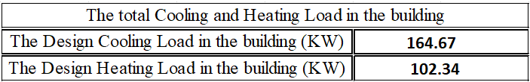


Mechanical aspects:
HVAC system design:
We used VRF system:

Slide 37



We used the fan coil system as we can see in the picture:

Slide 38


The diffusers & return:

Slide 39

Sample of the distribution of fan coil & diffusers in the celling lighting

Slide 40

Acoustic systems:

Slide 41


Acoustic consideration:
By using EASE software:
1-Meeting room:
RT₆₀ | NR (dB) | Noise level (dBA)
0.8 - 1.0 | 25-30 | 35

Slide 42

2- office room:
Reverberation time by EASE:
RT₆₀ | NR (dB) | Noise level (dBA)
0.8 - 1.0 | 20-25 | 30-40

Slide 43

3- Between offices (Internal partition):
Internal walls
By using INSUL software to find STC:
The recommendation STC is 35.
The STC for partition wall is 81 >>>> 35, its ok.

Slide 44

Internal glazing walls:
The STC for partition wall is 38 >>>> 35, its ok.

Slide 45


External walls:
The recommendation STC is 38.
The STC for partition wall is 39 > 38, its ok.

Slide 46


FLOOR:
Recommended IIC between (34-55) db.
IIC = 71 >>>>55 ITS ok.

Slide 47


Roof:
LPA =16 dB that’s ok in the rang (15-20).

Slide 48

POWER DESIGN:
Total power for the building = 241.62 KW
Total current for circuit breaker = 600 Amp.
Cable size = 3*300 mm^2
Main distribution board

Slide 49


Slide 50

Main distribution board for the ground floor:

Slide 51

Mechanical Design:
LIGHTING: \ G.F

Slide 52

Lighting F1:

Slide 53

F2:

Slide 54

F3:

Slide 55

Water supply:

Slide 56


Slide 57

Drainage system design:

Slide 58


Slide 59


Slide 60


Slide 61


Firefighting system design:
FIRE HOSE CABINET DISTRIBUTION:
ALARM SYSTEM:

Slide 62


DETECTORS DISTRIBUTION:
EXTINGUISHER:
Type A Extinguisher: Use in places exposed to Class A fires on common combustible materials, such as fabric, wood, paper, rubber, and many plastics. This type was used in the prayer room and corridors

Slide 63

Cost Estimation:
Bill of quantity (BOQ):

Slide 64
The unit cost of the project | The total cost of the project
1933 NIS / m2 | 19,328,665 NIS

Slide 65
THANK YOU
ANY QUESTIONS ?

