Slide 1


An-Najah National University
Facility of Engineering and Information Technology
Civil Engineering department
Structural Analysis and Design of Clock tower in Jenin
By: Mohammad Hijjawi, Nour Abu Hantash, Omar Yasin, Mohammad Bzoor

Slide 2

Content
1 – Introduction:
  Project description
  Codes used
  Material
  Seismicity of Site and Structure
  Loads and Load Combinations
2 – Preliminary design:
  Beam preliminary design
  Slab preliminary design
  Column preliminary design
  Walls preliminary design

Slide 3
Content
3 – Modeling and Analysis:
  Introduction
  Definition of materials and sections
  Definition of response spectrum
4 – Modeling and Analysis:
  Checks
  Compatibility check
  Equilibrium check
  Internal force check
  Irregularities check
  Drift check
  P-delta check

Slide 4
Content
5 – Design and Detailing:
    Programs and sheets used
  Beam design
  Column design
  Walls design
  Slab design
  Mat foundation design
  Folded shell design

Slide 5
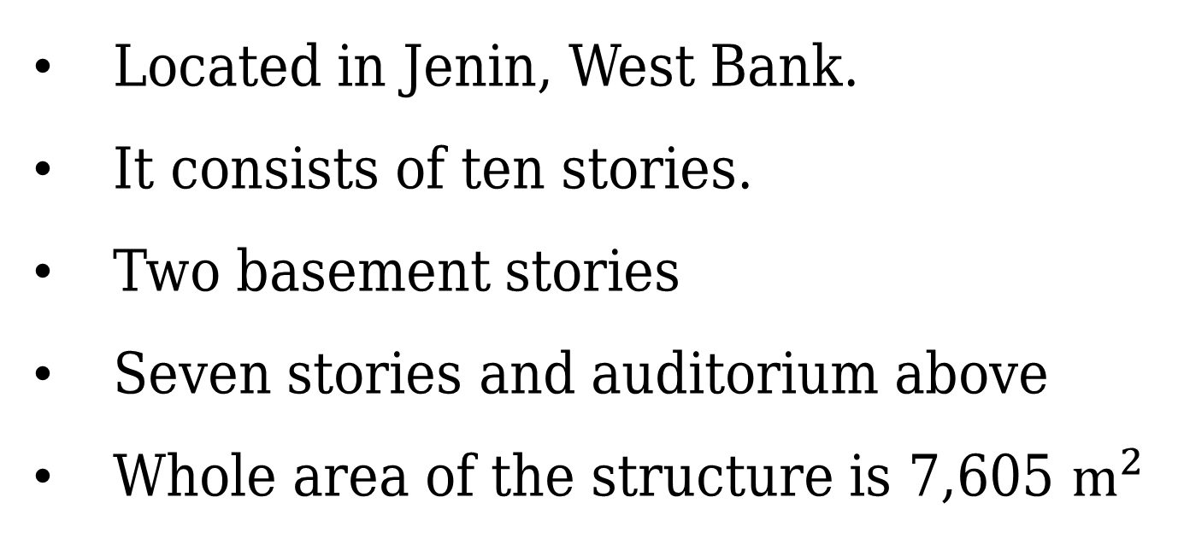
PART 1: INTRODUCTION
Located in Jenin, West Bank.
It consists of ten stories.
Two basement stories
Seven stories and auditorium above
Whole area of the structure is 7,605 $m^{2}$

Slide 6

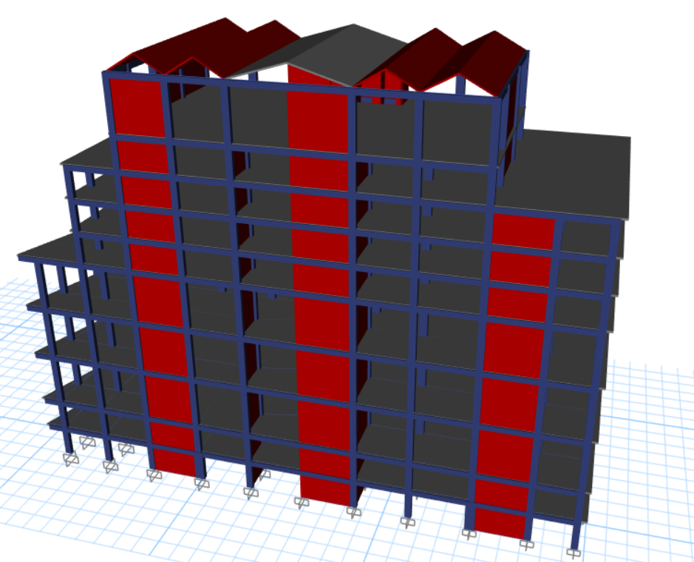
3D VIEW

Slide 7
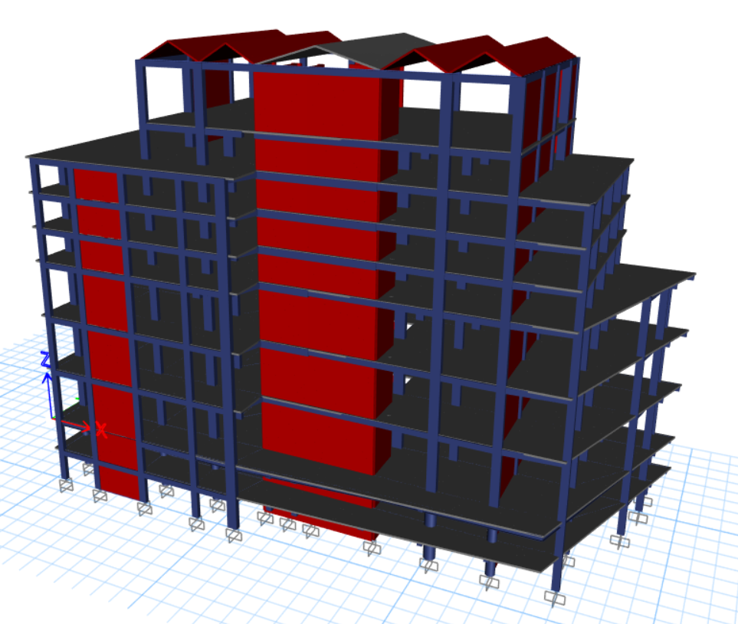
3D VIEW

Slide 8
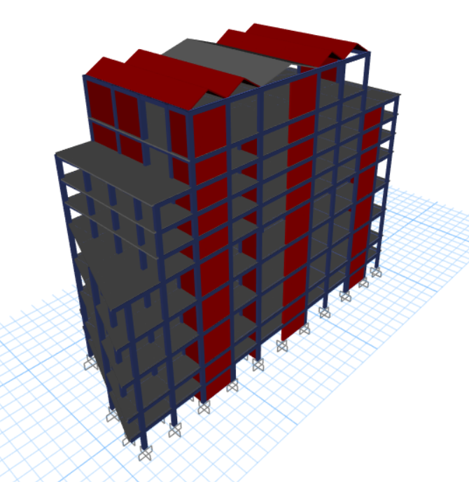
3D VIEW

Slide 9
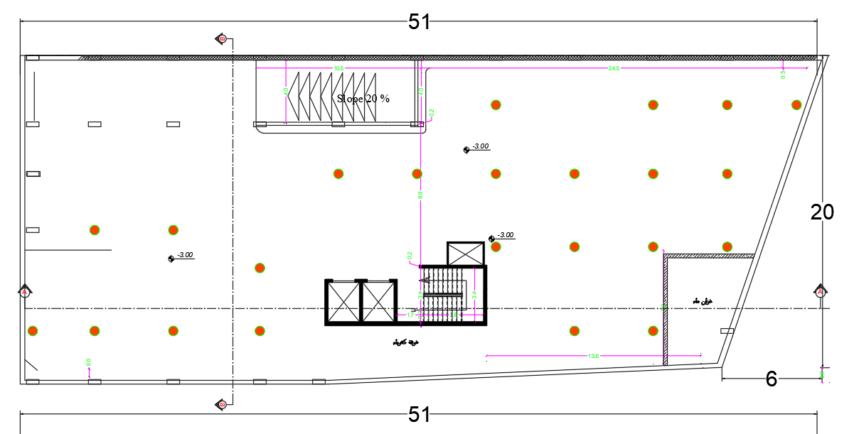
PLAN VIEW (Basement)

Slide 10
CODES AND STANDARDS
ACI 318-14
IBC 2015
ASCE 7-10

Slide 11
MATERIALS
28 MPa concrete
Property | Value
Compressive strength (Mpa) | 28
Modulus of Elasticity E (Mpa) | 24870
Unit Weight (Kn/m) | 25
Table 1: Concrete 28 properties

Slide 12
MATERIALS
35 Mpa concrete
Property | Value
Compressive strength (Mpa) | 35
Modulus of Elasticity E (Mpa) | 27800
Unit Weight (Kn/m) | 25
Table 2: Concrete 35 properties

Slide 13
MATERIALS
Steel Grade 60
Property | Value
Yielding Strength (Mpa) | 420
Modulus of Elasticity E (Gpa) | 200
Table 3: Steel grade 60 properties

Slide 14
MATERIALS
Non-structural materials
Material | Ɣ in kN/m³
Blocks | 12
Filling Materials | 18
Tiles | 26
Plaster | 23
Aggregate | 13
Concrete Mortar | 23
Masonry Stone | 26
Table 4: Non structural materials properties

Slide 15
SEISMICITY OF SITE AND STRUCTURE

Slide 16
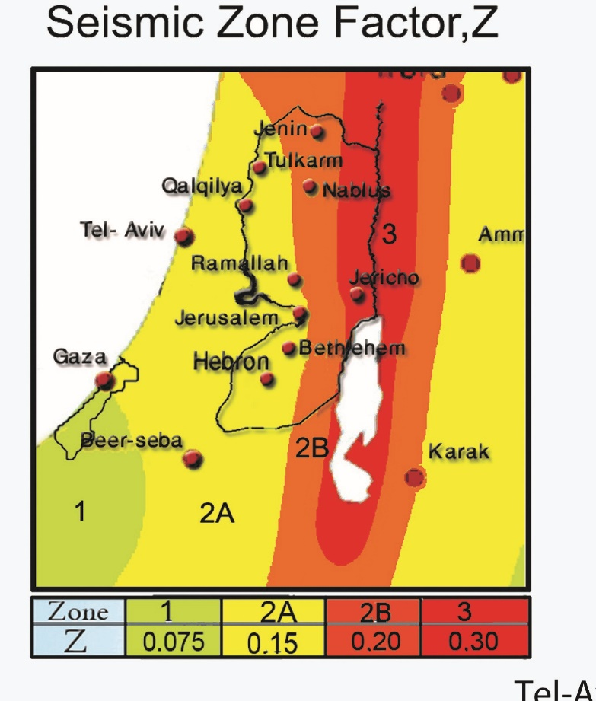
SEISMICITY OF SITE AND STRUCTURE
SS = 2.5Z
S1 = 1.25Z
Z for Jenin = 0.2
SS= 0.5, S1 = 0.25
SS(2%) = 0.75, S1(2%) = 0.375

Slide 17
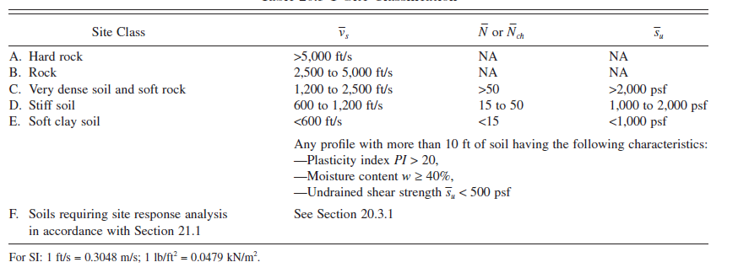
SEISMICITY OF SITE AND STRUCTURE
Site class ➔ Stiff Soil (D)

Slide 18
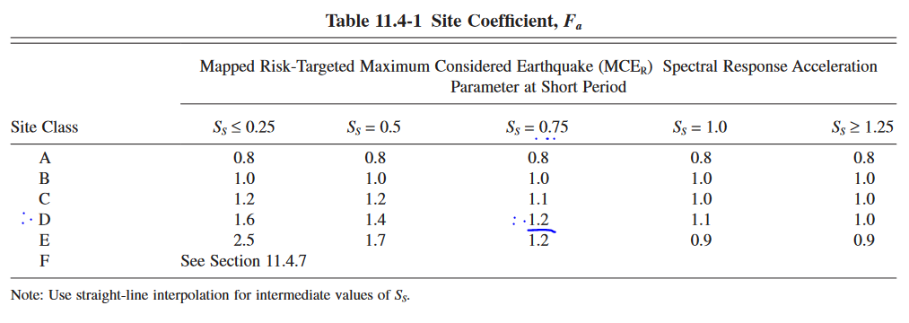
SEISMICITY OF SITE AND STRUCTURE
Site Coefficient Fa = 1.2

Slide 19
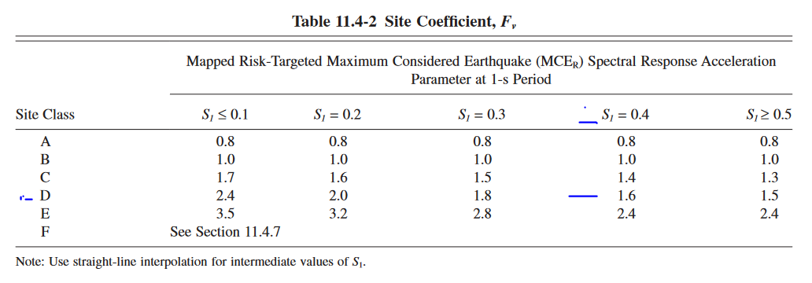
SEISMICITY OF SITE AND STRUCTURE
Site Coefficient Fv (by interpolation) = 1.65

Slide 20
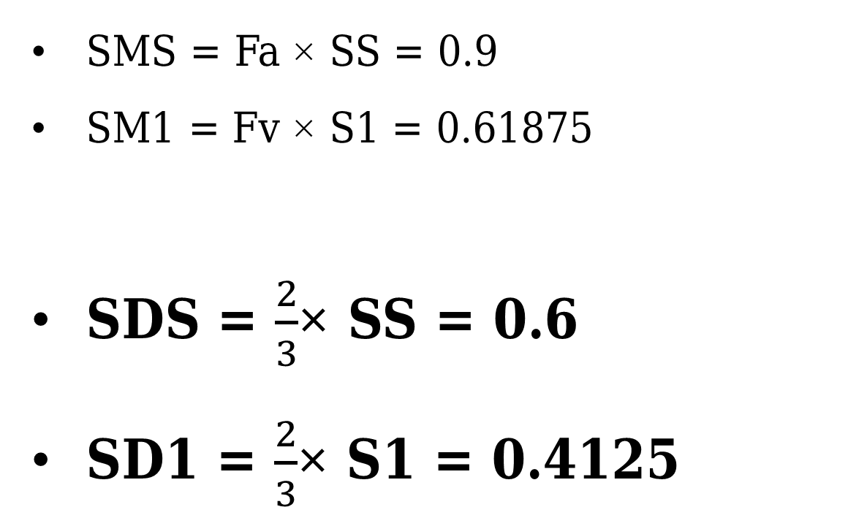
SEISMICITY OF SITE AND STRUCTURE
SMS = Fa × SS = 0.9
SM1 = Fv × S1 = 0.61875
SDS = $\frac{2}{3}$× SS = 0.6
SD1 = $\frac{2}{3}$× S1 = 0.4125

Slide 21
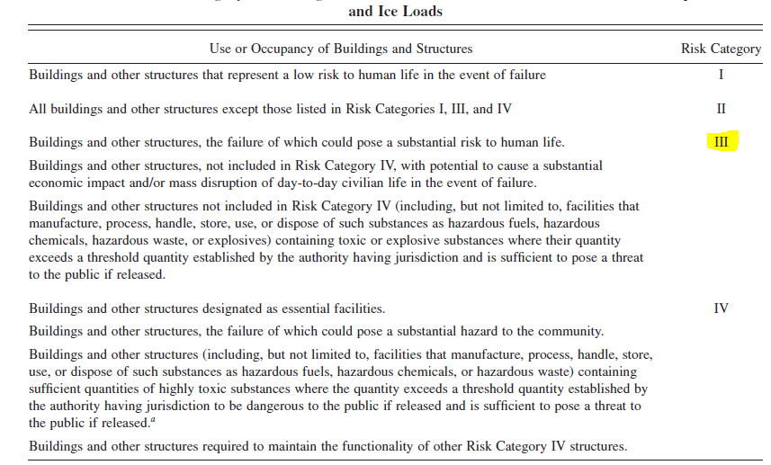
SEISMICITY OF SITE AND STRUCTURE
Determination of risk category
Risk Category = III

Slide 22
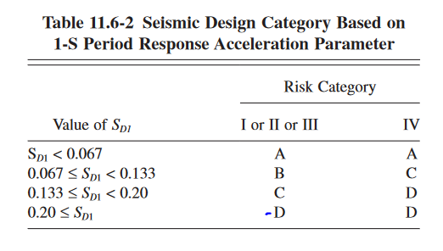
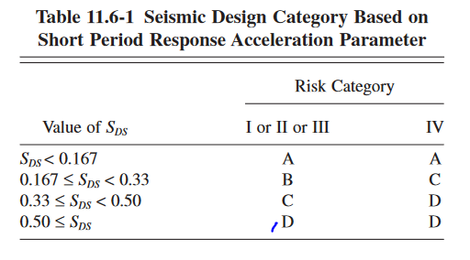
SEISMICITY OF SITE AND STRUCTURE
Determination of seismic design category
Seismic design category =D

Slide 23
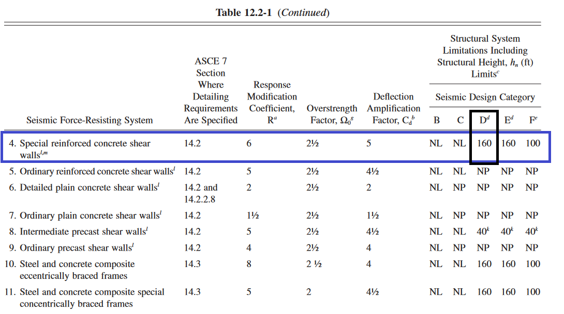
Structural system used
Structural system ➔Special reinforced concrete shear walls

Slide 24
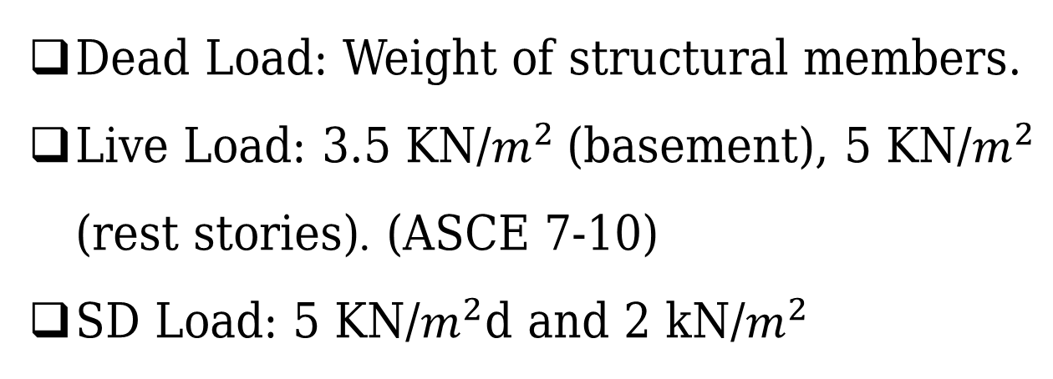
Loads and Load Combinations
Gravity Loads
  Dead Load: Weight of structural members.
  Live Load: 3.5 KN/$m^{2}$(basement), 5 KN/$m^{2}$ (rest stories). (ASCE 7-10)
  SD Load: 5 KN/$m^{2}$d and 2 kN/$m^{2}$

Slide 25
Loads and Load Combinations
Lateral Load
The method used in determination the effect of earthquake load is modal response method.
Verified by ELF

Slide 26





Loads and Load Combinations
Ultimate Load Combinations:
1.4 D
1.2D +1.6L
1.32D +L +1.3EQx +0.39EQy
1.32D +L +1.3EQy +0.39EQx
0.78D +1.3EQx +0.39EQy
0.78D +1.3EQy +0.39EQx
$$E=Eh+Ev$$
$$Eh=ρQE$$
$$QEy=Ey+0.3Ex$$
$$QEx=Ex+0.3Ey$$
$$Ev=0.2× SDs × D$$
$$ρ=1.3 For design category D$$

Slide 27





Loads and Load Combinations
Service Load Combinations:
D+L
1.084 D+0.91EQx+0.273EQy
1.084 D+0.91EQy+0.273EQx
1.063D +0.75L +0.683EQx +0.205EQy
1.063D +0.75L +0.683EQy +0.205EQx
0.516D+0.91EQx+0.273EQy
0.516D+0.91EQy+0.273EQx
$$E=Eh+Ev$$
$$Eh=ρQE$$
$$QEy=Ey+0.3Ex$$
$$QEx=Ex+0.3Ey$$
$$Ev=0.2× SDs × D$$
$$ρ=1.3 For design category D$$

Slide 28

End of Part 1
➔ Part 2: Preliminary design

Slide 29
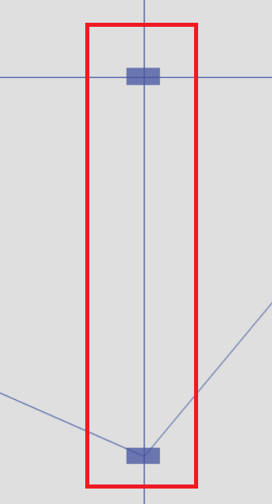
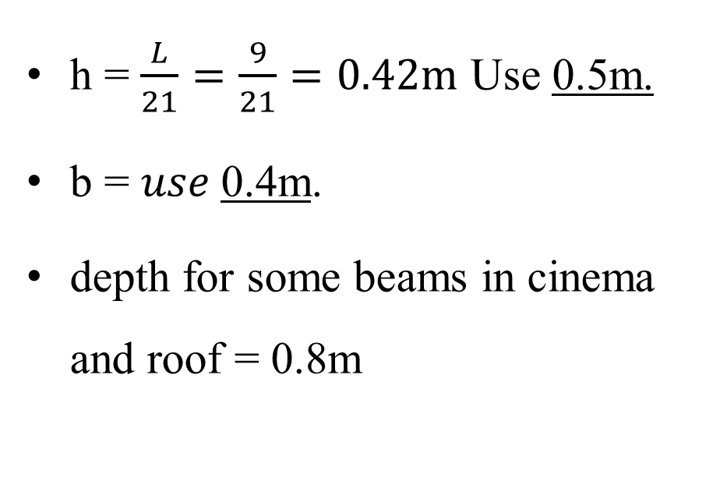
Part 2: Preliminary design
Beam preliminary design
h = $\frac{L}{21}=\frac{9}{21}=0.42m$ Use 0.5m.
b = $use$0.4m.
depth for some beams in cinema and roof = 0.8m

Slide 30
Part 2: Preliminary design
Columns preliminary design
Circular columns with diameter of 1000 mm.
Rectangular columns of 800X400, 700x400.

Slide 31
Part 2: Preliminary design
Walls preliminary design
350 mm
250 mm
Based on architectural drawings

Slide 32
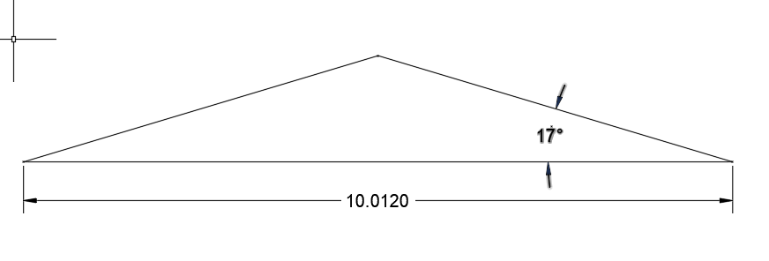
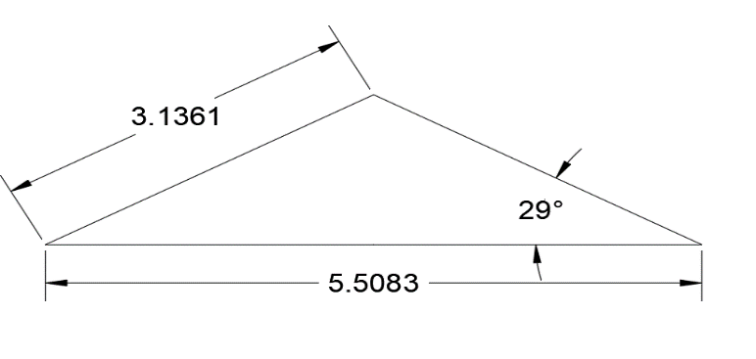
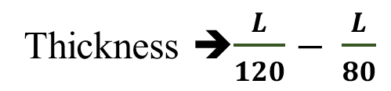
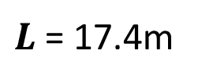
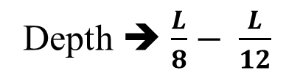
Part 2: Preliminary design
Folded shell preliminary design
Thickness $\frac{L}{120}− \frac{L}{80}$
Depth  $\frac{L}{8}− \frac{L}{12}$
$L$ = 17.4m
H = 15cm
Depth = 1.5m

Slide 33
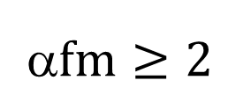
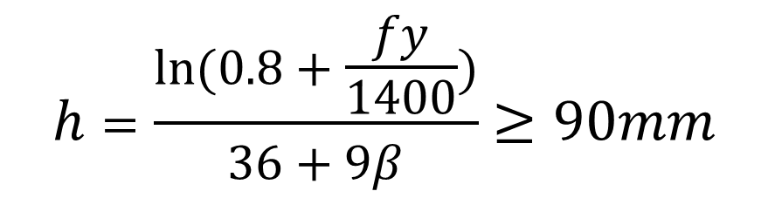
Part 2: Preliminary design
Slab preliminary design
Two way solid slab
$fm≥2$
$$h=\frac{ln⁡(0.8+\frac{fy}{1400})}{36+9β}≥90mm$$

Slide 34
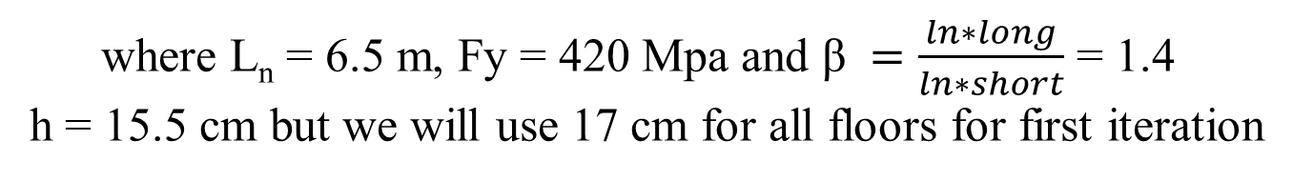
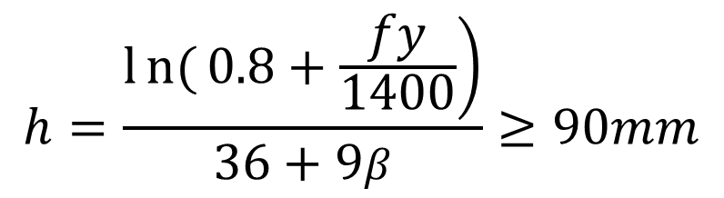
Part 2: Preliminary design
Slab preliminary design
$$h=\frac{\left.ln{(}0.8+\frac{fy}{1400}\right)}{36+9β}≥90mm$$
where L_{n} = 6.5 m, Fy = 420 Mpa and β $=\frac{ln∗long}{ln∗short}$ = 1.4
h = 15.5 cm but we will use 17 cm for all floors for first iteration

Slide 35
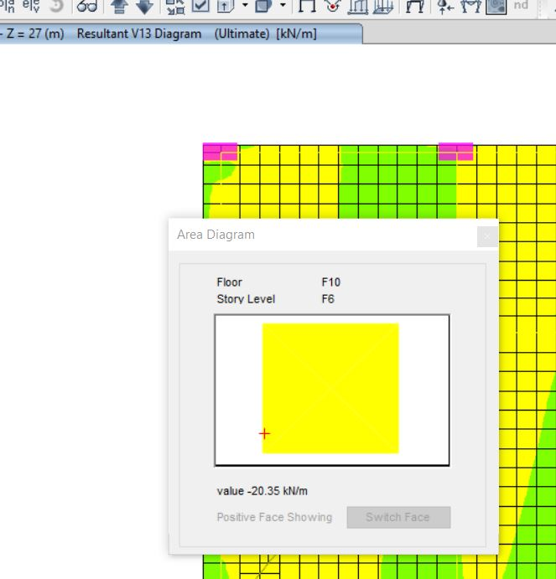
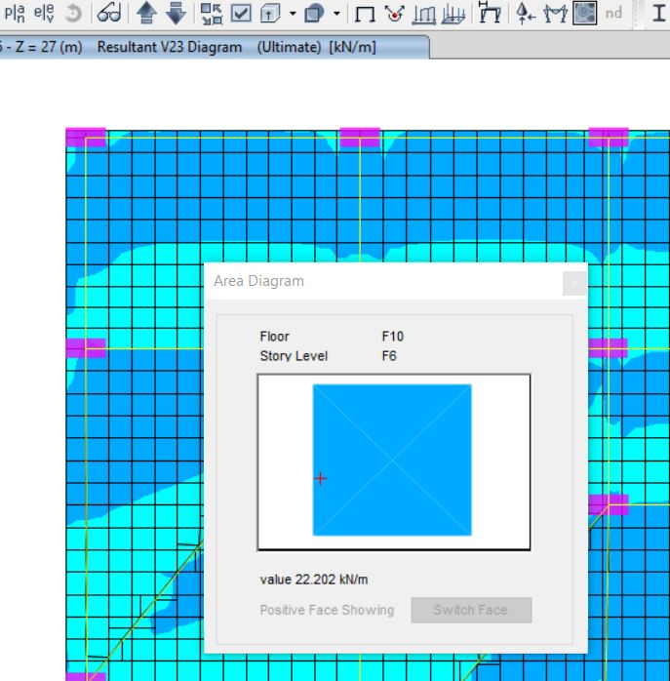
Part 2: Preliminary design
Check shear
$∅Vc=\frac{1}{6}∗0.75bd\sqrt{Fc}$ , where Fc=24 MPa, b=1000 mm, and d = 170 – 30(cover) = 140 mm.
∅Vc = 92 kN

Slide 36
Part 2: Final dimension
Walls:
  Wall 300mm
  Wall 400 mm
  Wall 250 mm

Slide 37
Part 2: Final dimension
Beams:
  Beam 400X500
  Beam 500X600

Slide 38
Part 2: Final dimension
Columns:
    Column 700X400
    Column 800X400
    Column 900X500
    Column D = 1000 mm
    Column D = 800mm

Slide 39
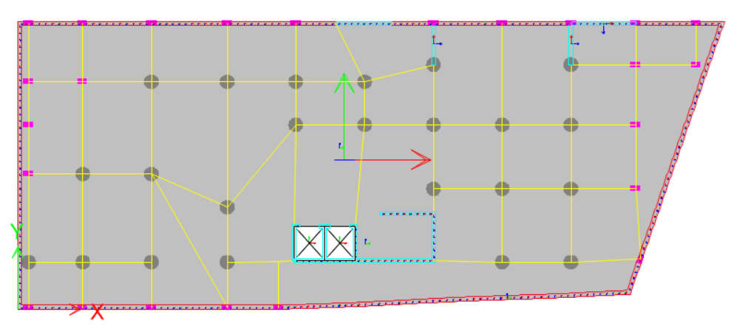
PLAN VIEW (Basement - Columns)

Slide 40
End of Part 2
➔ Part 3: Modeling

Slide 41
Part 3: Modeling
Modeling and analysis are performed by using ETABS 18 program.
All supports are modeled as Fixed support.
Ultimate strength method (LRFD) is used.
Exterior partition as linear load and interior partition as distributed load.

Slide 42
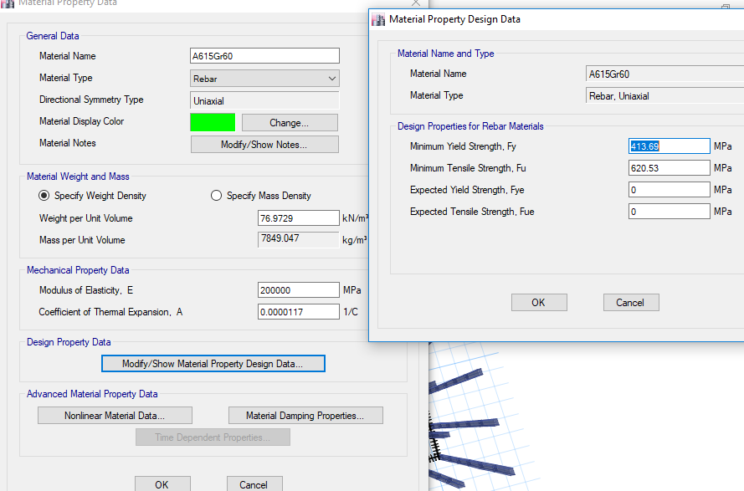
Steel material

Slide 43
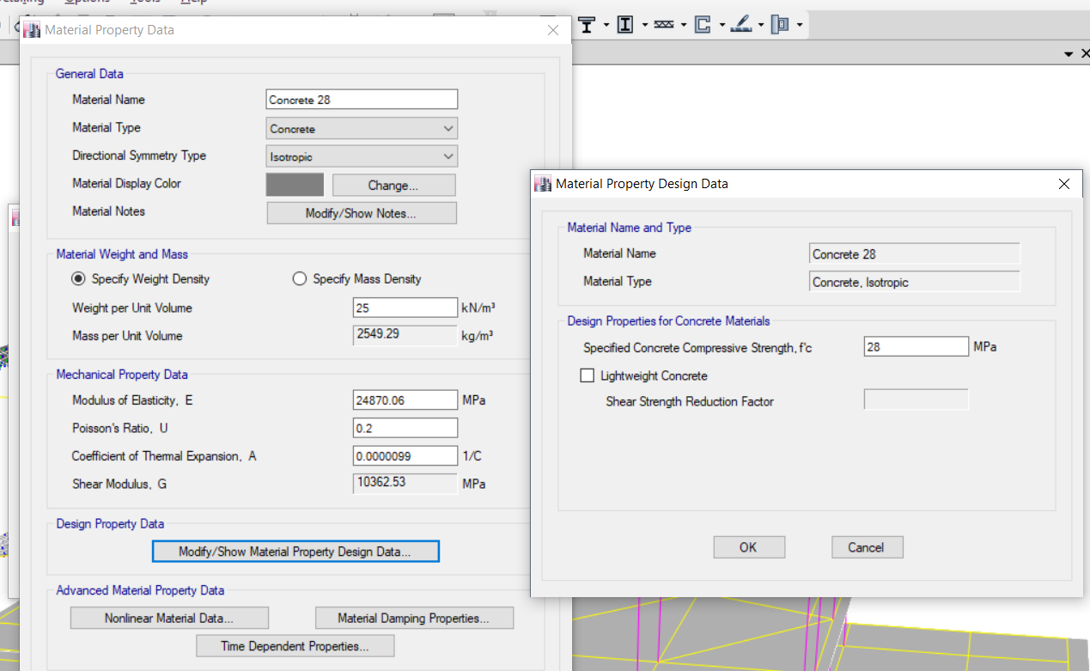
Concrete material

Slide 44
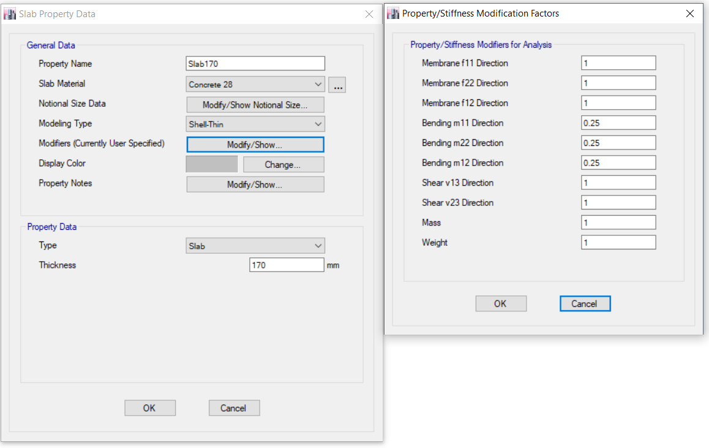
Slab section

Slide 45
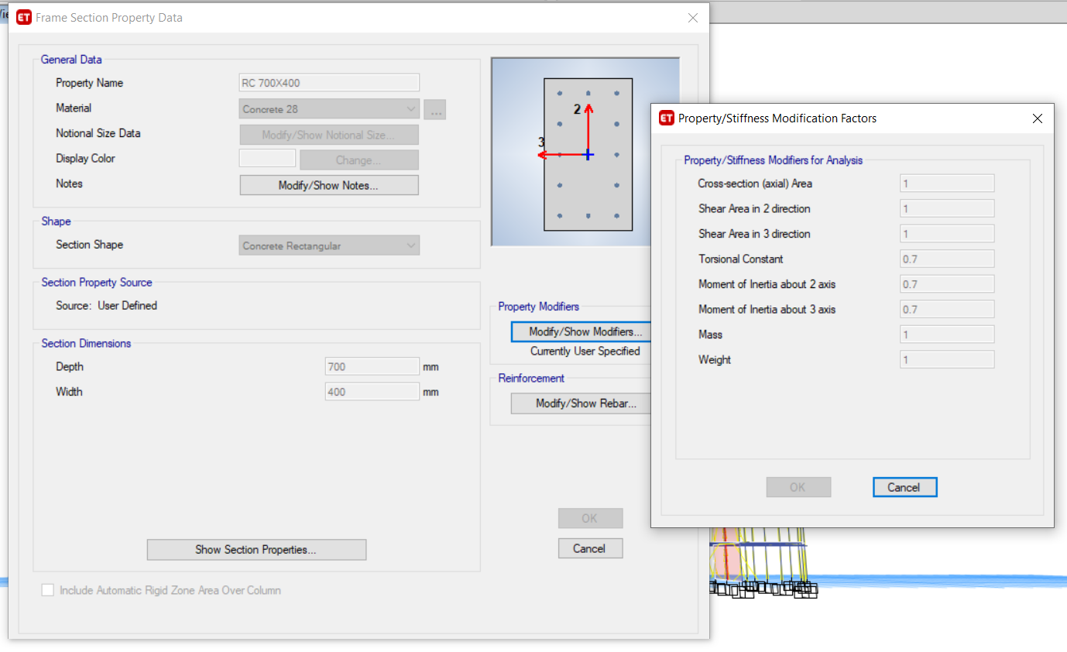
Column section

Slide 46
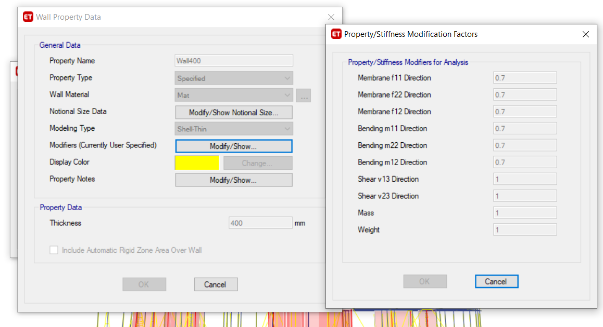
Wall section

Slide 47
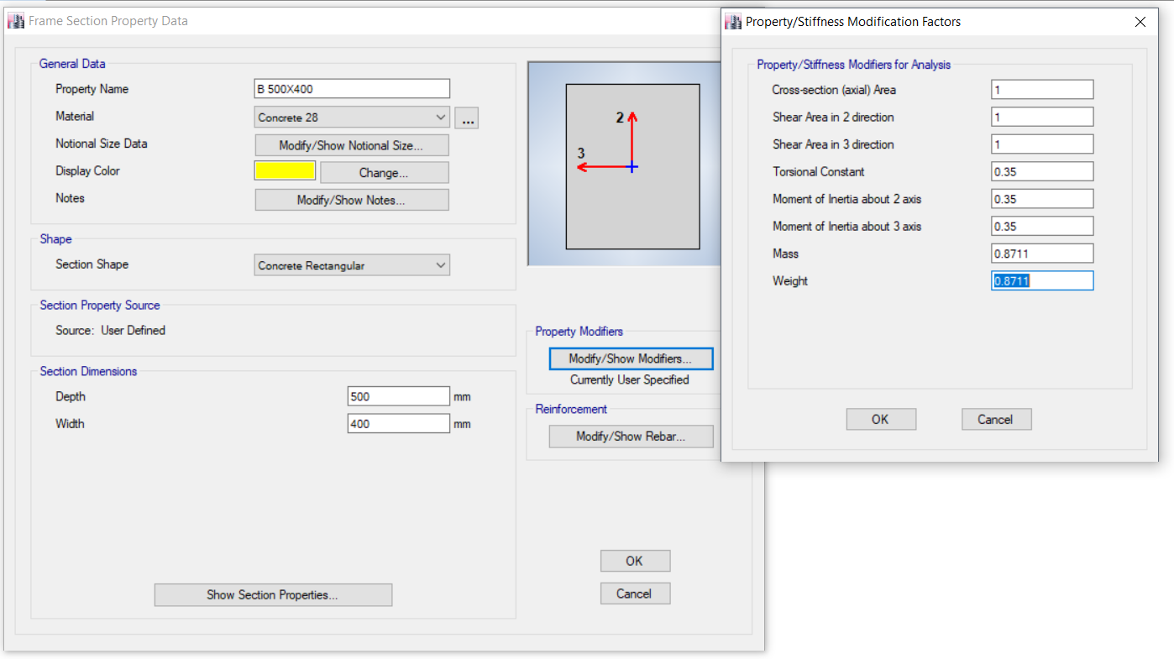
Beam (500x400) Section

Slide 48
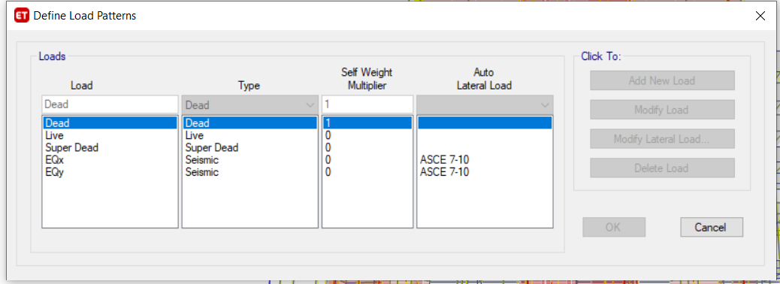
Load patterns

Slide 49
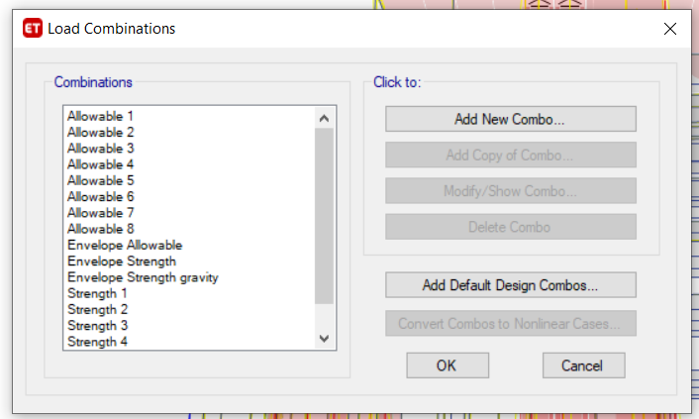
Load combinations

Slide 50
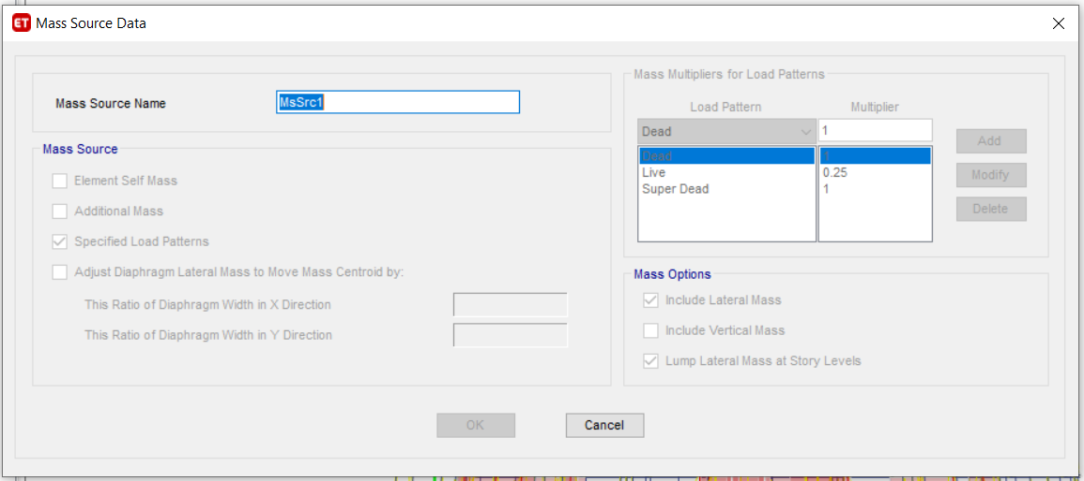
Mass Source definition

Slide 51
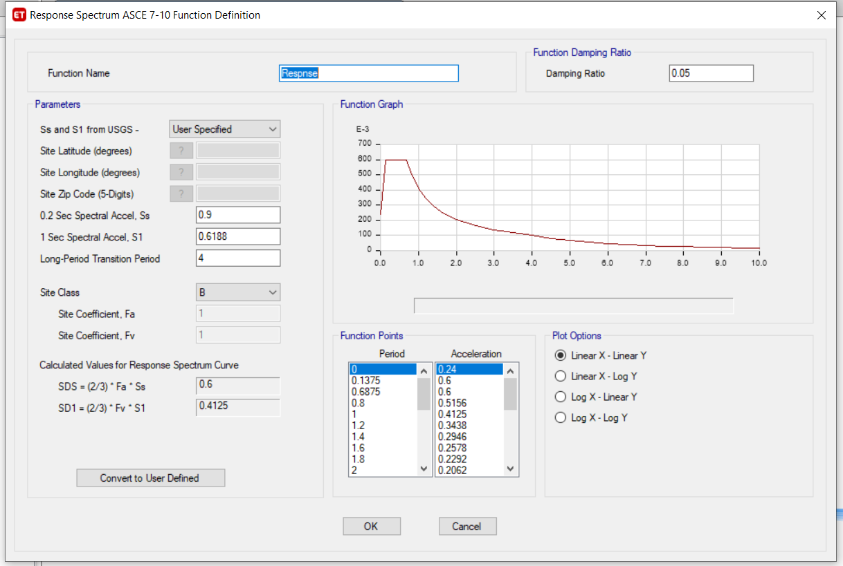
Response spectrum definition

Slide 52
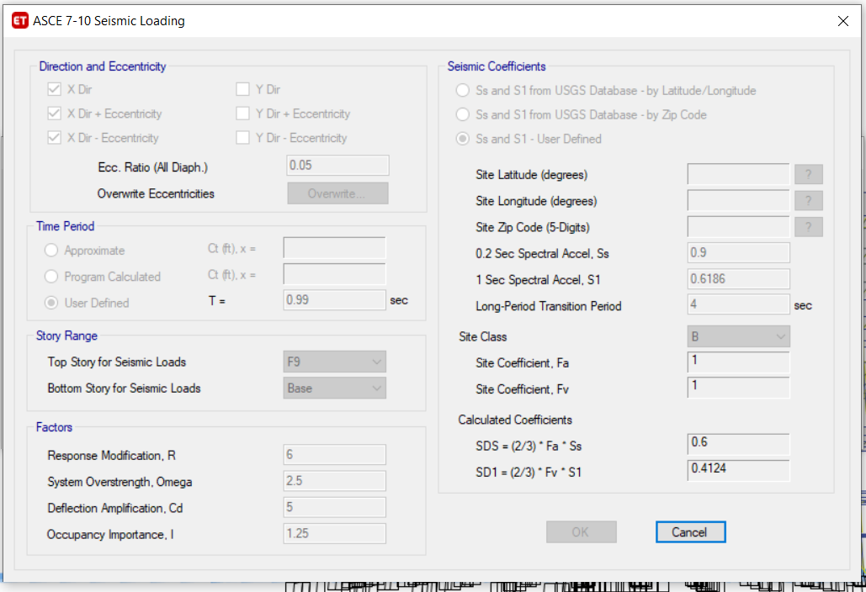
ELF – EQX Defintion

Slide 53
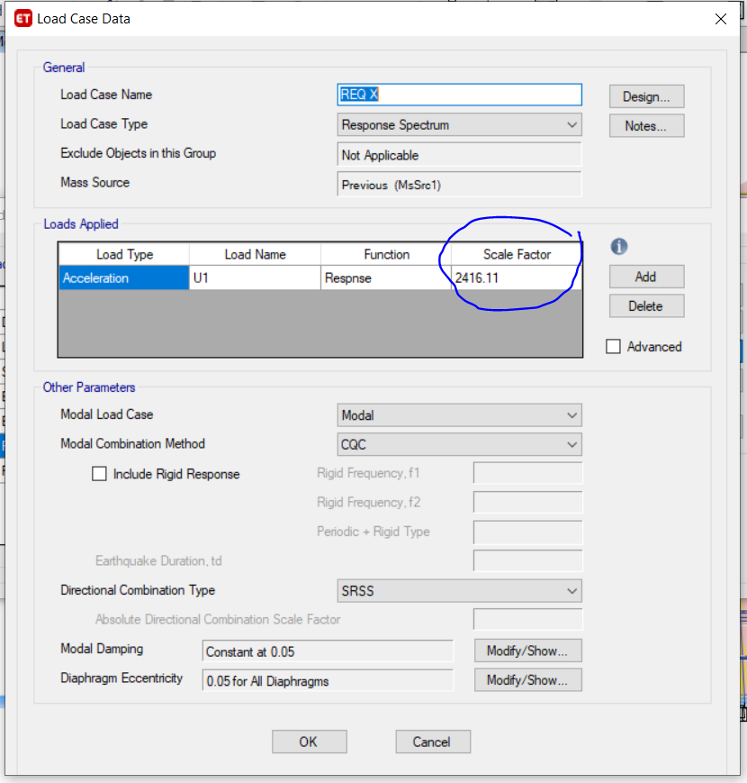
Modal EQX Defintion (Load Case)

Slide 54
End of Part 3
➔ Part 4: Checks

Slide 55
Part 4: Checks
Compatibility check
Equilibrium check
Stress-Strain (Internal force) check
Base shear check
Modal mass participation ratio check
Irregularities check
Drift check
P-delta check

Slide 56
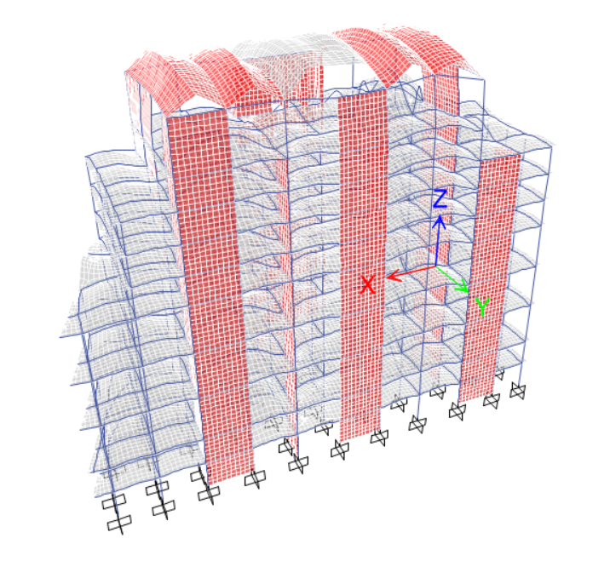
Compatibility check

Slide 57
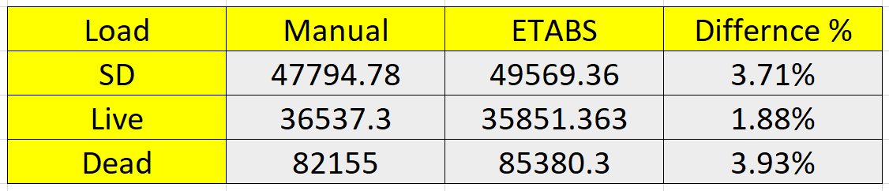
Equilibrium check

Slide 58
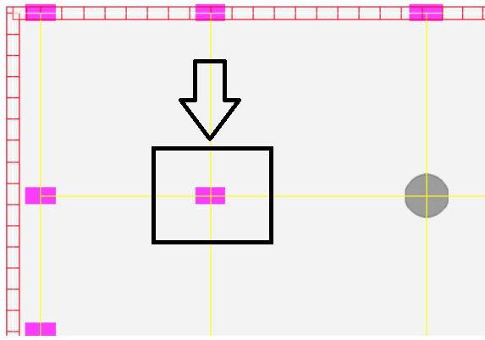
Stress – Strain Check
Column C1, 400X700 mm at Basement 2

Slide 59
- A_{tributary} = 4.465 × 5.5 = 24.6m²
- Weight of column = 0.4 × 0.7 × 25 × 30 = 210 kN.
- Weight of slab = 0.17 × 25 × 24.6 × 8 = 836.4kN.
- Weight of live loads = 8 × 24.6 × 5 = 984 kN.
- Weight of superimposed loads = 8*24.6*5 = 984kN
- Weight of beams = 0.5 × 0.4 × (4.465+5.5) × 25 × 8 = 298.95kN.
→ Axial load = 1.2 (210+836.4+984+298.95) + 1.6 (984)
= 4369.62kN.

Slide 60
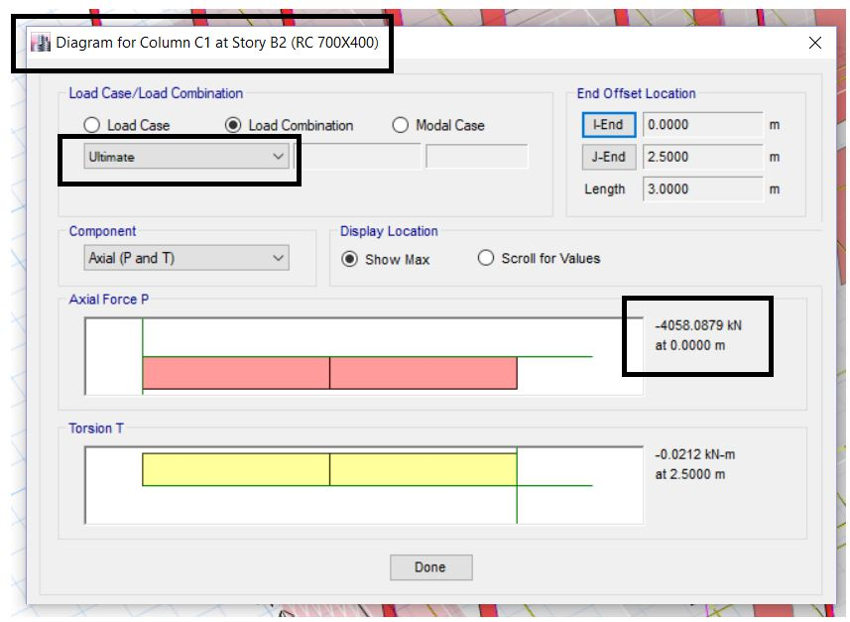
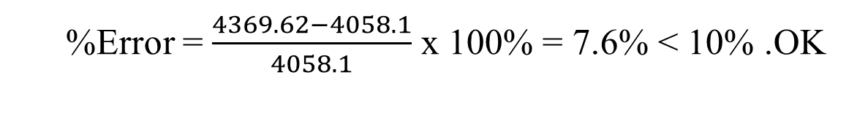
%Error = $\frac{4369.62−4058.1}{4058.1}$ x 100% = 7.6% < 10% .OK
ETABS result, C1, 400x700 (B2)

Slide 61
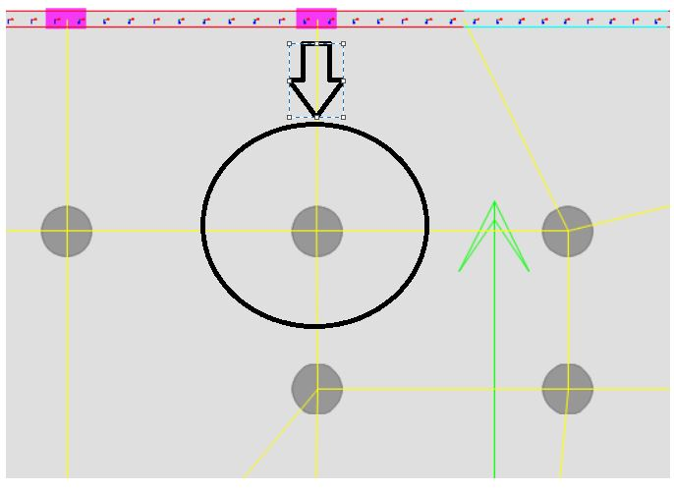
Column C9 at Basement 2

Slide 62
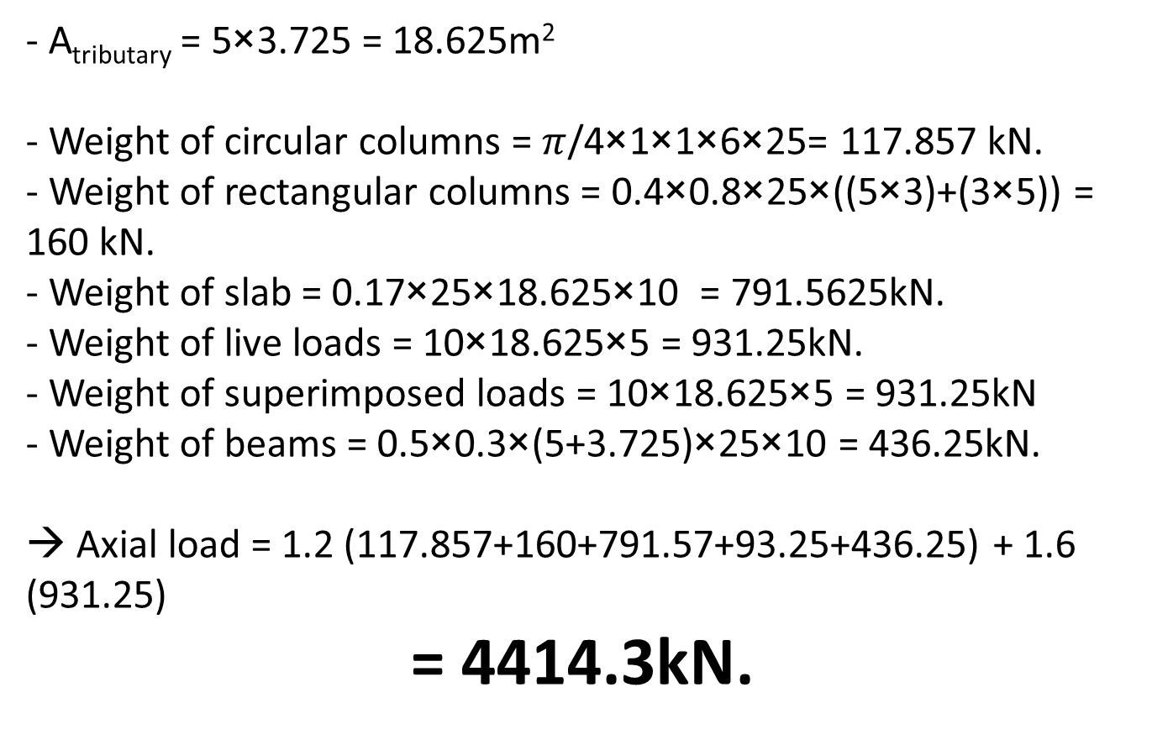
- A_{tributary} = 5×3.725 = 18.625m²
- Weight of circular columns = $π$/4×1×1×6×25= 117.857 kN.
- Weight of rectangular columns = 0.4×0.8×25×((5×3)+(3×5)) = 160 kN.
- Weight of slab = 0.17×25×18.625×10 = 791.5625kN.
- Weight of live loads = 10×18.625×5 = 931.25kN.
- Weight of superimposed loads = 10×18.625×5 = 931.25kN
- Weight of beams = 0.5×0.3×(5+3.725)×25×10 = 436.25kN.
→ Axial load = 1.2 (117.857+160+791.57+93.25+436.25) + 1.6 (931.25)
= 4414.3kN.

Slide 63
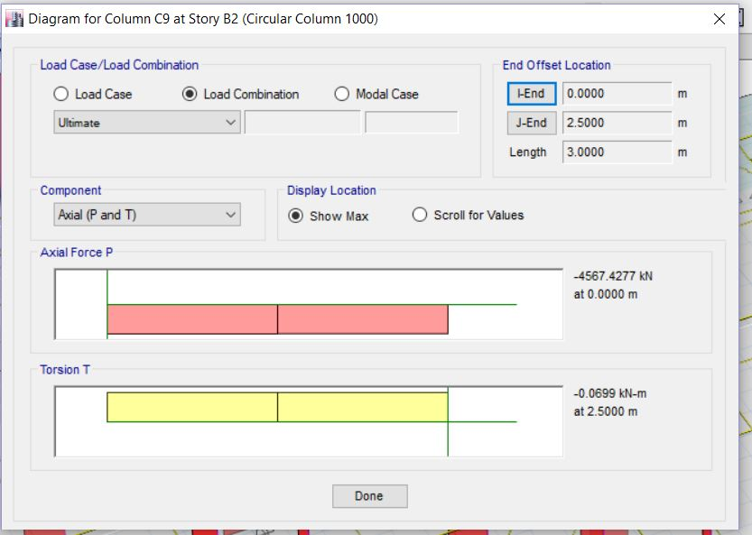
%Error = $\frac{4414.304−4567.4277}{4567.4277}$ x 100% = 3.35% < 10% .OK
ETABS result, Column C9 at Basement 2

Slide 64
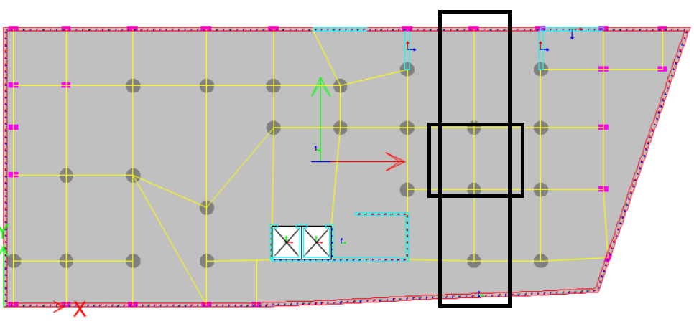
Stress-strain check (Beam)

Slide 65

Stress-strain check (Beam) – Section 1

Slide 66

Stress-strain check (Beam) – Section 2

Slide 67

Stress-strain check (Beam) – Section 3

Slide 68



Moment based on section cuts:
$\frac{19.35+20.77}{2}$ + 24.87= 44.93 KN.m
Moment by hand calculation:
Beam length = 4.6m
Frame width = 5m
Live load = 5m
$\frac{5×5×3.6×3.6}{8}$ = 40.5 KN.m
Error = $\frac{44.93−40.5}{44.93}$ = 1%

Slide 69

Base shear check
Manually ➔ V= CsW = 0.09 × 141218.3 = 12409.7 kN.
ETABS ➔

Slide 70

Base shear check

Slide 71

Base shear check
Result from ETABS, Modal resposne

Slide 72

Modal Mass Participation Ratio

Slide 73

Modal Mass Particpation Ratio

Slide 74
Drift Check
All supports are assumed to be pinned
Service (Allowable) load combinations are used

Slide 75

Drift Check

Slide 76

Drift Check
Floor |  |  | Elastic drift / Story height | Inelastic drift / Story height | Max drift / story height
F7 | Max | X | 0.001977 | 0.007908 | 0.015
F7 | Max | Y | 0.001903 | 0.007612 | 0.015
F6 | Max | X | 0.001371 | 0.005484 | 0.015
F6 | Max | Y | 0.001685 | 0.00674 | 0.015
F5 | Max | X | 0.001335 | 0.00534 | 0.015
F5 | Max | Y | 0.001902 | 0.007608 | 0.015
F4 | Max | X | 0.001363 | 0.005452 | 0.015
F4 | Max | Y | 0.001942 | 0.007768 | 0.015
F3 | Max | X | 0.00135 | 0.0054 | 0.015
F3 | Max | Y | 0.00191 | 0.00764 | 0.015
F2 | Max | X | 0.001315 | 0.00526 | 0.015
F2 | Max | Y | 0.001838 | 0.007352 | 0.015
F1 | Max | X | 0.001142 | 0.004568 | 0.015
F1 | Max | Y | 0.001564 | 0.006256 | 0.015
GF | Max | X | 0.000832 | 0.003328 | 0.015
GF | Max | Y | 0.001117 | 0.004468 | 0.015
B1 | Max | X | 0.00047 | 0.00188 | 0.015
B1 | Max | Y | 0.000551 | 0.002204 | 0.015
B2 | Max | X | 0.000231 | 0.000924 | 0.015
B2 | Max | Y | 0.000253 | 0.001012 | 0.015

Slide 77
Story | Max drift (mm) | Average (mm) | ratio
B2 | 0.65 | 0.641 | 1.014041
B1 | 2.03 | 2.02 | 1.00495
GF | 6.19 | 6.125 | 1.010612
F1 | 11.665 | 11.712 | 0.995987
F2 | 18.196 | 18.1185 | 1.004277
F3 | 22.345 | 22.2155 | 1.005829
F4 | 22.441 | 24.257 | 0.925135
F5 | 29.77 | 29.97 | 0.993327
F6 | 33.876 | 33.9035 | 0.999189
Torsional Irregularity check (X-direction)

Slide 78
Story | Max drift (mm) | Average (mm) | ratio
B2 | 0.765 | 0.6915 | 1.106291
B1 | 2.469 | 2.206 | 1.11922
GF | 7.574 | 6.762 | 1.120083
F1 | 14.51 | 12.905 | 1.12437
F2 | 24.558 | 21.7 | 1.131705
F3 | 30.1 | 26.4 | 1.140152
F4 | 35.6 | 31 | 1.148387
F5 | 41.4 | 35.9 | 1.153203
F6 | 42.5 | 35.7 | 1.167147
Torsional Irregularity check (Y-direction)

Slide 79

Vertical geometry irregularity

Slide 80

Vertical geometry irregularity

Slide 81

Permitted analytical procedures

Slide 82

P-Delta check
Floor | P | Vx | Vy | Height | THETA X | Theta Y
B2 | 170964.6 | 12407 | 12403 | 3 | 0.005002 | 0.005004
B1 | 155982.9 | 12287 | 12283 | 6 | 0.007731 | 0.007734
GF | 138458.5 | 11959 | 11948 | 11 | 0.010744 | 0.010754
F1 | 117300.6 | 11200 | 11195 | 16 | 0.012484 | 0.01249
F2 | 96142.6 | 10054 | 10001 | 21 | 0.012766 | 0.012834
F3 | 74984.64 | 8478 | 8436 | 24 | 0.012064 | 0.012124
F4 | 56136.24 | 6827 | 6793 | 27 | 0.011347 | 0.011404
F5 | 37442.91 | 4882 | 4855 | 30 | 0.010362 | 0.010419
F6 | 18751.4 | 2717 | 2703 | 33 | 0.009814 | 0.009865
Cinema | 6893.258 | 1118 | 1101 | 38 | 0.011616 | 0.011796

Slide 83
End of Part 4
➔ Part 5: Design

Slide 84
Design and Detailing
Special Reinforced Concrete Shear Walls

Slide 85

Section Cut 1

Slide 86

Section Cut 2

Slide 87
Design and Detailing
Walls are designed to resist 100% of seismic force
Frames are designed only for gravity loads
Frames are designed as sway special
Model with 0.7 modifier
Model with 0.001 modifier
Mat Model

Slide 88
Design and Detailing
All members are designed using ETABS 18 software.
Verified Manually
CSI detailing 18

Slide 89

Design check - Beam

Slide 90

Design check - Beam

Slide 91

Design check - Beam

Slide 92

Design check - Beam

Slide 93
Design check - Beam
Excel show

Slide 94

Stirrups design - Beam
$s_{1}=Min\left\{\begin{aligned}\text{150 }\text{mm} \\ 6d_{b}=120 \\ d/{4=\frac{420}{4}=105}\end{aligned}\right\}$
s₂ = d/2 = 420/2 = 210

Slide 95

Design check - Column

Slide 96

Design check - Column

Slide 97

Design check - Column

Slide 98

Design check - Column

Slide 99

Design check - Column

Slide 100

Design check - Column

Slide 101

Design check - Column
$s_{0}=Min\left\{\begin{aligned}\text{least} \text{column} \text{dimension}\text{/}\text{4} \\ 6d_{b} \\ 100+{(350−h_{x})}/3 \\ \text{150 }\text{mm}\end{aligned}\right\}≥100 \text{mm}$
$$s_{1}=Min\left\{\begin{aligned}\text{least} \text{column} \text{dimension} \\ 6d_{b} \\ 48d_{s} \\ \text{150 }\text{mm}\end{aligned}\right\}$$

Slide 102

Design check - Wall

Slide 103

Design check - Wall

Slide 104


Design check - Wall
Check shear in X direction
V_{ux} = 41.64 Kn
φV_{c}=
$0.75×\frac{1}{6}×\sqrt{28}×\left(400−40\right)×3000×{10}^{−3}=714.3$ kN > V_{ux} OK
V_{uy} = 368kN
V_{c}
=$\frac{1}{6}×\sqrt{28}×400×\left(0.8×3000\right)×{10}^{−3}=$846 kN
use ρ=0.0025 ➔ As shear = 0.0025×3000× 400 = 3000 mm2 ➔ 1000mm2/m
Thickness = 400mm
Length = 3m.

Slide 105

Design check - Wall
Check shear in X direction
Mx = 2446
Pz = 5479
Thickness = 400mm
Length = 3m.
0.0025 × 3000 × 400 = 3000 mm2 (Total)

Slide 106


Design check - Wall

Slide 107

Slab, Mat design
How?

Slide 108

Slab, Mat design

Slide 109

Slab, Mat design

Slide 110
Folded shell design
How?
0.45 × 28 = 12.6 (Allowable compressive stress)

Slide 111

S11 - TOP

Slide 112

S22 - TOP

Slide 113

S11 - BOTTOM

Slide 114

S22 - BOTTOM

Slide 115

Tension check

Slide 116

Folded shell design
Maximum tensile load = 853 kN
As = $\frac{Tension force}{Allowable stress}$ = $\frac{853}{0.4× 420}$ = 5077 mm²

Slide 117
Folded shell design
3D Video

Slide 118
THE END
☺
Thank you for being here

Slide 119
THE END
☺
Thank you for being here

Slide 120

➔ fr = 3.28 Mpa

Slide 121

Wall section

