Slide 1

An-Najah National University
Civil Engineering Department
Structural Design of
Movenpick Hotel
Prepared By:
Nibal Qundos
Omar Kamal
Farouq Sarsour
Supervisor:
Mr. Ibrahim Arman

Slide 2
Table of content
Chapter 1: Introduction
Chapter 2: Preliminary analysis and design
  Chapter 3: Three Dimensional analysis and design

Slide 3
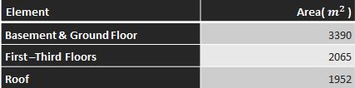
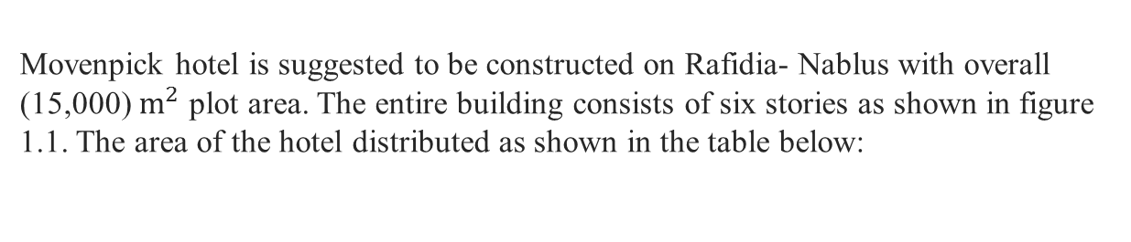
Chapter 1: Introduction
Project Description
Movenpick hotel is suggested to be constructed on Rafidia- Nablus with overall (15,000) $m^{2}$ plot area. The entire building consists of six stories as shown in figure 1.1. The area of the hotel distributed as shown in the table below:
-The commercial building is designed using reinforced concrete .
-The project is designed manually and using SAP program version 15, and according to ACI code 2008 and IBC 2009
-The project is designed for gravity and Seismic loads.

Slide 4
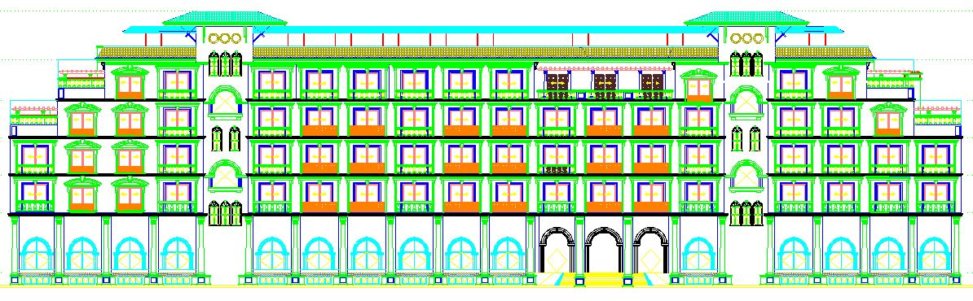
Chapter 1: Introduction

Slide 5
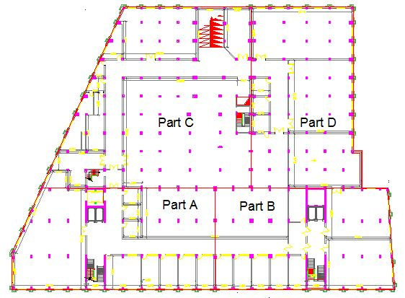
Chapter 1: Introduction

Slide 6
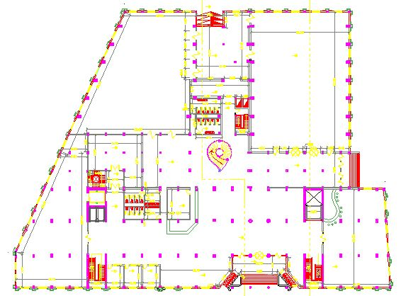
Chapter 1: Introduction

Slide 7
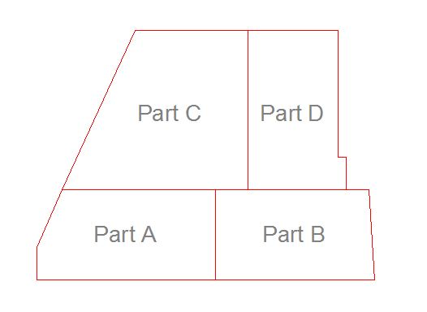
Chapter 1: Introduction

Slide 8
Chapter 1: Introduction
Materials
In this project, a group of materials will be used, where concrete and reinforcing steel are structural materials.
-The compressive strength of concrete cylinders in this project is:
f`c = 30 Mpa
-Steel for reinforcement accordance to ASTM standards
1- Modulus of elasticity, Es= 200000 Mpa..
2- Yielding strength, fy= 420 Mpa.
-Prestressed reinforcing steel
Fpu=1862Mpa.

Slide 9
Chapter 1: Introduction
Design codes and load analysis
-ACI code and IBC code are used in the project
-Load analysis:
Dead load : own weigh +SIDL
SIDL=3.79 KN/m²
SIDL=4.79 KN/m²
Live load =5 KN/m²
Live load =2.5 KN/m²
-Load combination: 1.2D+1.6L

Slide 10
Chapter 1: Introduction
Design codes and load analysis
- Seismic loads parameters:
Seismic zone factor (Z) = 0.2
Spectral accelerations for short periods (Ss)=0.5
Spectral accelerations for 1-second period. (S1) =0.25
Response modifier factor R = 5
Scale factor = g*I/r = 9.81*1/5=1.962.
- Soil Type C
- Soil Capacity = 350 KN/m²

Slide 11
Chapter 2: Preliminary analysis and design
  Preliminary analysis and design of slabs
-The preliminary design includes all the hand calculation we made in the project , the preliminary design is very important process because it's define the preliminary loads and dimensions that need to be entered in the SAP program , and help understand the structure.
-The preliminary design is not precise but should be within accepted tolerance.

Slide 12
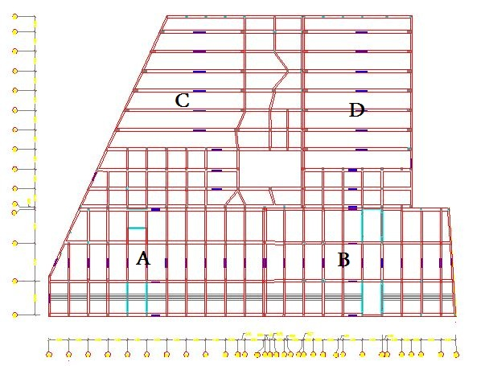
Chapter 2: Preliminary analysis and design

Slide 13
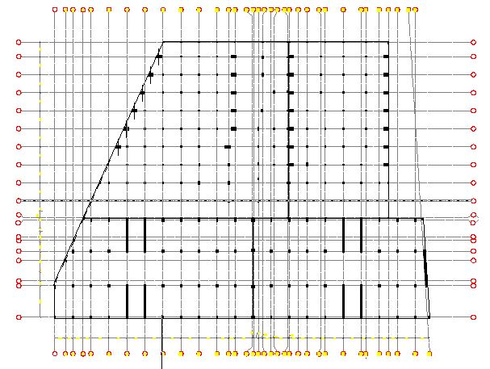
Chapter 2: Preliminary analysis and design

Slide 14
Chapter 2: Preliminary analysis and design
Part B
Slab system in the project is one way solid slab in Part A & B, one way solid slab in Part C & D.
** Slab thickness
h= 0.23 m … One way rib slab
h= 0.17 m … One way solid slab

Slide 15
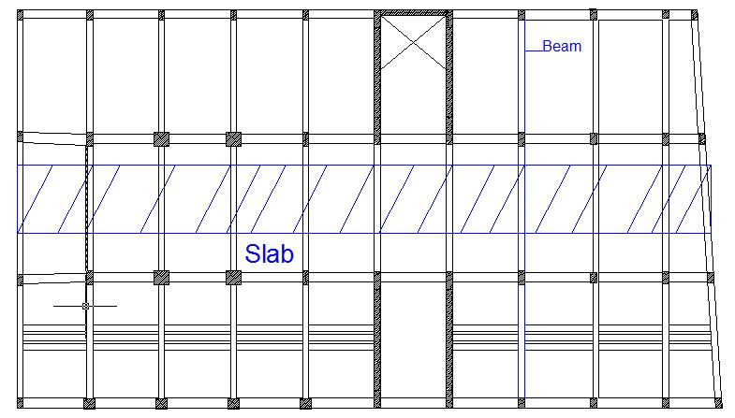
Chapter 2: Preliminary analysis and design

Slide 16
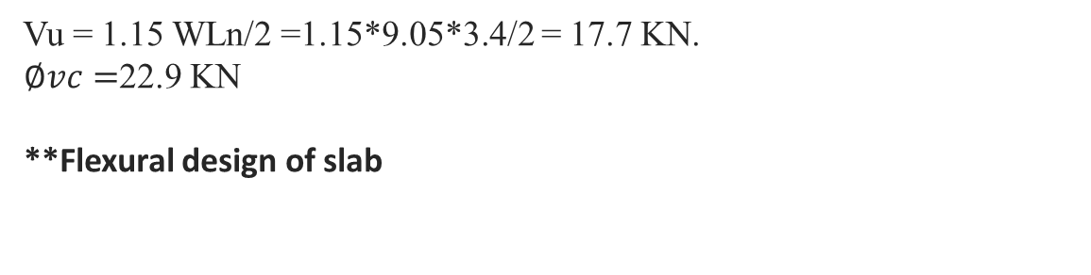
Chapter 2: Preliminary analysis and design
** Check slab for shear
Vu = 1.15 WLn/2 =1.15*9.05*3.4/2 = 17.7 KN.
$∅vc=$22.9 KN
**Flexural design of slab

Slide 17
Chapter 2: Preliminary analysis and design
Structural Model of beam

Slide 18
Chapter 2: Preliminary analysis and design
Bending Moment Diagram
3Ø20 6Ø20 6Ø20 3Ø20
4Ø20 4Ø20 4Ø20
Beam Reinforcement

Slide 19
Chapter 2: Preliminary analysis and design
  Preliminary analysis and design of columns.
ɸP_{n} = ɸ*λ*(0.85*f'c*(A_{g}-A_{s}) + F_{y}*A_{s})
Where:-
Ag: -cross section area of column.
As: - area of longitudinal steel.
Ø:-strength reduction factor.
Ø=0.65 (tied column).
Ø=0.70 (spirally reinforced column).
λ:- reduction factor due to minimum eccentricity,
λ=0.8 (tied column).
λ=0.85 (spirally reinforced column).

Slide 20
Chapter 2: Preliminary analysis and design
Column ID | Pu (KN) | Dimensions |  | Longitudinal Steel |  | Included Columns
 |  | Width (mm) | Depth (mm) | Area (mm²) | Bars
C1 | 1900 | 300 | 600 | 1800 | 10ɸ16 | 1-4, 7-17, 20-24, 34-35, 43-45, 56-57, 66-67, 69-70, 73-84, 111-112, 126-127, 141-143, 147, 175, 191, 218, 230, 205, 249.
C2 | 1000 | 300 | 300 | 900 | 6ɸ14 | 25, 46, 68, 85-110, 113-125, 128-140,144-145, 148-150, 153-157, 159-161, 163-166, 169-173, 176-177, 179-182, 185-189, 192, 194-197, 200-203, 206, 208-210, 213-216, 219, 221-223, 226-228,231, 233-235, 237-248, 250-279, A, B.
C3 | 2800 | 600 | 400 | 2400 | 12ɸ16 | 26-33, 36-42, 47-48, 51-55, 58-61, 64-65, 71-72.
C4 | 1800 | 1100 | 600 | 6600 | 26ɸ18 | 146, 151, 152, 158, 162, 167, 168, 174, 178, 183, 184, 190, 193, 198, 199, 204, 207, 211, 212, 217, 220, 224, 225, 229, 232.

Slide 21
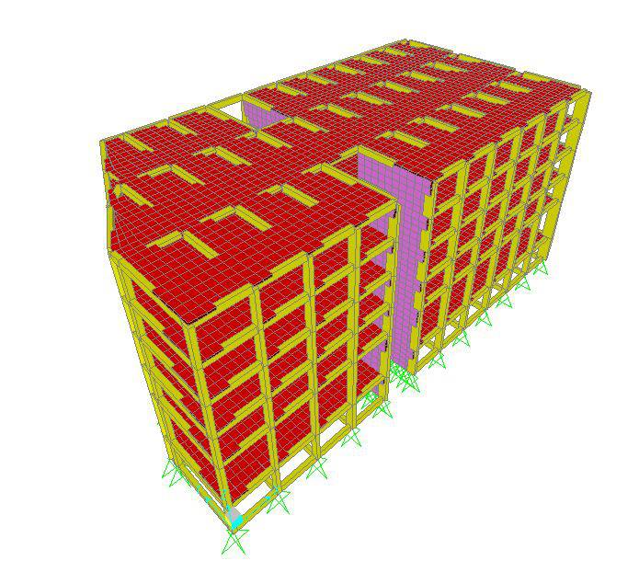
Chapter 3: Three Dimensional analysis and design
In three dimensional analysis we use SAP program .
Structural Model
Part A

Slide 22
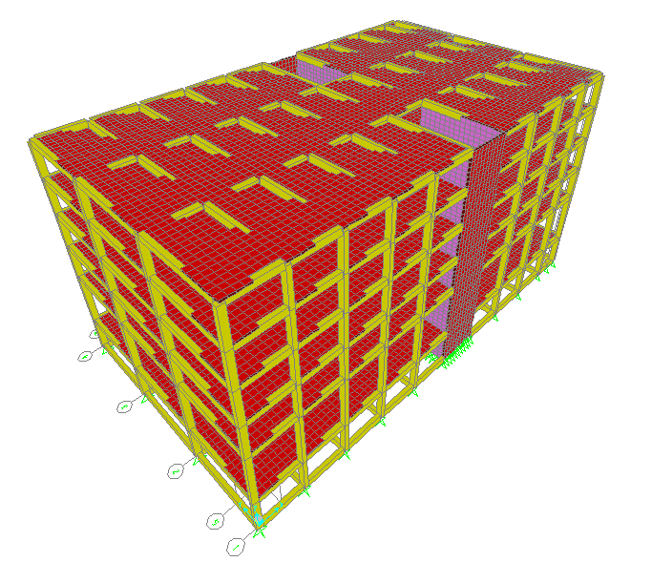
Chapter 3: Three Dimensional analysis and design
Structural Model
Part B

Slide 23
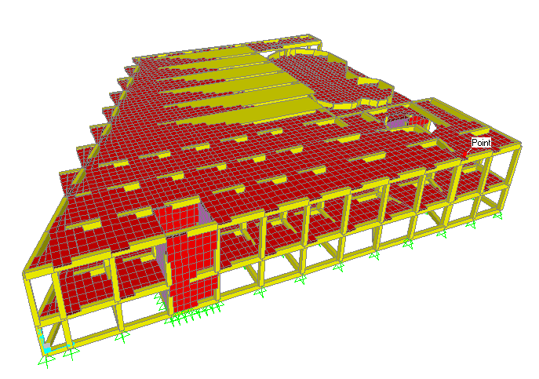
Chapter 3: Three Dimensional analysis and design
Structural Model
Part D

Slide 24
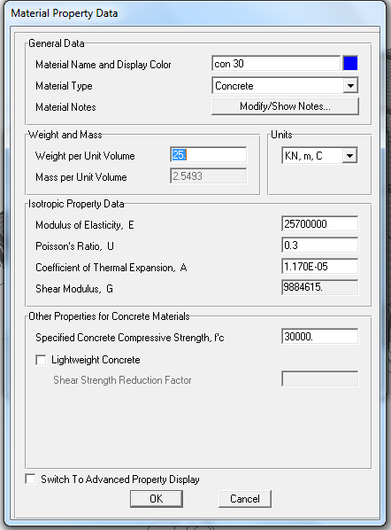
Chapter 3: Three Dimensional analysis and design

Slide 25
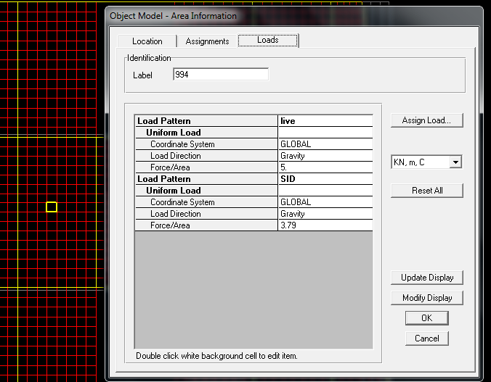
Chapter 3: Three Dimensional analysis and design

Slide 26
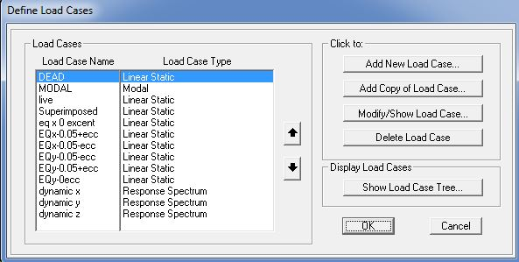
Chapter 3: Three Dimensional analysis and design

Slide 27
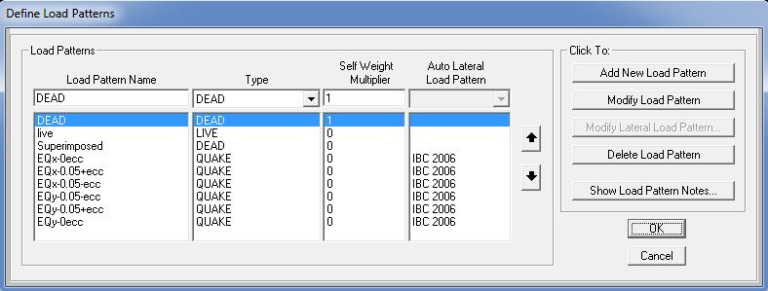
Chapter 3: Three Dimensional analysis and design

Slide 28
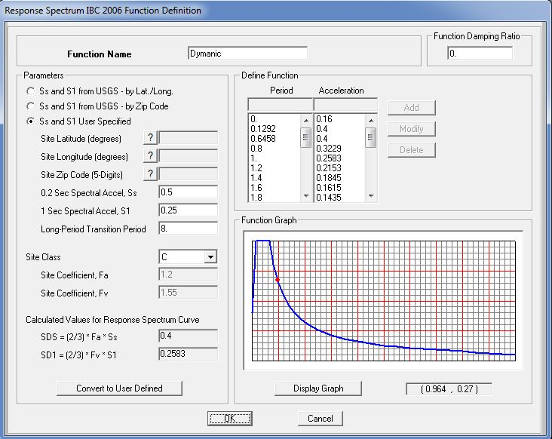
Chapter 3: Three Dimensional analysis and design

Slide 29
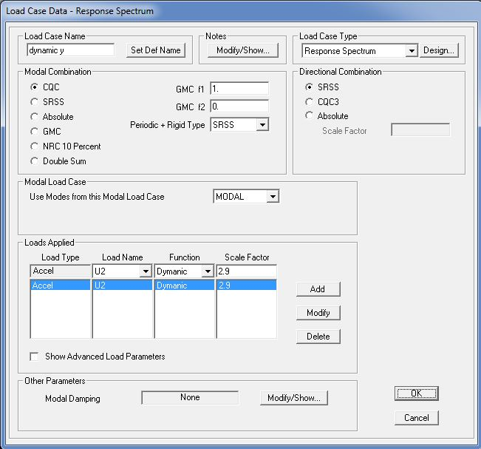
Chapter 3: Three Dimensional analysis and design

Slide 30
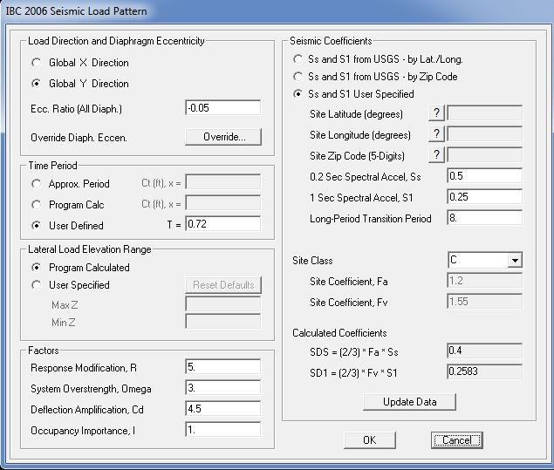
Chapter 3: Three Dimensional analysis and design

Slide 31
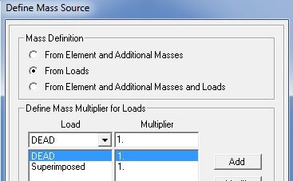
Chapter 3: Three Dimensional analysis and design

Slide 32
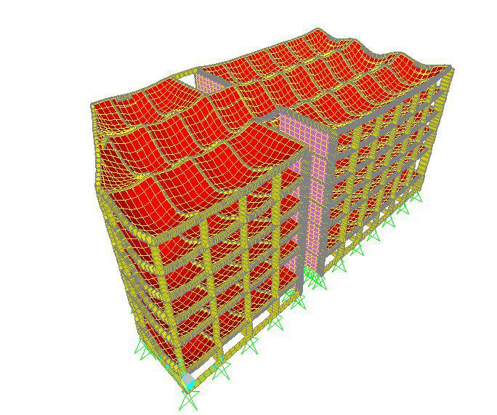
Chapter 3: Three Dimensional analysis and design
Verification of structural analysis
Compatibility: The whole building movements (Joint displacements) are compatible.
Deflection shape part A

Slide 33
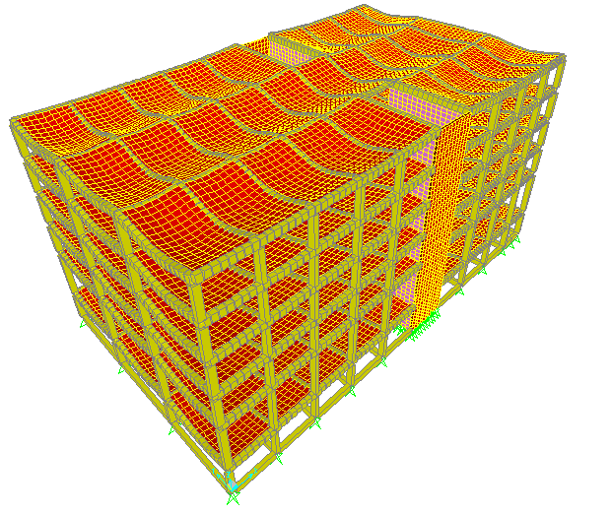
Chapter 3: Three Dimensional analysis and design
Deflection shape part B

Slide 34
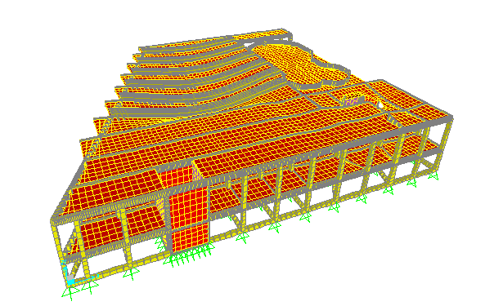
Chapter 3: Three Dimensional analysis and design
Deflection shape part D

Slide 35
Equilibrium: we do a check for part B and get this results .
Beams weight =12101 KN.
Columns weight =3511 KN.
Slabs weight =20408 KN.
Shear wall =5740 KN.
Total Dead load =41760 KN.

Slide 36
Comparison between hand calculation and SAP result for equilibrium in part B.
% of error | Hand Calculation (KN) | SAP (KN) | Load
0.6% | 13843 | 13928 | LL
0.5% | 31241 | 31396 | SID
0.4% | 41760 | 41935 | DL

Slide 37
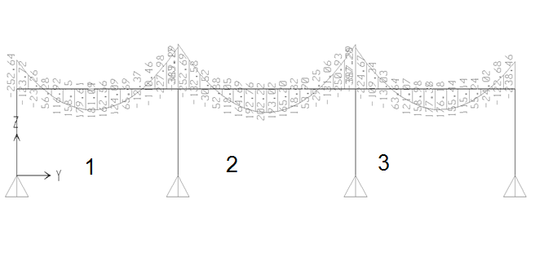
Chapter 3: Three Dimensional analysis and design
Stress strain relationship
For B2-350*600 the moment in the middle span

Slide 38
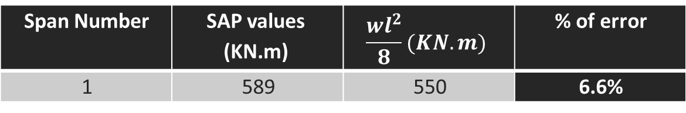
Chapter 3: Three Dimensional analysis and design
% of error |  | hand calculation (KN.m) | Span Number
6.6% | 589 | 550 | 1
Since the calculated error in the middle span less than 10 %.the results are acceptable.

Slide 39
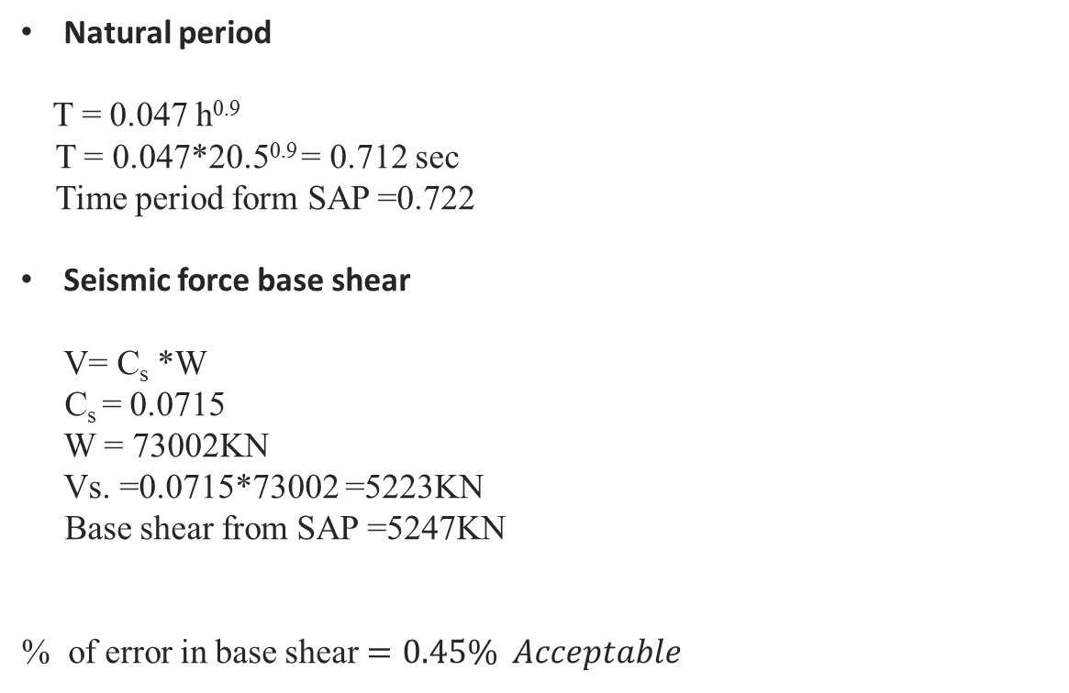
Chapter 3: Three Dimensional analysis and design

Slide 40
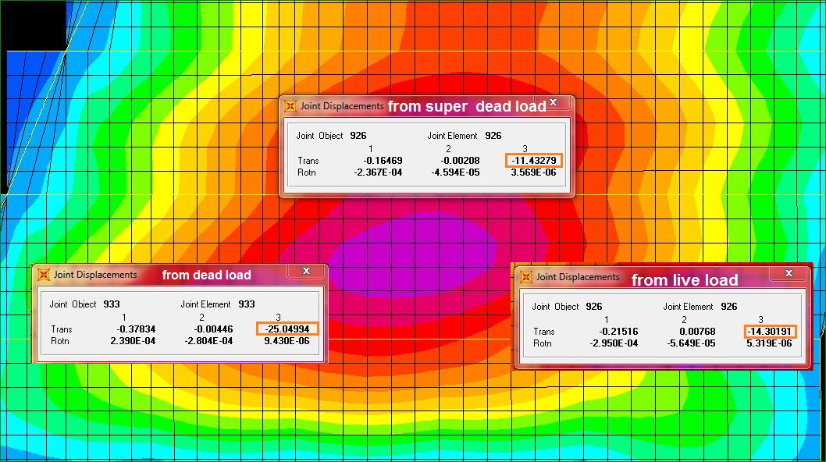
Chapter 3: Design Of Slabs
Check Deflection:

Slide 41
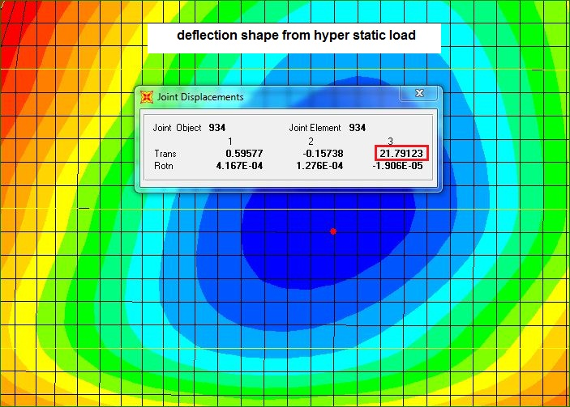
Chapter 3: Design Of Slabs
The allowable deflection = L /240 = 23000 /240 = 95.833mm for beam and slab.
Slab deflection from SAP and beam = 71.03mm. < 95.833mm >>>OK
Slab deflection =11.3mm < =L /240 =4000/240 = 16.66mm

Slide 42
Design Of Slab For Shear and Bending:
The max shear = 37KN/m.
ØVc=125KN/m
125 ≥ 37>>>OK
So the slab is Ok for shear.
The max moment on slab = 19.3KN.m .
P = 0.00363
As= 0.00363*1000*120=435mm²
As _{shrinkage} = 0.0018 *1000* 170= 306mm²
As _{shrinkage} =306mm²/m.
Using 4Ø 12 / 1000mm then

Slide 43

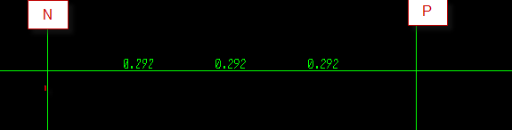
Chapter 3: Beam Design:
From 3 D model in SAP.
Vu= 183 KN
Vu < Vc >>>> OK
Use =
Error = (0.31-0.292)/0.31
=5.8% < 10%

Slide 44
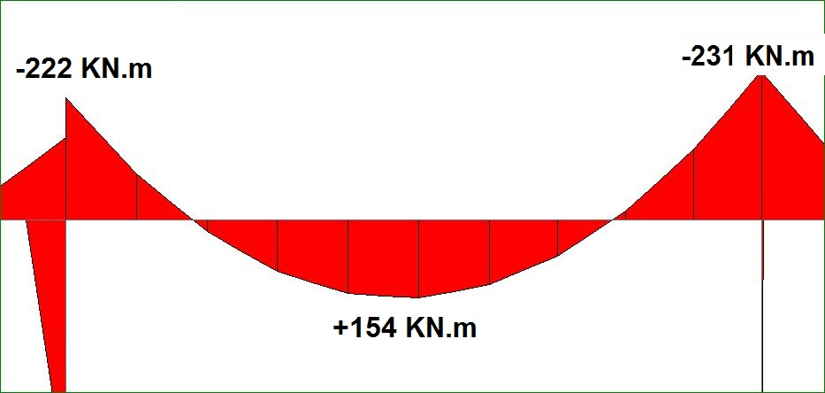
Chapter 3: Beam Design:
Design of beams for flexure

Slide 45
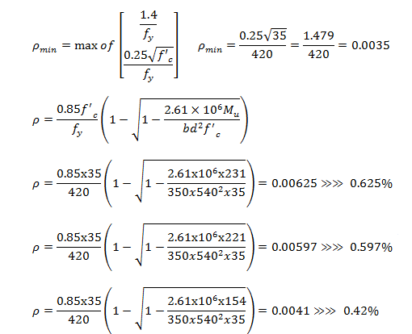
Chapter 3: Design Of Beams
Design of beams for flexure

Slide 46
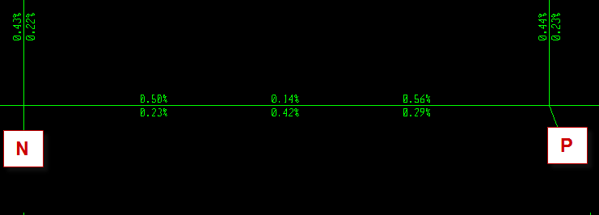
Chapter 3: Design Of Beams
Reinforcement Distribution of beams
Error = (0.625-0.56)/0.625
=9.4% < 10%

Slide 47
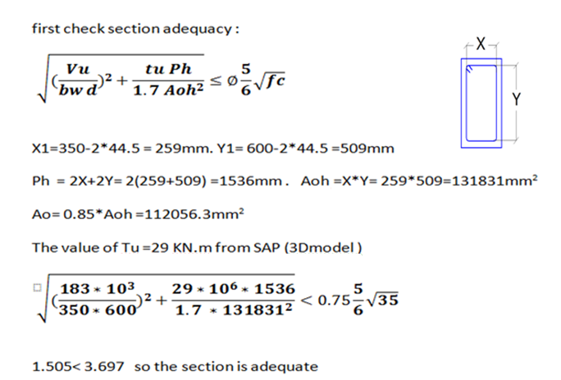
Chapter 3: Design Of Beams
Design For Torsion:

Slide 48
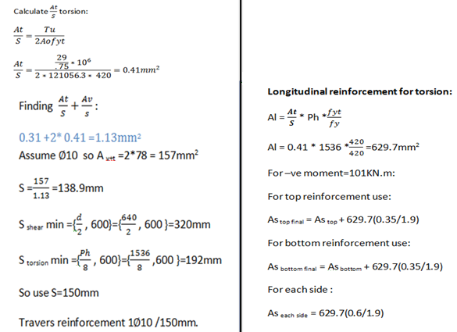
Chapter 3: Design Of Beams
Design For Torsion:

Slide 49
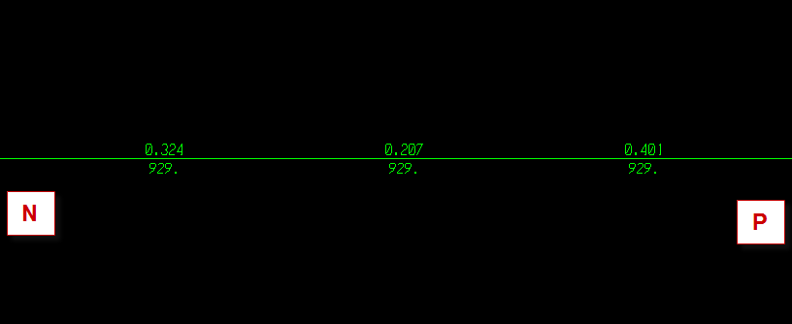
Chapter 3: Design Of Beams
Design For Torsion:
Error = (0.41-0.4)/0.41
=2.4% < 10%
Al = 618 mm from SAP but 929=618 + 311(minimum reinforcement)
Error = (629-618)/629
=1.7% < 10%

Slide 50
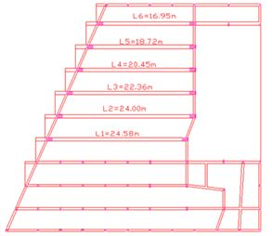
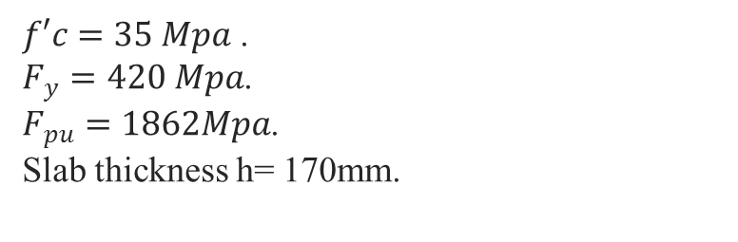
Chapter 3: Design Of Beams
Design of pre-stressed concrete beams
$f′c=35 Mpa$ .
$F_{y}=420 Mpa$.
$F_{pu}=1862Mpa$.
Slab thickness h= 170mm.

Slide 51
Chapter 3: Design Of Beams
From SAP and after making some iteration the section and area of prestressing steel
L | A( mm2) | Number of strands
16.94 | 1981 | 20
18.72 | 2673 | 27
20.45 | 2475 | 25
22.36 | 3069 | 31
24 | 3366 | 34
24.58 | 3069 | 31

Slide 52
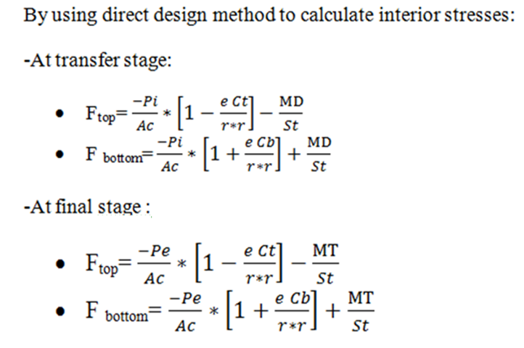
Chapter 3: Design Of Beams
Design of pre-stressed concrete beams

Slide 53
Chapter 3: Design Of Beams
Check Internal Stresses
L | A mm | moment DEAD | M DEA/ST | M DEAD/SP | F TOP | F TOP
16.94 | 1981 | 5.70E+08 | 1.23E+00 | 2.38E+00 | -3.39E+00 | 2.19E-01
18.72 | 2673 | 7.64E+08 | 1.65E+00 | 3.18E+00 | -4.56E+00 | 2.75E-01
20.45 | 2475 | 8.94E+08 | 1.93E+00 | 3.73E+00 | -4.63E+00 | 1.03E+00
22.36 | 3069 | 1.03E+09 | 2.23E+00 | 4.31E+00 | -5.57E+00 | 9.69E-01
24 | 3366 | 1.13E+09 | 2.45E+00 | 4.72E+00 | -6.11E+00 | 1.06E+00
24.58 | 3069 | 9.66E+08 | 2.09E+00 | 4.03E+00 | -5.43E+00 | 6.85E-01
L | Area of prestressed | moment service | moment ultimate | M ser/St | Mu/St | F TOP SER | F TOP ULTI
16.94 | 1981 | 4.65E+08 | 9.58E+08 | 1.004912 | 2.070334 | 0.653363 | -0.41206
18.72 | 2673 | 6.00E+08 | 1.66E+09 | 1.29666 | 3.591749 | 0.94088 | -1.35421
20.45 | 2475 | 8.93E+08 | 1.51E+09 | 1.929862 | 3.263261 | 0.141934 | -1.19146
22.36 | 3069 | 1.04E+09 | 1.93E+09 | 2.241061 | 4.170923 | 0.327967 | -1.6019
24 | 3366 | 1.19E+09 | 1.93E+09 | 2.571709 | 4.160118 | 0.245934 | -1.34247
24.58 | 3069 | 1.10E+09 | 1.74E+09 | 2.37721 | 3.764637 | 0.191817 | -1.19561

Slide 54
Chapter 3: Design Of Beams
Check Internal Stresses
L | Area of prestressed | moment service | moment ultimate | M ser/Sb | Mu/Sb | F TOP SER | F TOP ULTI
16.94 | 1981 | 4.65E+08 | 9.58E+08 | 1.9375 | 3.99E+00 | -6.0152 | -3.96103
18.72 | 2673 | 6.00E+08 | 1.66E+09 | 2.5 | 6.93E+00 | -8.23073 | -3.80573
20.45 | 2475 | 8.93E+08 | 1.51E+09 | 3.720833 | 6.29E+00 | -6.21502 | -3.64419
22.36 | 3069 | 1.04E+09 | 1.93E+09 | 4.320833 | 8.04E+00 | -7.99963 | -4.2788
24 | 3366 | 1.19E+09 | 1.93E+09 | 4.958333 | 8.02E+00 | -8.55443 | -5.49193
24.58 | 3069 | 1.10E+09 | 1.74E+09 | 4.583333 | 7.26E+00 | -7.73713 | -5.06213

Slide 55
Chapter 3: Design Of Beams
Final design of pre-stressed concrete beams

Slide 56
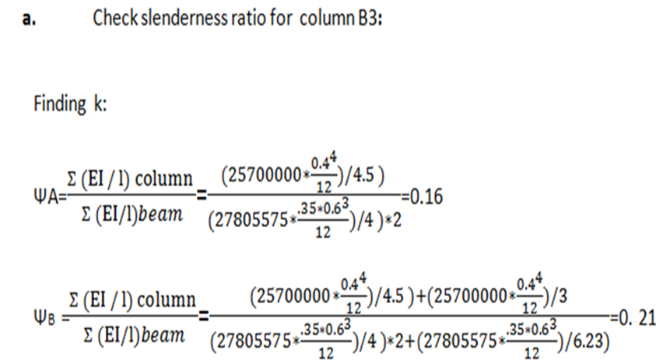
Chapter 3: Design Of Columns
Design of columns

Slide 57
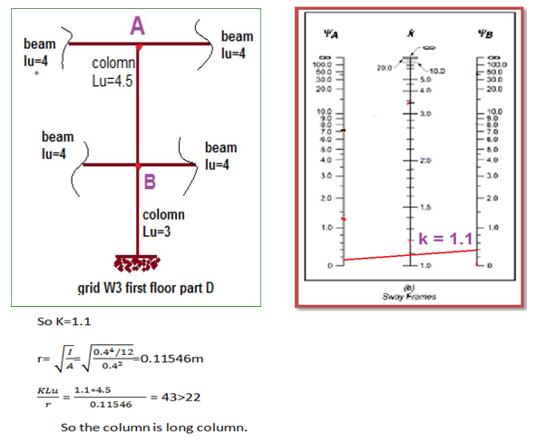
Chapter 3: Design Of Columns

Slide 58
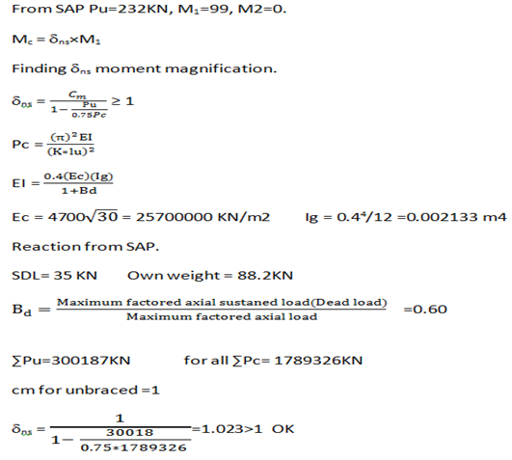
Chapter 3: Design Of Columns

Slide 59
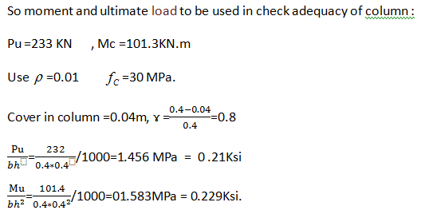
Chapter 3: Design Of Columns

Slide 60
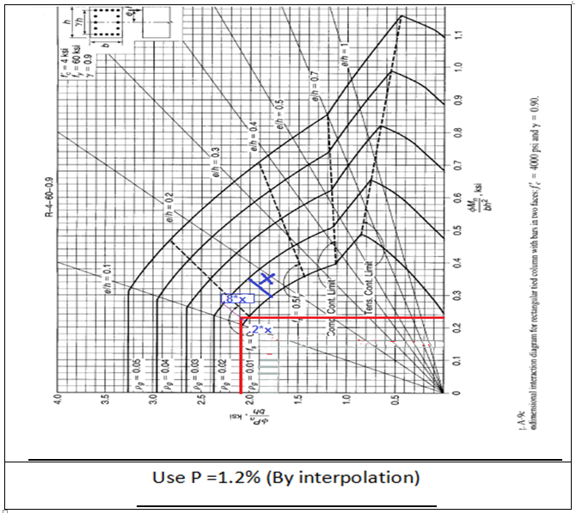
Chapter 3: Design Of Columns

Slide 61

Chapter 3: Design Of Columns
P =2111.83/(400*400)
= 1.3%
Error =(1.3-1.2) /1.2
= 8.3% < 10%

Slide 62
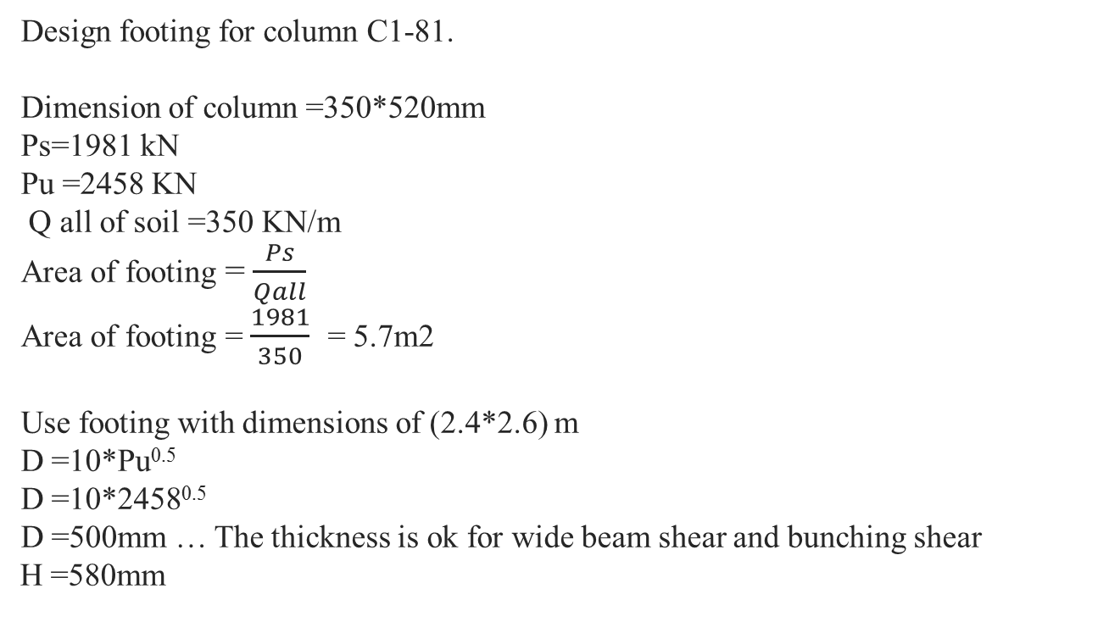
Chapter 3: Design Of Footing
-Design of footing
Design footing for column C1-81.
Dimension of column =350*520mm
Ps=1981 kN
Pu =2458 KN
Q all of soil =350 KN/m
Area of footing =$\frac{Ps}{Qall}$
Area of footing =$\frac{1981}{350}$= 5.7m2
Use footing with dimensions of (2.4*2.6) m
D =10*Pu^{0.5}
D =10*2458^{0.5}
D =500mm … The thickness is ok for wide beam shear and bunching shear
H =580mm

Slide 63

Chapter 3: Design Of Footing
-Design footing for flexure
Mu=$\frac{394∗{1.04}^{2}}{2}$= 214KN.m
ρ = $\frac{0.85∗30}{420} (1−\sqrt{1−\frac{2.61∗214∗{10}^{6}}{30∗ 100∗{500}^{2}}})$=2.3*10⁻³
As = 2.23*10⁻³*1000*500=1155mm²
As _{min} =1044mm²
Use As =1155mm²
Use 8Ø14/m
550

Slide 64
Chapter 3: Design Of Footing

Slide 65
Chapter 3: Design Of Footing

Slide 66
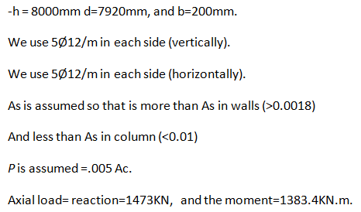

Chapter 3: Design Of Shear walls

Slide 67
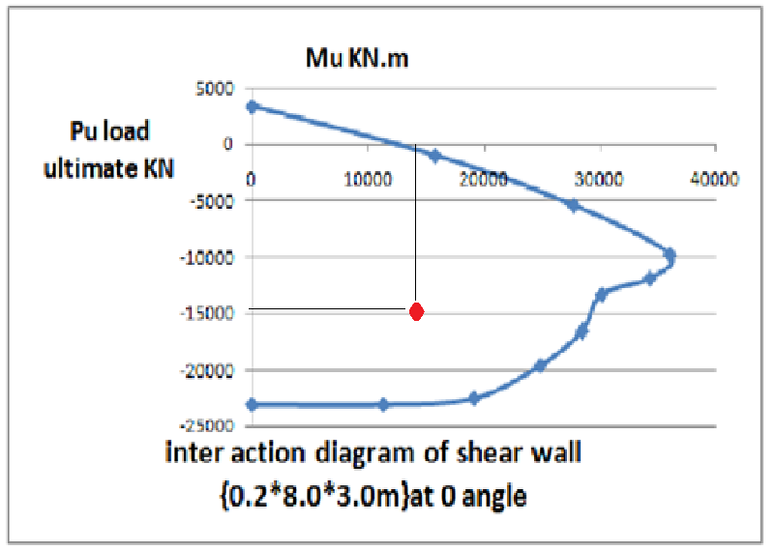
Chapter 3: Design Of Shear walls

Slide 68
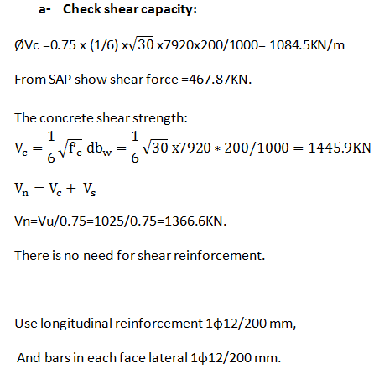
Chapter 3: Design Of Shear walls

Slide 69
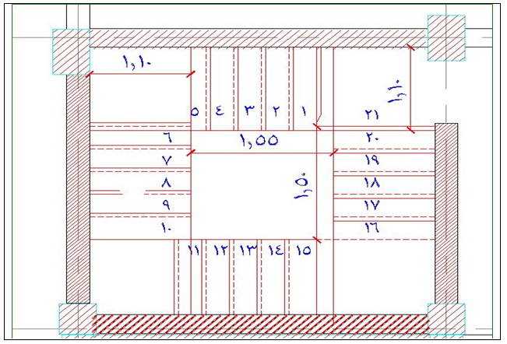
Chapter 3: Design Of Stairs
Design of rectangular stairs
Design Of Rectangular Stairs

Slide 70

Chapter 3: Design Of Stairs
Design of rectangular stairs

Slide 71



Chapter 3: Design Of Stairs
Design of rectangular stairs
Check for shear:
To insure that the thickness of stairs is adequate check If Ø Vc >Vu.

Slide 72
Chapter 3: Design Of Stairs
Design of rectangular stairs
Design for flexure
The ultimate –ve moment =6.5 KN.m
and the ultimate positive moment =4.5 KN.m and it gives AS= (255mm², 176 mm²).
As min =0 .0018 *b*h = 0.0018 *1000 *200 = 360
So use 5 Ø10/m

Slide 73

Chapter 3: Design Of Stairs
Design of spiral stairs

Slide 74

Chapter 3: Design Of Stairs
Design of spiral stairs

Slide 75



Chapter 3: Design Of Stairs
Design of spiral stairs
Check for shear:
To insure that the thickness of stairs is adequate check If Ø Vc >Vu.

Slide 76
Chapter 3: Design Of Stairs
Design of spiral stairs
Design for flexure
The ultimate –ve moment =35 KN.m
and the ultimate positive moment =15 KN.m and it gives AS=(1425mm²,596 mm²).
As min =0 .0018 *b*h = 0.0018 *1000 *250 = 450
So use 7 Ø16/m for negative moment and 6 Ø12/m for positive moment.

Slide 77
Thank You

