Slide 1
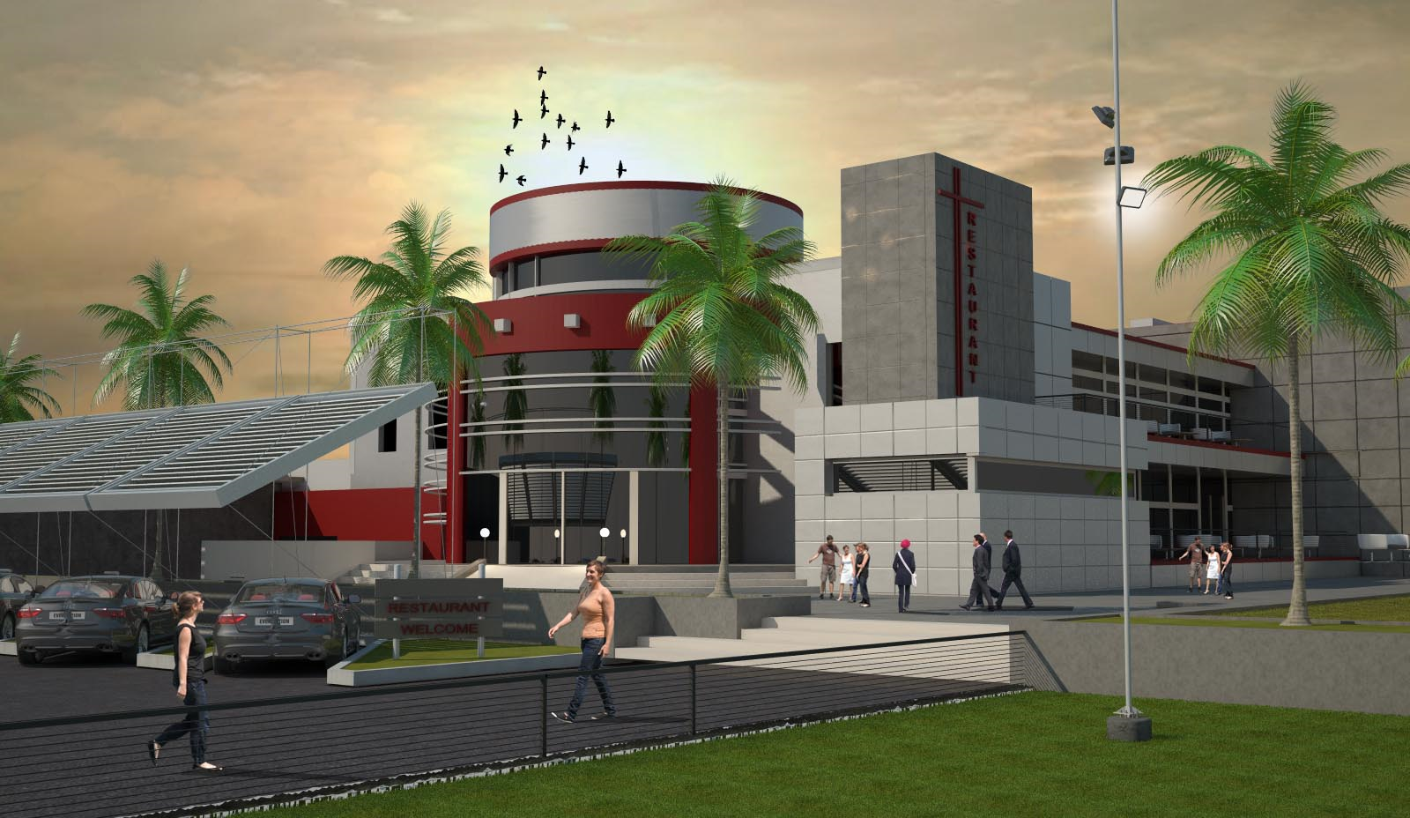
Restaurant Design
Graduation Project “2”
Prepared by:
Isra’ Hasan Ali
Lubna Ahmad Jallad
Masa Jamal Shanteer
Maysa’ Mohammed Anaya
Supervisor :
Dr. Mokarram Abbas

Slide 2
Outline:
Introduction
Structural Design
Quantity Surveying and Cost Estimation
Environmental Design
Mechanical Design
Electrical Design
Architectural Design
Safety Design

Slide 3
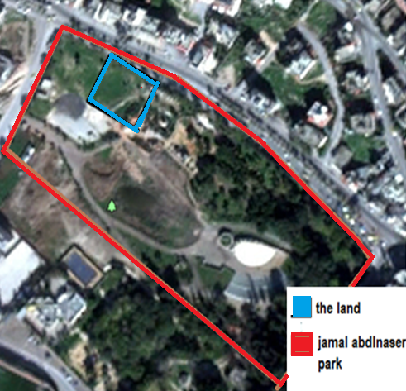
Introduction
Location
  - Jamal Abdel- Naser park
  in Nablus.
Type of restaurant
  -Fine dining
Project significance
  -The park has no restaurant
  -Attraction element
Notes:
Location of the project is in jamal abd alnaser park in nablus in yafa street , type of restaurant is fine dinning
The project is important because the municapility workiing to develop the park and theres no restaurants so it will be destination for the vsitors
Area =2000m^2

Slide 4
Architectural Design

Slide 5
Architectural Design:
1-video and elevations
2- site plan and accessibility
3- the plans
4- sections
5-Requirements for Handicapped People

Slide 6
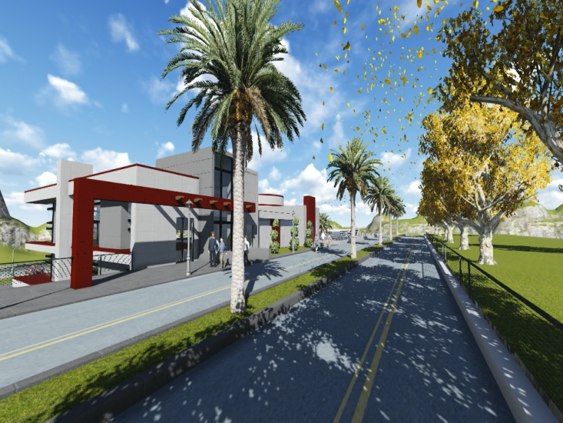
Architectural Design:

Slide 7
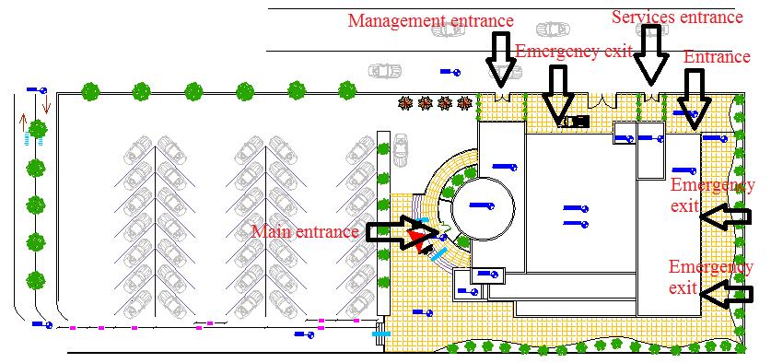
Site plan:
Notes:
The main entrance of the restaurant is from Jamal Abdel Nasser Park, the secondary entrance of parking, management, and services are from Yafa Street as shown in the figure below.
The site contains parking which the capacity of it about 36 car, and there are two ramps the first one for entrance, and the second one for exit

Slide 8
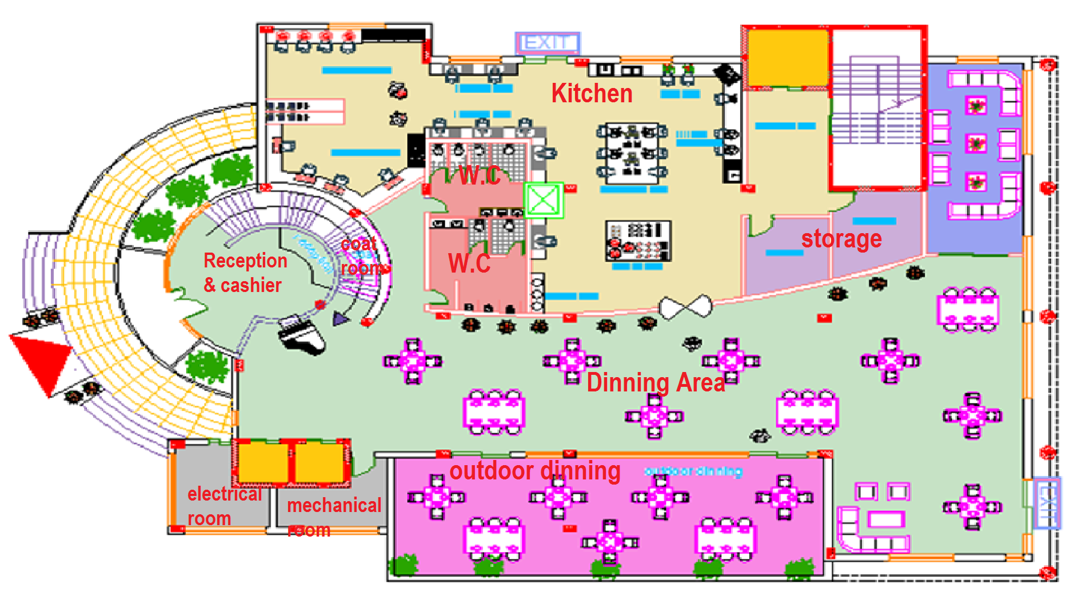
Architectural Design:
Ground Floor
Area=726m^2
Notes:
The ground floor contains the reception and cashier, coat room, kitchen, dining area, mechanical and electrical rooms and storage

Slide 9
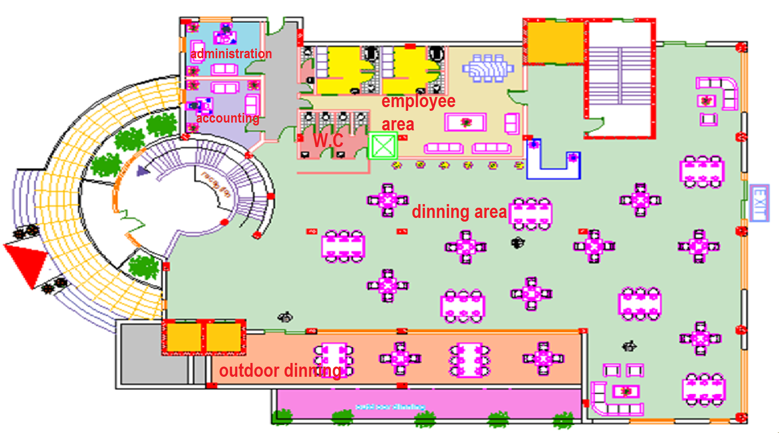
Architectural Design:
First Floor
Area=864 m^2

Slide 10
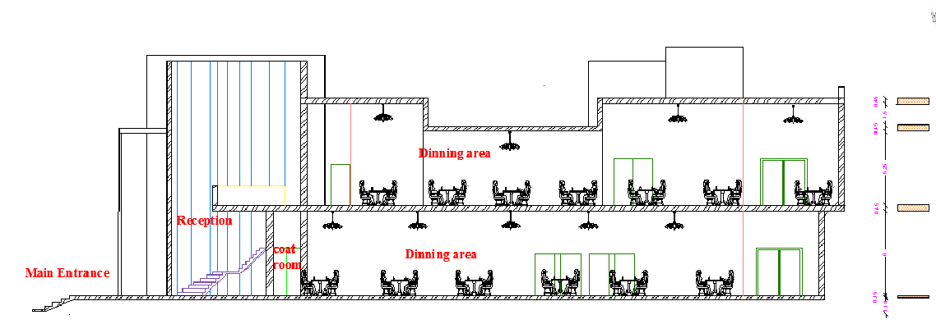
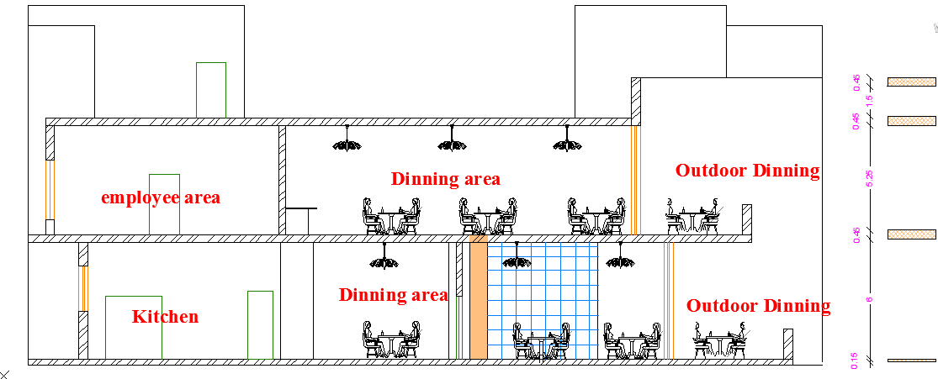
Architectural Design:
Sections
Section A-A
SectionB-B

Slide 11
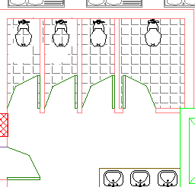
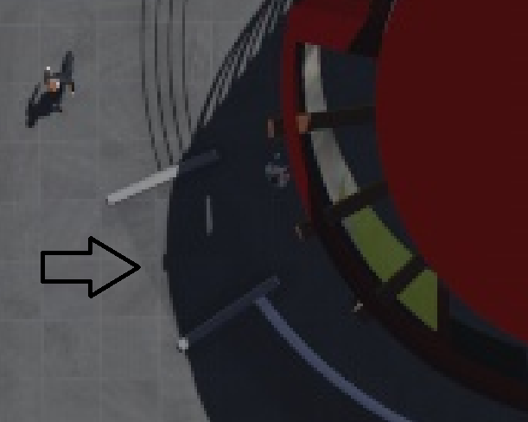
Architectural Design:
Requirements for Handicapped People
Special W.C
Ramps

Slide 12
Structural Design

Slide 13
Structural Design:
1- Design codes
2- Loads
3- Sap model and checks
4- Structural elements and detailing

Slide 14
Structural Design:
Design Codes:
ACI -318-08 (American Concrete Institution) for reinforced concrete structural design.
UBC-97 (Uniform Building Code) for earthquake load computations.
ASCE (American Society Of Civil Engineers) for design loads.

Slide 15
Structural Design:
Loads:
Type of loads | Load (KN/m2)
Live load | 5KN/m²
Super imposed | 4KN/m²
Exterior walls | 25KN/m

Slide 16
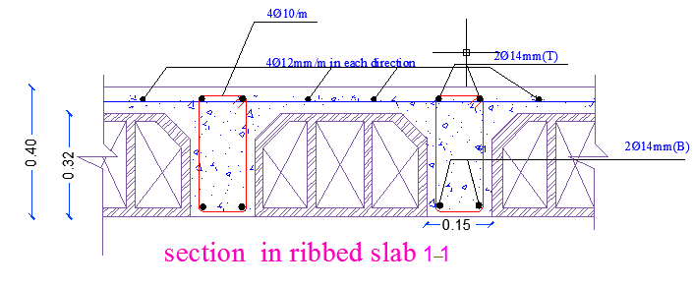
Structural System:
The system of the slab is one way ribbed slab(30 cm thickness ) with Drop beams
Beam girder system

Slide 17
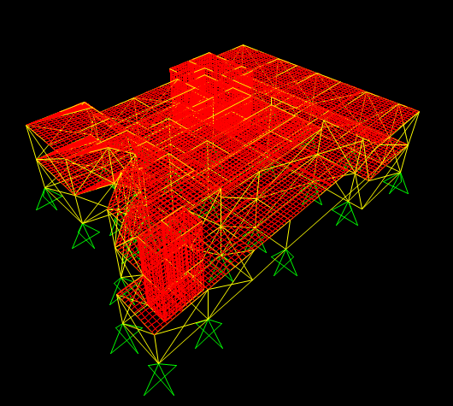
Sap model:

Slide 18
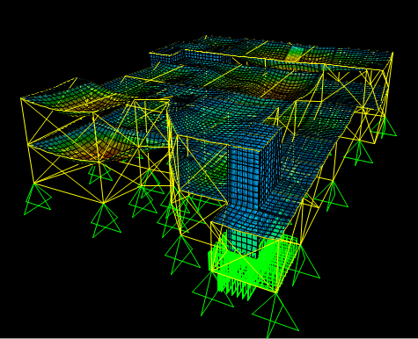
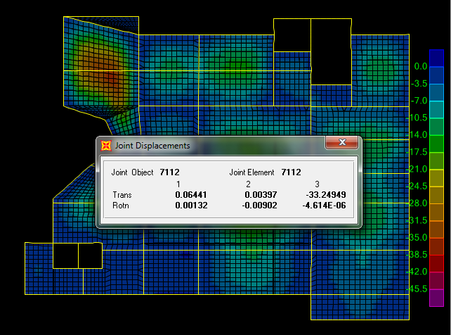
Checks for model :
1. Compatibility check:
Deflection check:
U from sap = 33.25 mm < U max= 39mm
Notes:
compatibility had achieved as shown in the figure

Slide 19
2. Equilibrium check:
Load | Manual | Sap | Error
Dead load | 21570.22 KN | 21874.4 KN | 1.39 %
Live load | 7368.77 KN | 7463.7KN | 1.3 %
Super imposed | 12486.7 KN | 12560.96 KN | 0.6 %
3. Internal Forces Check:
Load | Manual | Sap | Error
For Dead load | 350.33 KN.m | 360.4 KN.m | 2.79 %

Slide 20
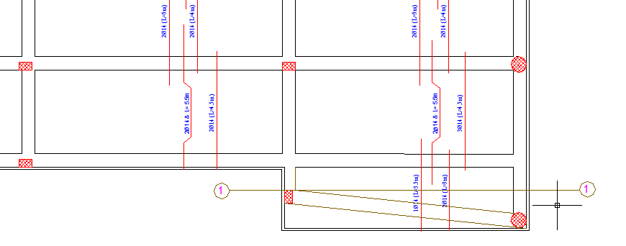
Design of Slab: One-Way Ribbed Slab

Slide 21
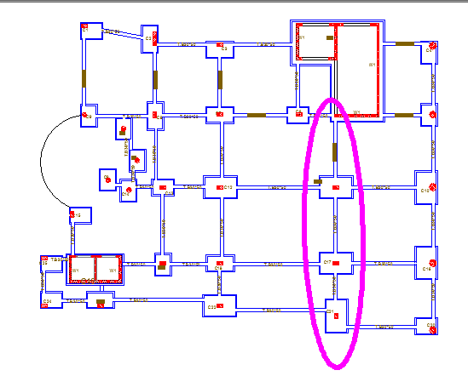
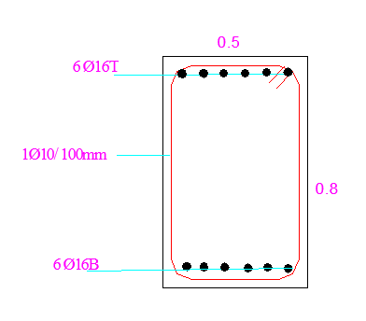
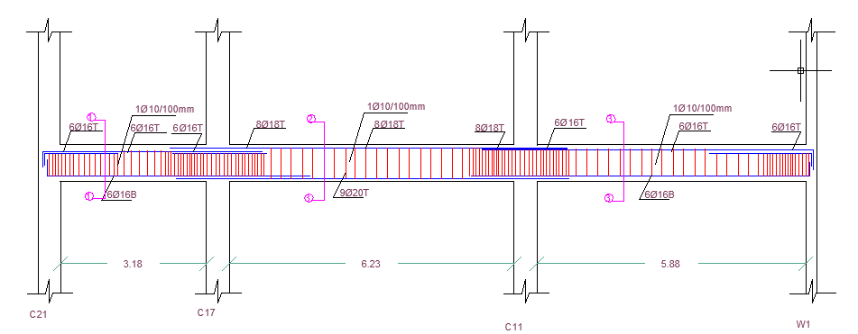
Beam Design:

Slide 22
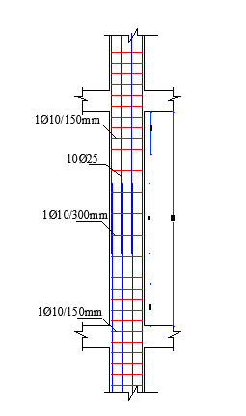
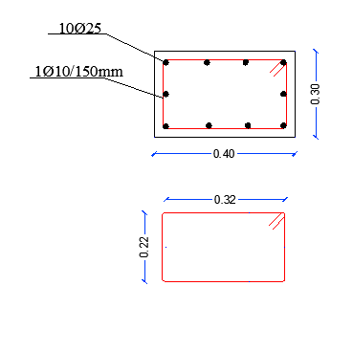
Column Design:

Slide 23
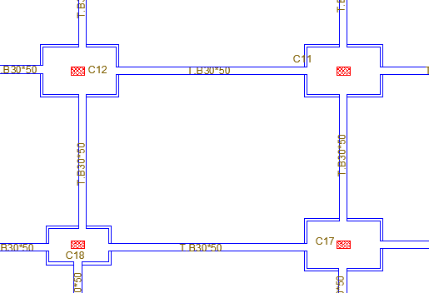
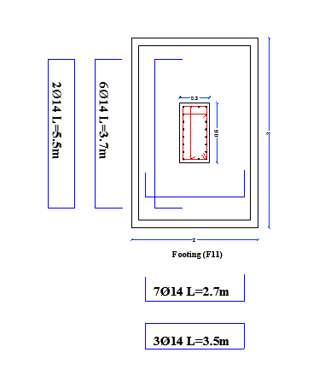
Footing Design:

Slide 24
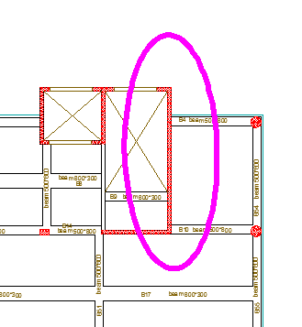
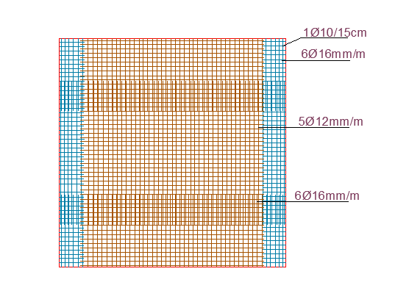
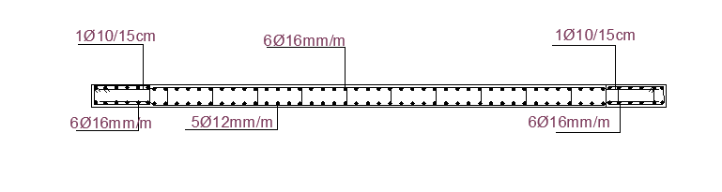
Shear Wall Design:

Slide 25
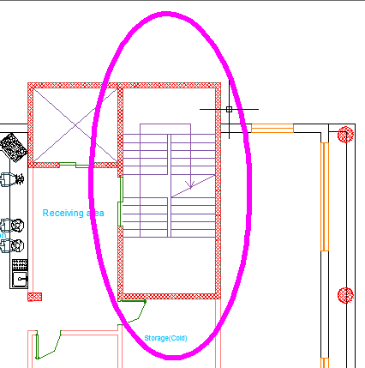
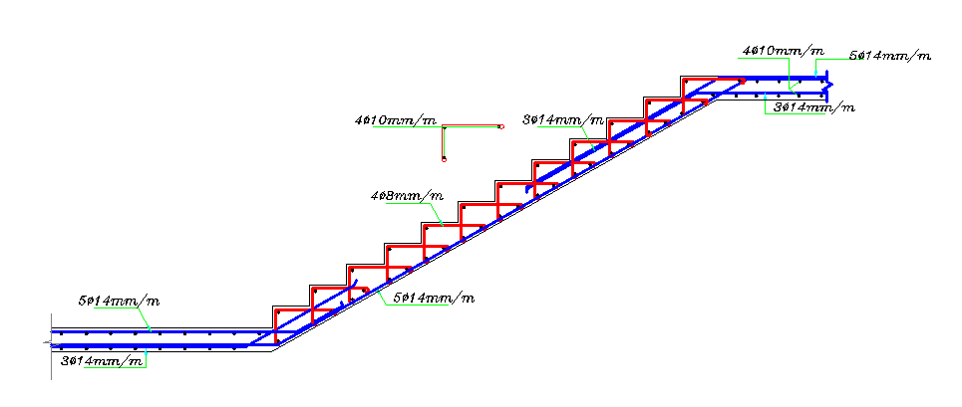
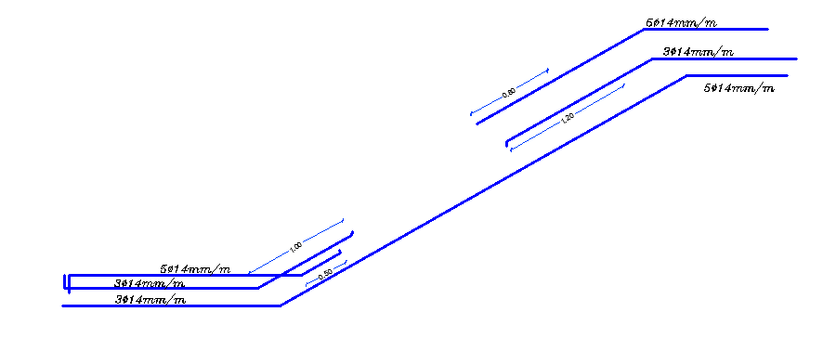
Stair Design:

Slide 26
Mechanical Design

Slide 27
Mechanical design:
1. Water supply
2. Water drainage
3. Water refining
4.Water tanks
5. HVAC system

Slide 28
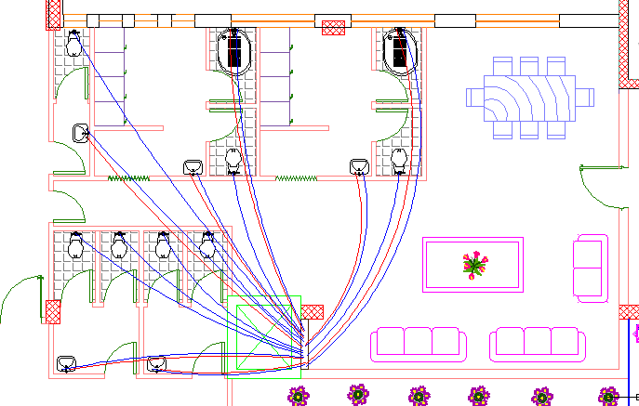
Water supply
In ground &first floor :
meter : 2"
vertical : 2"
horizontal : 1.5"
branch: 3 /4“

Slide 29
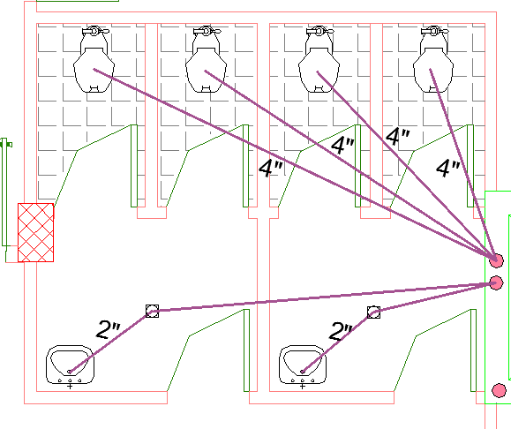
Water drainage
Branches diameter: 2“
Minimum Trap size :1.5˝

Slide 30
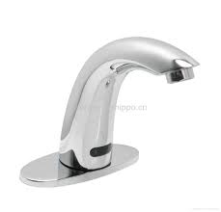
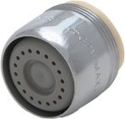
Water refining
The saving of drink water=56%
The savings after using the proposed Water-use Equipments will increase by 20% at least
(Savings in Water costs estimation> 60%)

Slide 31
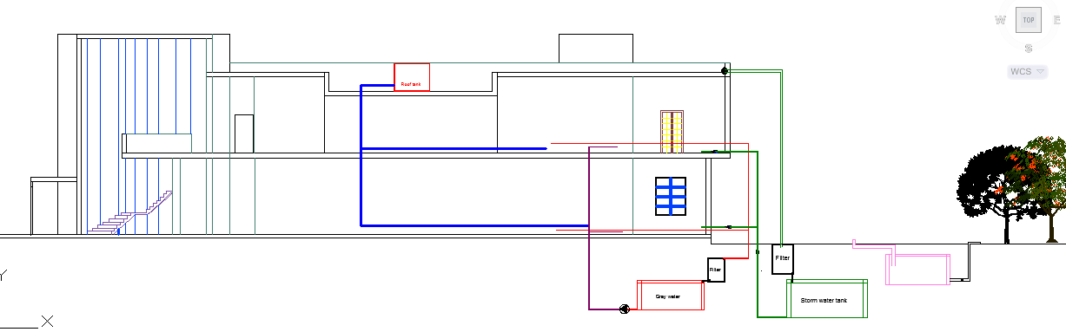
Water refining
Notes:
Irrigate grass

Slide 32
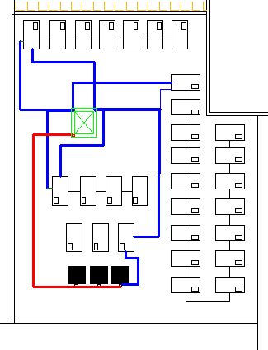
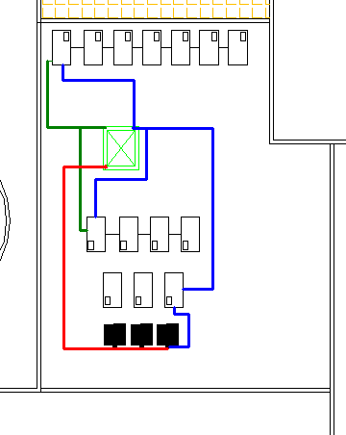
Water tanks:
Before refining
N=30 tanks
After refining
N=17 tanks

Slide 33
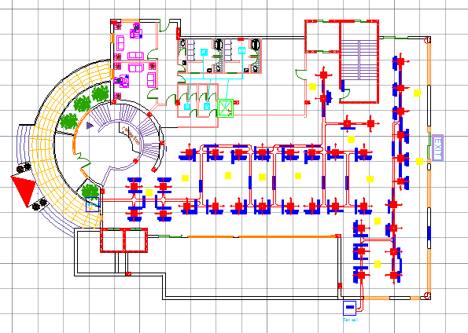
HVAC System
Dinning F1 | Area :428.886 | Cooling load :53.6 | # of diffusers : 60
Notes:
This figure shows the distribution of the diffusers in Dinning 1stfloor .

Slide 34
Electrical Design

Slide 35
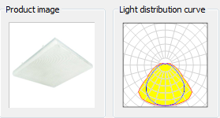

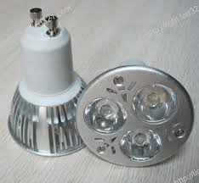
Artificial lighting for dinning
  Factors: U > 0.6 & UGR < 19%
General Artificial Lighting used:
  Lamps: ELBA FIDA 05-418P
  Chandeliers (Incandescent)
  Spot Lights Lamp used ( Disano Janes)
Notes:
Dialux program were used in our analysis to get a helpful and useful allocation of the artificial lighting, two different spaces were chosen to test and those were, manager ,dinning, kitchen, employee area and storage.
a targeted value of U (uniformity) and (unified glare rating) UGR shall be achieved for each space where U >0.6 and UGR should not exceed 19, so to get these values suitable paint, tile, color of furniture and appropriate type of lamp have to be applied.[25]

Slide 36
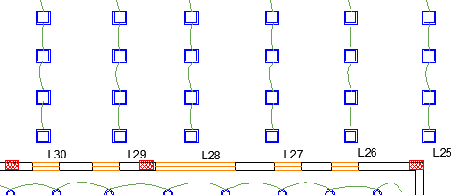
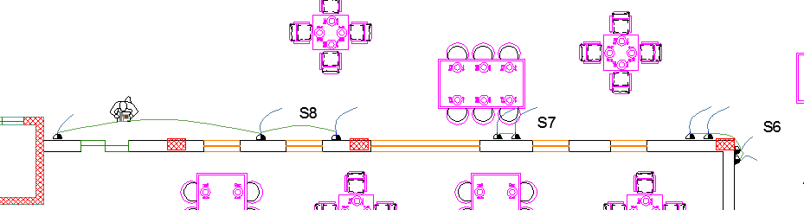
Artificial lighting for dining room

Slide 37
Safety Design

Slide 38
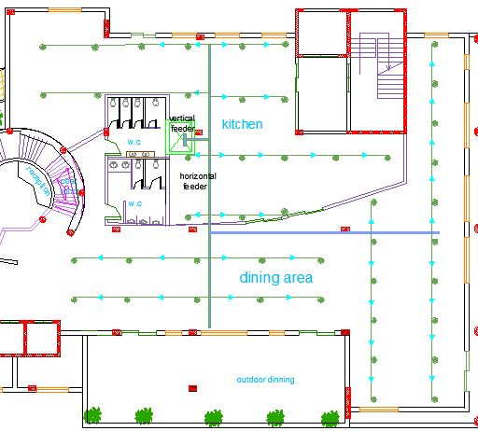
Fire system
Sprinkler system
Notes:
This figure shows the distribution of the sprinkler units in part of the restaurant.

Slide 39
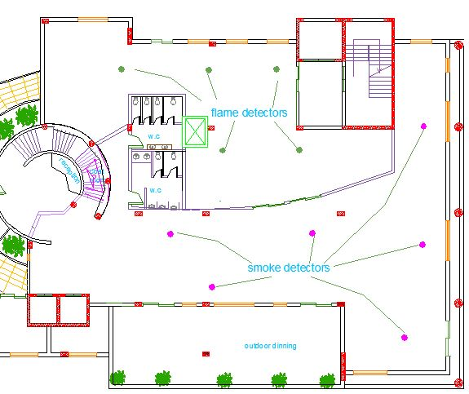
Fire system
Detector system
Notes:
This figure shows the distribution of the smoke and flame detector units.
Two fire detectors are used in this design:
A) Flame detector: this detector is found in two main areas:
- The service area (Restaurant kitchen).
- The parking area
The purpose of using this type to detect and response for any flame or fire presence
Note: Gases usually exists, so if smoke detectors are installed there will be always a false alarm.
B) Smoke detectors: This type is found in the dining areas, reception and in the manager room.

Slide 40
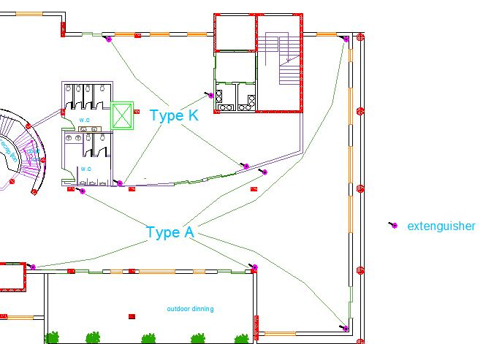
Fire system
Extinguisher system
Notes:
This figure shows the distribution of the extinguisher.
- Type K: It is located in the cooking zone which is specialized in kitchen hazards.
- Type A: It is located in the dining areas, corridors and the manager office.

Slide 41
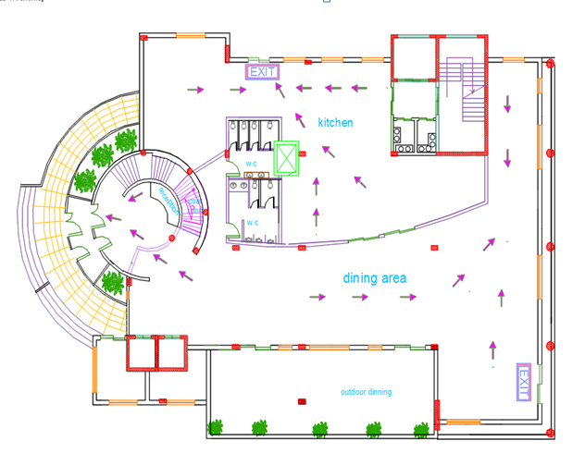
Emergency Exits
Exit

Slide 42
Environmental Design

Slide 43
Environmental Design:
1- The layers for the elements
2- Thermal analysis
3- Daylight factor
4- Shading design
5- Photovoltaic System
6- Acoustical design

Slide 44
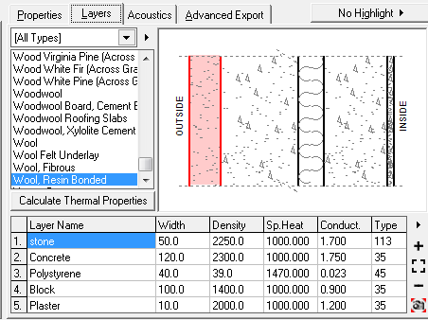
External Wall Material
U-Value:0.47 (W/m².K)

Slide 45
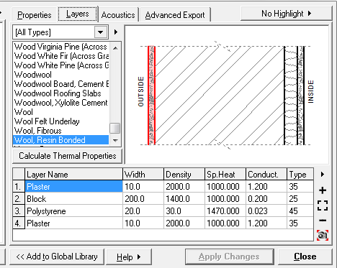
Partition Material
U-Value:0.64 (W/m².K)

Slide 46
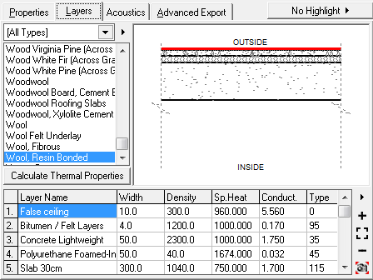
Roof Wall Material
U-Value:0.43 (W/m².K)

Slide 47
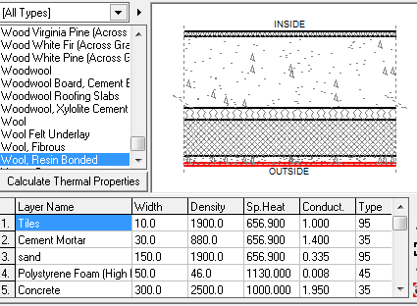
Floor Material
U-Value:0.14 (W/m².K)

Slide 48
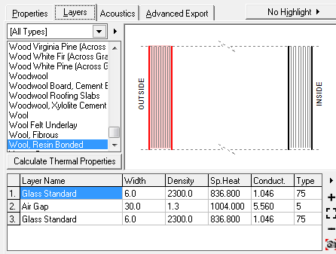
Glasses Material
U-Value:2.41 (W/m².K)

Slide 49
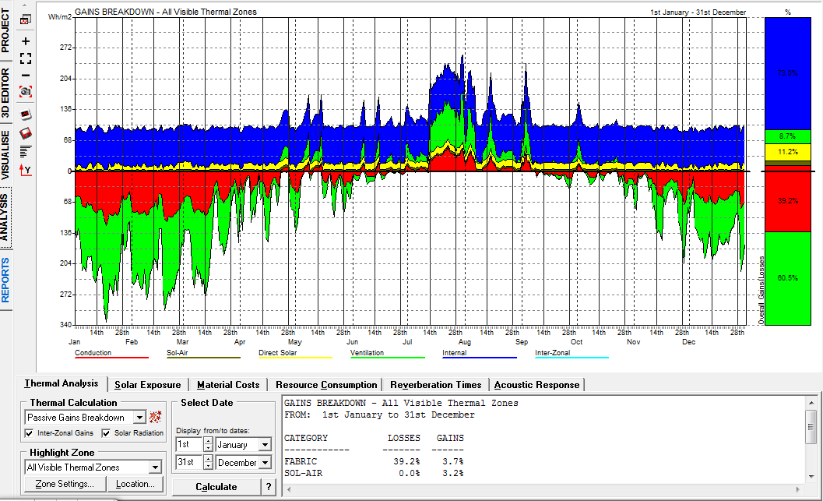

Thermal Analysis
Gain Breakdown

Slide 50

Energy Simulation
Restaurant with large number of people (250 persons)
Monthly heating and cooling loads with 250 persons
Notes:
Note : values form the schedule

Slide 51
Cooling loads
Zone | Area | Cooling load
Dinning | 351.376 | 44
Kitchen | 156.594 | 30.5
Storage | 47.09 | 9.1
E+M | 23.412 | 4.6
Dinning 1 | 428.886 | 53.6
Adme | 59.398 | 11.6
Employe | 69.518 | 13.6

Slide 52
Heating loads
Zone | Area | Heating load
Dinning | 351.376 | 10.489
Kitchen | 156.594 | 2.078
Storage | 47.09 | 0.117
E+M | 23.412 | 0.842
Dinning 1 | 428.886 | 13.163
Adme | 59.398 | 0.297
Employe | 69.518 | 1.3

Slide 53

Glazing material properties
Daylight factor

Slide 54





Average Daylight Values
Zone | Floor | Orientation | DF-Value | Uniformity distribution | Picture
Kitchen | Ground floor | north | 2.1% | 62%
Dinning | Ground floor | South-east | 5.31% | 64.6%
Manger | 1st Floor | West | 4.12% | 60.2%
Employee | 1st floor | North | 3.59% | 60.4%
Dinning | 1st floor | South-east | 5.92% | 70.7%

Slide 55




Shading Design
the concept of vertical louvers in the east and west elevation
the concept of horizontal cantilevers in the south elevation

Slide 56

Photovoltaic system

Slide 57

Acoustical Design

Slide 58

RT60 Values for dinning room in GF floor before modifications
Notes:
As it's shown in the standards, the reverberant time inside the Dining room does not match the specifications of restaurants that is ( 0.8 – 1.2 ) s

Slide 59


Cloudsorba suspended acoustic panels and the installation of it.
The absorption of Cloudsorba suspended acoustic panels in all frequencies.
Frequency(Hz) | 125 | 250 | 500 | 1000 | 2000 | 4000
Absorption Coefficient | 0.45 | 0.85 | 0.95 | 1 | 1 | 1

Slide 60


RT60 Values for dining room in GF floor before modifications
RT60 Values for dining room
in GF floor after
modifications
Notes:
All values lies in the range (0.8-1.2) Which is suitable for Dining rooms.

Slide 61

STC Calculations
Required STC 50-54
53.3

Slide 62

STC Calculations
Required STC 50-55
51.63

Slide 63

Speakers:
Sound system calculations for the restaurant were only made for the dining halls.

Slide 64

The distribution of loudspeakers in G.F

Slide 65

The distribution of loudspeakers in F.F

Slide 66
Quantity surveying and cost estimation

Slide 67
Quantity surveying and cost estimation:
The total cost of the restaurant is about 1.21 million NIS
The total cost per meter square for the restaurant is about 776.45 NIS/m².

Slide 68


