Slide 1
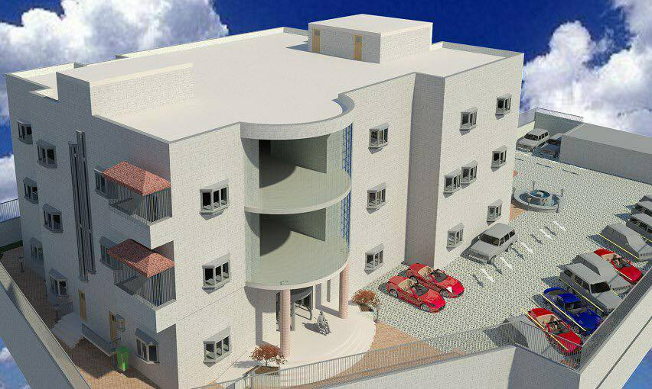
Health Care Center
Prepared By: Dana Heigeh
Isra’ Atallah
Manar Raddad
Supervisor: Dr. Monther Dwaikat

Slide 2
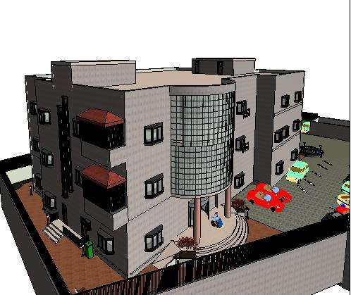
outlines
Introduction.
Site Location
Architectural Design.
Environmental Design.
Structural Design.
Electrical Design.
Mechanical Design.
Safety Design.
Quantity Surveying and Cost Estimation

Slide 3

Introduction

Slide 4
Introduction
Health centers are structural buildings that provides a range of medical services including: consultations, treatment, diagnosis, minor surgery and health education
The Ministry of Health decided to select this site because of:
  The lack of health centers in the eastern region of Nablus.
  The location is close to most of the villages and camps in the eastern area.
Location Advantages
The land has a small slope.
Quite region.
Located in the middle of three streets.
No surrounding high buildings to prevent Sun.

Slide 5
Site Location
Near Masjed Abu Baker Al-Siddiq in Balata Village in Nablus.

Slide 6
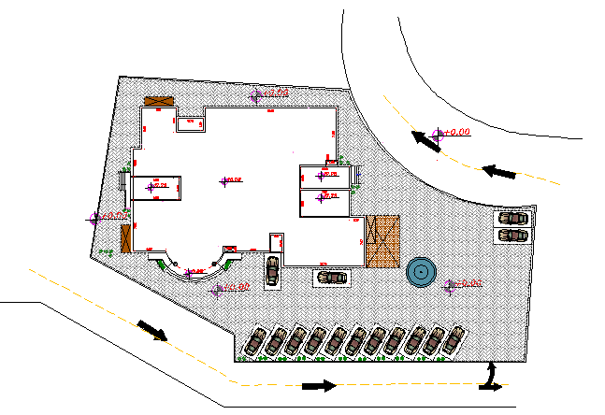
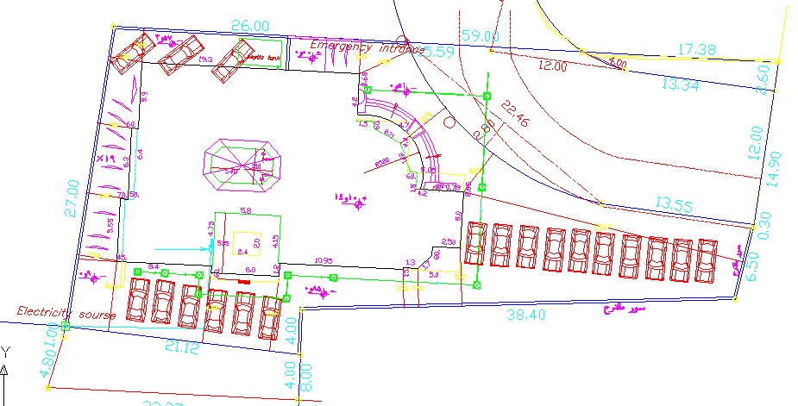
Site Plan

Slide 7
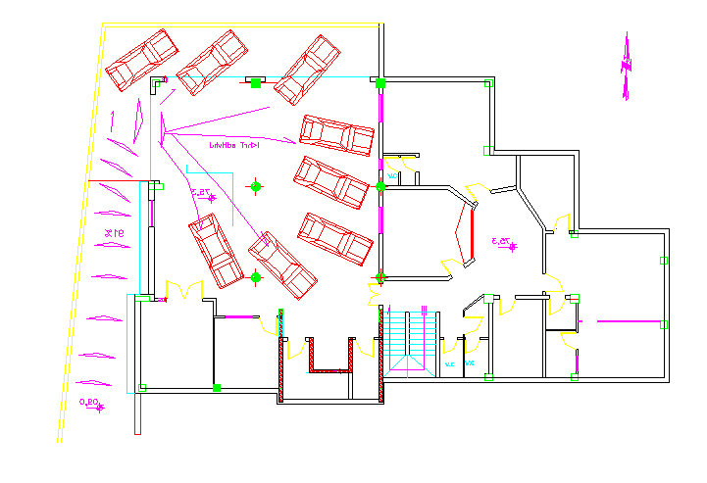
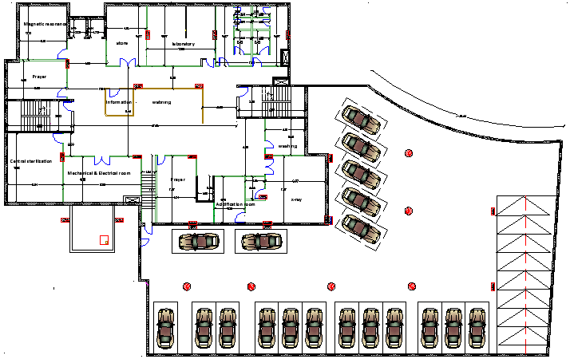
Architectural Design
Plan for the basement floor:

Slide 8
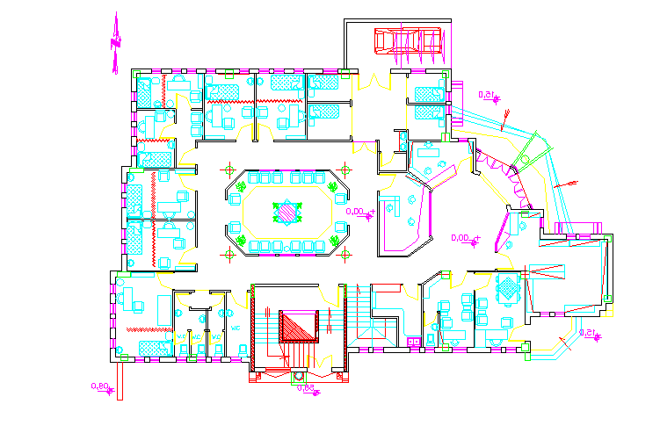
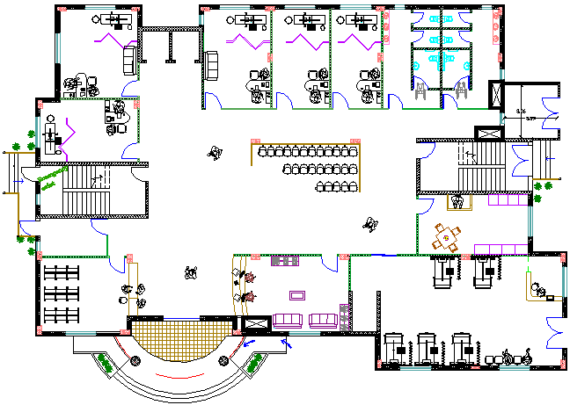
Architectural Design
Plan for the ground floor:

Slide 9
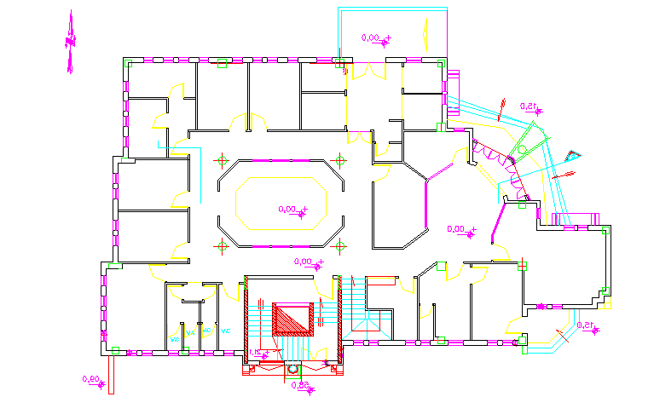
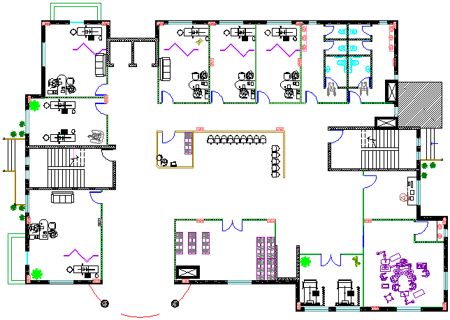
Architectural Design
Plan for the first floor:

Slide 10
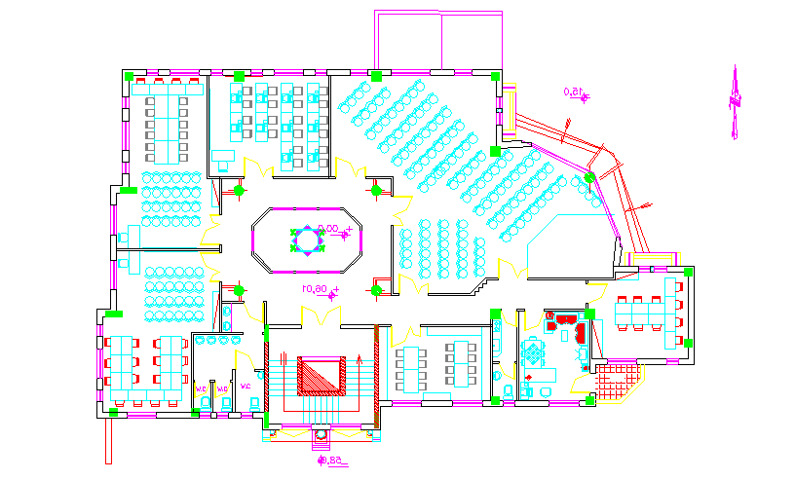
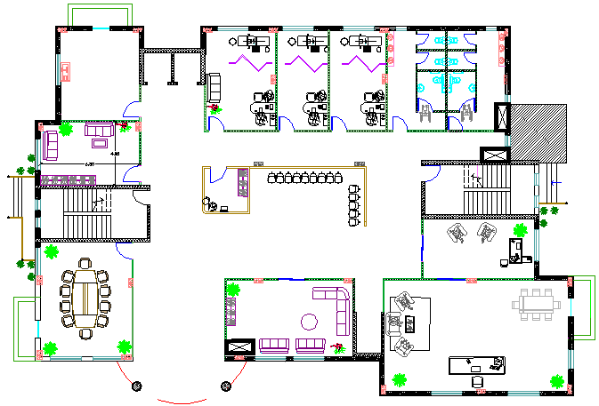
Architectural Design
Plan for the second floor:

Slide 11
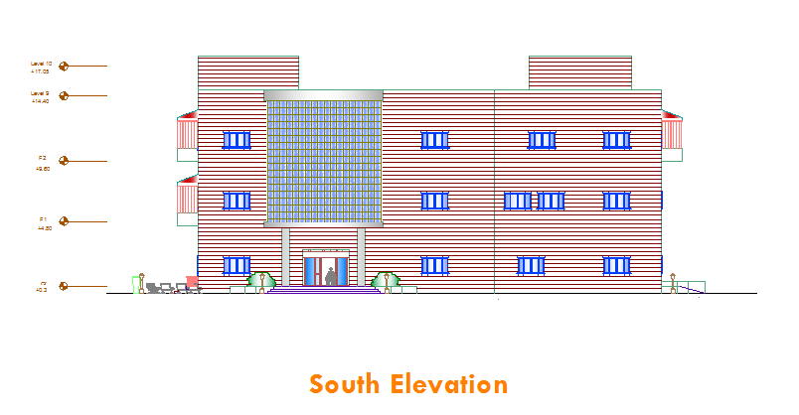
Architectural Design

Slide 12
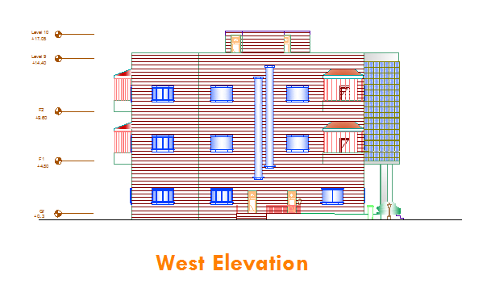
Architectural Design

Slide 13
Environmental
Design

Slide 14
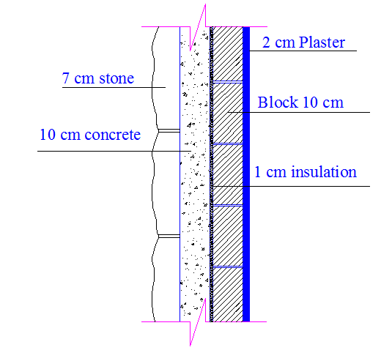
Thermal Calculations
Layers for external walls
(U = 0.87 W/m².k):
Thickness(cm) | Layer
7 | Stone
10 | concrete
1 | Polystyrene
10 | Block
2 | Plaster
We used double glazed windows with U=2.71 W/m².k.

Slide 15
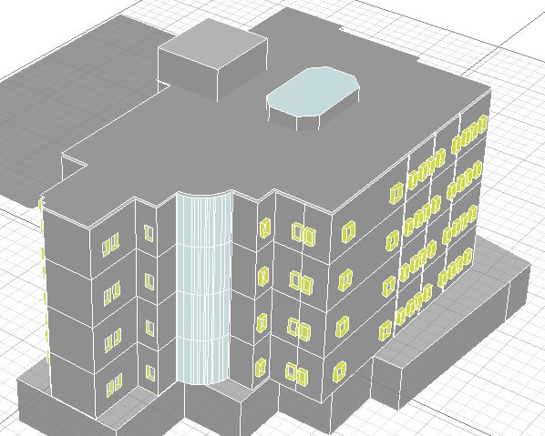
Environmental Design
Ecotect model for original design of the health center.

Slide 16
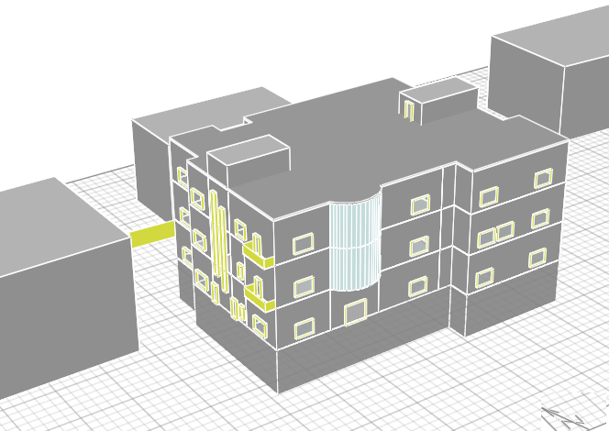
Environmental Design
Ecotect model for the new design of the health center.

Slide 17
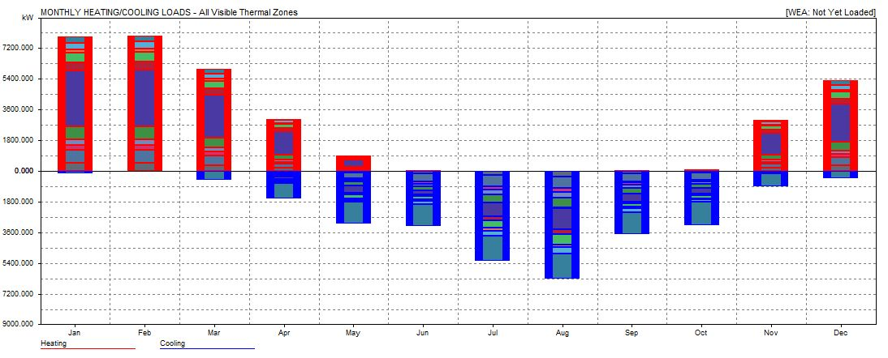
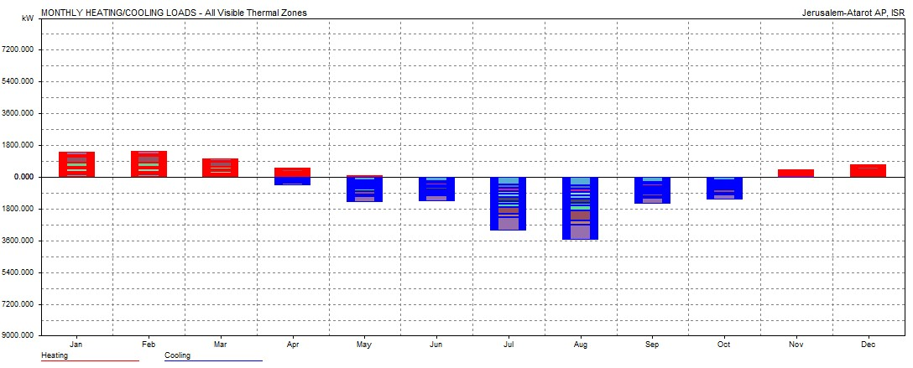
Environmental Design
The original design.
Heating load =19 W.h/m²
Cooling load =24 W.h/m²
The new design.
Heating load = 9 W.h/m²
Cooling load =19 W.h/m²

Slide 18
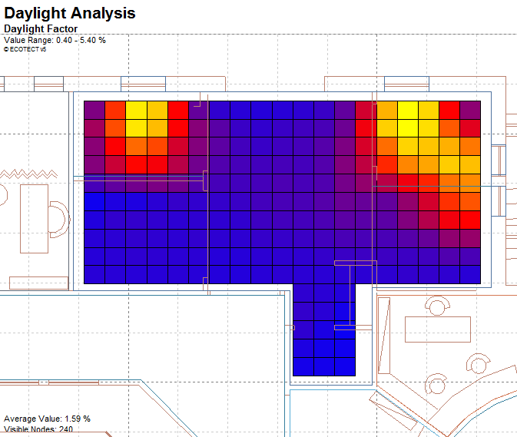
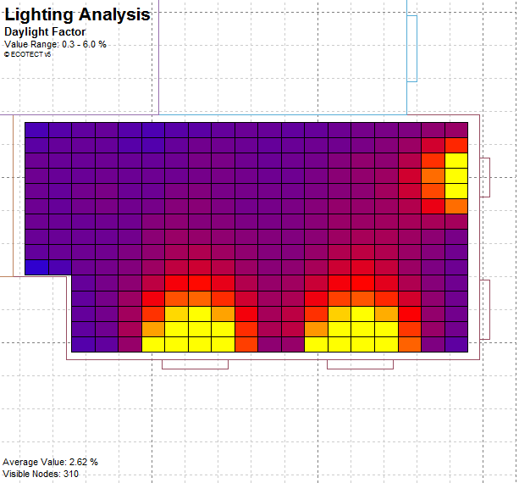
Environmental Design
Emergency department-The original design.
1.60%
Emergency department-The new design.
2.60%

Slide 19
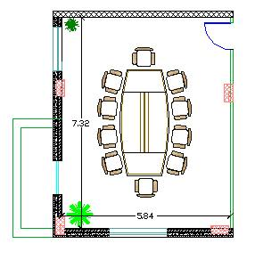
Acoustical Design
Meeting room was chosen.
The required optimum value of RT₆₀ level in the meeting room is
0.5 -0.7 sec.
RT₆₀=0.6→in range

Slide 20
Acoustical Design
% Alcon =6%
Range between 3 and 7→ % Alcon is good.
The recommended STC=42 dB.
Modifications for STC ratings:
Layer | STC
4 in dense hollow block | 39
Plaster on both sides | +4
total | 43

Slide 21
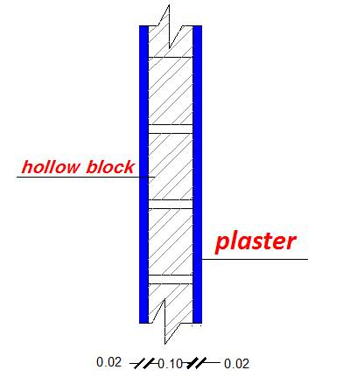
Acoustical Design
Section in the inside wall
Section in the outside wall

Slide 22
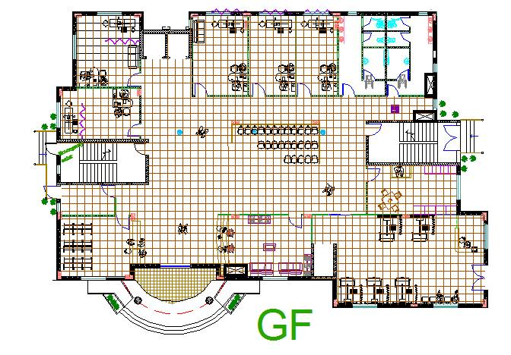
Acoustical Design
Loudspeakers for waiting hall.
The diameter of loudspeaker equal to 6.4m.

Slide 23
Structural &
Seismic Design

Slide 24
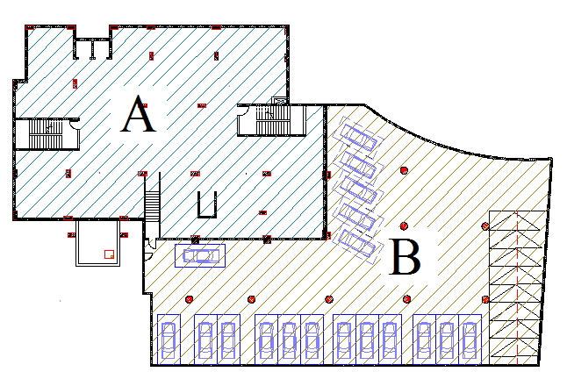
Structural Design
The project consists of two block separated by 5cm structural joint.
Ribbed slab of 25 cm thickness.
Beam girder system.

Slide 25
Structural Design
Design codes :
ACI -318-11 for reinforced concrete structural design.
UBC -97 for earthquake load computations.
ASCE for load computations.
(ACI 350.3-06) for computing loads applied on water tanks under earthquake action.
The analysis and design were done using SAP2000 program.

Slide 26
Loads Used
Structural Design
Block A
Block B
Type of load | Load (KN/m²)
Dead Load (Own weight) | 5.63
Super Imposed | 5
Live Load | 6
Type of load | Load (KN/m²)
Dead Load (Own weight) | 5.63
Super Imposed | 2
Live Load | 6

Slide 27
Structural Design
Seismic load:
Soil type SD and the bearing capacity of soil = 220 KN/m²
Z=0.2
I=1.25
Cv=0.4
Ca=0.25
R=5.5

Slide 28
Structural Design
Element | Name | Dimensions (cm)
Tie beams | TB1 | 50*40
beams | Main | (50*60), (80*60)
 | Secondary | (40*60), (40*40)
columns | C1 | 90*40
 | C2 | 70*30

Slide 29
Equilibrium Checks-Block A
Load | Manual calculations (KN) | SAP results (KN) | %Error
Dead | 41200 | 64800 | 2 % <10%
Live | 13600 | 13600 | 0.2% <10%
Internal Forces Checks
Structural element | Manual moment (KN.m) | SAP moment (KN.m) | % Difference | Check <10%
Slab | 23 | 24.5 | 6.5 | <10% OK
Beam | 479 | 456 | 4.8 | <10% OK

Slide 30
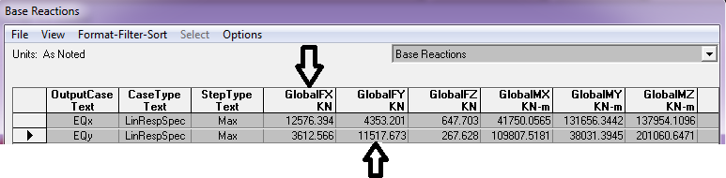
Structural Design
Checks on SAP model :
Base shear ( V ) for seismic design :
Manual calculation for ( V ) = 11391KN .
From SAP :
Mass participation ratio is larger than 90% in X, Y .

Slide 31
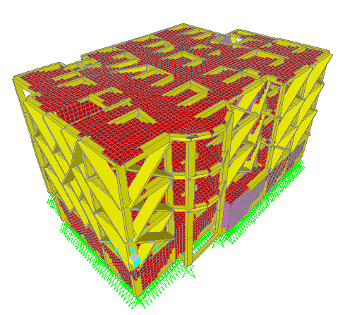
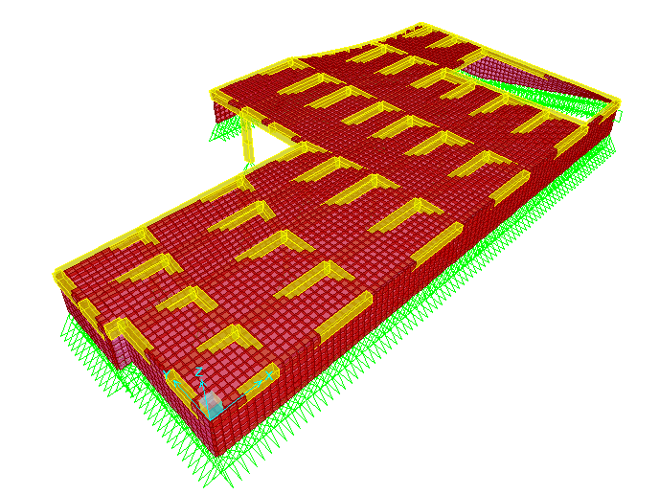
3D Model for The Blocks
Block B
Block A

Slide 32
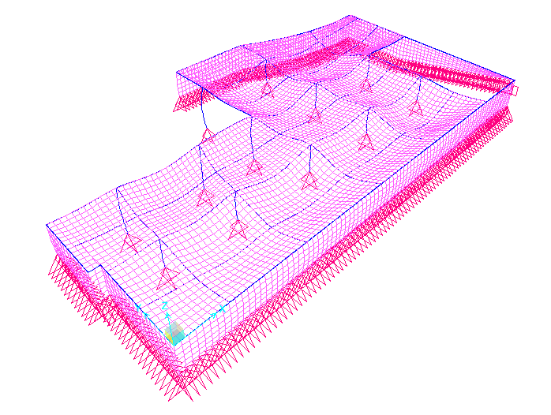
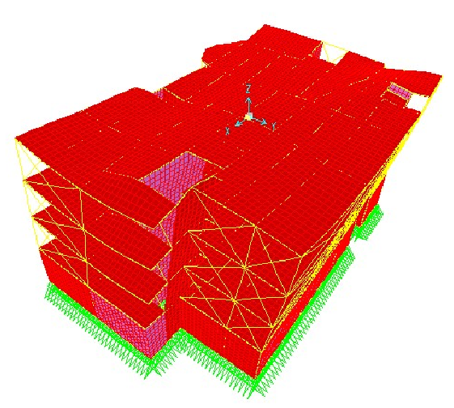
Deformed Shape
Block A
Block B

Slide 33
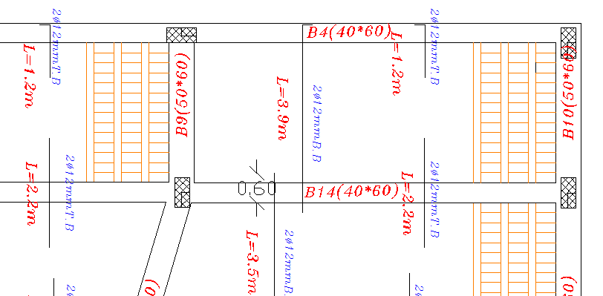
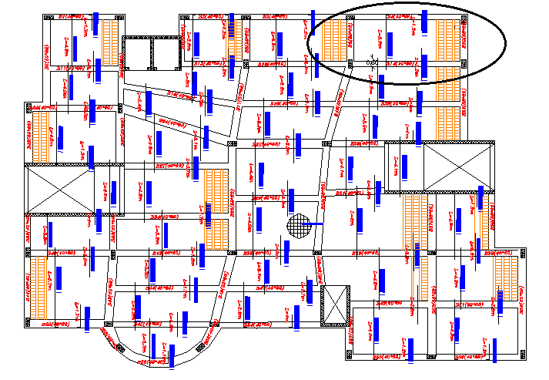
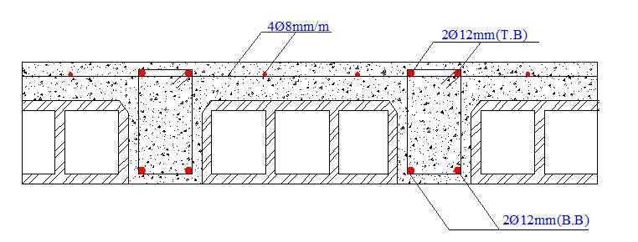
Design Stage
Slab reinforcement

Slide 34
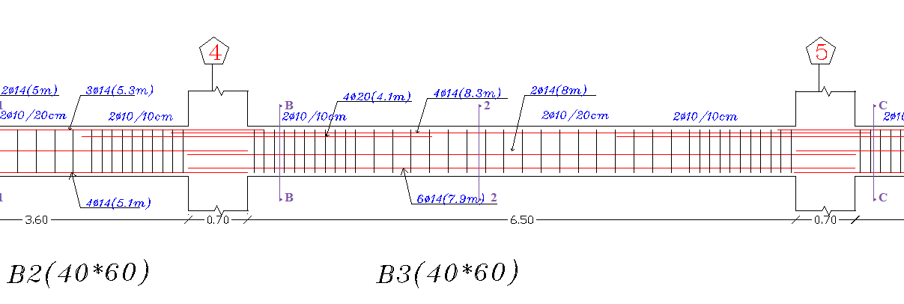
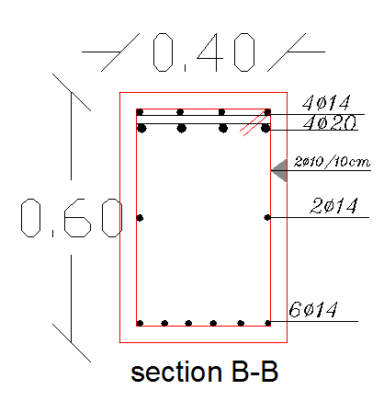
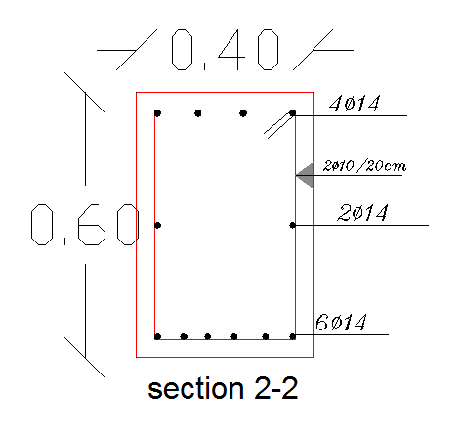
Design Stage
Beam reinforcement

Slide 35
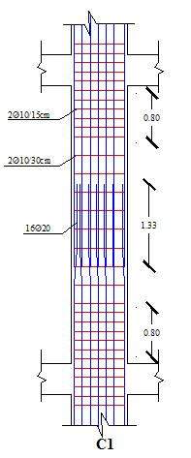
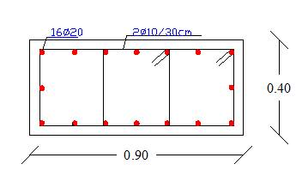
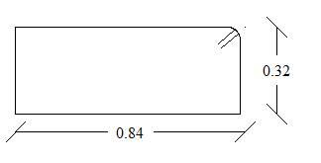
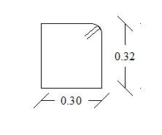
Design Stage
Column reinforcement

Slide 36
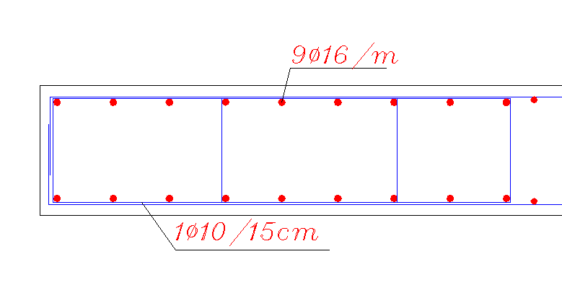
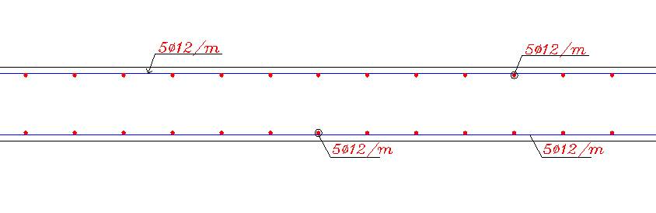
Design Stage
Shear wall reinforcement
For boundaries
For web

Slide 37
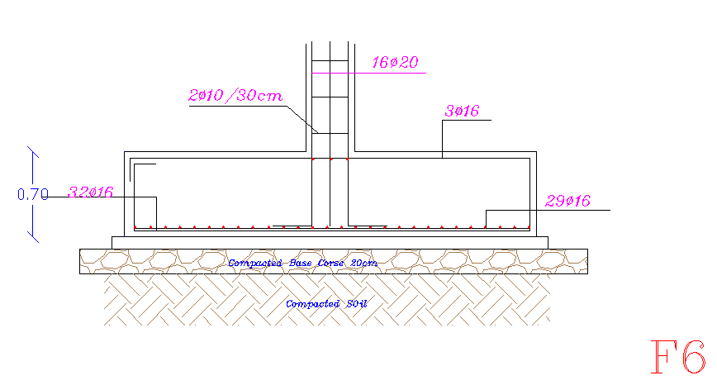
Design Stage
Footing reinforcement.
Isolated footing:

Slide 38
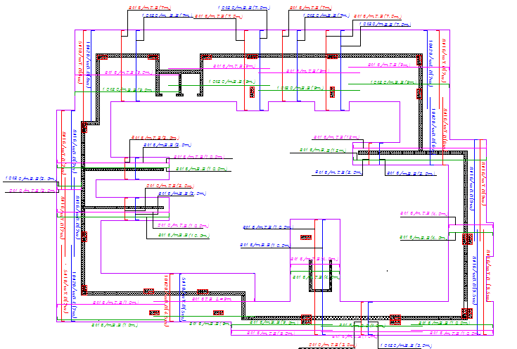
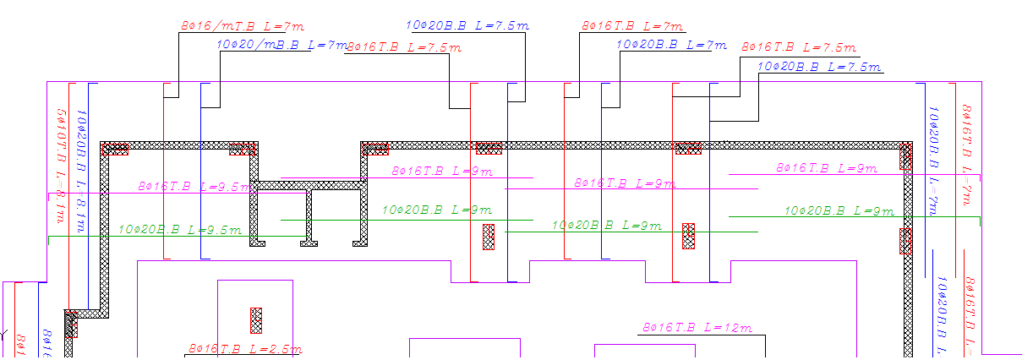
Design Stage
Footing

Slide 39
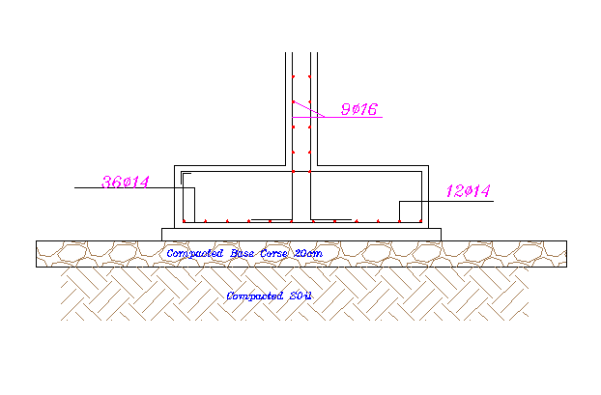
Design Stage
Wall footing

Slide 40
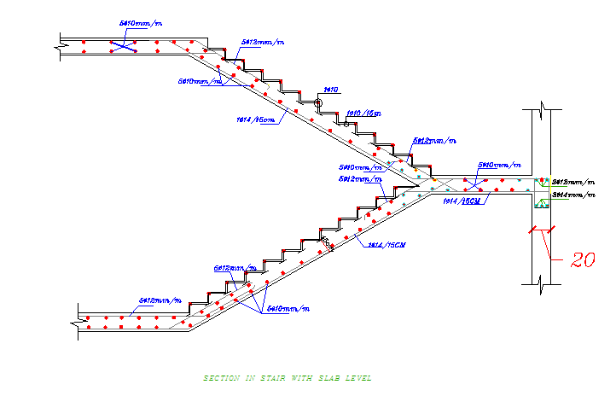
Staircase Design

Slide 41
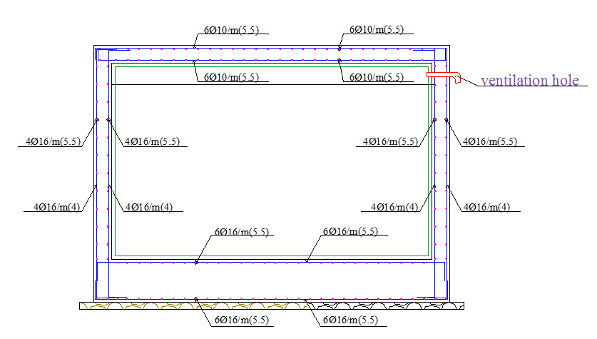
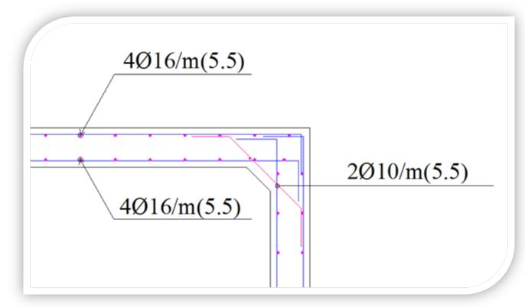
Design Stage
Water tank
(ACI 350.3-06) was used to compute loads applied on water tanks under earthquake action.
tank reinforcement

Slide 42
Electrical
Design

Slide 43
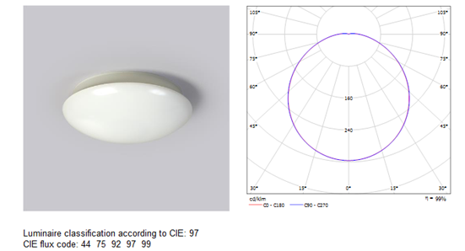

Electrical Design
staircase
W.C’s
corridors

Slide 44

Electrical Design
Store.
The recommended minimum luminance level E (lux) for store is equal to 300 lux. 4 luminaries are needed.

Slide 45

Electrical Design
Meeting room:
The recommended minimum luminance level E (lux) for meeting room is equal to 500 lux

Slide 46

Electrical Design
luminaries distribution for the ground floor

Slide 47

Electrical Design
Sockets distribution for the basement

Slide 48
Mechanical Design

Slide 49

Mechanical Design
Water supply for First floor

Slide 50

Mechanical Design
Supply water for bathroom

Slide 51

Mechanical Design
Drainage system

Slide 52

Mechanical Design
Drainage system for the roof.

Slide 53

Mechanical Design
HVAC system
1
1

Slide 54
Safety Design

Slide 55




Safety Design
Fire extinguishers
Fire hoses
Sprinklers system
Detectors
Fire Extinguisher
Hose Station
Sprinklers
Smoke Detectors

Slide 56


Safety Design
Sprinkler distribution in a clinic and laboratory.

Slide 57

Safety Design

Slide 58

Safety Design
Exit routs

Slide 59
Quantity Surveying and Cost Estimation
Cost ($) | Material
90700 | Steel
173000 | concrete
20130 | Mechanical work
2400 | HVAC
7800 | Electrical work
 | finishes
500$/m2 | Total/m2

Slide 60


