Slide 1

My Photographer
Prepared by: Imad & Kareem Shak’a
Supervised by: Dr. Luai M. Malhis
Department of Computer Engineering
Monday, December 9, 2013

Slide 2

Introduction and Motivation

Slide 3
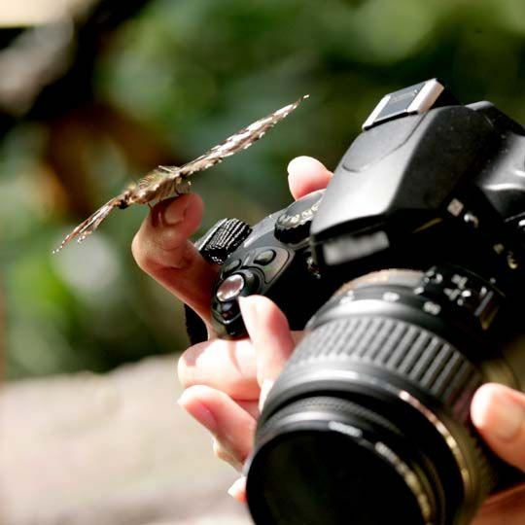
Everybody likes photography

Slide 4
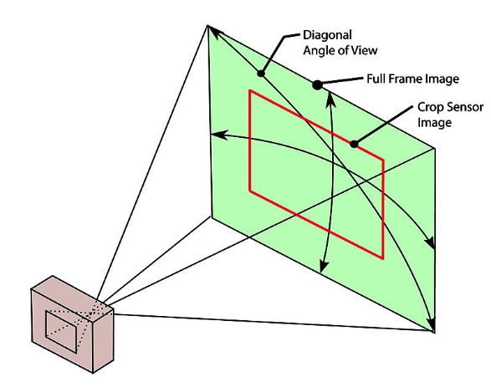

Slide 5
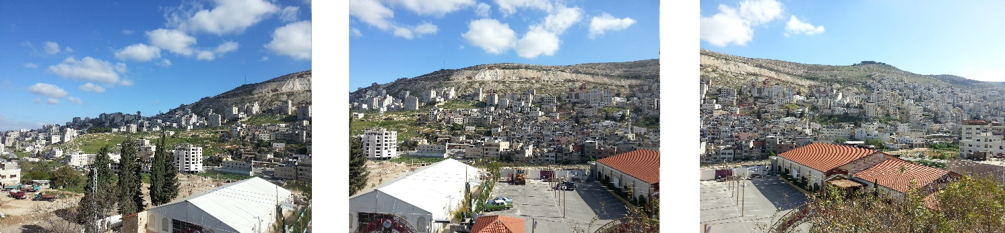
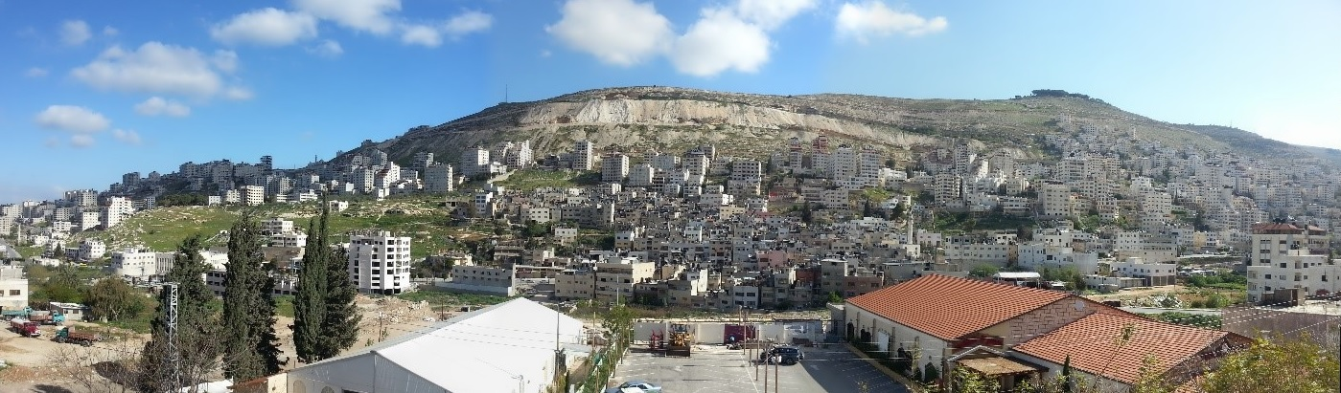
What is Panorama?
Panoramic Photography is capturing images on a wider format, so
It includes much more than what eyes can see naturally from a point.

Slide 6
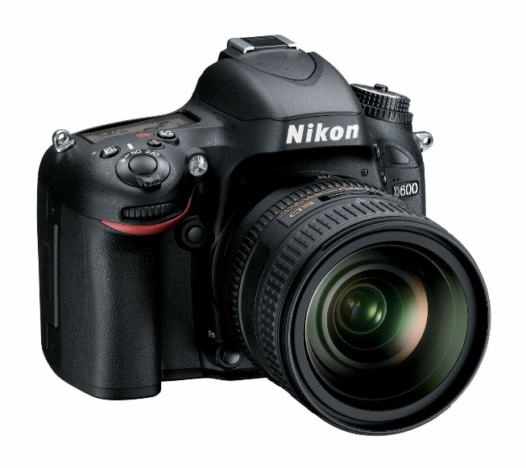

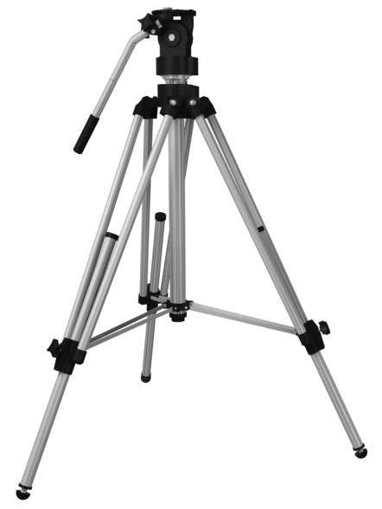

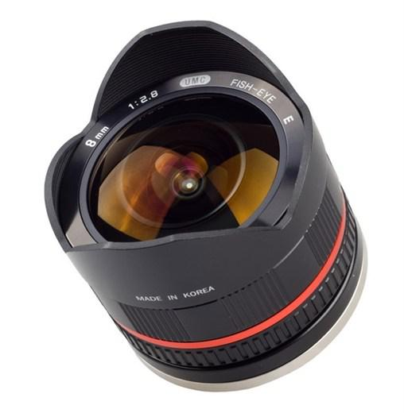
What you need to take a good one?

Slide 7
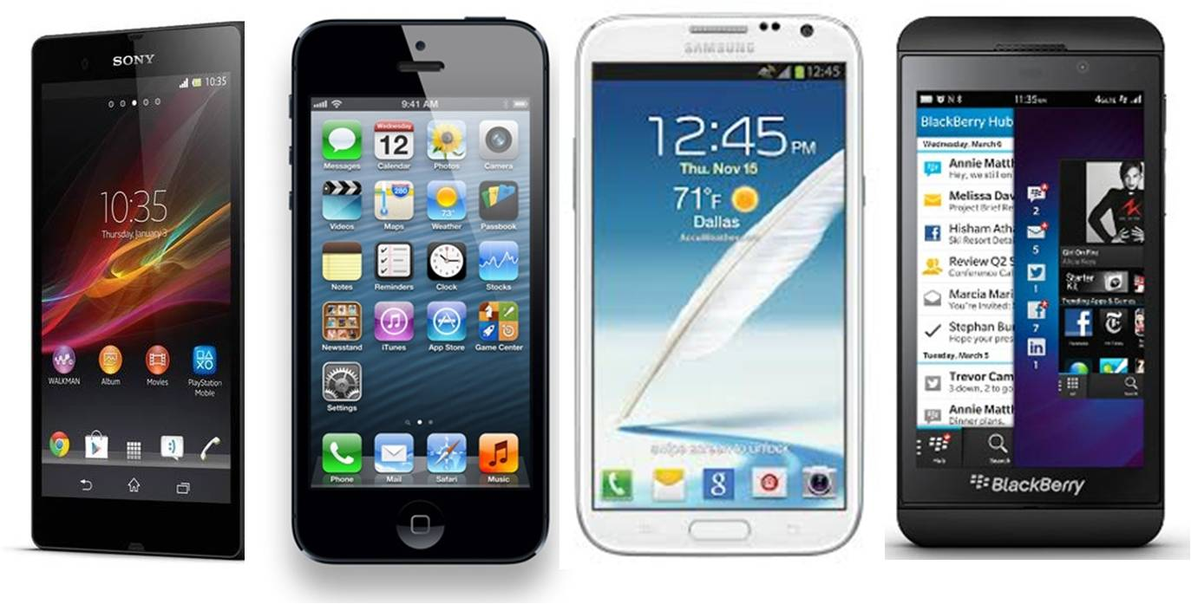

Slide 8


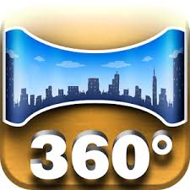
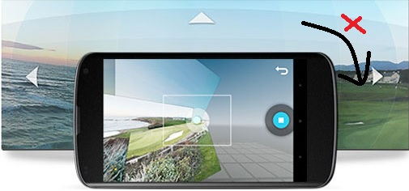
Existing Applications
FOCAL

Slide 9
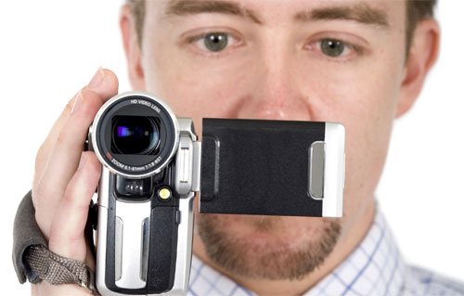
The problem in video recording

Slide 10
The Solution is
My Photographer

Slide 11

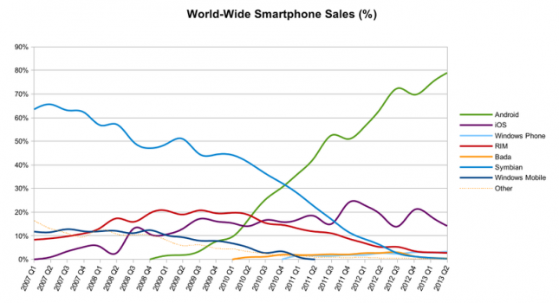
Why choosing Android?

Slide 12
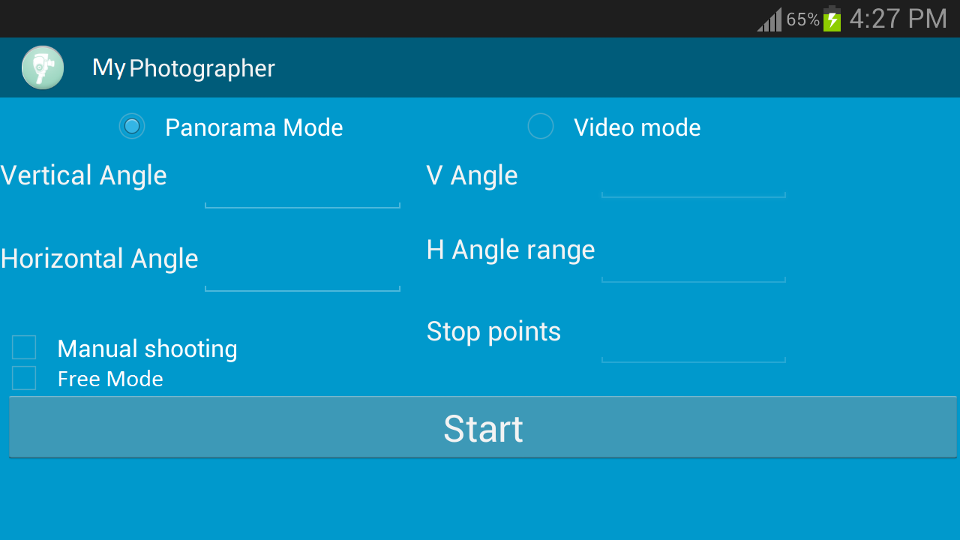

Slide 13
180
90
360
150
30:300; 90:30;

Slide 14
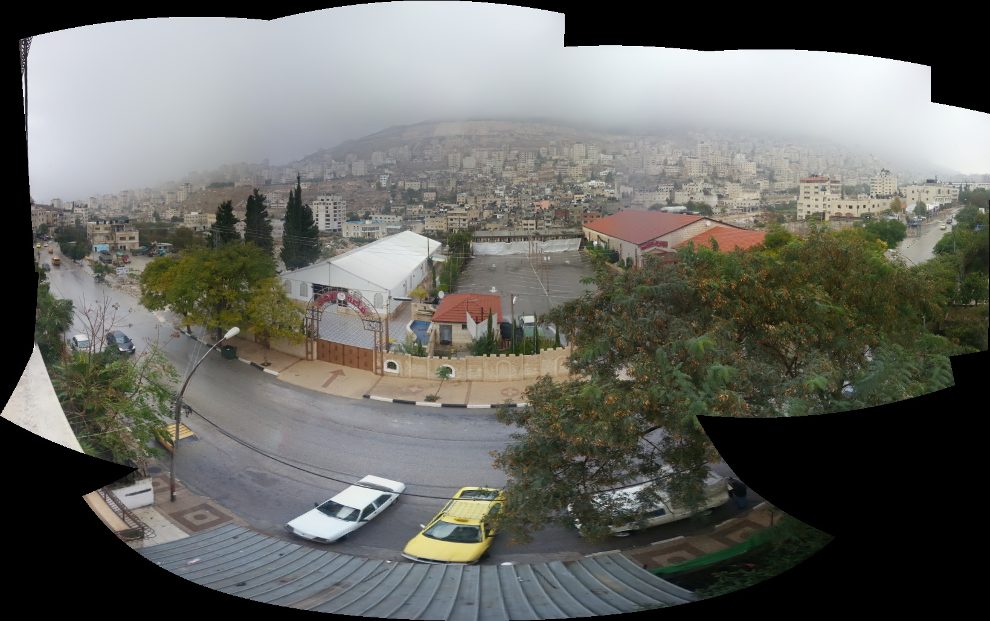
Default mode (By stand)

Slide 15
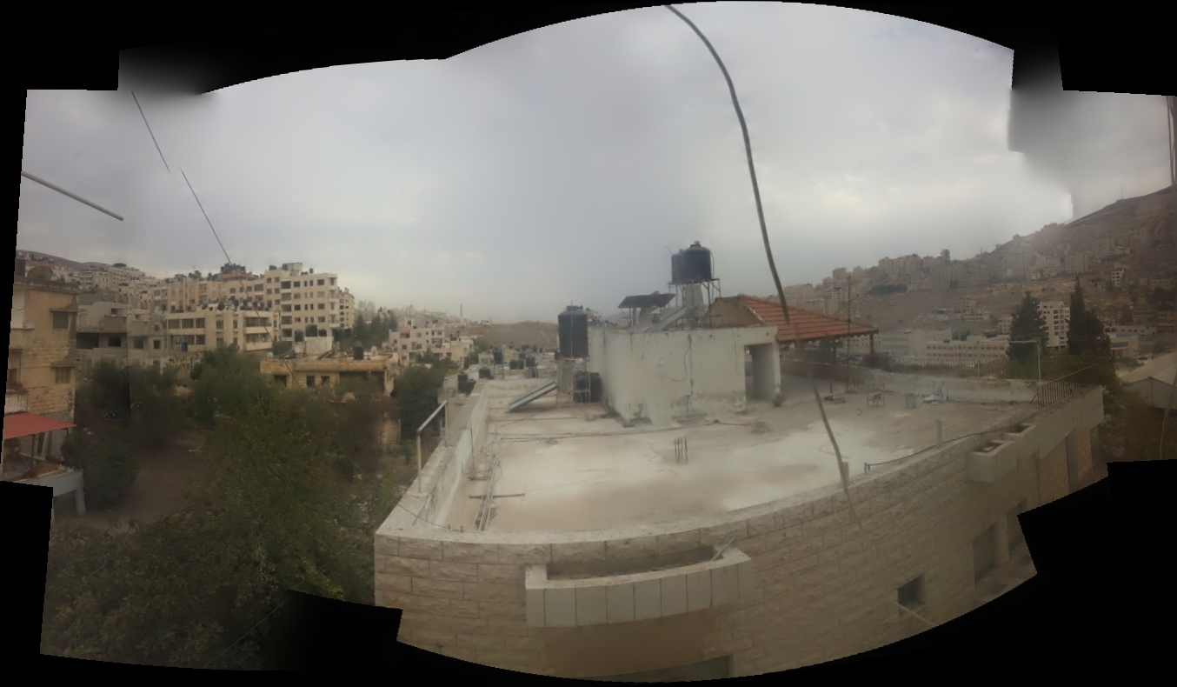
Manual mode (By hands)

Slide 16
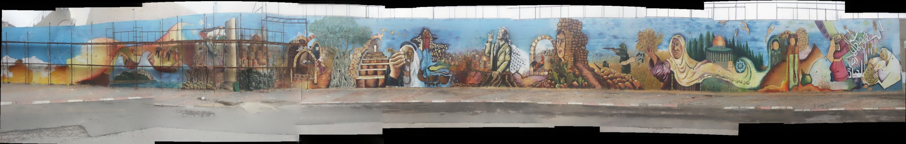
Free mode

Slide 17


Slide 18
Designing the stand with flexible motion in all direction.
Sending movement commands from mobile to the stand.
Capturing the appropriate photos according to Specific angles. And moving to the stop points in video mode.
Stitching photos to create the panoramic image.
Viewing the panoramic images in an interactive way.

Slide 19
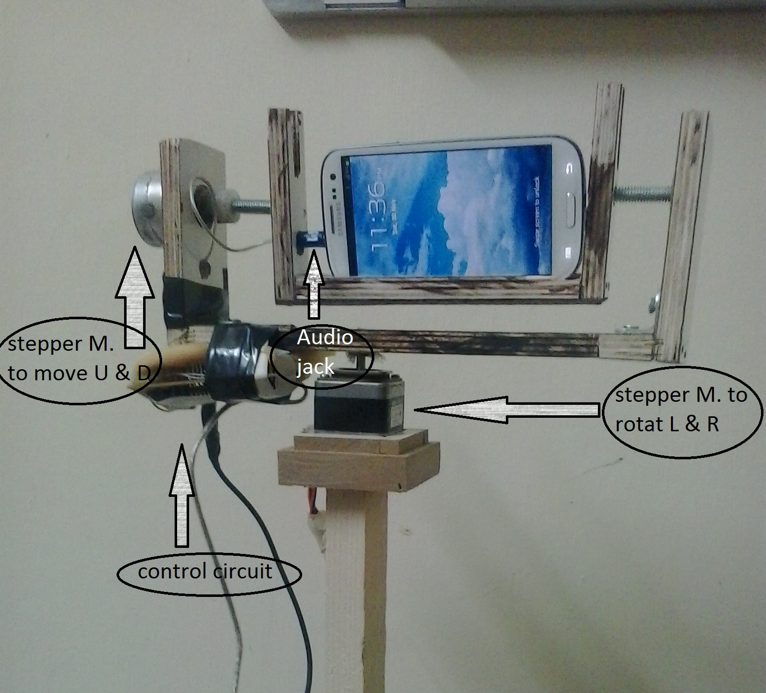
Designing the Stand

Slide 20
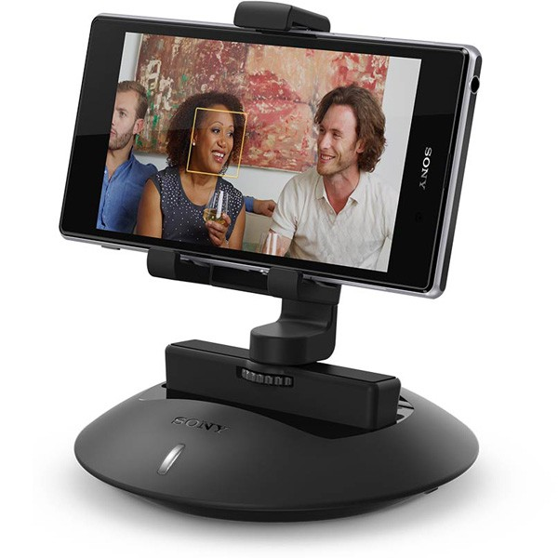
release by Sony in 27/9/2013

Slide 21
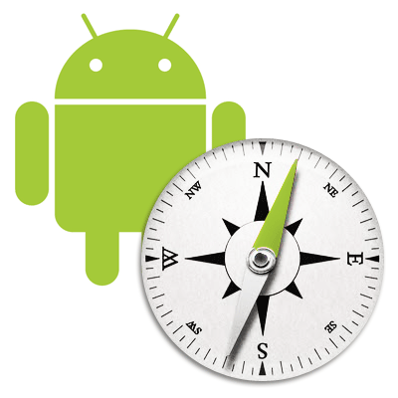
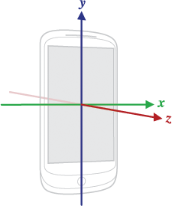
How to know the current angles?
Compass sensor
Accelerometer sensor

Slide 22
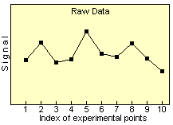
Signal Smoothing Algorithms

Slide 23
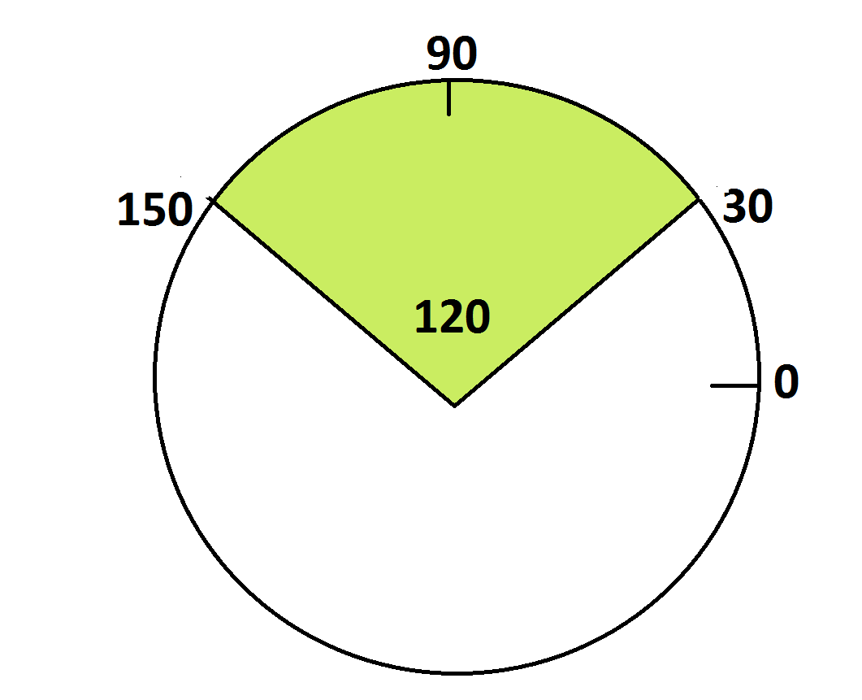

What is the appropriate photos

Slide 24
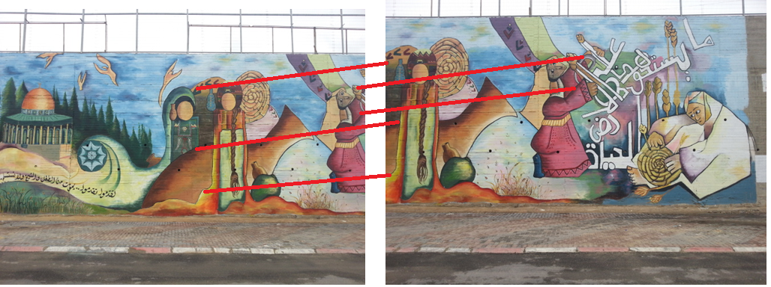
Stitching photos
- Finding the Key Points
Ex.

Slide 25
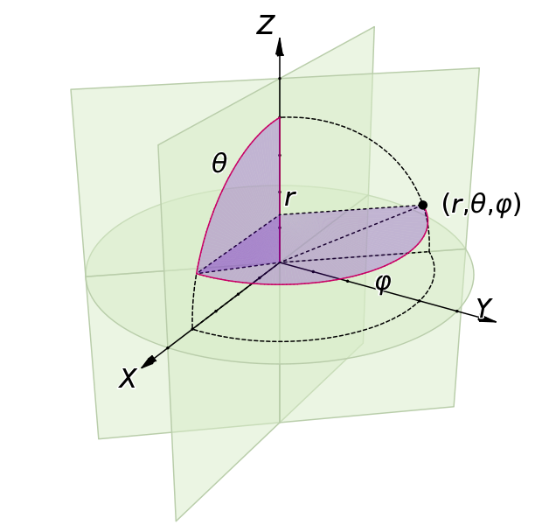
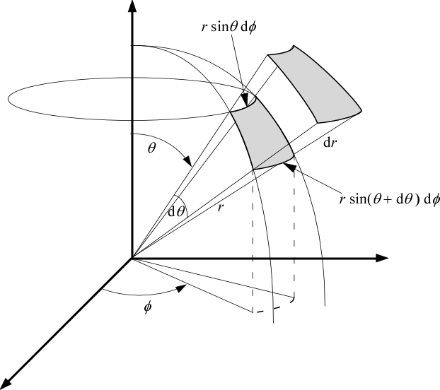
Find matches and change the scaling

Slide 26


The most important tools
NDK
Native Development Kit

Slide 27
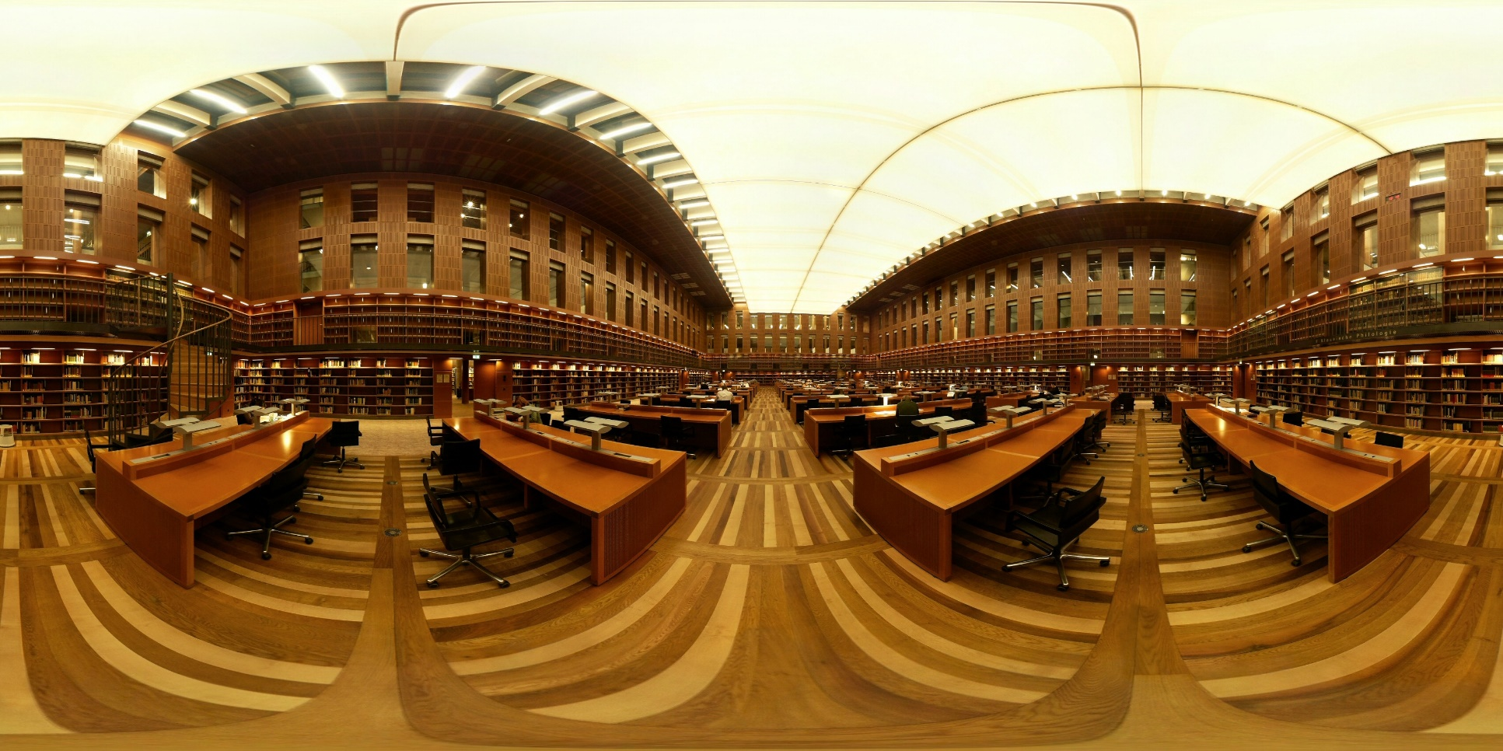
Viewer

Slide 28
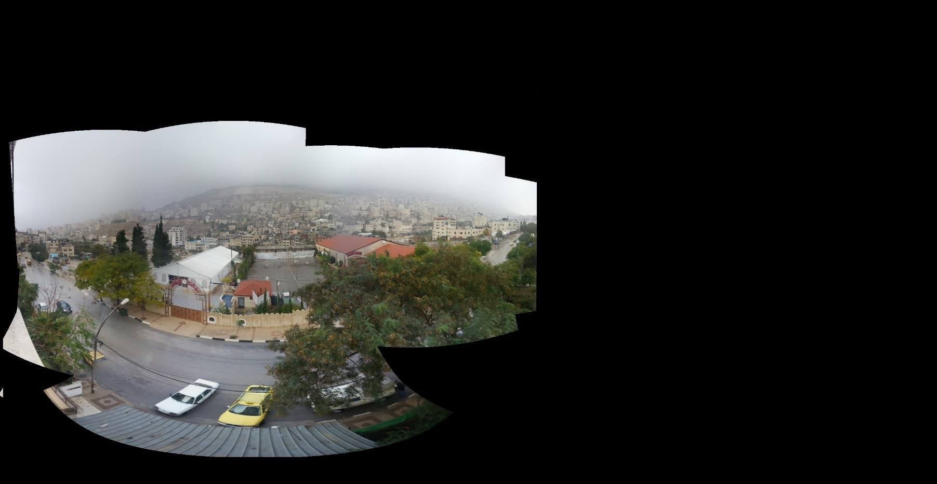
How about the partially spherical image

Slide 29
Demo 1: already done (Video recording)
Demo 2: Capturing Panorama
Demo 3: Viewer…

Slide 30
Question & Discussion

