Slide 1

Wireless Headphones
By:
Wala’ Amjad Faqeh
Manar Mousa Al-Hamaidi

Slide 2
Outlines
1
Introduction
What is “Wireless Headphone”?
2
Methods and Features
3
How does “Wireless Headphone” work?
4
Problems
Future work
Conclusion
References

Slide 3
Introduction
Large number of people use headphone.
Comfortable use is needed.
Long distance far from the source is required.
Control remotely.
Wireless headphone has been developed to give more comfort in listening and controlling.

Slide 4
What is “Wireless Headphone”?
WIRELESS HEADPHONE is a device designed to demonstrate the transmission and reception of audio signal.
Two RF modules used to transmit and receive.
Much more effective than ordinary communication.
Helps to receive audio signals from the computer without disturbing others.
Provides minimum transmission loss.
no more need for wires!!!

Slide 5
Methods and features
Methods:
Hardware components:
Laptop used to run sounds player program.
Pic18F4620 microcontroller to control overall process.
Two XBEE shields Series 1 (802.15.4) used to demonstrate the transmitter and receiver of audio signal.
EasyVR module to make voice recognition and make control on tracks by spoken words.

Slide 6
Software methods:
PICC Compiler used to write the code in C language which then compiled to a hex file and uploaded to PIC18F4620.
BootLoader program to upload a hex file into the PIC18F4620 Microcontroller.
Microsoft Visual C# 2010 used to implement sounds player software program.
X-CTU Program used to make the configurations and settings of the XBEE Shield.
EasyVR Commander to configure and train EasyVR module connected to PC through serial port.

Slide 7
B. Features
Facilitate people handling with sounds player with no wires needed.
Listen from a large distance that can reach about 100 m, more than Bluetooth support.
terrific choice for listening to sounds without disturbing others.
The actual, physical features are simple and uncomplicated.

Slide 8
Features cont.
User friendly sounds player application.
Easy to Send control requests by pushing a button or speak this request in the microphone.
Great solution for blind people that enable them to listen and control the tracks by using their voice.

Slide 9
How does wireless headphone work?
Wireless transmit the order to computer
The user open sound player.
Choose sound files for his list and can go far.
computer receive request.
Send file from it to the wireless shield that connected to computer.
ready to receive other requests
File received to XBEE #2
Headphone play the sound
Send music file by wireless to other side
User give order to computer.
Play the music file that user need.

Slide 10
Wireless Headphones system consists of three parts:
The transmitter.
The receiver.
Control unit.

Slide 11
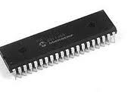
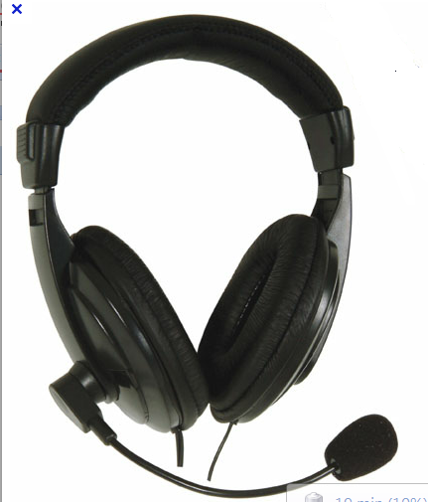
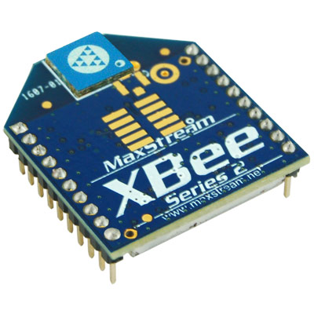
Parts of the receiver side
1: PIC18F4620
3: Headphone
2: XBEE (series1)

Slide 12
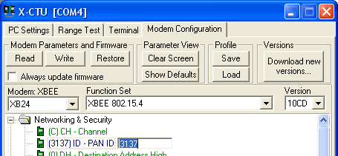
Making configurations of XBee
  Setting the network ID :
  Changing the PAN(Personal Area Network – ID
  Using X-CTU:
  select a new ID and we write it to the module
Notes:
For a simple network, we want two modems to talk only to each other.

Slide 13
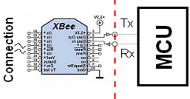
XBEE and Microcontroller(PIC) can be connected as follows:
Din and Dout pins on XBEE connected to PORT C on Microcontroller (pins C6 and C7) respectively that used to transmit and receive data serially.
XBEE with PIC

Slide 14
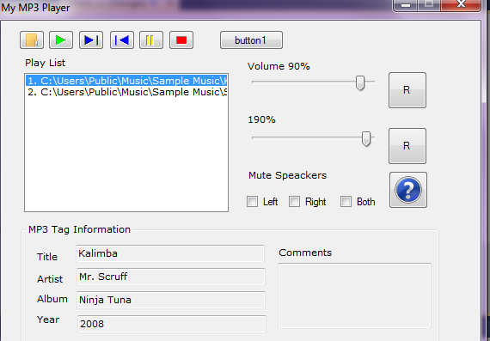
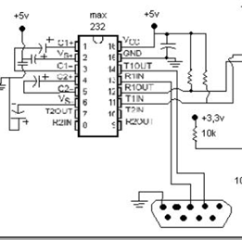
Parts of the transmitter side
1. Software application
2. XBEE
Notes:
Max picture

Slide 15
Software application
software application presents two functionality:
Play the sounds or tracks in PC.
Send sound to the user, so he can listen to this sound in his headphone.

Slide 16
Functions of the software application
Play function: we can take the path of files and play it in laptop .
Forward function: user can choose the next track in the list to play.
Backward function: user can choose the previous track in the list to play.
Stop function: stop the current playing sound file.
Thread function: single thread is used to perform the request. If another request comes, this thread appends its work and starts the new work depending on what user like to listen.

Slide 17
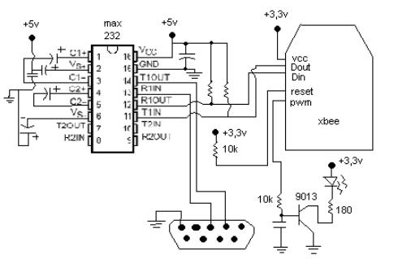
XBEE with MAX232 connection
Sound file is transmitted to the receiver depends on its request. This transmission is done by XBEE .

Slide 18
How to transmit sound
The XBEE has integrated A/Ds.
This allow the module to be connected directly to analog devices.
Analog devices can send analog signal serially.
that signal transmitted directly to the other XBEE in the receiver side.
Notes:
ADCs (Analog to Digital Converters) is to allow the analog signals to be converted to a digital format that can be easily read/transmitted in digital form

Slide 19
Enabling the A/D s in XBEE
The A/D feature can be enabled with the ATDx=2 command
Vref : able to read analog signals (0 < Vref <= Vcc).
Notes:
The XBee has 6 usable A/D pins on it that allow the user to select one or all of those A/Ds

Slide 20
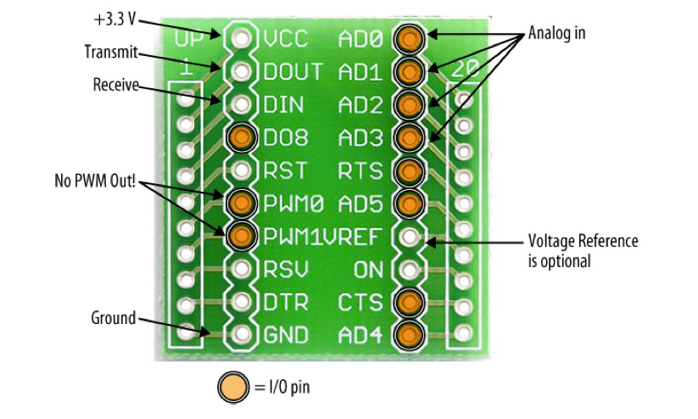
Input/Output Wiring

Slide 21
How to receive sound
PWM Data
take the output from PWM in XBee on receiver side .
In order to enable PWM output then we set ATP0 and/or ATP1 equal to 2 (this will only convert for A/D-0 and A/D-1 respectively).

Slide 22
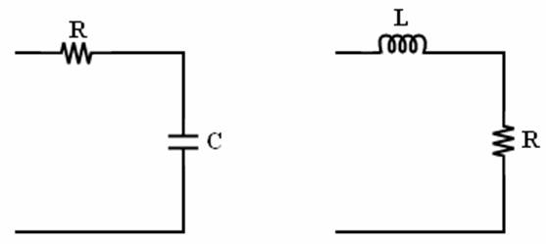
How to minimize noise
A low pass filter can be used to out an analog signal without noise.
So this give 3.5 KHZ
RC Filter RL Filter
Notes:
Output from xbee#2 that take it from pwm
Enter to low pass filter

Slide 23
Control part
Control on sound tracks that have to be sent to the transmitter has been done by two ways:
By using four push buttons to:
Play
Stop
Go next
Go back
By using voice recognition to several words as the four orders above.
Notes:
حطي بتن
صوت

Slide 24
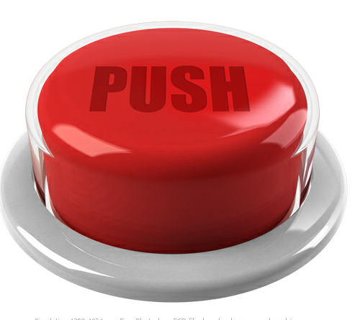
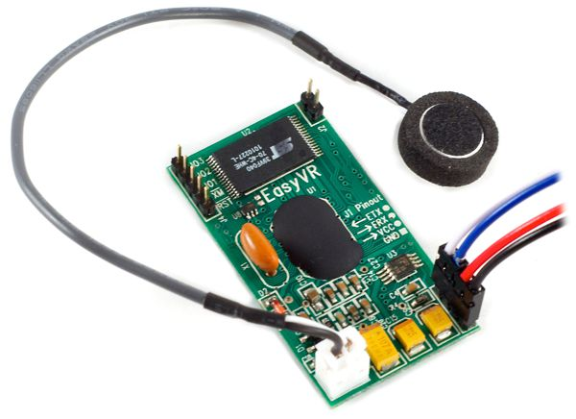
Components of Control unit
1. Push buttons
2. EasyVR
Notes:
بتن

Slide 25
Push buttons
Used to give order by pressing a button:
Forward
Backward
Stop
Play

Slide 26
Making configurations of EasyVR
At first, configure baud rate to be 9600,8 bit data, No parity,1 bit stop.
Speech Recognition:
Notes:
The recognition function of the EasyVR works on a single group at a time, so that users need to group together all the commands that they want to be able to use at the same time.
When EasyVR Commander connects to the module, it reads back all the user-defined commands and groups, which are stored into the EasyVR module non-volatile memory. You can add a new command by first selecting the group in which the command needs to be created and then using the toolbar icons or the “Edit” menu.
A command should be given a label and then it should be trained twice with the user's voice: the user will be guided throughout this process when the "Train Command" action is invoked.
You can add a new command by first selecting the group in which the command needs to be created and then using the toolbar icons or the “Edit” menu.
A command should be given a label and then it should be trained twice with the user's voice: the user will be guided throughout this process when the "Train Command" action is invoked.

Slide 27
EasyVR cont.
We choose one group and use four commands:
Forward
Backward
Stop
Play

Slide 28
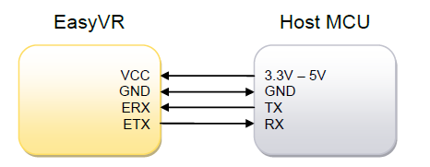
EasyVR connection with PIC
Communication with the EasyVR module uses a standard UART interface.
A typical connection to an MCU-based host:

Slide 29
Microphone
The microphone provided with the EasyVR has the following properties:
Sensitivity -38dB
Load Impedance 2.2K
Operating Voltage 3V
Almost flat frequency response in range 100Hz – 20kHz

Slide 30

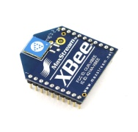

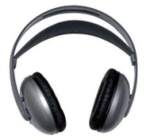
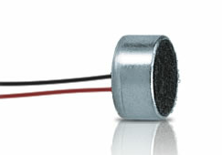
Work flow of the system
C# sounds player program
Send order to laptop
Serial
Connection
Sending sounds via wireless
PIC18F4620

Slide 31
problems
waiting for a long time for the arrival of the two XBEE shields to the electronics market
Another solution is Wi-Fi shield, but it has a Volatile memory and every time it operate, needs to reconfigure its IP address.
Not hearing a correct output sound signal in the speaker but just noise.

Slide 32
Future work
Ideal for all types of modern music and TV use.
Make chatting by listening and speaking also from a very long distance far from the device.
Add another control way on sound. For example, by hand movement.
Using other communication methods to reach very long distances in Km.
Several choices of sound effects.
Ability to recharge to long hours using batteries.

Slide 33
Result
We can listen to sounds from laptop.
We can control the list of sounds by tow ways:
Voice.
Buttons.
But yesterday after we were trying to transmit sound to headphone the XBEE was destroyed.

Slide 34
Conclusion
Wireless headphones project keeps you a way from complicated connection wires. Listen sound from distance which reach 100 m.
It allows you to make control on the tracks you listening to in two easy ways: buttons and voice.

Slide 35
References
Tutorial for XBee Shield:
http://www.sparkfun.com/products/9976
Manual for EasyVR:
http://www.veear.eu/
DataSheet for PIC18F4620:
http://ww1.microchip.com/downloads/en/devicedoc/39626b.pdf
DataSheet for different IC’s:
www.alldatasheet.com
C# pieces of codes:
http://www.codeproject.com/KB/cs/

Slide 36

Any Questions?

Slide 37


