Slide 1

PropertyPro

Slide 2
INTRODUCTION
PropertyPro is a platform for selling and renting properties like apartments, chalets and separate rooms rental.

Slide 3
OBJECTIVES
Make it easy for owners to show off their properties.
Simplify the process of searching for a place to live, allowing users to connect directly with property owners.

Slide 4
USER ROLES
Normal User
Admin User
                Can add their properties.
                View other properties.
View Statistics.
Manage Properties.
User Management.
                to rent
                to buy

Slide 5
PLATFORMS
Mobile app (normal user).
Website (normal user).
Dashboard (admin).

Slide 6








TOOLS

Slide 7
FEATURES
Add Properties
Google Maps
Rate Properties
Notification
Roommate Match
Payment
Filtering
Booking Chalet
Chatting
Admin Dashboard

Slide 8
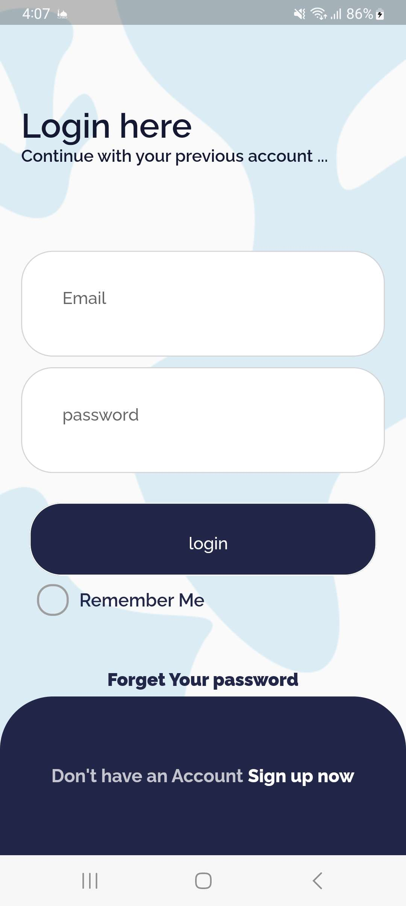
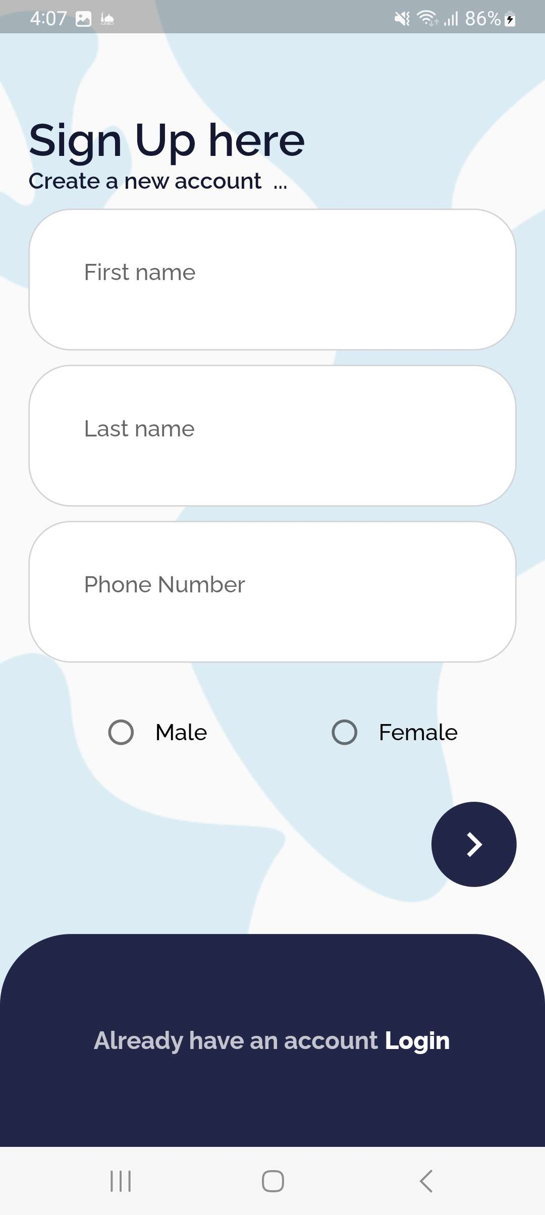
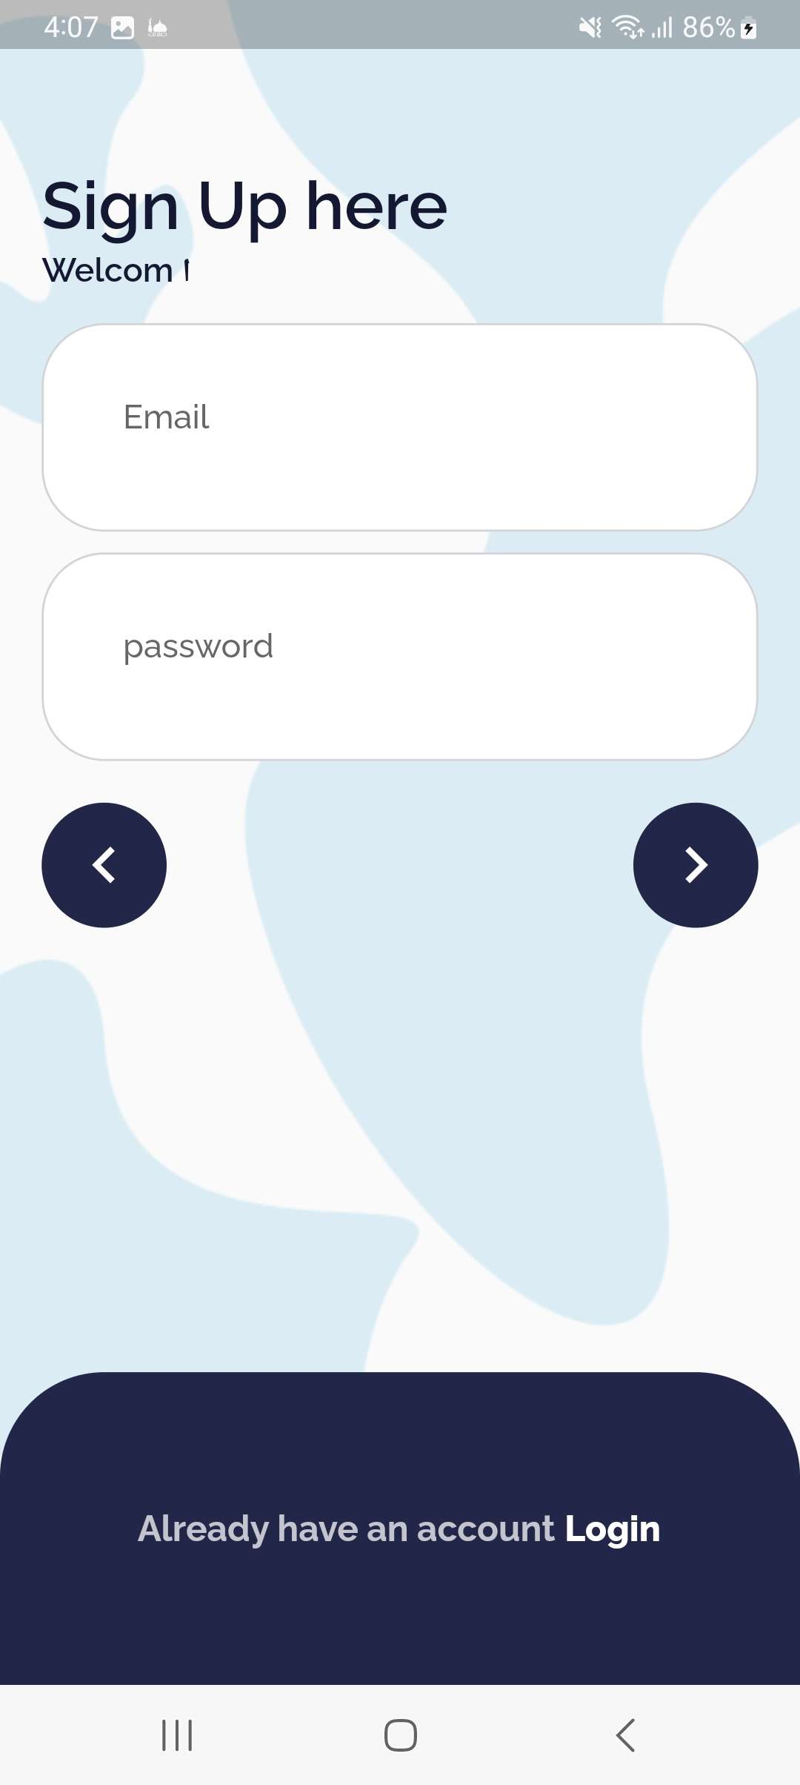
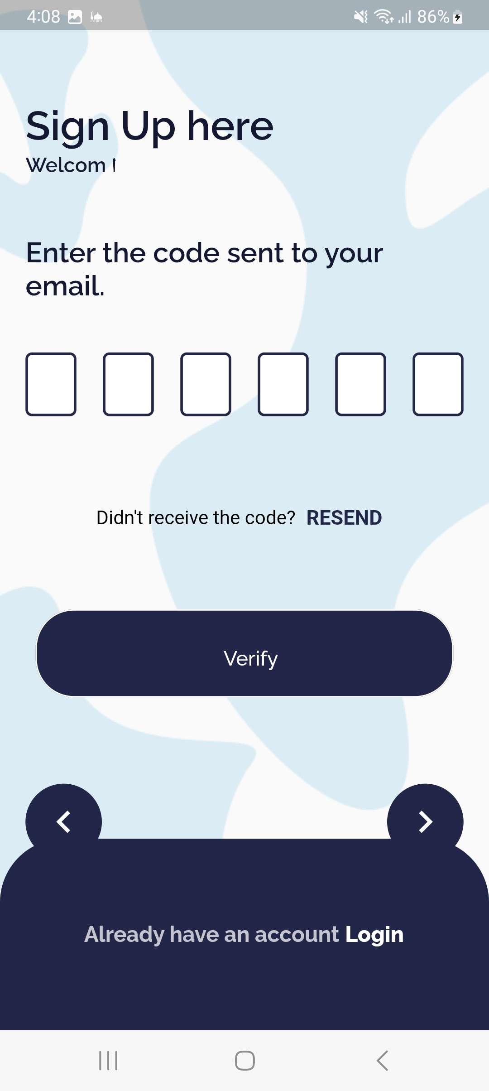
LOGIN & SIGNUP

Slide 9
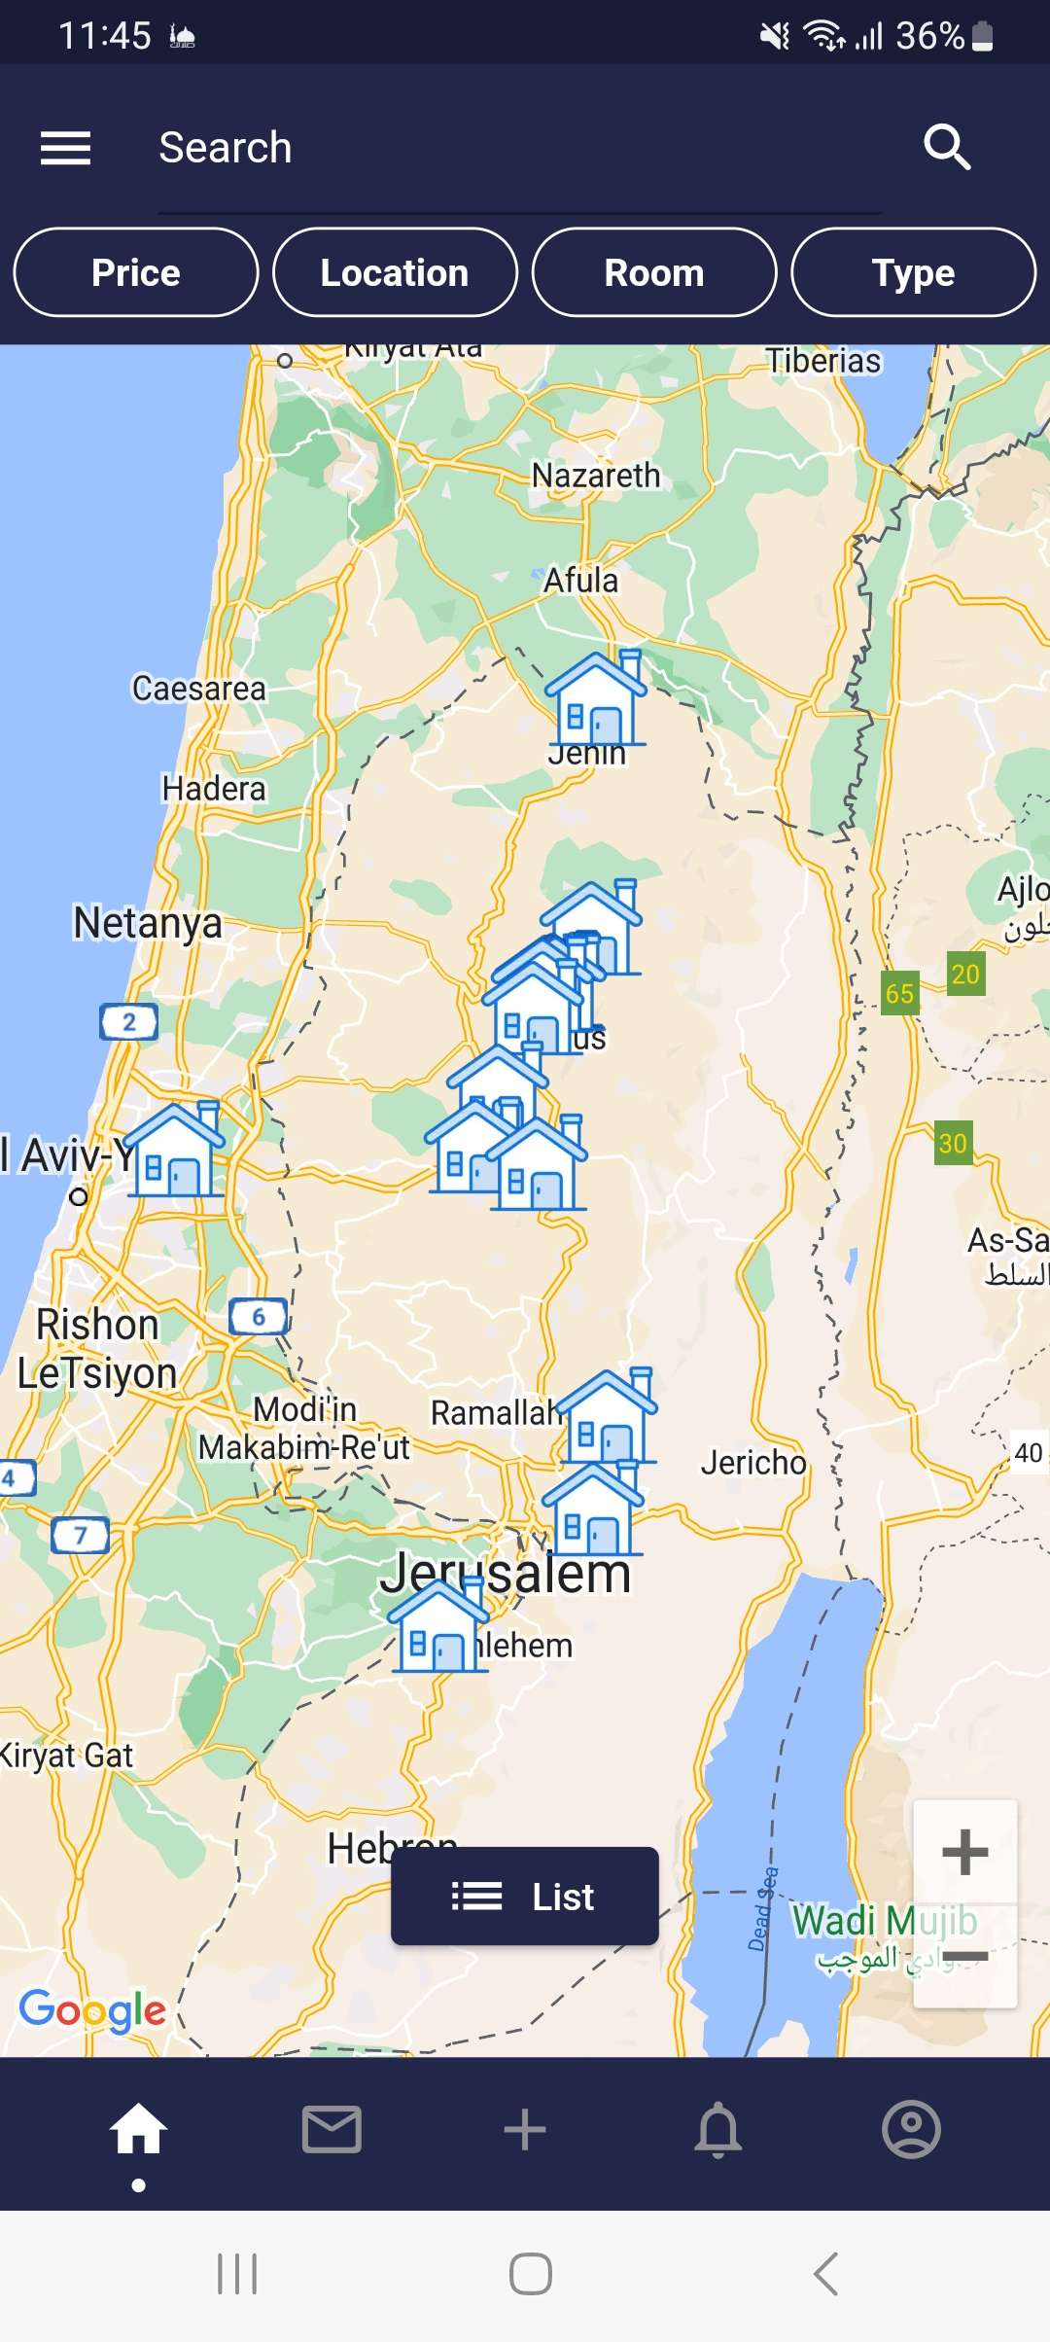
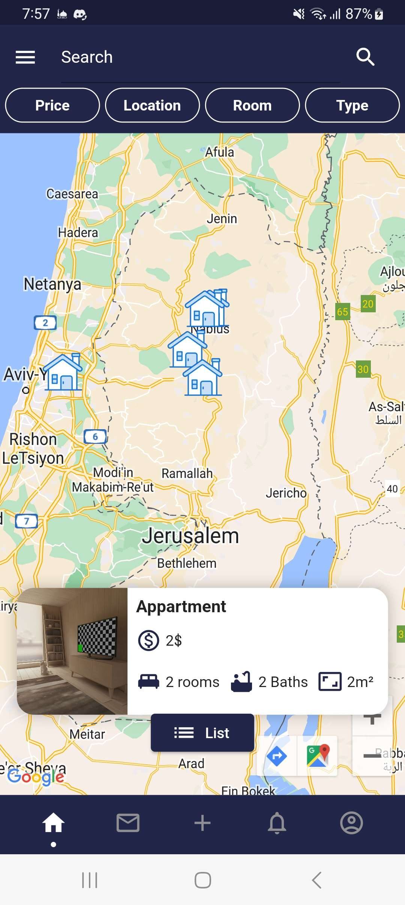
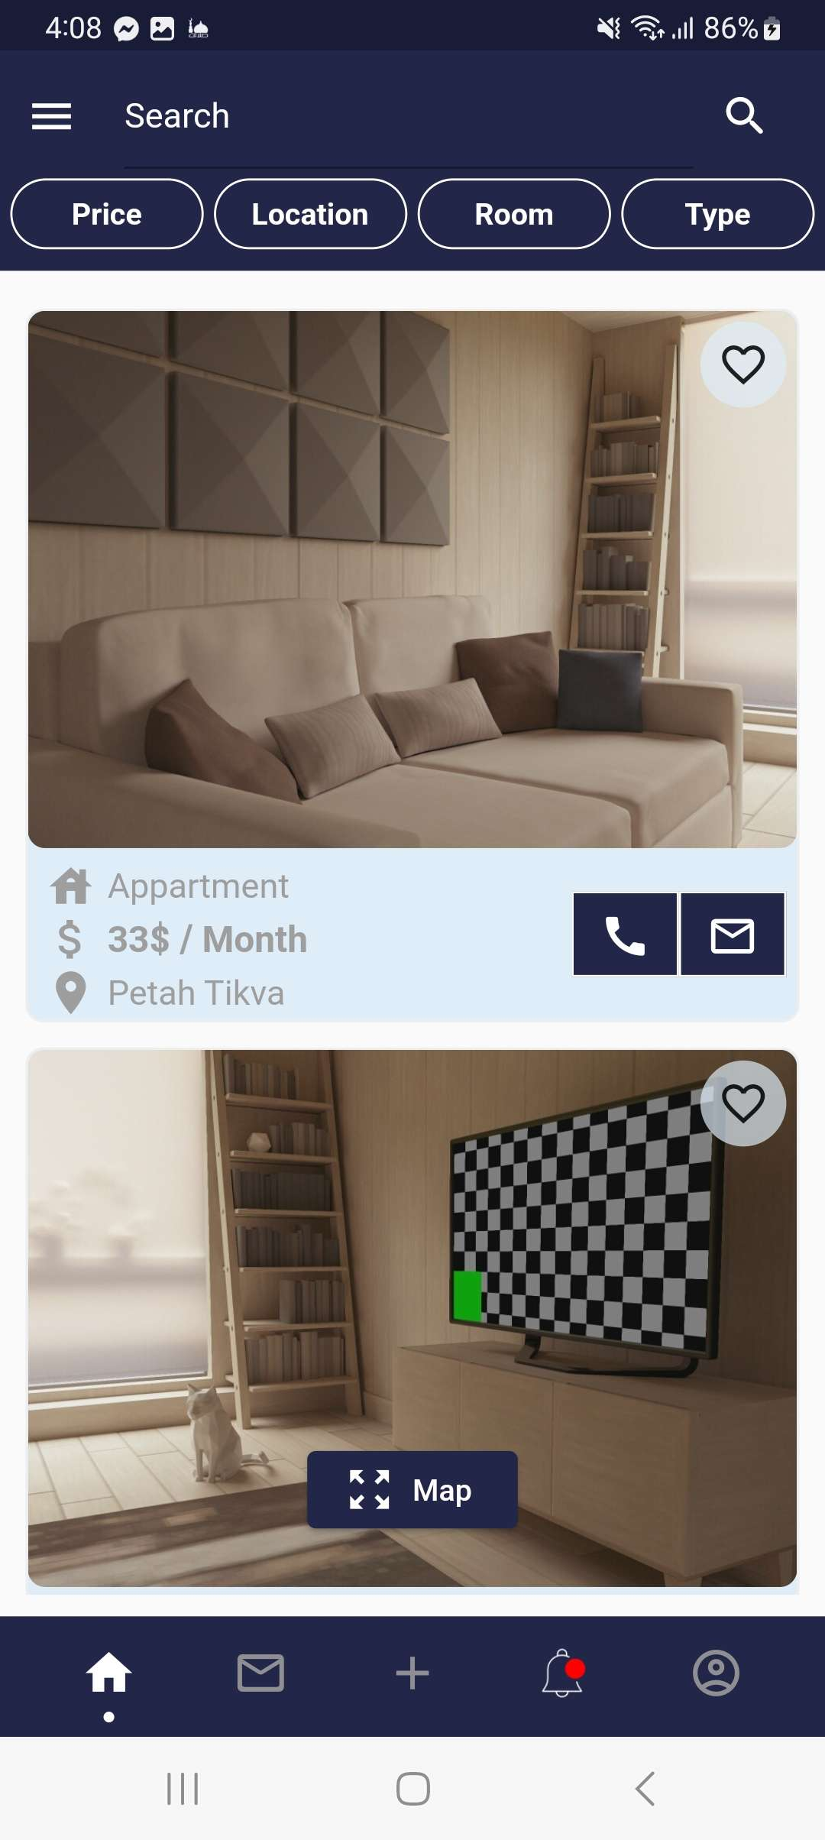
HOME PAGE

Slide 10
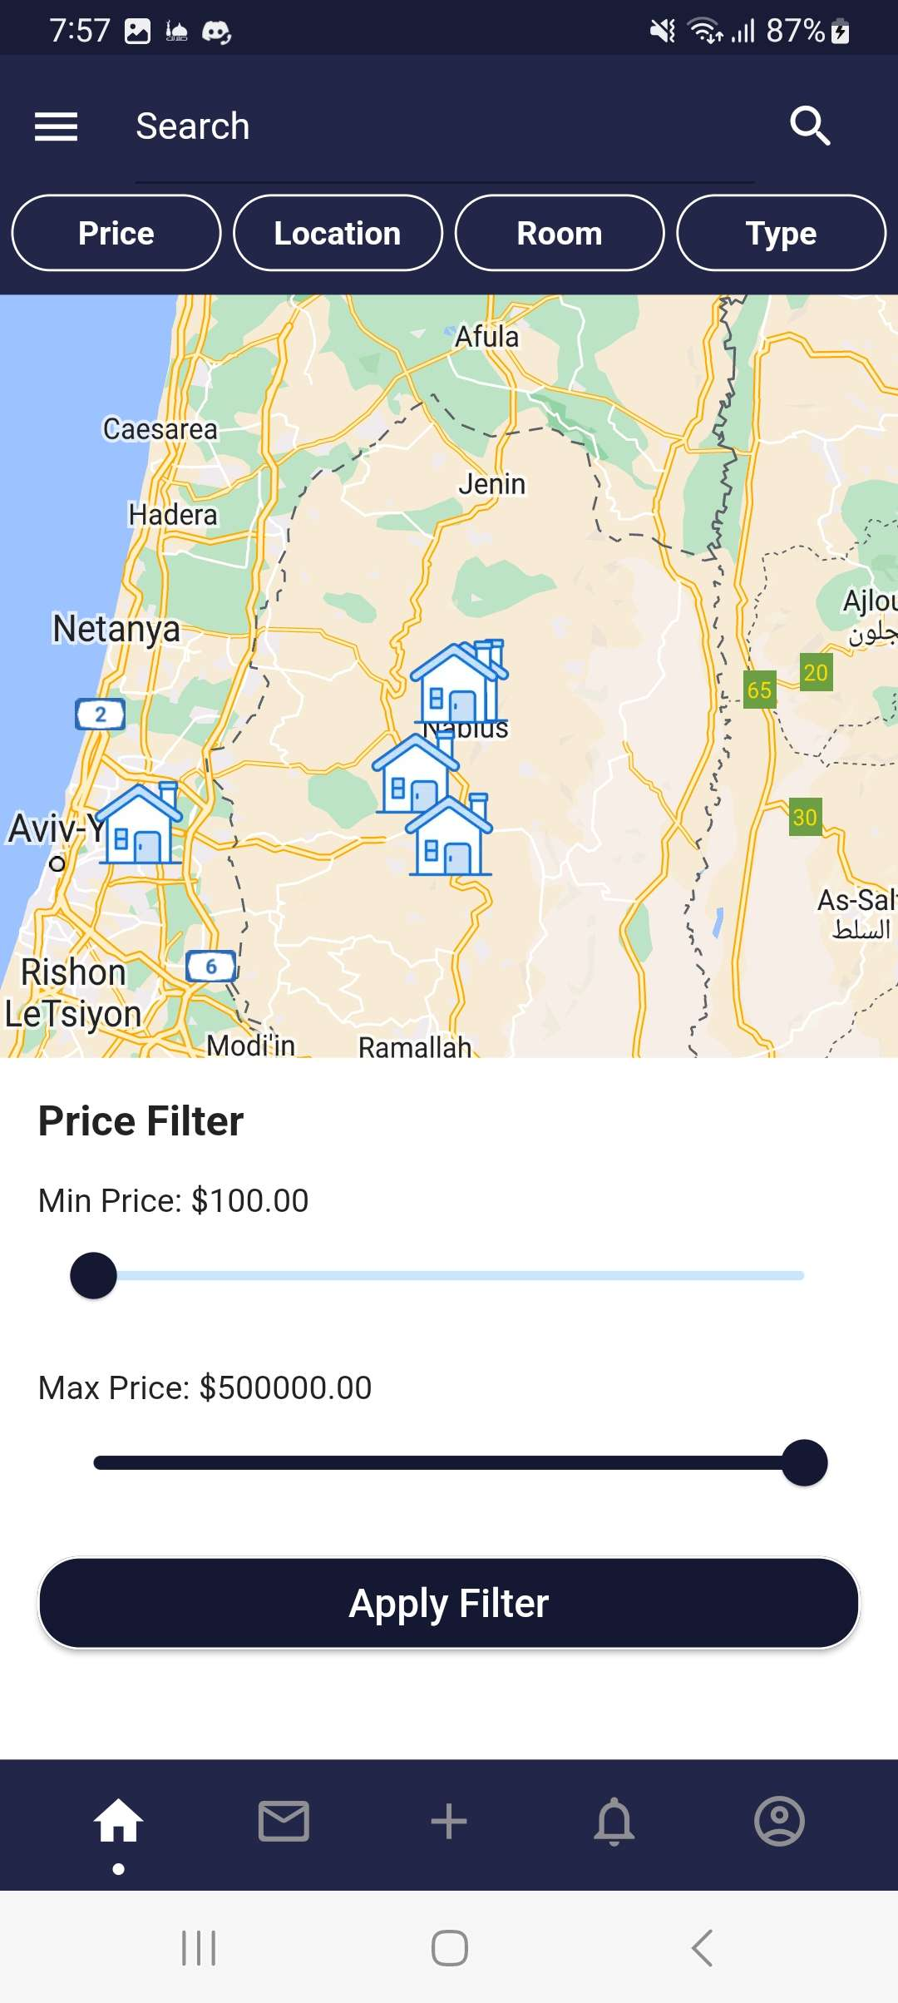
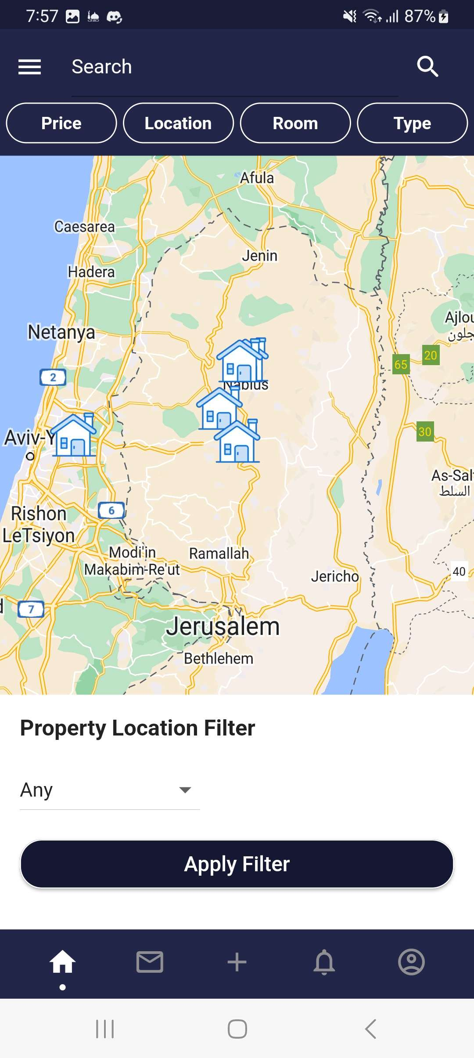
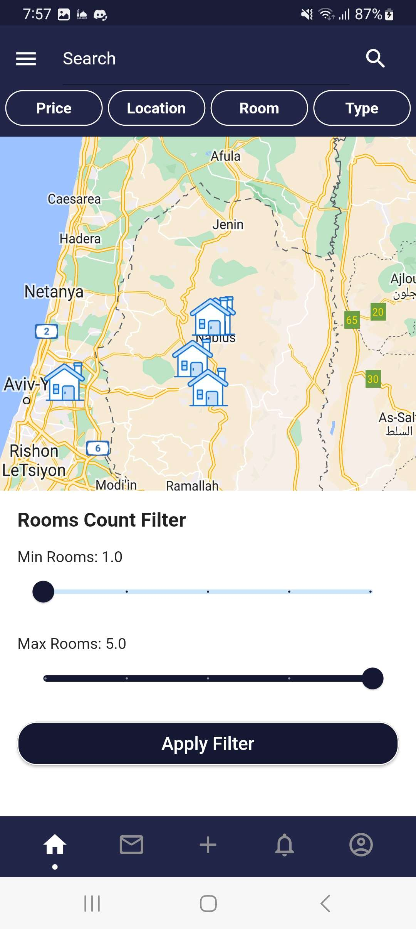

SEARCH FILTER

Slide 11
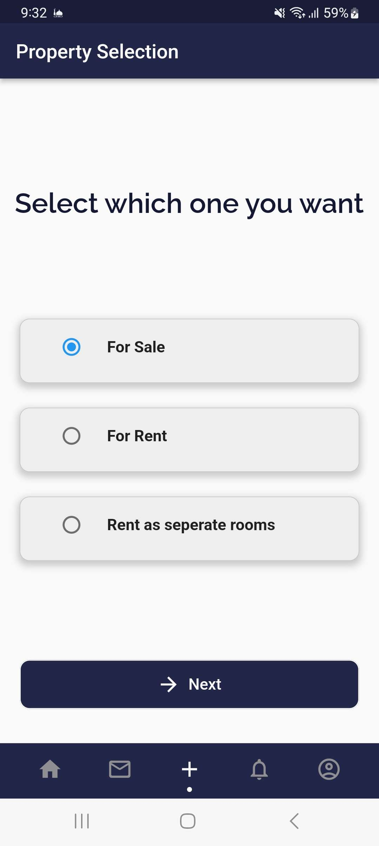
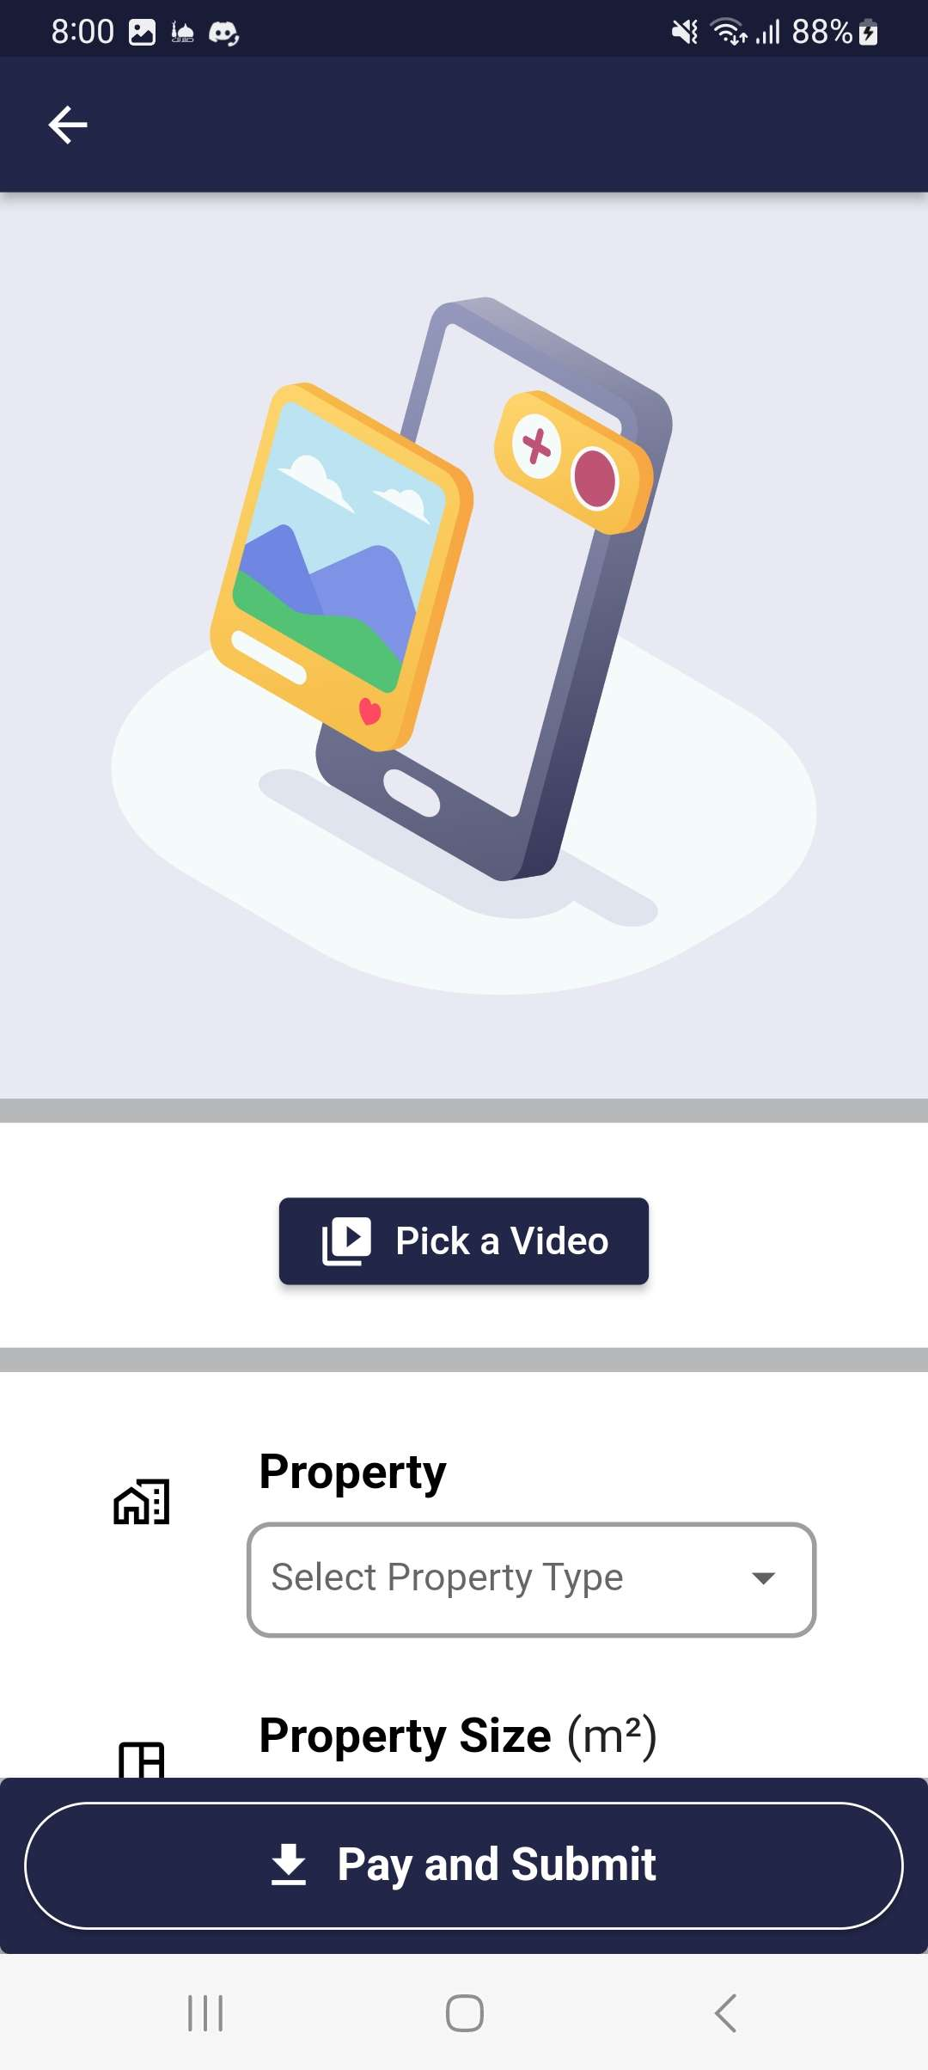
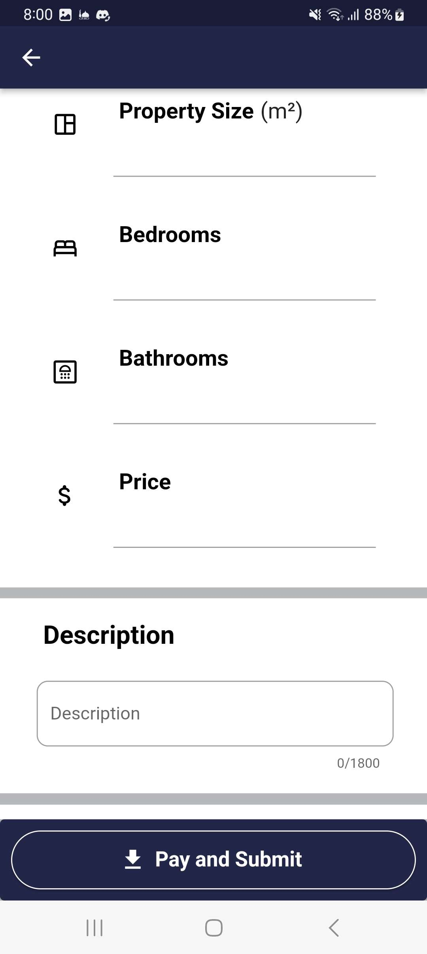
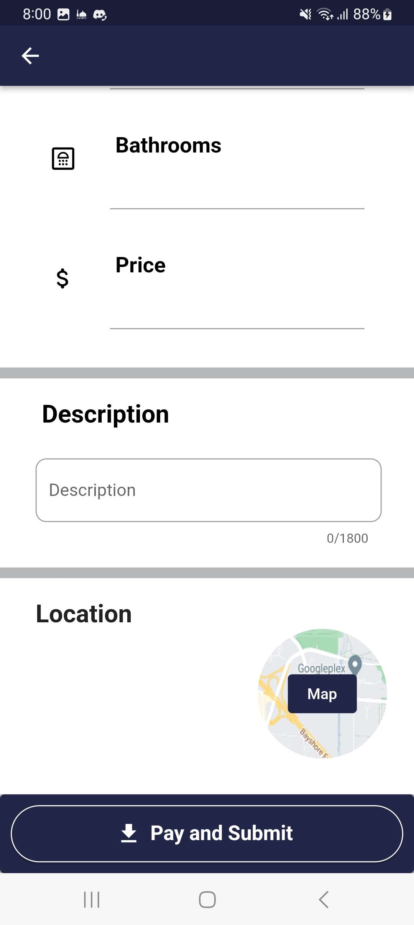
ADD PROPERTIES

Slide 12
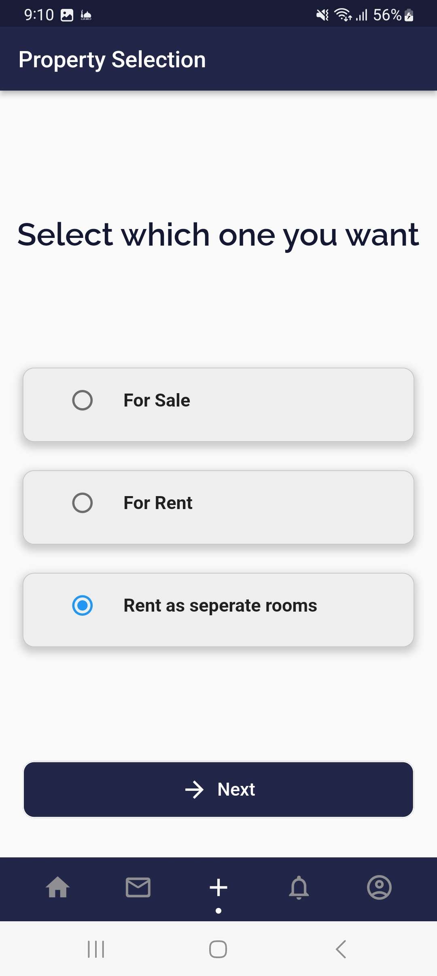
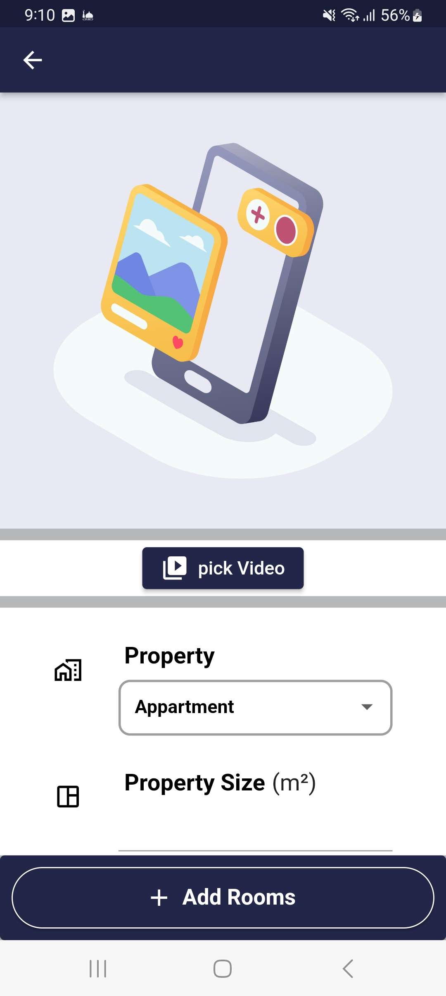
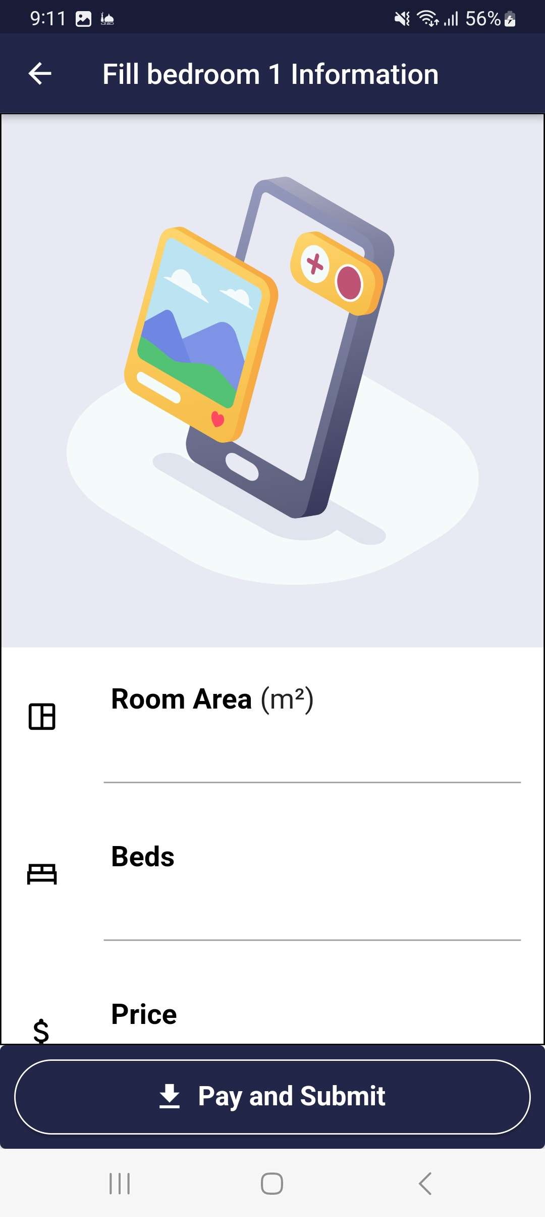
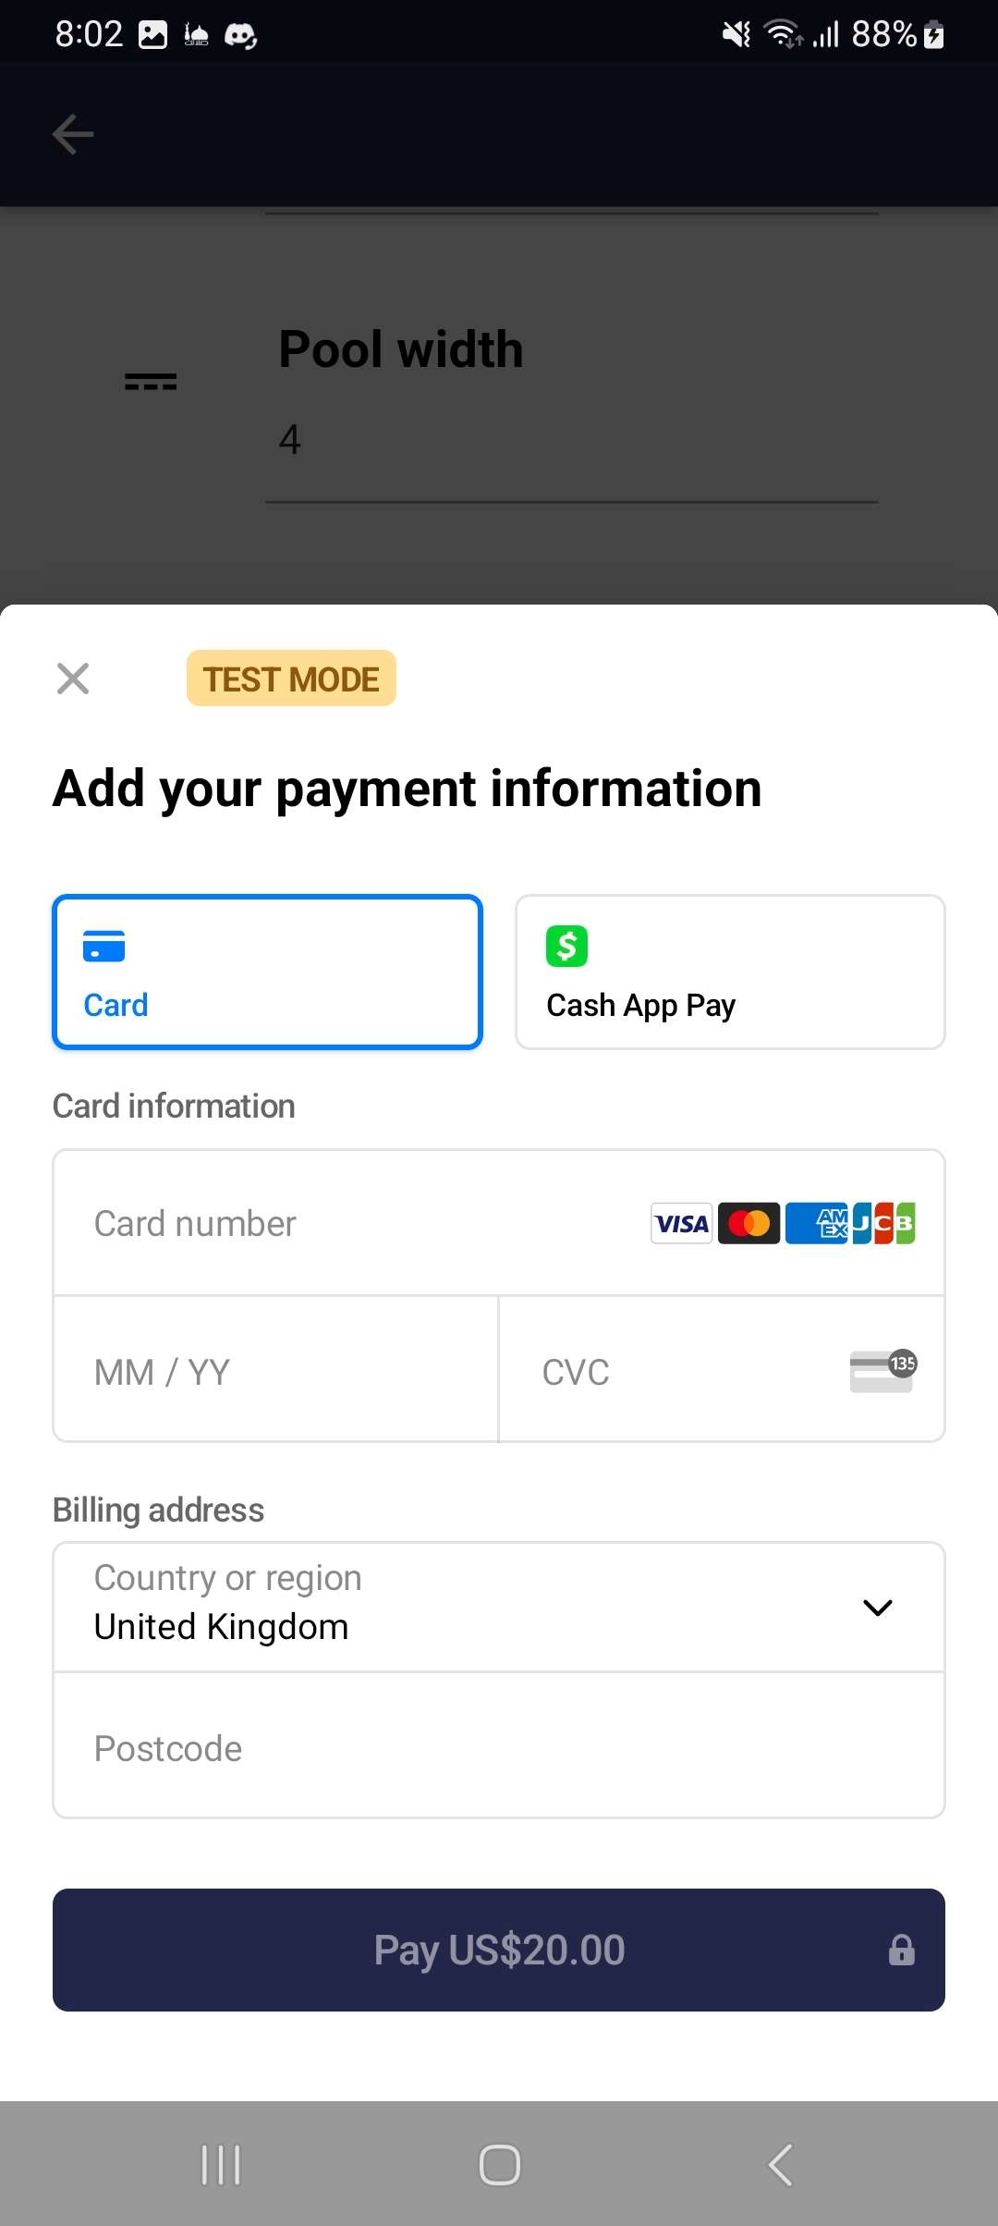
ADD PROPERTIES (Rooms)

Slide 13
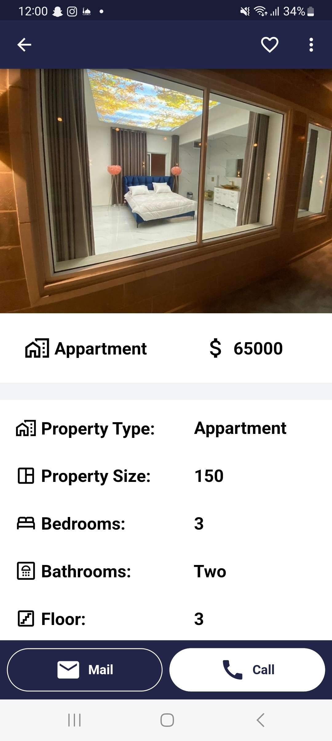
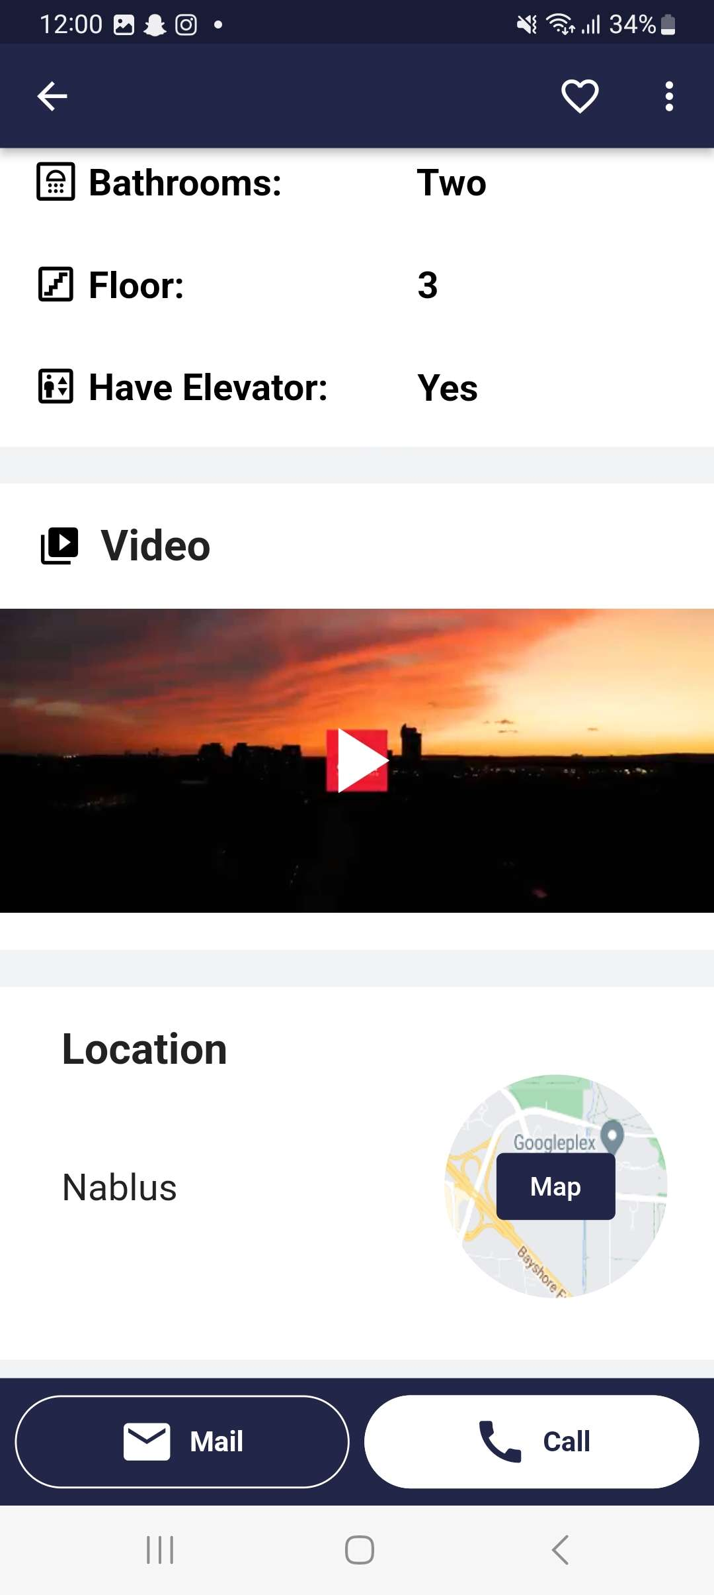
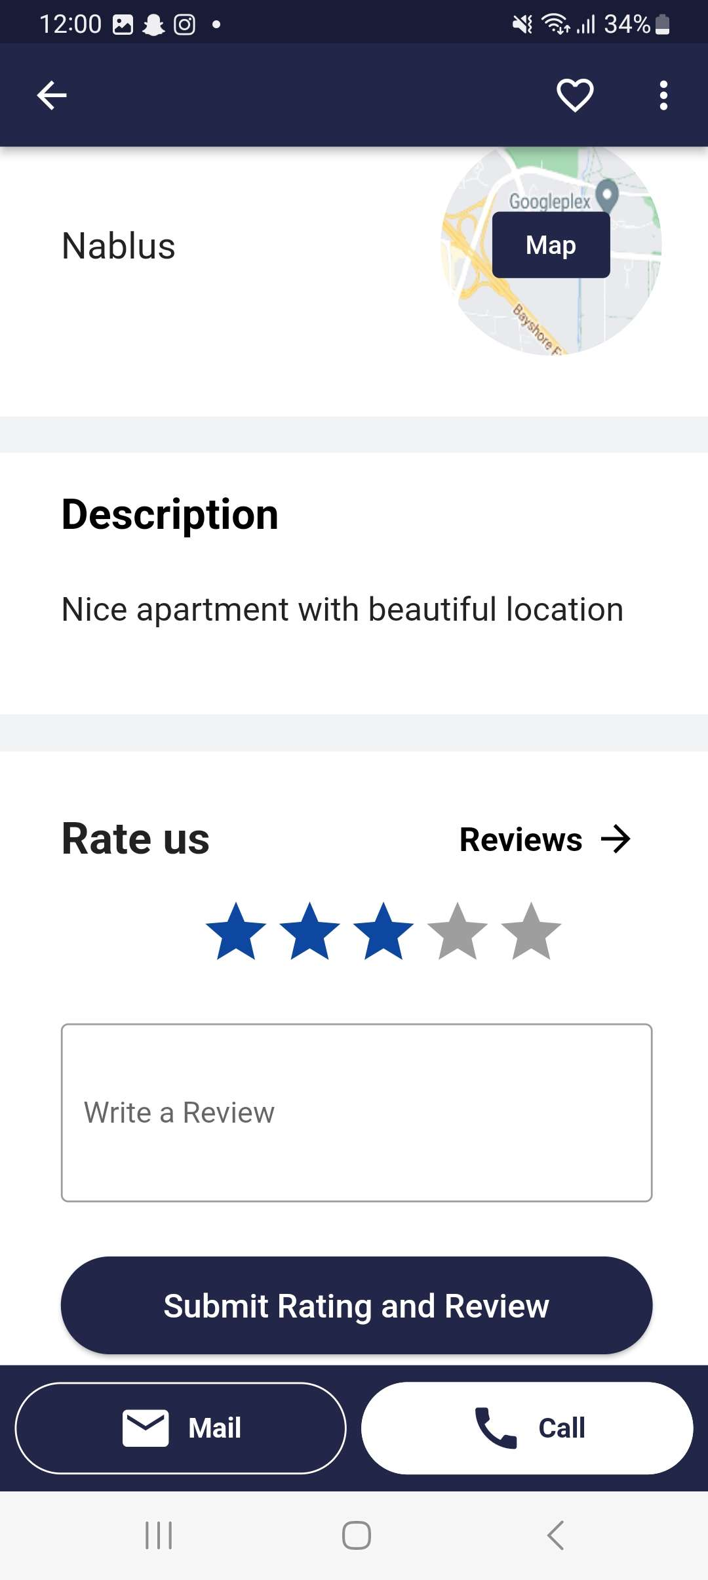
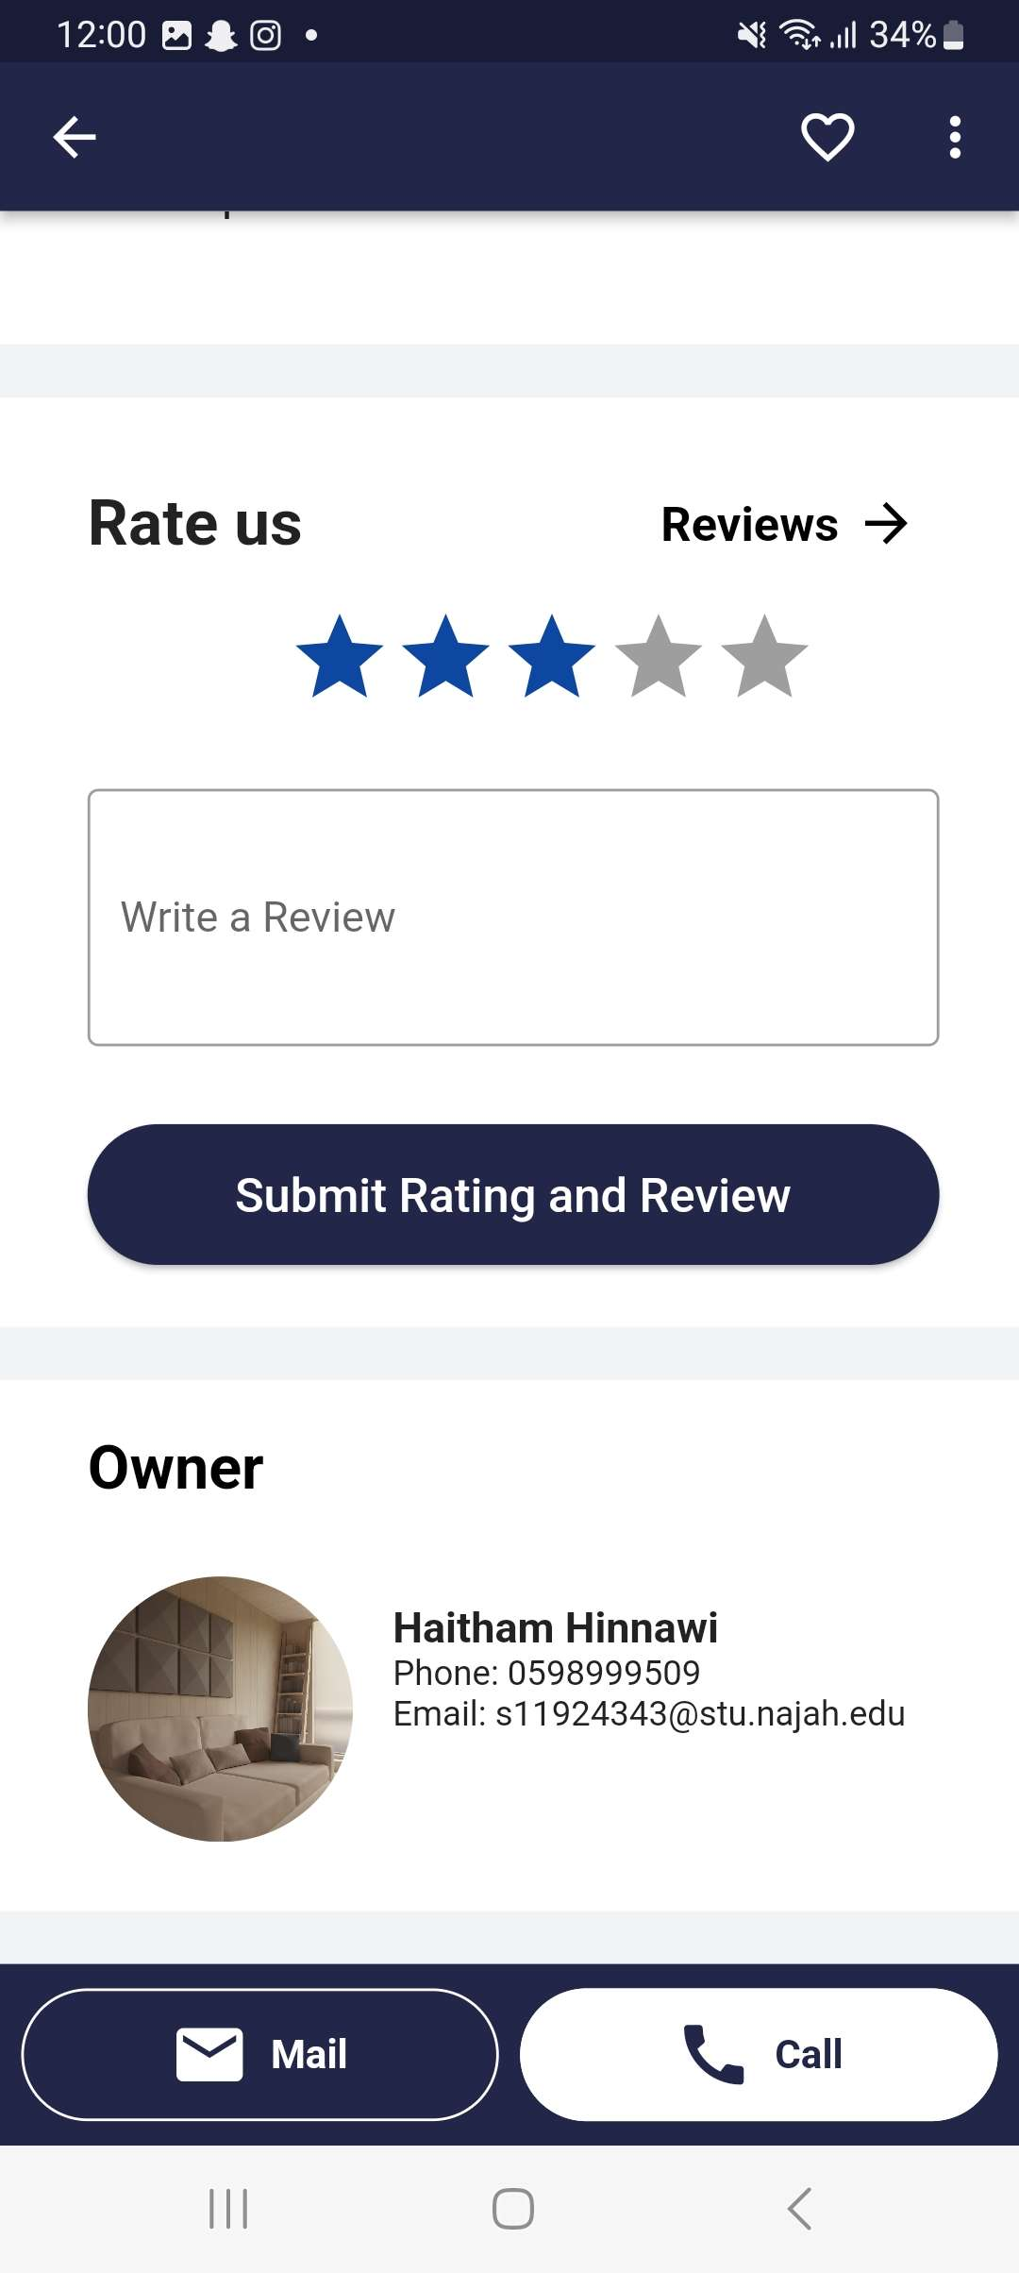
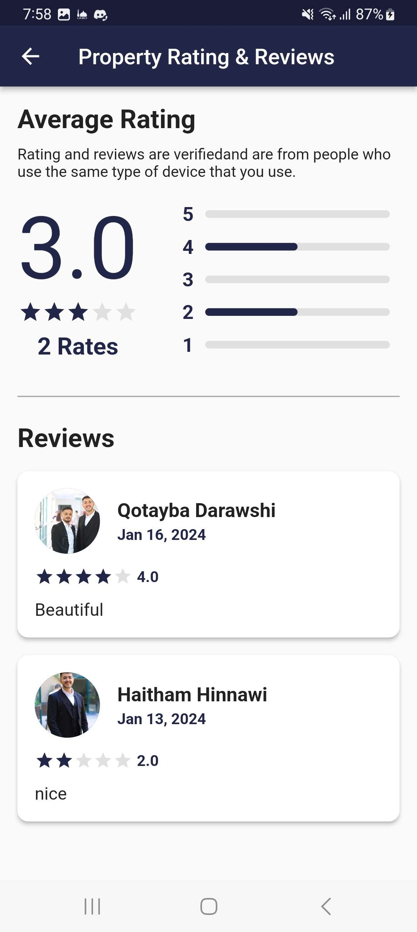

PROPERTY PAGE

Slide 14
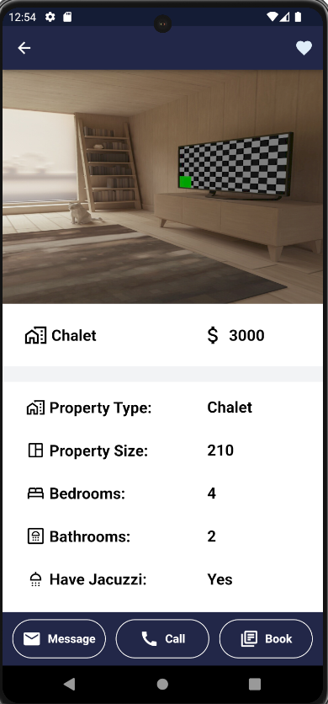
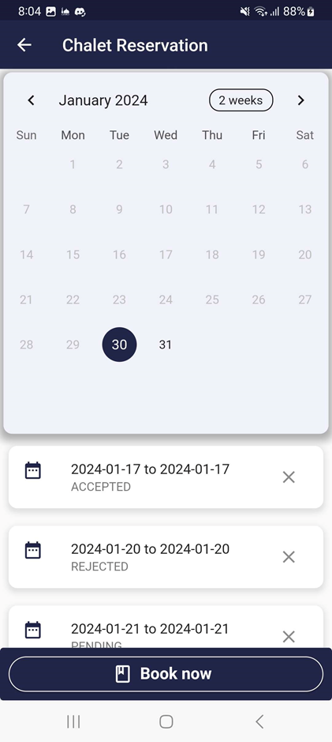
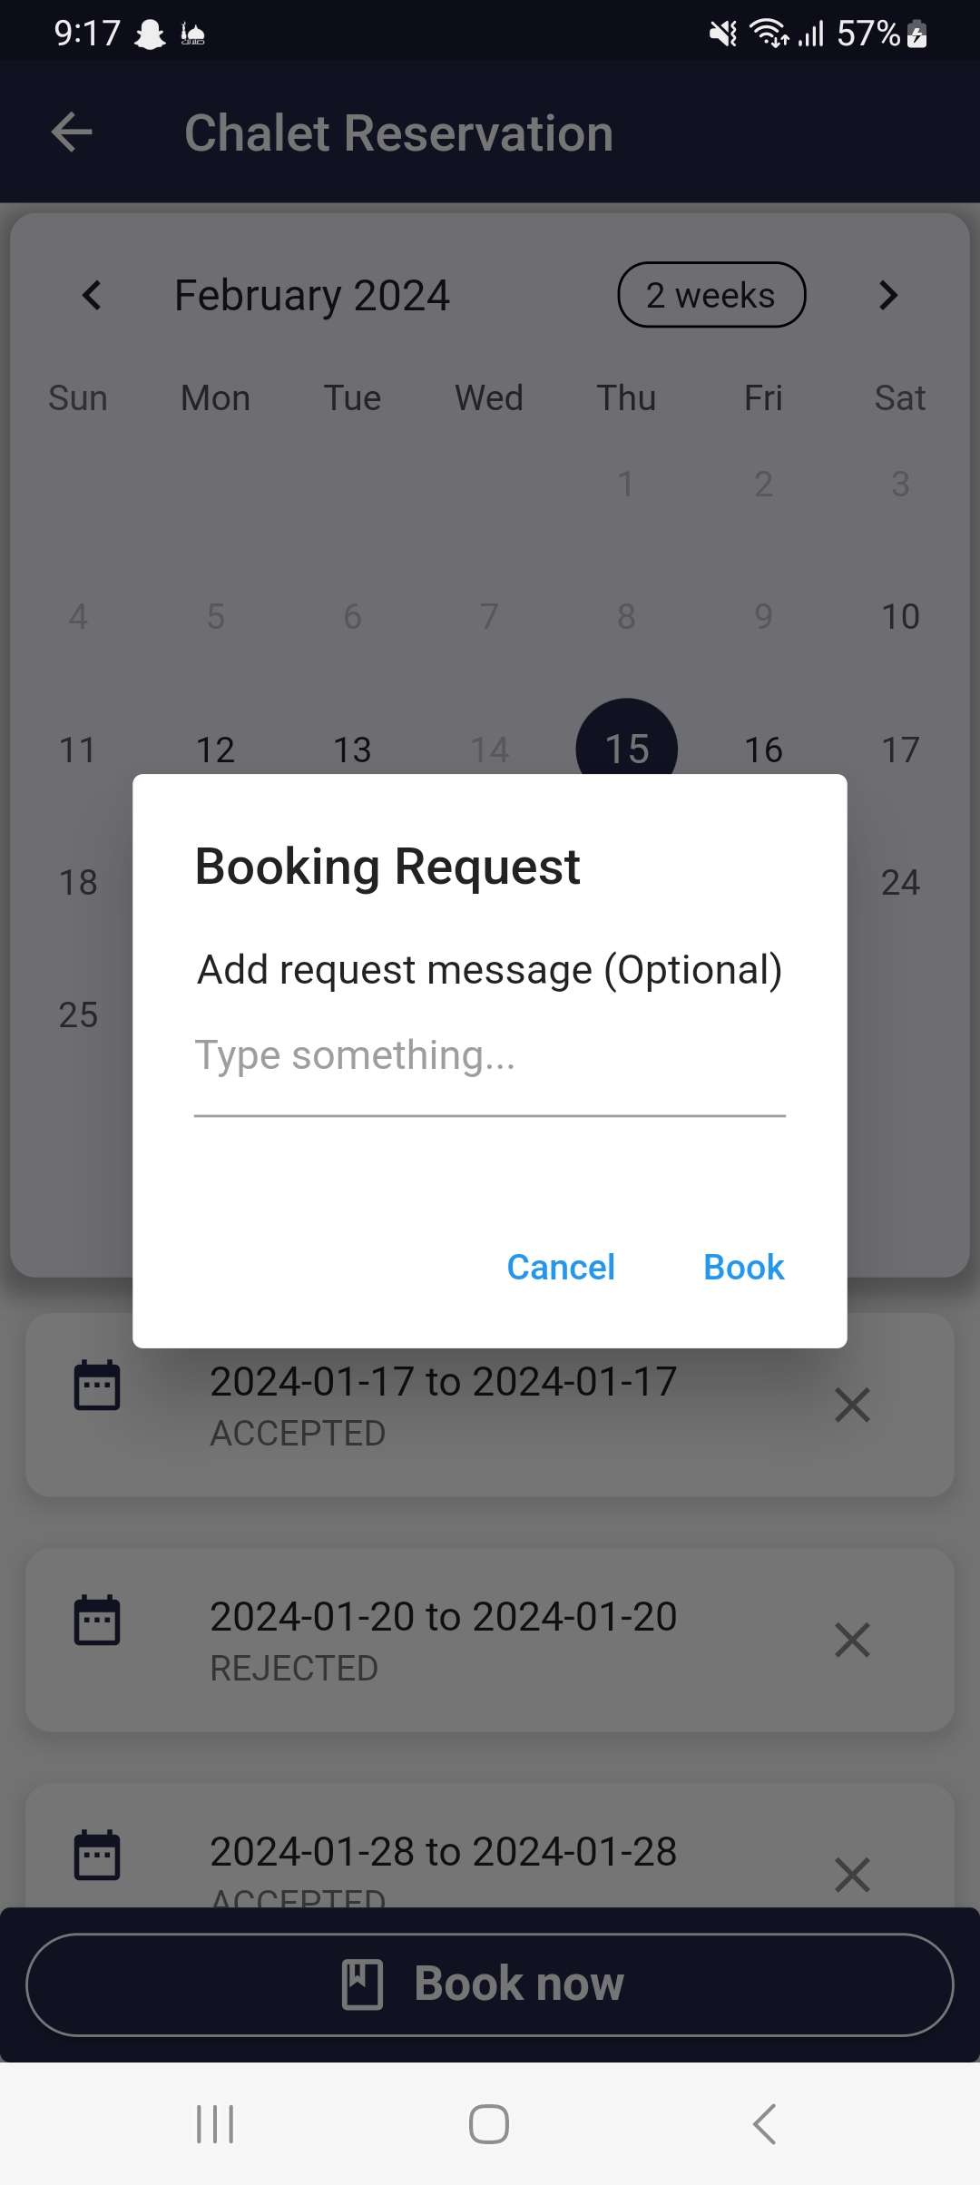
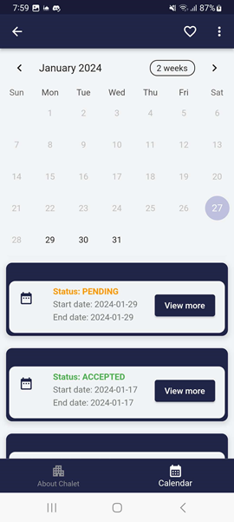
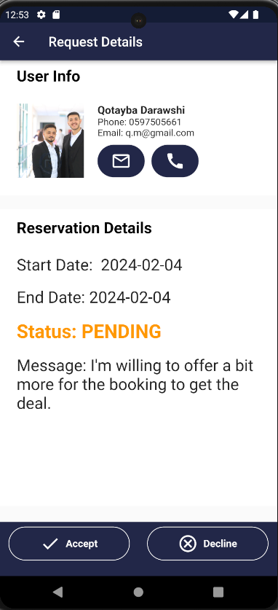
CHALET BOOKING

Slide 15
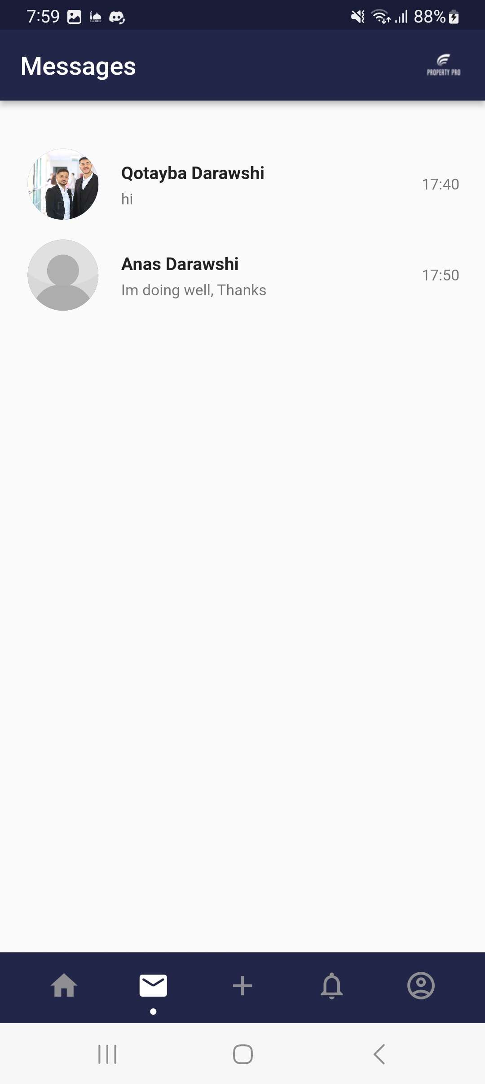
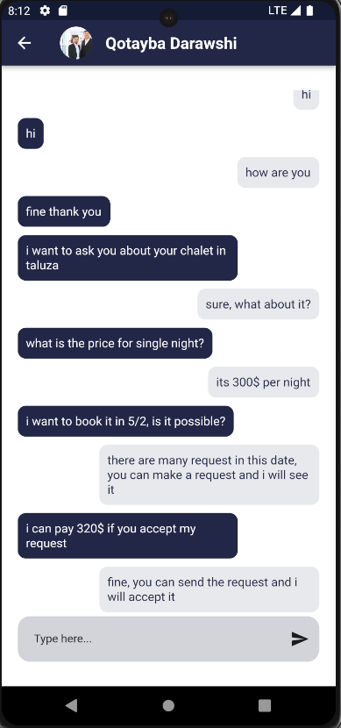
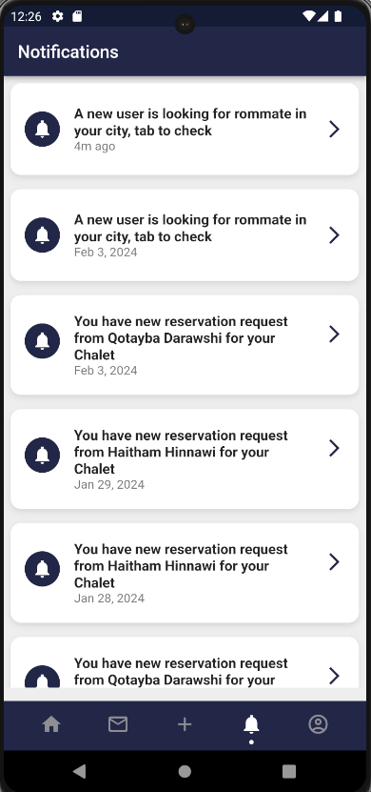
CHATTING & NOTIFICATION

Slide 16
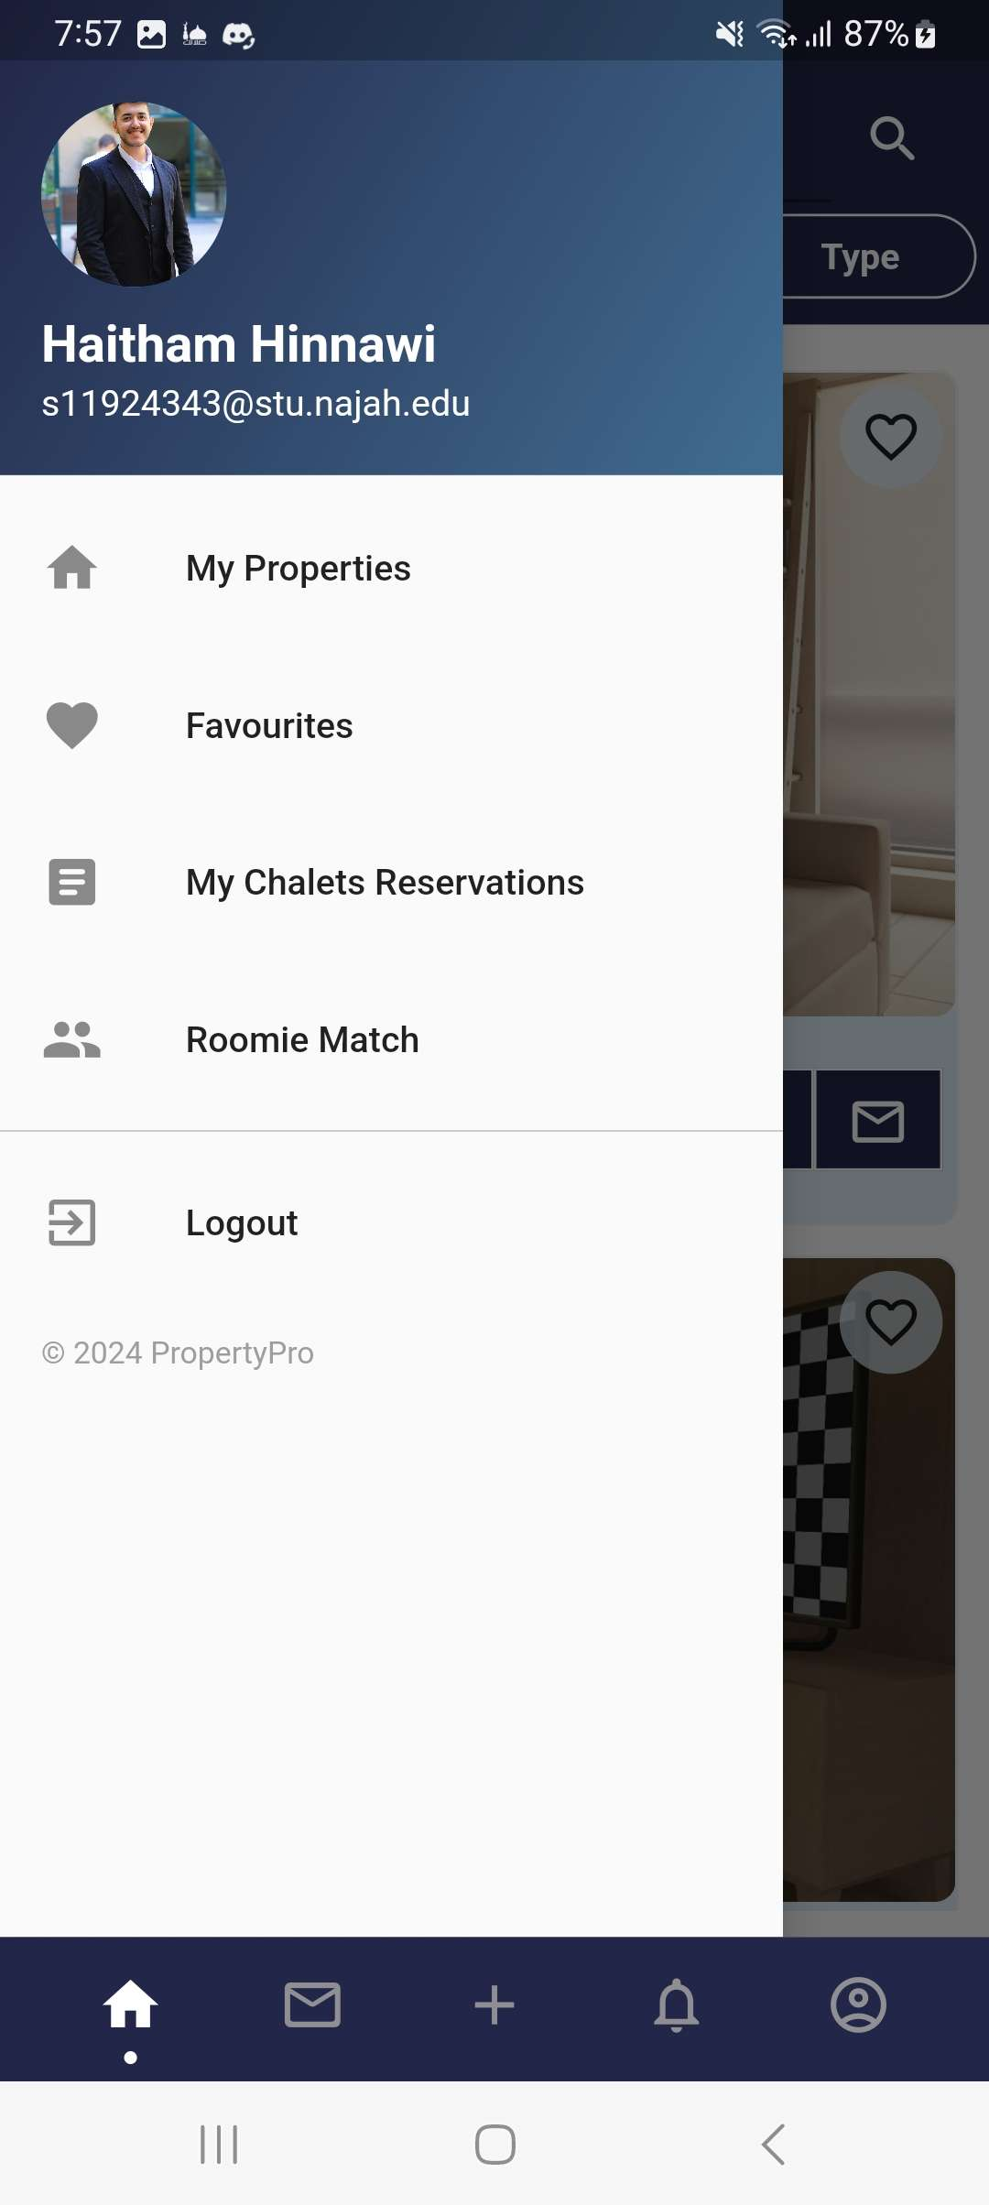
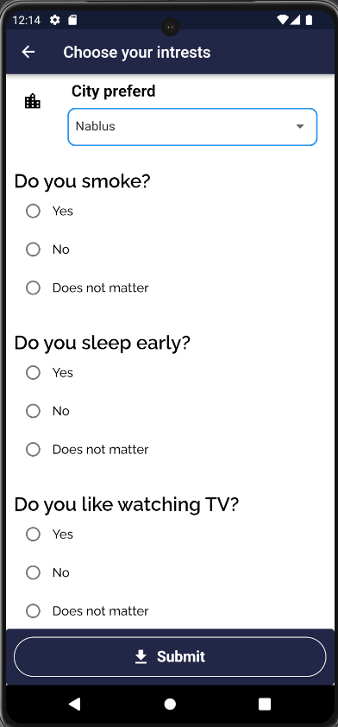
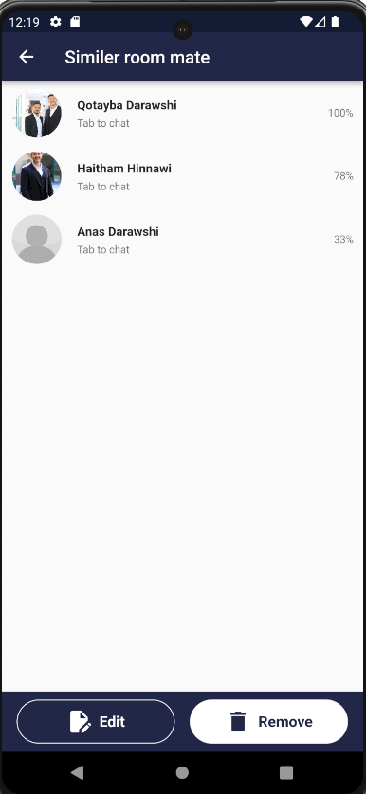
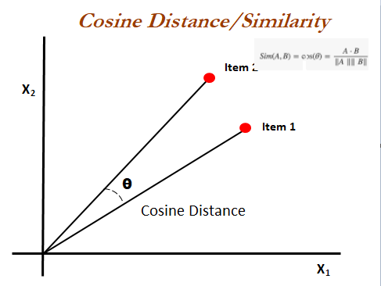
ROOMMATE MATCH

Slide 17
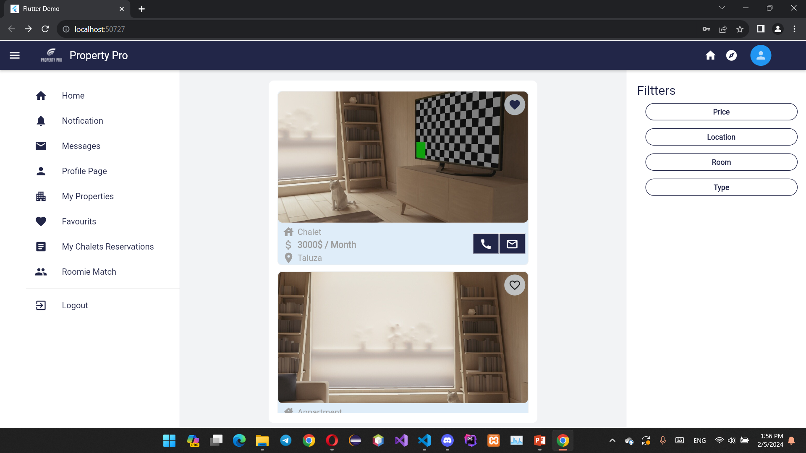
HOME PAGE - WEB

Slide 18
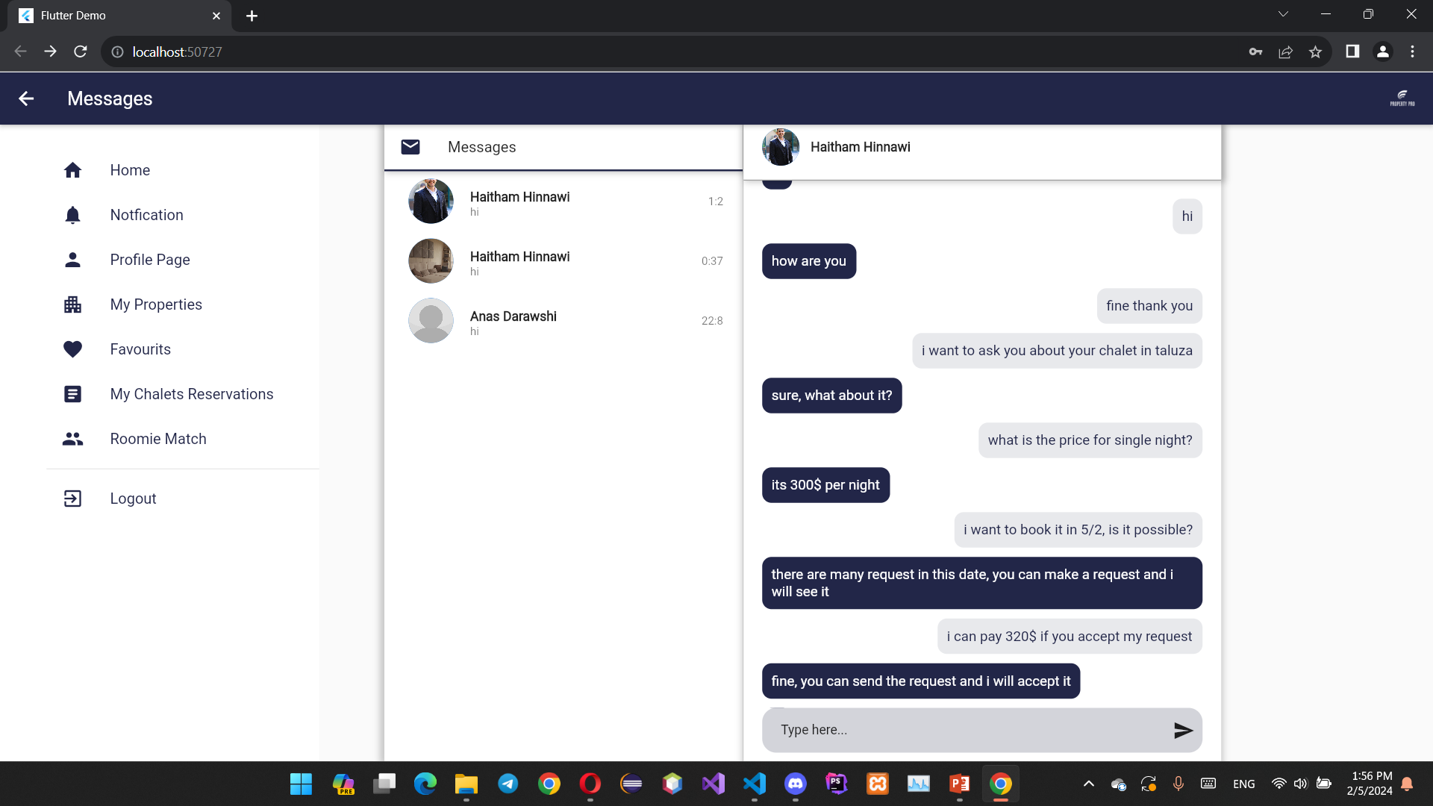
CHATTING - WEB

Slide 19
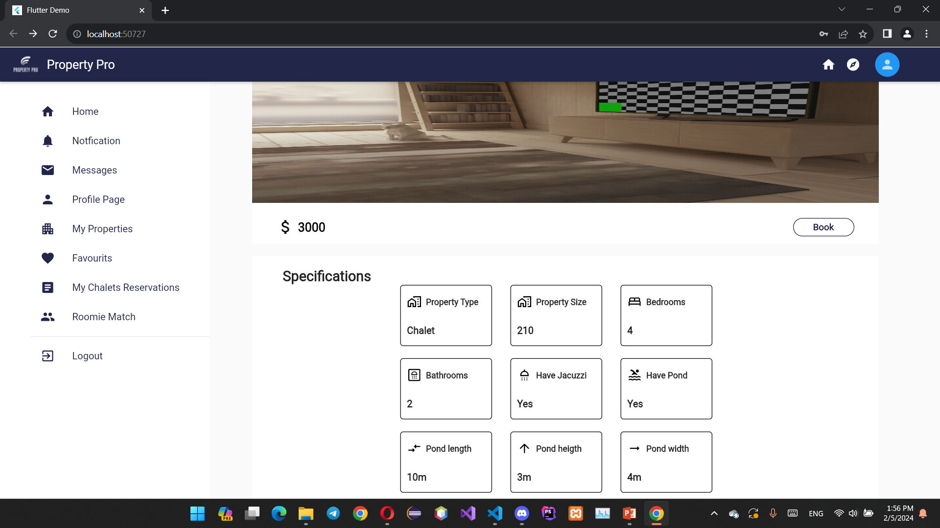
PROPERTY PAGE - WEB

Slide 20
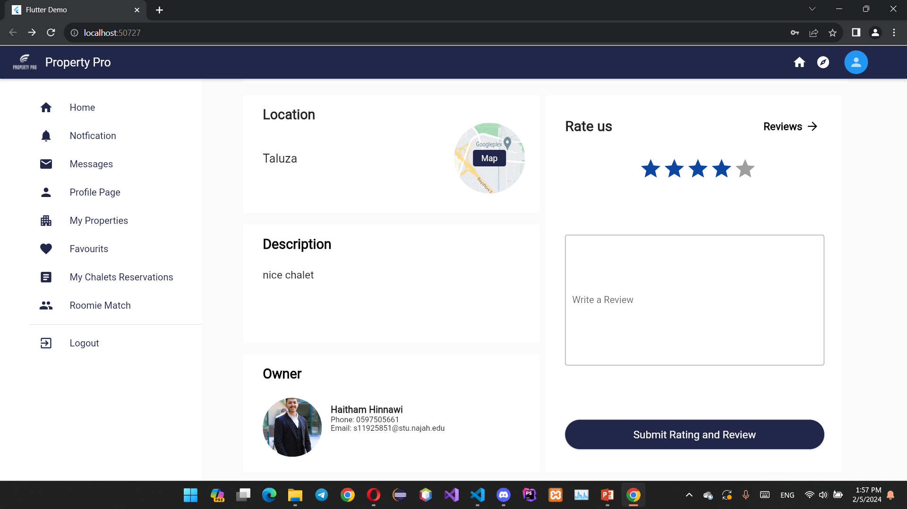
PROPERTY PAGE - WEB

Slide 21
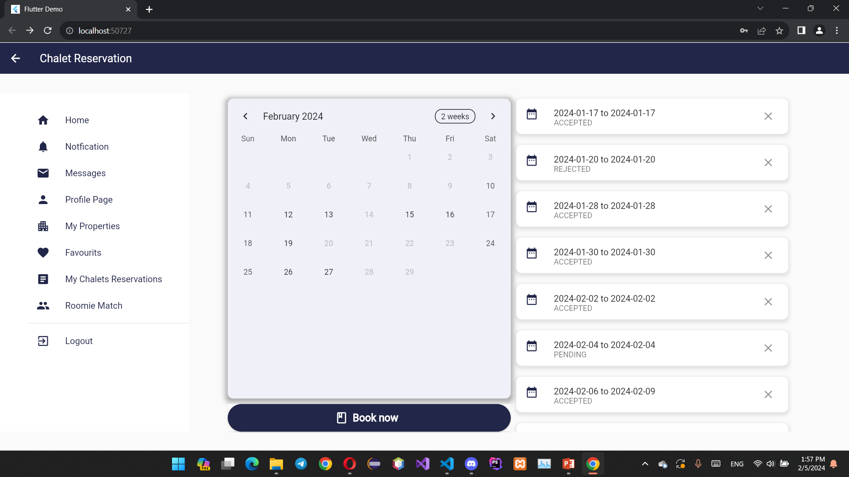
CHALET BOOKING - WEB

Slide 22
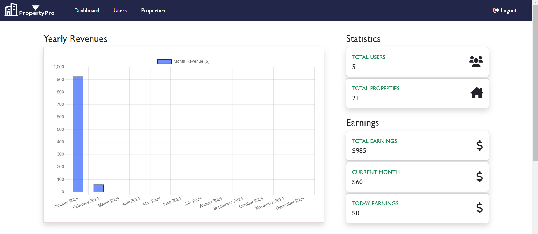
ADMIN DASHBOARD

Slide 23
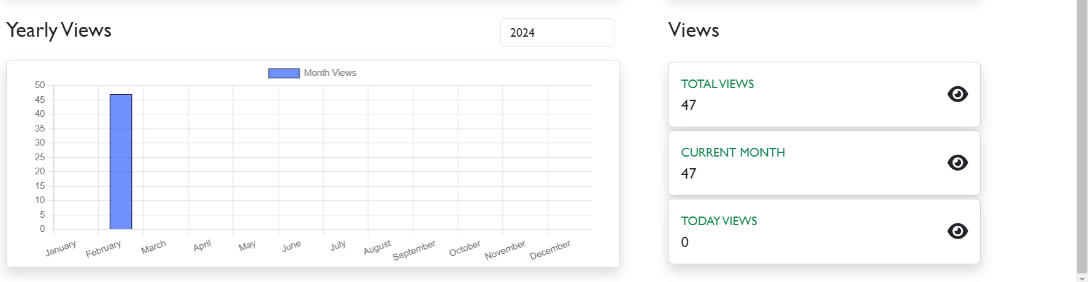
ADMIN DASHBOARD

Slide 24
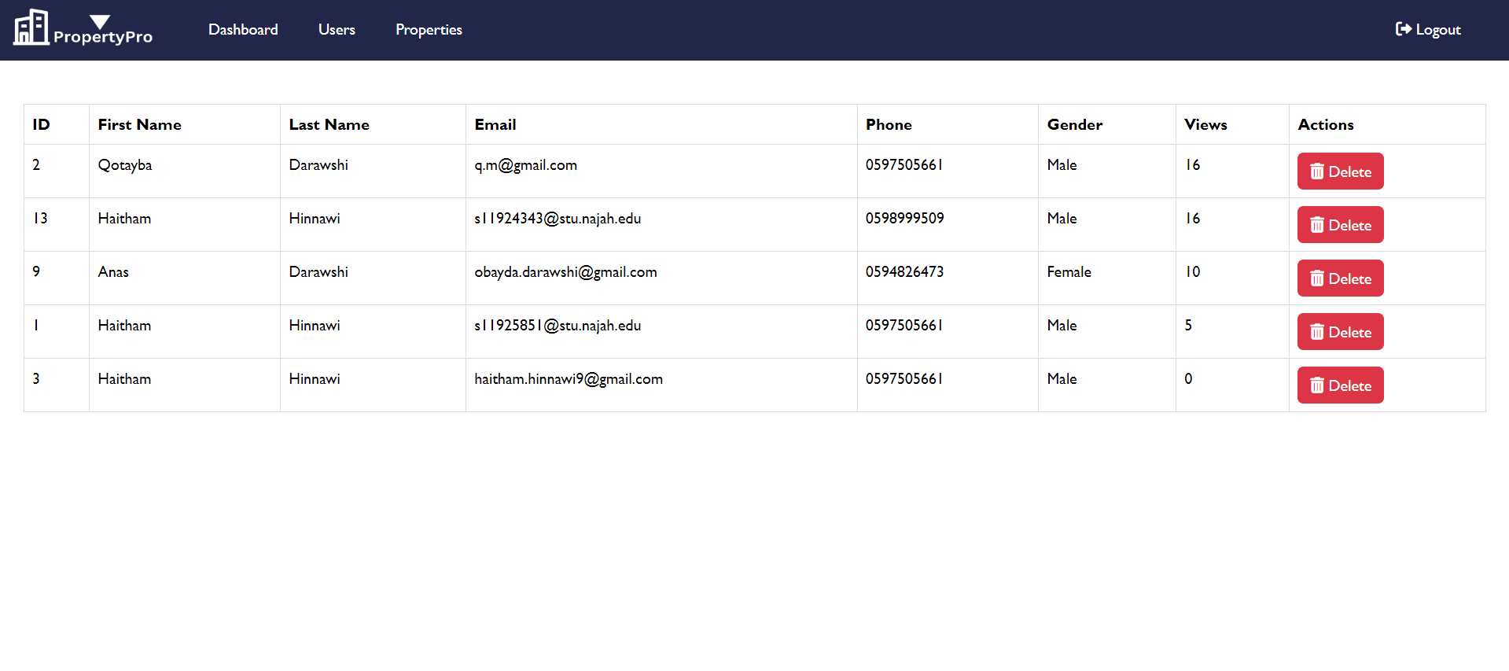
ADMIN DASHBOARD

Slide 25
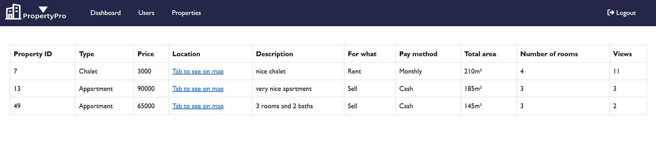
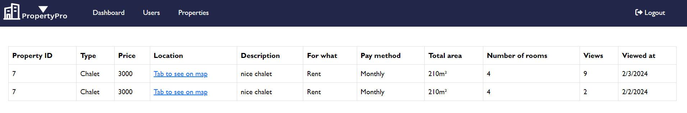
ADMIN DASHBOARD

Slide 26
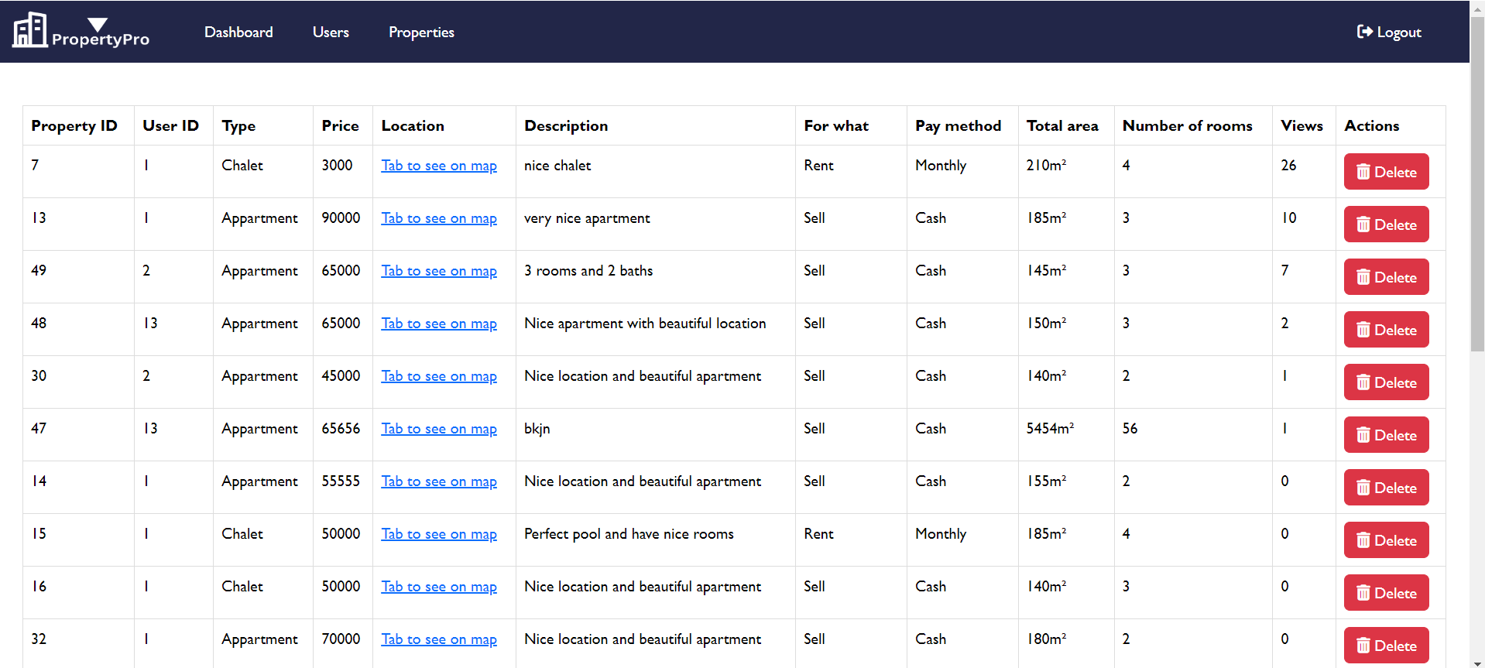
ADMIN DASHBOARD

Slide 27
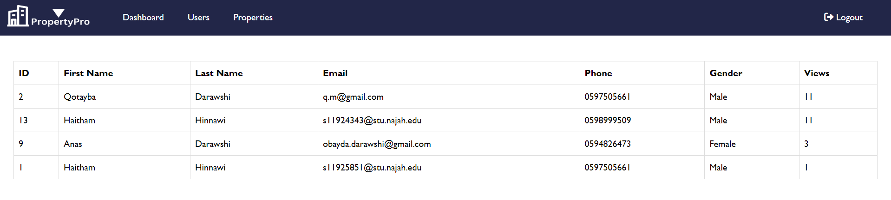
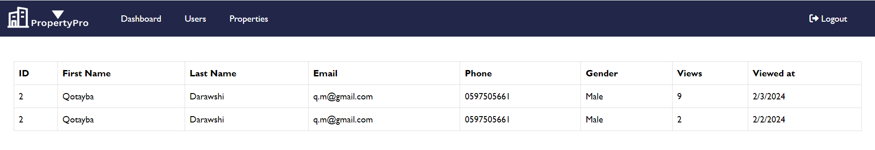
ADMIN DASHBOARD

Slide 28

FUTURE WORK
Document request from the property owner confirming his ownership of the property (when adding).
Add virtual house tour

Slide 29
THANKS FOR LISTENING

