Slide 1

IOT Water and Gas monitoring system
Presented by: Dr. Falah Mohammed

Slide 2

Overview
Introduction
Simulation and Results
Two Wi-Fi module (ESP12-F)
ESP8266 VS Arduino UNO
The Code as Flow Chart
Methodology

Slide 3
Introduction
We talked in our first graduation project about the importance of water and gas in our lives and how it affects the lives of people in all fields.
we had proposed an idea to protect water and gas by designing an alarm device that sends a short message to the user's phone.
the main piece in that project was the Arduino, but when we looked at it more broadly we thought that we need an advanced system that has more advantages in terms of cost, size and areas covered ...

Slide 4
Two Wi-Fi module (ESP12-F)
ESP-12F Wi-Fi module is developed by Ai-thinker Team. core processor ESP8266 in smaller sizes of the module encapsulates Tensilica L106 integrates industry-leading ultra-low power 32-bit MCU micro, with the 16-bit short mode, Clock speed support 80 MHz, 160 MHz, supports the RTOS, integrated Wi-Fi MAC/BB/RF/PA/LNA, on-board antenna. The module supports standard IEEE802.11 b/g/n agreement, complete TCP/IP protocol stack. Users can use the add modules to an existing device networking, or building a separate network controller. ESP8266 is high integration wireless SOCs, designed for space and power constrained mobile platform designers. It provides unsurpassed ability to embed Wi-Fi 30
capabilities within other systems, or to function as a standalone application, with the lowest cost, and minimal space requirement.

Slide 5
ESP8266 VS Arduino UNO
1- The voltage of operation of the ESP microprocessors is 3.3 V compared to the Arduino operating voltage of 5V.
2- We know that the current consumption is significant for battery-based projects to increase the lifetime of the project. In common the NODEMCU is based on the ESP8266 microprocessor have a very low current consumption between 15 µA and 400 mA which can be further decreased with the deep sleep mode activated to 0.5 µA.
3- As Arduino boards are all operating with 16 MHz . The ESP based boards are much faster with a clock speed of 52 MHz up to 160 MHz for the ESP32. This is 10 times faster.
4- The ESP based boards like the NODEMCU smaller than these Arduino boards .

Slide 6
The Code as Flow Chart

Slide 7
Methodology
We have developed our project by using two WiFi module (esp8266) instead of arduino uno.
And we use GSM Module to send SMS Alert and buzzer and blinking light Alarm .
Our system contains water and gas sensors to detect leakage, the sensors collect information and the system is controlled by the Wi-Fi modules (esp8266) which talk to each other.
the client one decides the danger according to the sensors information and send information to the access point
they work as a complete system and sends SMS to the owner using a GSM module.
also Sound and light Alarm will be ON according to the sensors information.

Slide 8
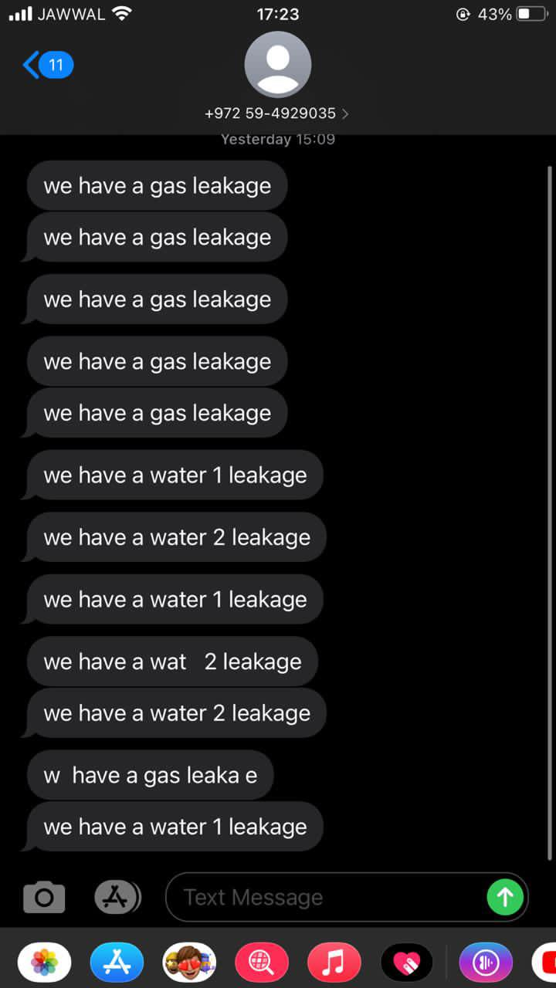
After applying the code and start the simulation we get several results depend on the situation around:
SIMULATION AND RESULTS

Slide 9

Thank You

