Slide 1

Power factor correction by Static
Variable Compensator (SVC)
Supervised by:
Dr. Kamel Saleh

Slide 2
Content
* Overview
* Project overall
* PF meter
* Calculation of firing angle
* Generation of firing angle
* Results
* Comparison
* Problems

Slide 3
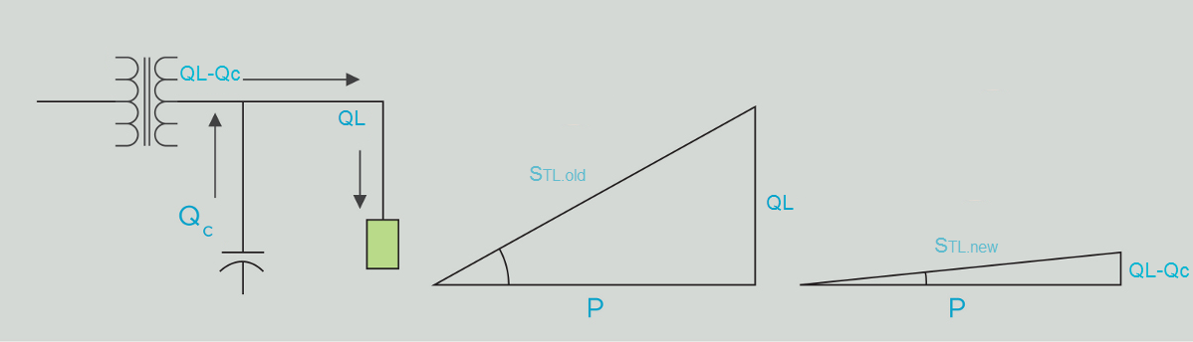


* Overview

Slide 4
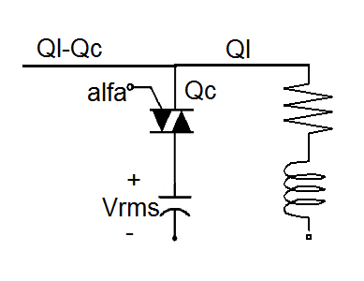

* Overview
This method uses only one capacitor bank and we control the PF by changing the RMS voltage applied to the capacitor other than controlling capacitance value.

Slide 5
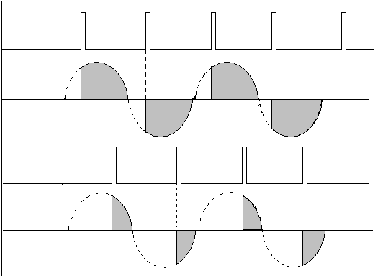


Overview

Slide 6
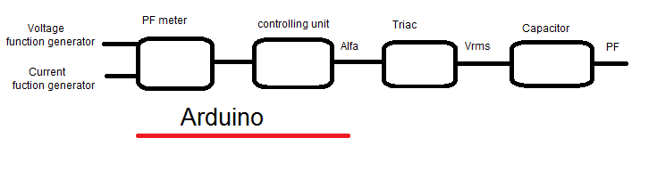
Project overall
The project consists of two main parts :
1 – Power Factor Meter.
2 – Compensation controller.

Slide 7
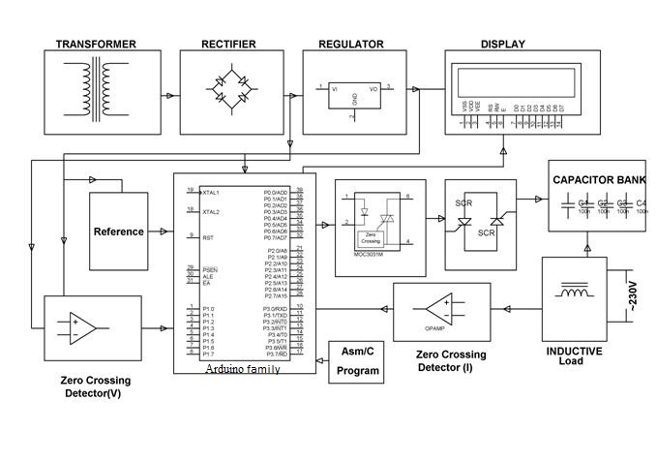

Slide 8

PF meter
* There is two main ways to calculate the PF
* first method use the real and reactive power as shown in the following equation
* the second method use the time shift between the the current and the voltage

Slide 9

PF meter
In our project the first mission is to find the phase shift between the voltage and the current
We could achieve this step using help of Zero Crossing Detector

Slide 10
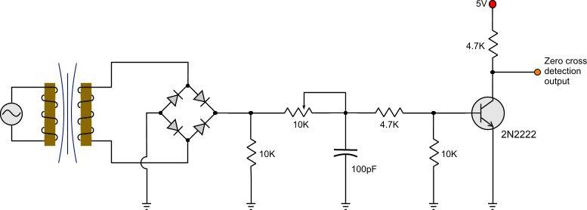
PF meter
Zero Crossing Detector

Slide 11
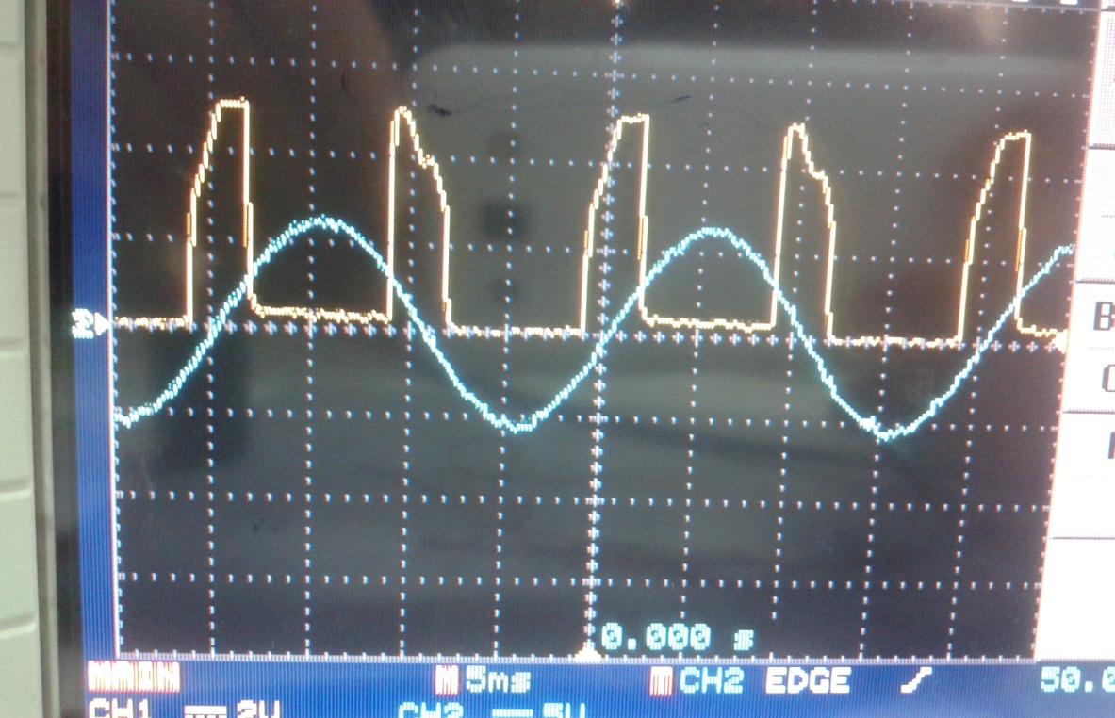
PF meter
Zero Crossing Detector
The zero cross detection is a circuit that gives a pulse as indication when the input voltage waveform crosses the zero axis

Slide 12
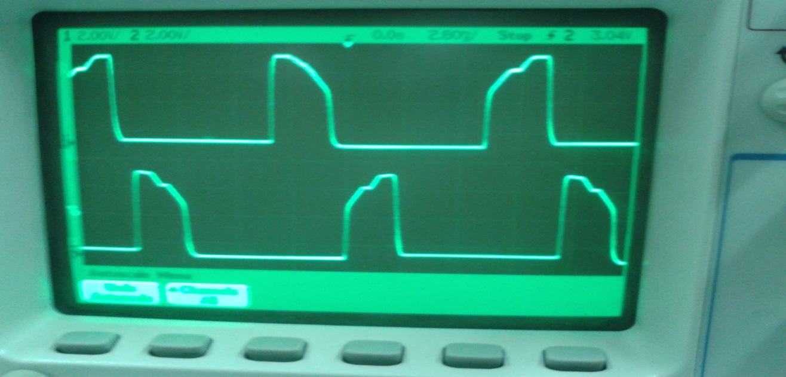
PF meter
Zero Crossing Detector
The zero cross detection output for both voltage and current will be the inputs for the Arduino microcontroller to calculate the power factor of the load

Slide 13


PF meter
Arduino
The arduino program performs the following tasks
1- counting the time between Voltage and Current pulses of zero crossing detector
2- determines the phase shift from the counted time
3- determines the PF from the phase shift

Slide 14
Calculation of firing angle
*firing angle should be the output of the controller, so it should be calculated
* Open loop method is used
*We made some assumptions which are
-Pload -Vbus -Qload are constants

Slide 15
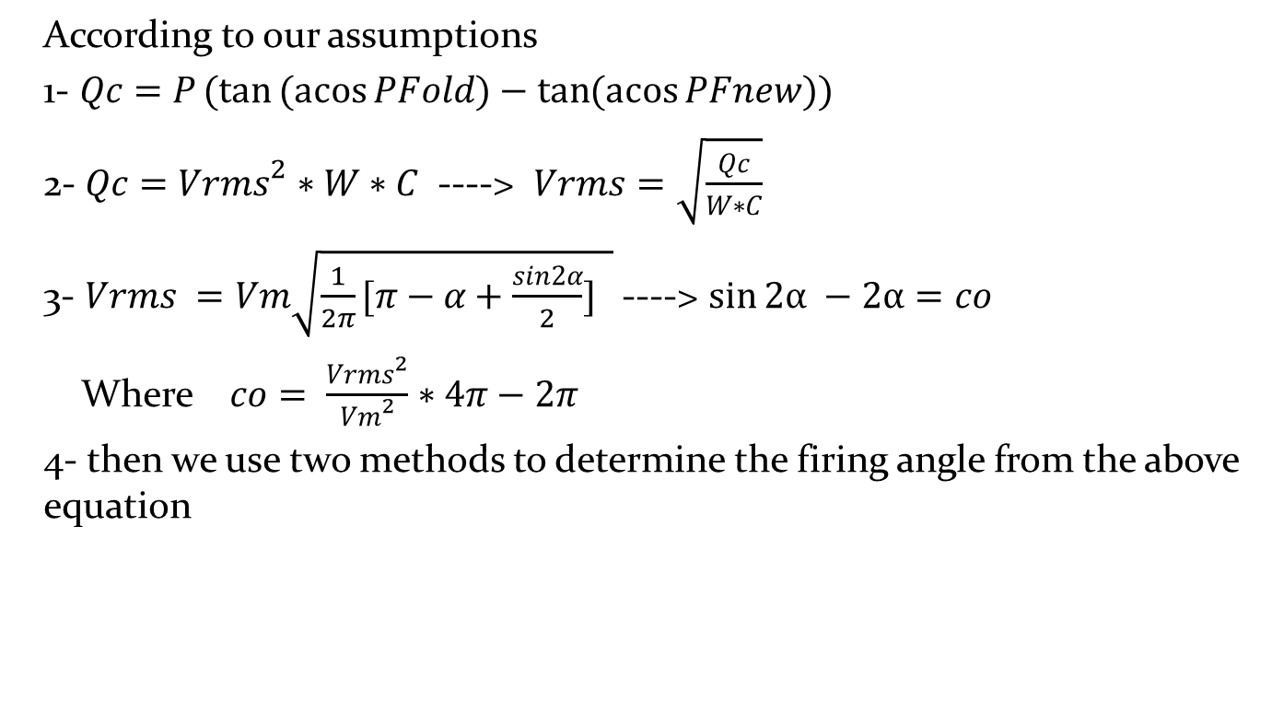
Calculation of firing angle
Procedures of determining the value of alfa

Slide 16
Calculation of firing angle
Numerical method
*Numerical method which is Bi-sectional Method use number of iteration to find the value of alfa until the different between the previous value and the current value will be less than the specific value
* This method is very practical in our situation because it can reach a good value of alfa after 10 iterations with very low
percentage of error
Number of iterations | Max Error (%) | Max Error (degree)
1 | 50 | 90
10 | 0.097 | 0.1746

Slide 17
Calculation of firing angle
Intervals methods
* In this method the measured PF of the load is divided
into intervals
*according to each interval, a specific firing angle is determined
* When number of intervals is increased, the accuracy of determining the value of alfa is increased
* The compiler takes too small time to perform this method with respect to the numerical method

Slide 18
Generation of firing angle
*From the calculated firing angle we transform this angle to a time value
*The time of firing angle should be related to the to the instant time when the voltage cross the zero axis
*So the generated firing angle to the triac should be synchronized with the zero crossing detector pulse of the voltage

Slide 19
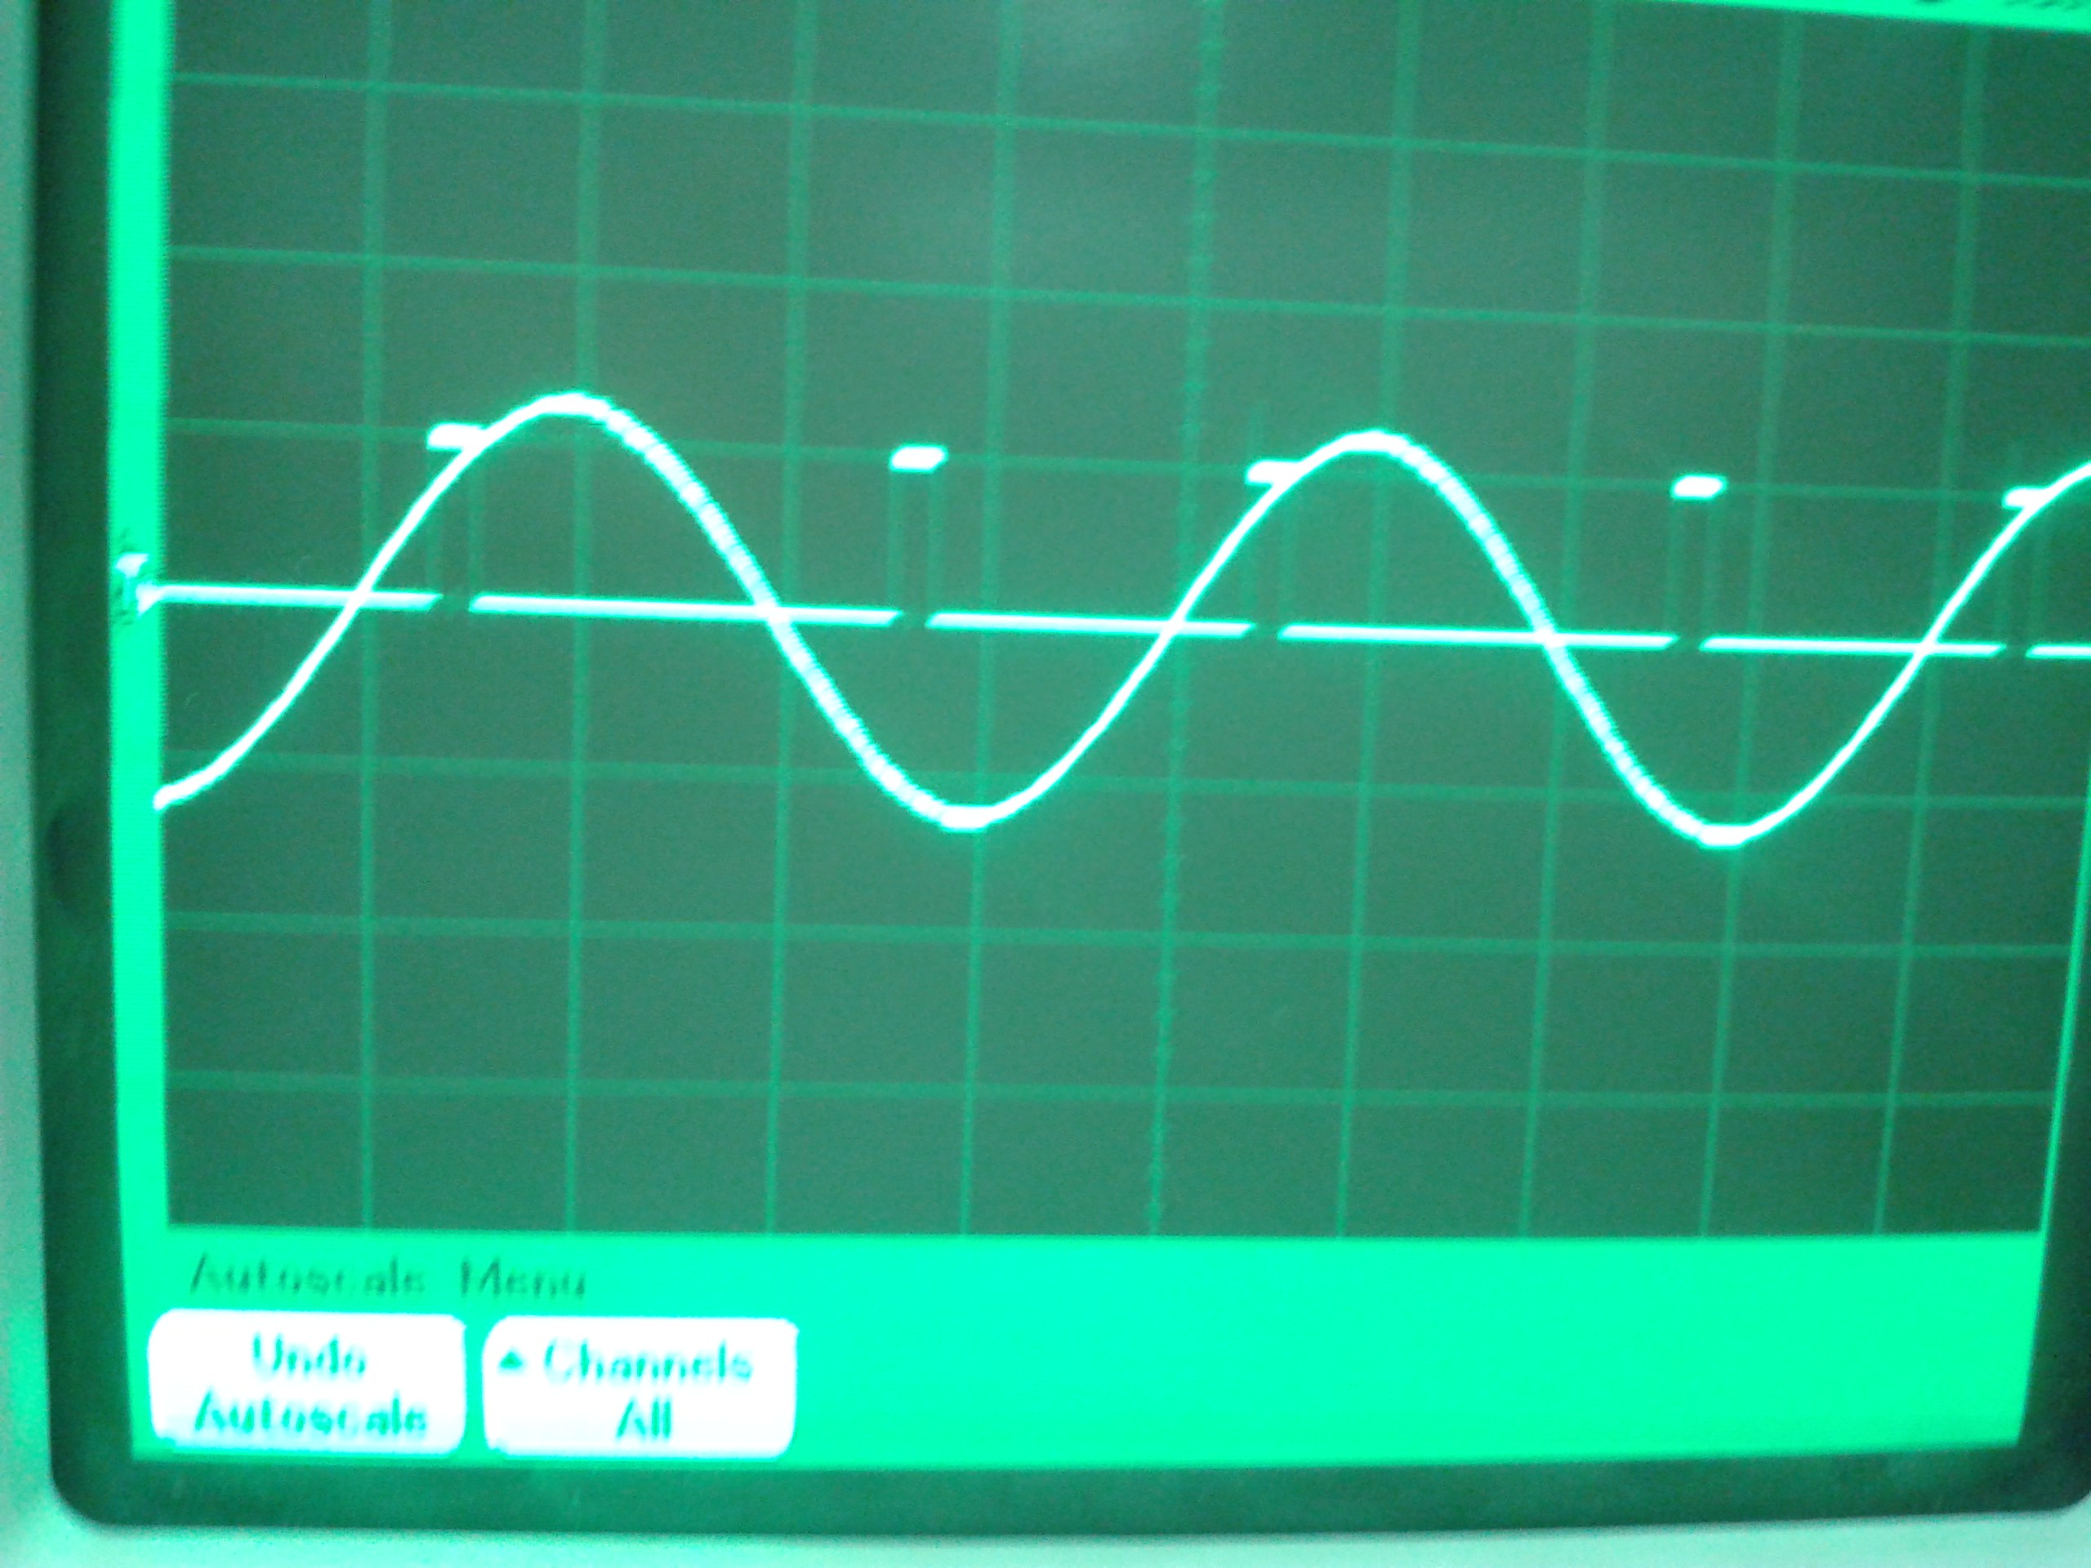

Slide 20
Results
The results of the project will be shown in videos

Slide 21


Comparison
problems in the ordinary method do not exist in our method
* improvement of PF in steps
* Life time is decreased by increasing the voltage
* As the V ➔ Qc ➔ V
*As the V ➔ Qc ➔ V

Slide 22
Comparison
After achieving the technical requirements, there is the economical advantages compared with the ordinary method :-
* Less cost of the capacitor banks
* No contactors requires
* Easy maintenance

Slide 23
Closed loop system
*Our project can be simply done by closed loop method
*The close loop controller is much easier than open loop
*In this method we only need PF meter which is built in this semester

Slide 24
Closed loop system
* System keeps adjusting the value of alfa until the measured PF of the load equal to reference PF , then means we don’t have to make any assumption to any value and the response will be more accurate
*No need to know the real power, reactive power or voltage at the bus of the load
*Simulation of close loop method was done last semester

Slide 25
Problems
Problems we faced:
*We could not use a closed loop system because we couldn’t find potential and current transformers
*We couldn’t find PF meter so we built one

Slide 26
Problems
Problems may the project face:
The main problem is the harmonics
* harmonics might be a problem for certain loads
*harmonics is a problem to the capacitor bank itself

Slide 27
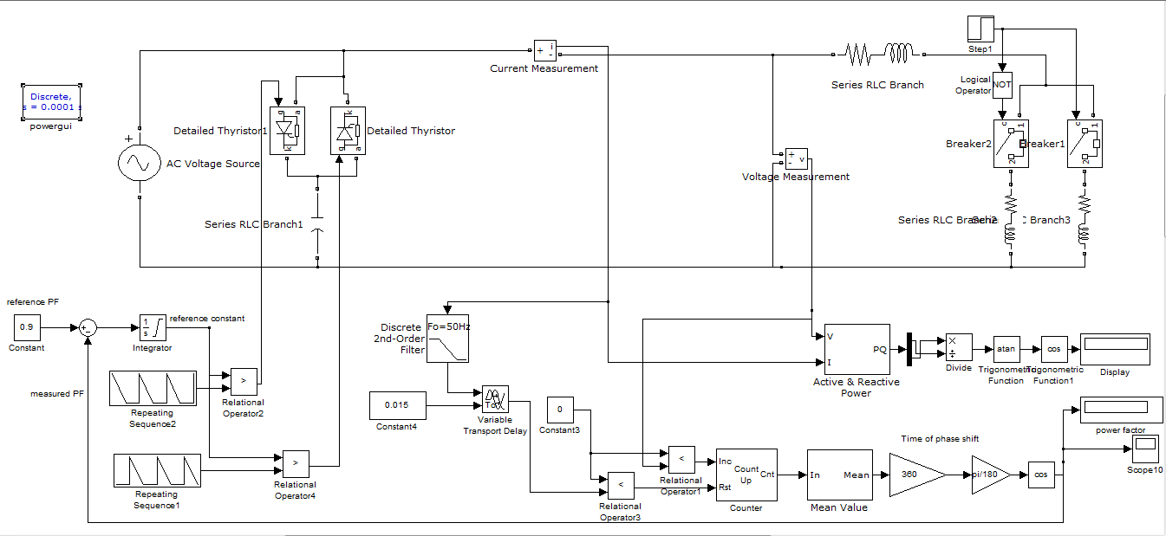
*Full Simulation of the project

Slide 28
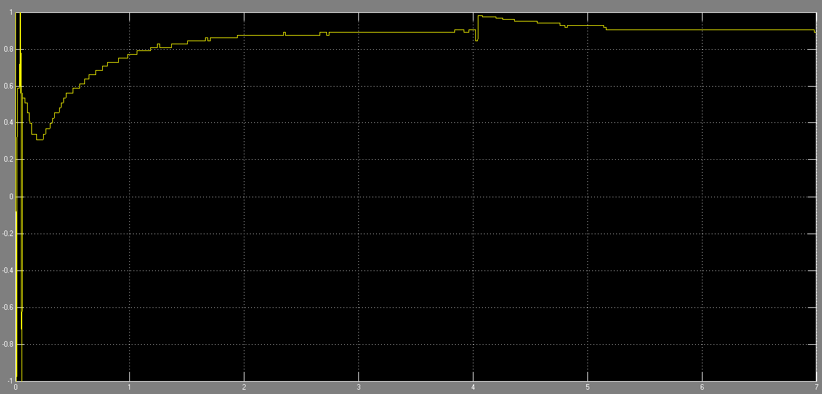

Slide 29


