Slide 1


Slide 2
Outline
Introduction.
The objectives of this project.
The methodology and challenging
Results of this project.
Conclusion and the recommendation.

Slide 3
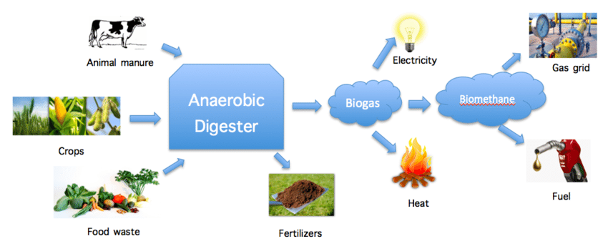
Introduction

Slide 4

AL ARZ Company
Al ARZ has evolved to be the leader of frozen treats market in Palestine. Since its establishment by the late Mohammad Anabtawi in Nablus, Palestine, Al ARZ grew into a successful producer of high quality ice cream, the production capacity reaching more 8 million litres of ice cream per month, using only the best equipment, and the waste accounts for 6% of monthly production.

Slide 5
The objectives
To convert the wastes from ice-cream to biogas using anaerobic digestion treatment process.
To study the effect of operating parameters such as temperature and seeding on the efficiency of anaerobic digester.
To investigate whether it was possible to produce bioethanol from ice-cream wastes.

Slide 6
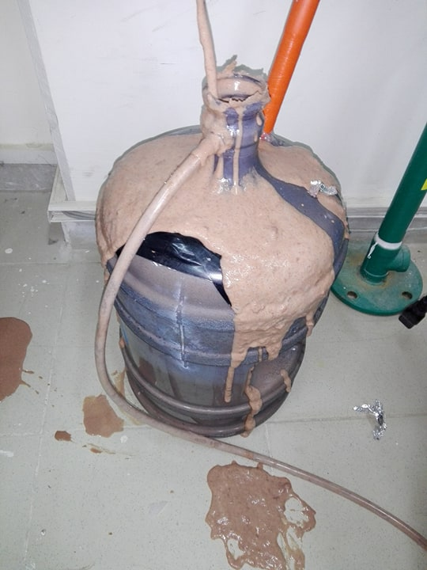
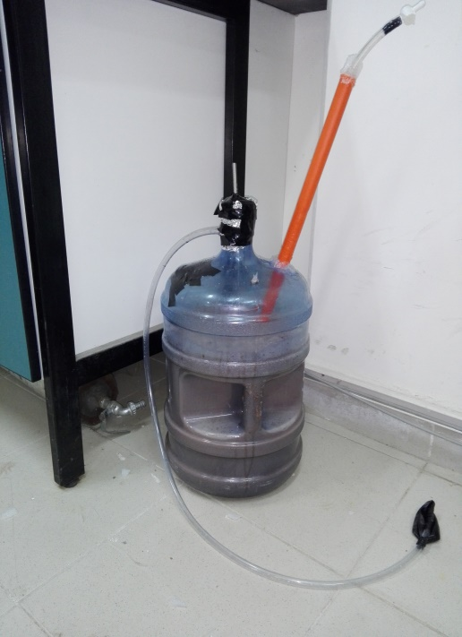
Methodology and Result
1. ice cream without seeding
Working volume 14L
mesophilic (at room temperature).

Slide 7
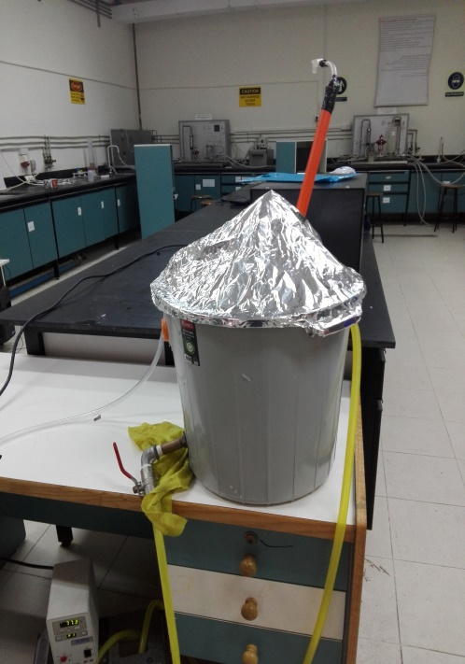
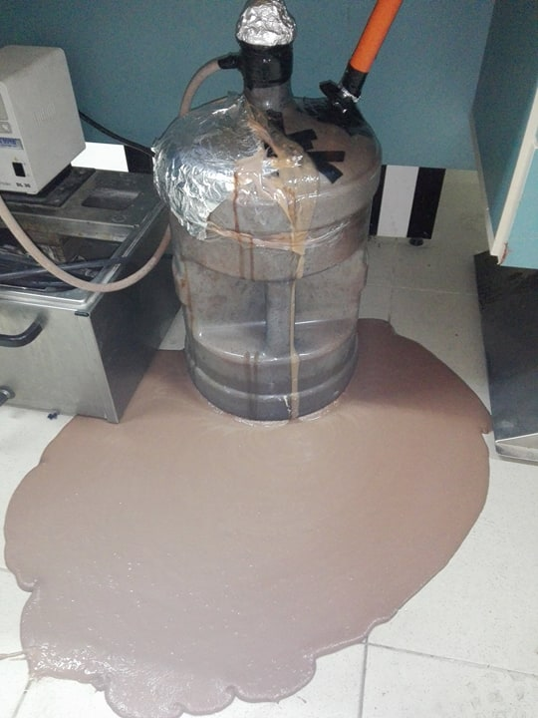
Sample 2
working volume 14 L.
Thermophilic condition.

Slide 8
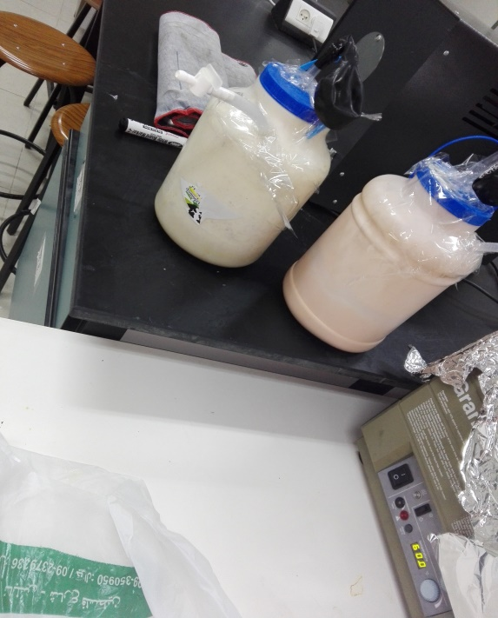
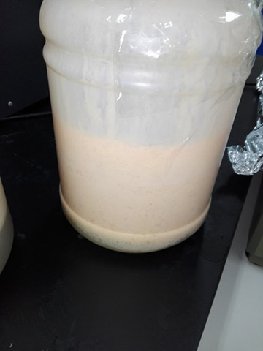
2.Ice cream+Poultry manure
Working volume 2.5 L. Ice cream waste to poultry manure ratio of 1:10(w/w).
Mesophilic (at room temperature)

Slide 9
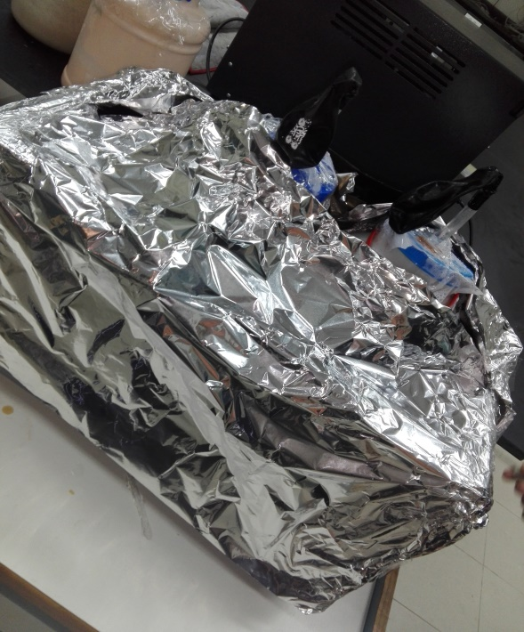
Sample 2
Working volume 2.5L
Thermophilic Condition
No bio gas produce

Slide 10
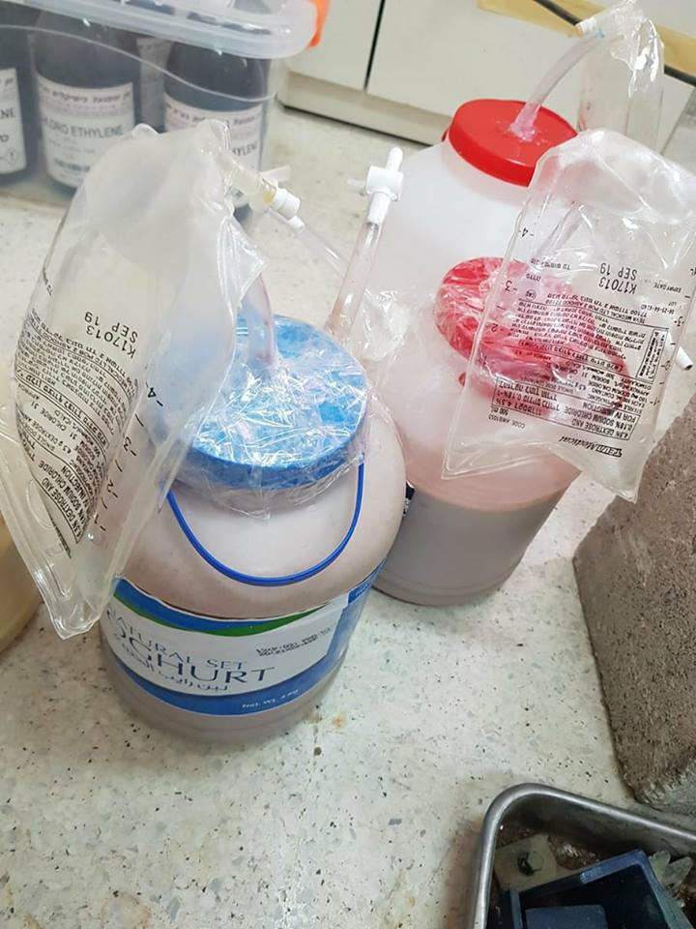
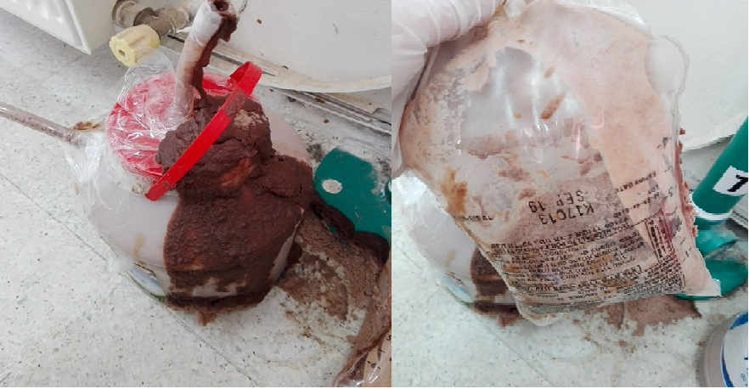
3.Ice cream+ cow manure
Working volume 2.7 L .Ice-cream waste to cow manure ratio of 1:5(w/w).
Mesophilic (uncontrolled)

Slide 11
foaming
Foam is a substance formed by trapping pockets of gas in a liquid.
Proteins play a crucial role in foam formation.
To study the effect of foam formation behaviour a set of experiments were performed by adding antifoaming material such as (Corn oil, olive oil, acetic acid and silicone oil )

Slide 12
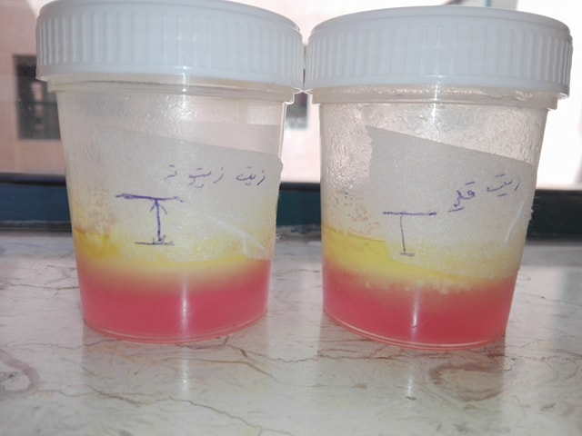
The amount of foam reduced .
Change in pH value (6-7).
Three layers were formed.
This choice is ignored.

Slide 13
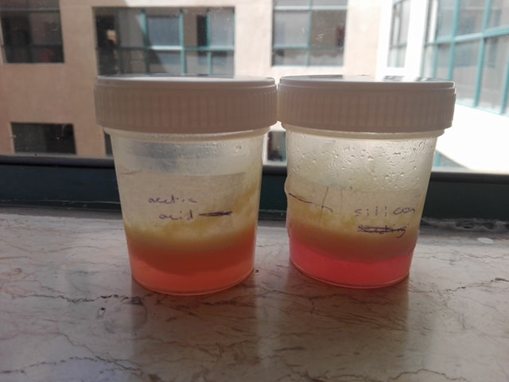
The foam was reduced.
The pH dropped to (3-5).
This choice is ignored.

Slide 14
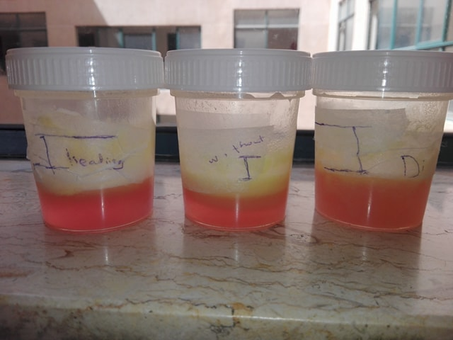
Diluted sample with a dilution factor 1:20.
The foaming problem was overcome by heating from 40 C to 60 C.

Slide 15
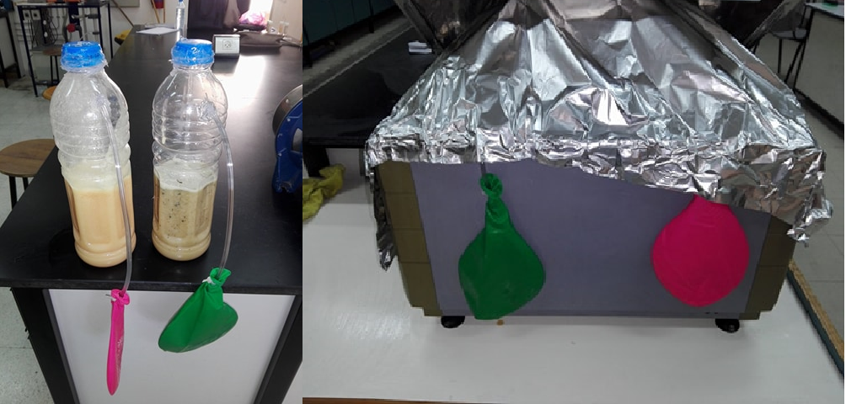
4.Ice cream +sludge sewage
Working volume 1L.Ice cream waste to sludge sewage ratio of 1:10(w/w).
Thermophilic 60 C.

Slide 16
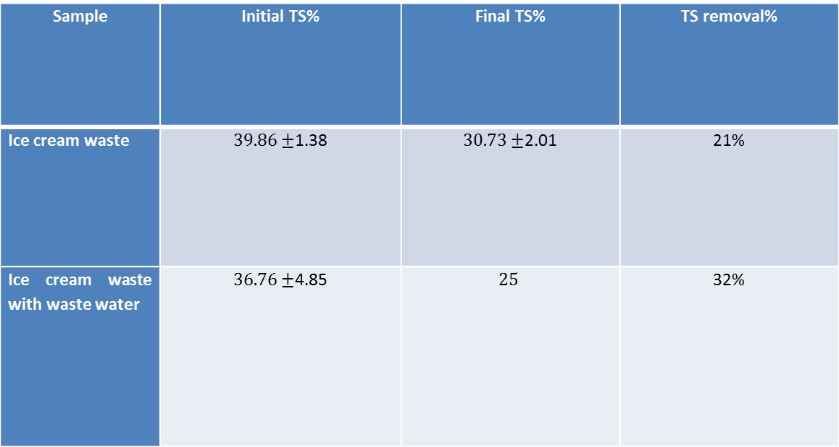
Total Solid Test
Sample | Initial TS% | Final TS% | TS removal%
Ice cream waste | $39.86±$1.38 | $30.73±$2.01 | 21%
Ice cream waste with waste water | $36.76±$4.85 | $$25$$ | 32%

Slide 17
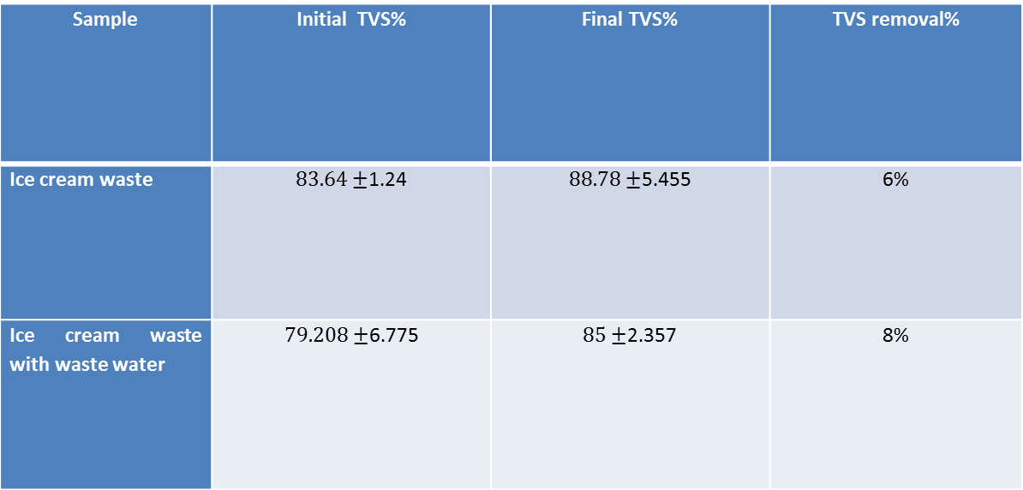
Total volatile Solid Test
Sample | Initial TVS% | Final TVS% | TVS removal%
Ice cream waste | $83.64±$1.24 | $88.78±$5.455 | 6%
Ice cream waste with waste water | $79.208±$6.775 | $85±$2.357 | 8%

Slide 18
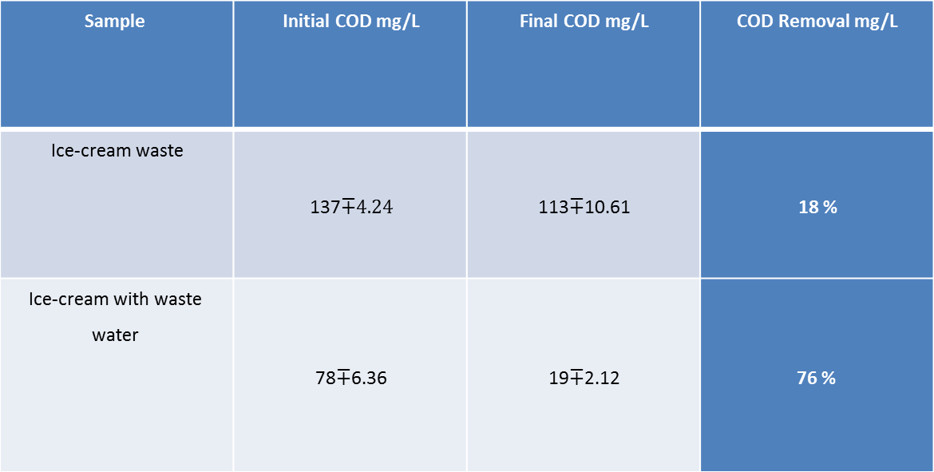
Chemical Oxygen Demand Test
COD Removal mg/L | Final COD mg/L | Initial COD mg/L | Sample
18 % | 113$∓$10.61 | 137$∓4.24$ | Ice-cream waste
76 % | 19$∓$2.12 | 78$∓$6.36 | Ice-cream with waste water

Slide 19
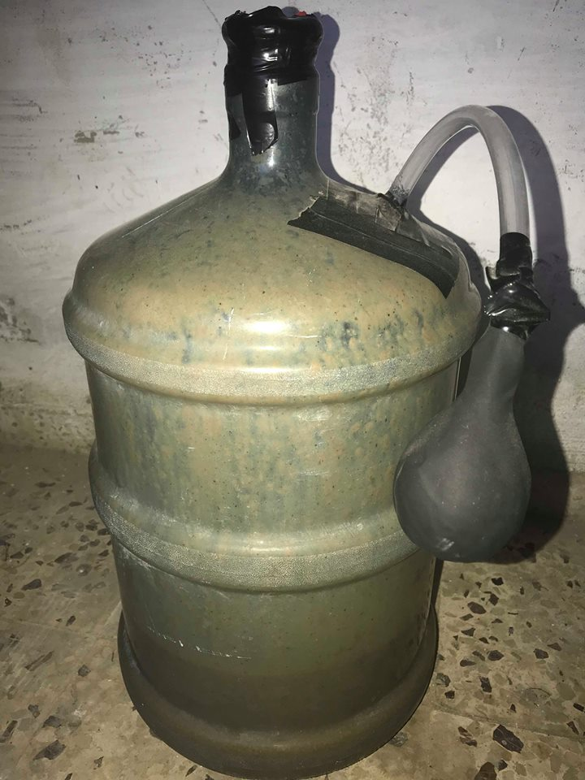
5. Ice cream+cow manure
Working volume 5.7 L Ice-cream waste to cow manure ratio of 1:10(w/w).
Mesophilic (uncontrolled)

Slide 20
It is possible to produce bio-ethanol from ice-cream wastes ??
step 1
Preparation of yeast culture
Yeast extract broth media
Defined media

Slide 21
Step 2
Fermentation
Yeast+ice cream were add to Yeast extract broth media also to Defined media.
The same think for Glucose

Slide 22
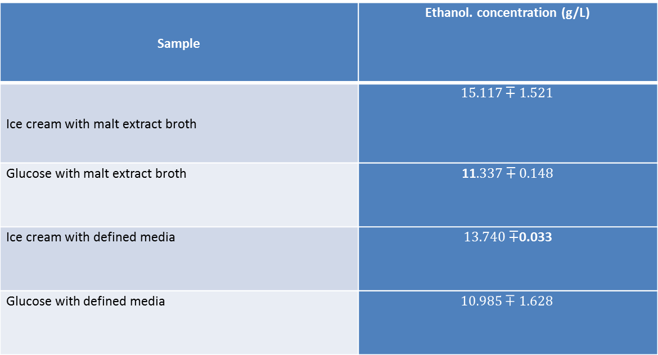
Step 3
Estimation of Ethanol Concentration
Ethanol. concentration (g/L) | Sample
$$15.117∓1.521$$ | Ice cream with malt extract broth
11$.337∓0.148$ | Glucose with malt extract broth
$13.740∓$0.033 | Ice cream with defined media
$$10.985∓1.628$$ | Glucose with defined media

Slide 23
conclusion
*A large amount of ice-cream waste is required to produce small amounts of bio-gas.
* Ice cream waste must be assisted by some seeding materials such as cows, poultry manure and others.
*The temperature plays a major role in the production of bio-gas, including mesophilic and thermophilic.
* TS, VS,pH and COD are very important parameters which give indication about efficiency of anaerobic digester.

Slide 24
Recommendation and future work
AD sensitive to different parameters such as heating and mixing. It must be taken into account.
The pH below 6.8 or above7.2 is restrictive and toxic to methane forming bacteria.
Thermophilic condition is the best for biogas production to eliminate the foam.
C/N it must be between 20-30 as optimum value otherwise it affects biogas production.
Use another method for ice cream waste disposal conversion such as bioethanol fermentation process.

Slide 25


Slide 26


