Slide 1
Brackish water treatment by CED for drinking & irrigation purposes in Jericho
Prepared By:
Mariam Dabous
Alaa Jadi
Muna Dilea
Supervision by:
Dr. Abdel-Fattah Hasan

Slide 2
Outline
Introduction
Objectives
Study Area
Water Quality
Desalination
Application
Conclusion
Recommendations

Slide 3
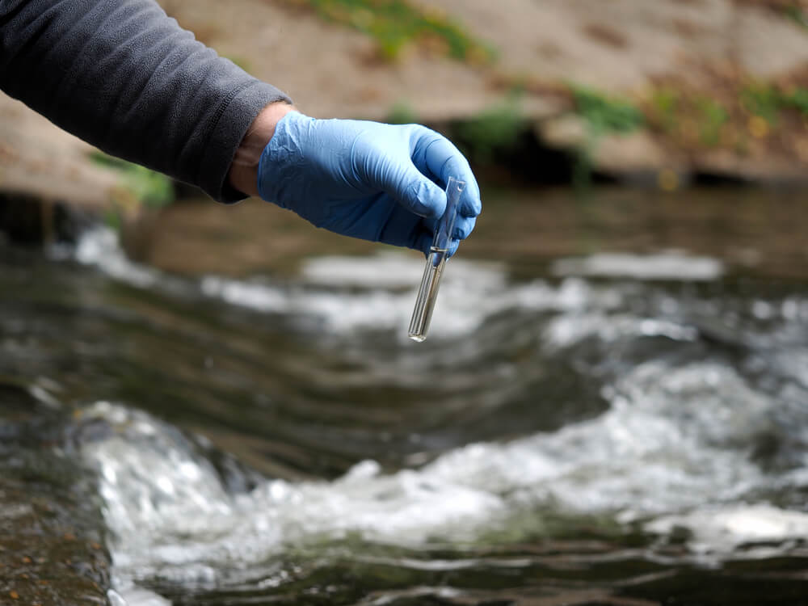
Introduction
Clean water is a limited and stressed as only a small portion (about 2.5%) of all Earth's water is suitable for direct human use and consumption.

Slide 4
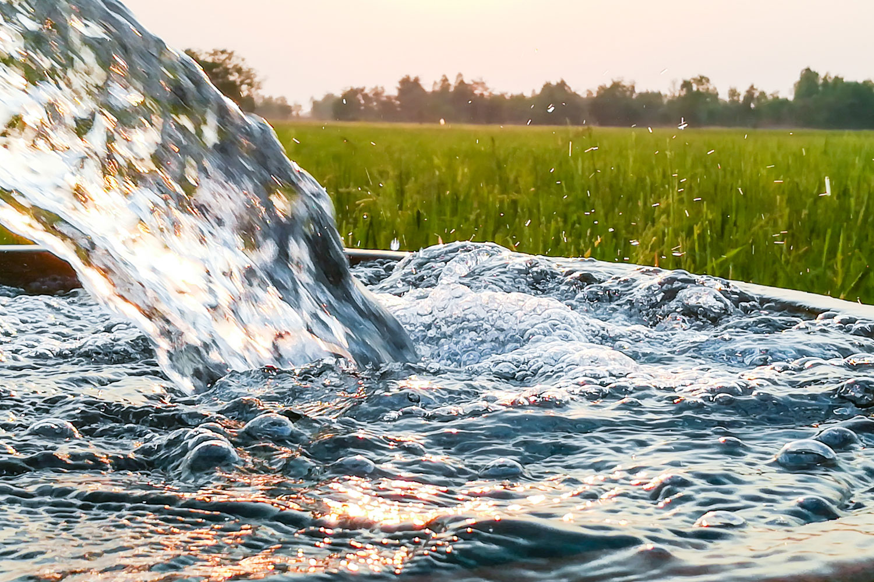
Introduction
Groundwater is the main source of water for the Palestinians in the West Bank and Gaza Strip and provides more than 90% of all water supplies.

Slide 5
Objectives
To understand the current situation in Jericho.
To assess the performance of CED for its suitability to
treat brackish water in Jericho for drinking and
irrigation purposes.
To assess CED operated regular from solar energy
under Jericho conditions.

Slide 6
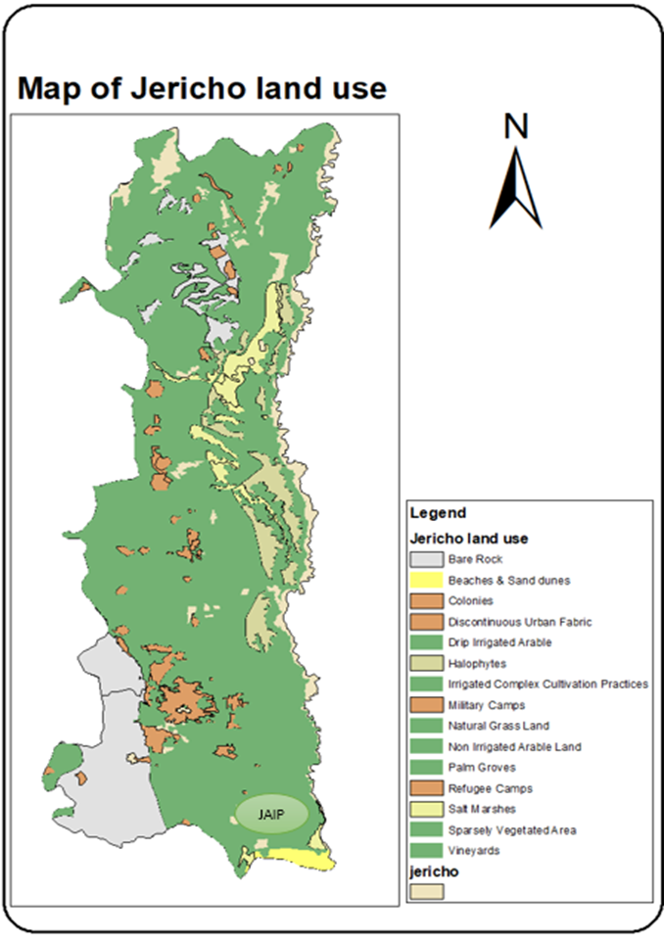
Study Area
Jericho is located at the east of West Bank.
lowest city in the world (273m below sea level).
Its climate is arid.
The Area is 592.8 Km².
Jericho is almost an agriculture city.

Slide 7
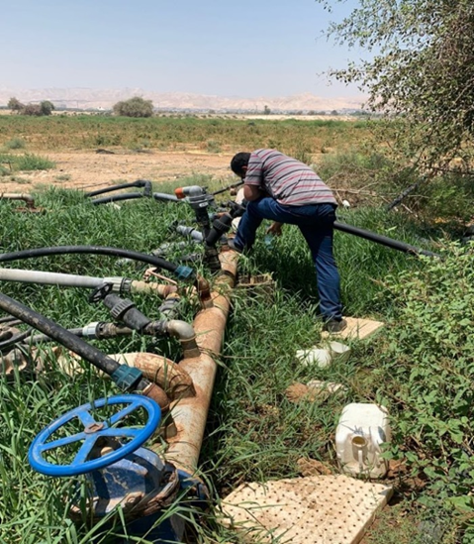
Water Quality
Data was collected from two sources:
PWA-NWSI.
6 wells from sampling:
  Nakheel well
  Sultan well
  Nweimeh well
  Iliah well
  Al-hamadoni well
  Al-d’aek well

Slide 8
Water Quality
Tests had been done:
Chloride
TDS
EC
Hardness
Nitrate
Sulfate

Slide 9
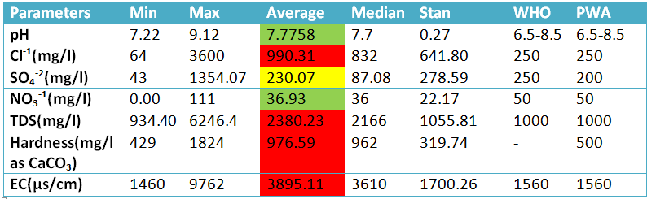
Water quality

Slide 10
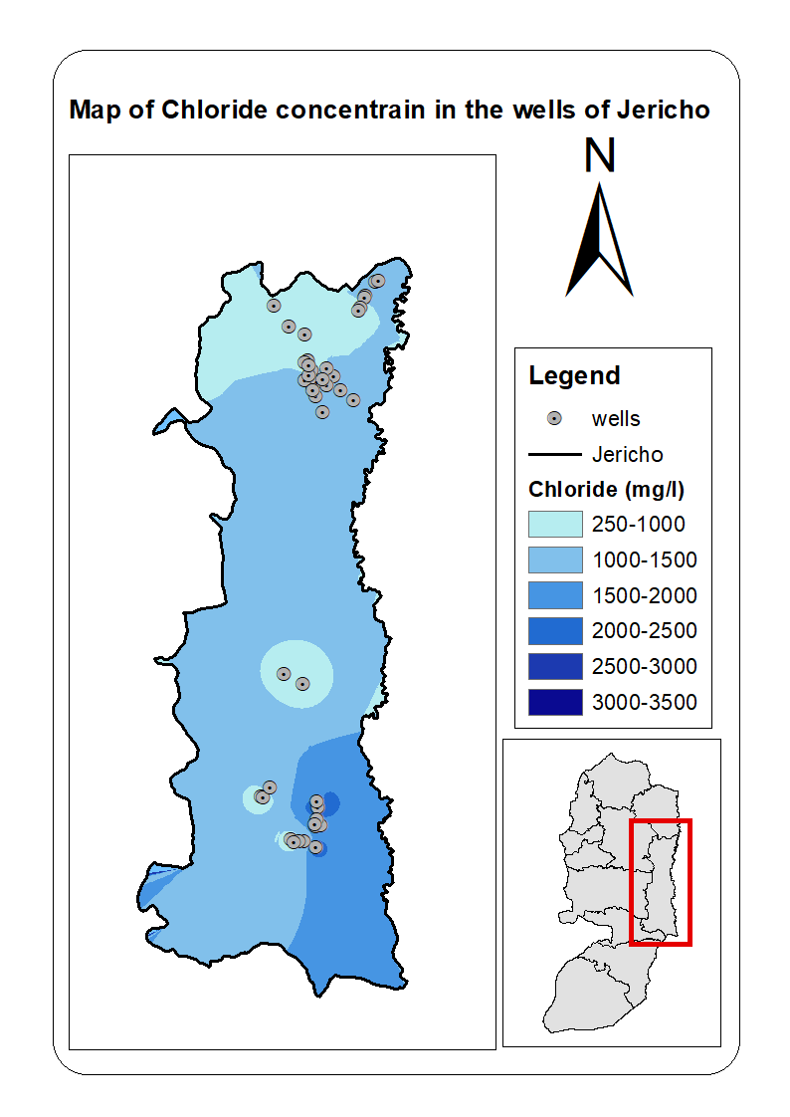
WATER QUALITY MAPPING
-
JERICHO

Slide 11
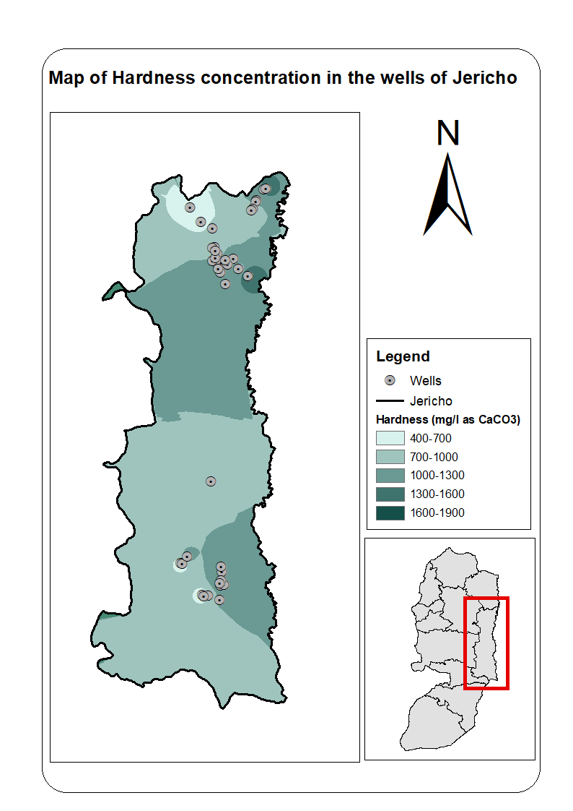
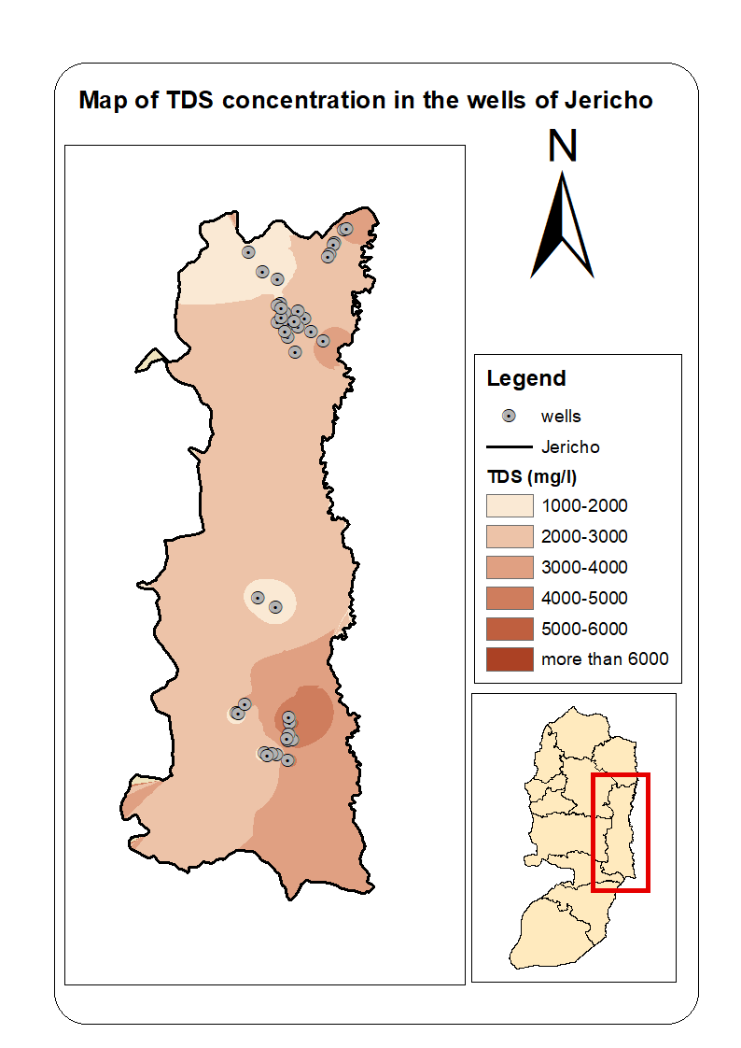

Slide 12
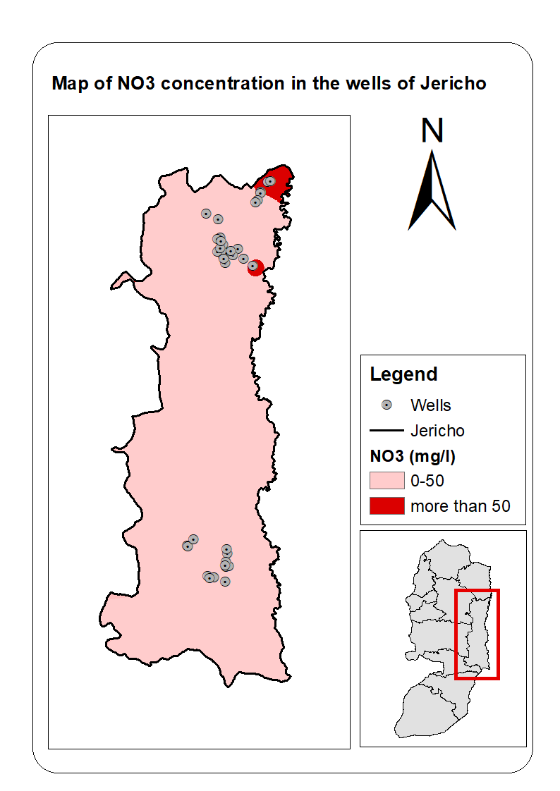
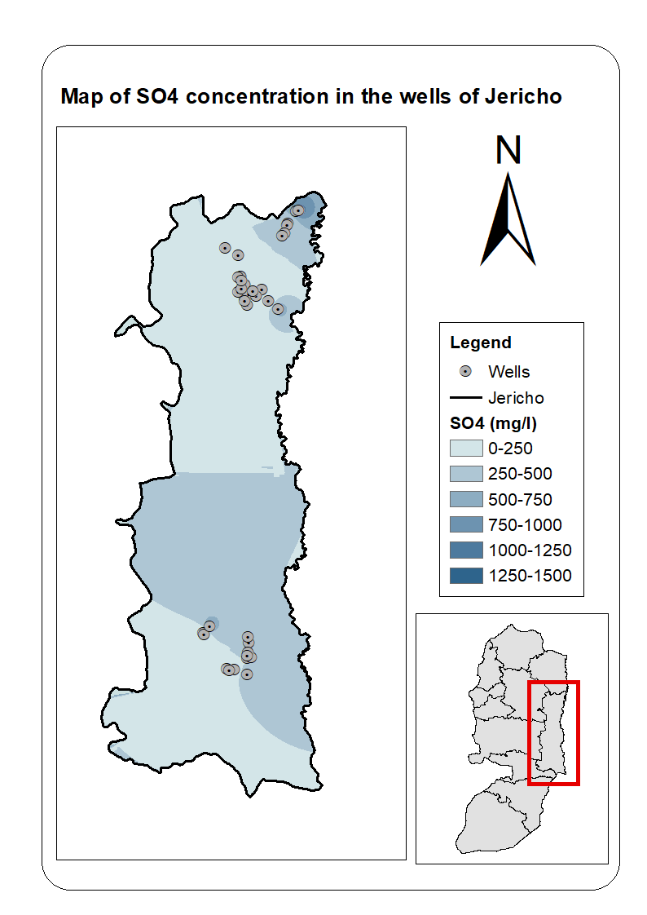

Slide 13
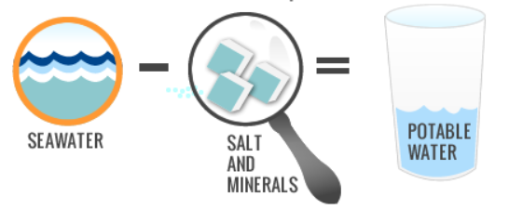
Desalination
Desalination is a water treatment process by which sea or brackish water is converted into water suitable for human consumption or irrigation.

Slide 14
Methods of Desalination
Reversal Osmosis
Electro-dialysis
Electro-dialysis Reversal
Capacitive Deionization
Capacitive Electro-dialysis
Others

Slide 15
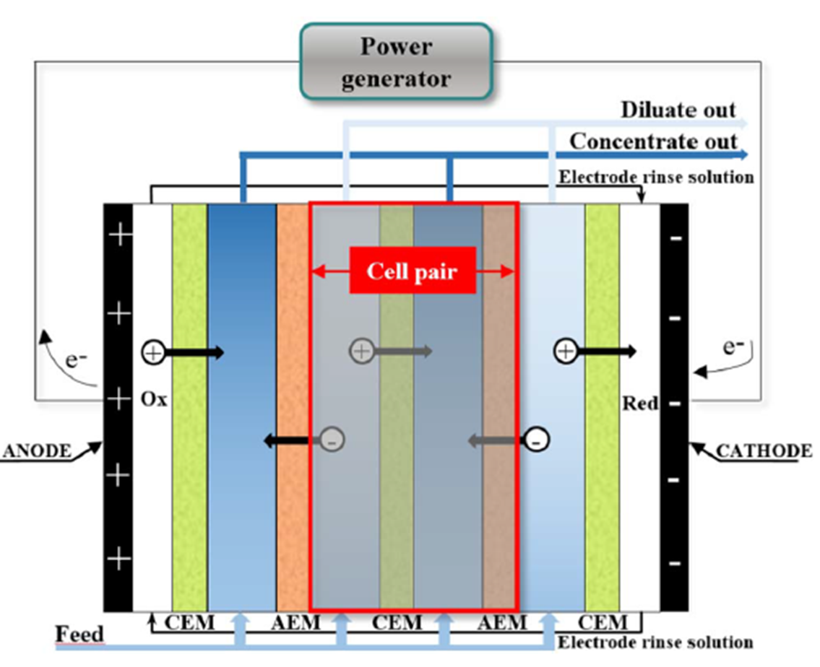
Capacitive electro-dialysis (ced)
Combination of 3 technologies:
Electro-dialysis
Electro-dialysis reversal
Capacitive deionization

Slide 16
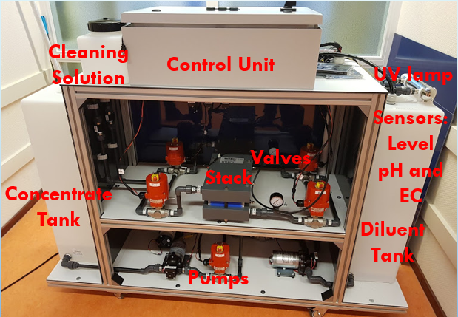
Main components of the CED Pilot System
Pre-treatment unit
CED unit
Post-treatment unit
Pumps
Valves and piping.

Slide 17
Experiment in pilot CED
Two runs were completed with 30 minutes of time cycle, one of them began with 5790 μs / cm and the other started with 4960 μs / cm.

Slide 18
Experiments in pilot CED
E1= 85%
E2= 81%
Effectiveness remains high regardless of the initial EC concentration.
Obvious declining in EC reading at the beginning of the cycle.

Slide 19
Experiments in pilot CED
The Effective of the time cycle was also studied by setting the initial EC and changing the cycle time.

Slide 20
Experiments in pilot CED
E1= 85%
E2= 94%
Cycle time is increased, the EC is decreased.

Slide 21
Experiments in pilot CED
Regeneration test was done to study the effect of cleaning the membrane with citric acid.

Slide 22
Experiments in pilot CED
Ebefore= 82%
Eafter= 92%
Cleaning repeatedly revives the membranes, which means that it maintains their durability.

Slide 23
Applications

Slide 24
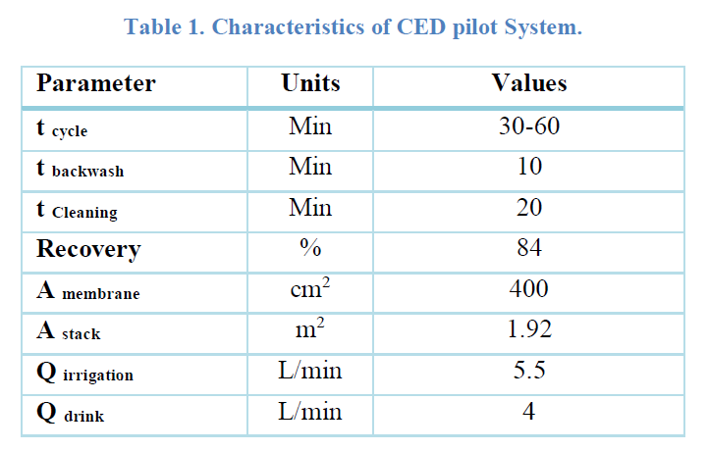
Scaling up the CED pilot system

Slide 25
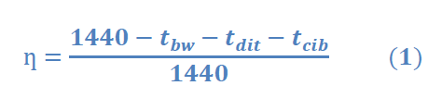

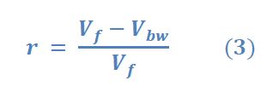

The percent of time that permeate is produced, or online production factor.
The water produced is determined from:
Recovery is the ratio of net water production to gross water production over a filter run:
Total membrane area is determined from:

Slide 26
Case 1, palm farm with small house:
Case 2, Grapefruit farm with small house:
Area | 1 donumn
NO. of trees | 15 tree
Irrigation consumption | 1.6 m³/day
No. of people | 5
Drinking consumption | 80 L/day /c
Area | 1 donumn
NO. of trees | 40 tree
Irrigation consumption | 17.3 m³/day
No. of people | 5
Drinking consumption | 80 L/day/c

Slide 27
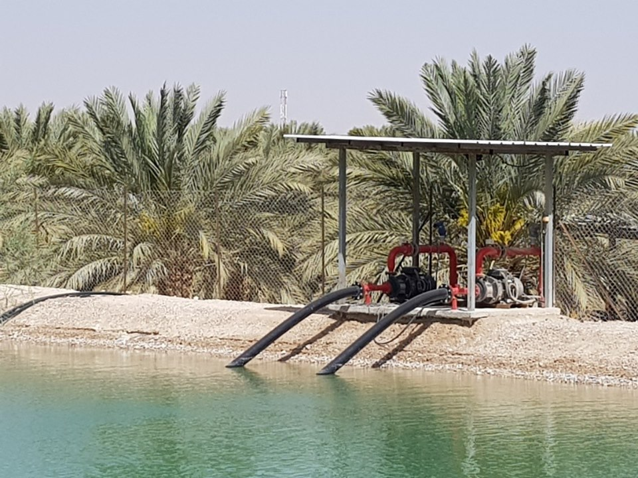
Case3: Nakheel farm in Jericho:
Area | 4000 donumn
NO. of trees | 40000
Irrigation consumption | 4260 m³/day
No. of people | 500
Drinking consumption | 50L/day/c

Slide 28

Scaling up the CED system
Case | No. of modules
Case 1 | 1 module
Case 2 | 4 module
Case 3 | 870 module

Slide 29
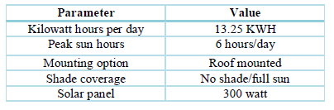
Solar energy
Case 1, one dunum palm farm.
Case 2, one dunum grapefruit farm.

Slide 30

Solar energy
Case1 need 12 solar panel with 24m² (15120 NIS )
Case 2 need 46 solar panel .

Slide 31
Conclusion
The main reason for increasing salinity is over pumping in agricultural region.
Desalination word is not about the efficiency. It should be cost effective and energy efficient.
Scaling up for CED device is not effective; it is suitable for
small scale farming and agriculture.
Solar panel is a good choice for one dunum farm, but not suitable to all type of trees and plants.

Slide 32
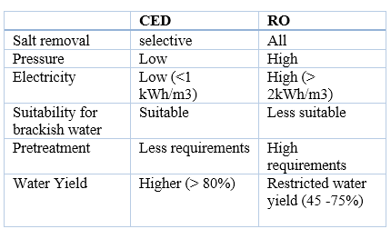
Conclusion
RO is widely used in Jericho; CED has more advantages than RO.

Slide 33
Recommendations
Develop laws and regulations that control the amount of water consumption, type and amount of fertilizers.
Make research to determine the allowable pumping.
How the CED system can be produced in larger quantities and assembled locally.
Make feasibility study for using solar energy panels

Slide 34


