Slide 1


Welcome
to Graduation Project 1

Slide 2
Welcome
to Graduation Project 1

Slide 3
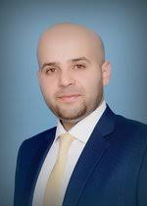


Welcome
Team
SUPERVISOR:
to Graduation Project 1
DR. IHAB H. ALSURAKJI
PREPARED BY:
MAJDI ABDULLAH
AHMED YAHYA

Slide 4


2022
Home
Chapter 1
Chapter 2
Chapter 3
Chapter 4
Chapter 5
Chapter 6
Chapter 7
Modelling and simulation of Pneumatic dough slicing machine
The project is a machine specialized in cutting dough with a specific system, which is the pneumatic system.

Slide 5

2022
Home
Chapter 1
Chapter 2
Chapter 3
Chapter 4
Chapter 5
Chapter 6
Chapter 7
Introduction
Developing bakeries in the Palestinian market.
Ability to design different machines.
Organizing ideas before beginning the design process.
Capability to learn and research in a variety of fields

Slide 6
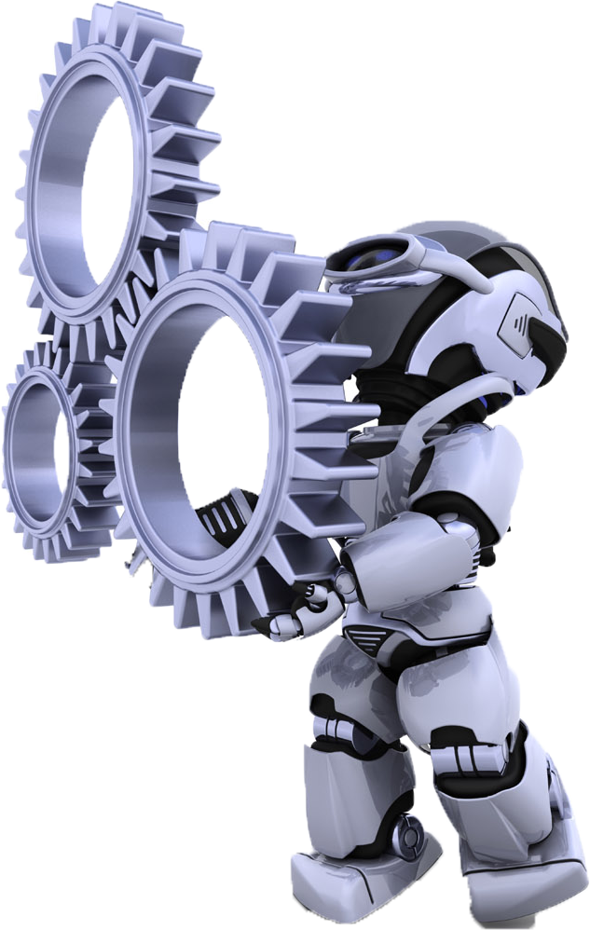
2022
Home
Chapter 1
Chapter 2
Chapter 3
Chapter 4
Chapter 5
Chapter 6
Chapter 7
Literature Review
This chapter mentions the history of bread and how it has been developed over time, the beginnings of the idea of mechanically slicing bread and the factors that helped in the production of these machines.

Slide 7
2022
Literature Review
Bread making history
Dough
Welding and metals
Extrude screw
Rheology

Slide 8

2022
Home
Chapter 1
Chapter 2
Chapter 3
Chapter 4
Chapter 5
Chapter 6
Chapter 7
Dough Slicer Machine Components
Machines consist of several mechanical, electric, and electronic parts. Each section here will discuss a specific aspect of these parts.

Slide 9
GO TO EON-XR

Slide 10
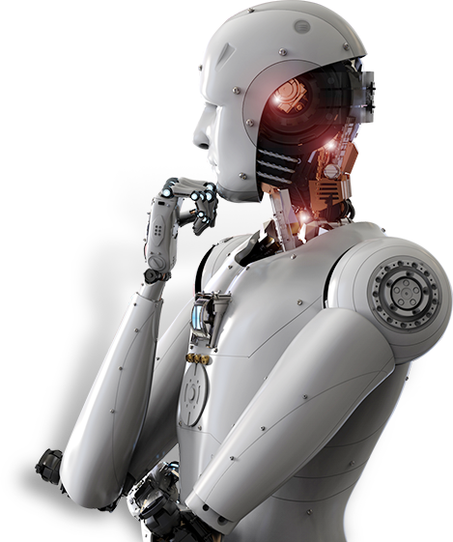
2022
Home
Chapter 1
Chapter 2
Chapter 3
Chapter 4
Chapter 5
Chapter 6
Chapter 7
Design of a Dough Slicing Machine
This chapter explains the equations for the main parts of the machine

Slide 11
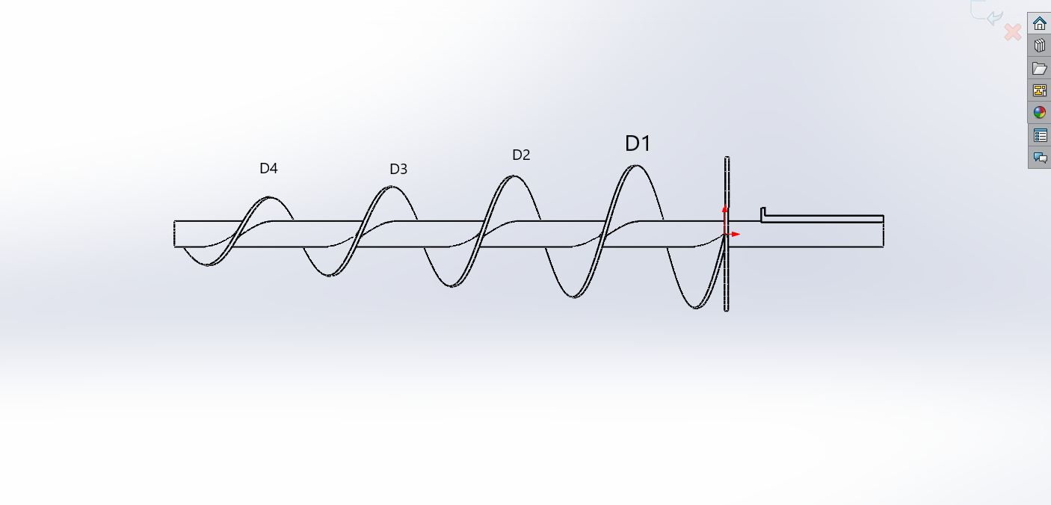
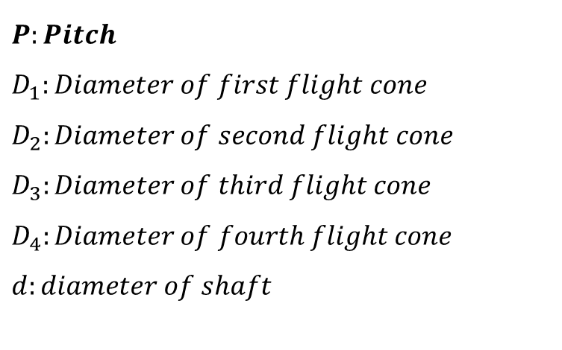
2022
Design of a Dough Slicing Machine
Screw conveyors
$$P:Pitch$$
$$D_{1}:Diameter of first flight cone$$
$$D_{2}:Diameter of second flight cone$$
$$D_{3}:Diameter of third flight cone$$
$$D_{4}:Diameter of fourth flight cone$$
$$d:diameter of shaft$$

Slide 12
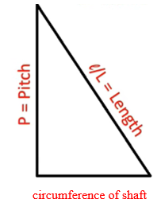
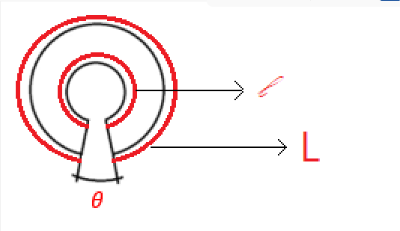


2022
Design of a Dough Slicing Machine
Screw conveyors
Part one: The sites on which the first flight cone is positioned and the distances between them are calculated using formulae.
$l=\sqrt{{\left(dπ\right)}^{2}+P^{2}}$
$L=\sqrt{{\left(Dπ\right)}^{2}+P^{2}}$

Slide 13
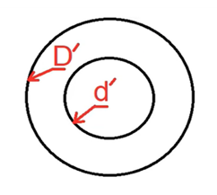
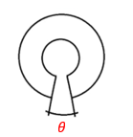
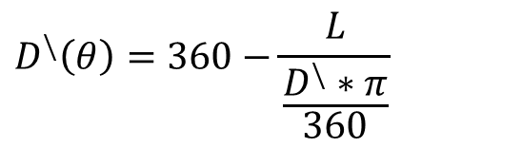

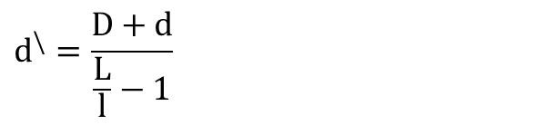
2022
Design of a Dough Slicing Machine
Screw conveyors
Part Two: As illustrated in the attached figures 20 , designing the flight cone that were installed on the points calculated in the first part in terms of diameter and cutting angle
$$d^{\backslash }=\frac{D+d}{\frac{L}{l}−1}$$
$$D^{\backslash }=\left(D−d\right)+d^{\backslash }$$
Figure 20 the diameter of flight cone
$$D^{\backslash }\left(θ\right)=360−\frac{L}{\frac{D^{\backslash }∗π}{360}}$$

Slide 14
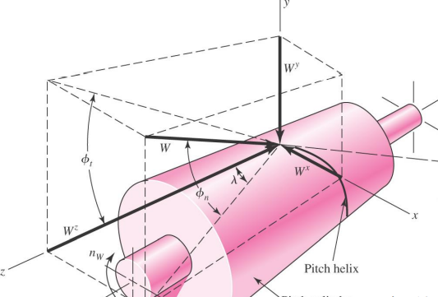

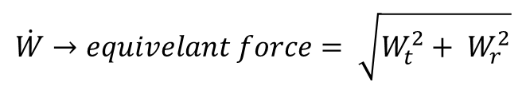


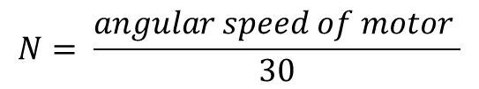
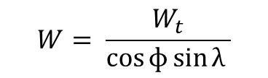
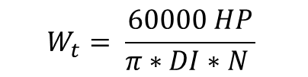
2022
Design of a Dough Slicing Machine
Bearings Design
$$W_{t}= \frac{60000 HP}{π∗DI∗N }$$
$$N= \frac{angular speed of motor }{30}$$
$$W_{t}=W\cos{ɸ}\sin{λ }$$
$$W= \frac{W_{t}}{\cos{ɸ}\sin{λ }}$$
$$W_{r}=W∗ \sin{ɸ }$$
$$W_{z}=W∗\cos{ɸ}∗\cos{λ }$$
$$\dot{W}→equivelant force= \sqrt{W_{t}^{2}+ W_{r }^{2}}$$

Slide 15
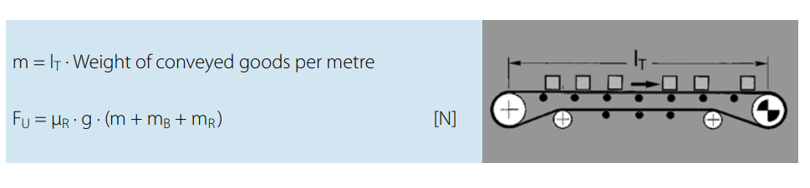
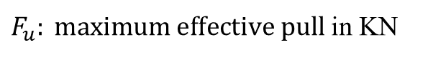
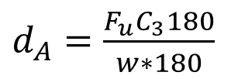
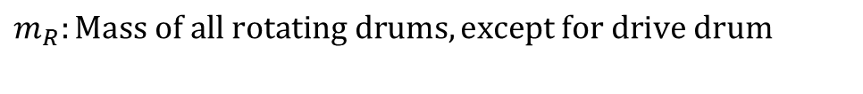
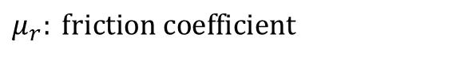

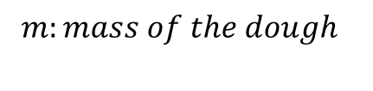
2022
Design of a Dough Slicing Machine
Conveyer belt:
$F_{u}: maximum effective pull$ in KN
$$m_{B}: mass of the belt$$
$μ_{r}: friction coefficient$
$m_{R}:Mass of all rotating drums, except for drive drum$
$$m:mass of the dough$$
Minimum drum diameter:
$d_{A}=\frac{F_{u}C_{3}180}{w∗180}$

Slide 16


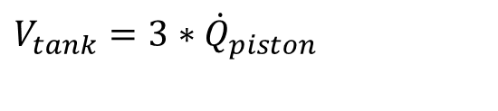
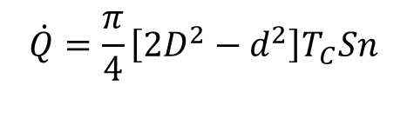
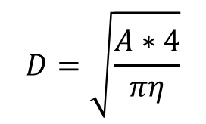
2022
Design of a Dough Slicing Machine
piston Design
$$A=\frac{F}{P}$$
$$D=\sqrt{\frac{A∗4}{πη}}$$
$$volume of compressor tank$$
$$V_{tank}=3∗{\dot{Q}}_{piston}$$
Volumetric flow rate for compressor :
$$\dot{Q}=\frac{π}{4}\left[2D^{2}−d^{2}\right]T_{C}Sn$$

Slide 17
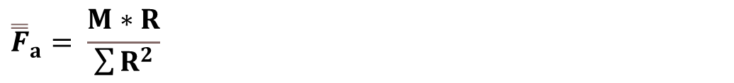
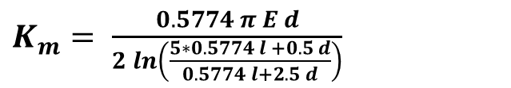



2022
Design of a Dough Slicing Machine
bolt-design
$$force from resultant moment:$$
The bolt stiffness:
$K_{b}= \frac{A_{d}∗ A_{t}∗E }{A_{d}∗ l_{t}+ A_{t}∗ l_{d} }$
$${\overset{̿}{F}}_{a}= \frac{M∗R}{\sum{R^{2}}}$$
The Bending Stress :
stiffness of the member:
$σ_{i}= \frac{F_{c}}{A_{bearing}}$
$K_{m}= \frac{0.5774 π E d}{2\ln\left(\frac{5∗0.5774 l +0.5 d}{0.5774 l+2.5 d}\right)}$

Slide 18

2022
Home
Chapter 1
Chapter 2
Chapter 3
Chapter 4
Chapter 5
Chapter 6
Chapter 7
Machine Controlling Unit
Control engineering is critical in today's technological systems. Improving industry control has a lot of advantages. They include raising product quality, lowering energy usage, reducing waste, boosting safety, and lowering pollution

Slide 19
2022
Machine Controlling Unit
The control panel contains
The motor
Inverter drive
the contactor (16 AMP(
Auxiliary electrical contacts for the contactor
Over load
Relay
PLC

Slide 20
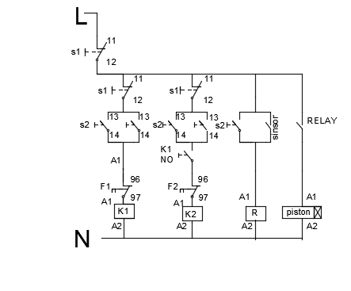
2022
Machine Controlling Unit
After identifying the parts of the control panel, the panel was assembled and shown as follows :

Slide 21
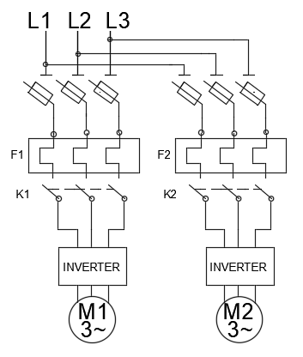
2022
Machine Controlling Unit
The figure below shows the outline of the power system.

Slide 22
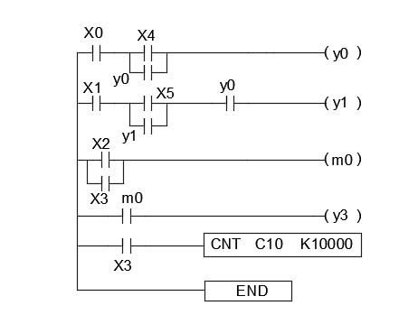
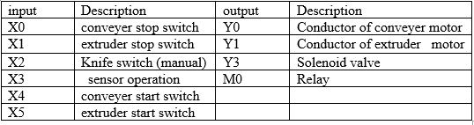
2022
Machine Controlling Unit
The figure below shows the programming scheme of the PLC system.

Slide 23
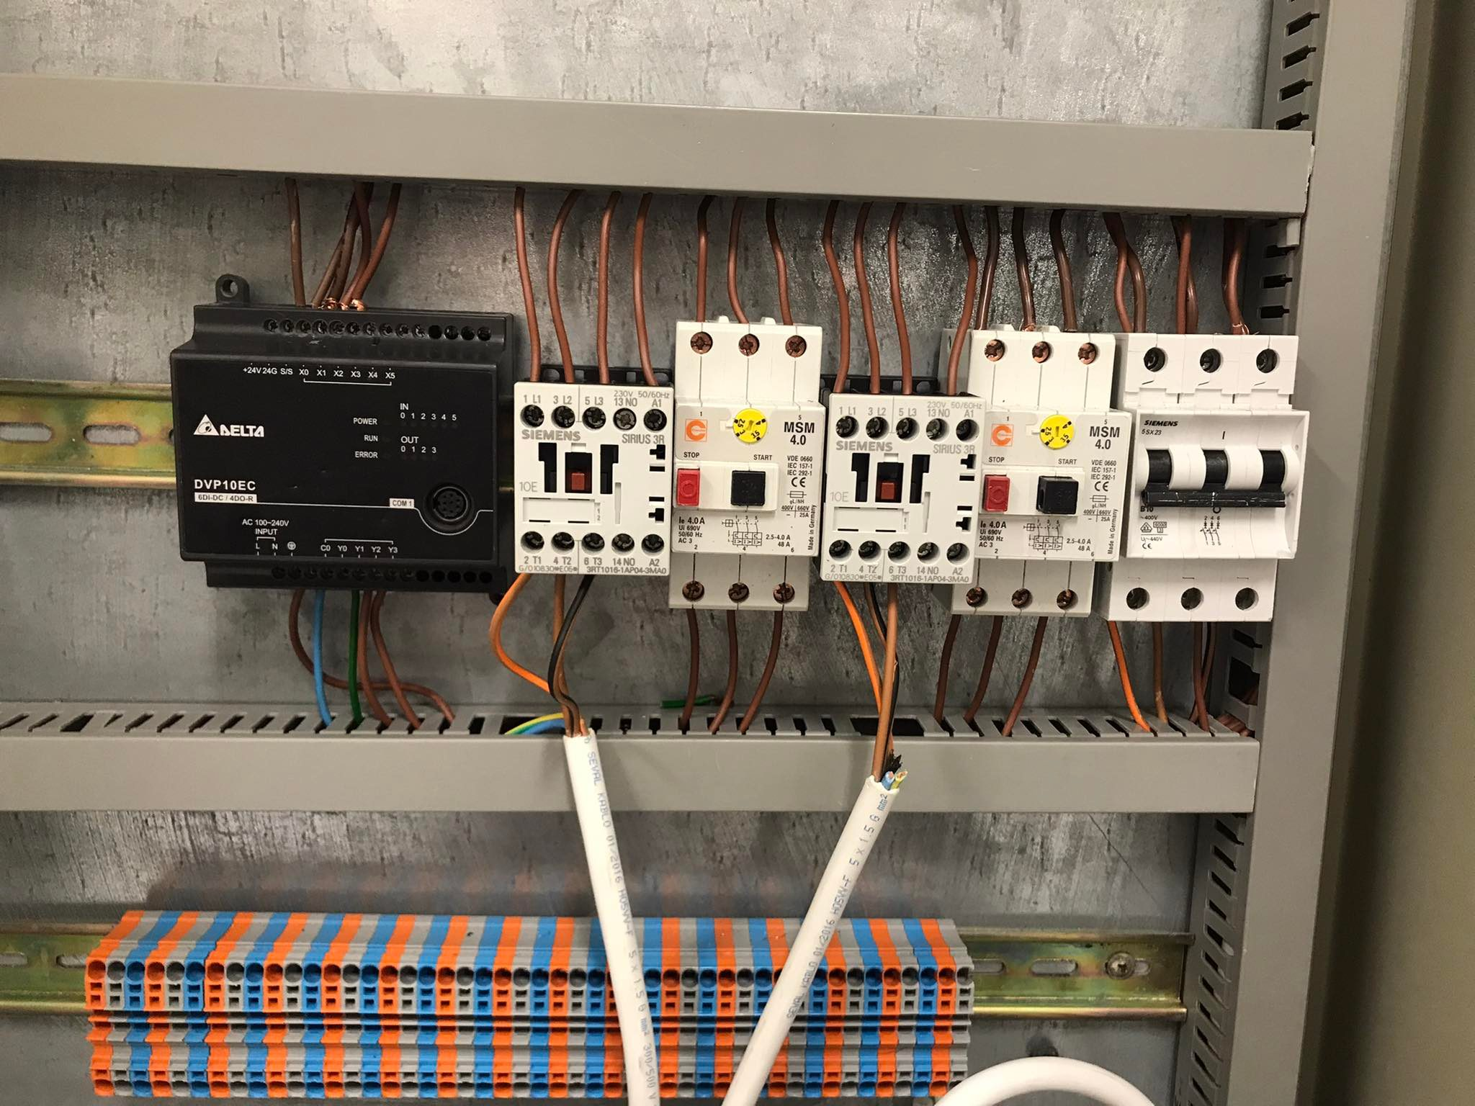
2022
Machine Controlling Unit

Slide 24

2022
Home
Chapter 1
Chapter 2
Chapter 3
Chapter 4
Chapter 5
Chapter 6
Chapter 7
Feasibility Study
This research focused on the machine created for this project, which is used in the bread-making process and specializes in the cutting of dough.

Slide 25
Feasibility Study
2022
The quotation is divided into mechanical and electrical parts, and annual prices and costs for the machine are shown in the tables below.
Fixed cost
Machine part | NIS
Extruder | 1500
Container | 2500
Bearing | 70
Motor (1 hp) | 1200
Motor (0.5 hp) | 700
Conveyer belt | 2500
Sheet metal | 1200
Frame | 700
Electrical panel | 310
PLC | 750
Inverter *2 | 1500
Compressor | 1500
Unexpected cost | 5000
Total | 19430
expected fixed cost and initial capital cost
expected variable cost in one year
Annual cost (NIS)
Annual salary cost | 28800
Annual electricity cost | 1633
Annual maintenance cost | 3650
Total | 34083

Slide 26
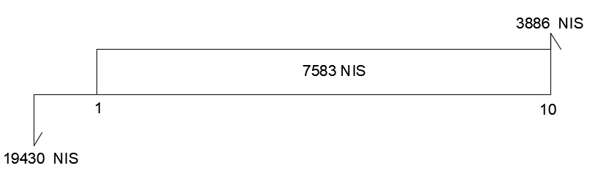
2022
Feasibility Study
It is now possible to calculate the return on investment and the payback period for the capital using the mentioned information.
cash flow diagram

Slide 27
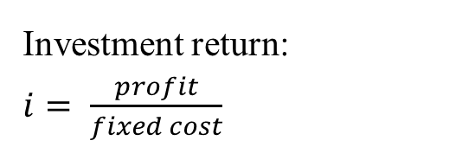

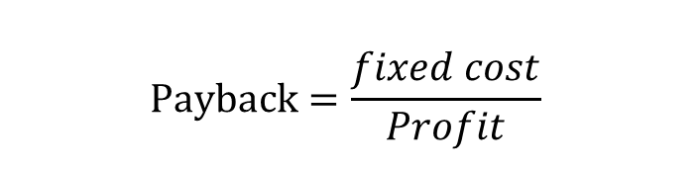
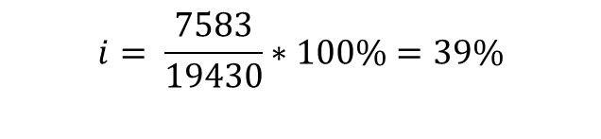
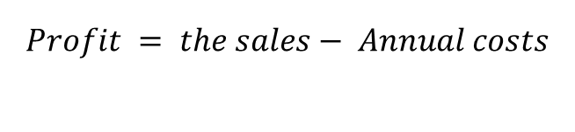
2022
Feasibility Study
Investment return:
$i= \frac{profit}{fixed cost}$
$$Profit = the sales− Annual costs$$
$$i= \frac{7583}{19430}∗100\%=39\%$$
Payback period:
$$Payback=\frac{fixed cost}{Profit}$$
$Payback=\frac{19430}{7583}=2.5$ year

Slide 28
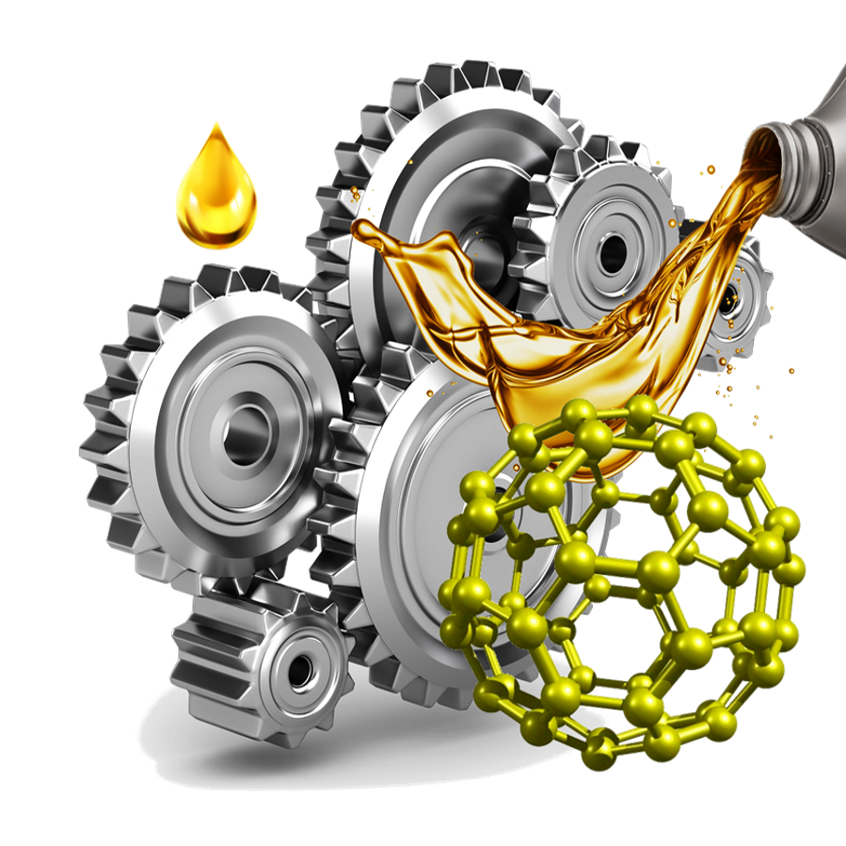
2022
Home
Chapter 1
Chapter 2
Chapter 3
Chapter 4
Chapter 5
Chapter 6
Chapter 7
Discussion and Recommendation
The main goals of this project were to learn how to start designing a complete integrated machine from the beginning of the idea to the completion of the design, and to benefit as much as possible from university materials and link them to design in theory.

Slide 29
2022
Discussion and Recommendation
as well as the possibility of expanding in different fields, such as PLC programming and gaining good experience.
the possibility of connecting a control panel and linking it to the machine in practice.
Using PLC programming, we may improve the machine by adding unique weight sensors to precisely control the weight of the dough piece, as well as a safety system that alerts us if a malfunction happens during the manufacturing process.

Slide 30
2022
Discussion and Recommendation
After completing a financial analysis and a market analysis, it was discovered that the machine is more economically and mechanically practicable than its imported version.
Finally, if there is someone who requires it, we can begin manufacturing it and add it to the production line.
as we can use the machine in many production lines such as bread, sweets, biscuits, and other production lines while keeping in mind the safety specifications due to the fact that it is designed from stainless steel material for the health of the product.

Slide 31
thank you

