Slide 1

Design of Wastewater Collection Network for Burqa Village
Prepared by:
1. Ahmad Hajji
2. Hassan Hassoun
3. Mohammad Abdel Dayem
4. Omar Nassar
Under supervision of: Dr. Sameer Shadeed

Slide 2
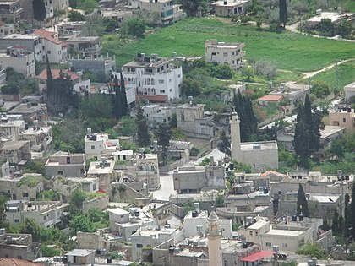
Introduction
Burqa village lies in the north west of Nablus city in Palestine, Burqa has a total area of about 26,800 donums .
Elevations in the village vary significantly from one place to another with maximum and minimum values of 570 m and 350 m AMSL.
Burqa is shown in the Figure.

Slide 3
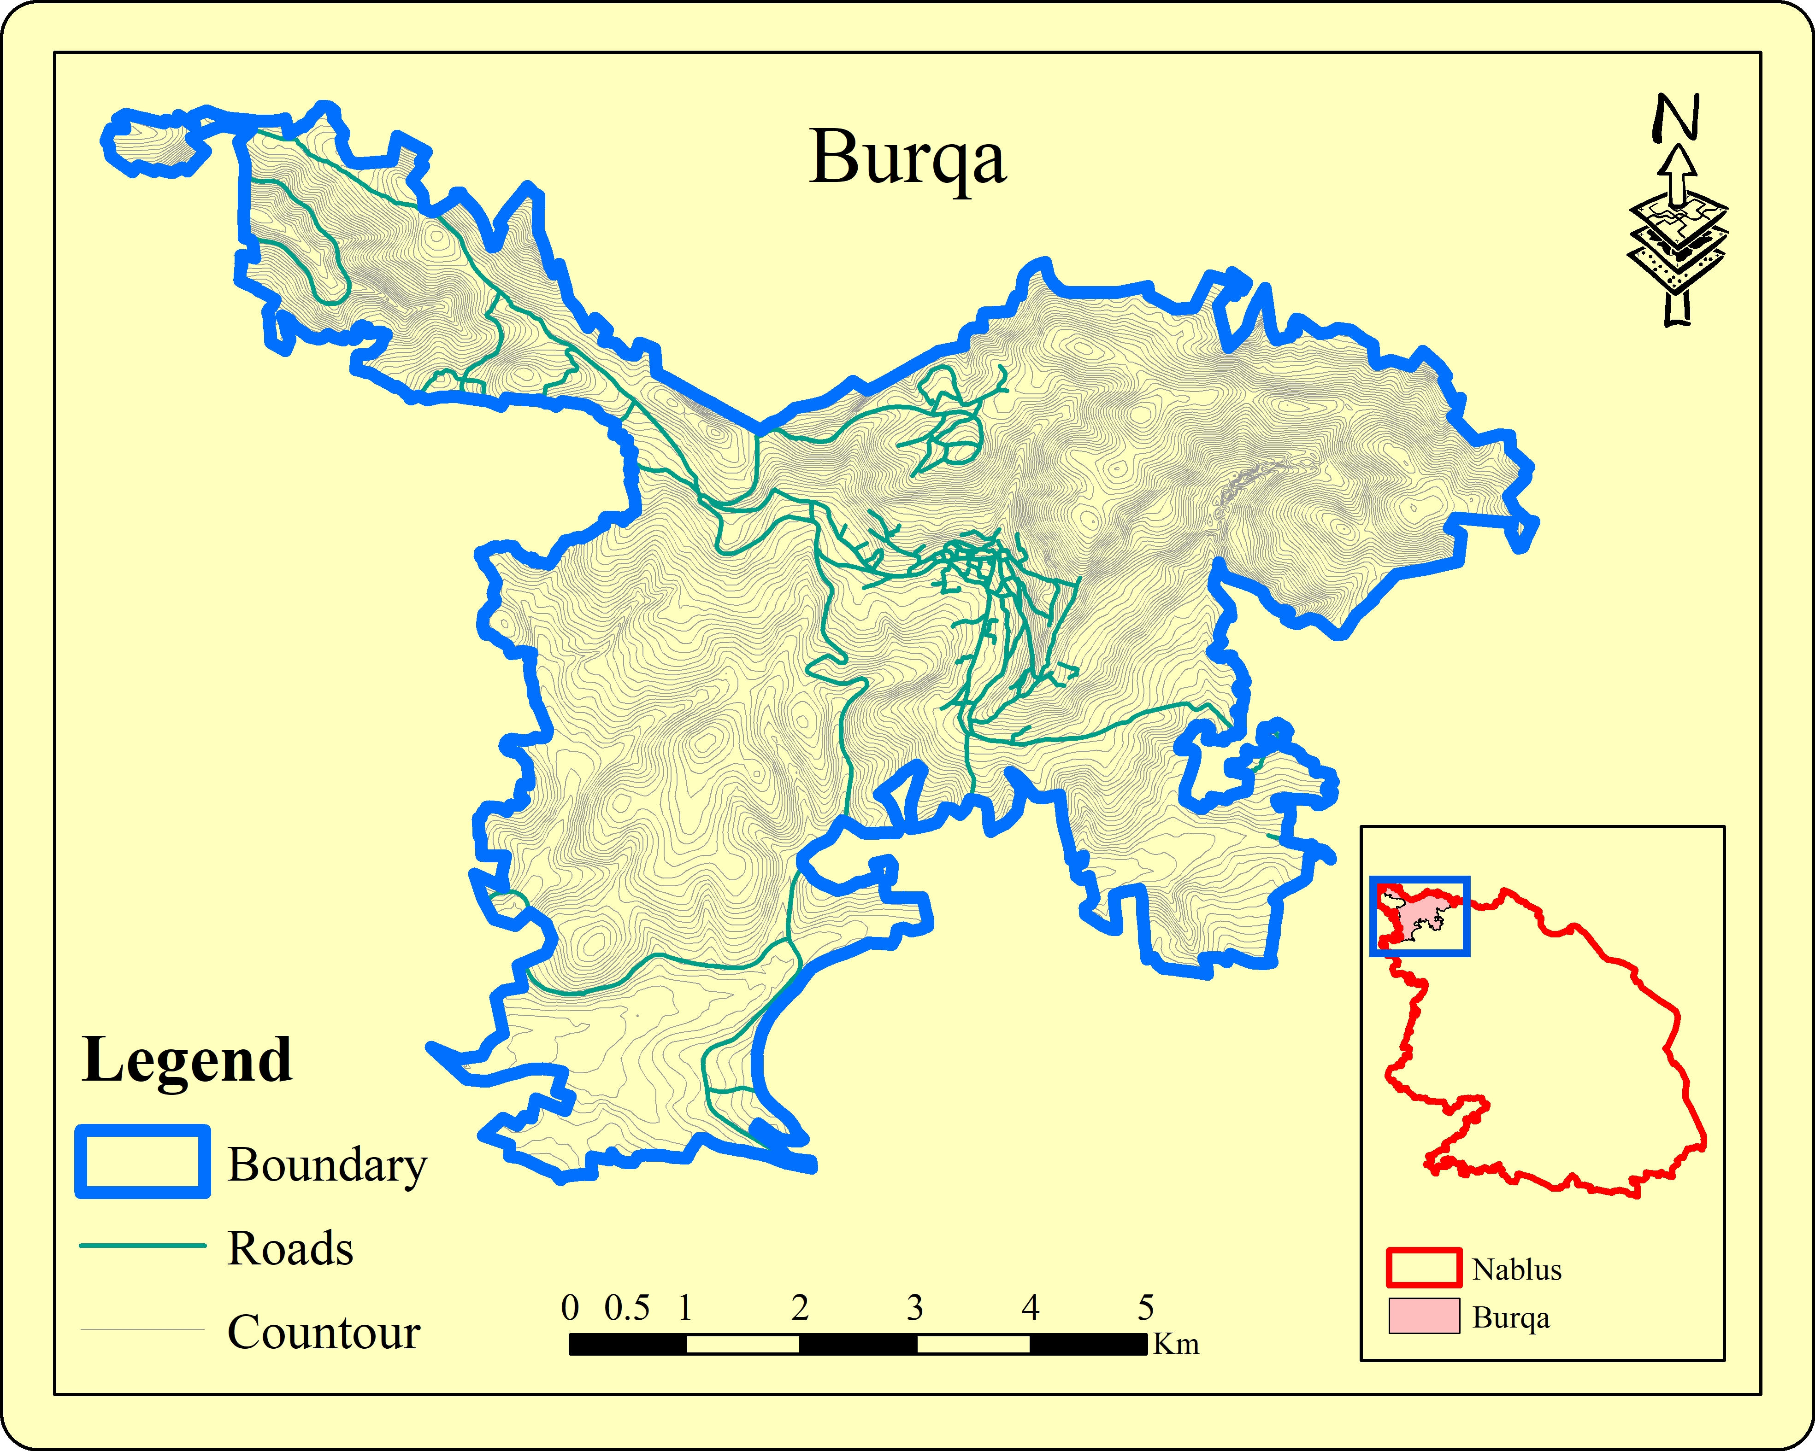

Slide 4
Introduction
Burqa village isn’t serviced by a WWCN, cesspits are the only available way of wastewater disposal in the village.
The objective is to design a WWCN for Burqa village to serve for the next 30 years.
In the West Bank, more than 60% of local communities are not serviced by WWCNs.
The population of Burqa was obtained from the PCBS for the census years of 2007 and 2017 are as presented.
Year | Population (persons)
2007 | 3,631
2017 | 4,116

Slide 5
Standards & Specifications
Water consumption is 120 l/c. d.
return flow of 85% of the consumption.
infiltration rate of 20% of the flow.
Manholes: minimum 60 cm.
Length of conduit: 30-50 m.
Material: PVC pipes.
Pipe sizes: minimum 8 inches (200 mm).
Full flow: 75% of the cross section.
Peak Factor (PF): The peak factor used is 3.
Velocity: 0.6-3 m/s.
Cover: 1-4.5 m.
Slope: 1-15%.

Slide 6
Project constraints and limitations
Nature and topography of the study area: the village has difficult terrain and high slopes which affect the design.
Location of streets: The issue here is that some areas of the village are not serviced with streets.
Location of buildings: urban plans are not up to date and do not describe the real situation.
Village boundaries: A boundary was adopted based on observations and experience of the village.

Slide 7
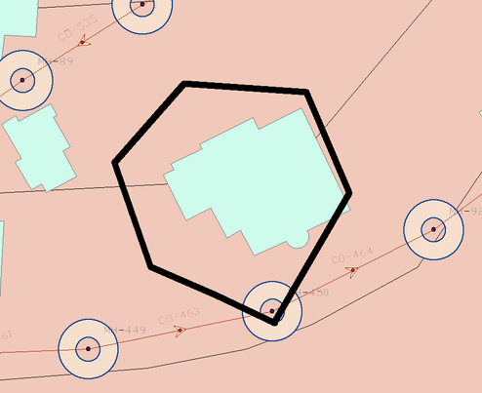
Design methodology
AutoCAD drawings: were converted to GIS shapefiles.
SewerCAD: exporting shapefiles to SewerCAD, and sketching the WWCN.
Load allocation: the load on each manhole is calculated with the assist of excel, applying the concept of a sewershed.
Defining different parameters: defining the elevations using TRex tool in SewerCAD.
Running the model: running the developed WWCN model and by applying the trial-and-error procedure, proper design was obtained.

Slide 8
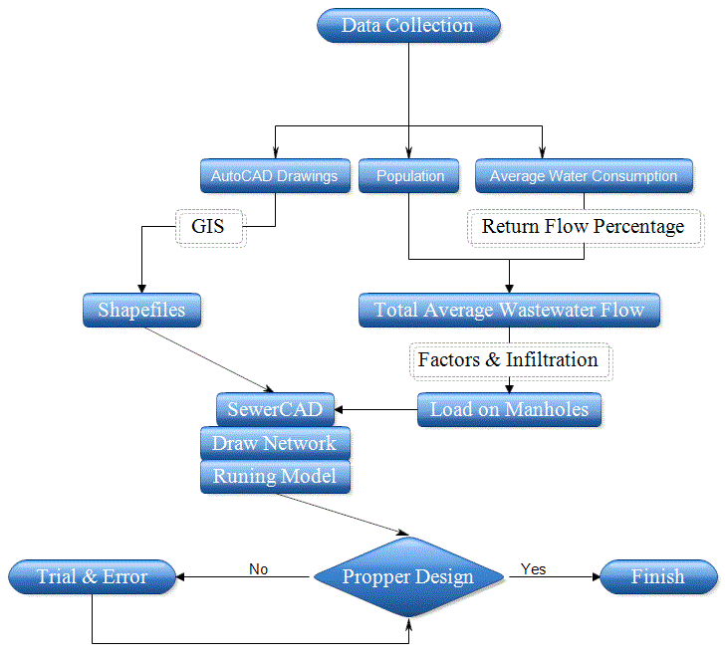

Slide 9
Population and growth rate
P2007 = 3,631, P2017 =4,116.
Growth rate:
P_2017 = P_2007 (1+r)^{n}
4116 = 3631 (1+r)¹⁰
R = 0.0126 = 1.26%
Population after 30 years:
P_2050 = P_2017 (1+r)^{n}
P_2050 = 4116 (1+0.0126)³³ =6,222 persons

Slide 10
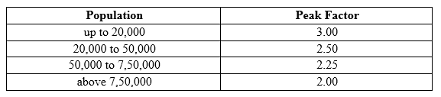
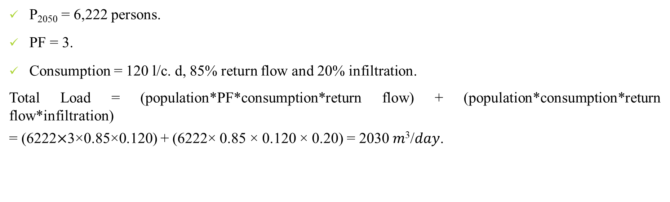
Total load
P₂₀₅₀ = 6,222 persons.
PF = 3.
Consumption = 120 l/c. d, 85% return flow and 20% infiltration.
Total Load = (population*PF*consumption*return flow) + (population*consumption*return flow*infiltration)
= (6222$×$3×0.85×0.120) + (6222× 0.85 × 0.120 × 0.20) = 2030 𝑚³/𝑑𝑎𝑦.

Slide 11
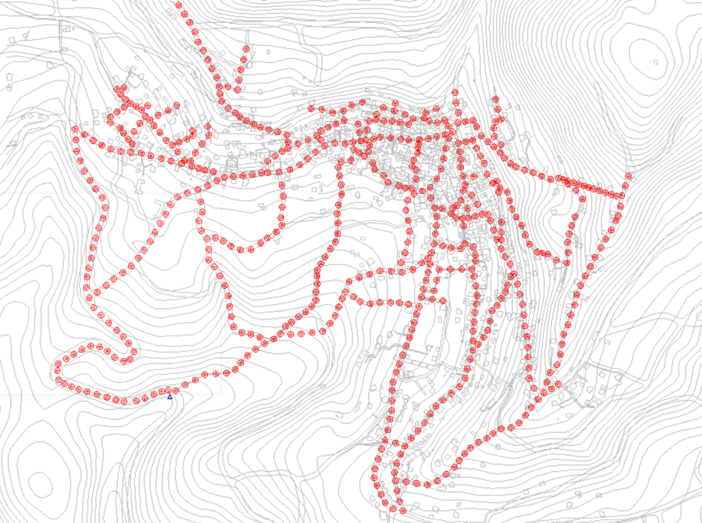
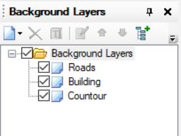
Modeling, analysis and design of WWCN
Adding Shapefiles to SewerCAD.
Drawing the Manholes: In this step the manholes are drawn with consideration to changes in direction, grade, or pipe size or at intersections of collection sewers.

Slide 12
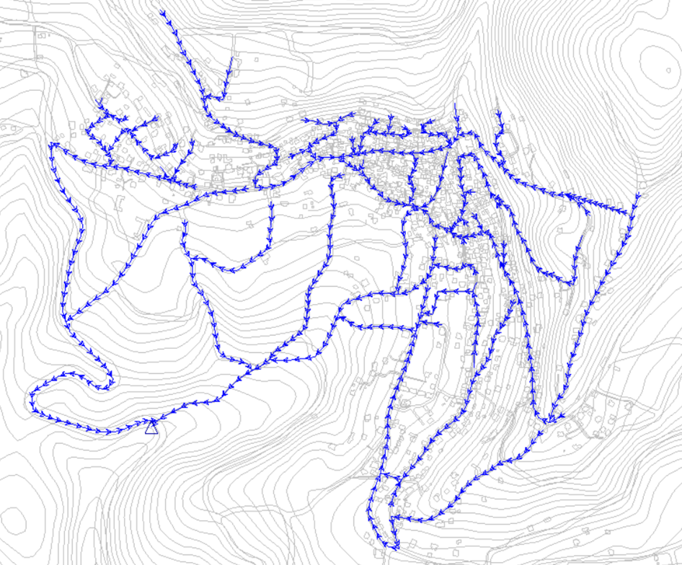
Modeling, analysis and design of WWCN
The next step is to add the elevations using the TRex tool in SewerCAD.
After adding the elevations, the conduits are drawn with respect to the manholes as shown.

Slide 13
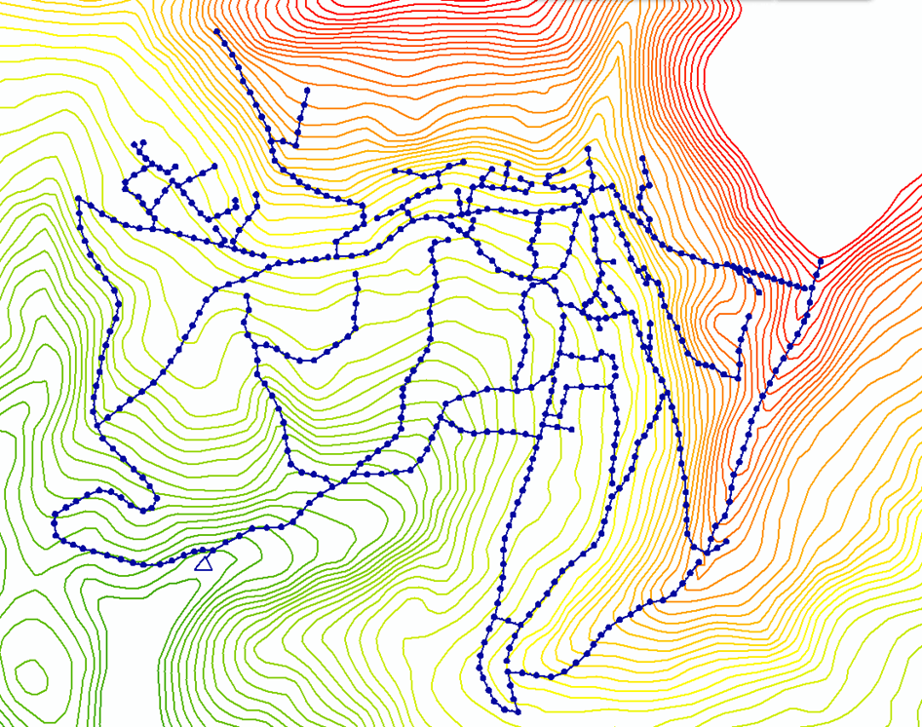
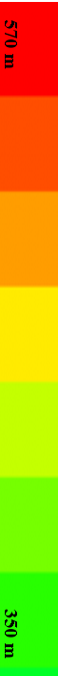

Slide 14
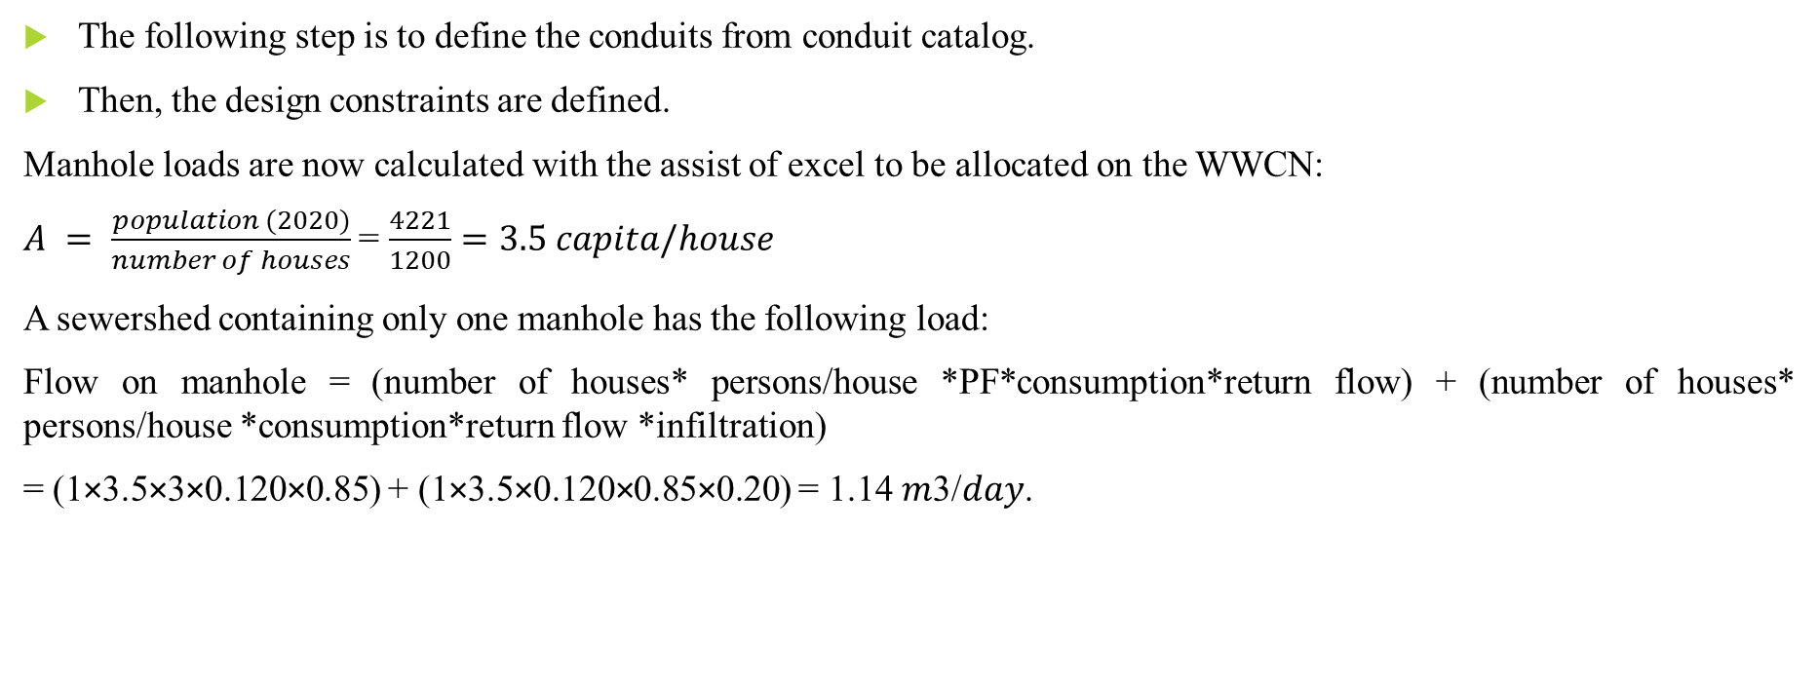
Modeling, analysis and design of WWCN
The following step is to define the conduits from conduit catalog.
Then, the design constraints are defined.
Manhole loads are now calculated with the assist of excel to be allocated on the WWCN:
$A = \frac{population (2020)}{number of houses}$ = $\frac{4221}{1200}=3.5 capita/house$
A sewershed containing only one manhole has the following load:
Flow on manhole = (number of houses* persons/house *PF*consumption*return flow) + (number of houses* persons/house *consumption*return flow *infiltration)
= (1×3.5×3×0.120×0.85) + (1×3.5×0.120×0.85×0.20) = 1.14 𝑚3/𝑑𝑎𝑦.

Slide 15
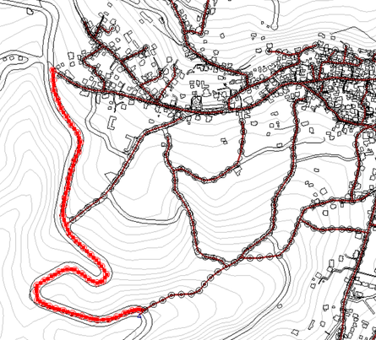
Manhole loads: special cases
The total load on the area that was allocated a load based on the sewer shed concept manually 1693.8 m³/day
In the figure, the shown manholes are near an Israeli settlement which prohibits building activity along its side (street n area C). Thus, these manholes were given a load of 0.1 m³/d each since SewerCAD doesn’t work if the loads were zero.

Slide 16
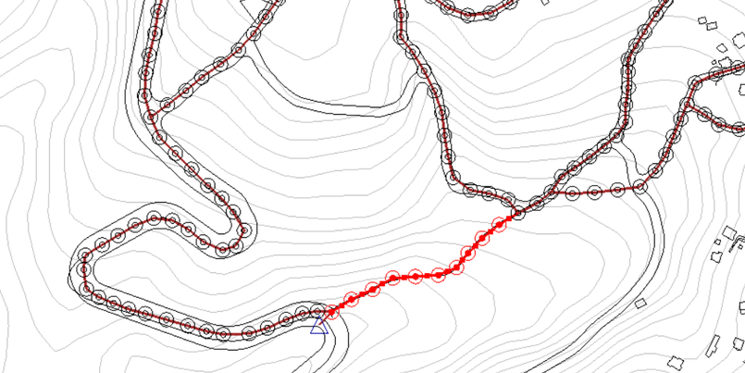
Manhole loads: special cases
In the figure, the shown manholes are in an area of low building activity (wadi). Thus, these manholes were given the minimum load of one house each 1.14 m³/day.

Slide 17
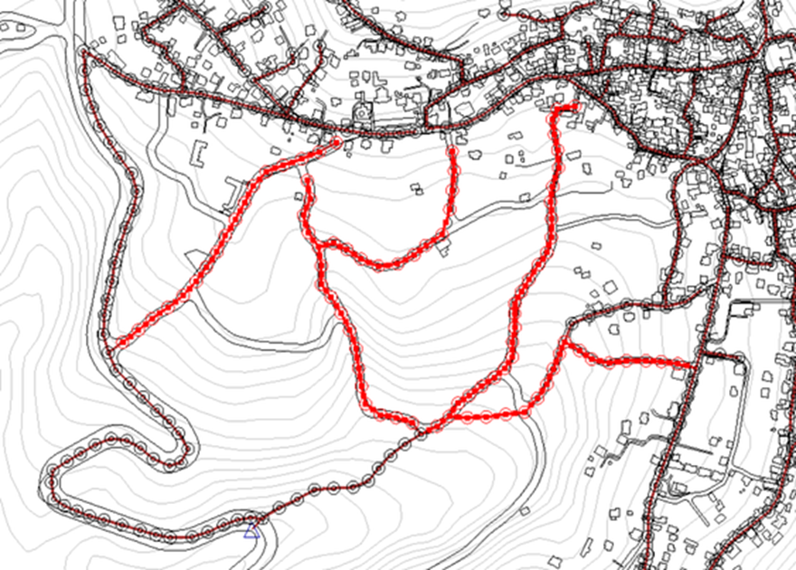
Manhole loads: special cases
In the figure, the rest of the manholes that were not allocated loads using the methods mentioned before.
Area | Load on each manhole (m³/day) | Number of manholes | Total load on manholes in the area (m³/day)
Settlement | 0.1 | 48 | 4.8
Wadi | 1.14 | 10 | 11.4
Remaining manholes | 2.285 | 140 | 320

Slide 18
Design of the WWCN
the solver calculation options in SewerCAD are set to steady state time analysis and design calculation type, the conduit type is set to catalog conduit.
Trial and Error:
High cover-starts were solved by using more manholes in the same area drop manholes, or decreasing the conduit length between such manholes.
Zero-slope streets which create very high cover after a long line of manholes, were solved by changing the direction of conduit paths of such manholes.
Negative-slope streets were treated by rotating the line such that the slope becomes positive.

Slide 19
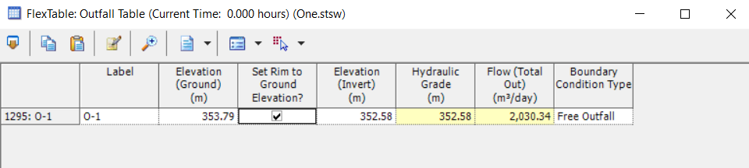
Results
The results of the design are a WWCN with 586 manholes, 586 conduits and one outfall having an elevation of 354 m AMSL as shown.
The calculated total load of 2030 m³/day is matched at the end.

Slide 20
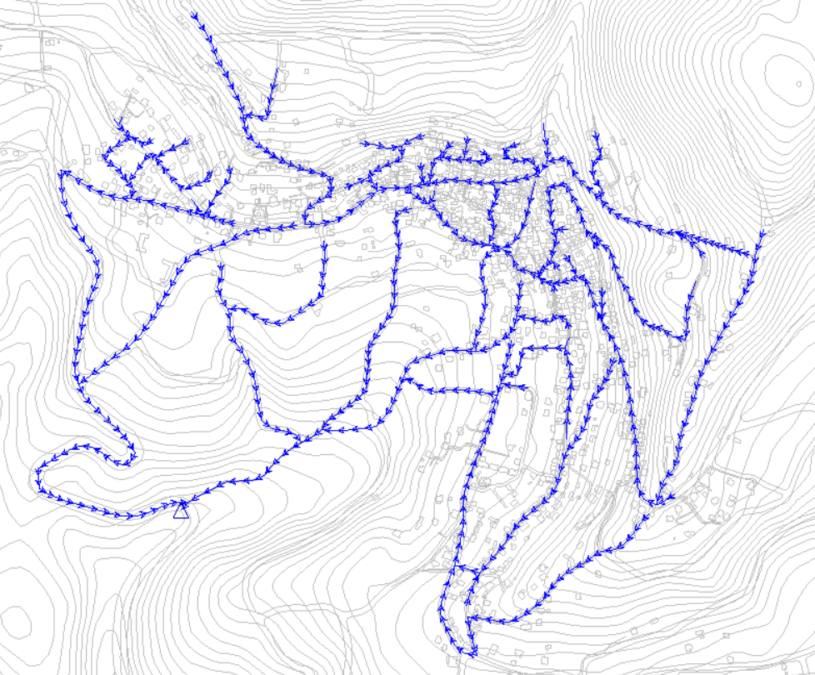

Slide 21
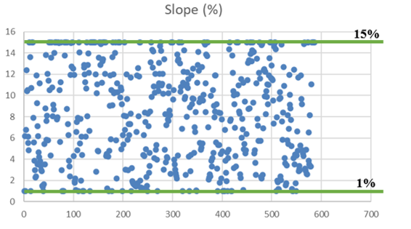
Slopes

Slide 22
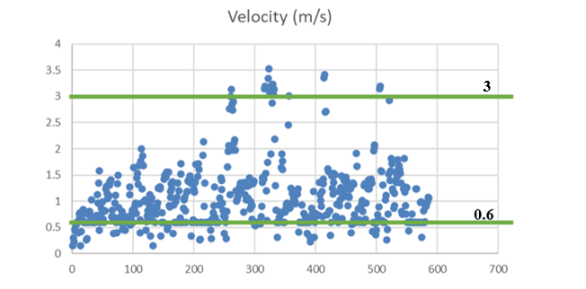
Velocities

Slide 23
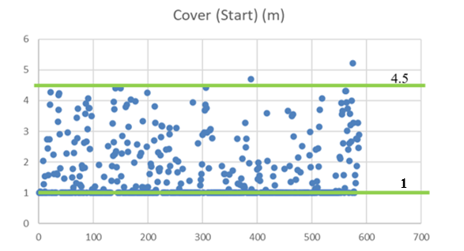
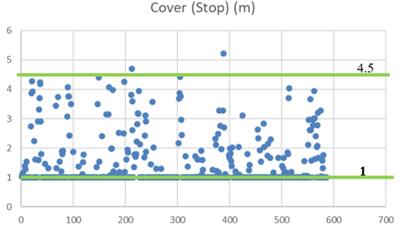
Cover (start and stop)

Slide 24
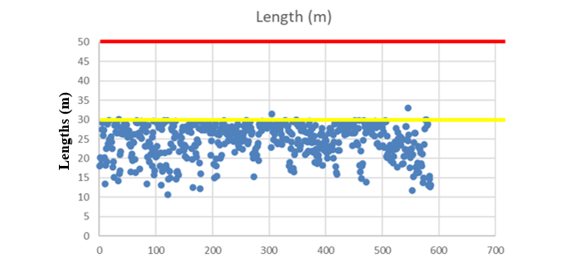
Lengths

Slide 25
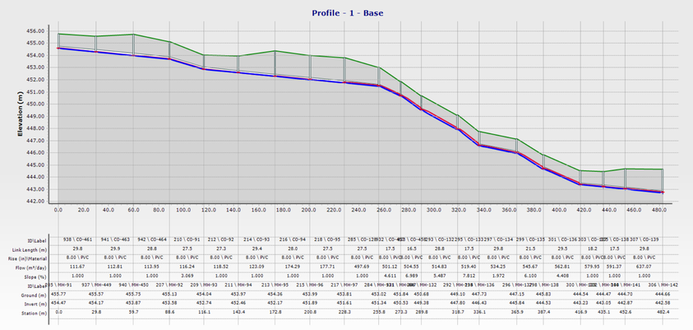
Profiles

Slide 26
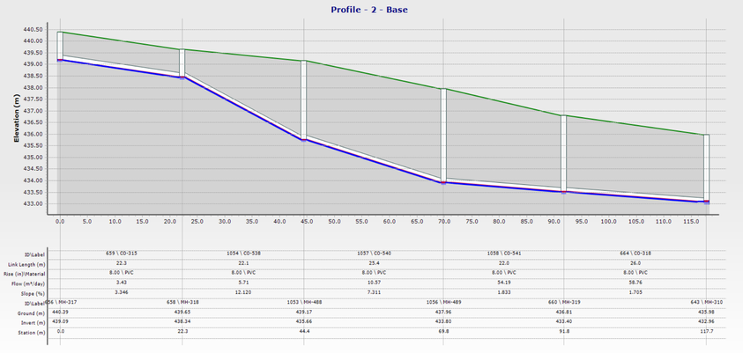
Profiles

Slide 27
Discussion
Slopes: All values of slopes of conduits are within the specified range of 1% -15%.
Velocities in conduits: Generally, the values of velocities in the conduits are within the specified range of 0.6-3 m/s. There are a few values under and a few ones over.
Cover (start and stop): Overall, the values of covers are within the specified range of 1-4.5 m. There are only 4 values over the constraint but they are acceptable since there is only 4 out 586 and it’s not significantly higher than the constraint.
Diameters: all diameters are 8 inches since the flow inside them doesn’t even reach a 75% so there is no need for larger conduits.
Lengths: the values of lengths are all below maximum 50 m.

Slide 28
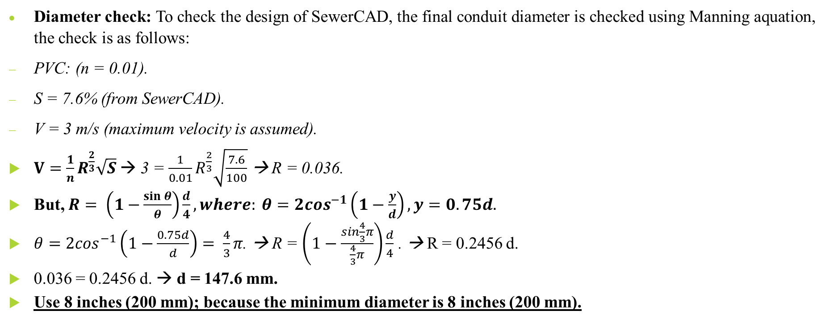
Diameter check
Diameter check: To check the design of SewerCAD, the final conduit diameter is checked using Manning aquation, the check is as follows:
PVC: (n = 0.01).
S = 7.6% (from SewerCAD).
V = 3 m/s (maximum velocity is assumed).
$V=\frac{1}{n}R^{\frac{2}{3}}\sqrt{S}$→ 3 = $\frac{1}{0.01}R^{\frac{2}{3}}\sqrt{\frac{7.6}{100}}$ → R = 0.036.
But, $R= \left(1−\frac{\sin{θ}}{θ}\right)\frac{d}{4}, where: θ=2\cos^{−1}\left(1−\frac{y}{d}\right), y=0.75d.$
$θ=2\cos^{−1}\left(1−\frac{0.75d}{d}\right)= \frac{4}{3}π$. → R = $\left(1−\frac{\sin{\frac{4}{3}π}}{\frac{4}{3}π}\right)\frac{d}{4}$ . → R = 0.2456 d.
0.036 = 0.2456 d. → d = 147.6 mm.
Use 8 inches (200 mm); because the minimum diameter is 8 inches (200 mm).

Slide 29
Conclusions and recommendations
It can be concluded that:
A WWCN is designed to accommodate burqa village’s current and future wastewater disposal needs.
The use of the designed WWCN will create a much healthier environment (groundwater) than the used cesspits.
There is one outfall in the lowest possible area of the village. This outfall could have a wastewater treatment plant (WWTP) of its own, or it could be connected to Nablus’s WWTP in the future.
Finally, after putting the proposed WWCN under review by professionals and concerned parties, the recommendation of this GP is to hopefully implement the proposed WWCN as it solves wastewater disposal problems in the village and above all this project offers a healthy public and a healthy environment. This improvement should not stop at just a WWCN the outfall of this WWCN should be connected to a WWTP to help in recycling wastewater and serving the environment.

Slide 30
Thank you for listening

