Slide 1

Warehouse design in A.R. Alhijjawi and Sons Company
Prepared by:
Latifa Nouri Ala’ Hashash
Masa Akoubeh Farah mohsen
Supervisor:
Dr. Ramiz Assaf

Slide 2
Agenda
Introduction
Objectives
Methodology
Literature Review
Calculation and Analysis
Rack Structure Design
Cost Analysis
Administration System
Conclusions and Recommendations

Slide 3
History of
A. R. Hijjawi And Sons Company

Slide 4

Problem Statement
explanation video for current situation

Slide 5
Objectives
Design and reorder for all warehouses for Al-Hijjawi Company.
Make a good utilization for available resources (space, equipment and time).
Maximizing throughput and storage capacity.

Slide 6
Objectives
Minimize of the expected annual operating cost
Design rack system
Build a proper administrative system for control in management warehouse

Slide 7
Methodology
Collect data about the existing problem.
Studying the relevant literature about Warehousing Systems
Make interviews with employees
Classify the problems in each warehouse
Solving problems with offering several proposals.
Designing rack system and build administration system.

Slide 8
Literature Review
Study number | Relevant study
1 | Warehouse on a wheel (joseph A.standlely, september 2006)
2 | The Optimum Design of A Warehouse System on Order Picking Efficiency (Trebilcock, 2006)
3 | Analysis for The Rack Configuration (Francis, 7 September 2009)
4 | Warehouse Design Factors (Bartholdi, 2002)
5 | Modern Material Handling (Falconer, 2003)

Slide 9
    Warehouse Design Factors
The design of a warehouse floor layout is chosen from numerous generated alternatives. One of these alternatives is ultimately chosen because it minimizes the distance travelled by workers, minimizes processing time and maximizes warehouse throughput.

Slide 10
A Real Event !!
It is worth mentioning that Alhijjawi and Sons printing Company suffered a loss of NIS 60,000 resulting from damaged due to improper arrangement and overstock of the storage in addition to the loss of goods so they decided to Design there warehouse.

Slide 11
About two years ago a fabricated fire has happened by a thief to cover their stealing

Slide 12
Definition
During our work we want to fuscous on this two
performance indicators:
Storage capacity(Sc): Maximum number of Unit load locations in the warehouse.
Throughput(TH): number of input/output pallet at specific time.

Slide 13
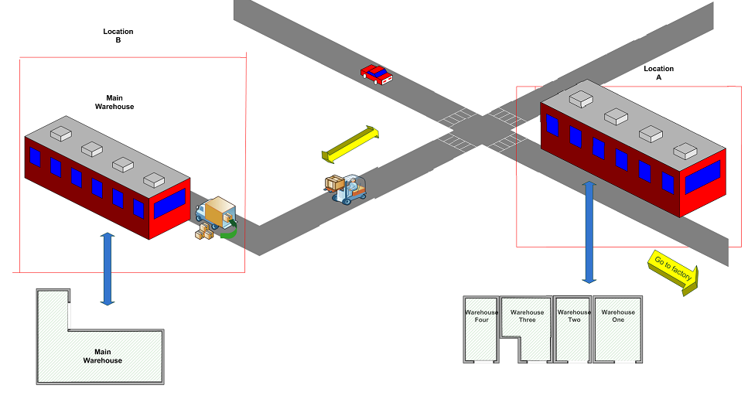
Warehouses Location

Slide 14
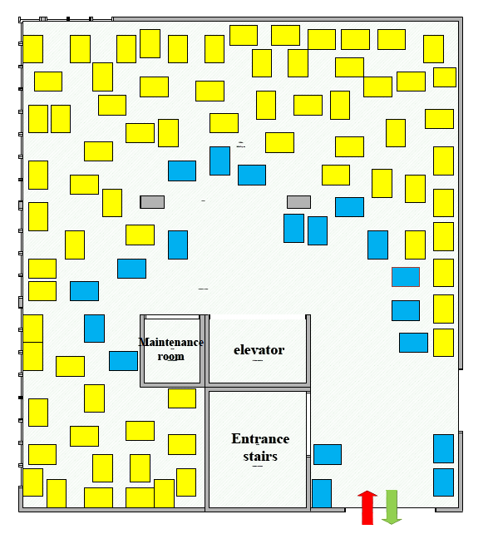
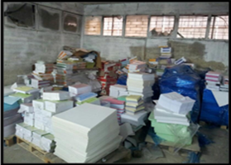
Current Situation for Warehouse One

Slide 15
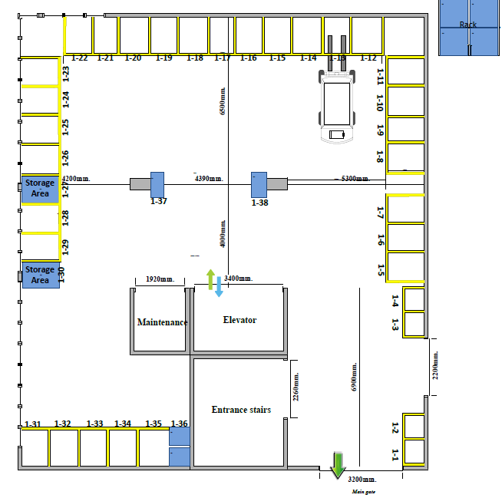
Proposed Situation for Warehouse One

Slide 16
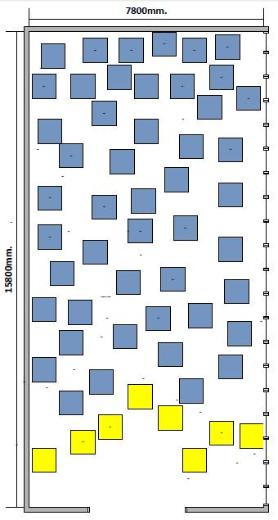
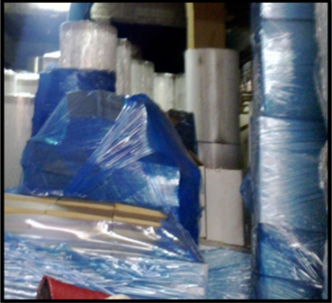
Current Situation for Warehouse Two

Slide 17
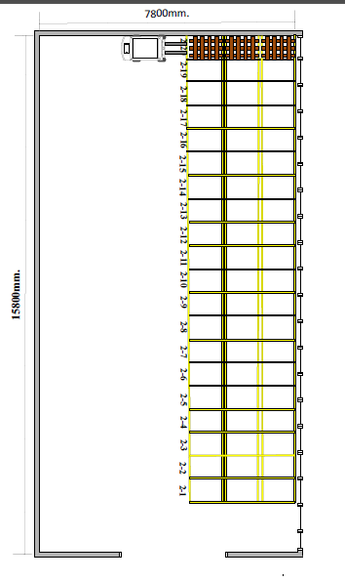
Proposed Situation for Warehouse Two

Slide 18
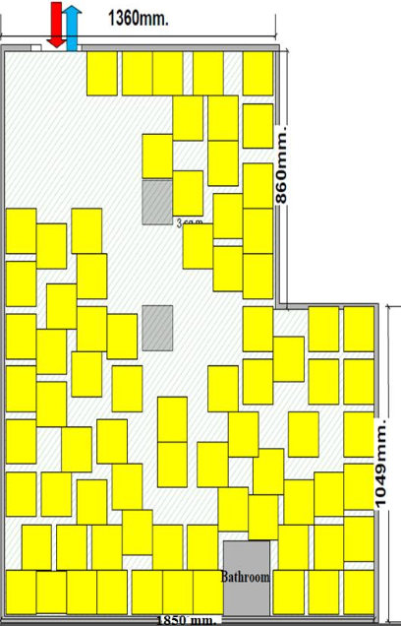
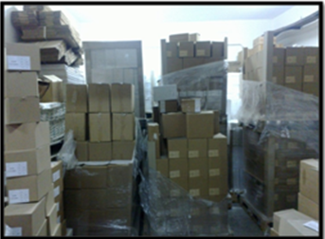
Current Situation for Warehouse Three

Slide 19
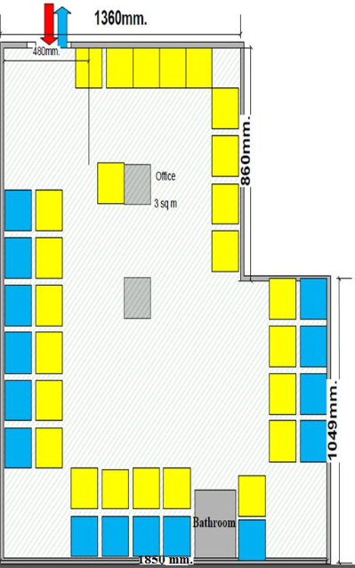
Proposed Situation for Warehouse Three

Slide 20
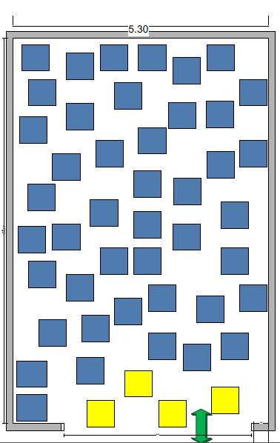
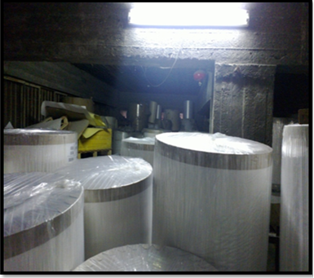
Current Situation for Warehouse four

Slide 21
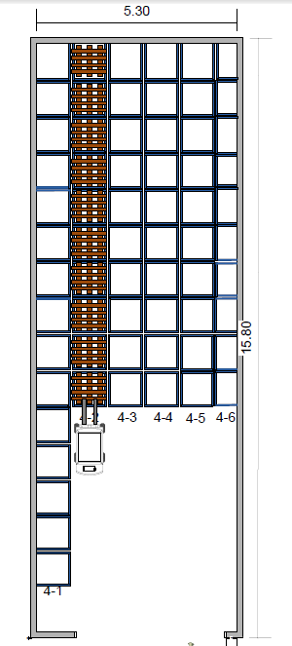
Proposed Situation for Warehouse Four

Slide 22
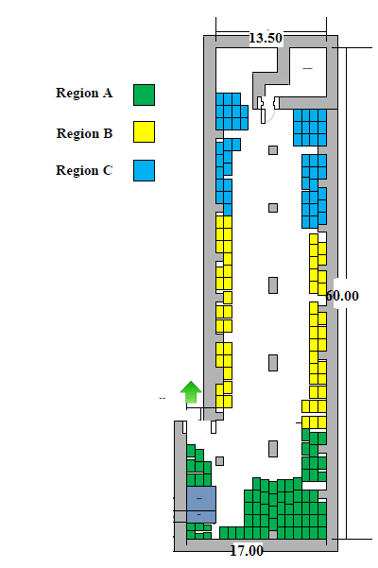
Main Warehouse
In this warehouse we use the system of ‘A, B, C’ that separate the warehouse area into three main regions depending on demand of the pallets from the production line.

Slide 23
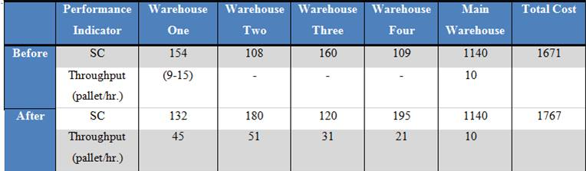
Comparison Between Current Situation and Proposed Situation

Slide 24
Rack System
The rack system is the system we followed to solve the bulk store system problems,
Design shelves depends on the maximum dimensions [70*100] and weights for the pallets
Good arrangements for shelves to good utilization of the space
It will facilitate throughput and accessibility.

Slide 25
Current Situation for Warehouse one

Slide 26
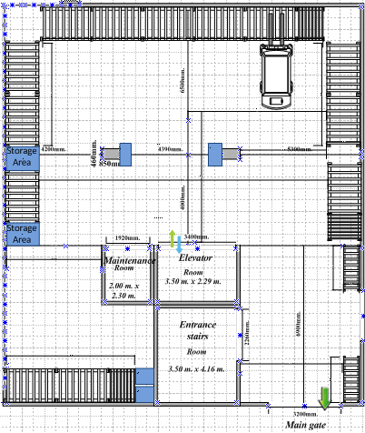

Slide 27
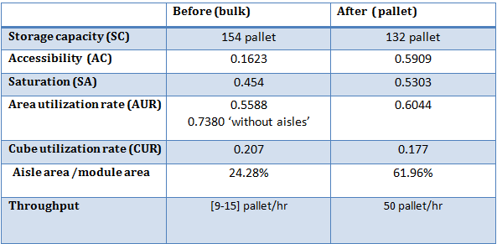
Performance Indicator in Warehouse One

Slide 28
Summery of Rack System
There is an improvement in storage capacity and throughout
Solving bulk storage problem

Slide 29
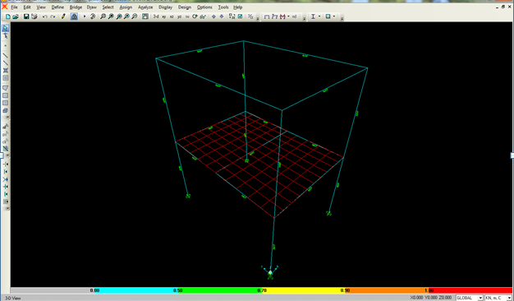
SAP Analysis

Slide 30
Cost Analysis for Rack System
Calculating total cost and benefit for building rack system in Warehouse One. The cost include structure cost that contains: cast iron grade 50(columns and beams), slabs, screws, plates and welding rods.

Slide 31
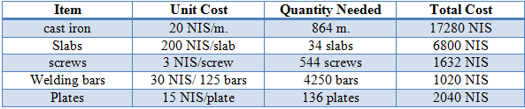
Quantitative Analysis for The Cost of The Rack System
Rack system cost
Additional costs
Installation cost= 1496 NIS
Painting cost =8636 NIS

Slide 32
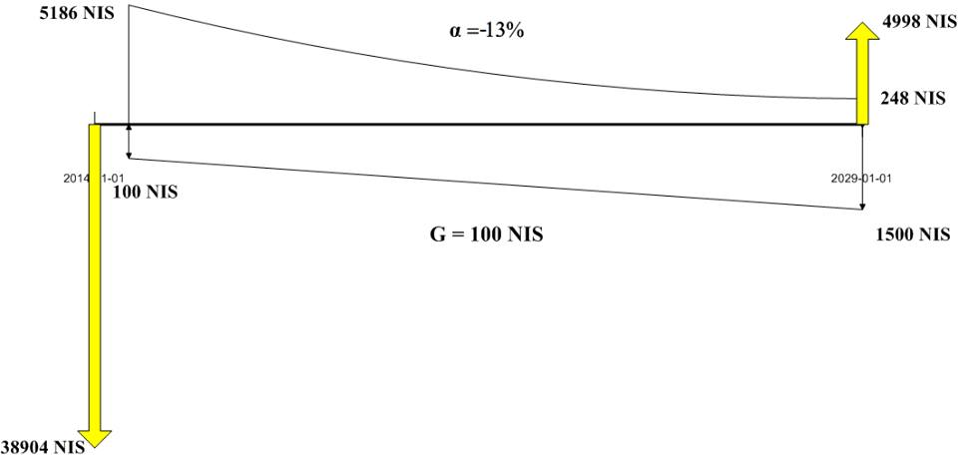
Cash Flow Diagram

Slide 33
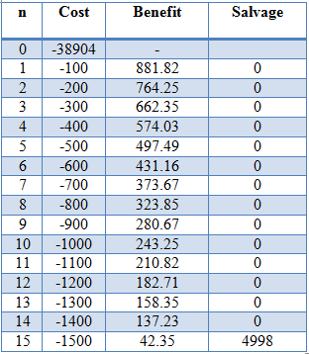
Total Annual Cost
Total annual cost = 3848 NIS
But the cost in month equal 321 NIS
S implied > S estimated
Unnecessary to stop charging

Slide 34
Warehouse Administration System
We will build administrative system to organize storage process, and link main warehouse with other warehouses.

Slide 35
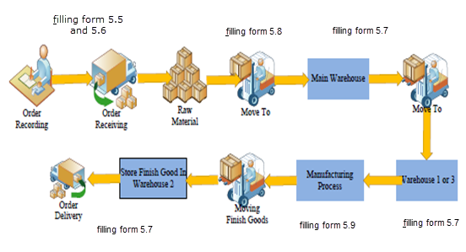
Process of Receiving Container

Slide 36
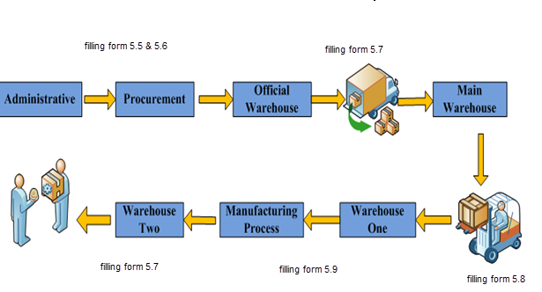
Process of Customer Request

Slide 37
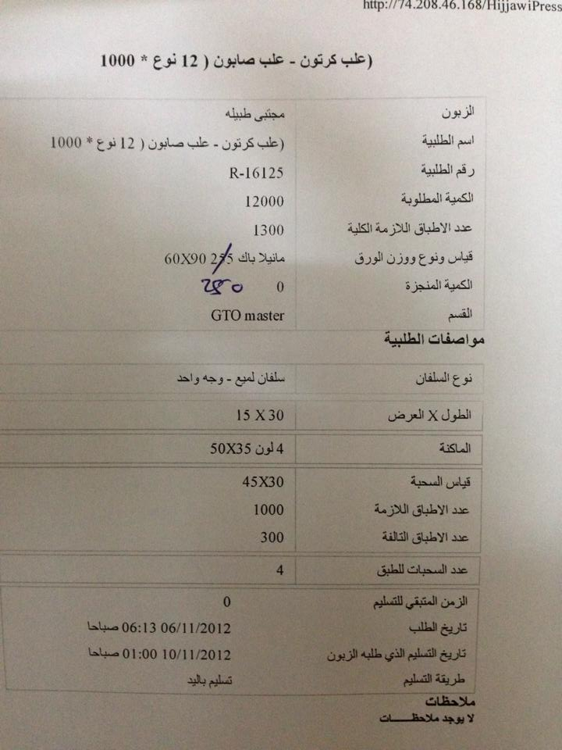
Current Situation
There is a form used by procurement engineer and official warehouse.

Slide 38
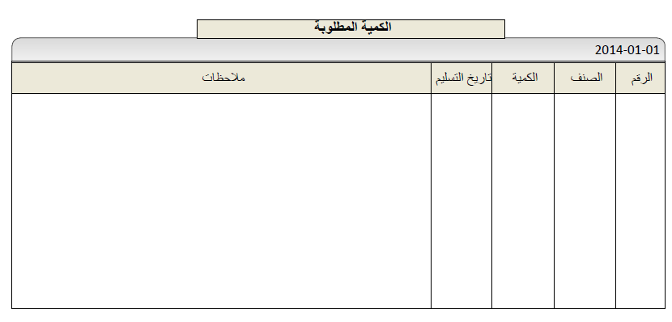
Order Recording Form

Slide 39
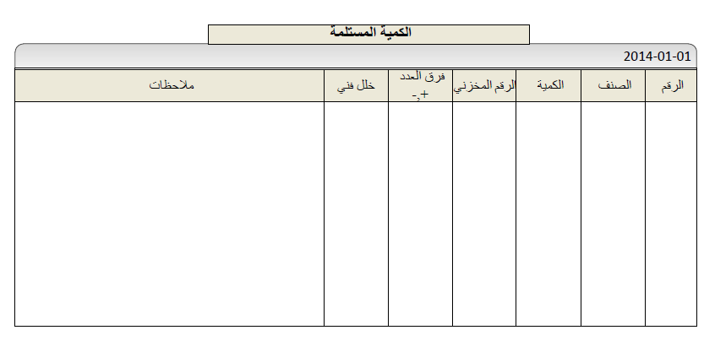
Order Receiving Form

Slide 40
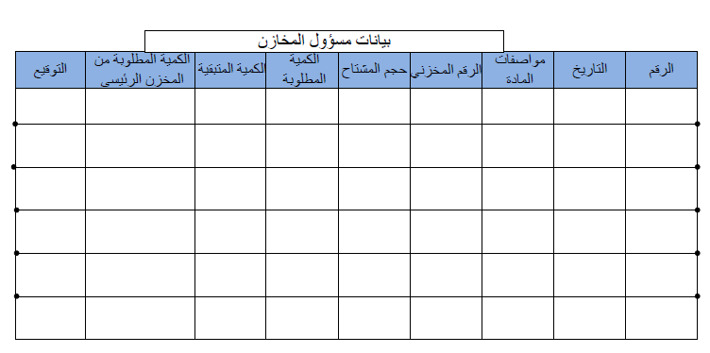
Official Warehouse Form

Slide 41
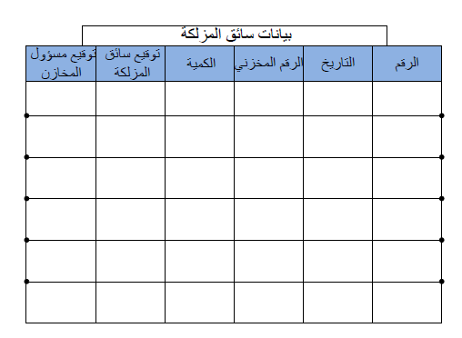
Forklift Driver Form

Slide 42
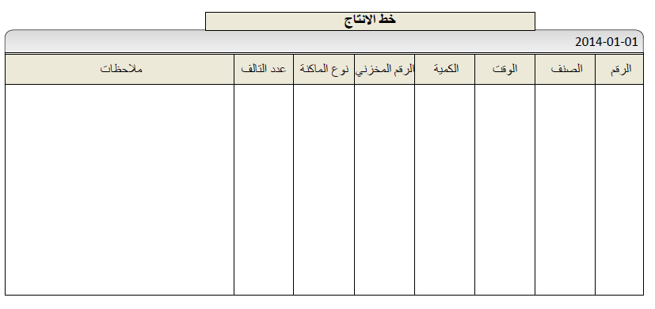
Production Line Form

Slide 43
Forklift Movement
From here we decided to number each warehouse from 1-4 also number each pallet location from 1 - n , for example if we want to bring a pallet from warehouse number 2 pallet location 10 then we say to the forklift driver brings the (2-10) pallet.

Slide 44
ABC System
Main warehouse has the largest area comparing with other warehouses. So the forklift has to cut a large distance to bring the order
Minimize the time of getting orders to production line.

Slide 45

Traveling Time
We calculated the traveling time before and after classification of the warehouse depend on the rectilinear distance from the entrance of the warehouse to the center of the needed region and on the speed of the forklift.

Slide 46
Conclusions
From our several visits to Alhijjawi warehouses over eight months we noticed that there is a poor organization and arrangement of goods in the warehouses from here we began our project idea.

Slide 47
Conclusions
There is no method adopted to arrange the pallets where we see the pallets putting on a top of each other
there is a one warehouse needs to design using a rack system but the other warehouses need to organized by planning the ground
Also observing the absence of an administrative system that connects the warehouses directly and accurately to production lines

Slide 48
Conclusions
After we calculate the performance indicators and the costs we compare them with the current situation of Alhijjawi warehouses and we observed that the application of this system will be economically viable and administratively, which will satisfy the benefits of Alhijjawi warehouses from increase the storage capacity, throughput and the accessibility.

Slide 49

Recommendations
Build rack system in warehouse one.
Build systems like ventilation, electrical, safety and lightening system.
Purchase another forklift with size less than the available forklift.

Slide 50
Recommendations
We recommend people to work on warehouses problems in the future, because it is very useful, and area of improvement is very wide and applicable if they do it correctly. We recommend to apply our work in Alhijjawi warehouses, based on analysis and all work it justify that the applying of this study we return with benefits on the company.

Slide 51

Thank you

Slide 52
Appendix

Slide 53

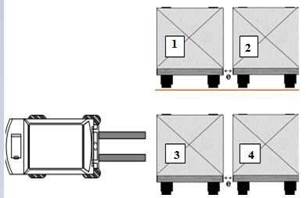
Performance Indicator for Warehouse One
Throughput:

Slide 54
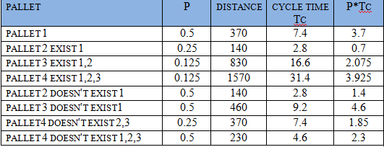

Cycle time for forklift from the main entrance to center point= 22.32 second
The time required to give Instruction = 20 second
Tc:

Slide 55
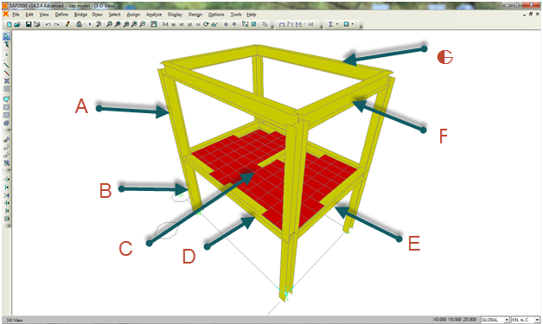

Slide 56
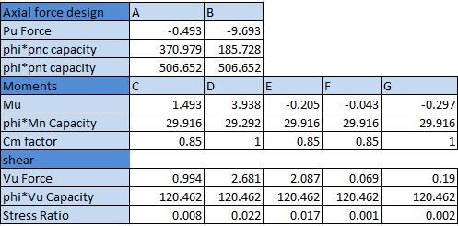
SAP Analysis for Single Deep Rack

Slide 57
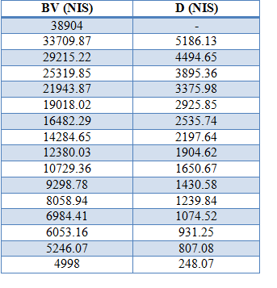
DDB Analysis

Slide 58
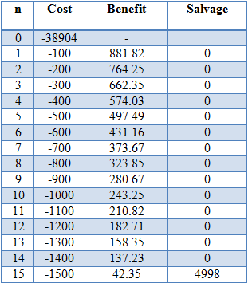
Cash Flow Analysis

