Slide 1
A Pilot Study on Parking Systems and Modeling Parking Behavior
Prepared BY:
Zeina Shakhshir
Ahmad Abu-Aisheh
Supervisor
Prof. Sameer Abu-Eisheh

Slide 2
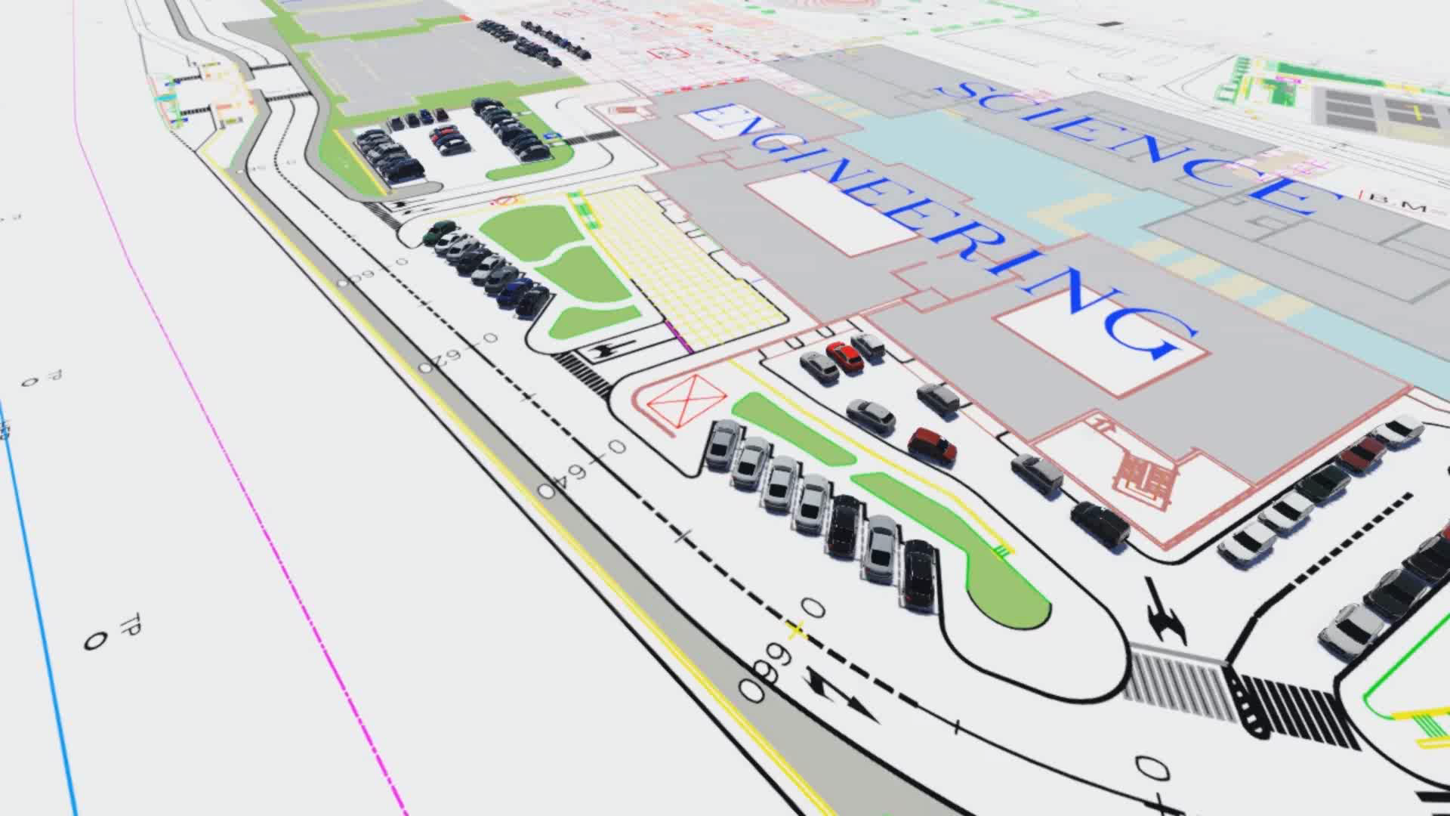
Introduction

Slide 3
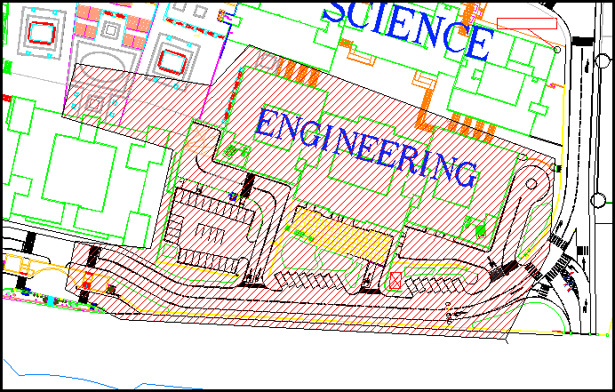
Methodology
Blocks:-

Slide 4
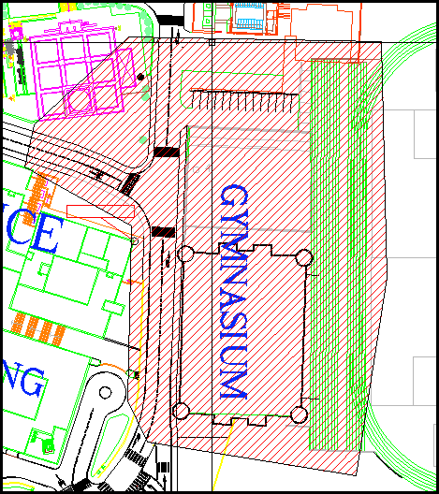
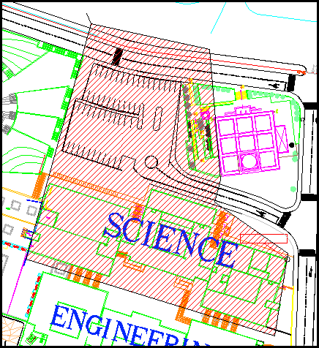

Slide 5
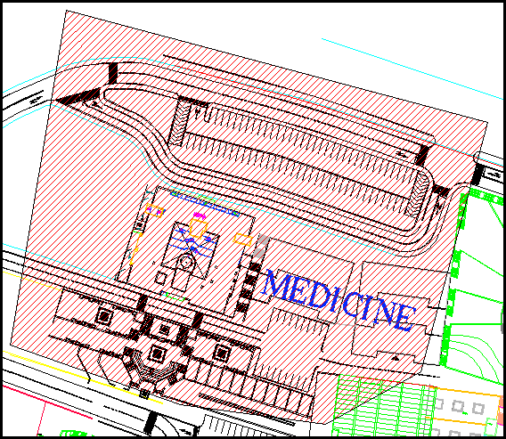
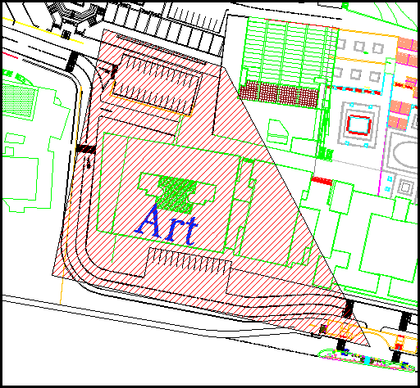

Slide 6
Engineering Block Accumulation Curves

Slide 7
Engineering Block Accumulation Curves

Slide 8
Survey

Slide 9
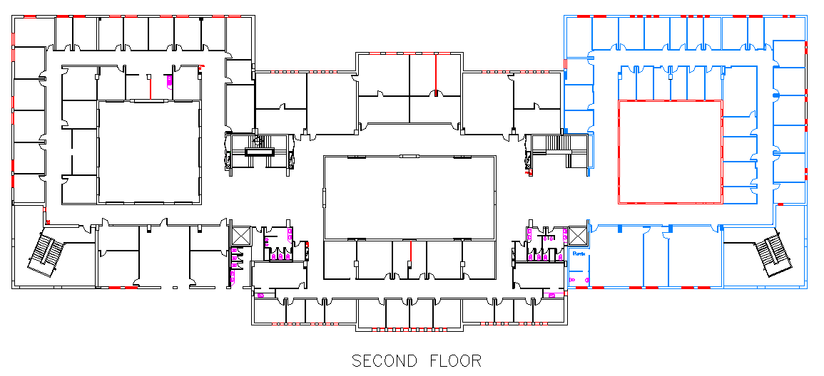

Slide 10
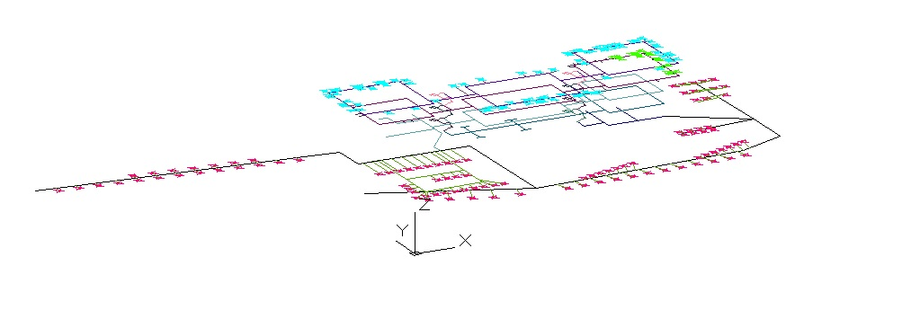
Modeling and Design:

Slide 11
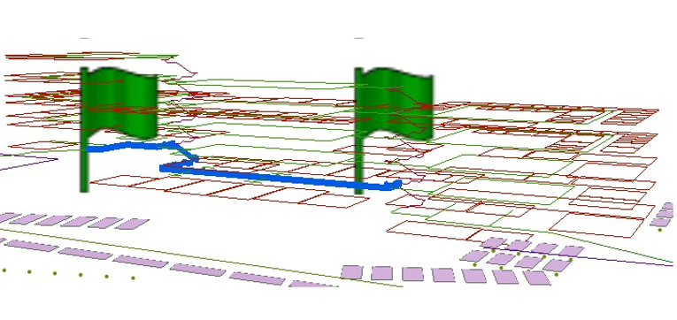

Slide 12
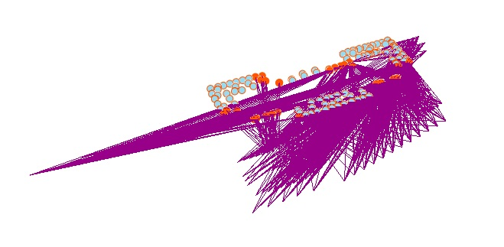
OD-Cost Matrix view (3D-Network) :

Slide 13
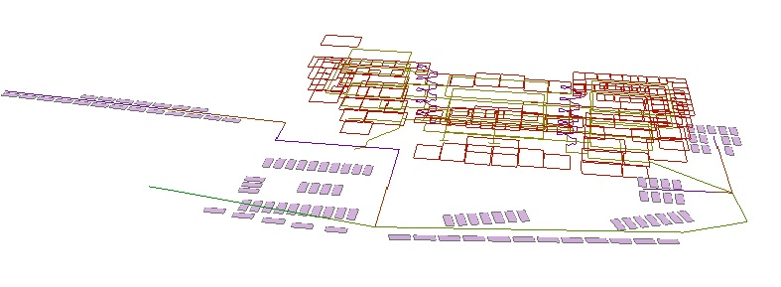
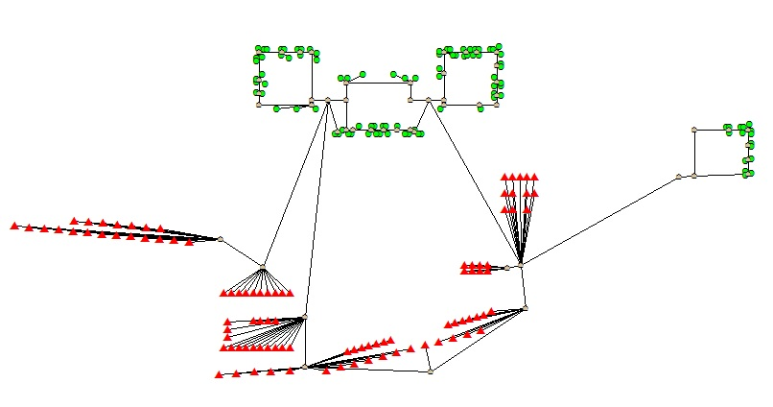
3D
2D

Slide 14
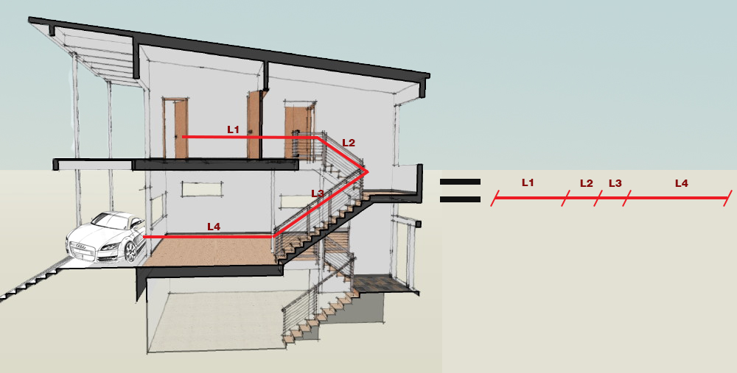

Slide 15
2D- Network:

Slide 16
OD-Cost Matrix (2D-Network)
The matrix takes just 41 offices
The results are
4081 cells contain 41 columns

Slide 17
Results
Office NO. | Parking NO. | Distance(m) | Office NO. | Parking NO. | Distance(m)
15 | 26 | 122.93 | 53 | 32 | 101.71
32 | 27 | 95.80 | 54 | 44 | 108.68
33 | 25 | 105.86 | 55 | 31 | 82.09
34 | 28 | 106.23 | 56 | 43 | 81.89
35 | 86 | 62.59 | 57 | 19 | 83.84
36 | 85 | 64.78 | 83 | 81 | 91.98
37 | 84 | 66.53 | 85 | 89 | 96.06
38 | 83 | 67.25 | 86 | 88 | 100.40
39 | 82 | 71.57 | 87 | 79 | 104.77
41 | 24 | 74.17 | 88 | 80 | 105.23
42 | 29 | 76.20 | 89 | 87 | 103.00
43 | 23 | 78.09 | 90 | 91 | 107.29
44 | 30 | 75.86 | 91 | 92 | 111.07
45 | 22 | 75.73 | 92 | 90 | 103.95
46 | 21 | 77.20 | 93 | 93 | 102.61
47 | 34 | 84.73 | 94 | 78 | 100.49
48 | 47 | 85.70 | 95 | 77 | 102.30
49 | 33 | 83.01 | 96 | 96 | 98.99
50 | 46 | 80.26 | 97 | 97 | 99.27
51 | 45 | 80.98 | 98 | 95 | 99.21
52 | 20 | 99.59

Slide 18
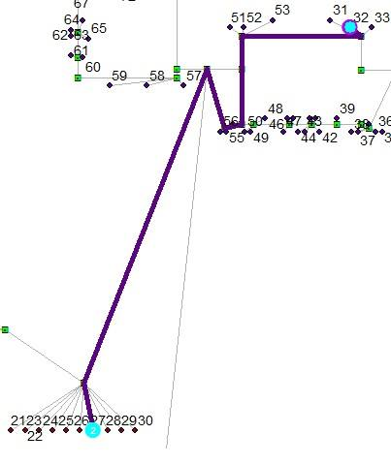
Office NO. | Parking NO. | Distance(m)
32 | 27 | 95.80

Slide 19
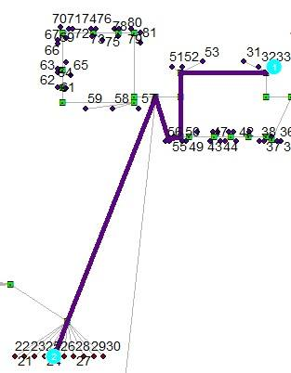
Office NO. | Parking NO. | Distance(m)
33 | 25 | 105.86

Slide 20
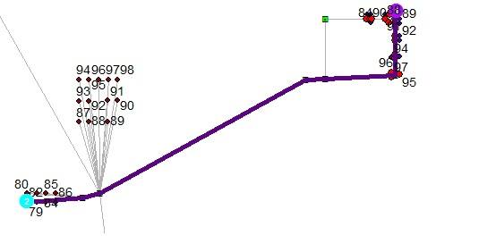
Office NO. | Parking NO. | Distance(m)
88 | 80 | 105.23

Slide 21
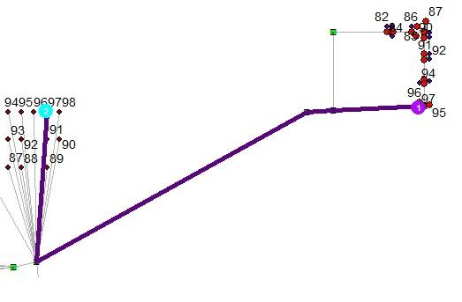
Office NO. | Parking NO. | Distance(m)
95 | 77 | 102.30

Slide 22
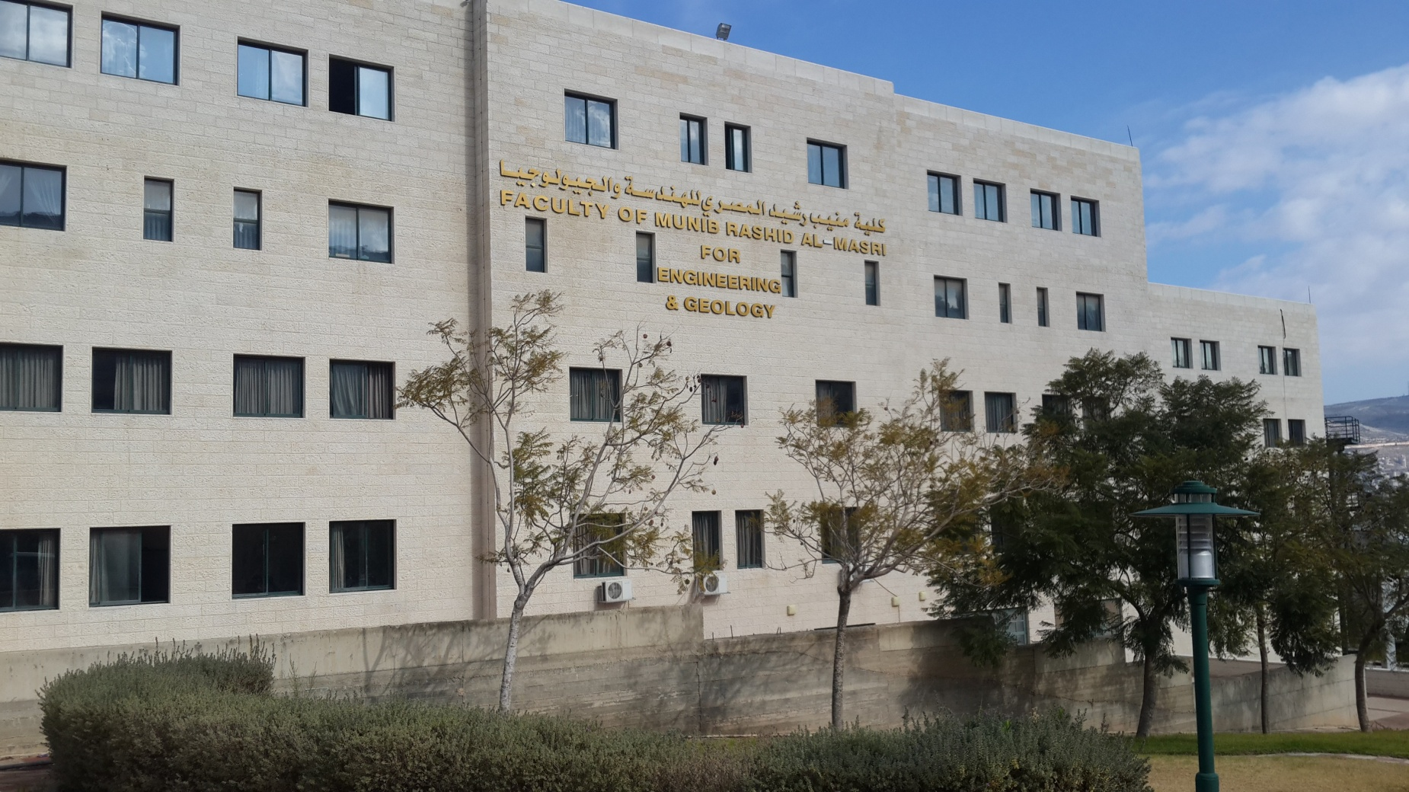
Conclusion

Slide 23

Recommendations
3G services
Considering turn over and average parking duration
User equilibrium

