Slide 1

Auto- Farm

Slide 2


Ibrahim Shalhoub
Faiza Batta
Supervisor: Dr. Mohannad Al-Jabi

Slide 3
Plants need special care, and farms or people who own planted home gardens may not have enough time to take care of them, so these farms are often neglected.
Problem
:

Slide 4
Solution
To solve this problem, we have created this automatic - manual system to solve, which will help the farmer to take care of their farms, and will certainly save time and effort on it, which will provide many advantages, including opening and closing the gate, sensing any movement, extinguishing the fire in the event of its occurrence and other advantages
:

Slide 5

1.
Save Time
2.
More Saftey
3.
Save Effort
4.
Encrease Sequrity
Users

Slide 6
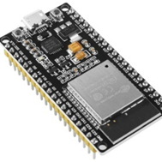
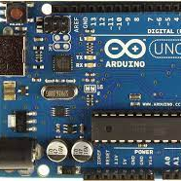
Serial Communication
ESP32 Microcontroller​
Arduino UNO Microcontroller​
We Will Connect Tx with RX for Both ESP and Arduino

Slide 7
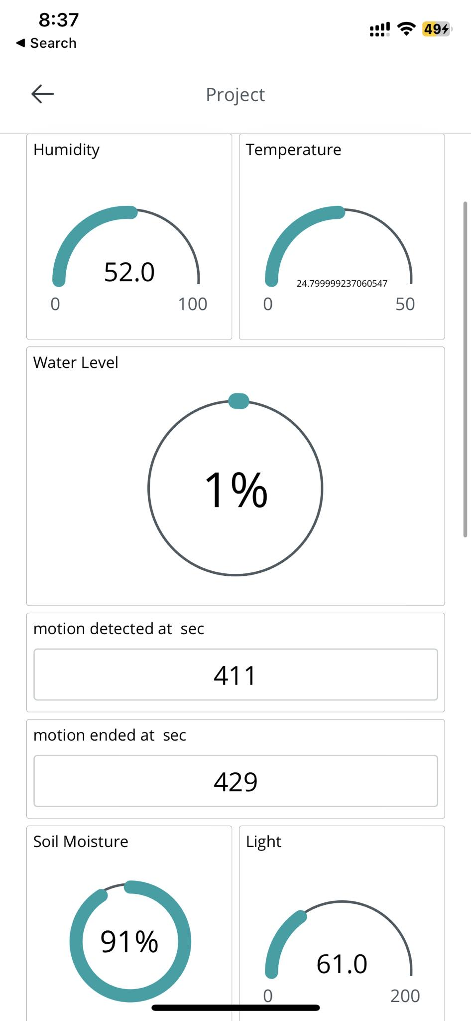
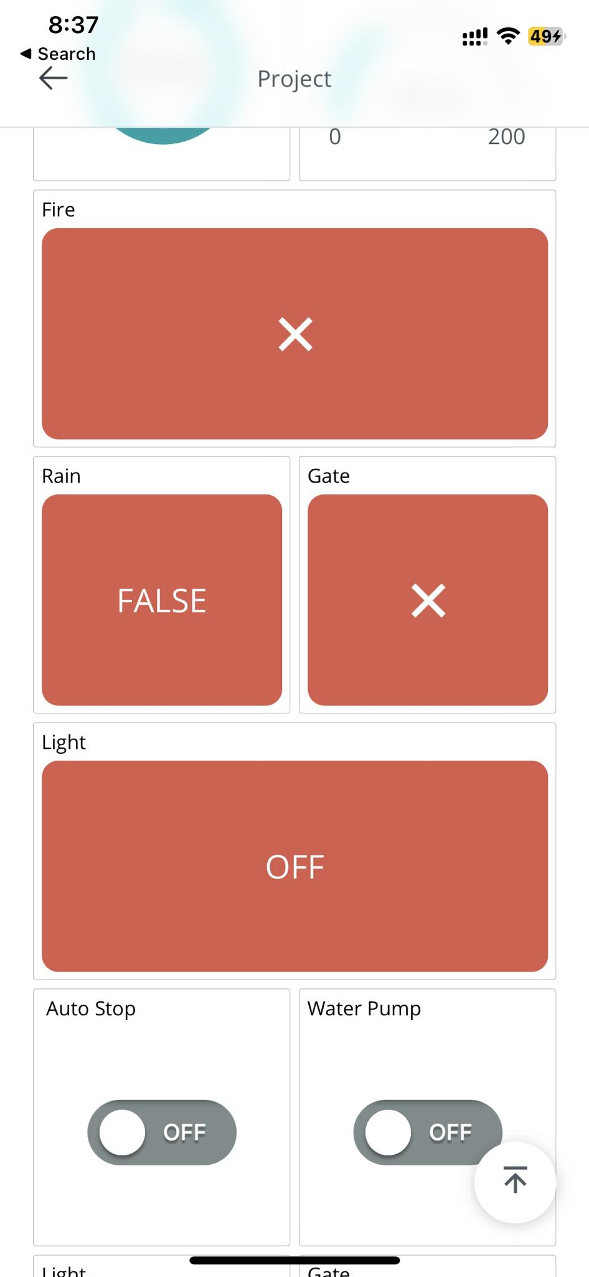
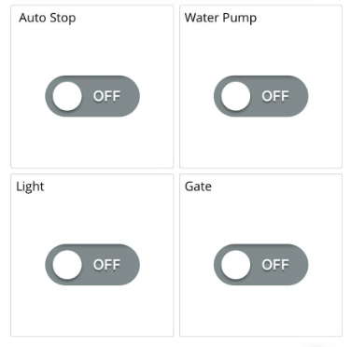
Mobile Application View

Slide 8
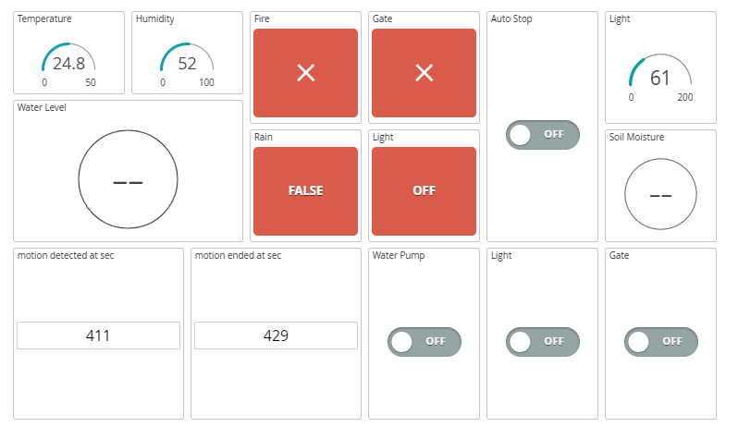
Web View

Slide 9
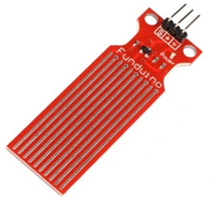
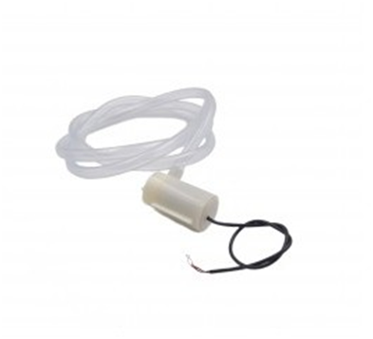
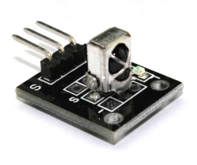
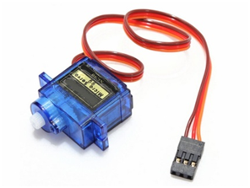
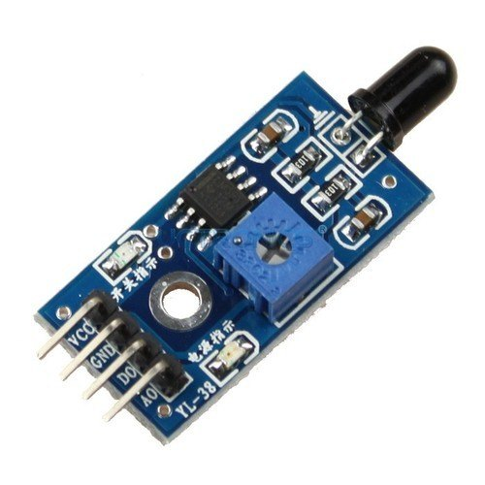
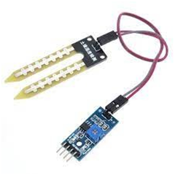
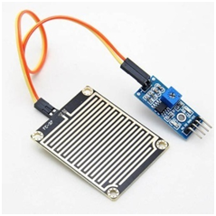
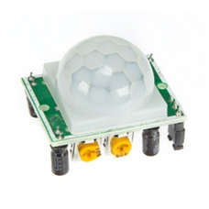
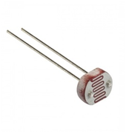
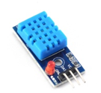
Used Parts
Water Level Sensor
IR Sensor
Servo Motor
Water Pump
Flame Sensor
Soil Moisture Sensor
Raindrop Sensor
DHT Sensor
LDR Sensor
PIR Motion Sensor Driver

Slide 10
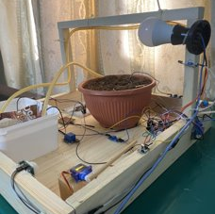
Implementation
This Project Could be controled by several ways:
-Automatically
-Manually

Slide 11
Automatic Mode:
If the light intensity reading in the room is less than required, the system automatically turns on the light.
If the soil moisture is less than 60%, the water pumps will turn on automatically to adjust the deficiency.
If the fire sensor senses any flame, it will turn on the second pump to extinguish it.

Slide 12

Manual Mode:
After turning off the automatic mode first through the application we will be able to control :
Water Pump
Servo Motor(Gate)
Light

Slide 13
Future Work
Future Work
Add Camera in front of the plants with image proccessing and machine learning.
Add more Sensors to add more features as leaf wetness sensor, Carbon Dioxide (CO2) Sensors.

Slide 14


