Slide 1

Applying Statistical Quality Control (SPC) tools in Construction Industry ( Mawasi Factory case study)
Presented to :
Dr. Tamer Haddad
Dr. Mohammad Othman
Dr. Ahmad Zaid
Prepared by:
Hiba Ratrout Jihan Bitar
Mai Jarrad Raneen Ratrout

Slide 2
Contents
Introduction
Problem Statement
Objectives
About the factory
Methodology
Results
Conclusion
Recommendations

Slide 3
Problem Statement
This project focus on the concrete manufacturing process, due to the danger of carelessness in this product, and also because it use from all people in all sectors and not specialized for one sector. Concrete may has influences on the sustainability of building and the cause of the landslide if the manufacturers don’t focus on it to be within the standards. Good concrete play a big role on the safety of people who work on construction and also who live inside building.

Slide 4
As a manufacturer , you have a responsibility to produce a high-quality product that meets the expectations of your customers and will last for the long term. But if your project fails to meet certain standards, as a result there will be a damage in the building . Construction defects can have extensive ramifications, including legal costs, rework to correct the problem, and damage to your reputation.

Slide 5
Project Objectives
1. Improve and implement advanced quality system for concrete products to increase customer satisfaction.
2. Reduce the percentage of out of control to achieve continuous improvement for the process.
3. Calculate the capabilities of the process which are measurable property of the process to specification.
4. Implementation SPC tools.

Slide 6
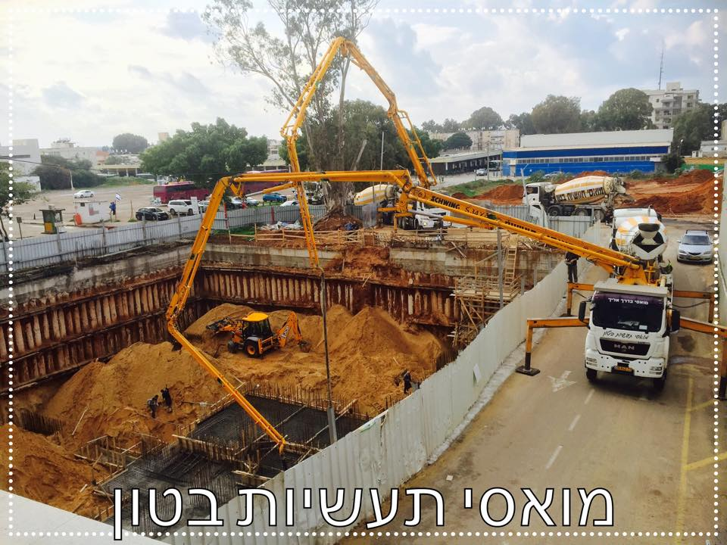
About The Factory
This project dealing with Mawasi factory which has been rated as the most economically competitive industry in the construction sector .
This company founded in 1976 , it’s the leader company for the production of concrete .More than 40 years of service the company produces large amounts of concrete in variety types : Concrete 500 kg/cm2 (B:50) , Concrete 300 kg/cm2 (B:30), Concrete 200 kg/cm2(B:20) and Concrete 250kg/cm2(B:25).

Slide 7
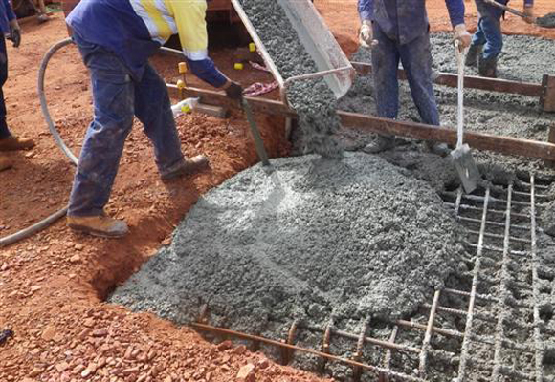
Concrete 300 kg/cm2 (B:30) selected in this project because the demand of this type is very large , and it is used especially in residential Buildings construction. This type of concrete composed of sand , cement, water and three types of gravels which are import from Israel and Jordan.
To ensure a good quality of concrete that required, SPC is the best tools to make control on raw materials and the final product which produce of mixing these materials together.

Slide 8
Literature review
Quality
Quality does not only refer to goods and services but includes qualiy of time, place, equipment and tools, processes, people, the environment and safety, information and measurement (Dale 2003; Schonberger 1990).
Quality definition
Quality, according to Juran , means that a product meets customer needs leading to customer satisfaction, and quality also means all of the activities in which a business engages in, to ensure that the product meets customer needs.

Slide 9
Control chart
Yang and Yang (2004) used control charts as a process monitoring and control instrument that can be used to distinguish between assignable and common causes of variation in the process
Shewhart developed the control chart by using statistical analysis to monitor the consistency of a process (Shewhart, 1986).

Slide 10
SPC Tools
According to Mason and Antony (2000), in their study on improving service and manufacturing quality stated that SPC is an essential component which not only helps in improving quality but also act as an effective tool for the continuous .
Variation
Poor productivity is a major concern in the construction industry, and high variation in the productivity rate of crews is a “strong indicator of poor labor performance” (Thomas, 2012,

Slide 11
Methdology
This project was started at the beginning of the semester January 2015-2016 at Mawasi factory for concrete. During our visit we saw the factory layout and the machines used in the manufacturing process.

Slide 12
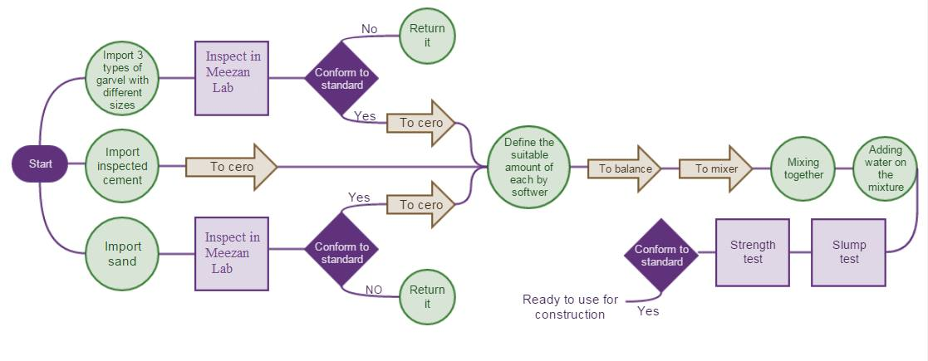
1- Process Flow Chart

Slide 13
2- Taking samples
When the amount of sand received to the factory ,the factory send samples to the laboratory. The size of samples are equals to the size of worker hand then the laboratory did the tests as needed.
The sample taken of aggregate as taken in sand.

Slide 14
The cement is checked by supplier ( From Jordan, Turkey or Israel).
The final product (concrete) tested by taking samples ,each sample equals to 3 specimen (each specimen contains two cube) ,this samples taken during the pouring stage ,it took from the middle of pouring , in order to make the tests.

Slide 15
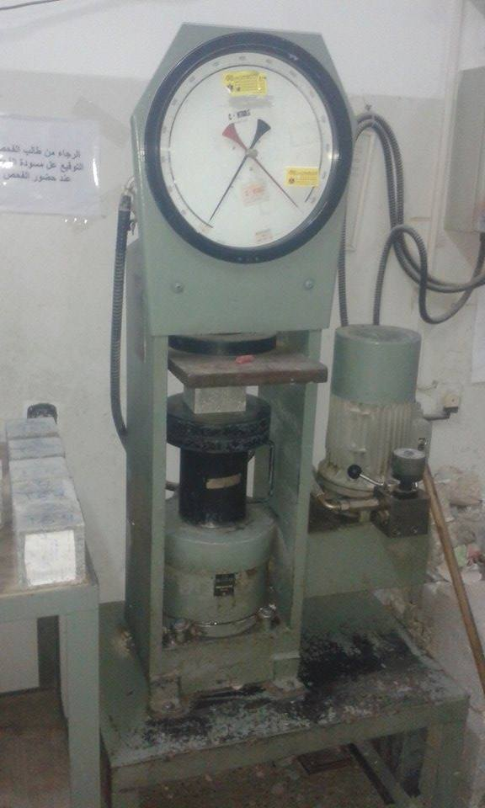
3- Tests
1- Compression strength test:
This specification show us how to make
the Compression strength test on the final
product (Concrete300kg/cm2 (B:30)),also
the methods of taking samples and how to
compare the results with the standard limits .

Slide 16
Concrete 300 kg/ cm2 (B:30)
Specification Number | Test Name | Specification Limit | Sample Size
PS 55 P1 2002,2,3 4 2007 | Compression Strength Test | Around 30 Mpa | 3 specimen per mixer *every specimen=2 cube
PS 55 -2001 | Slump Test | 116 -140 mm | Depends on contract between tester and customer

Slide 17
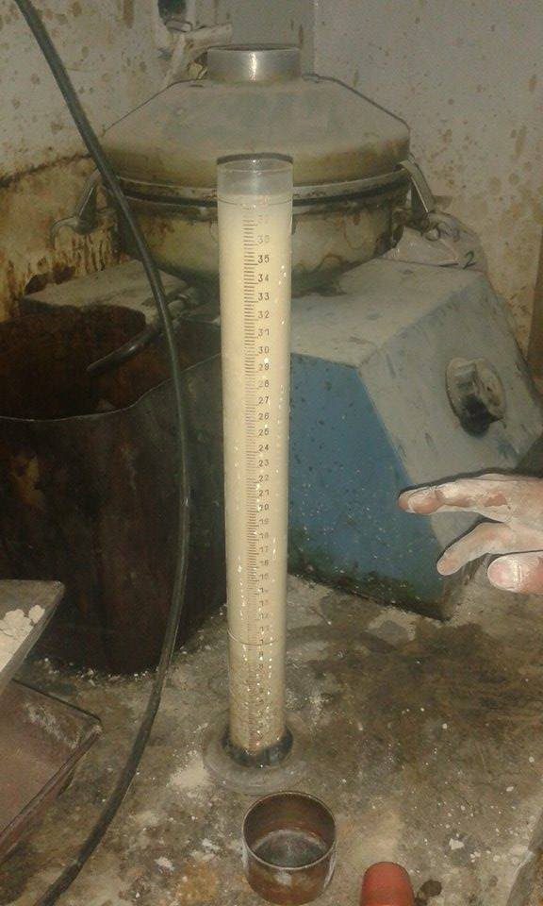
2-Sand equivalent:
The sand equivalent test is a rapid field test to show the relative proportions of fine dust or clay-like materials in fine aggregate .

Slide 18
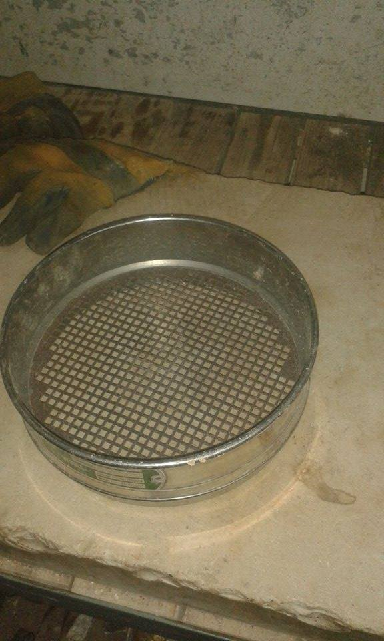
3-Passing Sieve:
The standard grain size analysis test determines the relative proportions of different grain sizes as they are distributed among certain size ranges.

Slide 19
Sand Tests
Specification Number | Test Name | Specification Limit | Sample Size
PS: No. 48:1997 | Sand equivalent | Minimum 70% mm form the sample size | One sample *Sample= Size of the worker hand
PS: No. 48:1997 | Passing Sieve No.200 (Clay content) | Maximum 5% mm from sample size | One sample *Sample= Size of the worker hand

Slide 20
4-Aggregate Test :
The purpose of this test is to determine the extent of water absorption of the aggregate after immersion it in the water for 24 hours. In this test we use tools as: sensitive balance, pot to submerge the sample, drying oven and dress cloth for drying.

Slide 21
Aggregate Tests
Specification Number | Test Name | Specification Limit | Sample Size
PS: No. 48:1997 | Absorption Test for Fol Aggregate | Maximum 2.5% | sample Sample= Size of the worker hand
PS: No. 48:1997 | Absorption Test for Adas Aggregate | Maximum 2.5% | sample Sample= Size of the worker hand
PS: No. 48:1997 | Absorption Test for Somsom Aggregate | Maximum 1% | sample Sample= Size of the worker hand

Slide 22
5-Cement Test:-
The test performed outside Palestine from the company that export the cement, and the results of test attached with the cement.
6-Water Test:-
The water must be without impurities and clean.
The results of the tests was collected for serial period of time(from January to September of 2016),these results are collected by two laboratories: Meezan and Hijjawi laboratories.

Slide 23
SPC Tools:
Flow Chart: A flowchart is a visual representation of the sequence of steps and decisions needed to perform a process. and to simplify and monitor all the process in sequence way ,also includes the tests that done.
Normality Test and Histogram: Use in order to make sure that the data have a normal distribution.
Control Charts: Which is a statistical process control tool used to determine if a manufacturing process is in a state of control.

Slide 24
Fish bone diagram (cause and effect diagram): It is simply a tree or hierarchy which show the possible causes that may affect the process and cause failures in it. This help by making brainstorming for all potential causes which may related to human(workers),materials, machines, administrative,…etc
Process Capability: To show the ability of a process to produce output within specification limits

Slide 25
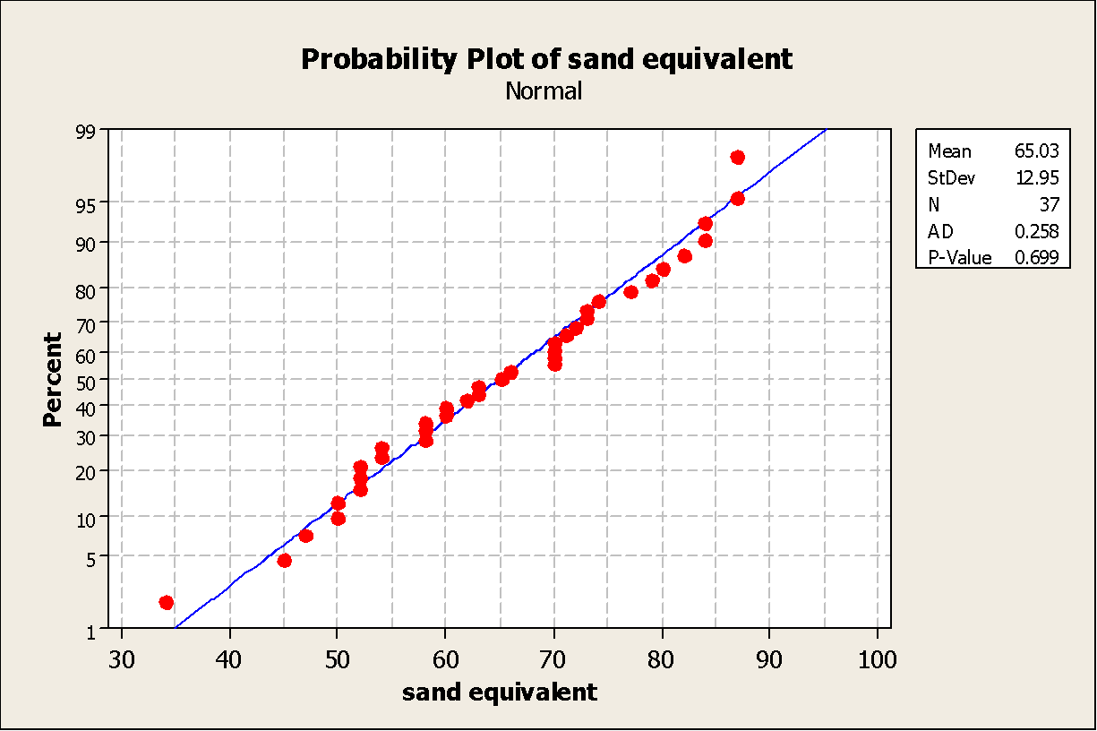
Results
1- Sand Test Results
Normality Test

Slide 26
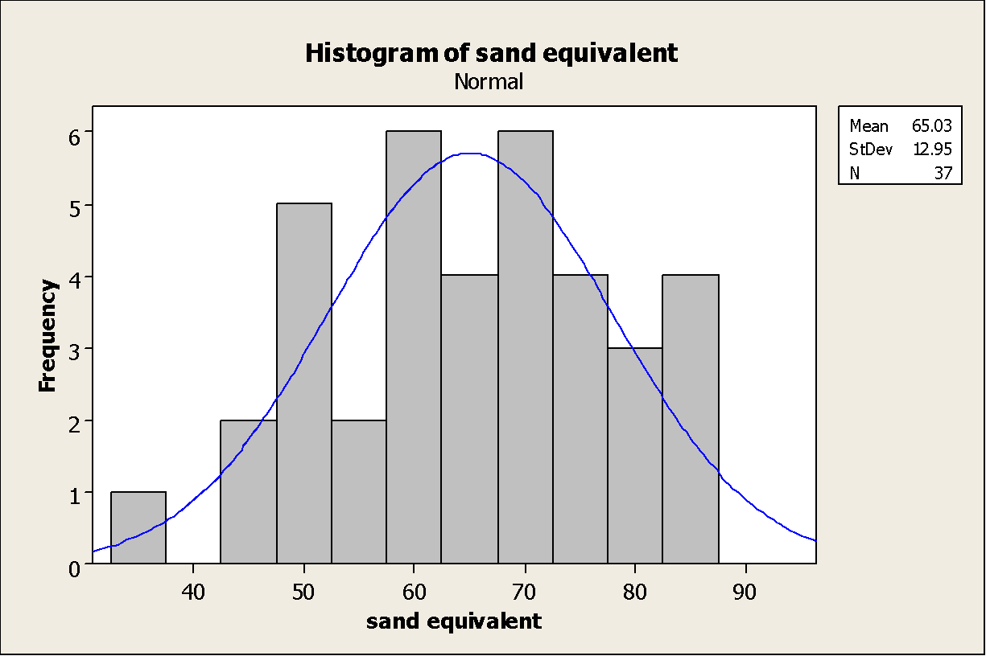

Slide 27
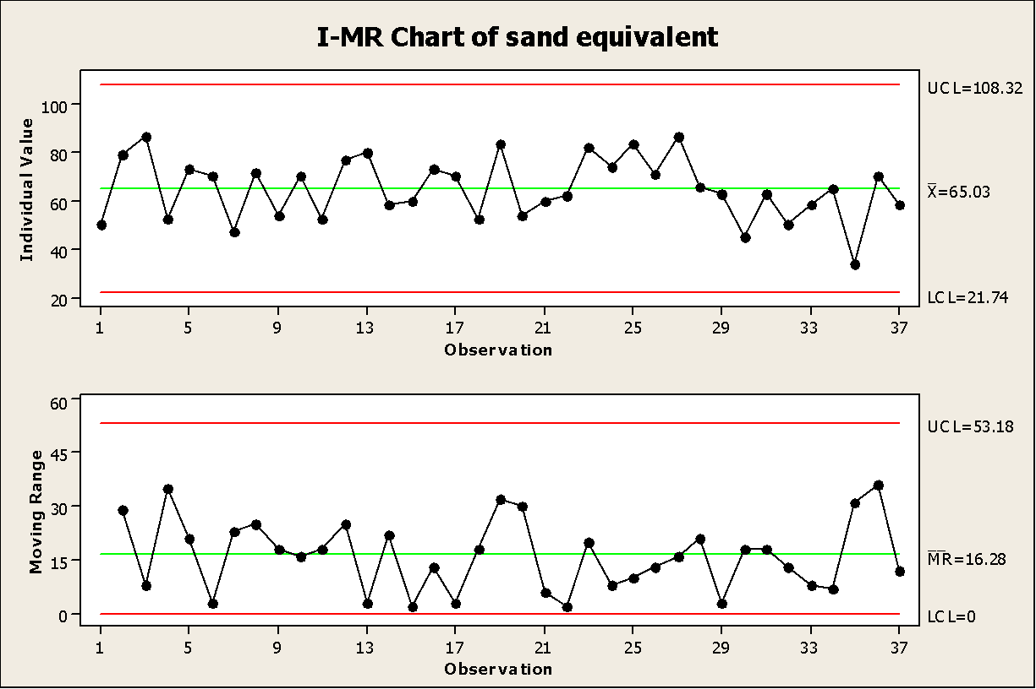
Control chart

Slide 28
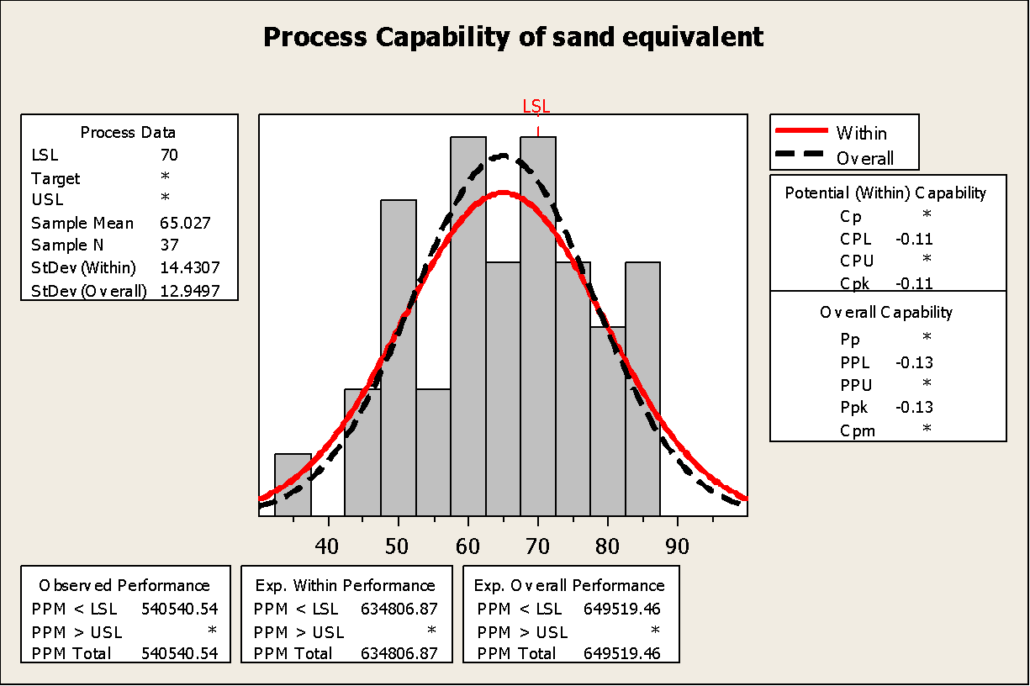

Slide 29
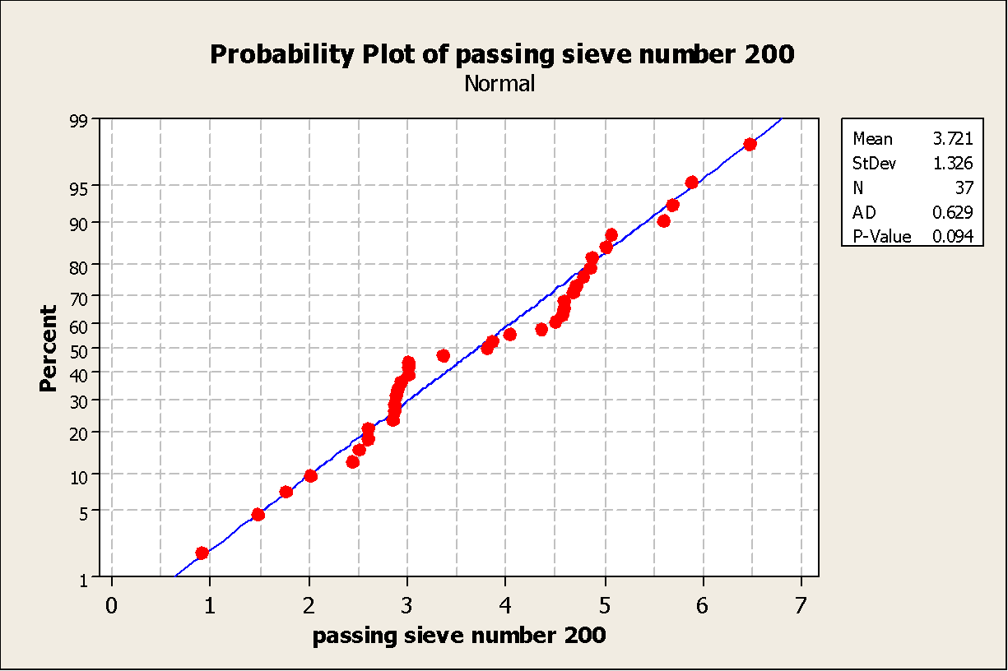
2- Passing Sieve Test
Normality Test

Slide 30
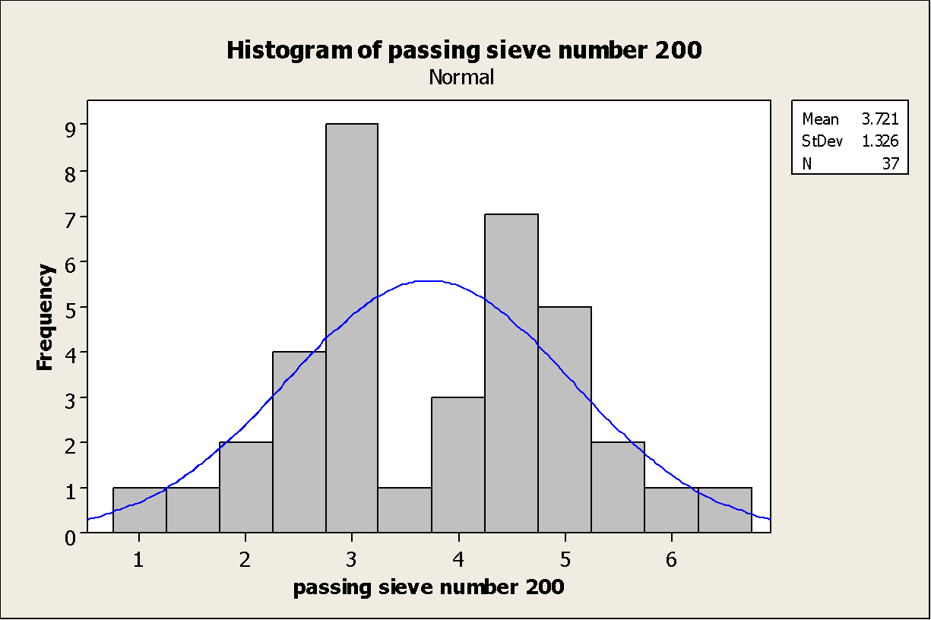

Slide 31
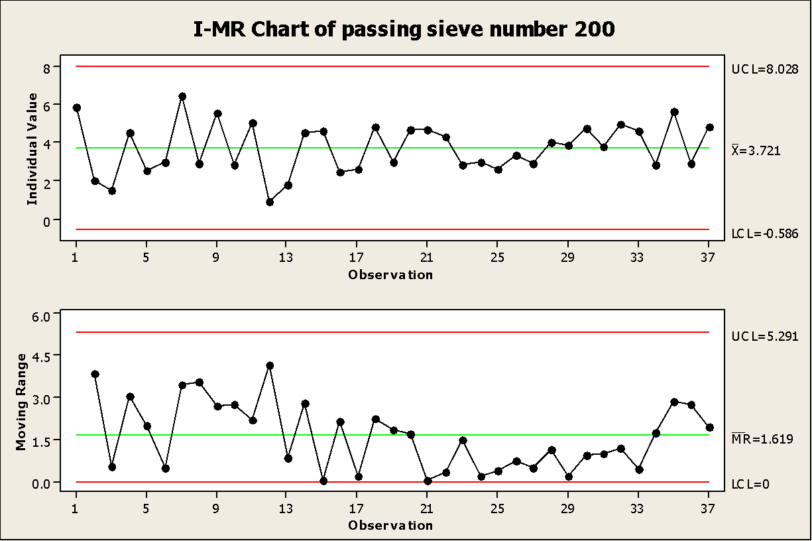
Control Chart

Slide 32
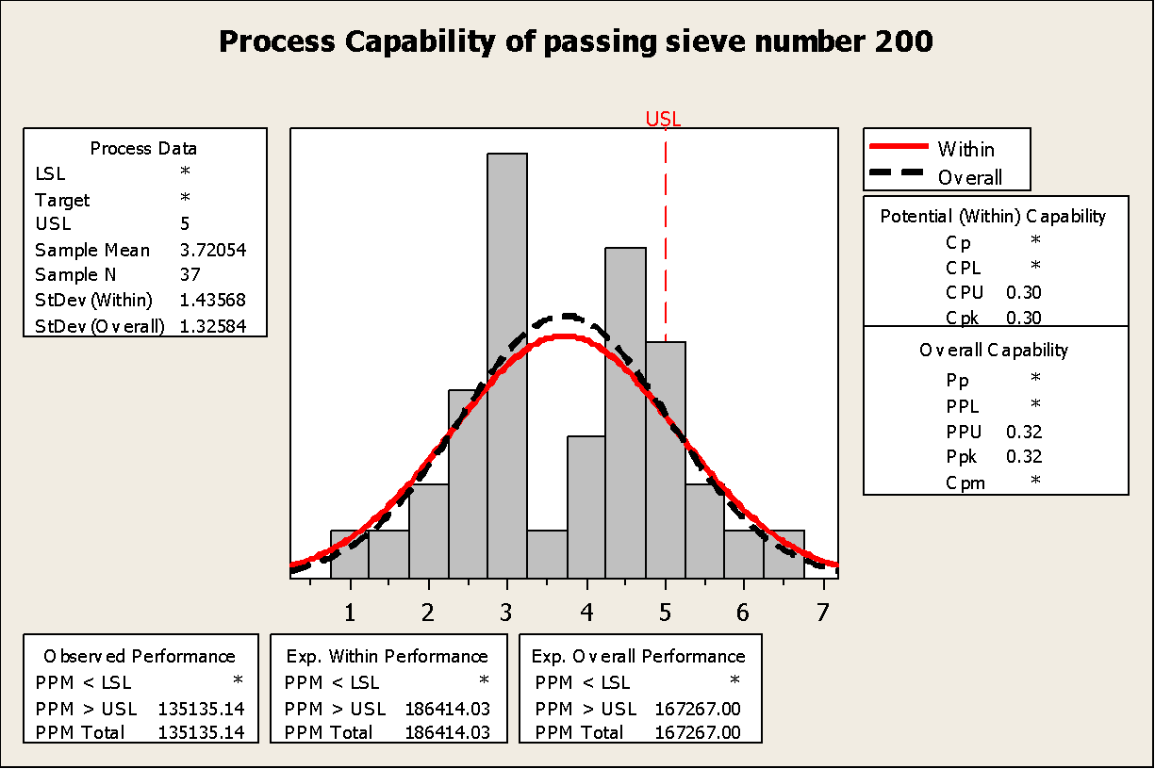

Slide 33
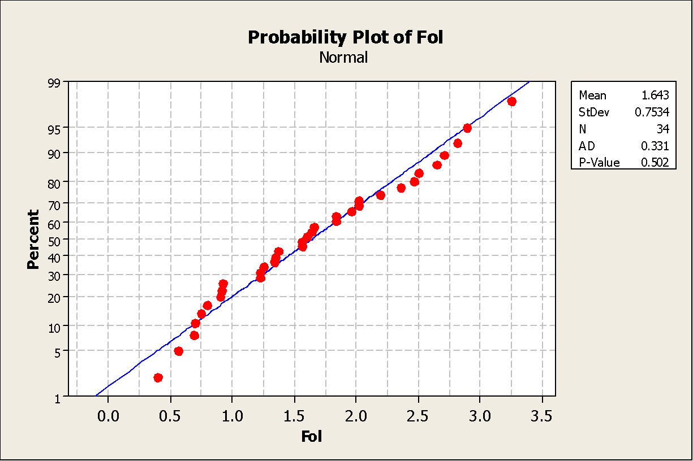
3- Aggregates Test (Fol)
Normality Test

Slide 34
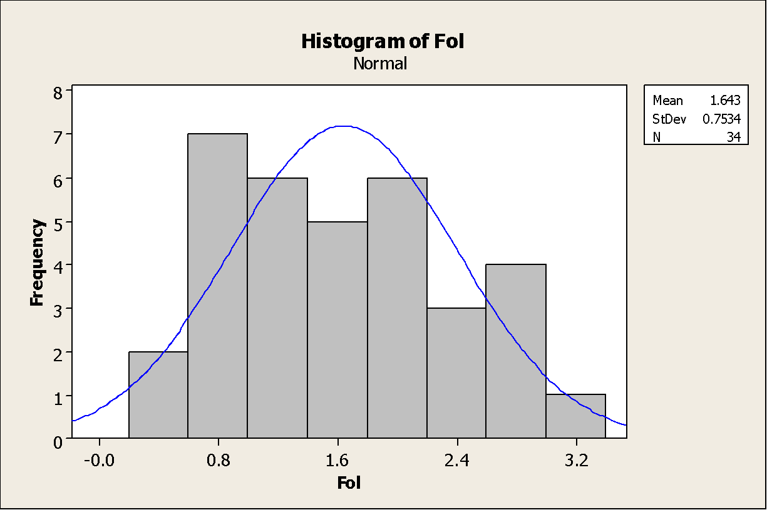

Slide 35
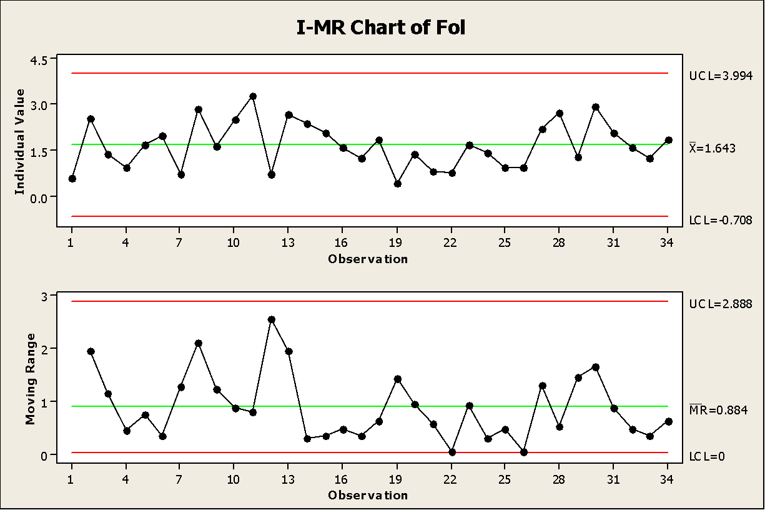
Control Chart

Slide 36
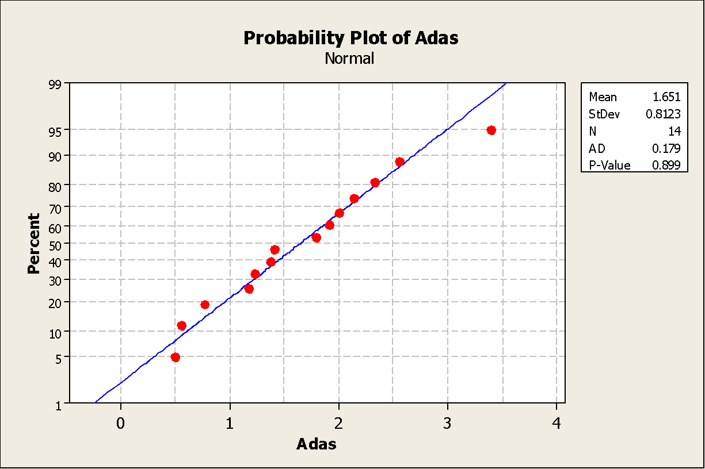
4- Aggregates Test(Adas)
Normality

Slide 37
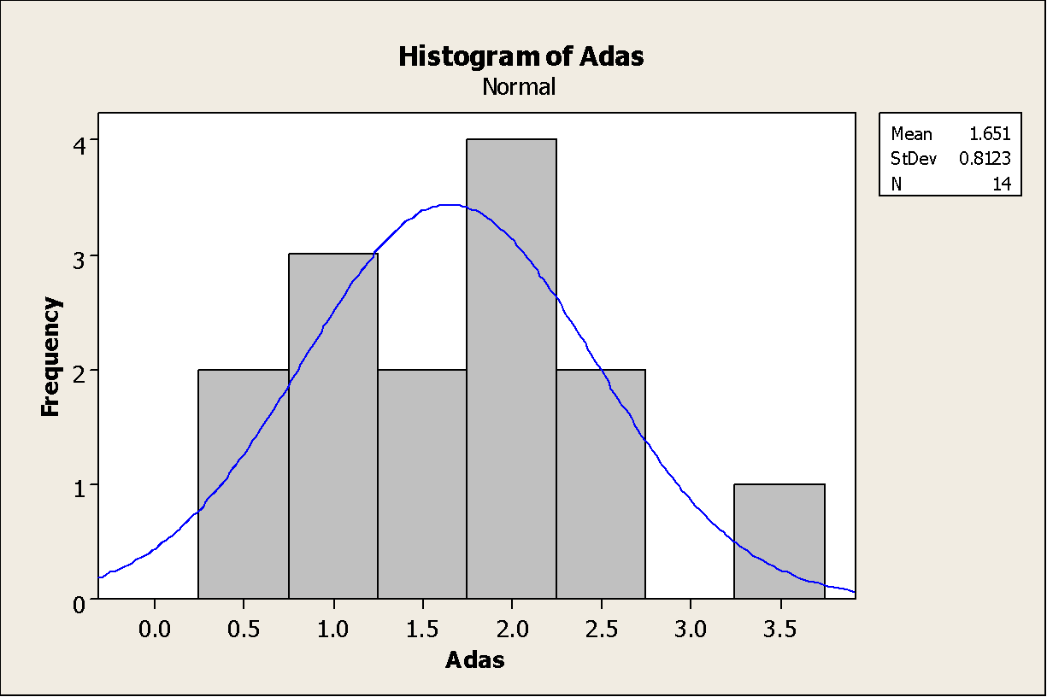

Slide 38
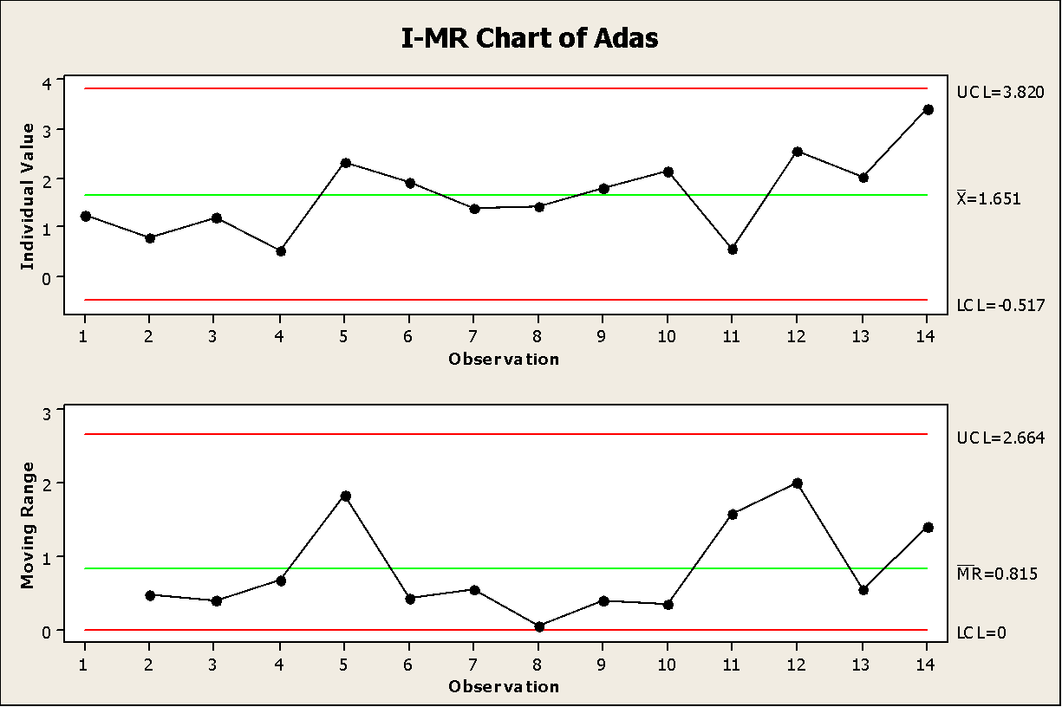
Control Chart

Slide 39
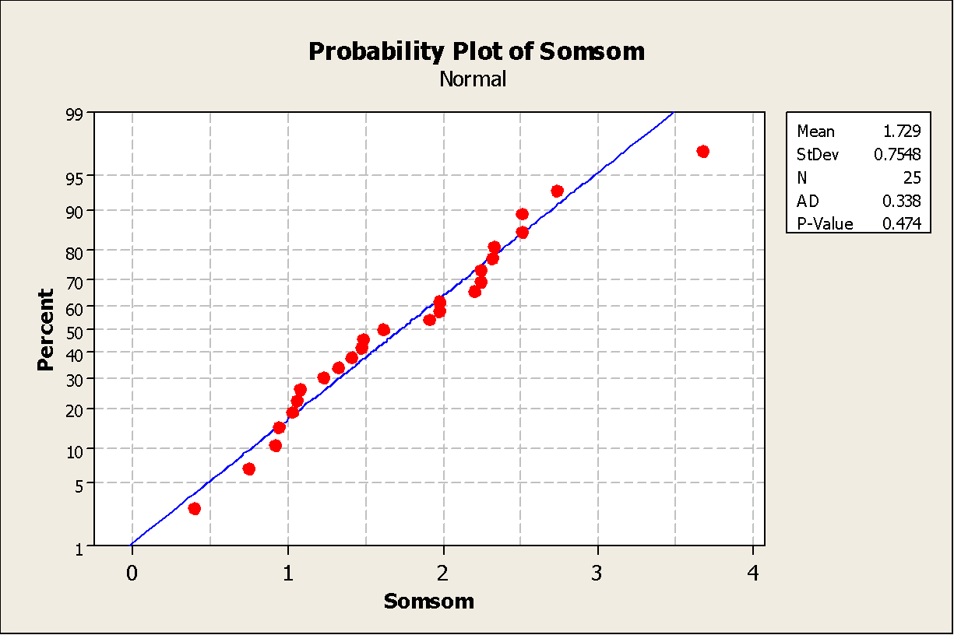
5- Aggregates Test (Somsom)
Normality Test

Slide 40
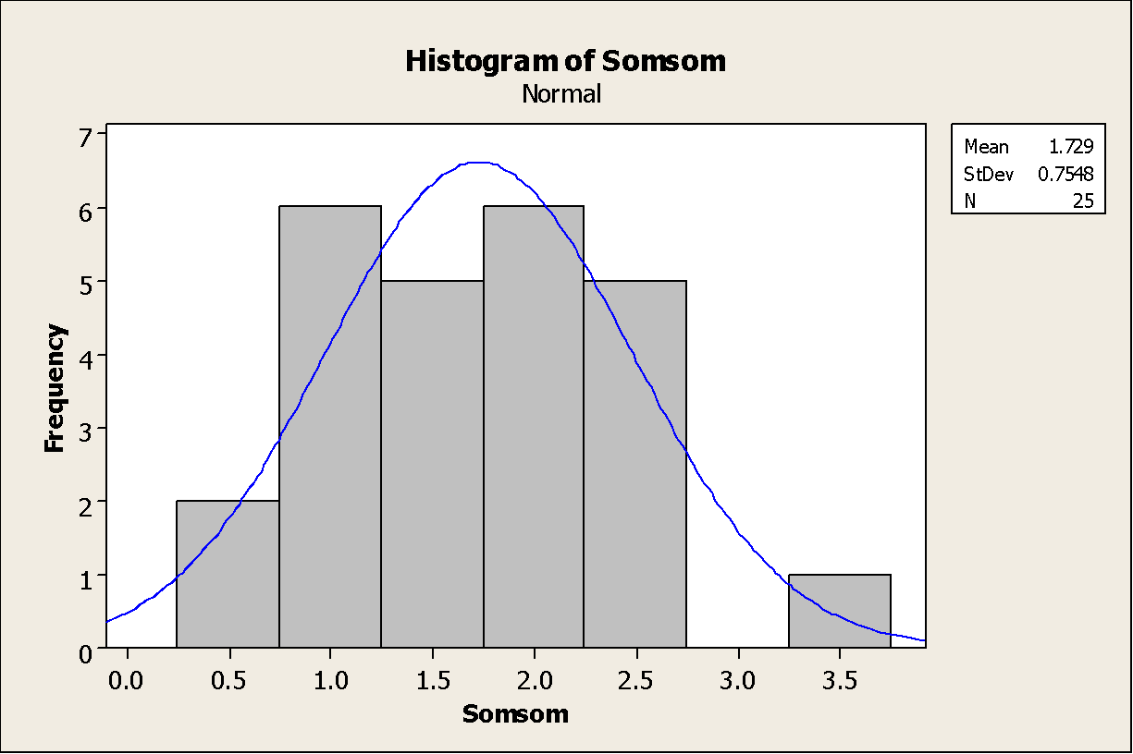

Slide 41
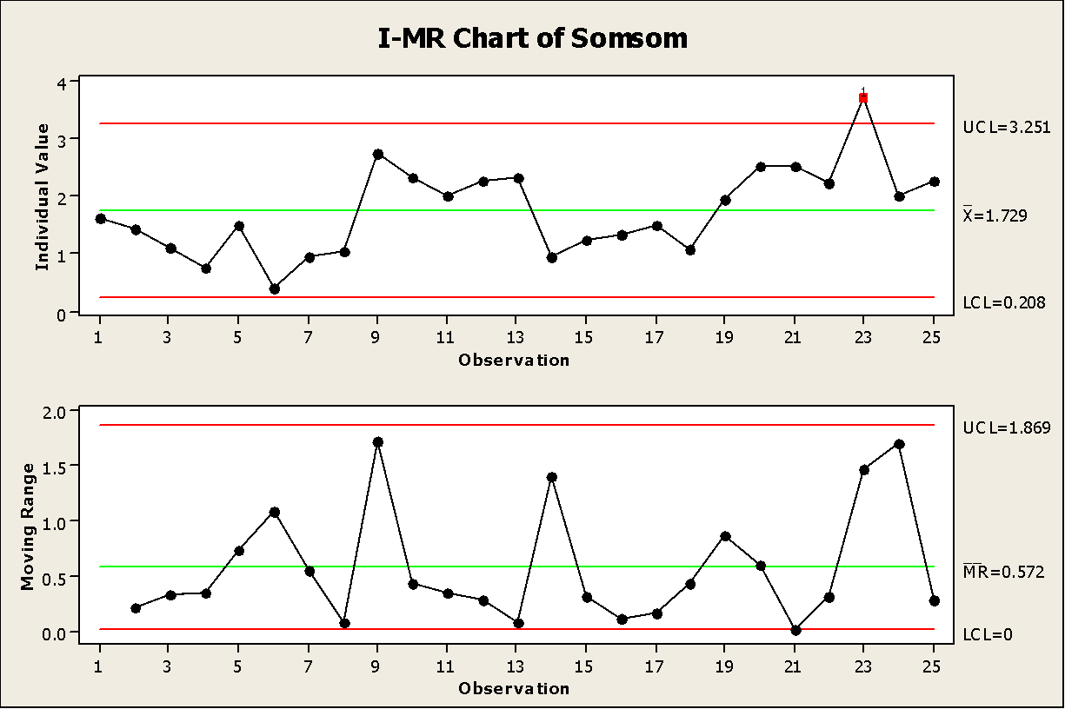
Control Chart

Slide 42
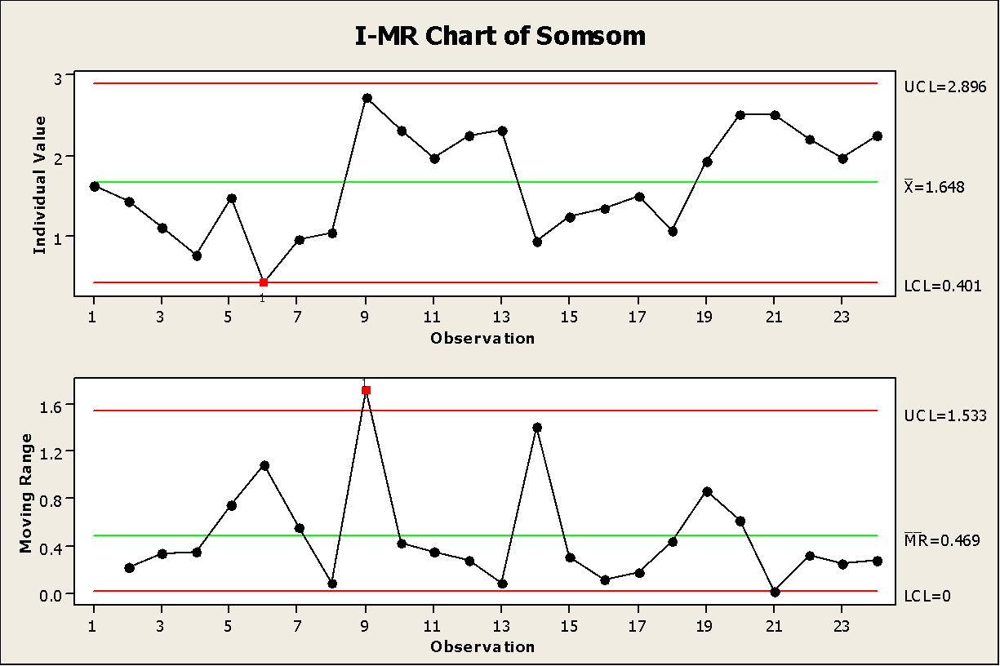
Point number 23 was eliminated because it out of control limits.

Slide 43
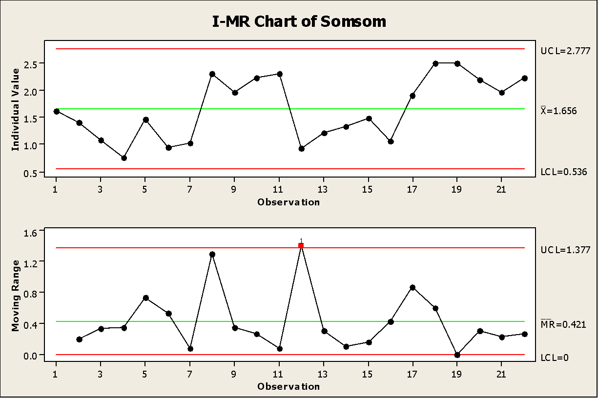
The points 6 and 9 was deleted:

Slide 44
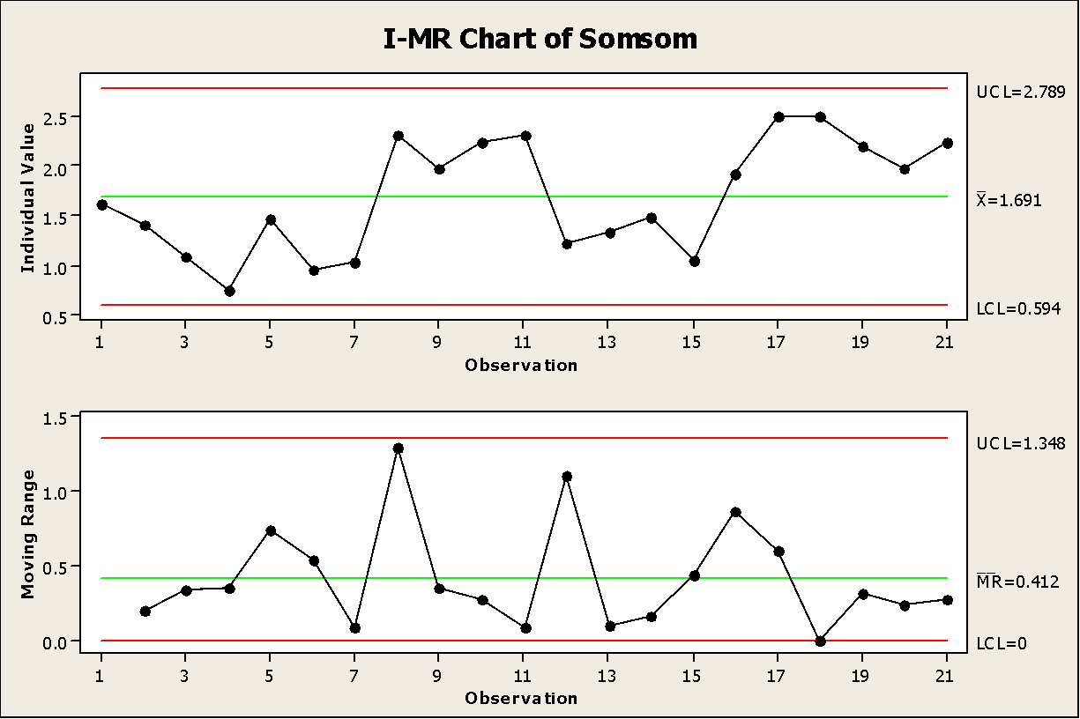
Point number 12 was deleted:

Slide 45
6-Concrete Tests (Compression strength test )
Hypothesis
let Mu1(µ1) : Mean in 28 day.
let Mu2(µ) : Mean on 7 days.
Null hypothesis (H0): The mean of compression strength test on 28 day larger than on 7 days.[ µ1- µ2 = 0]
Alternative hypothesis(H1): The mean of compression strength test on 28 day larger than on 7 days. [ µ1- µ2 > 0]

Slide 46
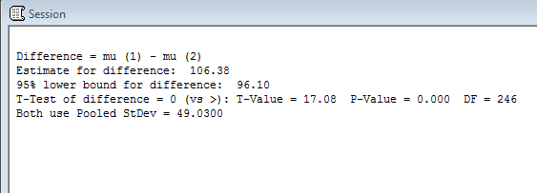

Slide 47
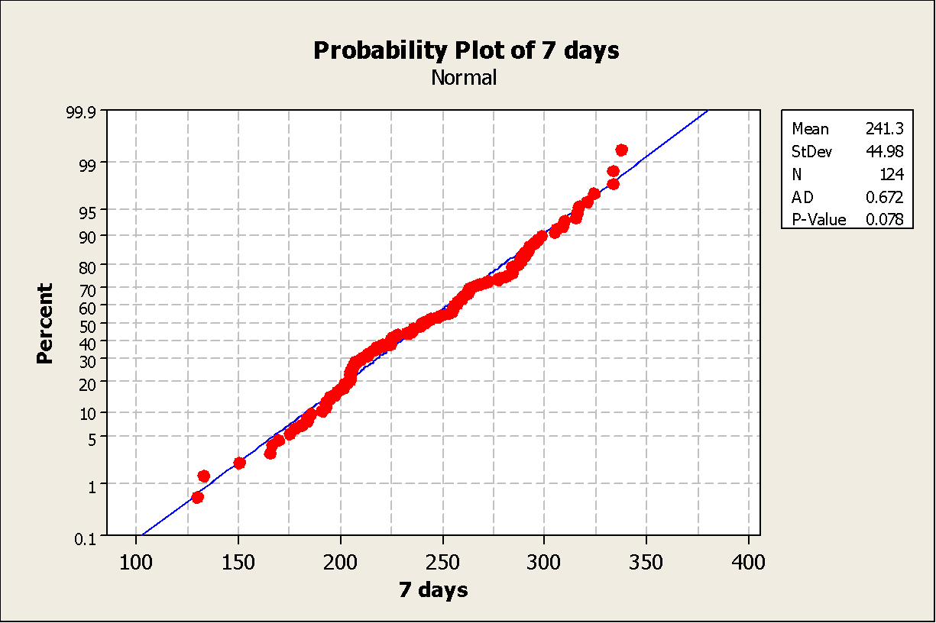
Compression strength test for 7 days
Normality test

Slide 48
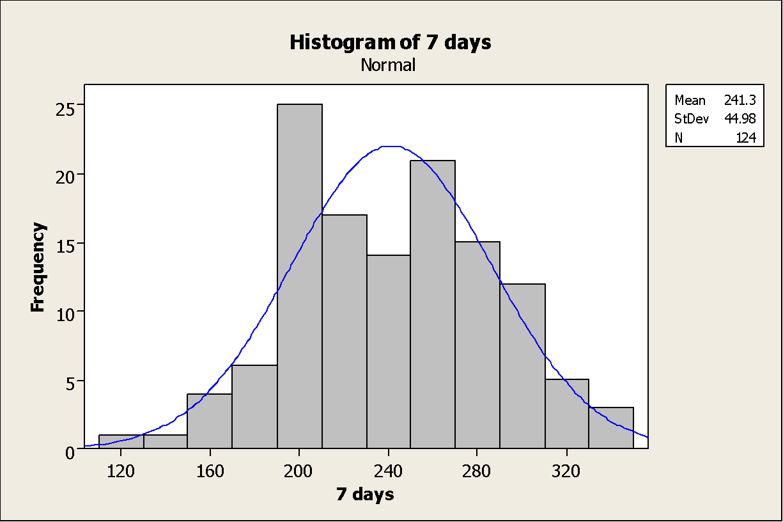

Slide 49
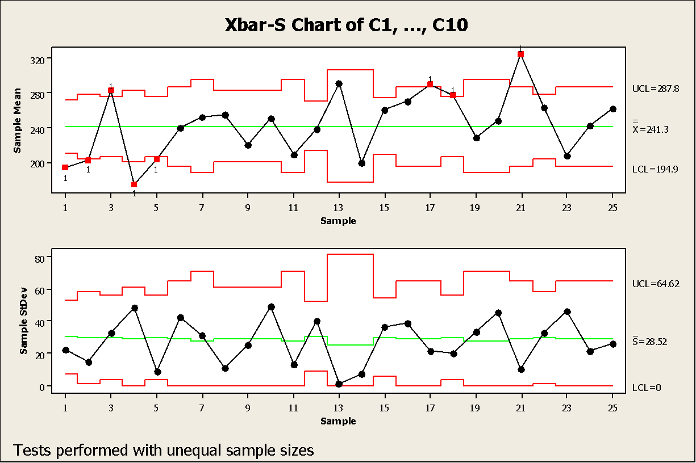
Control Chart :This graph show that there are 8 points ( point : 1, 2, 3, 4, 5, 17, 18, 21) are out of control in x̅ chart, which mean that there is a deviation in the process mean. So these points was omitted and a new samples was taken from the period of September.

Slide 50
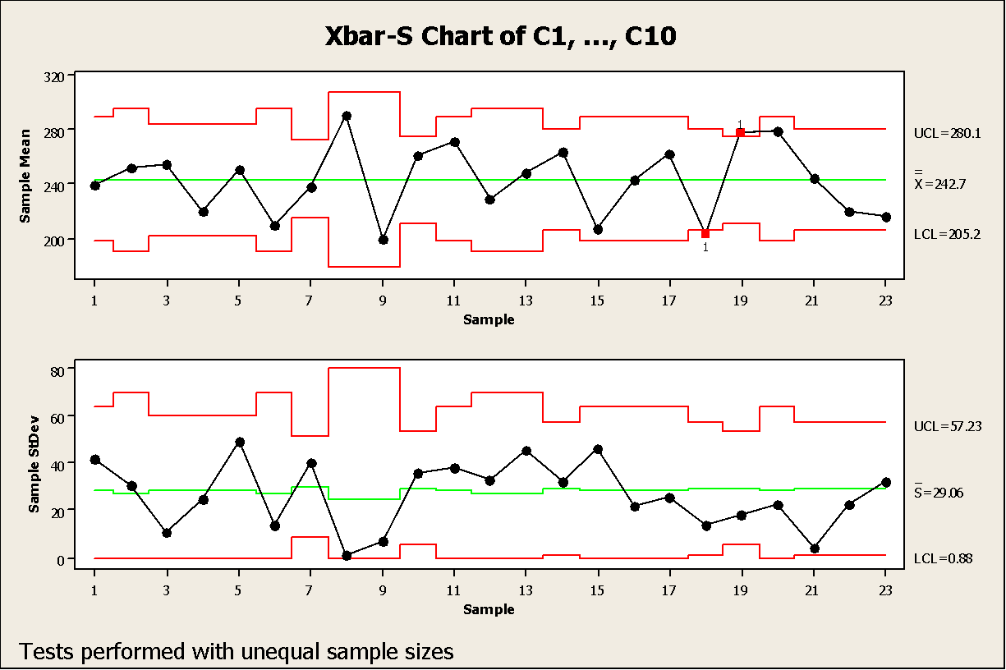

Slide 51
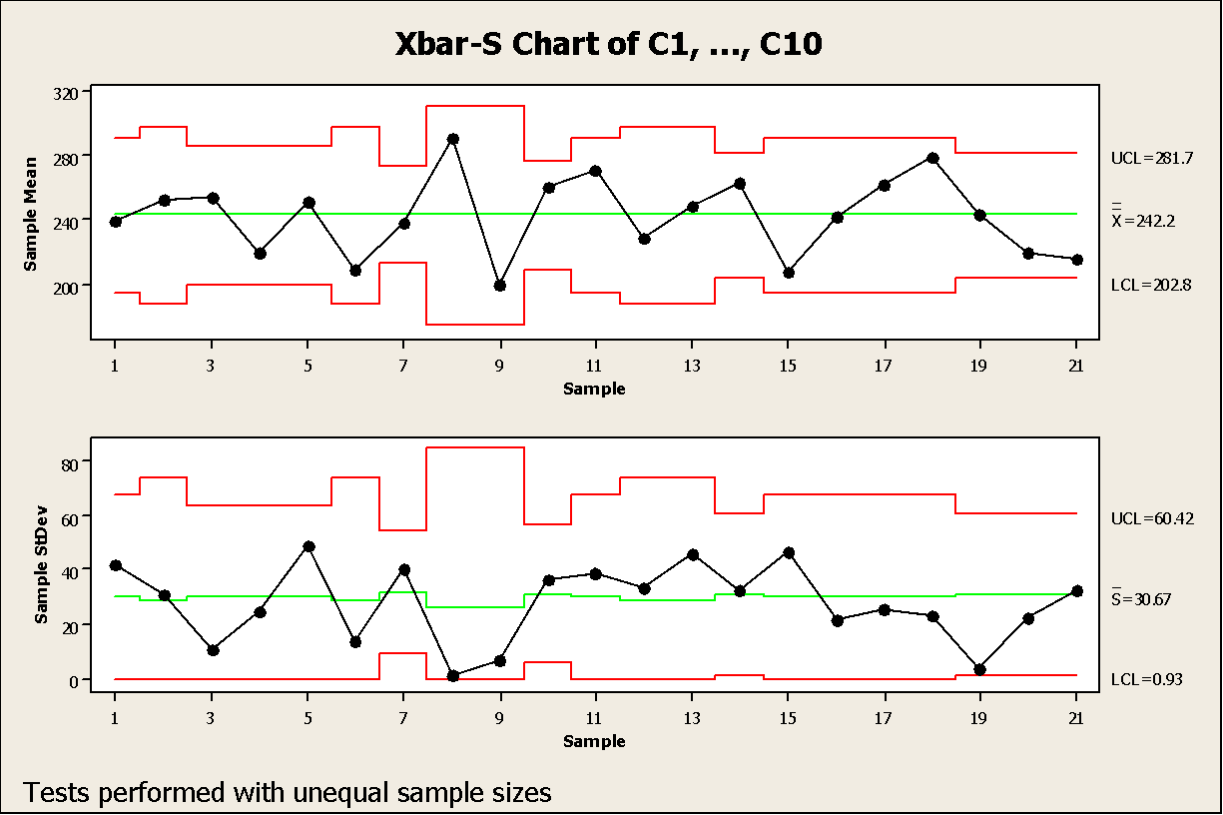
There is a two points are out of control (18 & 19 which represent the points 26 & 27),

Slide 52
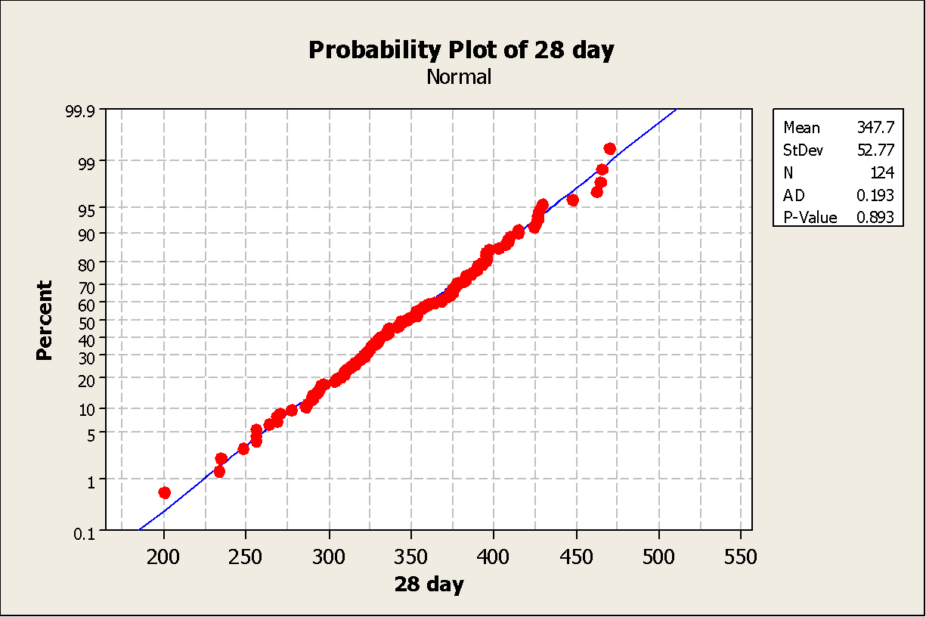
Compression strength test for 28 day
Normality test

Slide 53
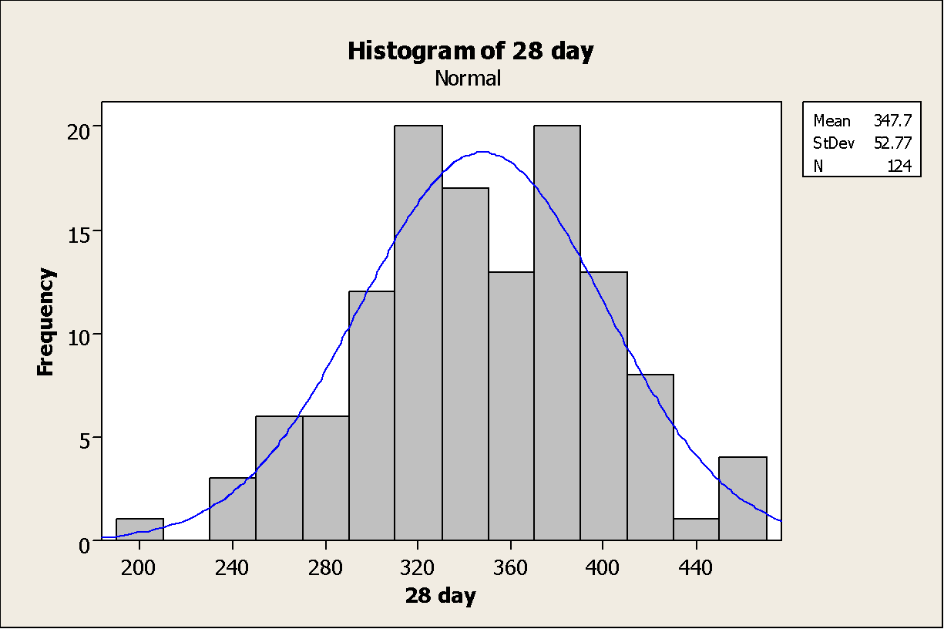

Slide 54
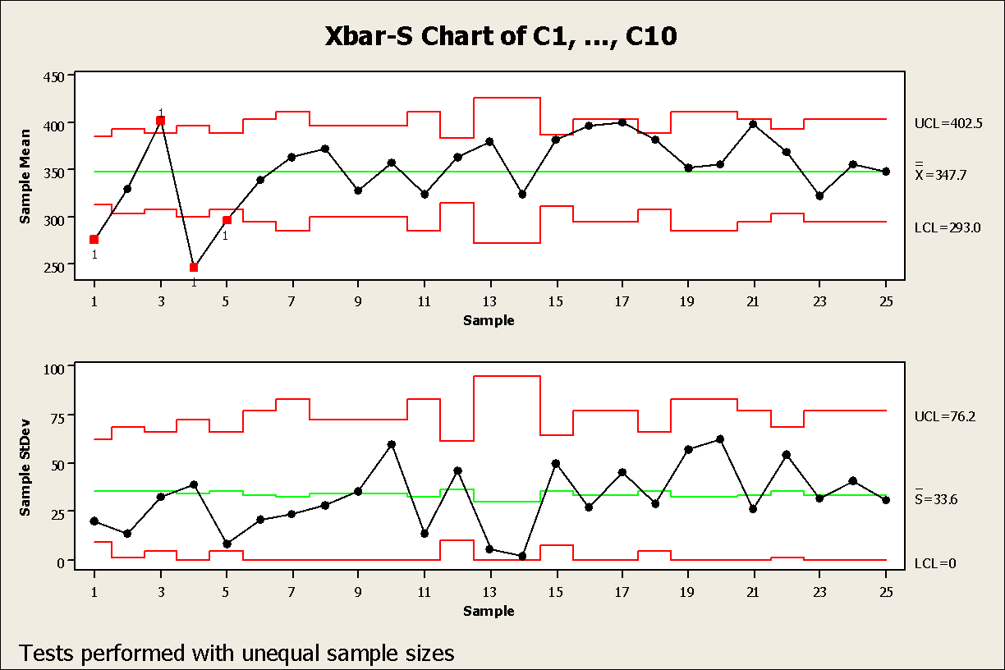
Control Chart: This graph show that there are 4 points ( point : 1, 3, 4, 5 ) are out of control in x̅ chart

Slide 55
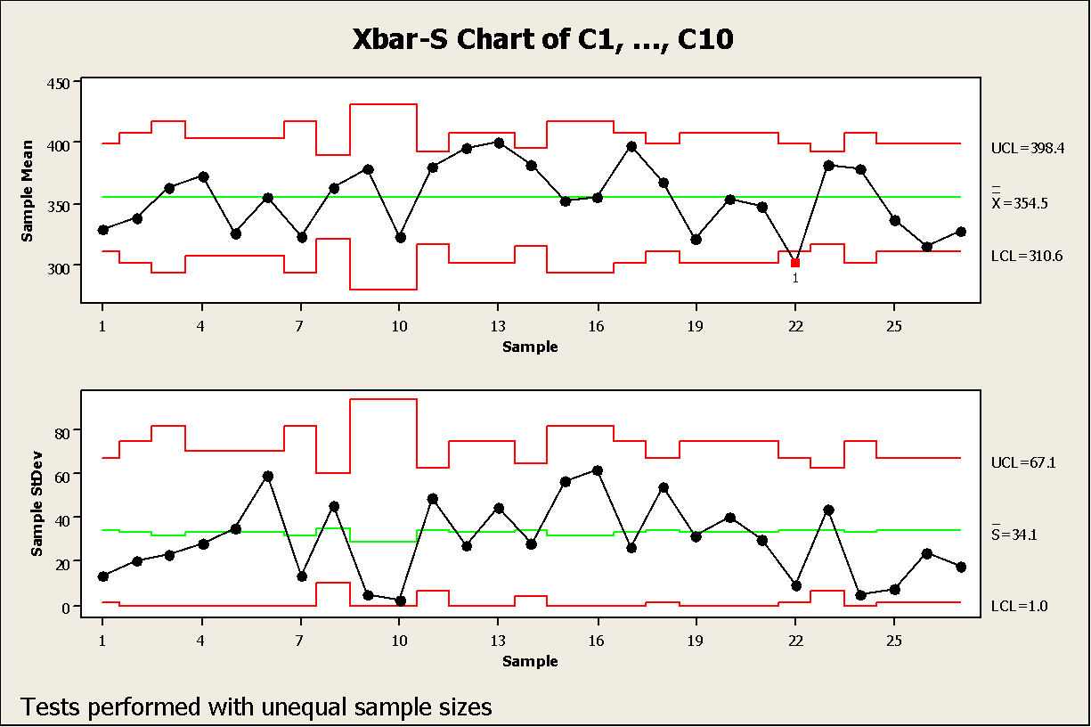

Slide 56
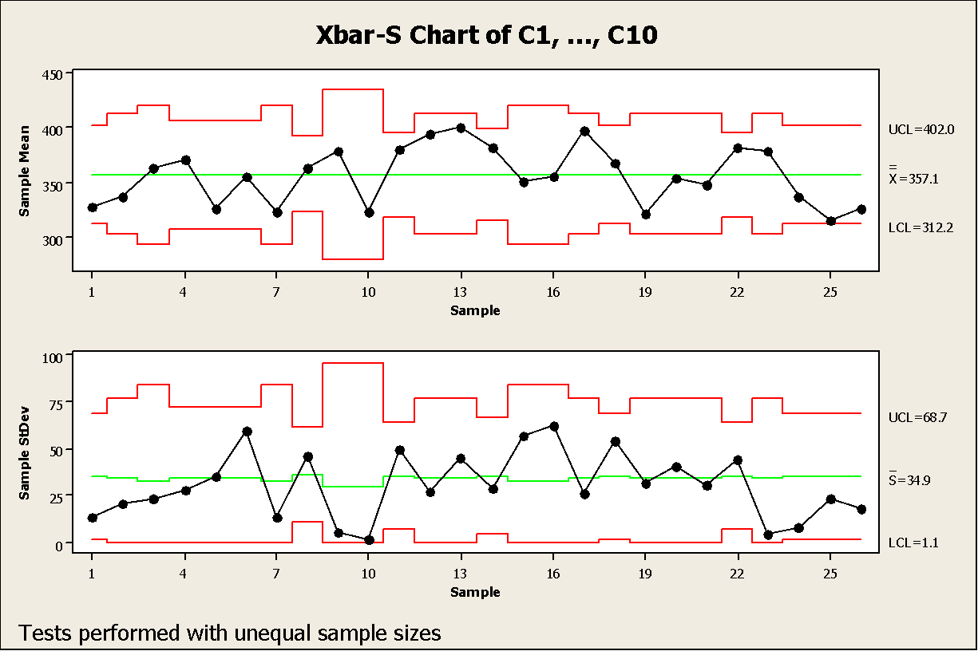
After point 22 was deleted(which represent point 26)

Slide 57
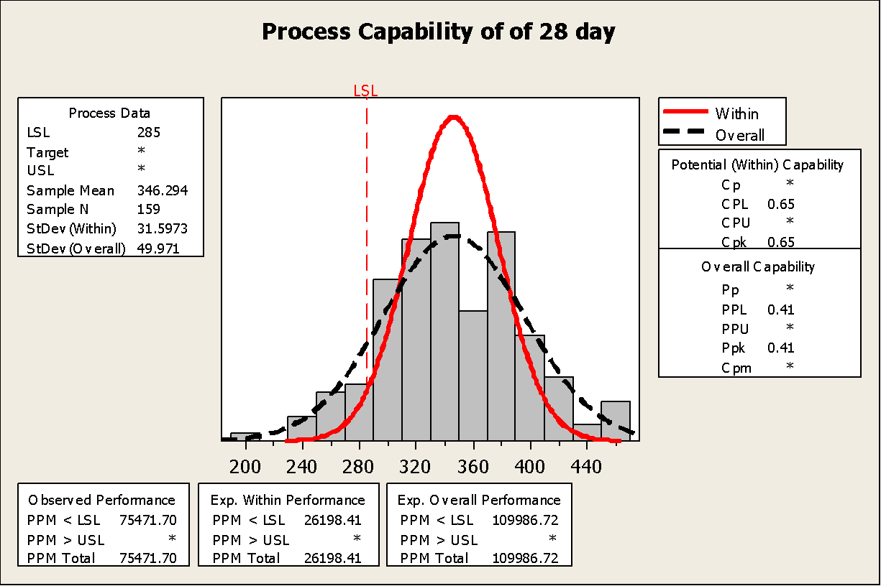

Slide 58
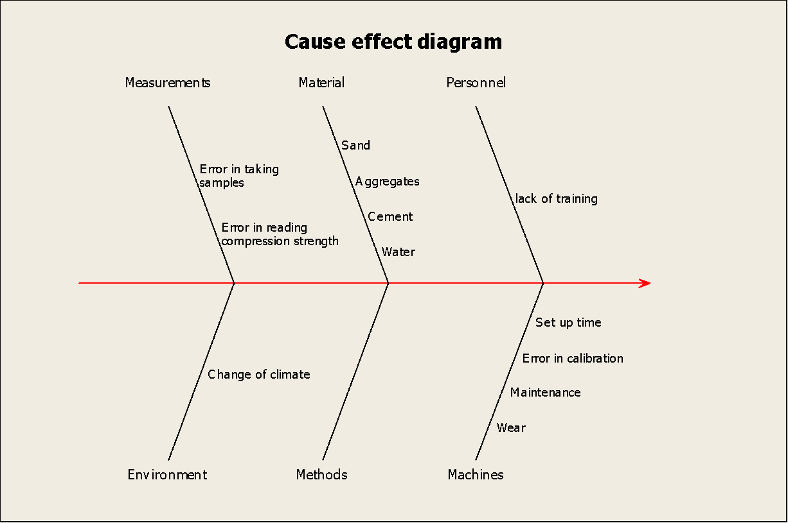
Concrete does not meet specifications

Slide 59
Conclusion
The project concerned on concrete as it the essential element in construction industry, also due to the damage that may happen if the tests that must do on the raw materials and on the concrete itself not as identified in the Palestinian standard.
Some calculations were done on the means and standard deviation of the data ,the main aim of these calculation is to monitor the process if it is in control or out of control, and if it is not in control it must make some adjustment at the data to make it in control in order to start our calculation and start tracking the process to reach to the final result ,these calculation give the reader a convincing reason about the losses in the concrete production .

Slide 60
Recommendation
1-The factory have to use the seven tools as fishbone diagram ,control chart to increase their awareness about the problem.
2-Making sure that the preventative maintenance of the equipment that used in doing the test on the raw materials and the final product at AL mezan and hijjawi Laboratory is done.
3-The laboratory must take into consideration the Palestinian standard in taking samples and the way of testing.

Slide 61
4-The results of the tests are affected by the weather so the laboratory have to take into consideration these differences .
5-The factory and the laboratory have to develop the safety considerations for the worker .
6-The workers who is specialized in collecting the samples have to be well trained.

Slide 62
Thank you for listening

