Slide 1
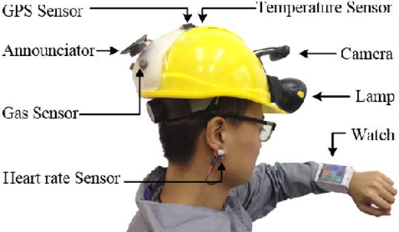
IIoT Smart Safety Helmet
Presented by: Leen Taweel,
Sujood Boulad
Njoud Safadi
Supervised by: Dr.Saed Tarapaih

Slide 2
Outline
Introduction
What is IoT?
Statistics
Main Features
Main Tools
ThingSpeak Side
Results and Discussion
SWOT Analysis
Future Work
Demo

Slide 3
Introduction
Problem Statement:
Protection and safety are the most talked of issues in every aspect of our time. In the present day, we find many causes of death because of accidents that occur in the workplace. And it is a major topic that requires particular attention.
Objectives of the project:
Enhance public safety, especially for engineers in fieldwork. By using modern technologies to serve and protect them and design a simple smart helmet that able to serves public safety and give good quality of service with an efficient cost.

Slide 4
What is IoT?
Internet of Things, also called the Industrial Internet, is a new technology model envisioned as a global network of machines, devices and things that capable of interacting with each other. Things can be connected wired or wirelessly. In IoT, the wireless connection will be the main way.
The IoT is recognized as one of the most important areas of future technology and is gaining large attention from a wide range of industries.
In the internet of things, the physical world and information world are mixing together. Sensors play a very important role to bridge the gap between the physical world and the information world. Sensors collect data from their environment, generating information about the context. So, the changes in their environment can be monitored and the corresponding things can make some responses if needed.

Slide 5
Statistics
Causes of injuries | The number of injuries
Hand injury and collision | 16
Things fall | 29
People fall | 30
Fall into tight spaces | 18
Other accidents | 38
Causes of injuries | The number of injuries
Hand injury and collision | 3
Things fall | 30
People fall | 1
Fall into tight spaces | 4
Fire and explosion | 1
Other accidents | 30
Table 1. Statistics of injuries in construction site for the year2019
Table 2. Statistics of injuries in construction site for the year2020 until March
*Source: Labor Directorate in Nablus, Statistics Department

Slide 6
Questionnaire
Percent of engineers who got injured in the construction site and percent of engineers who didn’t
Number of people who chose the most important safety clothing piece according to their experience
Percent of people who support the idea of linking technology to safety in the workplace versus who’s not

Slide 7
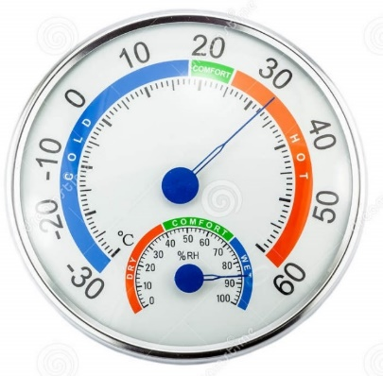
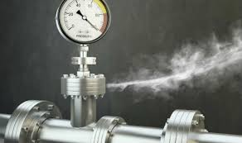
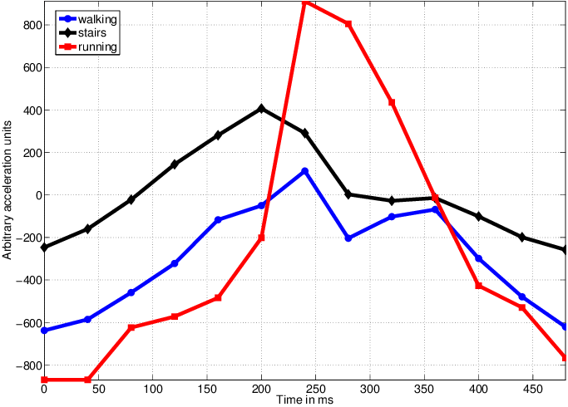
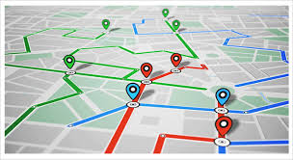
Main Features
Measuring Temperature and Humidity Measuring Gas Leakage
Tracking Acceleration changes Tracking the Location of Workers
Notes:
*measuring the temperature and the humidity of the workplace environment by DHT11 Sensor.
*Detect the Gas leakage in the environment around the workers by MQ-2 Sensor which provides high sensitivity and fast response time measurements.
* Detecting changes in motion and body position by tracking acceleration changes in three orthogonal directions using ADXL345 Sensor.
*Tracking location by using Google Geolocation which tracks the nearby Wi-Fi networks then based on their information. The location is displayed at the monitor station.

Slide 8
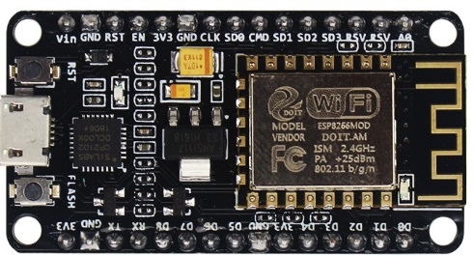
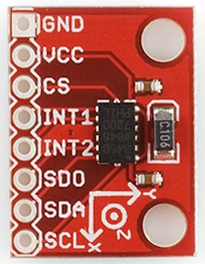
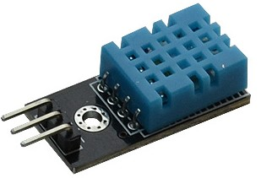
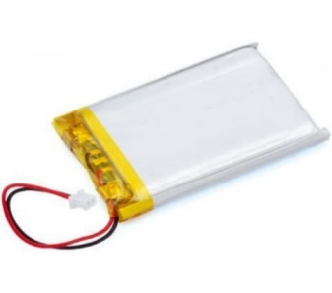
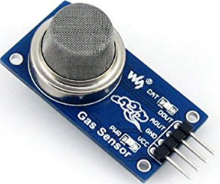
Main Tools
NodeMCU.
ESP8266 Arduino Core.
DHT11 Sensor.
Gas Sensor (MQ-2).
ADXL345 Sensor.
Lithium battery.
ESP8266 NodeMCU
ADXL345
DHT11
Lithium battery
MQ-2

Slide 9
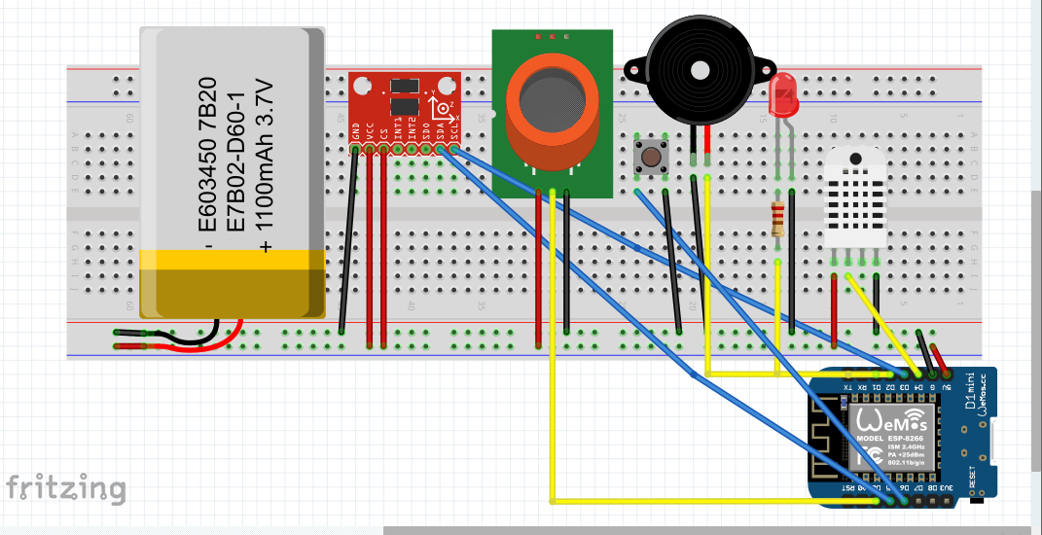
Project circuit diagram

Slide 10

ThingSpeak side
ThingSpeak is an open-source IoT platform, used as the cloud platform and API to store all the data collected by the sensors, analyze it, and display it.
Data collected from NodeMCU will be sent to ThingSpeak via an HTTP request and API.
It has integrated support from the numerical computing software MATLAB from MathWorks
It is simple and easy

Slide 11
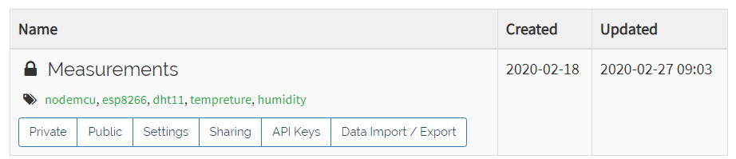
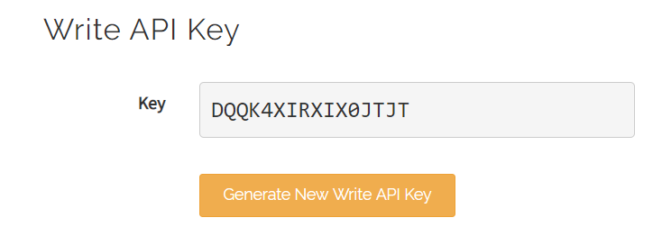
Procedures
Creating a private channel on ThingSpeak
unique ID is set to the channel and an API key was generated

Slide 12
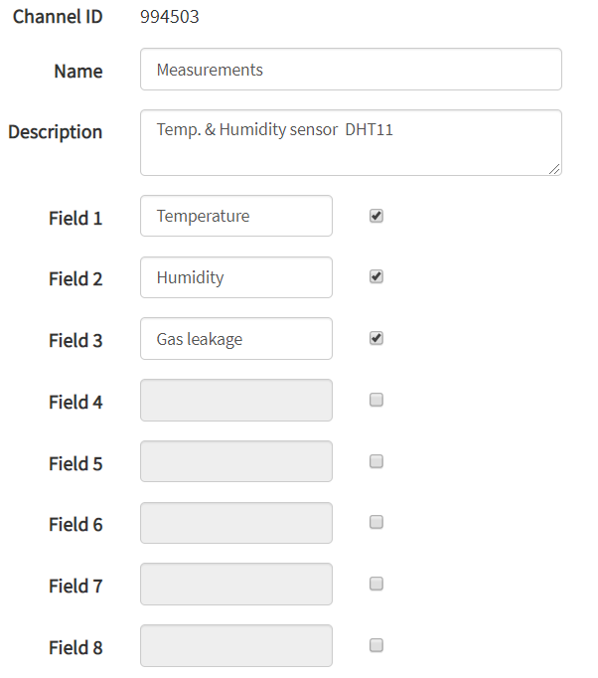
Set three fields for our channel for each sensor measurements.

Slide 13
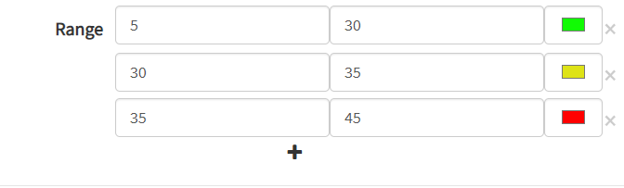
Set the range for the first channel(Temperature) and indicates the hazardous levels by colors
* And so on for the rest of channels for each sensor.
The Measurement channel here is as a monitoring station for the construction site environment which can be used to detect hazardous events for a quick response

Slide 14
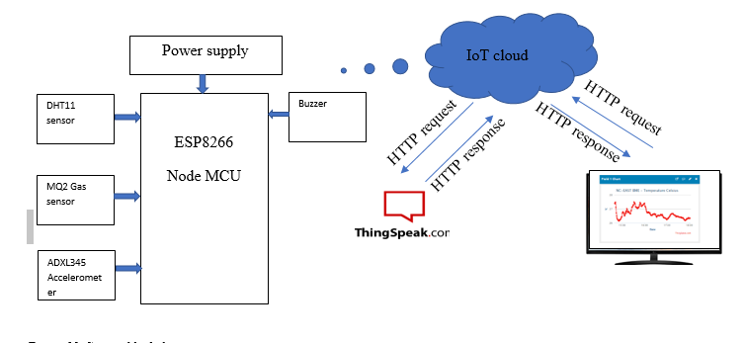
System block diagram

Slide 15
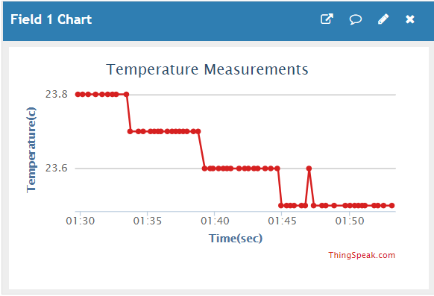
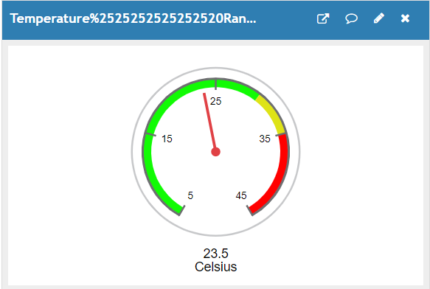
Results and Discussion
Obtained Temperature Measurements
Temperature severity levels

Slide 16
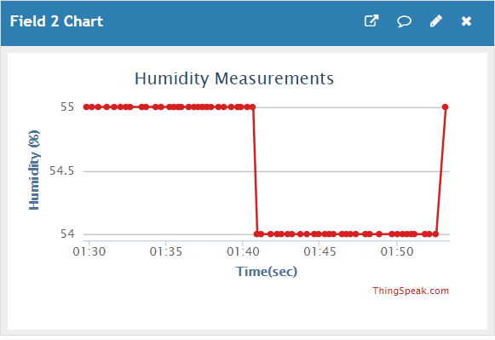
Obtained Humidity Measurements

Slide 17
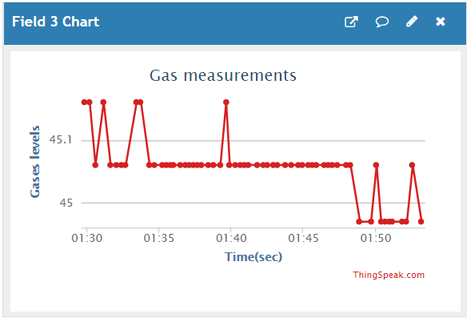
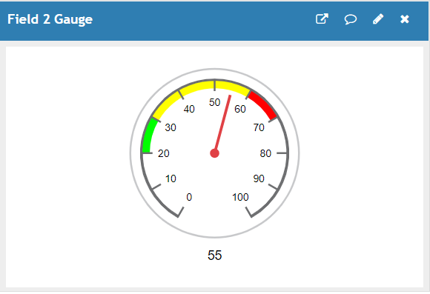
Obtained Gas Measurements
Gas severity levels

Slide 18
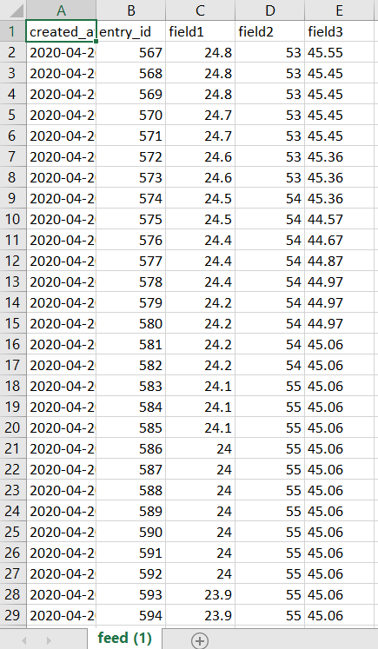
Exported data

Slide 19
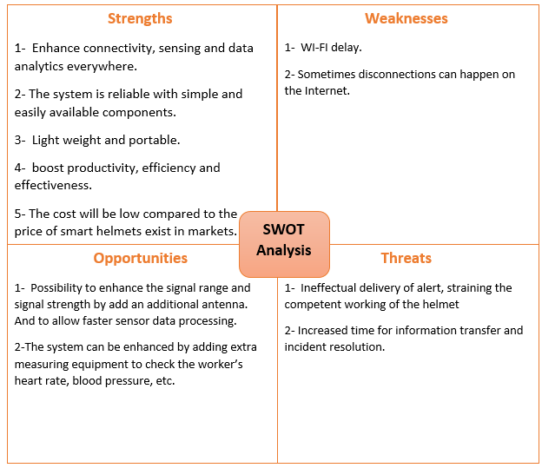
SWOT Analysis

Slide 20
Future Work
We will complete the project, work on hardware part
Provide a speaker with Headphones to supply a communication between workers.
Work on the mobile application associated with it
And then we will present the project as a product to some government or private institutions concerned with public safety
And provide a sample of the project for everyone who wants to experiment.

Slide 21
Thank you!

