Slide 1
Fireball
Prepared by: Mohammad Abu-Hasan & Oday Ashour
Submitted to: Dr.Husam Abd Elhaleem

Slide 2

Introduction
Fireball is a 2.5D game with a story theme to make it appealing and interesting for the player. It will have the defensive concept. Featuring 3D graphics, yet its gameplay is restricted to a 2D plane where the game action will occur at the same line.
2.5D games has proven lately to be more attractive, popular and more played than the original 2D games, it's also easier to implement.
2D logical & 3D graphical. For example, a platform with 2D game mechanics and physics, but rendered with 3D meshes and perspective camera. Most remakes of classic arcade games.
3D logical & 2D graphical. Examples include games like SimCity 2000 which have 3D game worlds, but are rendered in 2D isometric view.
Our Fireball game will be 2D logical and has a 3D graphical.

Slide 3
Gameplay Strategy, Story
Our game is mainly defensive game where you are a ninja girl firing a fireballs preventing the bad guys from getting in the castle, with a bit game changing end, where we aim to use the element of surprise and illusion for extra dose of amusement as the player finally come to realize that the ugly ogres he was firing are actually good guys, and the innocent ninja girl is not so innocent after all by using hits on your mobile touchscreen.

Slide 4
Abstract
Fireball is targeted to all mobile phone holder as it's easy to get and easier to play due to its friendly interface and attractive sound effects. It's also the best option for mothers to trust it with their kids, as it doesn't contain violence scenes, even mothers can play it too! In the bus, or in their way to work.

Slide 5
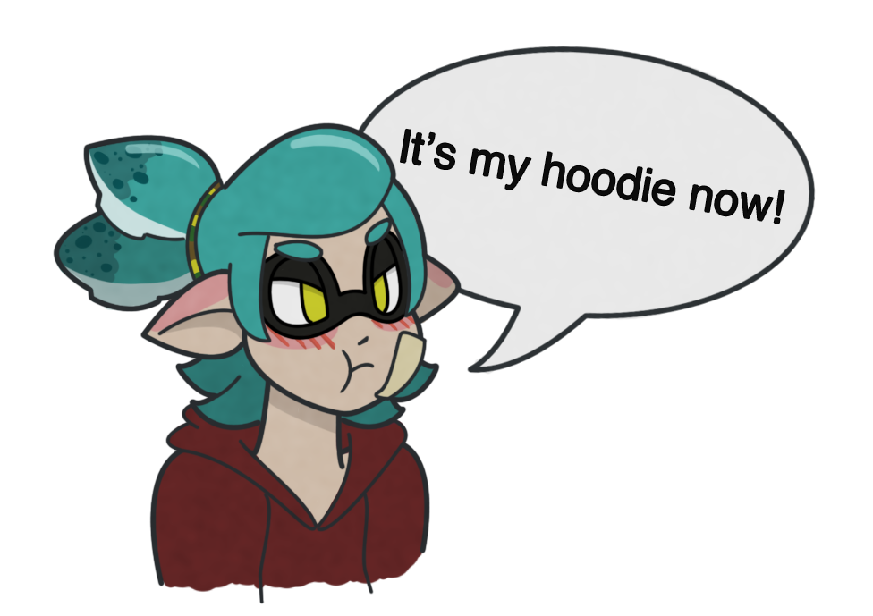
Characters
Ninja girl: which represent the main character the player plays with
This is the first picturing for the girl

Slide 6

Characters
Ogers.
Faded ogres.
Fast ogres.
Flying ogres.

Slide 7
Assists Needed:
2D
Static 2D background.
2.5D characters.
Sounds:
Sound list.
- Outside:
Menu sound and click sounds
- Inside:
Game play music interact with movement.
- Sound list (Ogres).
- Characters Movement sound list.
- Characters Hit / Collision sound list.
- Characters on injured / Death sound list.
Sound list (Ninja)

Slide 8
Assists Needed:
- Characters Hit fireball.
- Controls:
Simple game using mobile touchscreen or mouse for clicking or targeting enemies for pc.
- Level Design:
We use game chapters for level starting from simple game level and applying for more levels in the next game future plan with more plots, new characters, more sound & game effects.
- Plot:
Game plot to keep the enemies away from yours castle which surprisingly appears as a good guy that make the player feel the story and trying to guess what will happen next with the stress when he is facing the enemies and his health bar started to decrease after that, his fireballs starts to duplicate depends on how many enemies he killed which giving him another chance to stay alive and back to game again at the last movement he feels the death is near.

Slide 9
How to play
You press on the game icon.
The main menu should come to your main screen.
You look for the "Start" Button.
Press on that button.
Have fun playing the game.

Slide 10
Game scenario:
At the beginning of the game you will find yourself as a ninja girl, on a top of a calf, riding a fireball canon and ready to shoot.
The ogres will start coming one by one, and in increasing number depending on levels and game's difficulty.
The game is divided to many levels, when the level increase, the mount of your fireball will increase as well.
At the beginning you will start with one ball, then after a certain amount of kills you will get two fireballs per shot, and so on until you reach 4 balls.
You will be defeated if the enemies breached your safe area and sector.

Slide 11
Non-Functional Requirements
1. Usability
The maximum number of clicks for any clicks function in the system should is unlimited. This can be achieved by usability testing with random users.
2. Response time
The average response time between click and reaction must be less than 1 seconds. The maximum response time between click and reaction must be two seconds. Adding some simple classes and methods that will compute and display the time needed to process any operation can test this requirements.

Slide 12
Non-Functional Requirements
3. Required resources
The game must be able to run with minimum of 512 MB of RAM. The game must use less than one gig of hard disk space. Checking the total size of the folder in which the game was installed, for the hard disk space can test this requirement. For the RAM used, when playing the game, we can check the physical memory in the Windows Task Manager Performance tab or mobile requirement.
4. Platform
The game must run in Windows or mobile Ios /Android. Installing the game in a Windows XP environment and run simple tests to verify if the game properly works can test this requirement, unity game engine environment is needed.

Slide 13
Functional Requirements:
For the overall system:
When game application is loaded main screen must be visible.
Options must be chosen.
Options must be saved once edited.
Game player must receive high score data on the top of screen.
Game must play when play game option is selected.
Game must save at certain intervals.
Game must load paused game if continue game option is selected.
Once a win or lose condition is met the current game must end.

Slide 14
Functional Requirements:
For the gameplay:
Ogres must be moveable.
Game difficulty is increasing when level up.
Fireball shots increasing when level is up.
Ogres must attack when reach an appropriate target (Ninja girl).
Ogres must be fired by Ninja girl to defense and kept away from Ninja position.
Ninja must deliver fireballs if given Ogres reach target (Ninja girl).
Ogres cannot attack when spell comes.

Slide 15
Functional Requirements:
Ninja girl stable just moves fireball weapon.
When Ogres are moveable they may not attack.
Flying Ogres come when level is up.
Faded Ogres come when level is up.
The rate of coming Ogres increase.
Processed resources are added to the players’ total resources and the new total will be displayed in the heads up display (HUD).
Resources are also used to help calculate player score.
All game agents must lose health points when attacked proportional to the attack power of the attacker.
When any game player health points value = 0 that player must die.

Slide 16
Functional Requirements:
For the AI:
Defensive structures are stationary.
The attack function is activated when an enemy comes within range.
The target is free chosen depending on the attack level of all enemies in range.
Game theme changes.

Slide 17
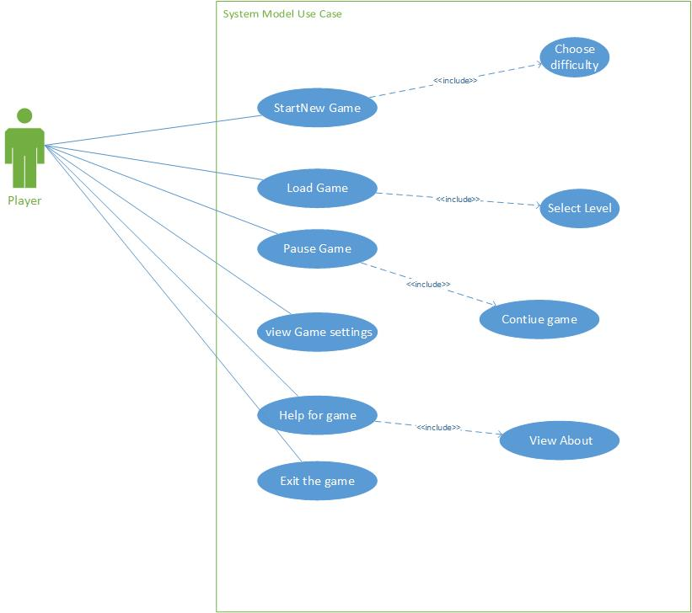
Fireball Use Case:
System Model Use Case:

Slide 18
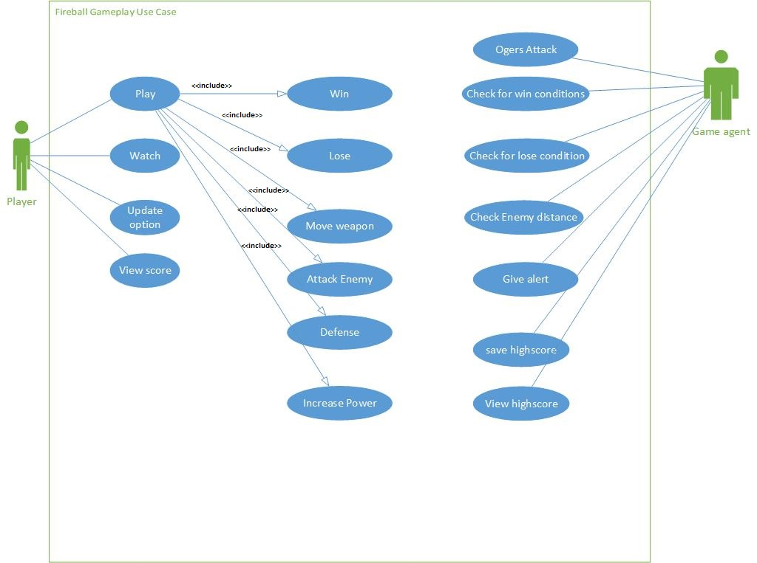
Fireball Use Case:
Gameplay Use Case:

Slide 19
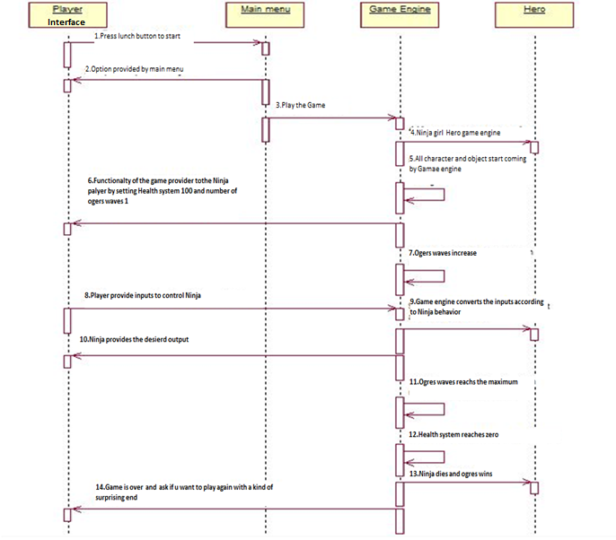
Sequence Diagram

Slide 20
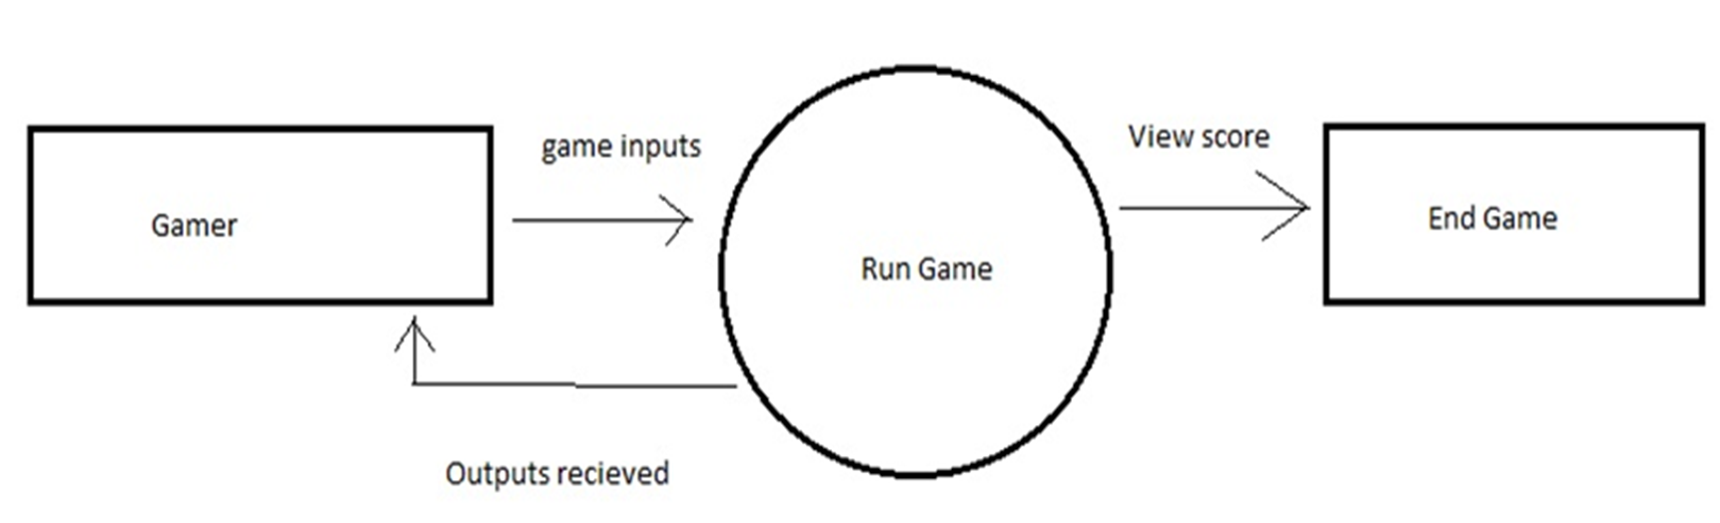
Fireball Data Flow Diagram:
Level 0 DFD:

Slide 21
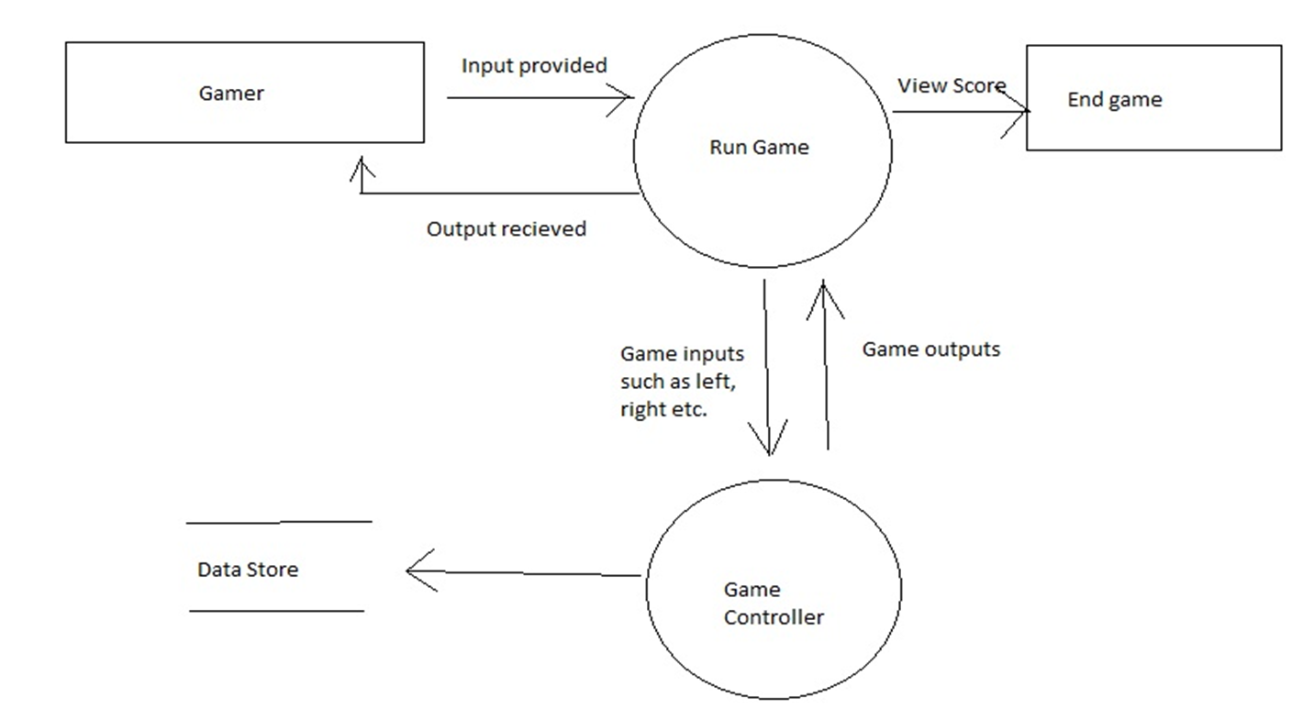
Fireball Data Flow Diagram:
Level 1 DFD:

Slide 22
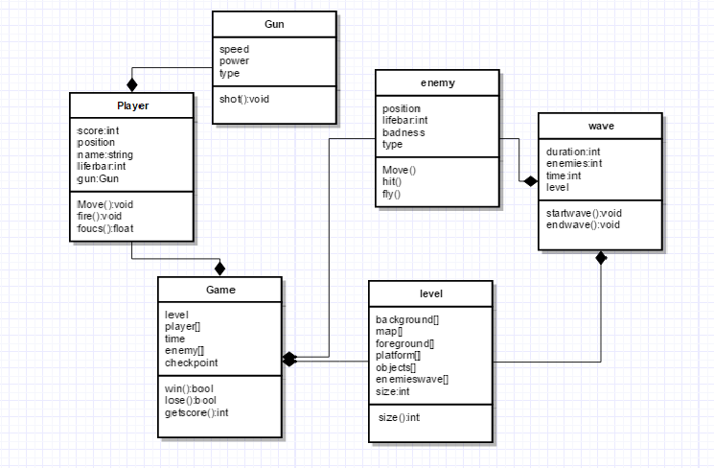
Fireball CLASS Diagram:

Slide 23
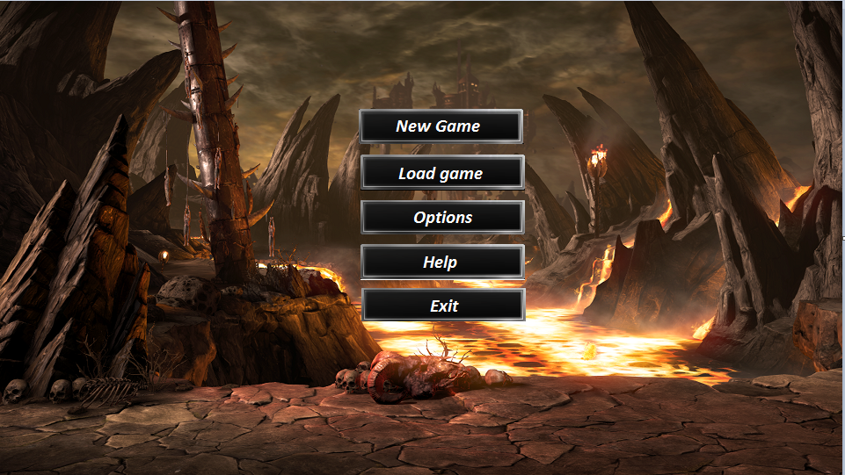
Game interface

Slide 24
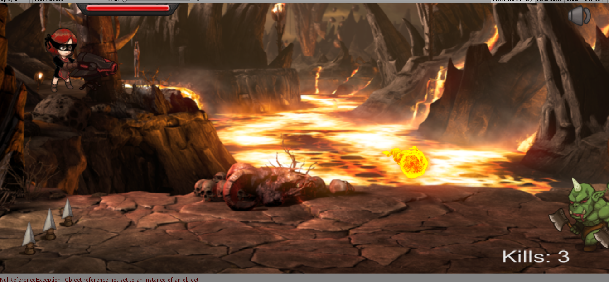
Game Interface

Slide 25
Thanks any questions?

