Slide 1
Social digital marketing monitor
Students:
Sujood aqraa.
Aseel sumodi.
Supervisor:
Dr.Muhannad aljabi.

Slide 2
Outline
Introduction .
Objective
Proposal approaches .
Constraint for some approaches .
Our methodology .
Future Work.
Demo.

Slide 3
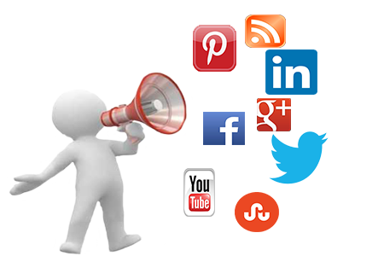
introduction
due to the increasing demand and importance of digital marketing, as well due to the wide usage of social media sites today, Therefore, there is an increasing demand for tools that monitor and evaluate the performance of social digital marketing.
.

Slide 4

The objective
This project designed to allow Users to search for there brand and get general idea about there customer . So our project will despise of hiring someone to personally sift through the millions of social media posts in order to figure out what’s relevant to the audiences.

Slide 5


Proposed approaches
We had two proposed social media apps to relied on , in order to serve the main objective of our project, they’re (Facebook and twitter).
Facebook approach
Twitter approach

Slide 6
Facebook approach .
We aimed to fetch all public posts that’s contain the searched query and evaluate there polarity based on their keywords.
Unfortunately ☹, Theirs no way to get this request done by using Facebook graph API , it was available in some previous versions but has now been removed ,
Since a new created App will only be able to use the latest/current API version, this made our request unavailable once a version is no longer usable ,
they have another API called “Public Feed” to do this , that too with limitations and it can’t be implemented as of now.
Access to the Public Feed API is restricted to a limited set of media publishers and usage requires prior approval by Facebook. we cannot apply to use the API at this time.
Therefore because of these restrictions we relied on second proposed approach to get data from.

Slide 7
Twitter approach
Despite of loosing usage of Facebook as one of the most common social media apps , twitter still also very important for marketing campaigns today for the following Features :
the most Popular microblogging site .
240+ million active users .
500 million tweets are generated everyday.
Users often discuss current affairs and share personal views on various subjects
Twitter audience varies from common man to celebrities .
Short Text Messages of 140 characters .
Tweets are small in length and hence unambiguous.

Slide 8
Our methodology
Getting twitter API keys
Installing twitter library
Connecting with twitter API
Evaluate its polarity (negative,
Positive , natural)
getting and processing the Data in Jason format

Slide 9
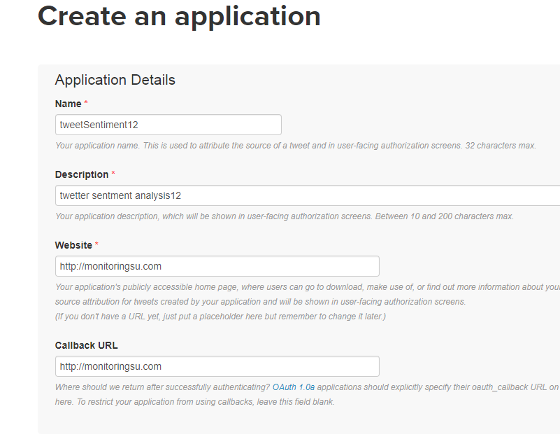
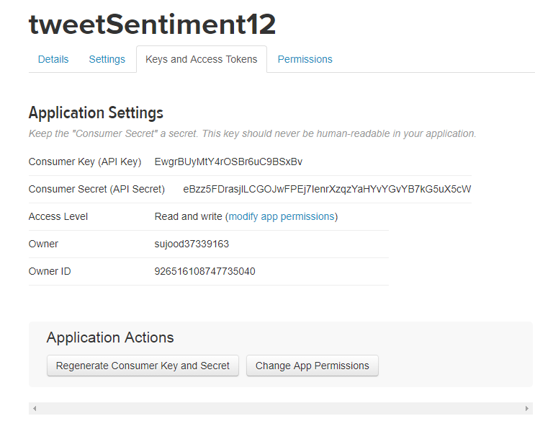
1. Create a Twitter application
In order to be able to search for particular tweets we must authenticate ourselves by using Oath protocol. Fortunately, the Twitter-API ­-client library takes care most of the tasks and enables a fast and easy integration, Still we are required to create a new Twitter application before using the library.

Slide 10

2.InstallingTwitter-API ­-client library
We used COMPOSER
app to do this .

Slide 11
3.Connecting with twitter API
REST APIs used to make our request , which gives historical tweets up to about a week with a max of a couple of hundreds.
We call the service search by passing our created app keys and GET method to fetch a list of tweets.

Slide 12
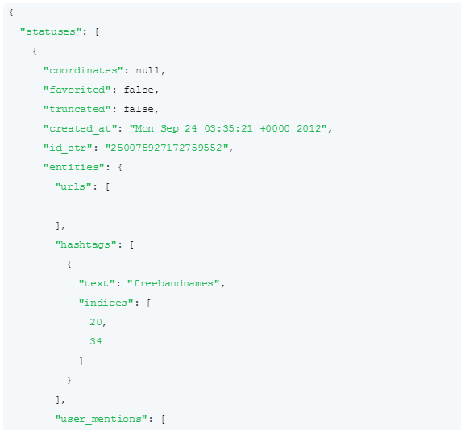
4.getting and processing the Data in Jason format
twitter API’s return tweets in JSON format contained several other types of messages (e.g. a tweet deletion notice, user update profile notice , text, id of user and username ,etc.)
We convert the JSON text to a nested PHP array ,
for each status(tweet) received we
choose(id, username , text ,and url )
to be printed.

Slide 13
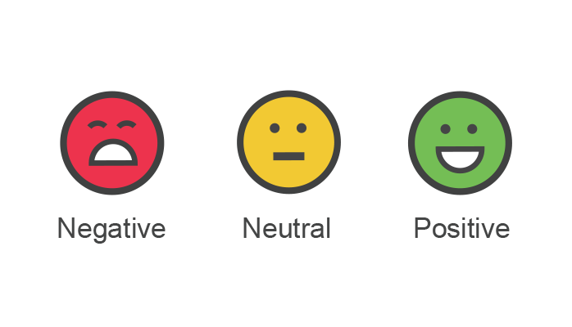
5. Evaluate its polarity
call for each tweet the sentiment service to get it’s polarity.
how??

Slide 14
Sentiment process
Input(keyword)
Tweets retrieval
tokenization
Sentiment in table and graphical representation
Classification using naïve bays
algorithm
Data pre-processing

Slide 15
tokenization
Return an array of tokens (break text of tweets into individual words)

Slide 16
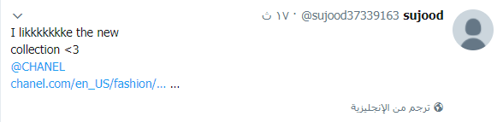
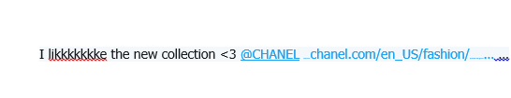
Tokenization (cont..)
  1. Replace the new lines with spaces

Slide 17

Tokenization (cont..)
2. Make all texts lowercase as the database of words in in lowercase

Slide 18
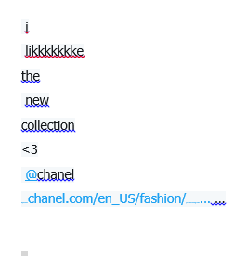
Tokenization (cont..)
3. Break string into individual words using explode putting them into an array

Slide 19
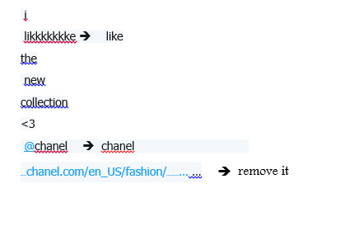
Pre-processing
Clean the array so its free from (URL’s @ # numbers and repeated letters ) for repested letters use preg_replacce methode that replace the repeated letters with first letter.

Slide 20
Classification
Tweets are categorized as positive ,negative and neutral , and naive bays algorithm used to calculate sentiment.
What naive Bayes classifier ?
Why naïve Bayes ?
Tools used for ?
Results ?

Slide 21
What Naïve Bayes?
Simple classification of words based on ‘Bayes theorem’
It is a ‘Bag of words’ (text represented as collection of it’s words, discarding grammar and order of words but keeping multiplicity)

Slide 22
Why Naïve Bayes?
because it is the simplest and most generally utilized classifier , and it’s accuracy around 75% which enough for marketer to take a general idea about their brand evaluation .

Slide 23
Tools used for ?
we used PhpInsight library that’s a sentiment classifier relied on naïve Bayes algorithm .

Slide 24
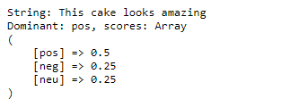
Results of Naïve Bayes ?

Slide 25
Finalizing the Result and Output
We make use of Google Chart Tools to show the sentiment in graphical Representation.
What's Google Chart ?
Its Tools provide a perfect way to visualize data on any webpage , charts maybe static or interactive,
in our project we used Interactive Charts which Use the Google Visualization API.
why interactive charts?
are far more flexible, because they can trigger events which we can use to interact with other elements in the page .

Slide 26
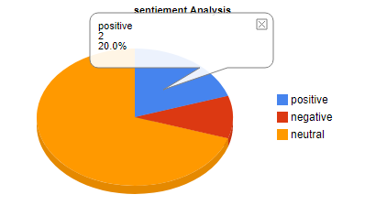
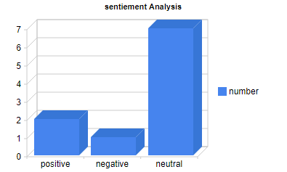
Result !
Pi-chart and column-chart both generated using the same data table :

Slide 27
Demo

Slide 28
Future work !
We will try to develop our website to have more features such as:
Web-Application can be converted to Mobile Application.
Sentiments analysis using Arabic words.
Integrate with other social media as google+ .
Have more benefits provided by social media API’S which service marketing like schedule tweets and posts .

Slide 29
Any Questions?
Thank you!

