Slide 1


A Study for Designing a Layout of a Washing Machine Assembly Line in Palestine
An-Najah National University
Faculty of Engineering and Information Technology
Industrial Engineering Department
Graduation Project ( II )
Submitted by:
Wafaa Fawzi Ziada
…
Supervisor Name: Dr. Muawia Tahseen Ramadan

Slide 2
Outline
Introduction
GP1 Overview
Methodology
Product & Process Design
Results & Analysis
FMEA
Conclusion

Slide 3
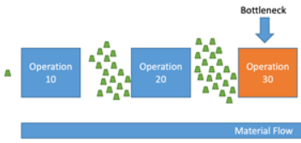




introduction
Problem statement | a poorly designed layout.
Project Objective | arranging workstations. optimizing the flow of materials.

Slide 4
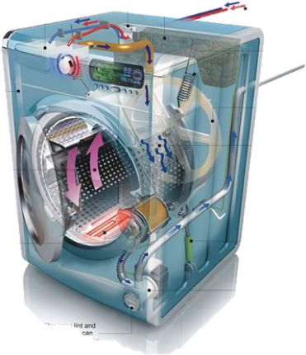
GP1 Overview
BOM
companies
•National Industrialization Company cover body, drum.
Flow process charts
FBC operating system
solid works
•Draw Internal parts
FBC production line
• dimensions

Slide 5



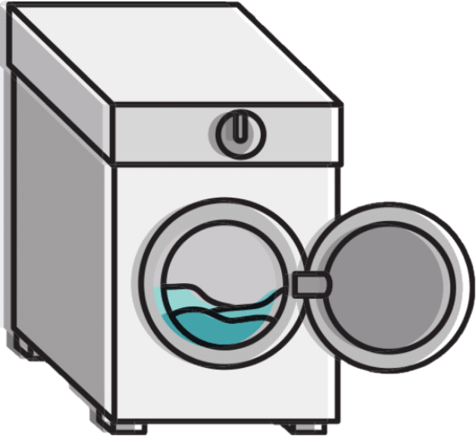

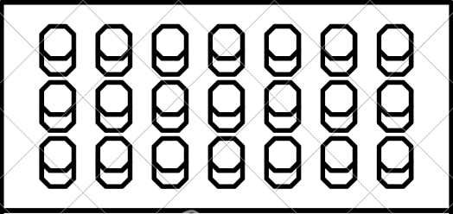



Methodology
Market study
-population-
Demand value
production rate
Dimensions
Layout(manufacturing line, assembly line)

Slide 6

Product & Process Design
Product Design

Slide 7
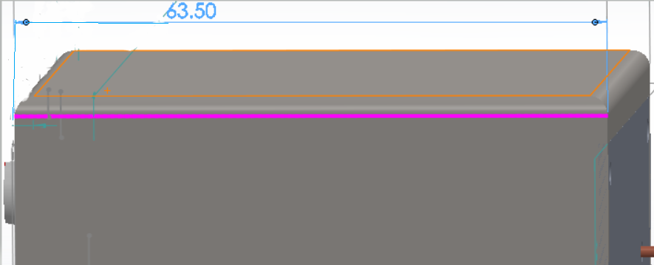
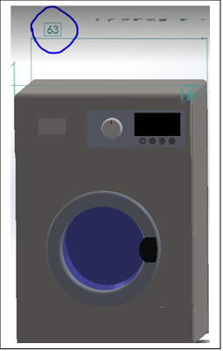
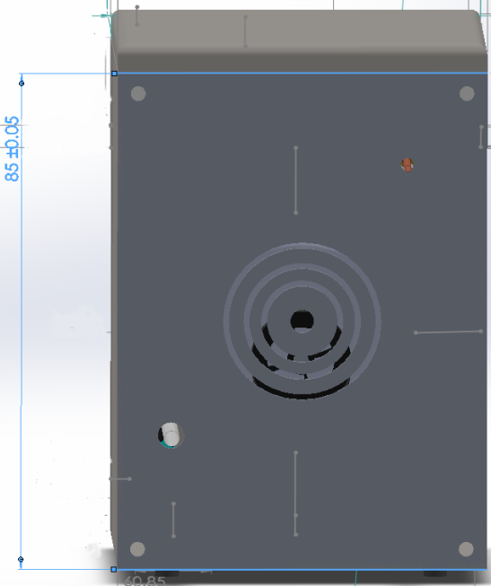
• Basic dimensions
Notes:
Basic dimensions

Slide 8
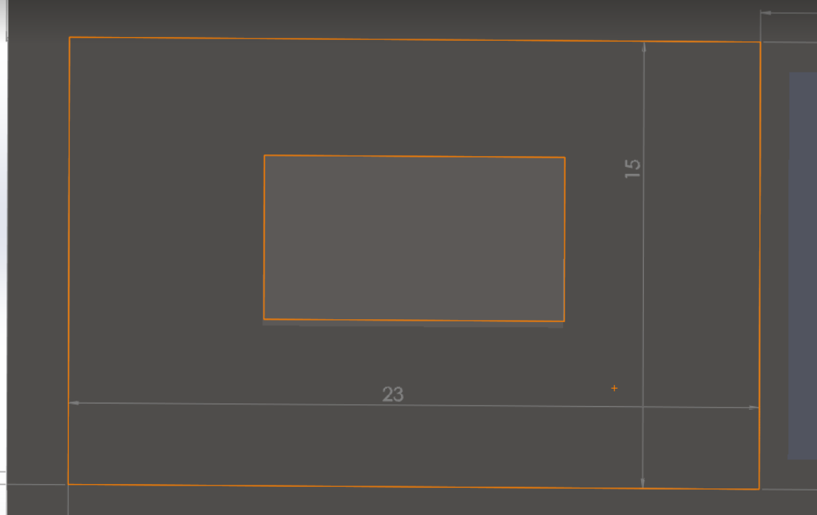
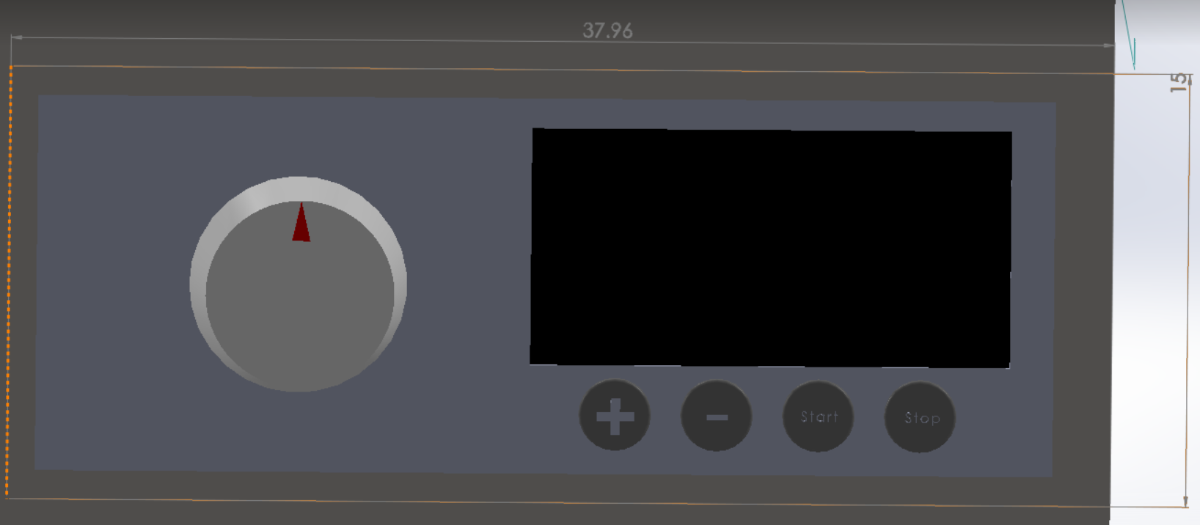
• Detergent Drawer Dimensions
• Control Panel Dimensions
Notes:
Detergent drawer dimensions

Slide 9
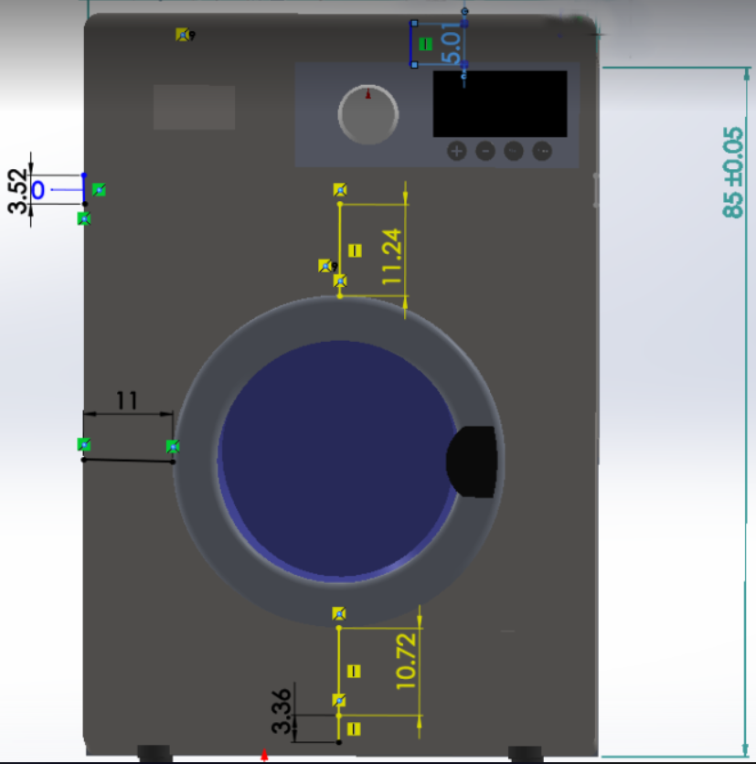
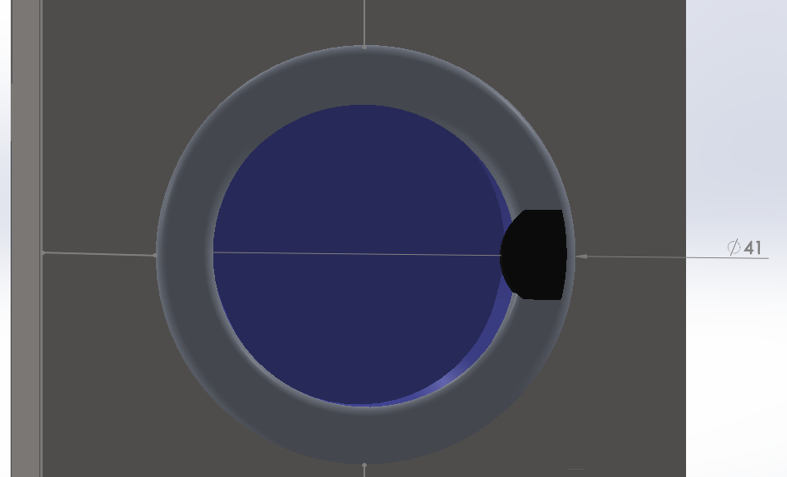
Door to the cover body, door-to-control panel, door-to-base sheet
Notes:
Door to body, door to control panel, door to base sheet

Slide 10
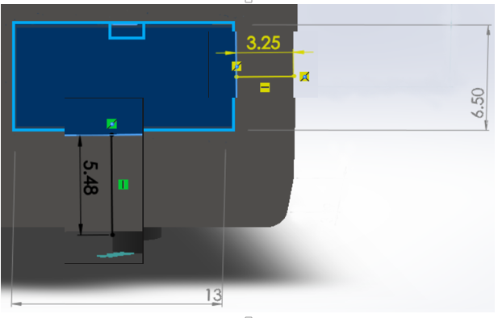

feet diameter dimensions
water filter dimensions

Slide 11
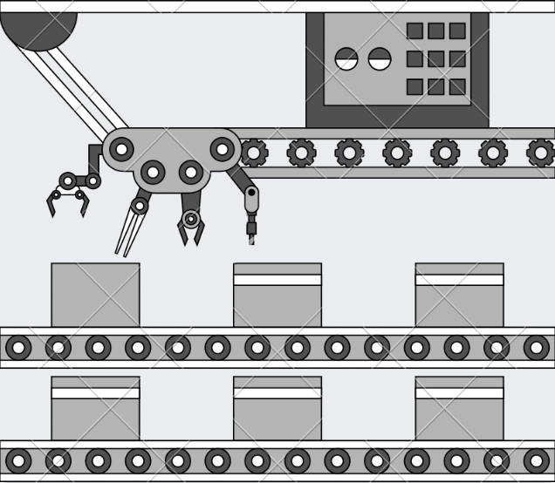
Product & Process Design
process Design

Slide 12
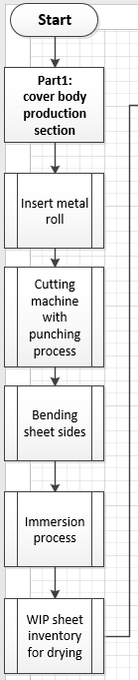
The first part is the Manufacturing line

Slide 13
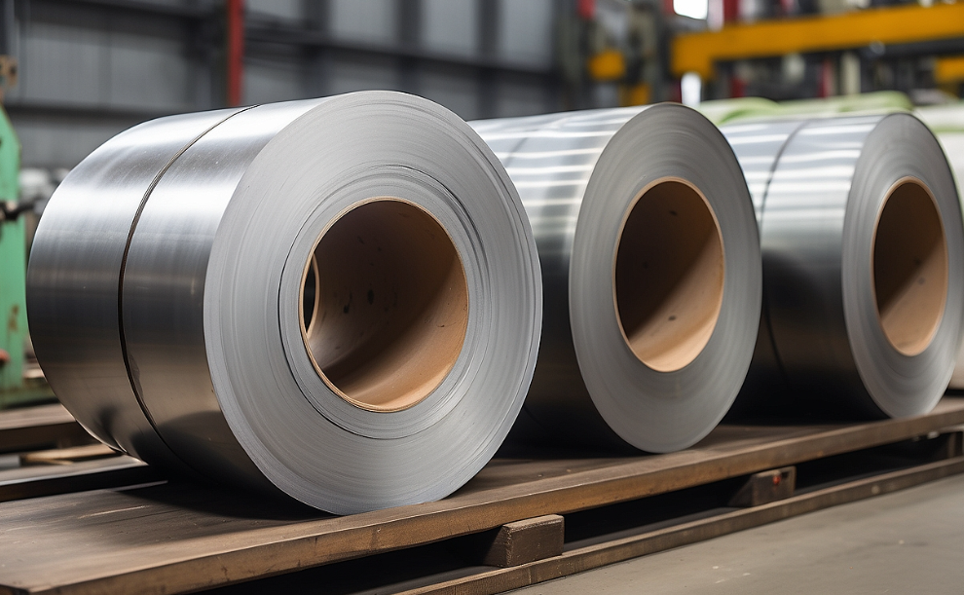
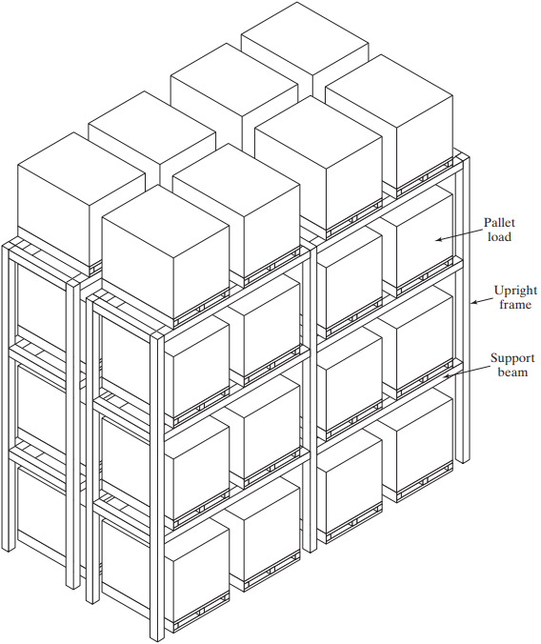
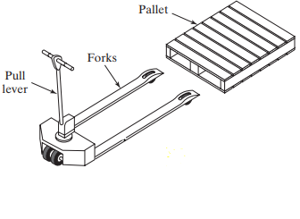
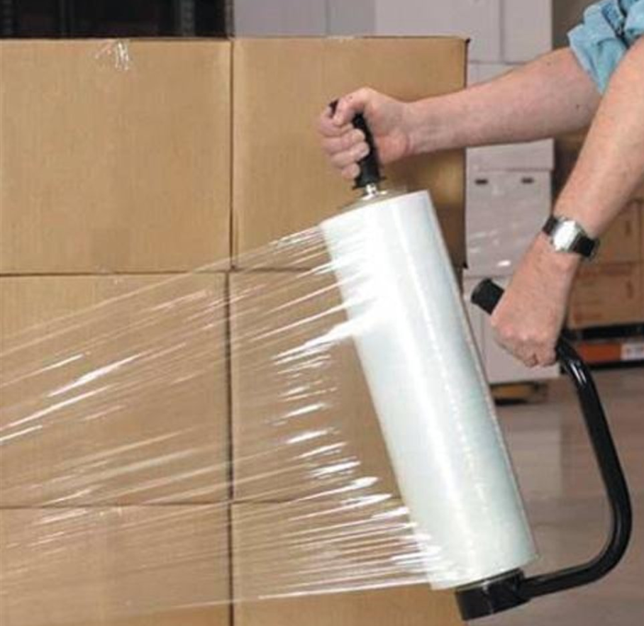
v
Sheet metal rolls
rack system
forklift
Nylon wrapper

Slide 14
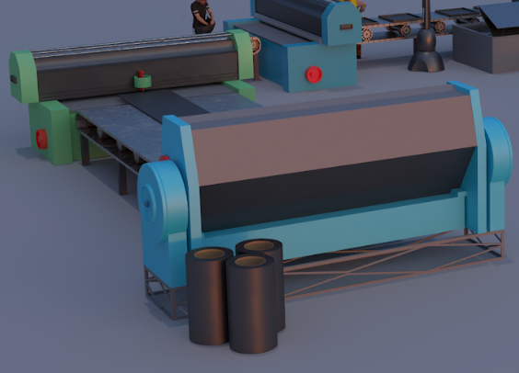
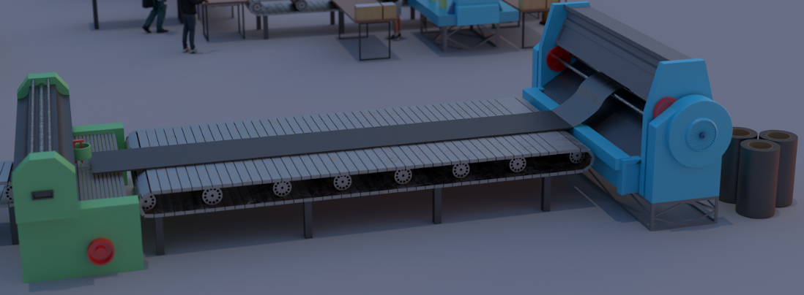

Slide 15
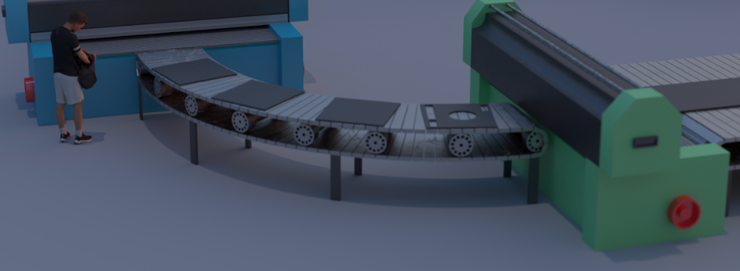
Cutting and bunching output

Slide 16
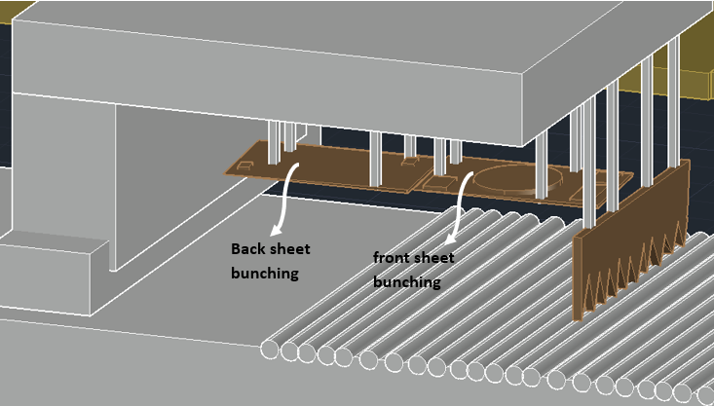
bunching

Slide 17
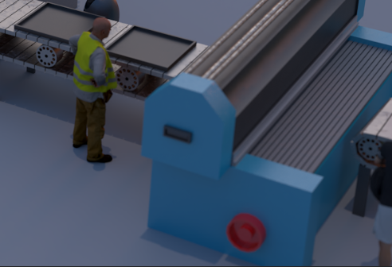
bending process

Slide 18
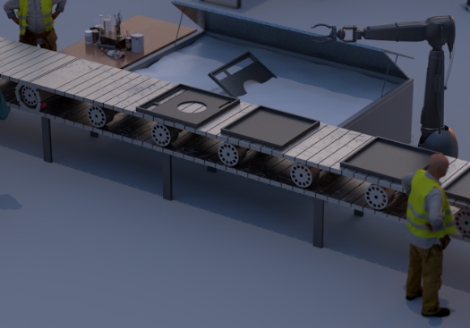
immersion process

Slide 19
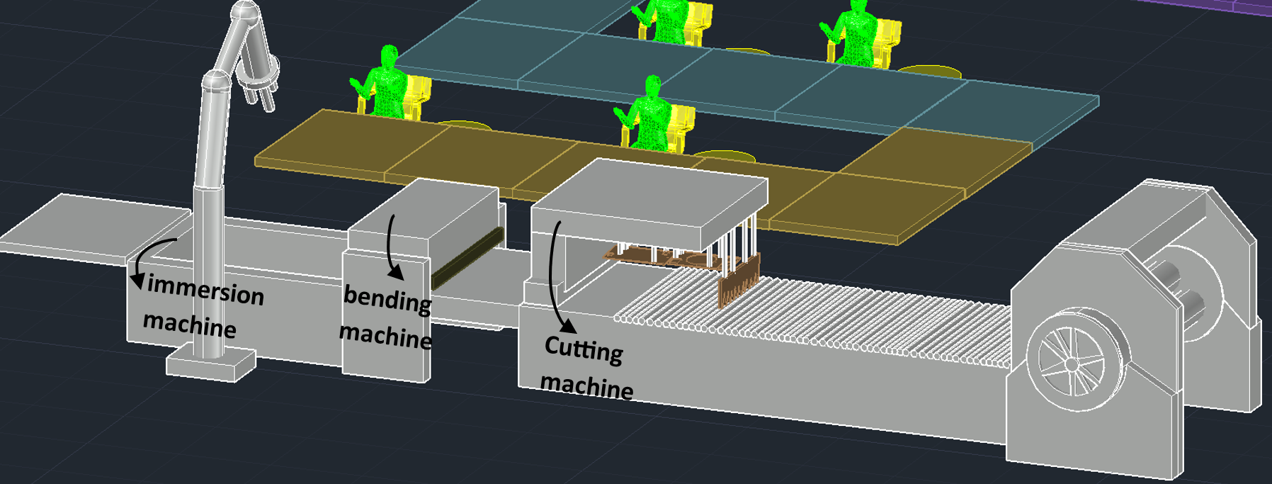

Slide 20
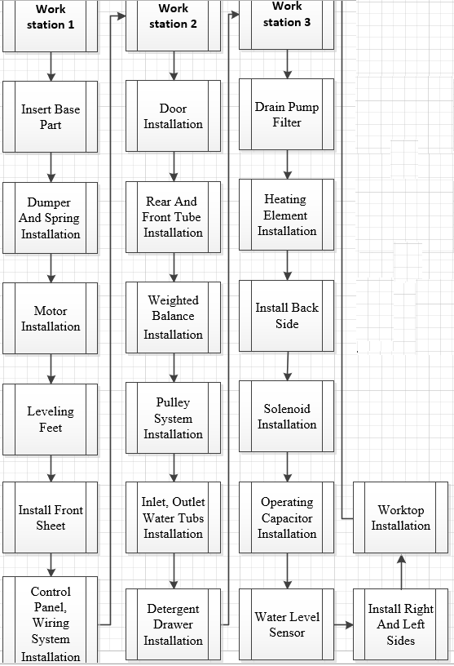
Assembly line part

Slide 21
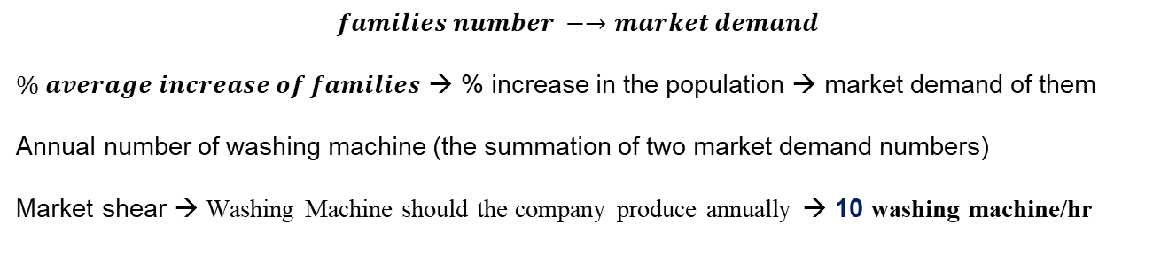
calculations
$$families number −→market demand$$
$\% average increase of families$ → % increase in the population → market demand of them
Annual number of washing machine (the summation of two market demand numbers)
Market shear → Washing Machine should the company produce annually → 10 washing machine/hr

Slide 22
Largest candidate rule
Station Number | Process Number | Process Time | Station Time (minute) | Workers Distribution
1 | E1 | 0.25 | 3.35 | 1 Basic, 1 assistant
 | E4 | 0.8
 | E8 | 0.8
 | E19 | 0.5
 | E2 | 0.2
 | E11 | 0.8
2 | E3 | 0.6 | 3.55 | 1 Basic, 1 assistant
 | E5 | 0.45
 | E6 | 0.6
 | E9 | 0.6
 | E12 | 0.6
 | E13 | 0.7
3 | E14 | 0.7 | 3.7 | 1 Basic, 1 assistant
 | E7 | 0.5
 | E10 | 0.25
 | E15 | 0.5
 | E16 | 0.5
 | E17 | 0.5
 | E18 | 0.5
 | E20 | 0.25

Slide 23
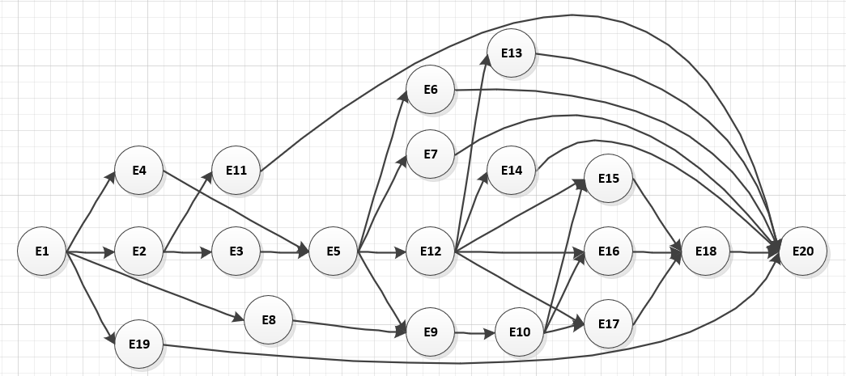
Station Number | Process Name
“Station 1” | Insert Base Part
 | Dumper And Spring Installation
 | Motor Installation
 | Leveling Feet
 | Install Front Sheet
 | Control Panel, Wiring System Installation
“Station 2” | Door Installation
 | Rear And Front Tube Installation
 | Weighted Balance Installation
 | Pulley System Installation
 | Inlet, Outlet Water Tubs Installation
 | Detergent Drawer Installation
“Station 3” | Drain Pump Filter
 | Heating Element Installation
 | Install Back Side
 | Solenoid Installation
 | Operating Capacitor Installation
 | Water Level Sensor
 | Install Right And Left Sides
 | Worktop Installation
Process Precedence diagram network

Slide 24
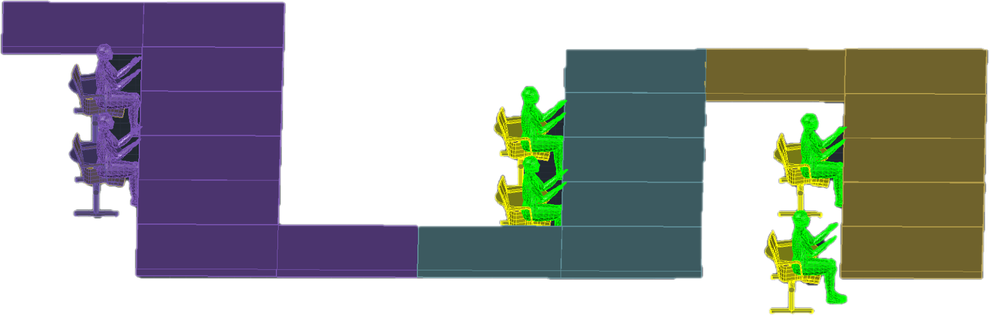
-the first station has 6 processes.
- the second station also has 6 processes.
- the third and last station has 8 processes.

Slide 25
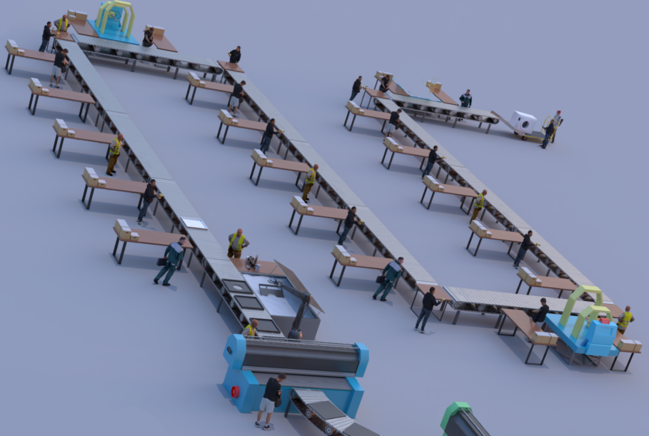

assembly line started with the base part
assembly line using 3D MAX

Slide 26
Results & Analysis
Comparison
Factor | Manufacturing line | Assembly line | Difference
Cycle time | 1.12 minute | 4.8 minute | 3.68 minute
Processes number | 3 processes | 20 process | 17 process
Automated level | Fully automated line | Manual line
Manufacturing line faster than assembly line
One day of the week for the Manufacturing line
2400 sheet for the manufacturing line day
10mach/hr | 80 | mach/day
 | 400 | mach/wk
 | 2400 | sheet/wk
solution

Slide 27

Departments:
1. Raw material inventory, rolls, and parts, packaging tools.
2. WIP, buffer finished sheets inventory.
3. Finished product inventory.
4. Manufacturing department.
5. Assembly department.
6. Inspection department.
7. Packaging department.
8. Management office.

Slide 28
Based on a qualitative understanding of the sequence
 | To
From | - | 1 | 2 | 3 | 4 | 5 | 6 | 7 | 8
 | 1 | - | U | U | A | A | I | E | O
 | 2 |  | - | U | A | A | I | U | O
 | 3 |  |  | - | U | A | U | A | O
 | 4 |  |  |  | - | U | U | U | O
 | 5 |  |  |  |  | - | A | U | O
 | 6 |  |  |  |  |  | - | A | I
 | 7 |  |  |  |  |  |  | - | O
 | 8 |  |  |  |  |  |  |  | -
Rating | Closeness relationships values
A | Absolutely necessary
E | Especially important
I | Important
O | Ordinary closeness
U | unimportant
from to chart departments table

Slide 29
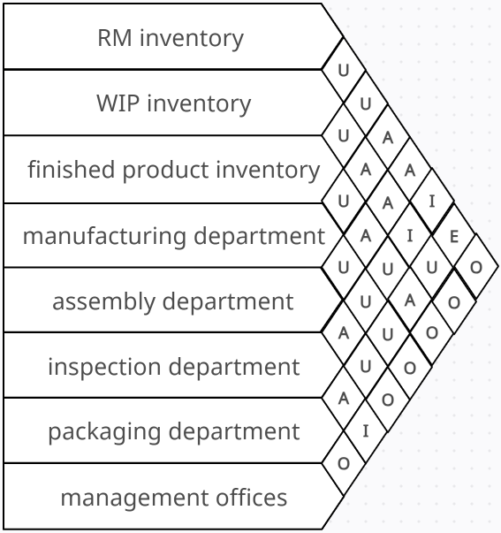
activity relationship chart

Slide 30
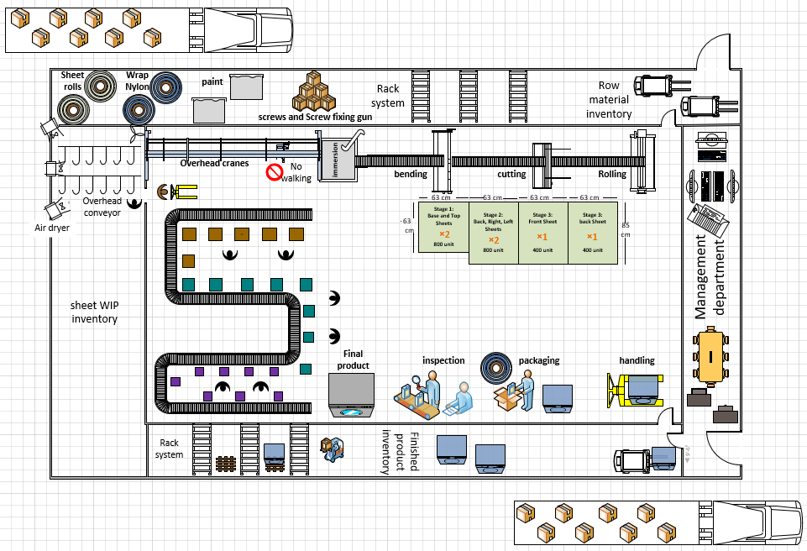
VISIO

Slide 31
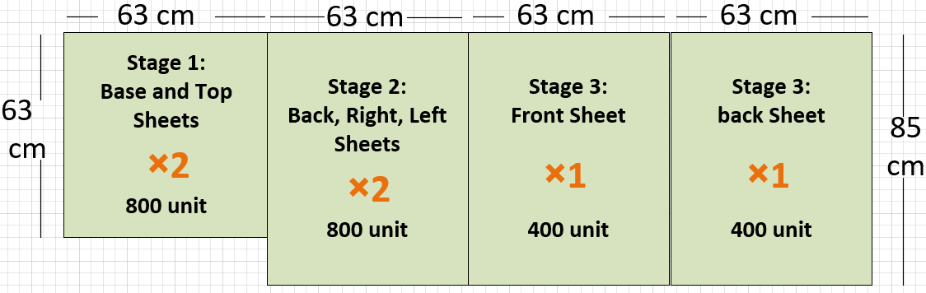
sheets sequence, dimensions, and quantities
Each 63 cm cutting occurs two times for the base and top
two times for right and left
one time for the front
one time for back

Slide 32
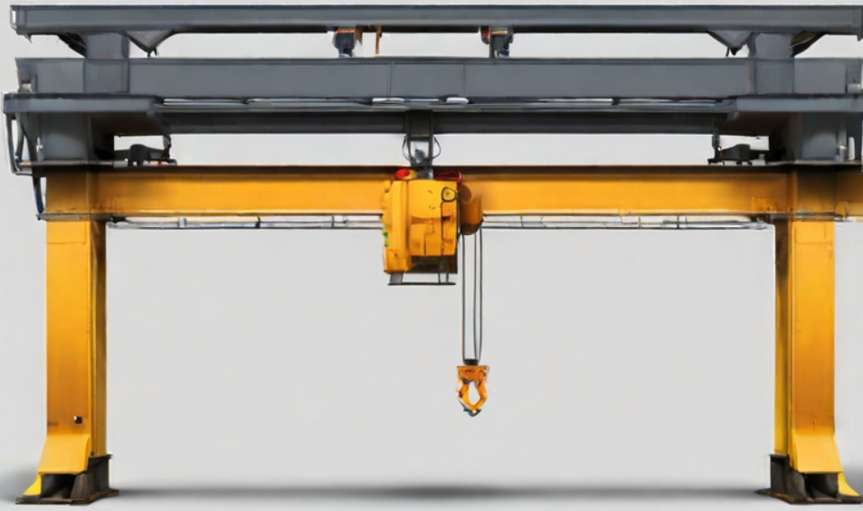
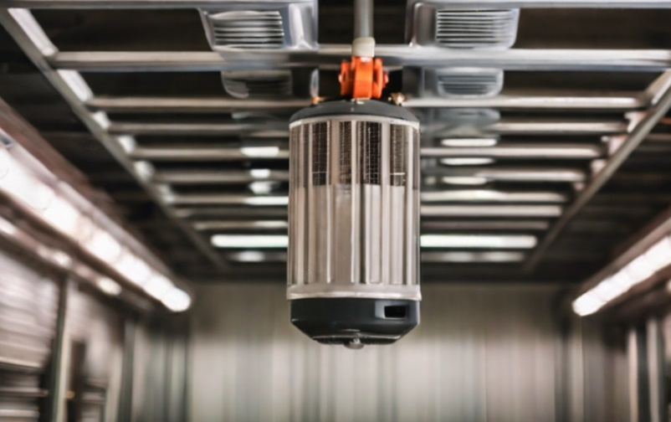
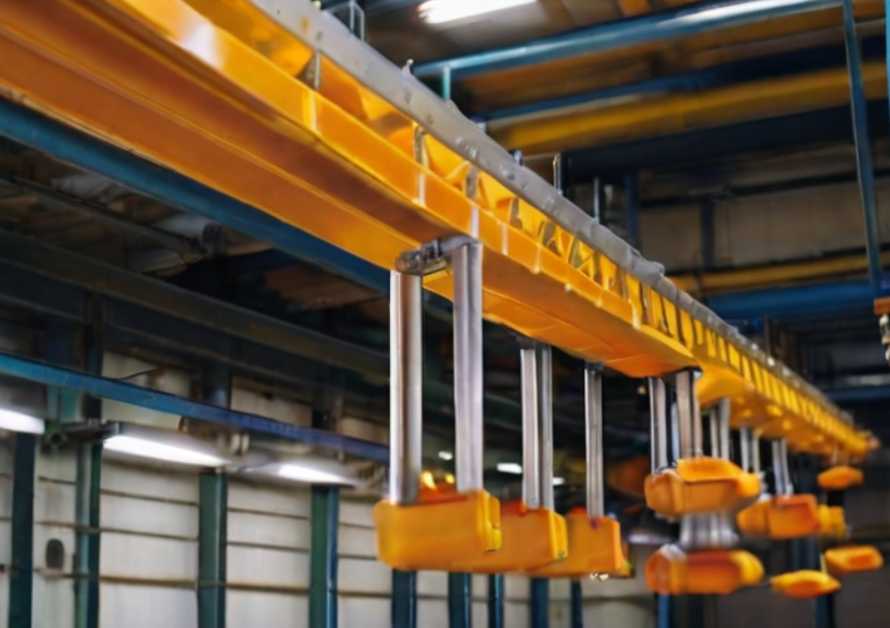
air dryer
Overhead cranes
overhead conveyor WIP sheet inventory

Slide 33
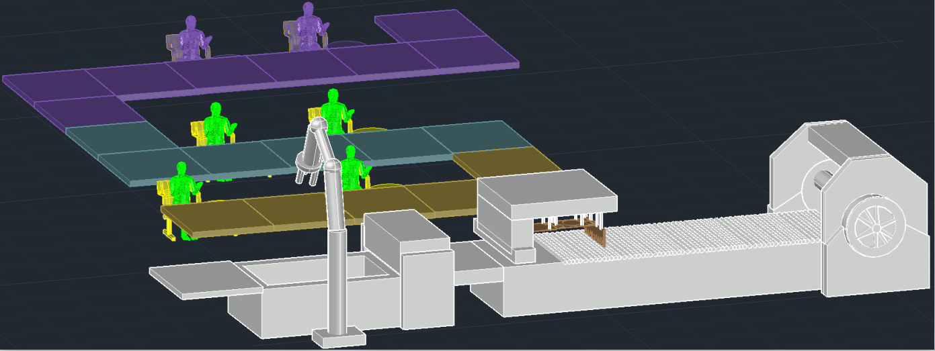

Slide 34
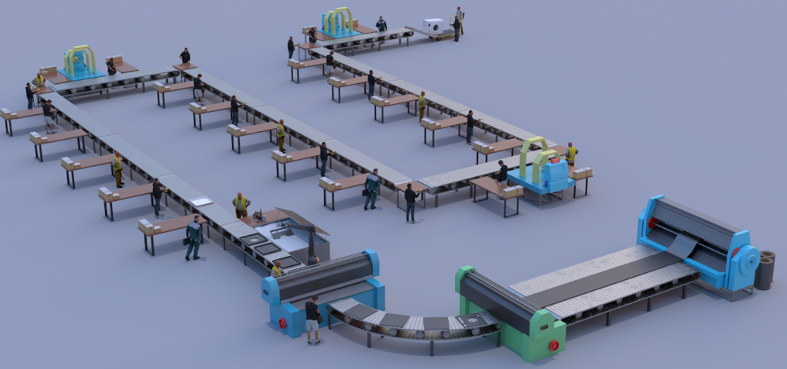

Slide 35
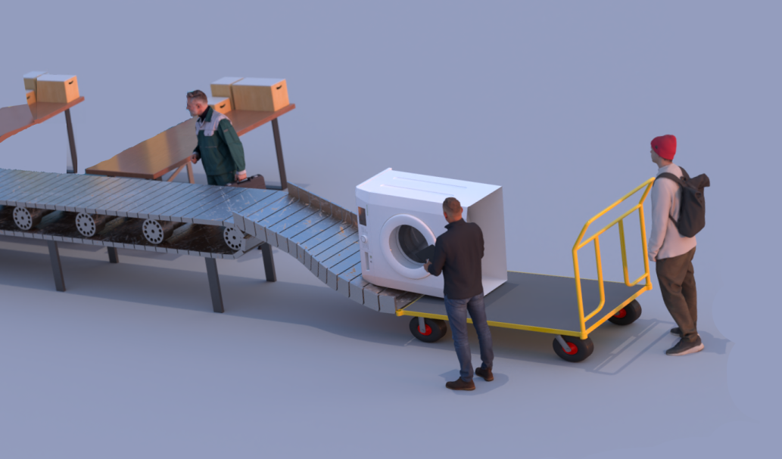
inspection and packaging

Slide 36

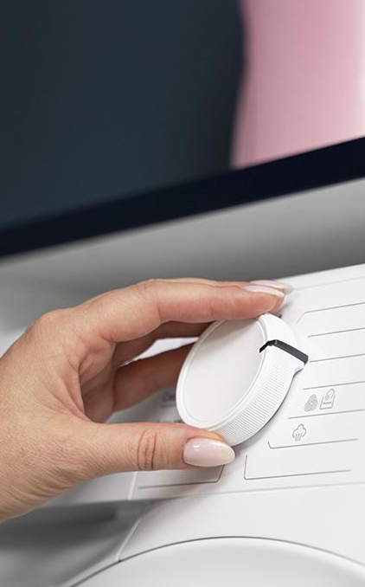
Failure Mode Effect Analysis
FMEA

Slide 37



3 factors
 | Severity (S) | Probability of Occurrence (O) | Detection (D)
meaning | impact of a failure | The probability that failure will occur. | failure can be detected before it causes harm
Scale 1 | negligible impact (Low impact) | highly improbable | effective detection
Scale 10 | catastrophic impact (Highly impact) | indicating almost certain | ineffective detection

Slide 38
Process number | Part name | Potentail Failure
1 | Cover Body | Inadequate material properties.
2 | detergent drawer | Clogging
 |  | Mold and Mildew Growth
3 | Door | Leaking Door
 |  | Misalignment
4 | Drum | Drum Doesn't Spin
 |  | Loud Noises during Spin Cycle
5 | pump filtter | Closed pump Filter
 |  | Leaks
6 | belt and pully | Belt Damage
 |  | Drum Not Spinning

Slide 39
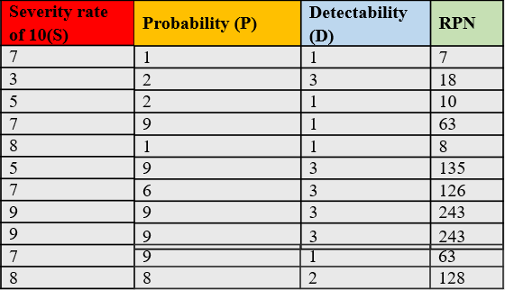
The indicator is Risk Priority Number
part name | Current Control
Cover Body | Material Defects, using low-quality materials.
detergent drawer | molds and tooling can wear out which leads to musty.
Door | Water Leakage due to gasket problems.
Drum | Welding Defects, incomplete welds
pump filtter | Using low-quality filter materials
belt and pully | Lack of effective quality control measures can result in defects in belts and pulleys.
For the example:
S→ impact of a failure is High impact (7)
P→ The probability that failure will occur is highly improbable (1)
D→ detecting the failure before it causes harm is effective detection (1)

Slide 40
Corrective Actions | S | P | D | R
replace the material | 4 | 1 | 1 | 4
Quality inspection for the incoming materials. | 1 | 1 | 1 | 1
Machine setup is done by qualified engineer | 3 | 1 | 1 | 3
Inspect the rubber gasket around the door for any visible cracks If you find any damage, it may need to be replaced | 4 | 6 | 1 | 24
tighten the screws and ensure that the door closes | 4 | 1 | 1 | 4
Inspect the belt for any signs of damage and replace it if necessary | 3 | 6 | 1 | 18
replace the bearings, Make sure your laundry load is evenly distributed in the drum | 4 | 3 | 1 | 12
Clean it by removing any sticking objects | 4 | 3 | 1 | 12
Replace any damaged components as needed | 4 | 4 | 1 | 16
replacement belt is needed | 3 | 4 | 1 | 12
Inspect the belt for any signs of damage and replace it if necessary | 4 | 4 | 1 | 16
Risk Priority Number, RPN = Severity (S) x Probability of Occurrence (O) x Detection (D)
Positive result
RPN was reduced
from rate 7 → rate 4

Slide 41


Slide 42



conclusion
strong basis for the establishment

Slide 43



