Slide 1
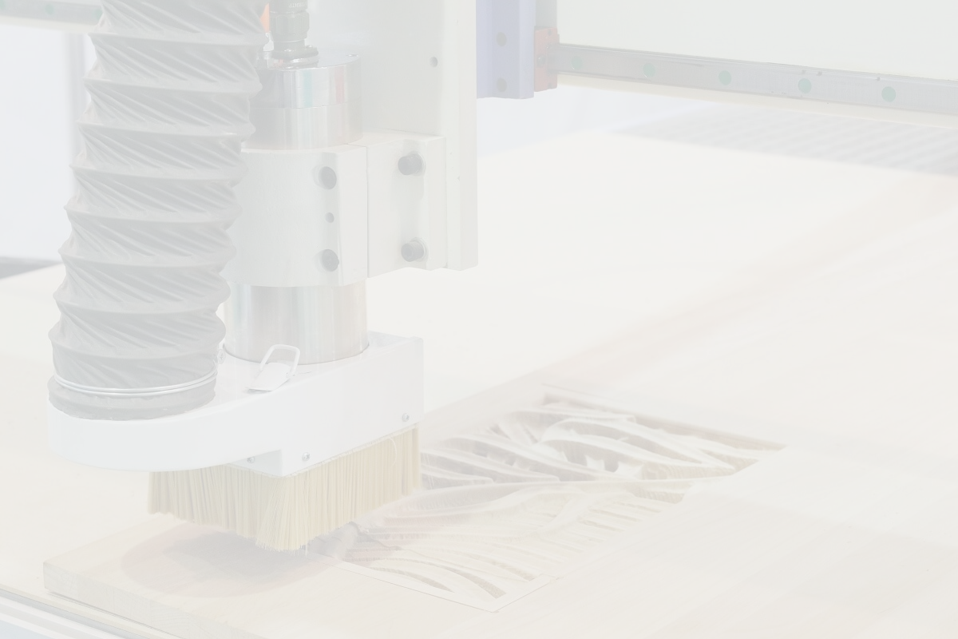

A MOBILE CNC MACHINE DESIGNED FOR ENGRAVING WOOD PANELS
Goliath CNC Machine.
GRADUATION PROJECT 2
By:
  YAZAN JABER
  Maen shalabi
  WALAA SADEQ
1
SUPERVISED BY: DR. BASHEER NOURI

Slide 2

  Table of content:
01
Motivation & Problem statement
02
Proposed Solutions
03
CNC Milling Machine Mobile Robot Design
04
Robot Control Design
05
Conclusion
2
06
Limitations and Future Work

Slide 3
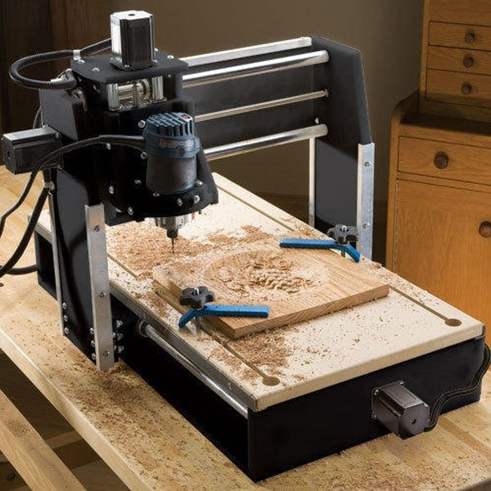
  Motivation & Problem statement
01
Wood CNC Machines
A wood CNC machine is a specialized tool used for cutting, carving, and shaping wood. These machines are equipped with a spindle motor that holds cutting tools, allowing for intricate designs and accurate woodwork.
3

Slide 4
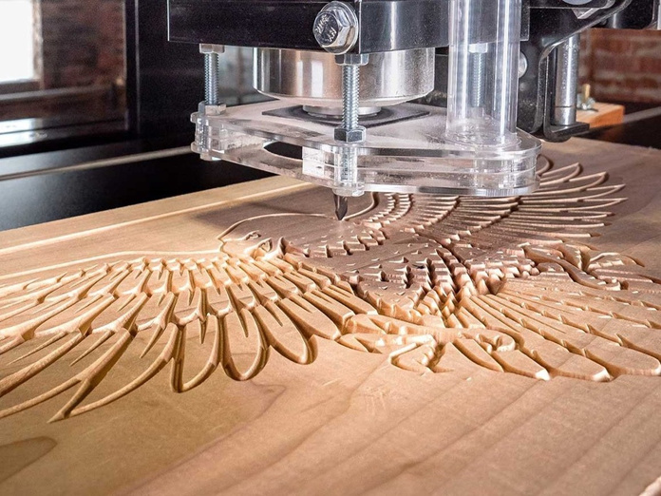
  Motivation & Problem statement
01
Wood CNC Machines
Wood CNC machines offer several advantages in woodworking and related industries:
  High precision in design
2. Versatility in Design
3. Reduced Labor Intensity
4

Slide 5
  Motivation & Problem statement
01
Wood CNC machines Limitation
However, wood CNC machines come with certain problems and limitations. The size of the workpiece that a CNC milling machine can accommodate is restricted by the machine's dimensions. Larger workpieces may require specialized, and potentially more expensive, equipment.
Furthermore, the initial cost and maintenance of CNC machines can be high, making them less accessible for smaller woodworking businesses.
5

Slide 6
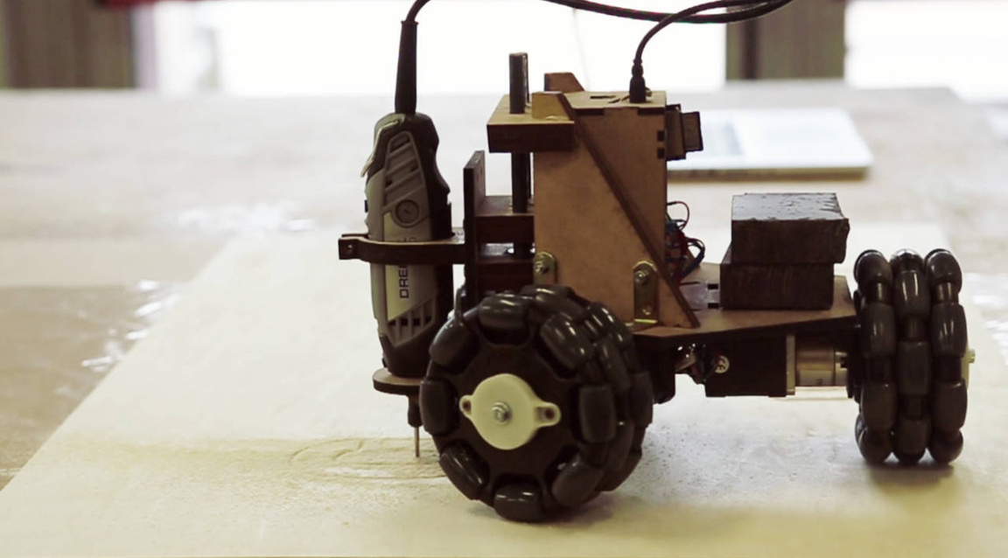
  Motivation & Problem statement
01
  Motivation
1. Portability
2. Autonomous Operation
3. Low power consumption
4. Save time
5. Versatility
6. User-Friendly Interface
6

Slide 7
2. Proposed Solutions
02
  Proposed Solutions
Goliath CNC Machine
7

Slide 8
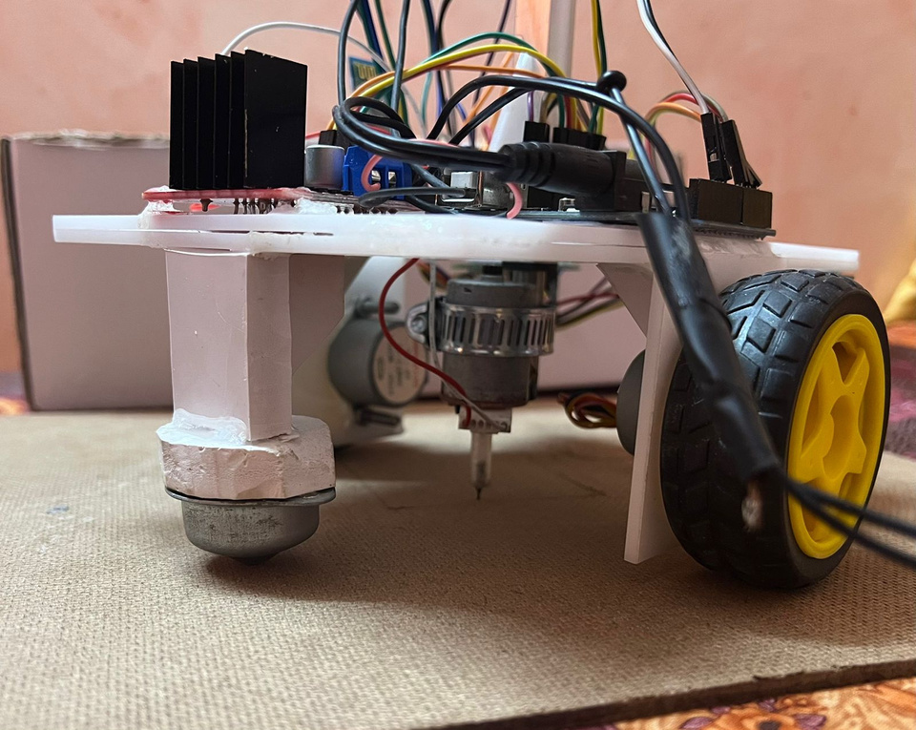
2. Proposed Solutions : Goliath CNC Machine
A
Goliath CNC Machine
Goliath represents a paradigm shift in CNC milling, seamlessly integrating autonomous capabilities that redefine the way we approach machining processes.
8

Slide 9
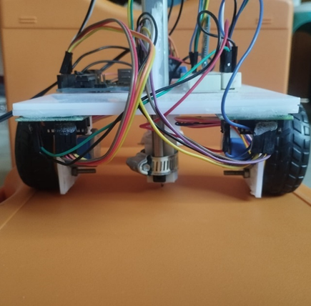
2. Proposed Solutions : Goliath CNC Machine
02
Goliath CNC Machine
With Goliath, we are redefining the possibilities of CNC milling, paving the way for a more efficient, productive, and autonomous future in the world of machining technology.
The calculations of equations allow the robot to interpret G-code and convert it into motor movements based on distance and angle, ensuring precise path control using two stepper motors in coordination. The robot uses both motors together to generate X-Y movements rather than controlling X and Y independently.
9

Slide 10
3. CNC Milling Machine Mobile Robot Design:
03
    CNC Milling Machine Mobile Robot Design
A. Mechanical design: Goliath CNC Machine
B. Electrical/Electronics System
C. Control System
10

Slide 11
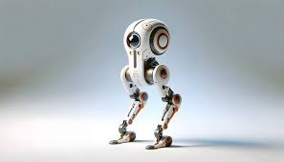
3. CNC Milling Machine Mobile Robot Design: A. Mechanical Design
A
    Mechanical Design
The mechanical design plays a crucial role in advanced manufacturing and automation, serving as a foundation for precision, efficiency, and versatility. These robots, guided by Computer Numerical Control, seamlessly integrate intricate mechanical components with cutting-edge technologies to achieve precise and automated motion. The design encompasses various elements, including robust frames, precise actuators, and sophisticated end-effectors that define the robots' operational capabilities.
11

Slide 12
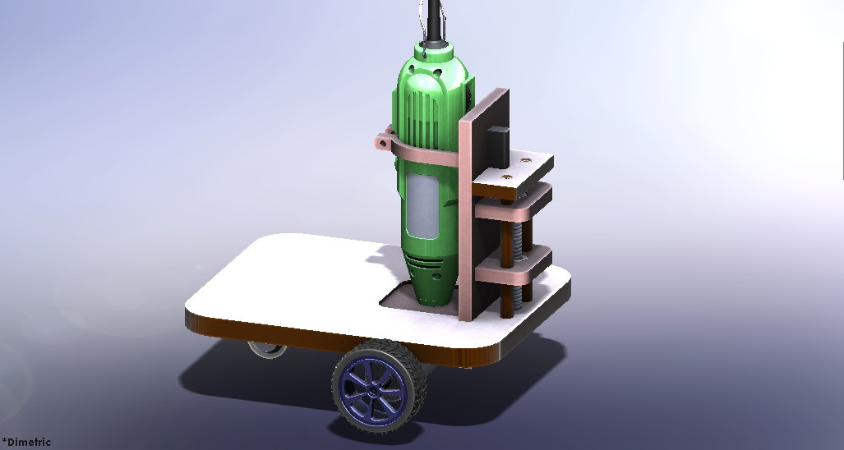
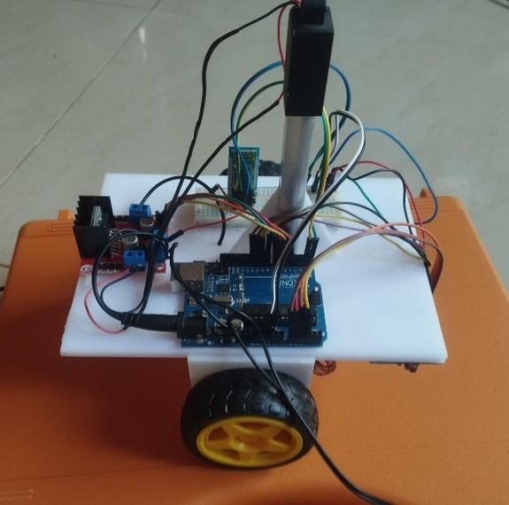
3. CNC Milling Machine Mobile Robot Design: A. Mechanical Design
03
  Mechanical Design: Goliath CNC Machine
We used SolidWorks to design the robot in the one project. In the second project we implemented it:
12

Slide 13
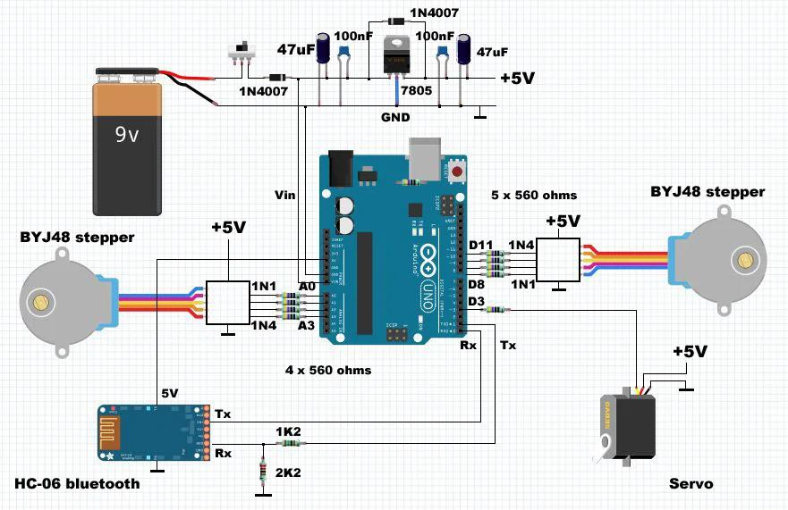
3. CNC Milling Machine Mobile Robot Design: B. Electrical Design
B
  Electrical/Electronics System
13

Slide 14
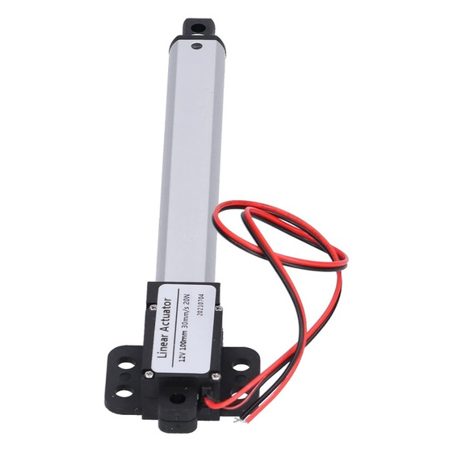
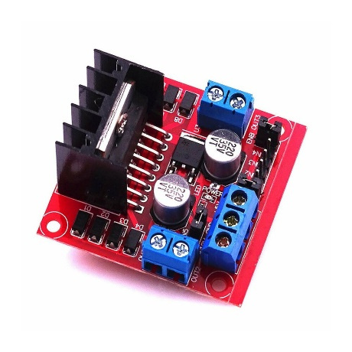
3. CNC Milling Machine Mobile Robot Design B. Electrical Design
03
  Electrical/Electronics System
14

Slide 15
4. Robot Control Design
04
  Robot Control Design
1. Reference Generation: Gcode
2. Robot Movement Mechanism
15

Slide 16
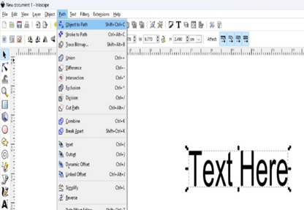
4. Robot Control Design: A. Reference Generation
A
Reference Generation
Inkscape
Various software tools can facilitate this conversion. Notable examples like Inkscape with Gcodetools extension. These tools enable the translation of graphical designs into the G-Code instructions needed for the CNC robot to execute the specified movements.
16

Slide 17
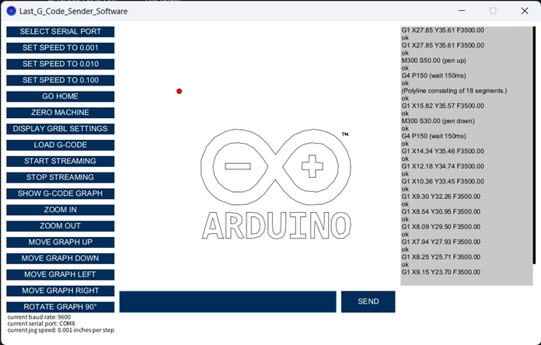
4. Robot Control Design: A. Reference Generation
A
  Custom Interface
G.Code
The G-Code instructions contain information about the desired movements, speeds, and tool actions. The mobile robot's processor translates these commands into specific voltages to drive the motors and the spindle. This translation process is critical for accurately reproducing the graphical design on the wood.
17

Slide 18
4. Robot Control Design: B. Robot Movement Mechanism
B
  Robot Movement Mechanism
The robot has two stepper motors: These motors operate independently, allowing for motion in 2D space. This setup enables diagonal, horizontal, and vertical movements, effectively controlling the robot's position across both X and Y coordinates.
The movement depends on:
  Pulse Input
2. Step Angle
3. Feedback Systems
18

Slide 19

5. Conclusion
05
    Conclusion
Built upon a robust modular chassis, Goliath is designed for easy customization and scalability, ensuring it can adapt to evolving industry demands. Its autonomous features are complemented by an array of safety measures, guaranteeing secure and reliable operation in diverse environments.
19

Slide 20
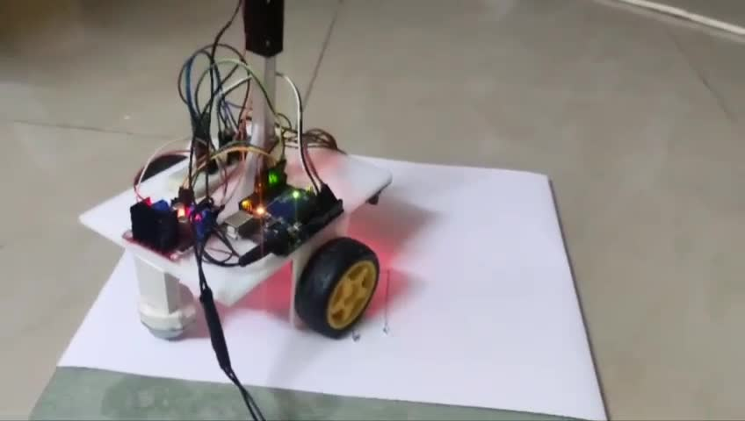
5. Conclusion
20

Slide 21
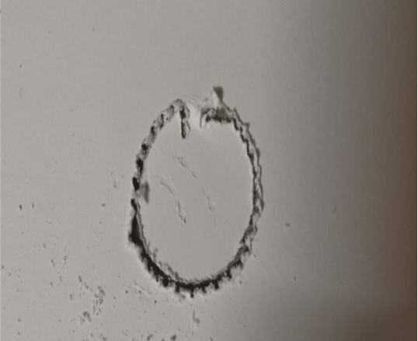
6. Limitations and Future Work
A
  Limitation
Based on the result, we noticed some bumps on the wood due to the wheels being exposed to high force during operation.
21

Slide 22
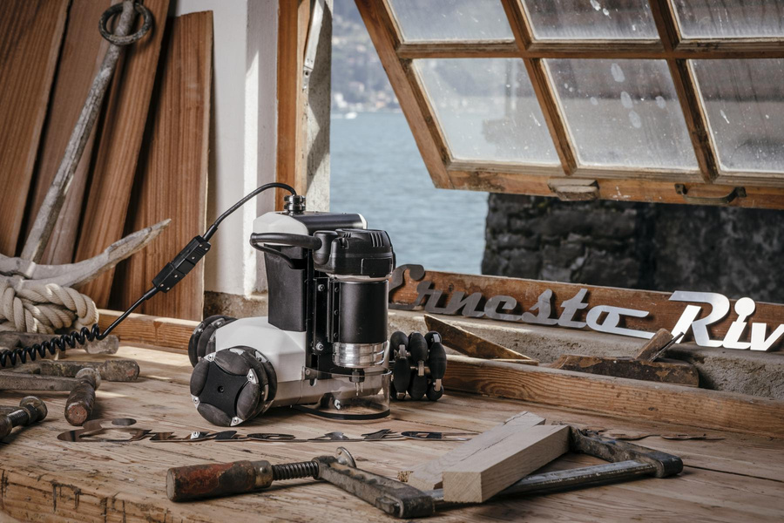
6. Limitations and Future Work
B
  Future Work
In the future, the wheels should be changed to get the best result and for the robot to operate flexibly and smoothly. In addition, we suggest adding a dust extraction pump.
22

Slide 23
THANK YOU!
23

