Slide 1

An-Najah National University faculty of Engineering and Information Technology
Civil engineering department
Methods of Composting

Slide 2
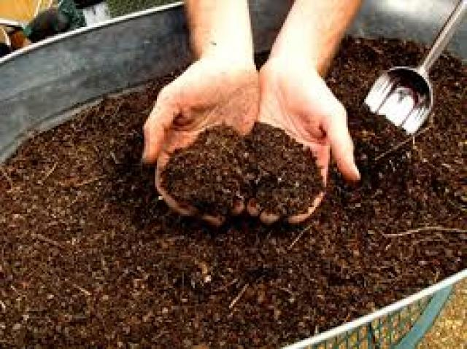
Introduction
Our project studies the importance of organic fertilizer and its impact on agricultural production through several methods. such as:
1-lifting Units.
2- Field compost.
3- Tunnels way.
4- Rotary Unit Method.
5- The piles.

Slide 3
Project description
After several studies that we have conducted to study organic fertilizers. These studies included several areas in the West Bank and also included places where compost is manufactured. Through these studies, the methods in which compost is manufactured were known, in addition to collecting observations from farmers on one hand and manufacturers on the other.

Slide 4
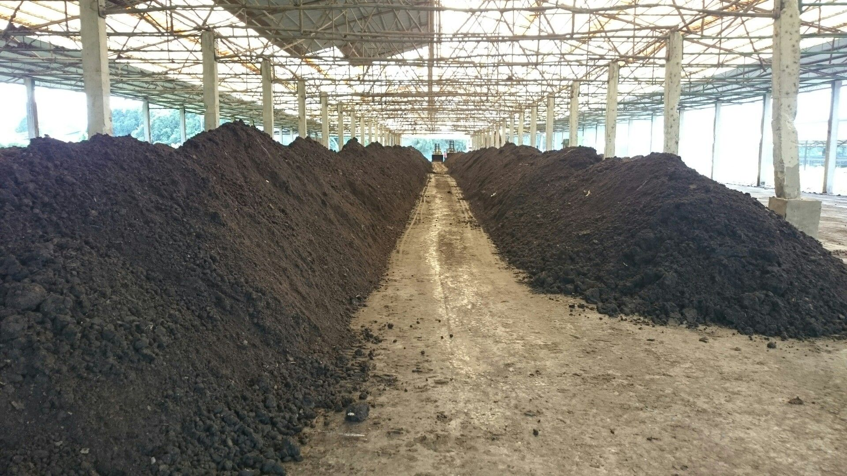
MANUFACTURE COMPOST

Slide 5
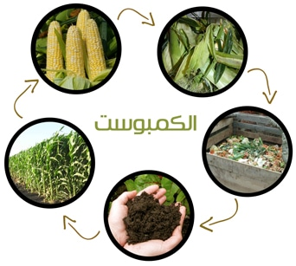
Lifting Units
The main objective of compost manufacturing is to obtain organic fertilizer instead of chemical fertilizer with high efficiency and to improve the properties of the soil, taking into account the required specifications in terms of good smell.
The good thing is that this method can be manufactured inside the house, as it does not need a large area

Slide 6
Compost steps
1- Residues are collected from inside and outside the house, such as food leftovers, vegetables, animal waste and tree leaves, taking into account avoiding animal fats that are found in bones and meat because they can bring mice and snakes.
2- Care is taken to collect nitrogen-rich wastes because this helps plant growth after its penetration into the soil and this leads to increased production, also taking into account the collection of carbon-rich materials and this would provide the appropriate environment for the growth of microorganisms that play an important role in the decomposition process and for this reason the percentage of carbon must be maintained 30 times greater than that of nitrogen.

Slide 7
3- In order to maintain this ratio, a green layer is placed between two brown layers, taking into account that the first layer and the last layer should be of the brown layer.
4- Any piece inside the mixture larger than 5 centimeters must be cut before the fermentation process.
5- The layers must be 10 to 15 centimeters thick, whether for the brown layers that rich in carbon or the green layers that are rich in nitrogen. After that, mixing is started to maintain homogeneity and water is added to maintain moisture.

Slide 8
6- It is allowed to add soil to the unit to help increase the number of microorganisms that helps decompose the added materials.
7- The unit must be stirred periodically every week to ensure that moisture has reached all parts of the unit.
8- In the end, the final product is obtained. Compost, and this process takes three to five months.

Slide 9
Characteristics
The final product is characterized by the original characteristics of compost, as it is brown in color and smells like wet dirt and the humidity in it is from 20 to 30 percent and its temperature is five degrees higher than the temperature of the surrounding.

Slide 10
Disadvantages
One of the disadvantages of this method is that during the fermentation process there is a very unpleasant smell and this can be due to the presence of animal waste in addition to fatty materials such as meat and bones.

Slide 11
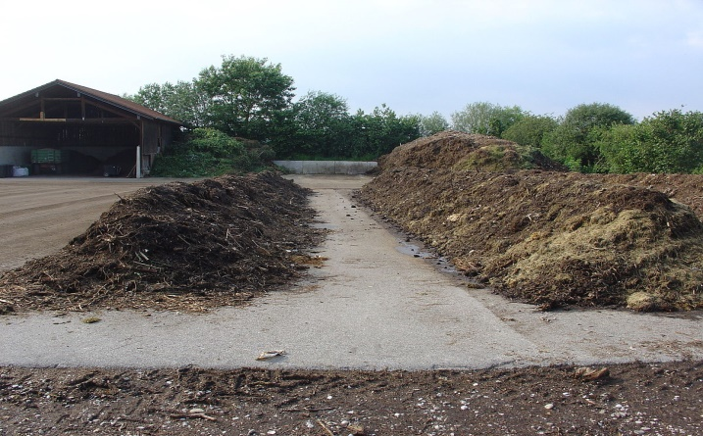
Field Compost
Organic waste of plant or animal origin shall be collected in the place where these wastes are located in the field. This method is characterized as being the least costly than other methods, as there is no need to transport this waste to another place. It is usually farmers, after trimming the trees that the pruned branches are left on the ground and with the presence of the appropriate factors of humidity and temperature these plant wastes turn into organic fertilizer over time.

Slide 12
Compost steps
1- It is preferable to choose an area of ​​land that is flat with a slight tendency to drain excess water and free of rocks so that it does not mix in the final product and be easy to work on.
2- Also, this area of ​​the land should be close to the place of collection, packaging and distribution.
3- Securing a nearby water source to be used in the fermentation process later.

Slide 13
4- Taking into account that the best place is under the trees shadows or industrial shades to avoid direct sunlight in the summer especially .
that can affect the quality of the final product, while making sure that the air reaches from all sides.
5- The layers are built in a hierarchical form with a base of 2 to 2.5 meters and a height of 1.5 to 2 meters.
6- If there are stuck pieces of plastic materials and fabrics, they must be disposed of.

Slide 14
7-An organic pyramid is built from several layers on top of each other from organic waste such as tree leaves, where an area of ​​land is chosen and sprinkled with water before placing the pyramid on it, a thick layer of solid waste is placed at the base, followed by another thick layer of animal waste with a thickness of three centimeters It is also sprinkled with water, a layer of poultry waste 15 centimeters thick, then a layer of mature organic fertilizer 15 centimeters thick and sprinkled with water and finally a layer of green residues 31centimetersthick.
8 - These layers are repeated until they reach a height of 2 meters.
9- Then it is covered with a layer of soil 5 to 10 centimeters thick. The aim of this layer is to prevent the spread of flies and insects.
10- You must follow up and stir periodically and spray it with water. To speed up this process, a bacterial liquid is sprayed during the stirring. This process takes 2.5 to 3 months in summer and 4 months in winter

Slide 15
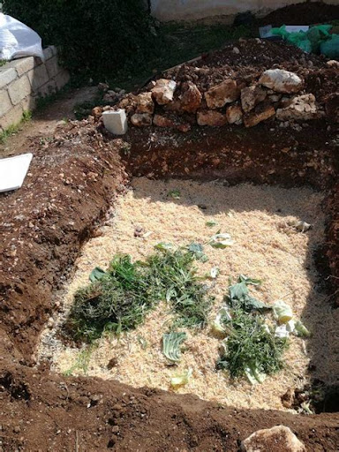
Tunnels way
It is another way to make compost. This method is done in agricultural places or in remote places, taking into account some specific needs in both cases, and this method has proven its effectiveness and low cost because working with it is in the same agricultural area. Here we need some equipment to dig the tunnel.

Slide 16
Compost steps
1- Tunnel digging, and this process aims to provide a suitable place for compost production in the same agricultural area. This tunnel is dug along the agricultural land itself, with a depth of 30 centimeters and a width of 40 centimeters. Then, the organic material to be converted into compost is placed inside it, taking into account the appropriate conditions for decomposition.
In the case of using this method in remote areas, the quantity of production must be increased, and for this purpose, the tunnel is dug in a larger size, with a length of 3 meters, a width of 1.5 to 2 meters, and a depth of 50 to 90 centimeters. If in this case we need heavy equipment to dig such a tunnel and to pour organic materials inside it ,
2- The next step is in both cases in case of digging the tunnel in the near or far areas, which is to create the appropriate conditions for decomposition.

Slide 17
3- We put a layer of rough wood at the bottom of the tunnel, a thickness of 5 to 10 centimeters, to ensure good ventilation in the tunnel.
4- A layer of dry plants is placed 5 cm thick and saturated with water.
5- A layer of green plants is placed, in addition to kitchen waste, with a thickness of 10 centimeters.

Slide 18
6- Then a layer of animal dung is placed, especially cows, chickens and rabbits, as it contains a high percentage of nitrogen.
7- A layer of soil is placed covering all these layers in order to prevent the spread of insects and unpleasant smells, and it is also sprayed with water.
8- These materials are stirred on a weekly basis and sprinkled with water when necessary, in order to maintain the degree of humidity.

Slide 19
Signs of a mature end product
1- When it is not possible to distinguish between the original materials that were used in the manufacture of compost.
2- The volume of the original materials is almost halved.
3- The resulting mixture shall have a decomposing texture and shall be smooth in texture and composition.
4- The composition of the mixture is coherent and smells like the smell of soil.
5- It is gray in color and tends to dark brown.

Slide 20
The benefits
It is preferable to use this method because it makes the process of making compost much easier than making it in the same agricultural area. Therefore, there is no need to take into account the ventilation and moisture in this method,
in addition to the fact that the tunnel provides the plants close to it with food as the roots of these plants make their way into the tunnel and thus these roots become more strong and able to withstand harsh conditions such as lack of food or drought Also.

Slide 21
Advantages
one of the advantages of this method is that the compost is invisible and buried under a layer of soil, and this eliminates the unpleasant odors drawn with the fermentation processes.

Slide 22
Uses
This method is used in several cases, including the incision of tunnels next to each row of plants, so that these plants can benefit from the nutrients found in this tunnel.

Slide 23
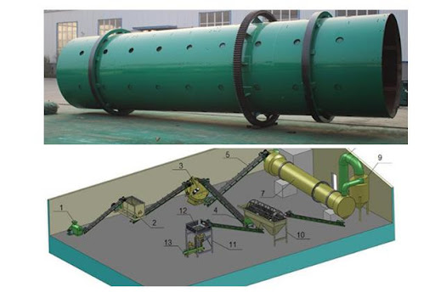
Rotary Unit Method
This method depends mainly on the machine, which is a barrel made of polyethylene, which is the material surrounding the barrel, and its characteristics are that it provides thermal insulation.
as maintaining the temperature resulting from the fermentation process is very important, in order to speed up the process of transformation from organic matters to fertilizer that can be used.

Slide 24
Explaining
These barrels come with a capacity of 60 liters and in different colors. Each barrel contains five fins that are used in the stirring process. The degree of rotation is determined using the cracks on the surface of the barrel, which also determine the depth of material landing inside the barrel.
leftovers, vegetables, fruits and tree leaves are placed inside it
This barrel is able to meet the compost needs of one house, taking into account that 3 to 4 people need to fill the cylinder completely and as quickly as possible, so that the fermentation process start in the same period.
The cylinder can be filled to 80% of its capacity and you must leave enough space 20 to 30 percent of the size of the cylinder for the stirring process.

Slide 25
This method may bring fly and insects, but with good ventilation and exposure to sunlight, they cannot survive.
And to carry out the fermentation process, the barrel is well rotated using the grooves inside it, and thus we get a good fermentation because the ingredients were mixed well and an appropriate distribution of moisture.
In addition, the process of stirring helps to support the bacteria with each other and this leads to their multiplication and be in equal proportions throughout the barrel.
After a month of continuous stirring, a pleasant smell begins to emerge from the barrel.

Slide 26
The pleasant smell needs 9 weeks to start appearing, but an accelerator can be added to the fermentation process, which is microbial cells that multiply quickly and work to decompose organic matters very fast, and thus we can get a period of 3 to 4 weeks.
To get rid of the unpleasant odor from the presence of holes in the barrel that work to strengthen and get rid of anaerobic microbes, if any.
The barrel is raised on a 1.5-foot stand to avoid rodents, but small holes on the wall of the barrel may allow entry to small ants. In the event that the barrel is exposed to rain, the small opening does not affect the fermentation process much, because the increase in the amount of water entering from these small openings into the mixture is almost negligible. However, it is preferable that the barrel be in a closed place.

Slide 27
Advantages
One of the advantages of this method is that it can be used at home and supply the barrel with waste products from the house to produce compost,
and the waste can be collected inside it for long periods, and thus we get compost for a short period if we follow the correct steps and use the accelerator on the fermentation process.

Slide 28
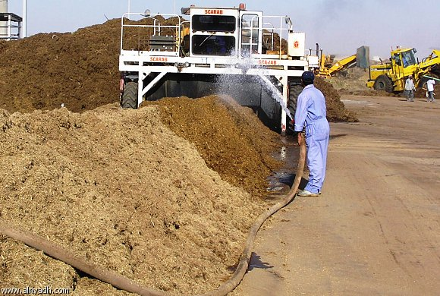
The piles
This method is very suitable for the production of compost in large quantities, where animal waste is piled up in the form of scattered piles.

Slide 29
Explaining
Taking into account the presence of pores to ventilate and increase the level of oxygen and mix between hot and cold areas inside the heap
And the temperature is monitored and recorded inside the heaps to find the right time to turn the heap every time, thus speeding up the process of obtaining the compost.
There are machines specialized in the stirring process, which are very large, 4 feet wide and 12 feet high. This machine slowly advances towards the piles, and it is equipped with paddles that work to overturn the layers saturated with oxygen into the pile. And take out the layers that are not saturated with oxygen to the outside.

Slide 30
And the humidity inside the heap ranges from 50 to 60 percent.
The manufacturing process lasts from 3 to 4 months, and the temperature reaches 25 to 75 degrees Celsius Where the duration of the first month and a half there is no permanent movement of the heap and then turned over once every one week and spray it with water, and in some cases it is not sprayed

Slide 31
Disadvantages
Because this method is used in open areas, it is more vulnerable than others to the unpleasant smell. In addition to unpleasant odors, it brings rodents and insects, and this is one of its disadvantages

Slide 32
The difference between the five methods in terms of Place of manufacture
 | Lifting units | Field compost | Tunnels method | Rotating units | Piles method
Place of manufacture | Inside the house or anywhere | Piles of tree leaves are made in the same place after being cut. | It is manufactured in the place of cultivation or in remote places. | Polyethylene barrels are used in the place of cultivation or any nearby place, and they can be made at home and use only the waste of the house. | Animal waste is collected in the form of piles in agricultural areas or in places close to them.

Slide 33
The difference between the five methods in terms of costs
 | Lifting units | Field compost | Tunnels method | Rotating units | Piles method
Costs | The cost is very low. The required waste can be obtained from leftovers, vegetables, tree leaves and organic waste. | They are considered the least expensive than other methods and the least cost of transportation. They are not considered expensive at all because the trees and their leaves are cut in the same place and placed in the form of a piles or pyramids of compost | This method has proven to be effective and low in cost, especially if it is used in places close to agricultural land, but it needs equipment and machinery to dig the tunnel, but this requires a lot of effort and time. | The use of this method is rather expensive because it requires the presence of barrels made of polyethylene to provide the thermal insulation property. | This method requires time and effort, but it is considered relatively cheap.

Slide 34
The difference between the five methods in terms of Sources
 | Lifting units | Field compost | Tunnels method | Rotating units | Piles method
Sources | Organic waste from the house or even from outside the house, such as food leftovers, tree leaves and animal dung | Remains of plant or animal origin (these remains remain in the places where they were collected) | A rough layer consisting of tree branches and roots, followed by a layer of green plants, then a layer of animal waste and kitchen waste. | leftovers, leaves of trees and vegetables are placed in this barrel in order for the fermentation process to take place inside, after which these organic materials are transformed into fertilizer. | Dung and animal waste are piled up in the form of piles

Slide 35
The difference between the five methods in terms of Smells
 | Lifting units | Field compost | Tunnels method | Rotating units | Piles method
Smells | It smells like soil | A layer of soil is placed on top of it, 5 to 10 centimeters thick, to prevent the spread of unpleasant odor and flies. | Here a layer of soil is also placed as a superficial layer covering the components of the compost and this prevents unpleasant odors and prevents the spread of flies, where the smell is often similar to the smell of wet soil. | To get rid of the unpleasant odors that come out of these barrels, there are ventilation holes on the wall of the barrel, Having in mind that there is a heat insulator to speed up the operations | This method is considered an unpleasant smell because the waste is piled on top of each other, and also brings rodents, snakes, insects and flies.

Slide 36
After studying the methods of compost production and comparing them, we concluded that the best way to manufacture compost is the "field compost", and this method is considered the most suitable method for the conditions of our country in Palestine. It is the cheapest method in terms of costs as well as the easiest to manufacture, as this method is implemented by heaping the leaves of trees after cutting them in the same place. While the rest of the methods require equipment to transport from one place to another, and this is considered very expensive. Also, this method does not require much effort, as it is about heaping tree leaves in the form of piles or in the form of hierarchical layers. A final layer of soil with a thickness of 5 to 10 centimeters is placed to prevent the spread of unpleasant odors and thus prevent the spread of insects. Therefore, this method is considered the safest and least polluting method, so that the smell of compost becomes similar to the smell of soil.
At the end,
the method of " field compost " is considered to be the best method for the reasons that mentioned above.

