Slide 1
Design of Foundation for Sa’ada building in Nablus
Prepared by :
Hilda Abu Baker
Neama Khlouf
Raghad Saqf Alhait
Submitted to:
Dr. Muhammad Ghazal

Slide 2
Objectives:
General description of the project.
Structural system.
Geotechnical conditions of the site.
Design of two types of foundation.

Slide 3
General description of the project
The project is about designing appropriate foundation of a building in Almakhfeye Street which has very week soil so we will give suitable solutions for the problem in this soil under which building is constructed.

Slide 4
Structural System
Dead load:
We assume dead load equal 11KN/m² .
Live load.
we assume the value of live load 7KN/m² for ground floor and 3 KN/m² for other floors.

Slide 5
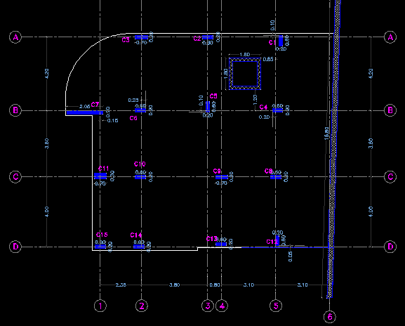
Columns layout

Slide 6
Loads on columns
We calculate loads by tributary area method and the results as follow

Slide 7
column number | col. Dim | P service | P ultimate
1 | 60*20 | 469.2 | 597.3
2 | 20*60 | 960.6 | 1231.1
3 | 20*70 | 1096.6 | 1411.2
4 | 20*60 | 898.2 | 1153.6
5 | 60*20 | 1636.8 | 2122.1
6 | 20*60 | 1621.7 | 2102.6
7 | 20*205 | 1302.9 | 1675.8
8 | 20*60 | 823.6 | 1057.8
9 | 20*70 | 1764.4 | 2287.6
10 | 20*60 | 1589.2 | 2060.5
11 | 30*70 | 681.4 | 870.6
12 | 60*20 | 458.8 | 585.1
13 | 20*60 | 1011.8 | 1297.7
14 | 20*60 | 904.7 | 1159.9
15 | 20*60 | 355.2 | 451.8
16 | shear wall | 482.6 | 625.7

Slide 8
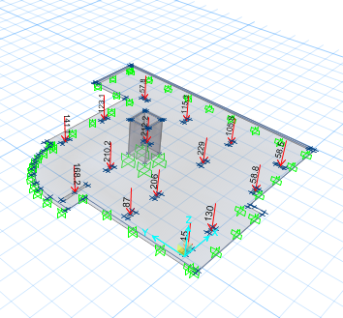
Also we determine the load by using SAFE program and the result as follow

Slide 9
In order to compare load from tributary area with safe load we take c13 and c14 as an example
C13:
%Error=(1297.664-1194)/1194=8.6% acceptable
C14:
%Error=(1159.8-1076.7)/1076.76=7.7% acceptable

Slide 10
Geotechnical Conditions of the site
The main soil description of the site states that it consist mainly of weak silty clay formation with occasional boulders to the full depth of exploration and the whole site is covered by a layer of fill material of rocks and boulders.

Slide 11
From soil investigation report we take:
ɸ = 19
C = 23 KN\m²
Unit weight for soil =18 KN\m³
Preliminary dimensions B=2m D=1.5m
Then we determine ultimate bearing capacity by Terzagi Equation
Then we determine allowable bearing capacity by take factor of safety equal 2.5.
We get qult = 505.5 KN/m²
qall=202KN/m² = 2.02 Kg/cm².
We use Qall = 220 KN/m²

Slide 12
Design of Foundation:
In our design we used two options, the first one was using the system of isolated and combined footing, and the second one was using the system of mat (raft) foundation.

Slide 13

Design of Foundation:
We found the preliminary area for each footing by using equation:
Where, qall = 220 KN/m²
And the results as follow:

Slide 14
Design of Foundation:
column number | P service | Area | L=B
1 | 469.2 | 2.1 | 1.5
2 | 960.6 | 4.4 | 2.1
3 | 1096.6 | 5.0 | 2.2
4 | 898.2 | 4.1 | 2.0
5 | 1636.8 | 7.4 | 2.7
6 | 1621.7 | 7.4 | 2.7
7 | 1302.9 | 5.9 | 2.4
8 | 823.6 | 3.7 | 1.9
9 | 1764.4 | 8.0 | 2.8
10 | 1589.2 | 7.2 | 2.7
11 | 681.4 | 3.1 | 1.8
12 | 458.8 | 2.1 | 1.4
13 | 1011.8 | 4.6 | 2.1
14 | 904.7 | 4.1 | 2.0
15 | 355.2 | 1.6 | 1.3

Slide 15
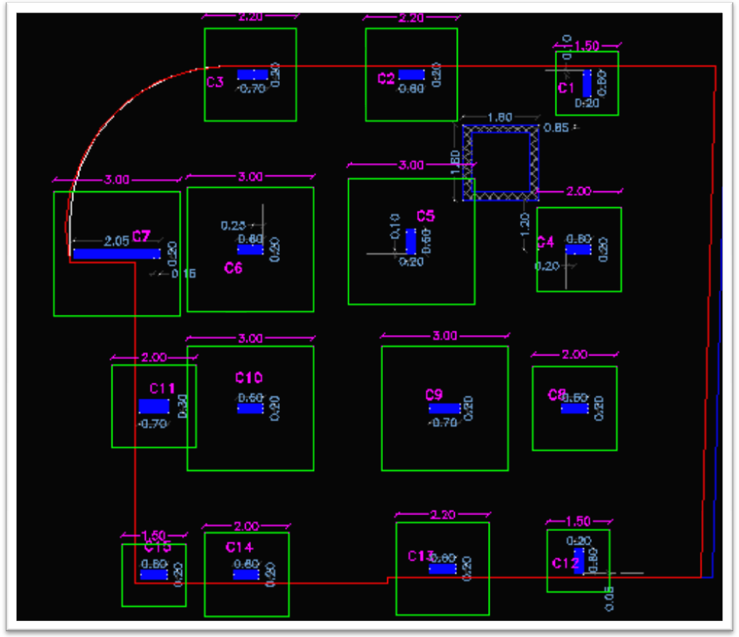
Design of Foundation:
Then we draw it using AutoCAD.

Slide 16
Design of Foundation:
System of isolated and combined footing:
For design purposes we tried to unifie the footing under columns with approximate equal loads, where:
F1 for C1, C12
F2 for C2, C3, C4, C8, C13
F3 for C5, C9
Where, F1 & F2 & F3 are combined footing
F4 for C7+C6
F5 for C10+C11
F6 for C14 +C15
Where, F4& F5 & F6 are combined footing
We designed the isolated and combined footing in the same system, and we use CDS program for design. We designed one footing manually to compare between the result.

Slide 17
Design of Foundation:
Design of isolated footing manually:
Take column 9 as an example:
Pservice = 1764 KN
Pultimate = 2288 KN
Qall=220 KN/m²
F’c=30 MPa
Fy = 420 MPa
col.dim. = 20*70 .
σmax = P/A ≤ Qall
A= 1764/220 = 8.02 m²
Assume B=2.5 m & L=8.02/2.5 = 3.2 m

Slide 18
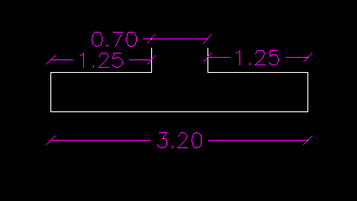
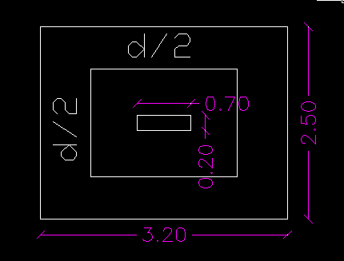
Design of Foundation:
Thickness:
Punching control
σmaxult = Pu/A = 2288/ (2.5*3.2) = 286 KN/m².

Slide 19



Design of Foundation:
b0 = 2*(700+d) + 2* (200+d) = 1800+4d
Vu= Pu = 2288 KN
H=550 mm.

Slide 20
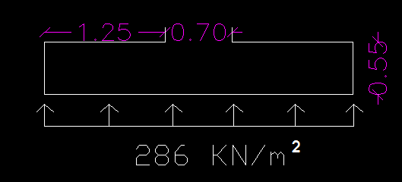


Design of Foundation:
Check this thickness for wide beam shear :
Vu = 286 *(1.25-0.5) = 214.5 KN/m

Slide 21



Design of Foundation:
Reinforcement:
Uniform stress equal 286 KN/m²
Long direction :
L=1.25 m
B=1000 mm ,, d =500 mm ,,h=550 mm
As = 0.00241 * 1000 * 500 = 1205 mm2/mm
Asmin = 0.0018*1000 *550 = 990
As > As min … use As

Slide 22



Design of Foundation:
Other direction :
L = 1.15 m
> As min
Longitudinal steel can be distributed uniformly :
As = 1205 mm²/ mm ,, use 6φ16 / m
Transverse steel : As = 1019 mm²/mm
Total As = 3.2 *1019 = 3567 mm²/mm
As2 = 3567 – 3129 = 438 mm²/ mm
As min = 0.0018 * 350 * 550 = 347 > (438/2) ,,, use As min

Slide 23
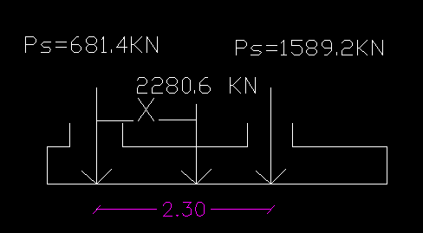


Design of Foundation:
Design of combined footing manually:
Take Column 11 & 10 as example :
681.4*0 +1589.2*2.3= 2280.6*X
X=1.6 m
Uniform stress σ max < Qall
,,, we assume B=2.3 m ,, L=4.5 m

Slide 24
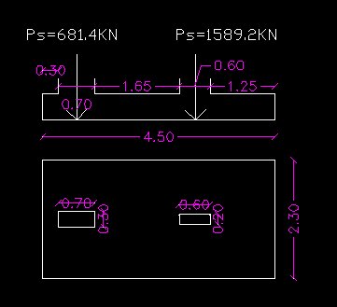
Design of Foundation:

Slide 25

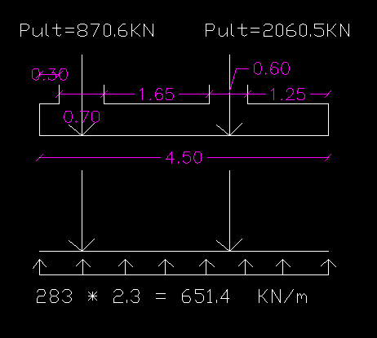
Design of Foundation:
Thickness :
For meter width = 283 * 2.3 = 651.4 KN/m

Slide 26
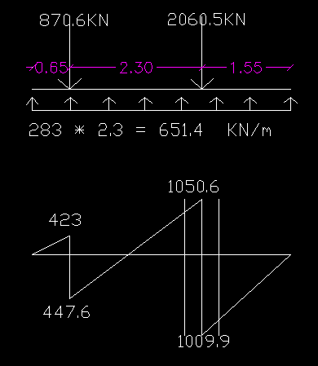
Design of Foundation:

Slide 27

Design of Foundation:
The critical is 1050.6 KN thus :
Vu=1050.6 – 651.4*(0.3+d/1000) = 855.2 - 0.6514d
d=0.384 m ,,, take d=0.5 m

Slide 28
Design of Foundation:
Result from program: (CDS)
Footing Design by CDS3mVer: the program CDS3mVer2 design the footing by assume dimensions and thickness for specific load which footing is exposed to it ,and this program gives if this dimensions satisfy Q_{all} and the punching is ok .In addition, it also gives another choices for dimension and thickness that suitable for design.

Slide 29
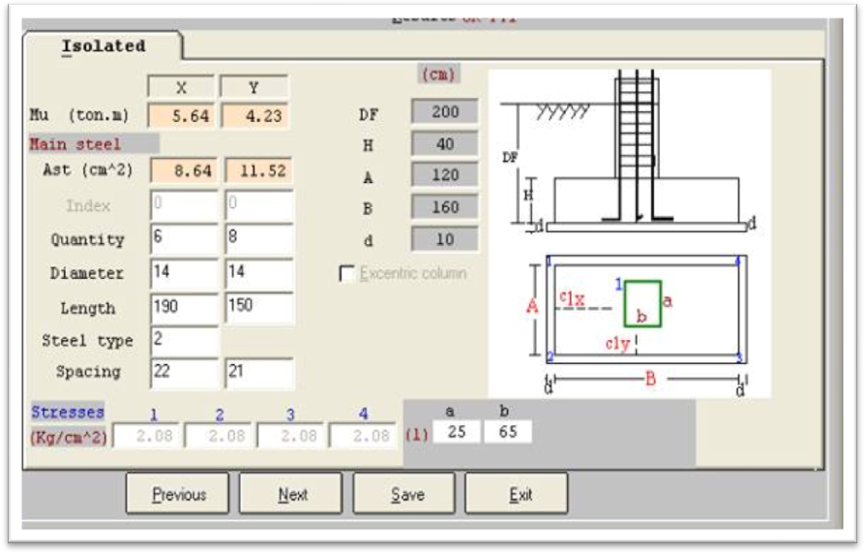
Design of Foundation:
We was using 60 ton for design F1:

Slide 30
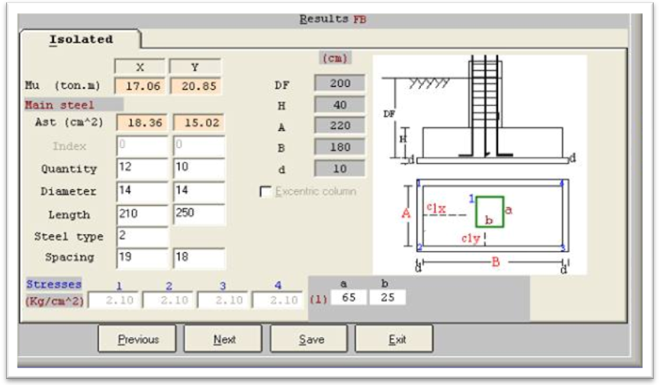
Design of Foundation:
We using 120 ton for design F2

Slide 31
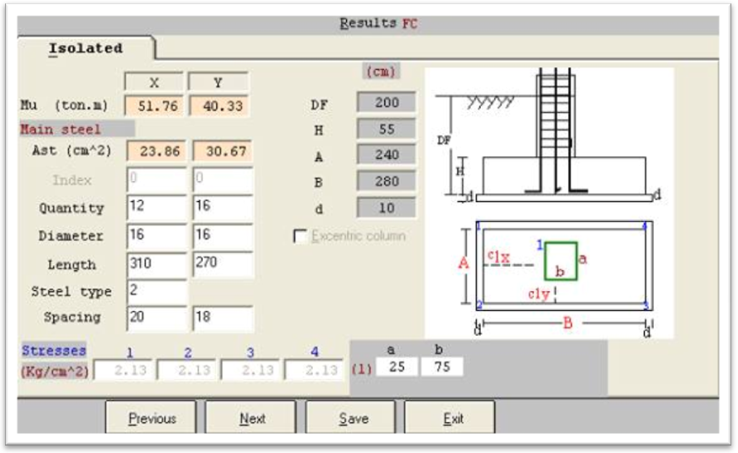
Design of Foundation:
We using 320 ton for design F3

Slide 32
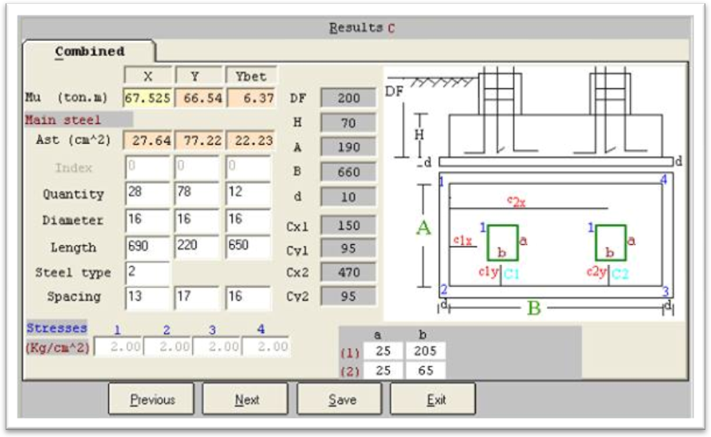
Design of Foundation:
Footing 4 , 5 & 6 we using the load that in the column :
F4:

Slide 33
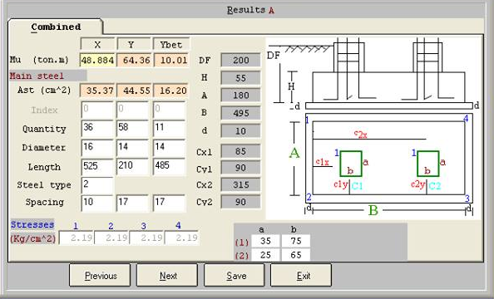
Design of Foundation:
F5:

Slide 34
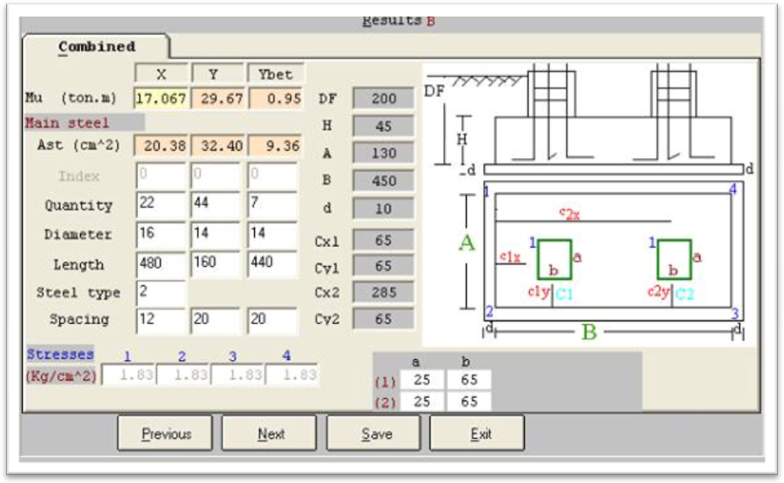
Design of Foundation:
F6:

Slide 35
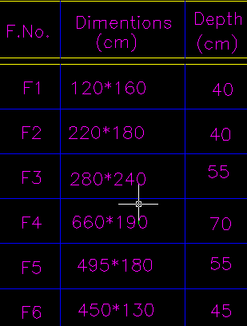
Design of Foundation:
footings dimension from program :

Slide 36
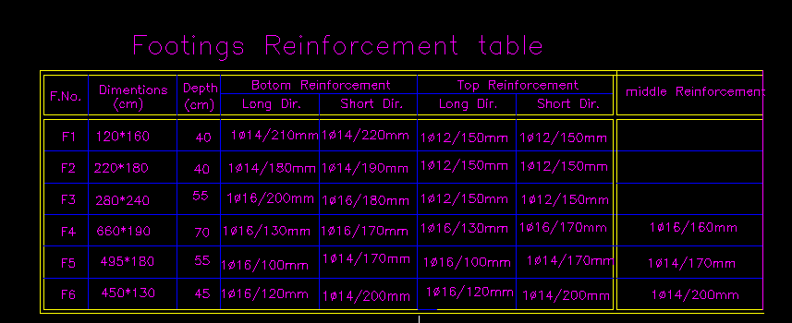
Design of Foundation:
Reinforcement of footing :

Slide 37
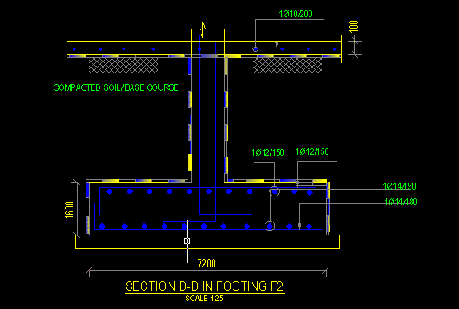

Slide 38
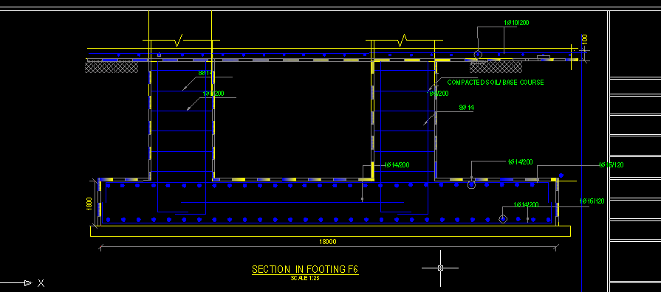

Slide 39
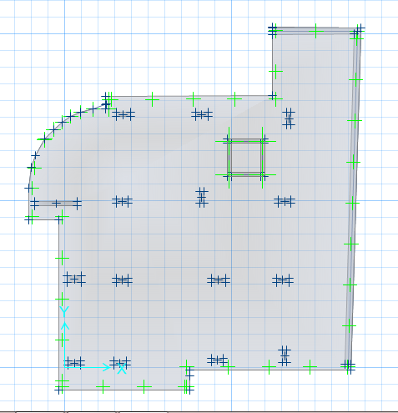
Design of Foundation:
Design of Mat(Raft) Foundation System:
We use SAFE program in order to design Mat foundation.

Slide 40
Design of Foundation:
Loads on columns

Slide 41
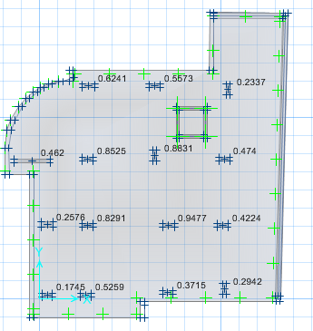
Design of Foundation:
We use thickness of mat foundation to be 70cm then we check it by display punching on columns and all results found less than 1 and it is ok.

Slide 42
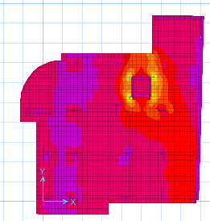
Design of Foundation:
The distribution of steel that we get from SAFE program as follow:
One direction top bar:

Slide 43
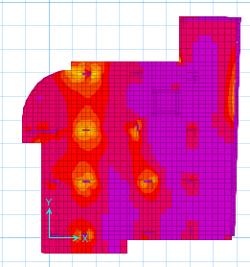
Design of Foundation:
One direction bottom bar:

Slide 44
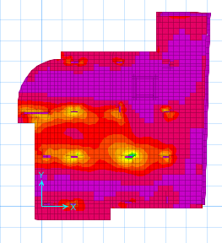
Design of Foundation:
two direction top bar:

Slide 45
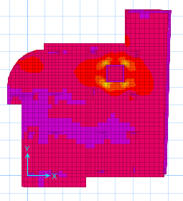
Design of Foundation:
two direction bottom bar:

Slide 46
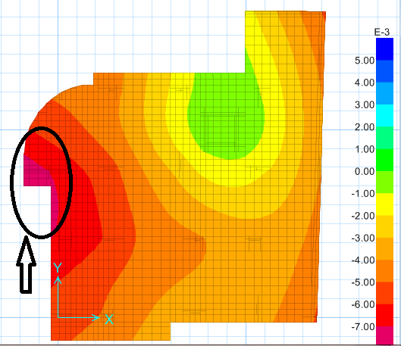
Design of Foundation:
Also, we check the settlement by show deformed shape and we find that the largest settlement equals 7mm around the largest column ( column No.7).

Slide 47
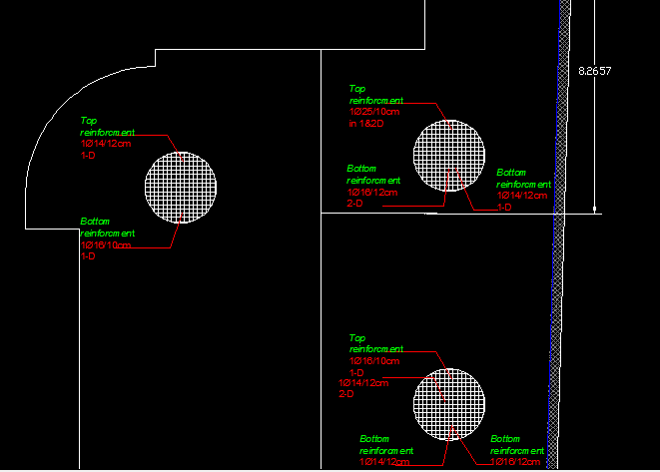
Design of Foundation:
Mat foundation reinforcement :

Slide 48
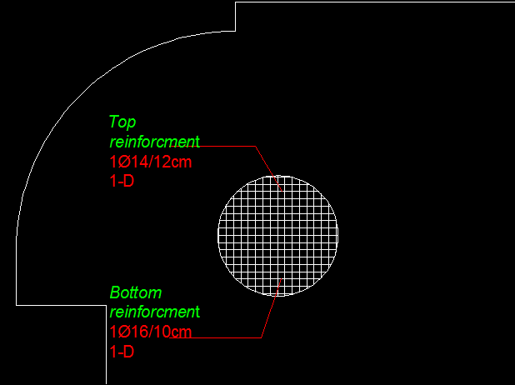
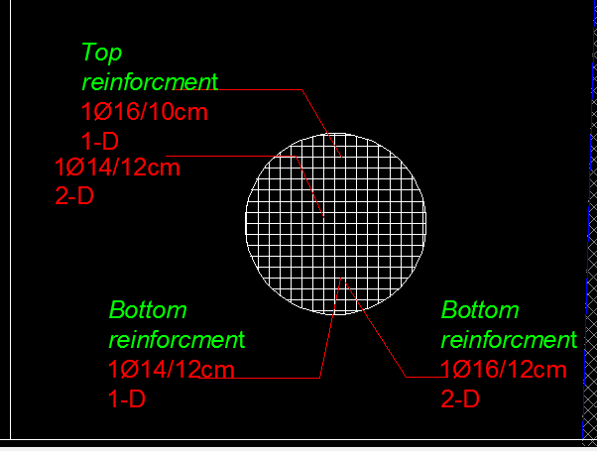
Design of Foundation:

Slide 49
Design of basement wall:
We assume the basement wall as a continuous beam that the base is fixed and the pin is the wall.
We use broken to design it .

Slide 50
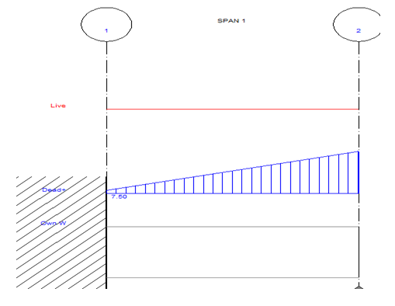
Design of basement wall:
The load distribution in the span of basement :

Slide 51
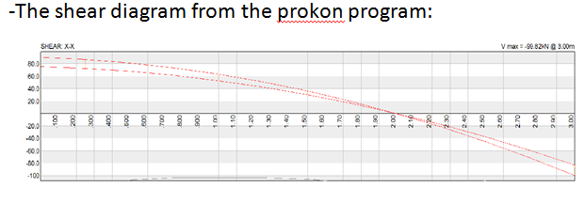
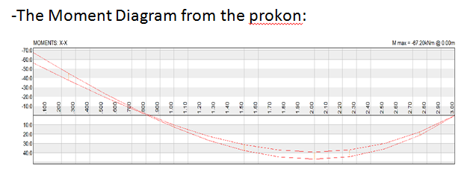
Design of basement wall:
Vu=99.82 KN @3m
Mu=67.2 KN @0m

Slide 52
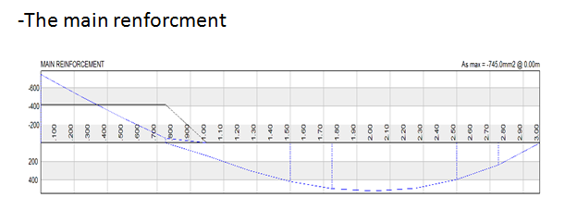
Design of basement wall:
Reinforcment :
As=745mm² from the graph

Slide 53
Design of basement wall:
Asmin=.0025*100*30=7.5cm²/m
=7.5cm^2/m>7.45cm²/m
Then we use Asmin So:
1 Ɵ 14/20cm in long direction
In the short direction for shrinkage:
As=0.0018*b*h
=0.0018*100*30
=5.4cm²/m
So we use:
1Ɵ12/20cm

Slide 54
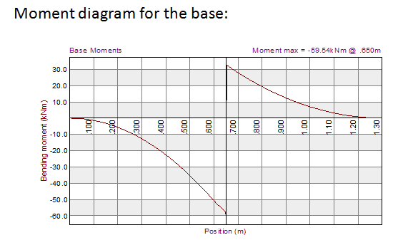
Design of basement wall:
Design the base :

Slide 55
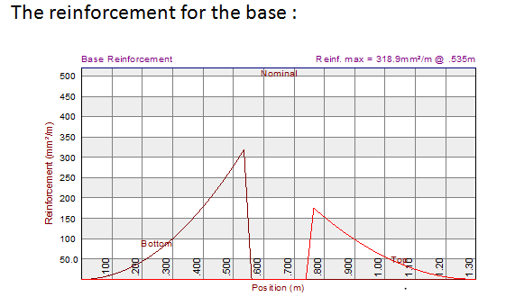
Design of basement wall:
Asmin=0.0018*b*h for the base
=0.0018*100*40
=7.2cm²/m > 3.18cm²/m

Slide 56
Design of basement wall:
In the (prokon program) the reinforcement less than min but we adjust it in the program to use As min
Which is: As min=7.2cm²/m so we use 1 Ɵ 14/20 cm in two direction and top and bottom .

Slide 57
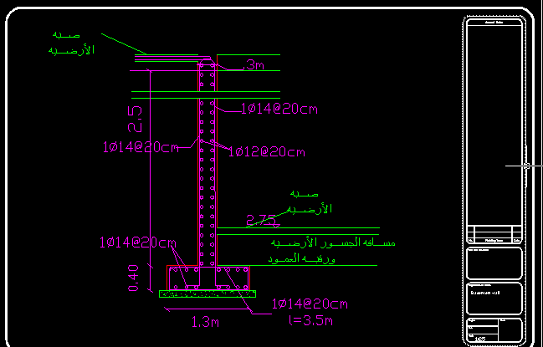

Slide 58


