Slide 1

An-Najah National University
Faculty of Engineering and
Information Technology
Civil Engineering Department
جامعة النجاح الوطنية
كلية الهندسة و تكنولوجيا المعلومات
Graduation Project II
Analysis of the Water Distribution Network of Arraba Village
Prepared by:
Ahmad Ardah– Reg. No: 11610042
Fadi Nuirat – Reg. No: 11611718
Under supervision of: Eng. Hamees Sameh Tubeileh

Slide 2
Outline:
Objective of the project.
Study area.
Network Analysis and Results.
Summary.
Recommendations.

Slide 3
Objective:
Analyzing the Existing Water Distribution Network in Arraba village

Slide 4
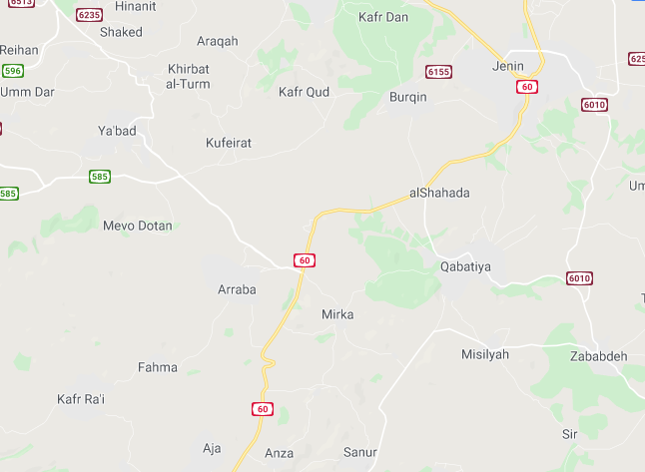
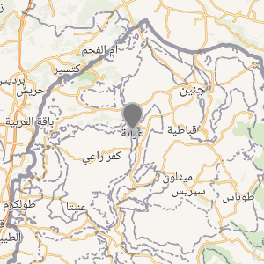
Study Area

Slide 5
Study Area
Site Location:
Arraba village is considered one of the biggest villages in Jenin’s governate with regard to both area and population. It lies on coordinates of 32°24′16″N 35°12′12″E and is located 13 kilometers southwest of Jenin.
Nature and Terrain:
Arraba’s nature is inconsistent and contains a lot of variation from one region to another. This variability in elevations contributes to a lot of the problems that will be discovered later on in the water distribution system.

Slide 6
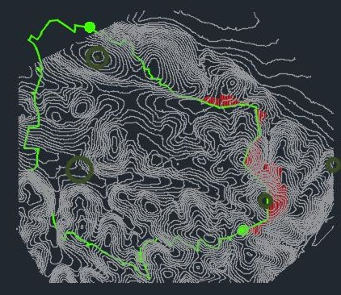
Arraba’s Terrain:

Slide 7
Study Area
Population and growth rate:
Arraba’s population was 11479 capita in 2017, however, we were able to estimate the current population of Arraba to be 11993 capita.
Water Sources:
Arraba and its neighboring villages all rely on a well east of Arraba for their water source. This well was administered and run by an Israeli water company “Makarot”, however, recently this well was given to the Palestinian Water Authority to administer.

Slide 8
Water Distribution Network Analysis

Slide 9
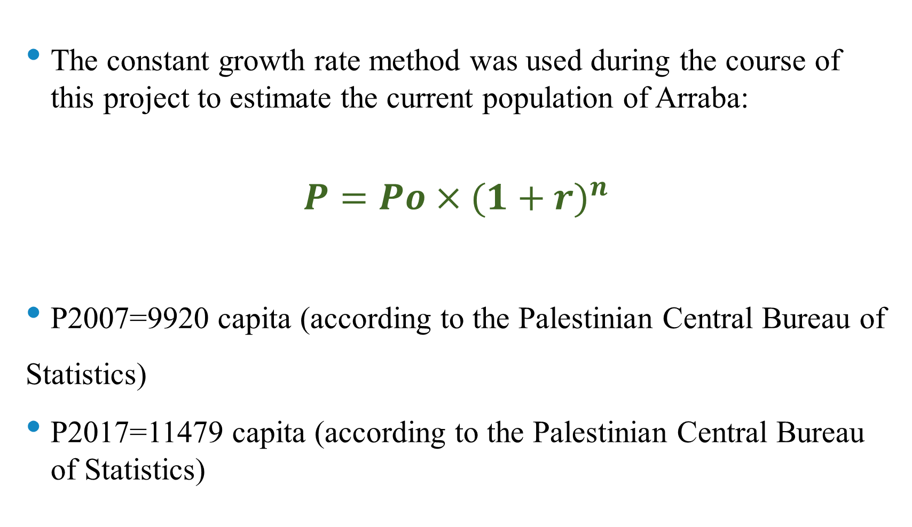
Population Estimation
The constant growth rate method was used during the course of this project to estimate the current population of Arraba:
$$P=Po×{(1+r)}^{n}$$
P2007=9920 capita (according to the Palestinian Central Bureau of Statistics)
P2017=11479 capita (according to the Palestinian Central Bureau of Statistics)

Slide 10
Population Estimation
The data in the previous slide was used to calculate the growth rate of Arraba’s village to be 1.4%.
R = 0.014 = 1.4%
Since the growth rate was found, we were able to estimate the current population:
P2020 = 11479 × (1+0.014) 3
P2020 = 11993 capita

Slide 11
Population Estimation
Year | Population
2007 | 9920
2017 | 11479
2020 | 11993

Slide 12
Consumption and Demand Estimation
Using the water bills of the entire population of Arraba provided by the municipality for a period of three months (November, December, January), the average consumption per capita was calculated. The procedure will be explained in depth below. Bear in mind that these bills will be shown in the appendix of this project.
At first, the total volume of water (m3) for every month was computed by simply adding up the bills and dividing the total cost by 5, which is the cost of 1 m3 of water.
Next, the total volume of water of each month was divided by the number of families that paid their bills in that particular month. Following that the values computed were divided by the average number of people per household in Arraba which is 4.8 (according to the Palestinian Central Bureau of Statistics),

Slide 13
Consumption and Demand Estimation
To further explain our approach, here are the calculations done on November values:
1- Total consumption cost = 33165 ILS in November
2- Cost for each m3 = 5 ILS
3- Quantity needed in November = 6633 m3
4- Number of families that paid for water bills during this month = 689
5- Average number of people per household in Arraba= 4.8 members (from the Palestinian Statistics Center)
6- Number of families * Average number of people per household member= 3307
7-Consumption per month per capita= quantity needed in November / 3307 = 2 m3 / month per capita
8- Consumption per day per capita = 66.67 l/capita/day

Slide 14
Consumption and Demand Estimation
The following steps were repeated with the values of the months December and January to find the consumption per day per capita, and then calculate the average consumption of the three months.
Months | Consumption (l/capita/day)
November | 66.67
December | 61.94
January | 63.2
Avg of the three months | 63.94

Slide 15
Consumption and Demand Estimation
Total Average Consumption = Average consumption of the three months × 10-3 × population × 3 days × (24hr/16hr)
Total Average Consumption = 3450.745 m3 /day
Total Demand = Total Consumption / (1 – loss factor)
(Given that the loss factor 16% according to Arraba’s municipality)
Total Demand = 4108 m3/day

Slide 16
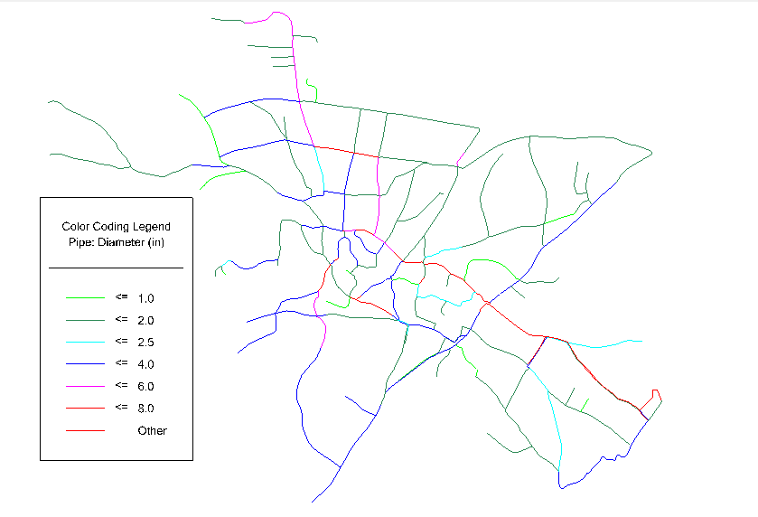
Water Distribution Network Drawing

Slide 17
Water Distribution Network Drawing
Since Arraba’s water network is huge containing 493 nodes and 535 pipes, it is necessary to divide the network into two zones (East and West), depending on the positions of the existing control valves provided by Arraba’s municipality, in order to have more accurate results.

Slide 18
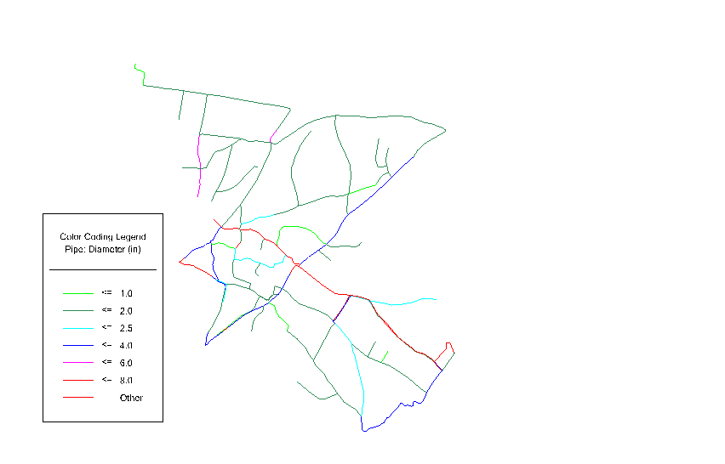
East Zone
Water Distribution Network Drawing

Slide 19
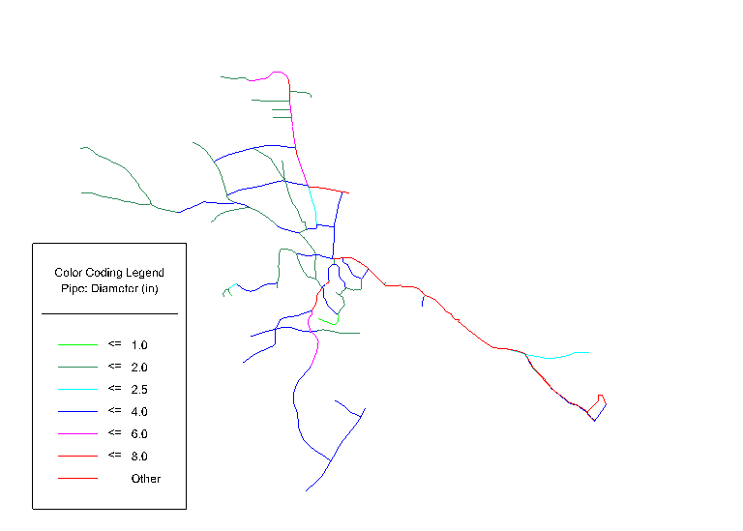
Water Distribution Network Drawing
West Zone

Slide 20
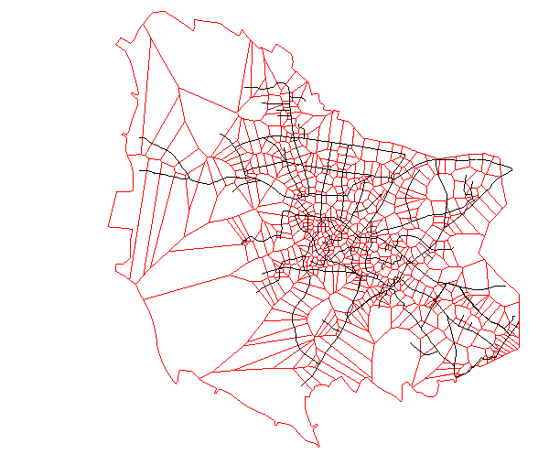
Demand Estimation
To estimate the demand at each joint, the ratio of demand for every joint was calculated by dividing the area around every joint that were previously calculated by the Theisen polygon method by the total area of Arraba.

Slide 21
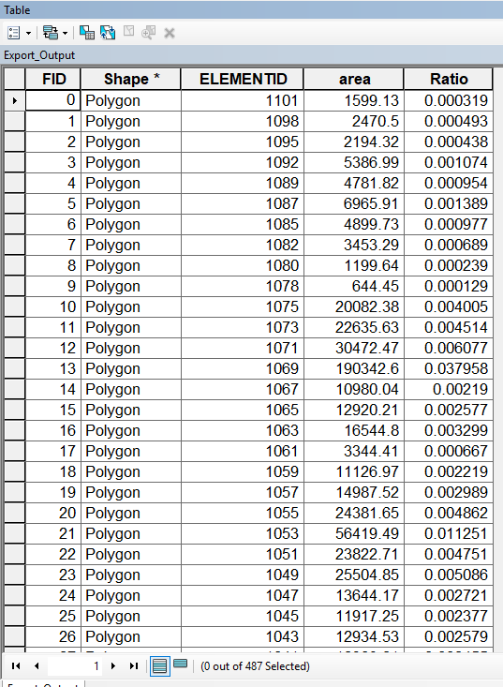
Demand Estimation

Slide 22
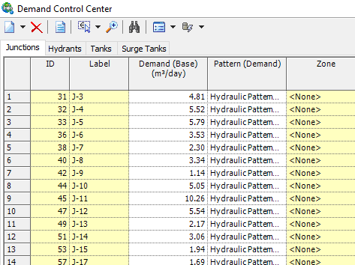
Demand Estimation
And next, the ratios of the junctions were multiplied by the collective demand of Arraba to determine the demand of every joint and by the demand control center tool in WaterCad their demands were inserted.

Slide 23
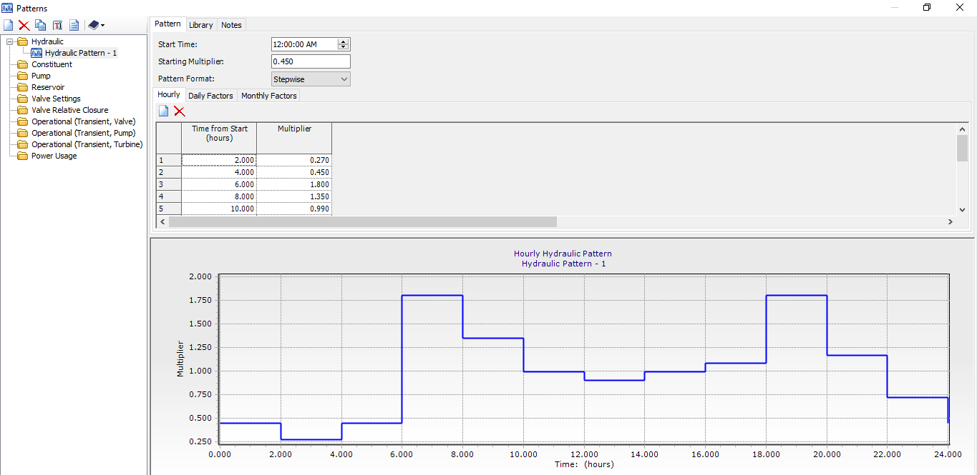
Demand Estimation

Slide 24
Demand Estimation
And finally, the Demand Factors were used to modify the values of the demand in order to see how the model will perform when it is analyzed under different circumstances.

Slide 25
Elements | Number of elements
Reservoirs | 1
Nodes | 493
Pipes | 535
Pumps | 7

Slide 26
Design Constraints
Pressure at Joints = 20 - 100 mH2O
Water Velocities in pipes = (0.3 - 3.0) m/s

Slide 27
Pressure on Nodes at Max Demand

Slide 28
Pressure on Nodes at Min Demand

Slide 29
Water Velocities in Pipes at Min Demand

Slide 30
Water Velocities in Pipes at Max Demand

Slide 31
Discussion
The figures above show the variability of pressure on the nodes during maximum and minimum demand hours, as well as, we can clearly see how the vast majority of the pressures lie within the acceptable range.
In addition, the figures above show how most of the water velocities inside the pipes lie beneath the criteria range, during minimum demand hours, which means that most of the diameters of the pipes are greater than needed.

Slide 32
Summary

Slide 33
Summary
We were able to analyze the water distribution system of Arraba by using the data provided by Arraba’s municipality along with the WaterCad software.
Since Arraba has a huge variation in its topography and is considered to be one of the biggest villages of Jenin Governate, the results of the pressures at the nodes and the water velocities in the pipes turned out to be varying within and outside the range of criteria, and thus the results of our project shows that a new water distribution network design is highly needed for Arraba. As well as, the results of our analysis solidifies the complaints of Arraba’s citizens about the water services in the village specially during peak hours of consumption.

Slide 34
Summary
One reservoir currently exists in the network, which we might have to change in the new design, because a new water reservoir is currently under construction.
Modification to the pipes diameters of the network has to be made in order to shift the velocities inside the water pipes to the allowable range, however, additional water pumps might be needed.

Slide 35
Sources of Error
1- The insufficient data provided by Arraba’s municipality
2-The imperfections of WaterCAD’s method of analysis since the water demand is not at maximum levels at all the nodes in a given hour
3-The error in the approach used to calculate the demand at the joints since the Theisen polygon method doesn’t give accurate results of the actual demand ratios for every node

Slide 36
Summary
Anyhow, the project is far from over, as we have yet to design a new water distribution system relying on the road plans provided by Arraba’s municipality and then proceed to make a total rough estimate of the entire project’s cost.

Slide 37
Thanks For Listening

