Slide 1
Graduation Project II
Analysis and redesign of water network for Sabastia Village
By:
Abdurra'oof Huwari
Under supervision of Dr. Anan Jayousi

Slide 2
Outline
Project objectives
Study area
Questionnaire Analysis
Data collection and calculation
Results of the current network
Future water consumption and demand needed
Redesign the water network
Cost of the new network

Slide 3
Project objectives
1) analyze the existing water distribution network in Sabastia village. According to:
-Questionnaire
-layout the exist water network and analysis it by WaterCAD
2) Redesign the water network for the future demand and calculate the cost

Slide 4
Study aria:
Sabastia
located 12 km north-west of Nablus city.
It has an area of 5000denims and a population of about 3200.

Slide 5
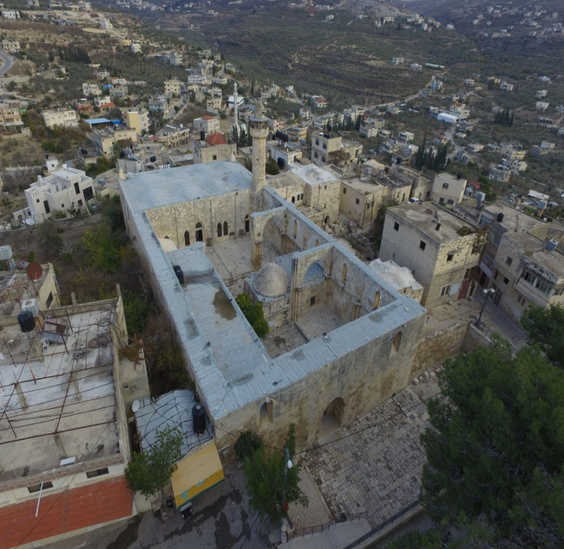
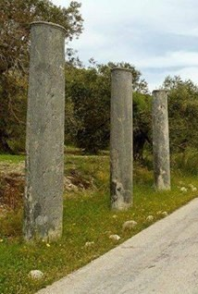
Study aria:
Sabastia
460 AMSL
annual precipitation rate of 589 millimeters
Historic village

Slide 6


Questionnaire Analysis
main purpose of the questioner is to evaluate the current situation of the network to estimate the main problems and how to fix them.
The main component of the questioner is family size analysis, water resources that the family use, and common problems in the network. The distribution of the questioner were been unbiased and random.
45 questioners were been distribute.

Slide 7
Results of questionnaire
Average family size = 6.37 capita
water consumption = 31.8 m3/month
So the average consumption = (31.6*1000)/(30*6.37)=165.3=165 L/C/day

Slide 8
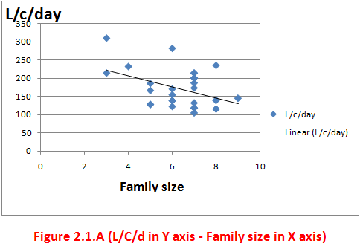
Results of questionnaire
The figure2.1.a shows that there is a trend to decrease in consumption with increasing the number of family members.

Slide 9
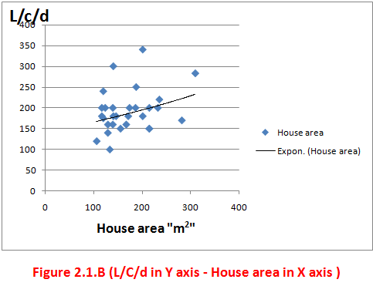
Results of questionnaire
The figure 2.2.b shows that there is a Positive relationship between the consumption (L/C/day) and the area home.

Slide 10
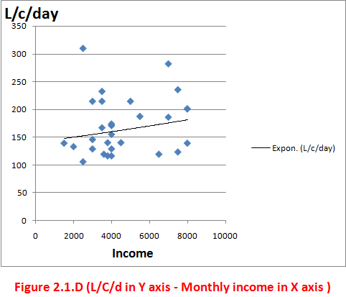
Results of questionnaire
The figure 2.3.d shows an increase in the per capita water consumption with the increase in the monthly income.

Slide 11
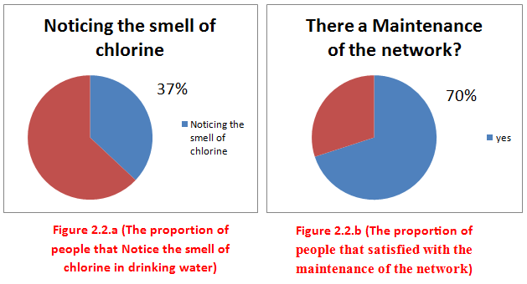
Results of questionnaire

Slide 12
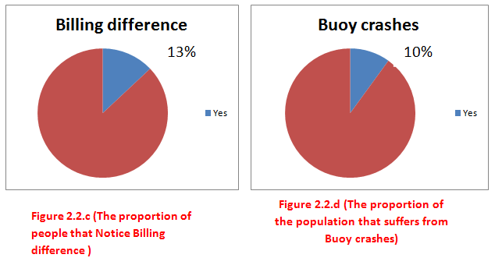
Results of questionnaire

Slide 13
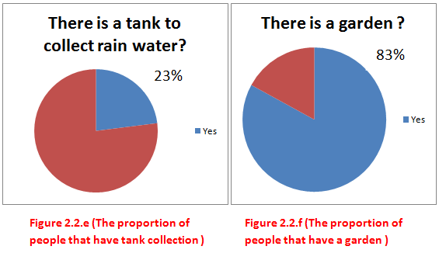
Results of questionnaire

Slide 14

Simulation Model (Water CAD):
WaterCAD which is the software program used for plane, design, analysis and optimize water distribution network.

Slide 15



Simulation Model (WaterCAD):
Equation Used in WaterCAD
Hazen-William Equation:
Darcy-Weisbach Equation:
Manning`s Equation:

Slide 16
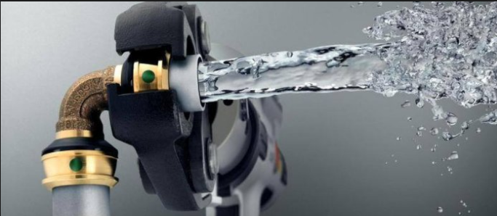
Data collection and calculation:
Existing water distribution network:
Performed and constructed in 2000
the length of the network 14KM
it has a diameters between 4 to 2 Inch.
From Haroon spring and water authority
There are three tanks: two connected directly with network and one to collect spring water
the peak amount of water that is pumped to the network in the summer reach to 13000 m³/Month

Slide 17
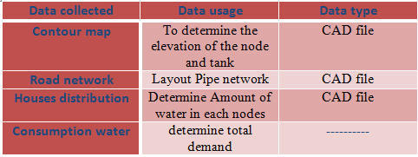
Data collection and calculation:

Slide 18
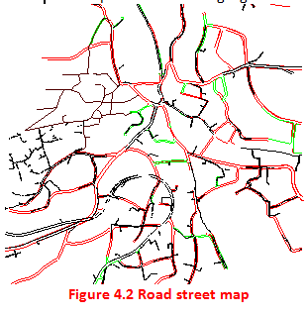
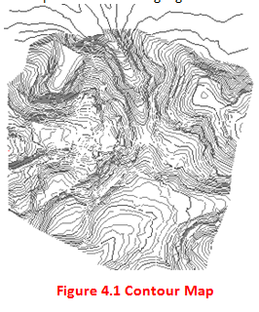
Data collection and calculation:

Slide 19
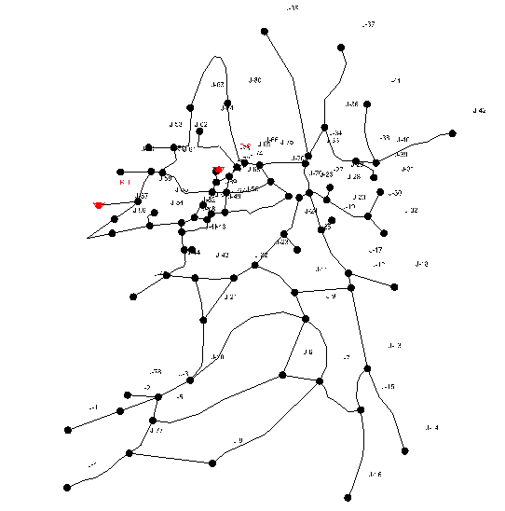
Data collection and calculation:
there's no map for the water network in Sabastia so I layout the network using Watercad program according to road network and the other information from Municipal council.

Slide 20
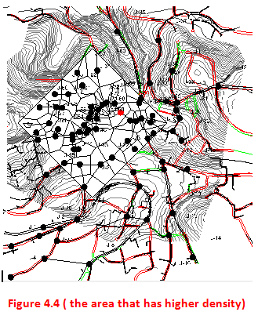
Data collection and calculation:
Total demand=434.3m3/Day
According to distribution of the houses the area in square (figure4.4) have the 60% from total demand( equal 261m³/Day) and the other nodes divided the rest (equal 173m³/Day).

Slide 21
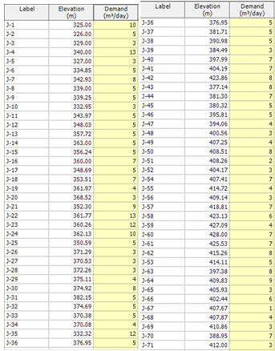
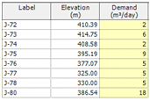

Data collection and calculation:

Slide 22
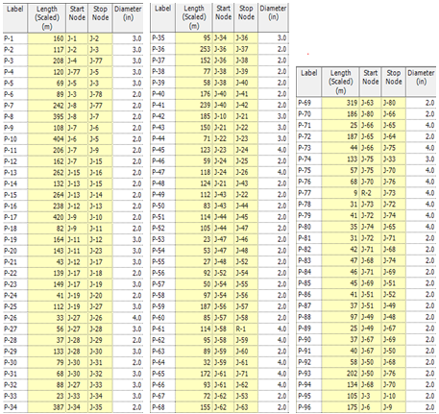
Data collection and calculation:

Slide 23
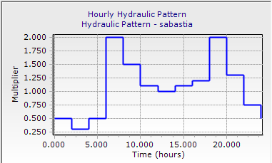
Results of the current network
Unsteady state case for Sabastia

Slide 24
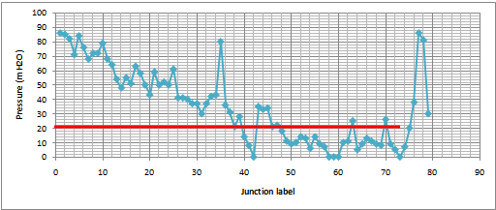
Result and discussion:
At
6:00 am
Pressure
According to specifications the allowable pressure is within the range ( 20-100 ) m H₂O.
In this network almost the nodes within the range except the area that near from the tanks (The Top of the hill)

Slide 25
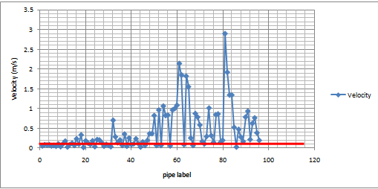
Result and discussion:
Velocity :
The allowable range for velocity is (0.1-3.0)m/s, but there a many of pipes have a velocity under the range specifically between (1-20).

Slide 26

Future water supply Network

Slide 27
Future population
The present population in Sabastia is 3172 capita,
The growth rate "i" by our calculation from the past years = 2.3% .
the future population in Sabastia up year 2046 can be determined by this equation:
p₂₀₄₆=p₂₀₁₆(i+1)³⁰
n=30 ,r=2.3%,P=3172.
P30=3172(1+.023)^{^30}= 6266

Slide 28
Future water consumption and demand needed
the future water consumption was considered to be 120 L/c.d,
the domestic water consumption forms 90% of the municipal water demand, Municipal = 120/.9 = 134 L/c.d
the physical losses which equals 30%
Supply= Consumption /(1-loss)=
134/(1-30%)= 178 L/c.d.

Slide 29
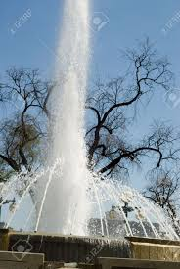
Demand factor
to estimate the future water demand for each node, the nodal resent water demand will multiply by a factor, which equal:
Demand factor:(future demand/ existing demand) * (future population/ existing population).
Demand factor= (6266/3172)(1115348/433333)=5.08

Slide 30

Applied the factor
The present nodes demand multiplied by the demand factor to obtain the future demand in each node.

Slide 31
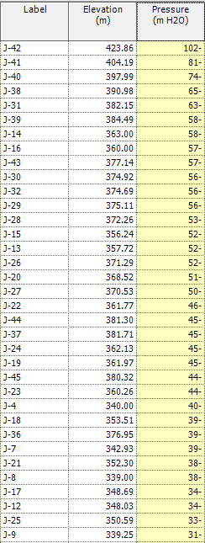
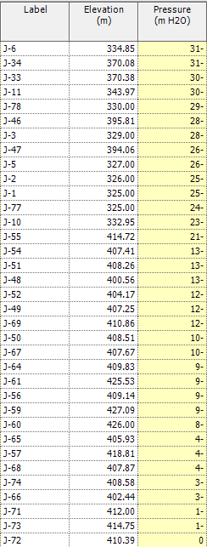
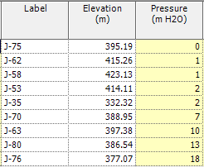
the values of pressure in the network after applied the factor

Slide 32
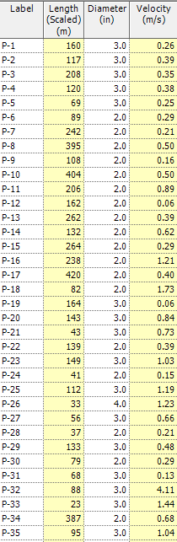
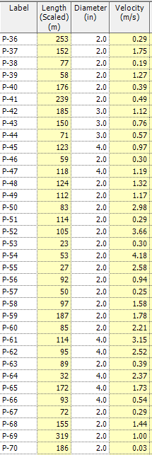
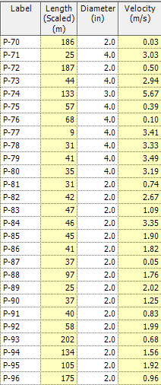
(the velocity in the pipes after applied the factor

Slide 33
Redesign the water network
will used in the design the maximum working that shows the maximum flow rate Q , will be at 6:00 am
Option 1:
this option is based on replace the pipes in other diameters to dispense put a pump

Slide 34
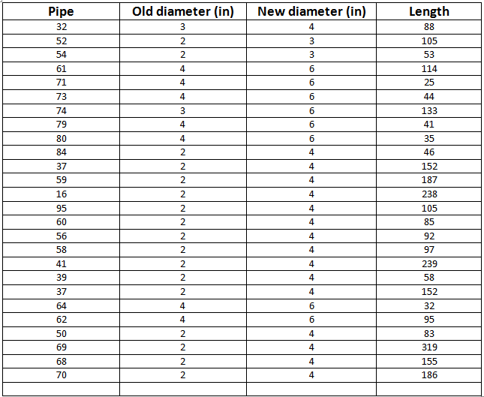
Option 1

Slide 35

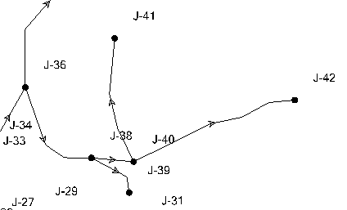
Option 1
Sum of the pipes that we will replace them = 3 km
But despite of all that !!
still an area that the pressure is very low "Tarayeb" it's a high area and Relatively distant from the sources.

Slide 36

Option 1
And to solve this problem: anyone wants to build in this area He must put a small pump with the tank home to strengthen the water pressure.

Slide 37
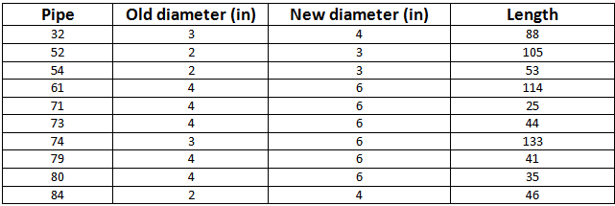
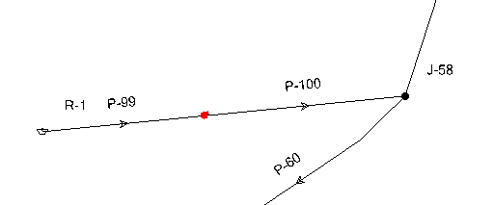
Option 2
To fit the velocities in range we replace this pipe:
and to fit the pressure in acceptable range we put a pump near the tank 1:

Slide 38
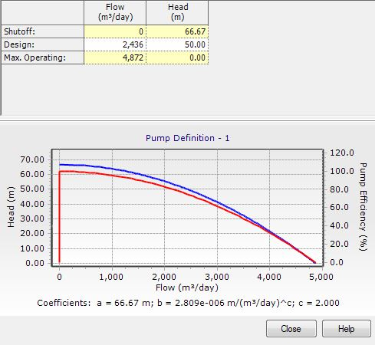
Option 2
Properties of the pump:
The same problem in "Tarayeb" area

Slide 39
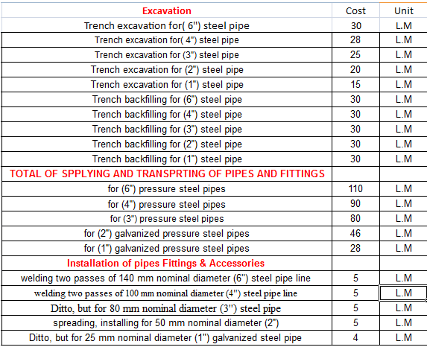
Cost of the new network
costs of each stage in the process of creating a new network

Slide 40
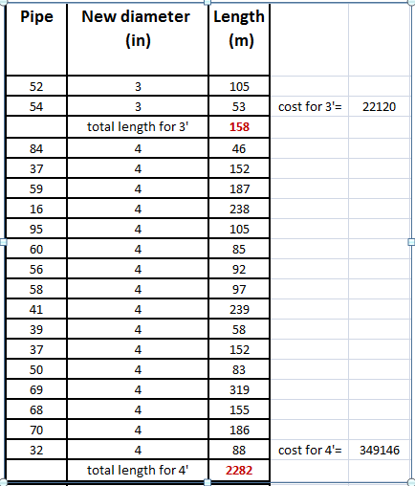
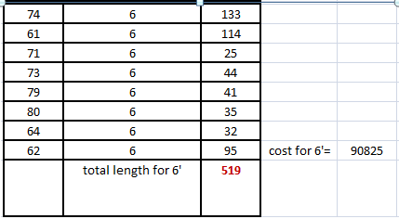
Cost of the new network
excel sheet to calculate the cost

Slide 41


Cost of the new network
the sum of cost is equal =22120+349146+90825= 462,091 NIS

Slide 42
Conclusions
- Our design is applicable and serviceable for the selected design period which is 30 years.
- the length of old network is 14 km , and the sum of the part that we redesign it equal 3 km at a cost of 462091 NIS.
- The value of velocity and pressure in the new network within the allowable ranges and in the design criteria.

Slide 43


