Slide 1

Graduation Project 2
Integrated Redesign of an Olympic building
Prepared by :
Hamsa Rajab Seham Mahajna
Farah Ibrahim
An-Najah National University
Faculty of Engineering
Building Engineering Department
Supervisor :-
Dr. Mutasim Baba

Slide 2
Layout:
Architectural- Environmental Aspects
Structure Aspects
Electro - Mechanical Aspects
Quantity Surveying & Cost Estimate

Slide 3
Architectural - Environmental
Design

Slide 4
introduction
The Olympic building its a Sports administrative building and located in Ram city in Palestine.
The Olympic building have 5 stories, in each story have different area. Each story (basement, ground, first and second floor) have 4-5 employees offices, 1 manger office, kitchen, 5 toilets and 1 server room. Cafeteria located in third floor included kitchen,1 library, 5 toilets, closet area fit 25 tables and open area fit 6 tables.

Slide 5
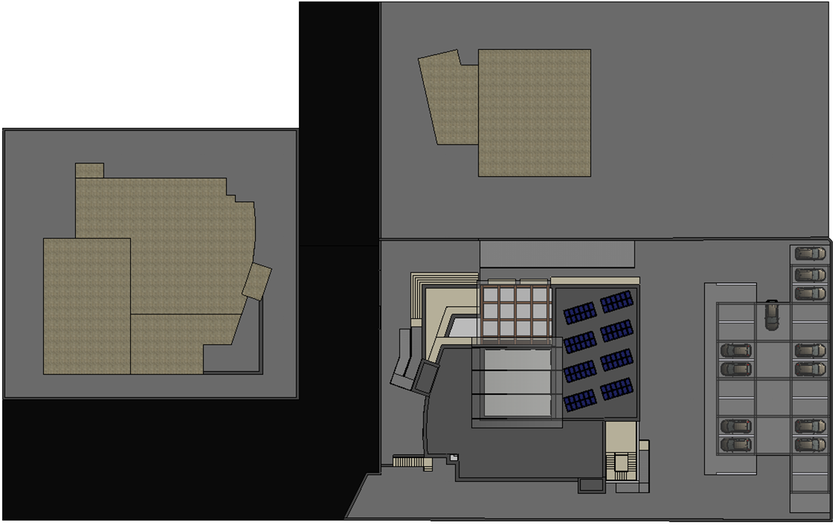
Site plan

Slide 6
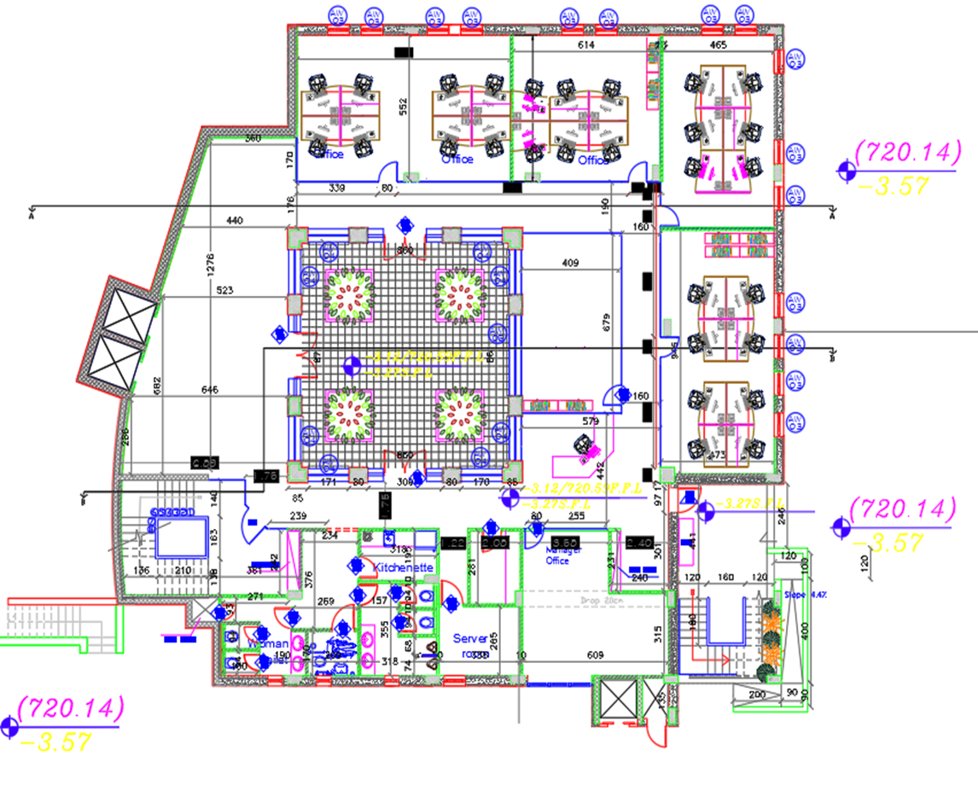
Basement floor

Slide 7
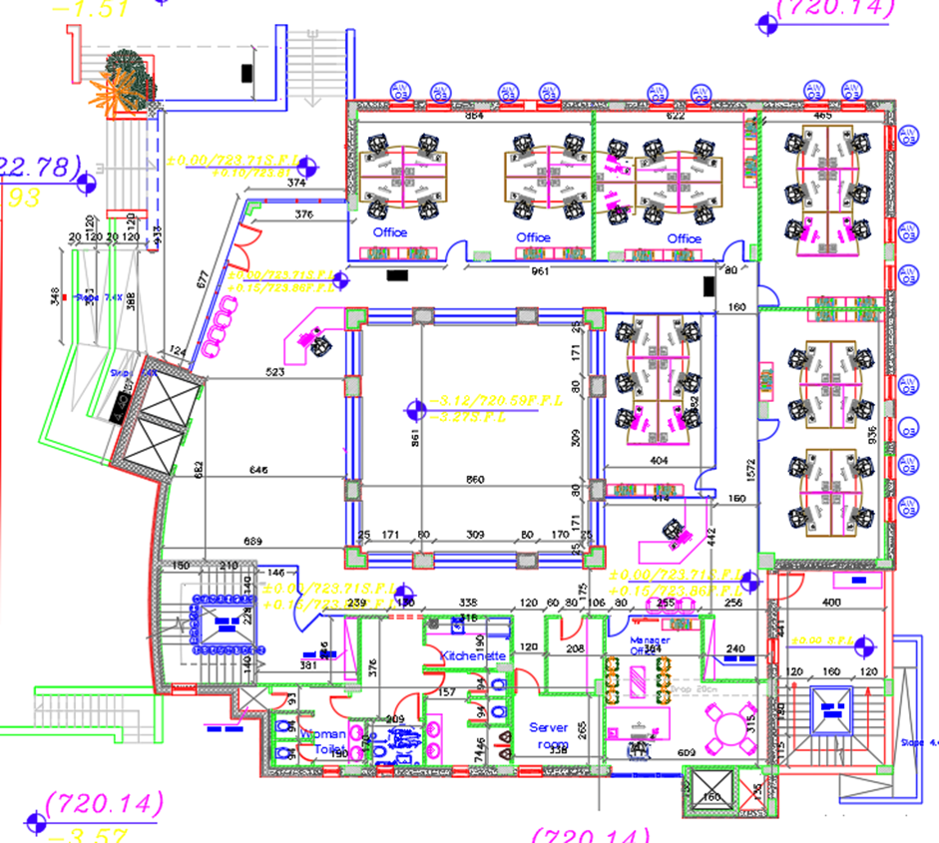
Ground floor

Slide 8
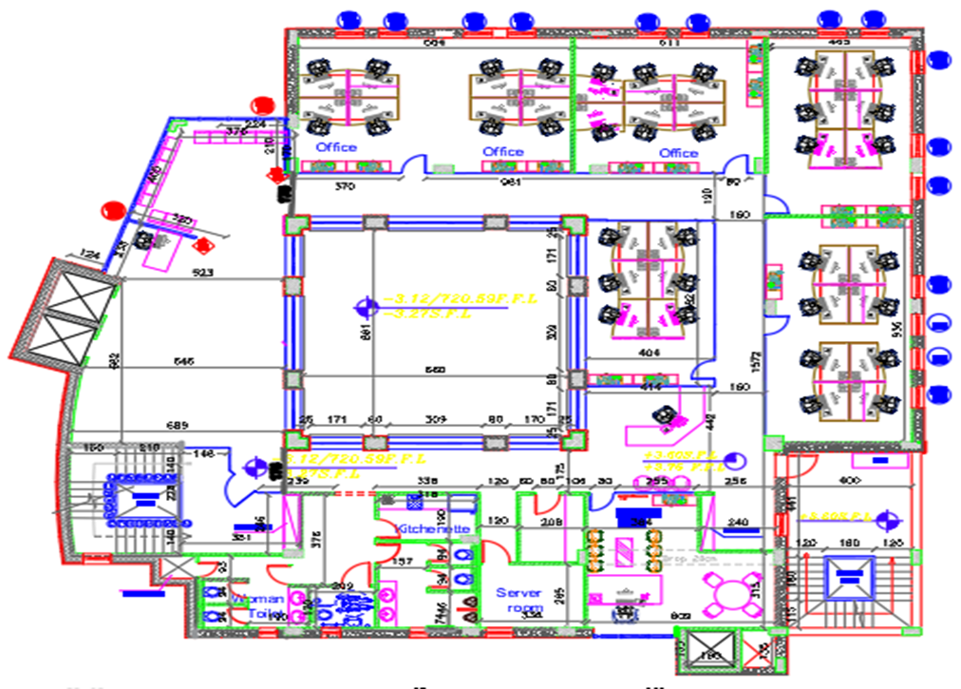
First floor

Slide 9
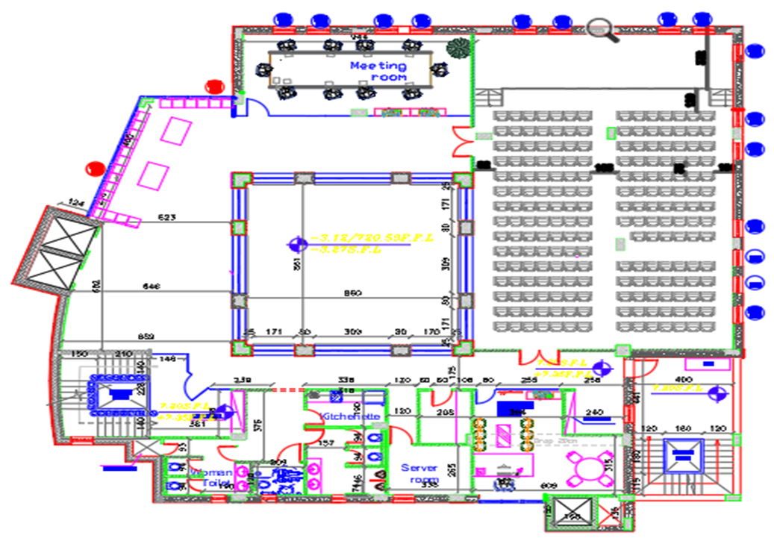
Second floor

Slide 10
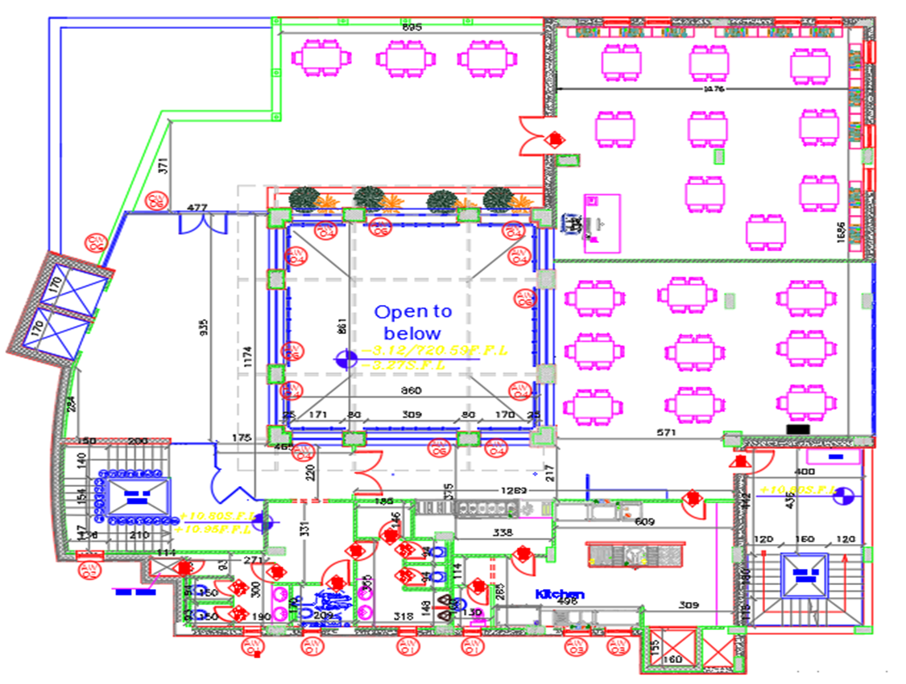
Third floor

Slide 11
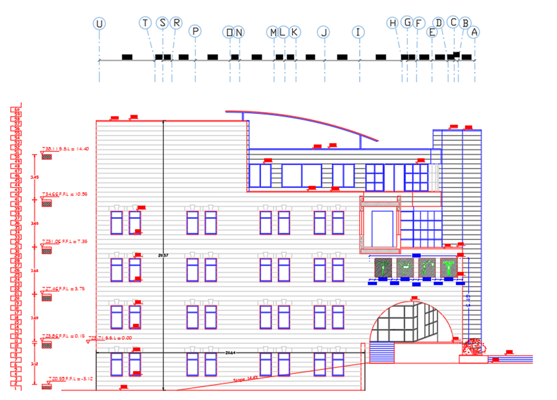
South elevation

Slide 12
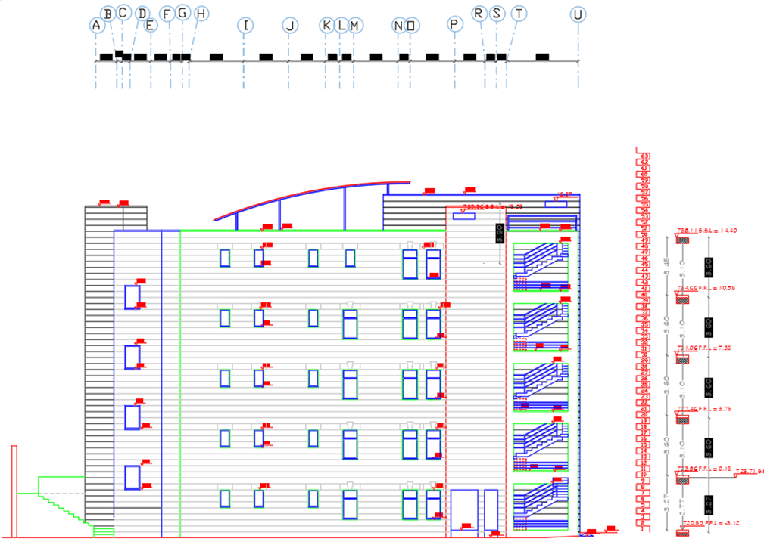
North elevation

Slide 13
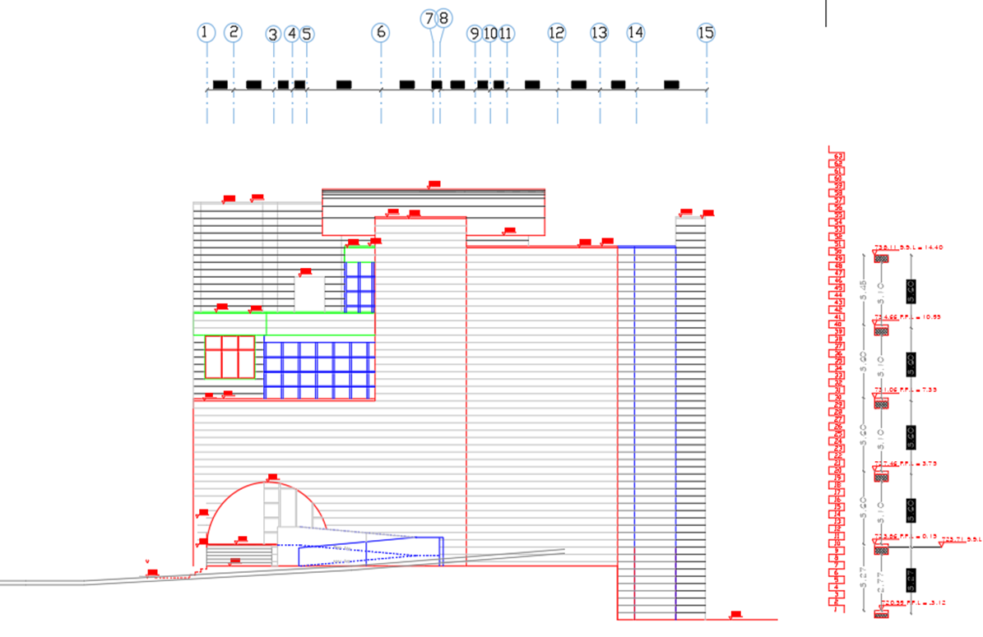
East elevation

Slide 14
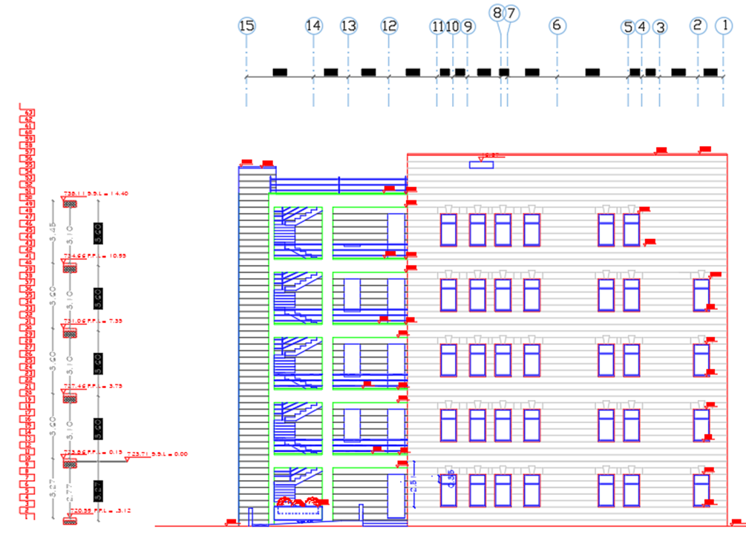
West elevation

Slide 15
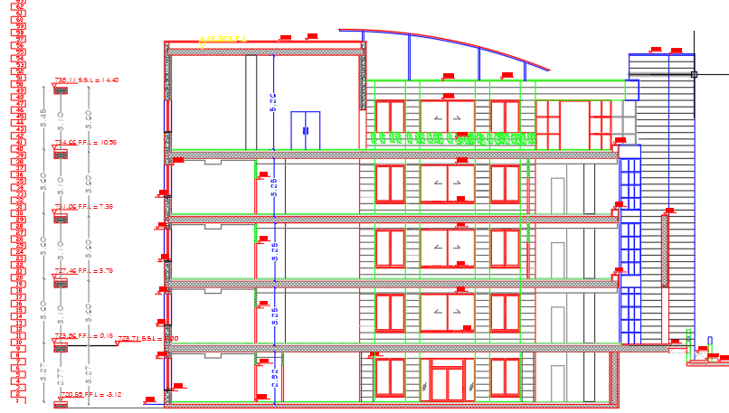
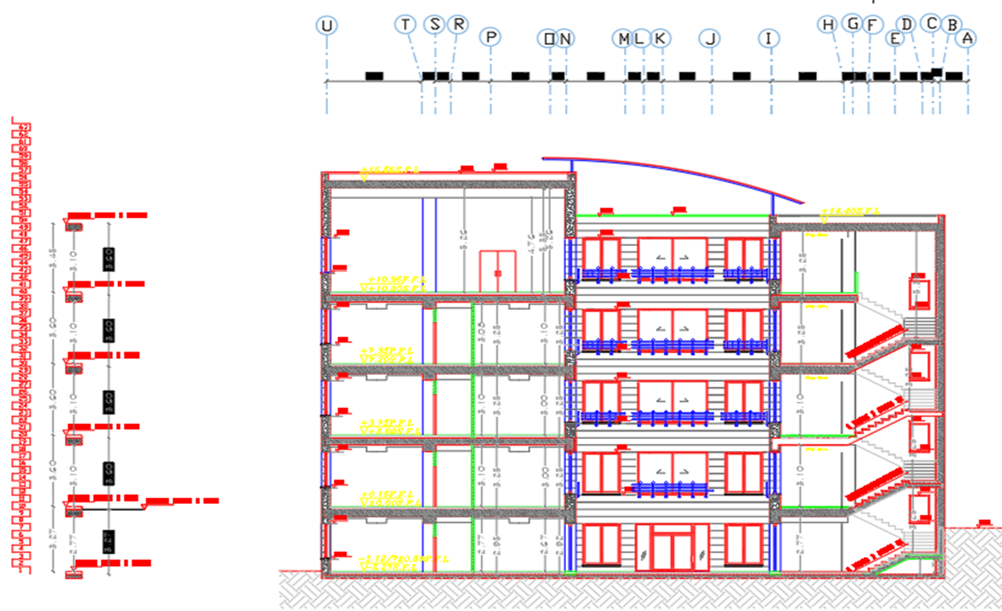
Sections

Slide 16
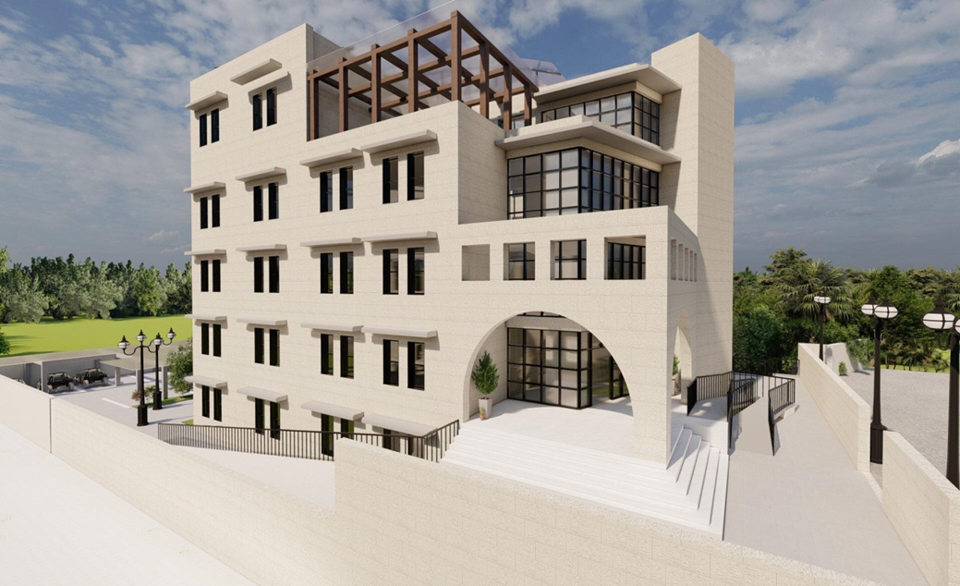
3D view

Slide 17
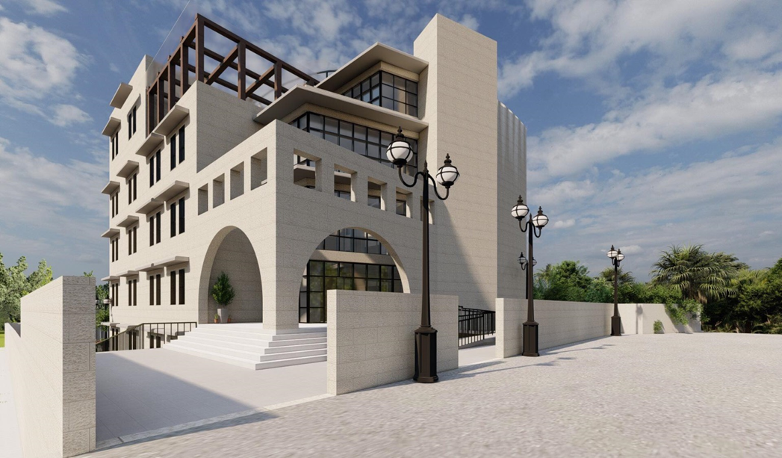
3D view

Slide 18
Environmental Design
Thermal Design
Shading
Daylight
CFD
Acoustics

Slide 19
Thermal design:

Slide 20
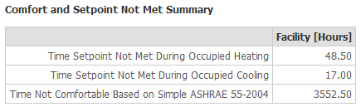
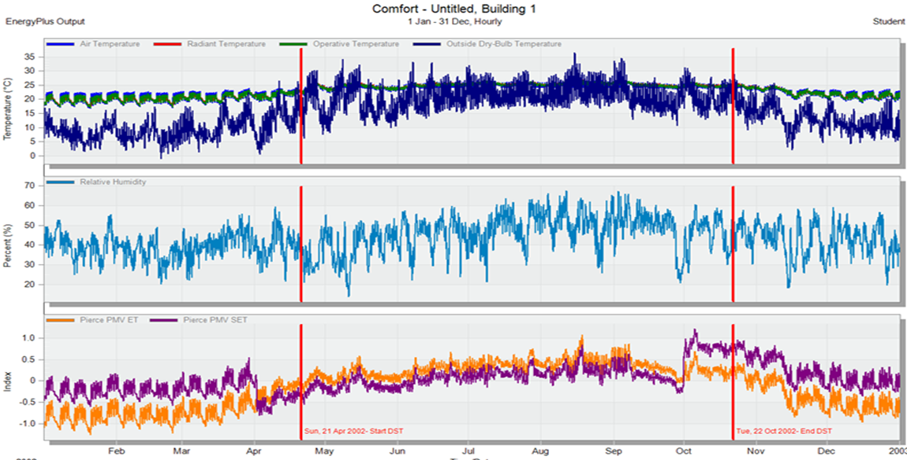
PMV and comfortable

Slide 21
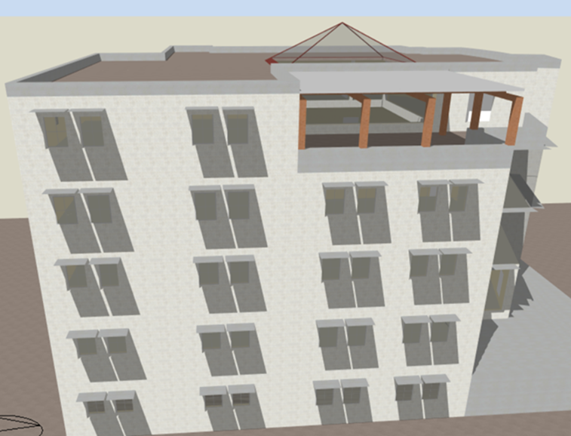
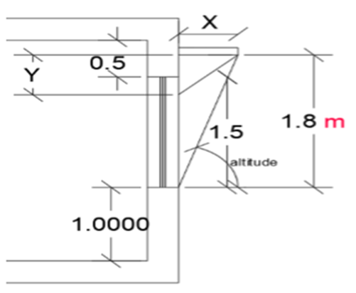
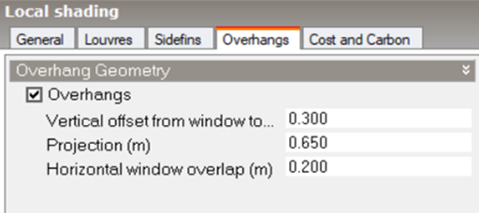
Shading system:
1.South windows (cantilever)

Slide 22
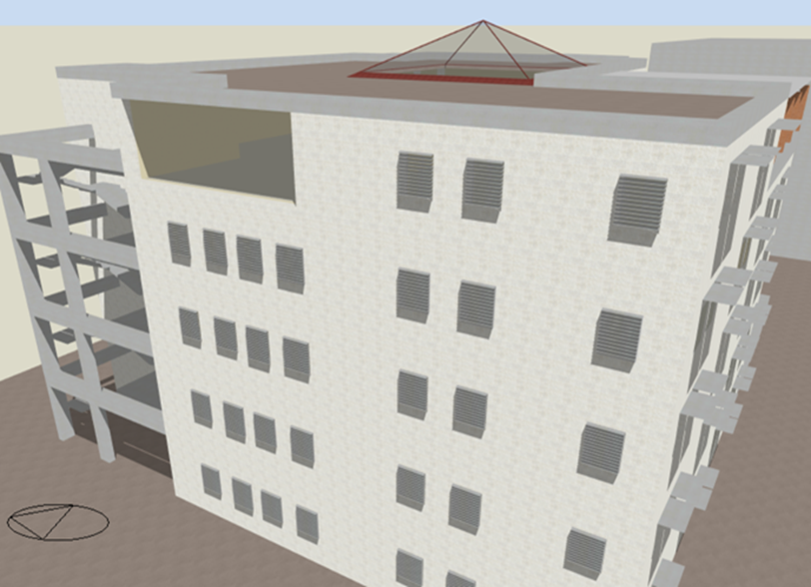
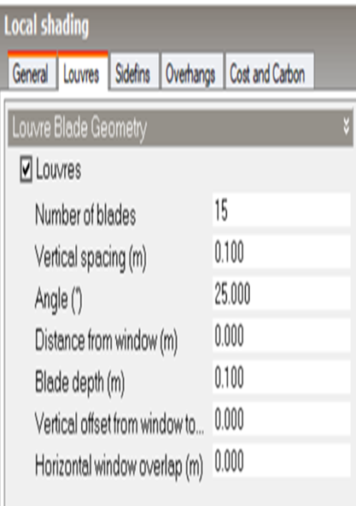
2.West windows (horizontal louver)

Slide 23
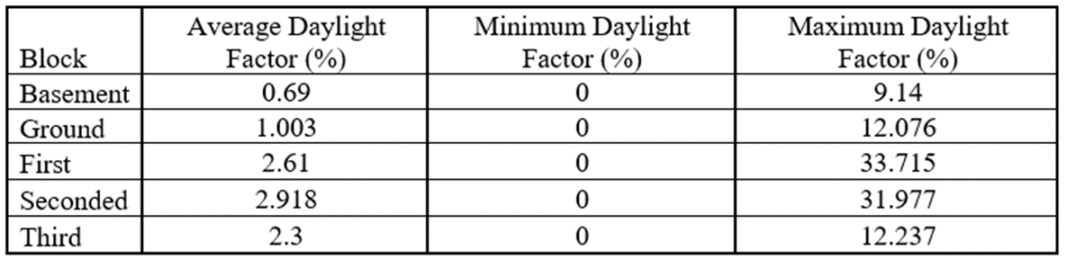
Day light factor

Slide 24
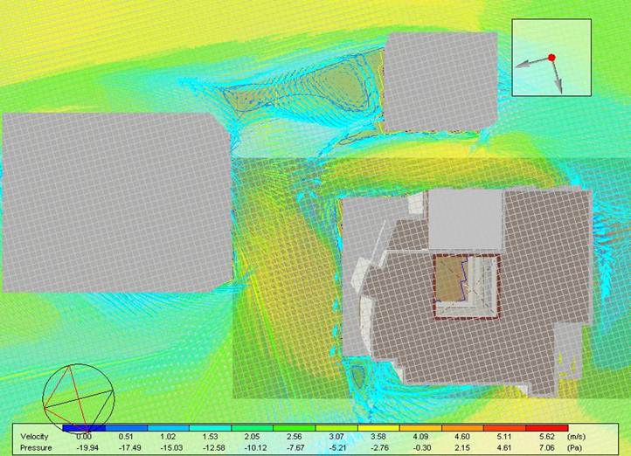
CFD external

Slide 25
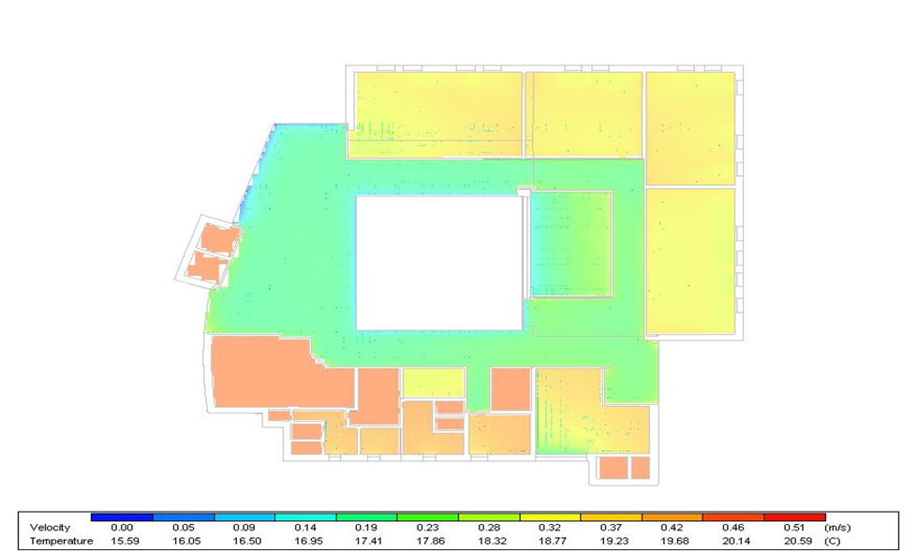
CFD internal

Slide 26
Acoustics
Reverberation time (RT60):

Slide 27
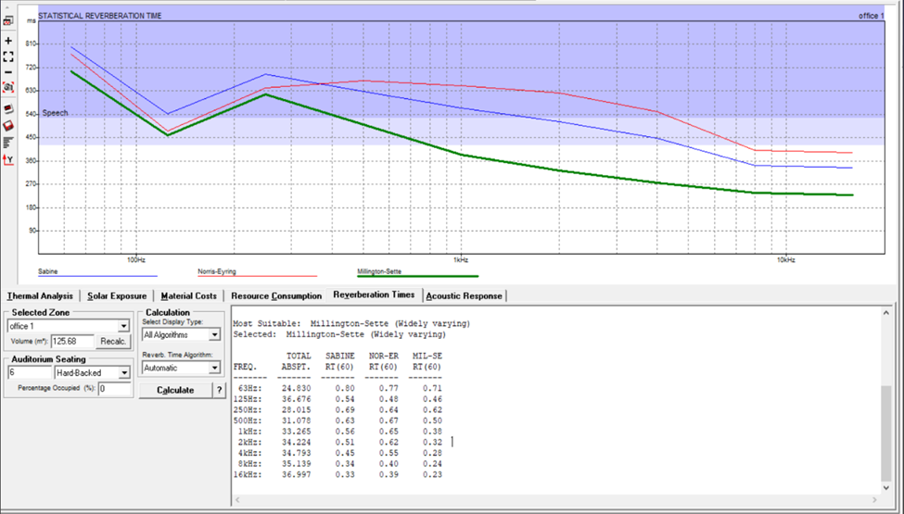
Reverberation time(RT60) for office room

Slide 28
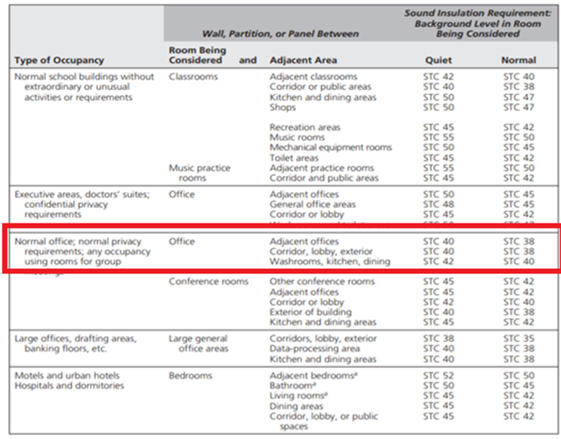
Sound transmission class (STC) standard

Slide 29
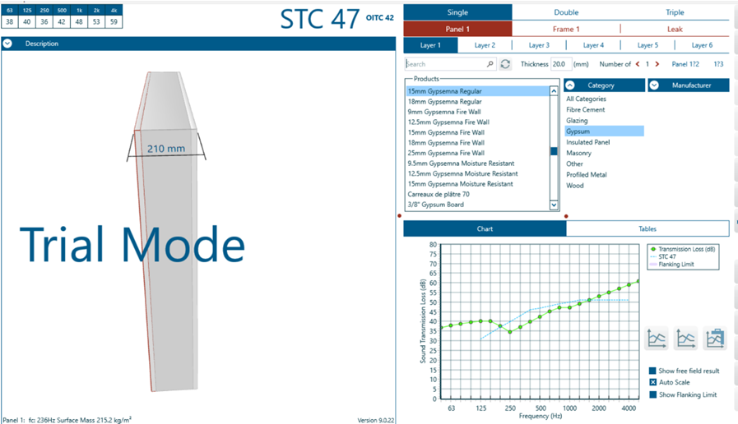
STC of the partition between two office rooms.

Slide 30
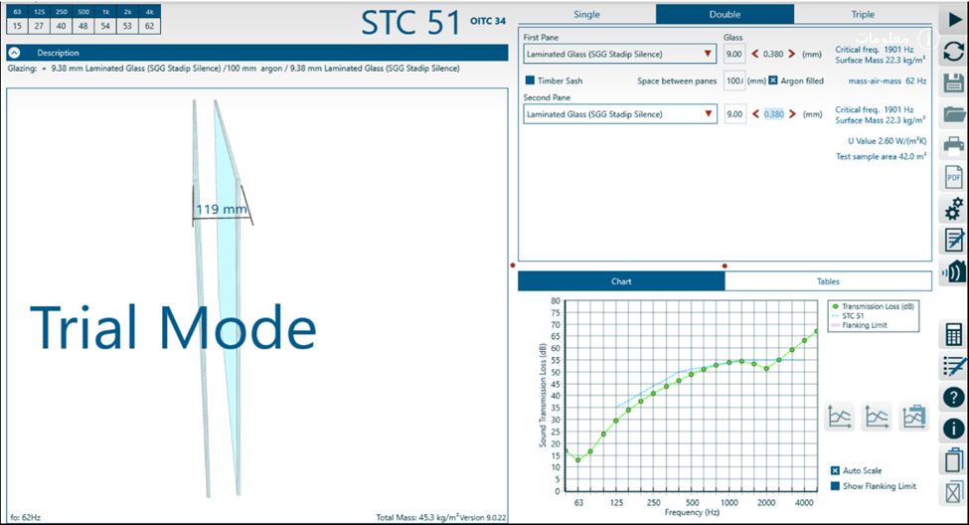
STC of the partition between office room and corridor

Slide 31
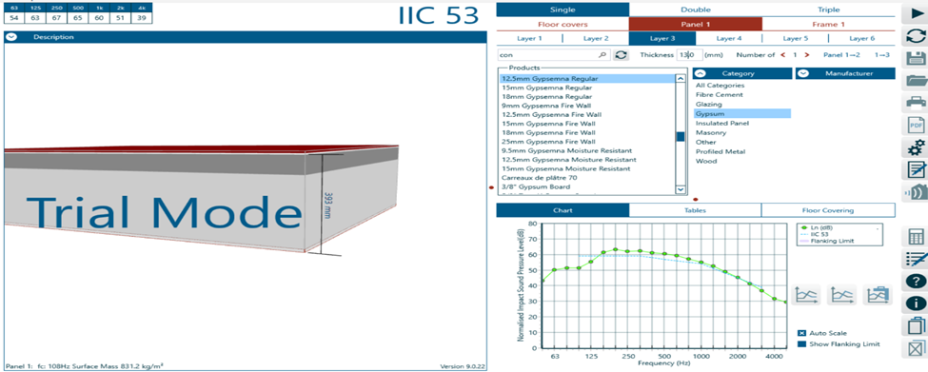
The IICC for the internal floor

Slide 32
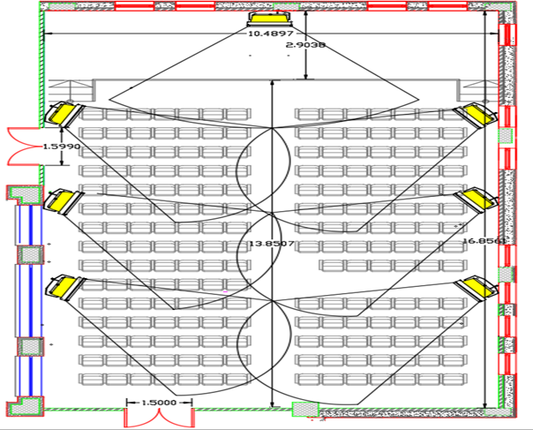
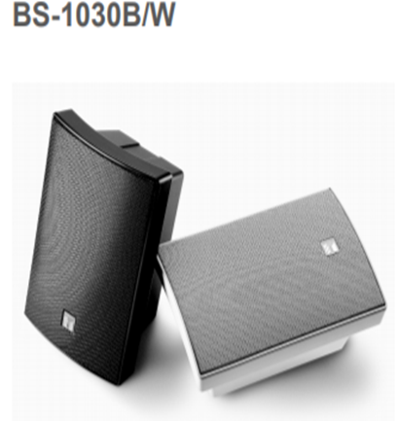
Speaker distribution in the conference hall
The # of speaker=
(area of space )/(coverage area)
=(177.5 )/25.2 = 7 speakers.

Slide 33
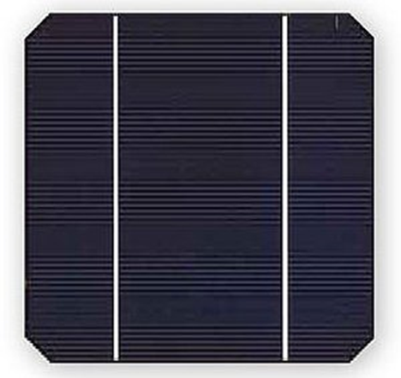
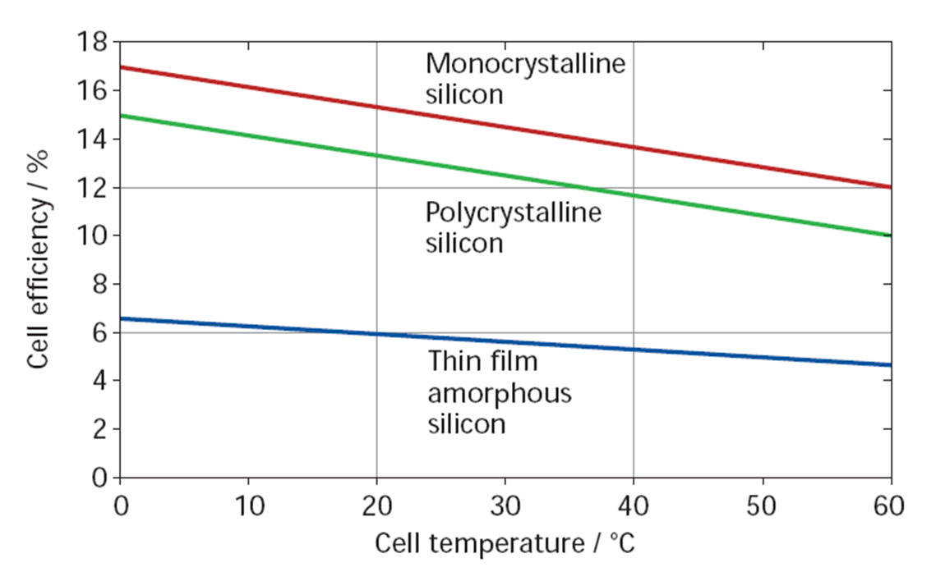
Photovoltaic
Monocrystalline

Slide 34
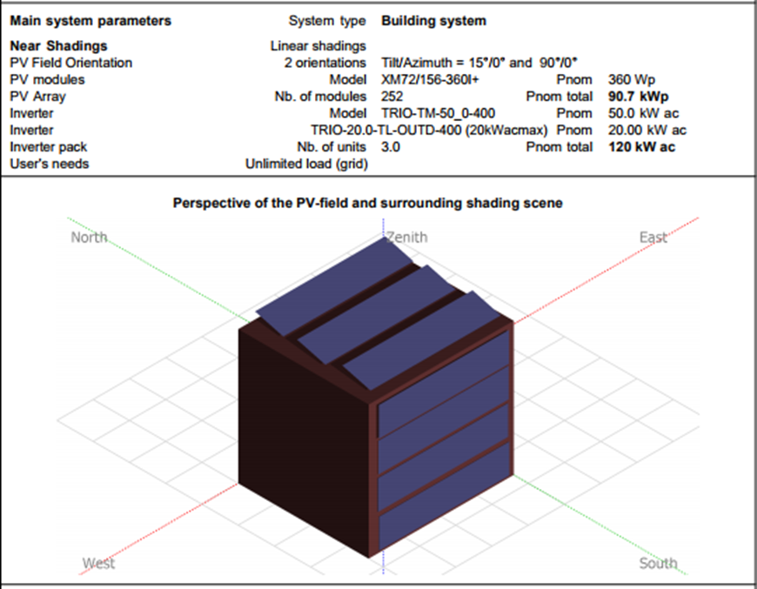
Photovoltaic
Total energy Produces the PV system=1348KWh/KWp/year*120KWp=161,760 KWh/year
Total energy Consumed the Building = 216,225.29 KWh/year
Plus Energy consumed from building = 216,225.29-161,760=54,465.29 KWh
Percentage of consumed energy from produced energy = 161760/216225.29×100=74.81%
This building is Nearly Zero Energy.

Slide 35
Structural
Design

Slide 36
Structural Design
Design Data :
Primary Design Assumptions
Slabs thickness 0.25 m
Columns(rectangular) 0.6×0.3m
0.6×0.4m
0.6×0.3m
0.6×0.6m
0.5×0.5m
Beams dimensions 0.6*0.25 m
0.6*0.35 m
0.6*0.40 m
0.6*0.50 m
0.25*0.25m
Shear Walls thicknesses 0.25 m
Structural system
Two way ribbed slab
Concrete Compressive Strength
Concrete B300
f’c =28 MPa
Yielding Strength Of Steel :
The Yield strength of steel Fy= 420MPa
Loads:
Live Load = 𝟒.𝟕𝟗 𝑲𝑵/𝒎²
SID= 2.5 𝑲𝑵/𝒎²

Slide 37
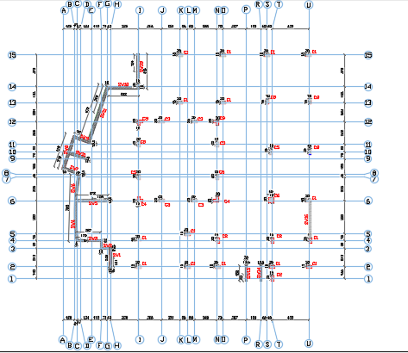
Structural Design
Columns Axis:

Slide 38
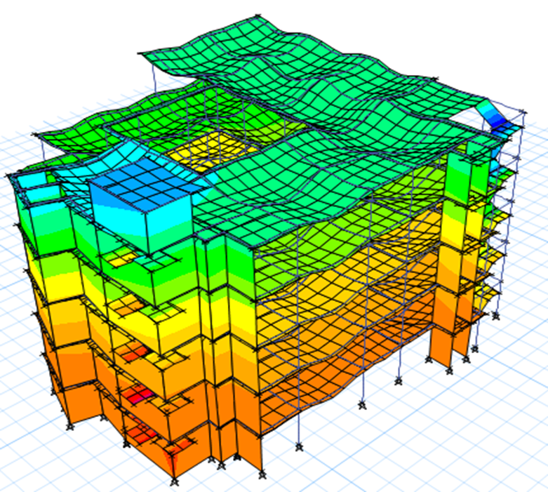
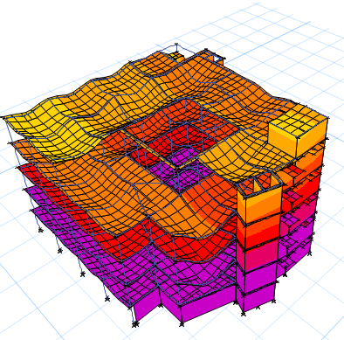
Structural Design
Compatibility Check
Check is OK

Slide 39
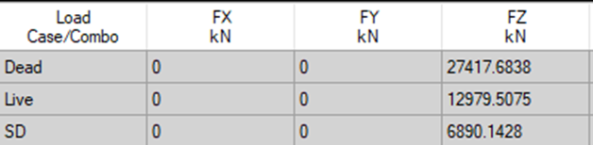
Structural Design
Equilibrium Check
Manually dead
load calculations
ETABS results
Error %
FLOOR | Slab area (m²) | DL _{SLAB} (KN) | DL _{BEAM} (KN) | DL _{COLUMN} (KN) | DL _{SHEAR WALL} (KN) | DL _{STAIRS} (KN) | DL _{TOTAL} (KN)
basement | 524.57 | 3,019.73 | 1,082.98 | 671.88 | 985.5 | 157.54 | 5,917.6
GF +FF+SF | 524.57 | 3,019.73 | 1,082.98 | 762.18 | 776.9 | 157.54 | 17,407.99
Third | 420 | 2,417.76 | 936 | 668.58 | 776.9 | 157.54 | 4,956.78
Four | 18 | 67.57 | 17.73 | - | 191.93 | - | 277.23
TOTAL DEAD LOAD (KN) |  |  |  |  |  |  | 28,549.63
LOAD | Manually calculation (KN) | ETABS Results (KN) | ERROR (%)
Dead | 28,549.63 | 27,417.68 | 4.13
Live | 12,866.86 | 12,979.5 | 0.87
Superimposed | 7,100 | 6,890.14 | 3.05

Slide 40
Structural Design
Stress &Strain check
Type | Manual Moment calculations (KN.m) | ETABS Moment Result (KN.m) | Error %
Slab | 64.76 | 62.42 | 3.75
Type | Manual Axial calculations (KN) | ETABS Axial Result (KN) | Error %
Column (corner) | 923.77 | 952.75 | 3.04
Column (edge) | 1,025.5 | 993.43 | 3.23
Column (Interior) | 3,244.2 | 3128.83 | 3.68
Type | Manual Moment calculations (KN.m) | ETABS Moment Result (KN.m) | Error %
Beam | 33.2 | 31.8 | 4.42

Slide 41
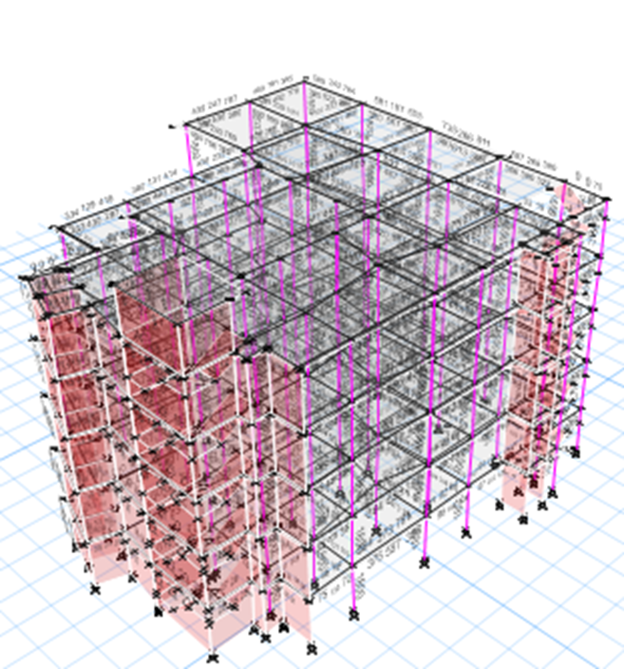
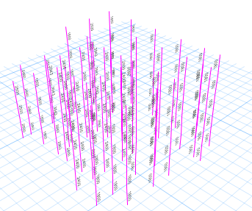
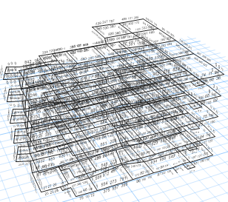
Structural Design
Check designed member

Slide 42
Structural Design
Seismic load
Load definition:
100%(D.L+SID)
25% L.L
Code: UBC-97
Definition function:
zone at Jerusalem, 2A
Seismic zone z=0.15
The soil type =S_{C}
Acceleration-dependent seismic coefficients Ca=0.18
Velocity-dependent seismic coefficients Cv= 0.25.
Importance factor I=1.25
Force reduction factor R=5.5
Load Combination:
Ws = 1.D.L +1.L.L +1.S.I.
Ws = 0.9 D.L + 0.9S.I + 0.71EQx.
Ws = 0.9 D.L + 0.9S.I + 0.71EQy.
Ws = 0.9 D.L + 0.9S.I + 0.75L.L+ 0.54EQx.
Ws = 0.9 D.L + 0.9S.I + 0.75L.L + 0.54EQy.
Wu= 1.2D.L + 1.2S.I + 1.6L.L.
Wu= 1.4D.L + 1.4S.I.
Wu= 1.3D.L + 1.3S.I + 1L.L ± 1EQx.
Wu= 1.3D.L + 1.3S.I + 1L.L ± 1EQy.
Wu= 0.8D.L + 0.8S.I ± 1EQx.
Wu= 0.8D.L + 0.8S.I ± 1EQy.

Slide 43
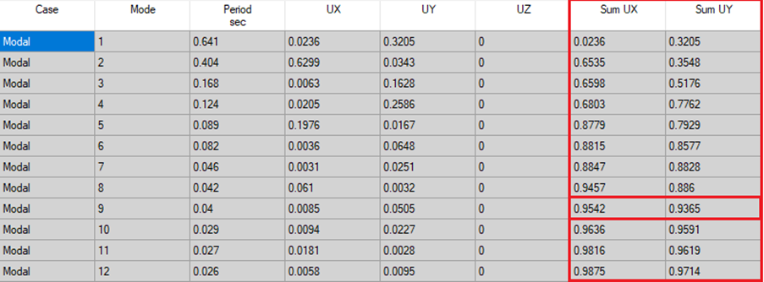
Structural Design
Modal Participating Mass Ratio Check
Period Check
9 modal needed to get 95.42 % in x and 93.65% in y-direction from the full mass of model.
T manually | 1.4*T Manually | T ETABS | T ETABS < 1.4*T Manually
0.468 sec | 0.6552 sec | 0.641 sec | 0.641<0.6552 OK

Slide 44
Structural Design
Base shear check
Manually Calculations: V=3,894.5 KN
ETABS Result: EQx (ETABS) = 5784.75 > 3894.5 (Manually)
EQy (ETABS) = 3901.31 > 3894.5 (Manually) check is OK.
Story drift check
TABLE: Diaphragm Center of Mass Displacements |  |  |  | ΔS |  | ΔM
Story | Load Case/Combo | UX (mm) | UY (mm) | Drift x | Drift y | x | y
Story6 | envelope Max | 23.405 | 6.288 | 3.442 | -21.378 | 13.25 | -82.3053
Story5 | envelope Max | 19.963 | 27.666 | 5.174 | 10.669 | 19.92 | 41.07565
Story4 | envelope Max | 14.789 | 16.997 | 5.47 | 8.347 | 21.06 | 32.13595
Story3 | envelope Max | 9.319 | 8.65 | 4.856 | 6.059 | 18.70 | 23.32715
Story2 | envelope Max | 4.463 | 2.591 | 3.38 | 2.03 | 13.01 | 7.8155
Story1 | envelope Max | 1.083 | 0.561 | 1.083 | 0.561 | 4.17 | 2.15985
Base |  | 0 | 0

Slide 45
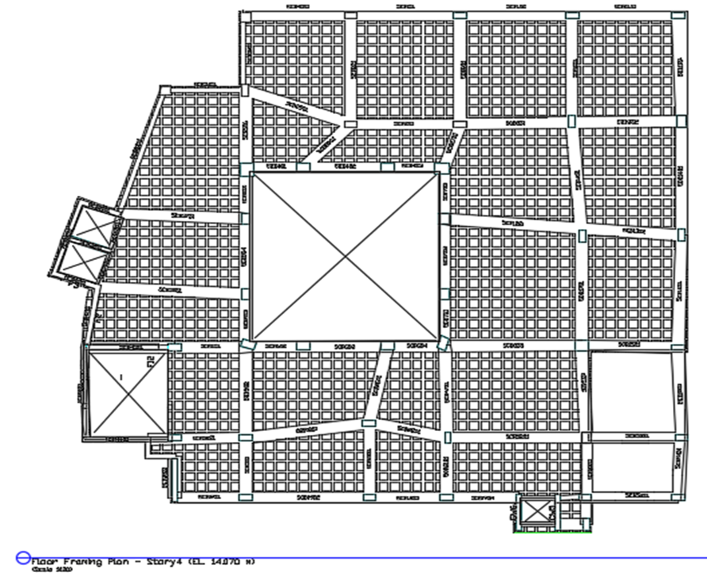
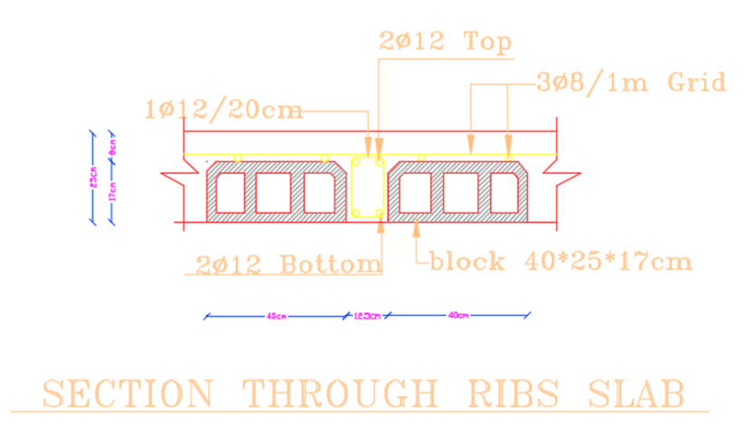
Structural Design
Detailing
Slab

Slide 46
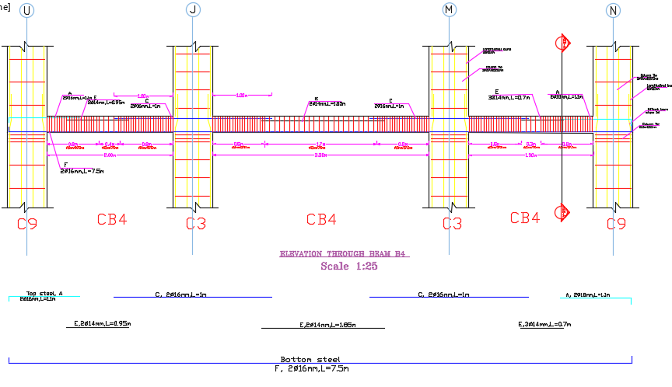
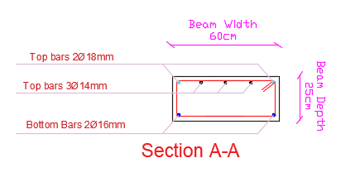
Structural Design
Detailing
Beam

Slide 47
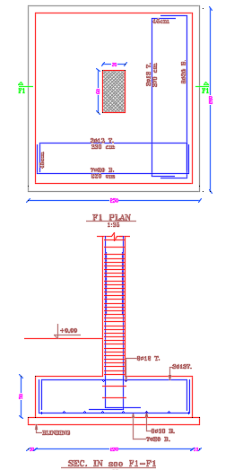
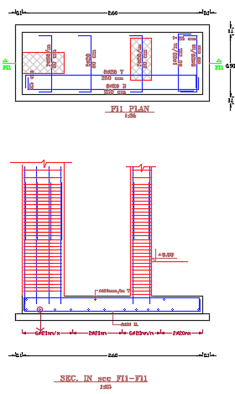
Structural Design
Detailing
Column & footing

Slide 48
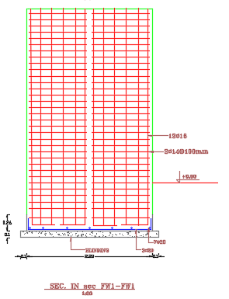
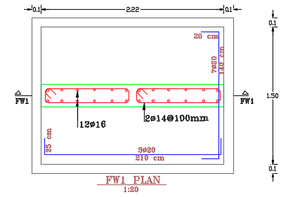
Structural Design
Detailing
Shear wall

Slide 49

Structural Design
Detailing
Stairs

Slide 50
Electro - Mechanical
Design

Slide 51



HVAC system design for heating and cooling:
This system is to make sure that all the employees in the building are comfortable in winter and summer. There are many HVAC system that can be used, but the VRF System are the suitable for the cooling and heating in the building
From Design Builder program simulation. the cooling load was a 117.4 KW and the heating load was 80.7 KW.
The components of the VRF system from Samsung Company:
1) Outdoor unit
The building needs a capacity of 118 KW (37 Ton).
2) Indoor unit
Fan coil: it has flow rate of 0.61 m^{3 ,} 0.28 m³/s and 0.19 m³/s
Diffusers (60*60): with a flow rate of 0.10 m³/s .
Diffuser model
fan coil unit
outdoor unit

Slide 52
The volumetric flow rate for each space in the building calculated from Design Builder program as can be noticed in below Table.
The calculated air flow for the basement floor
* From the calculated air flow, the number of fan coil calculated shown in below table.
The number of the indoor units that are needed in the basement floor

Slide 53

Below Figure, shows the HVAC design for the basement floor.

Slide 54

Duct sizing by using balanced pressure drop method
The balanced pressure drop method was used to find the channel diameters in the building.
The distribution of the ducts in the corridor
To calculate the channel size, Duct Sizer Program was used.

Slide 55
Safety design
The most usual hazard that occurs is fire hazard, and to protect the occupants, there is three stages as can be noticed in the following Figure .
1) Detection and notification system.
2) Suppression System.
3) Emergency signs and lights.
1) Detection and notification system
The importance of this system is to alarm the occupancies when the hazard occurs immediately, to stop the fire before it spread and cause many damages.

Slide 56




the detection and notification system symbols
Manual fire alarm
Smoke detector
Heat detector

Slide 57

2) Suppression System
In the following Figure, shows the symbols that will be used in the plans for this system.

Slide 58
In the following table, it shows the location of each type of sprinkler used that depends on the function of each space.
In the following Table , it shows the location of each type of extinguisher used depending on the function of each space.

Slide 59



3) Emergency Lighting and signs
The importance of this system when the fire occurred and the occupants are panic, so these signs tell them where to go and escape form the building safe.
Emergency rout sign
Exit sign
Emergency lighting

Slide 60

In Figure the following, shows the second floor that contains the safety and fire design.

Slide 61

Water supply system
Capacities and Tanks
In the beginning, volume and number of tanks must be determined. To start with this step, it is required to evaluate the amount of water that used in building per person.
Amount of water for institutions per person

Slide 62
Water Usage = 45 L/day. Person.
Average yearly rainwater fall thickness on meter² in Palestine = 600 ml.
18% from rainwater fall stored in water tank (W*L*H = 3*6*3) = 54 m³
Minimum amount of water for firefighting 30% from total water demand.
Capacity of each tank used = 3000 Liter, with 1.42 m width (radius) and 2 m height.
Tanks connection with each other in series mode.
Using Atmor devices beside lavatories for hot water.
Usage of water | Liter /P.day | Person number | Days | Total Liters | Tanks number
Fresh water | 45 | 200 | 3 | 27000 | 9 ( 3 m³ per Tank)
Rainwater (Cleaning) | - | - | - | 54000 | 1 ( 3*6*3 Tank) On basement
Rainwater (Cleaning) | - | - | - | 6000 | 2 (3 m³ per Tank) On Roof
Firefighting water | 30% of fresh water demand | - | - | 9000 | 3 ( 3 m³ per Tank)
Capacity and number of tanks

Slide 63
Pumps
Pump for rainwater tank on basement to supply water to rainwater tank on roof.
Two Pumps for firefighting tank on roof to supply water with suitable pressure to sprinklers and hoses.
Auxiliary pump for Second and Third floor with 6 Psi (Pressure).
Pipes for water supply system
From MEEB book the Number of fixture units was calculated :
Type of fixture | Occupancy | Type of supply | Fixtures number | Fixture Units | Total
W.C | Public | Flush Tank | 5 | 5 | 25
Urinal | Public | - | 2 | 3 | 6
Lavatory | Public | Faucet | 5 | 2 | 10
Kitchen sink | Public | Faucet | 1 | 3 | 3
Total Fixture units |  |  |  |  | 44
Fixture units in B1 Floor

Slide 64
Type of fixture | Occupancy | Type of supply | Fixtures number | Fixture Units | Total
W.C | Public | Flush Tank | 6 | 5 | 30
Urinal | Public | - | 2 | 3 | 6
Lavatory | Public | Faucet | 6 | 2 | 12
Kitchen sink | Public | Faucet | 1 | 3 | 3
Cafeteria Sink | Public | Faucet | 1 | 4 | 4
Total Fixture units |  |  |  |  | 55
Fixture units in 3rd Floor
* Total Fixture Units for Basement Floor = 44 F.U.
* Total Fixture Units for Ground Floor = 44 F.U.
* Total Fixture Units for First Floor = 44 F.U.
* Total Fixture Units for Second Floor = 44 F.U.
* Total Fixture Units for Third Floor = 55 F.U.

Slide 65
Diameters for pipes:
First step is finding water flow rates with gpm unit, Figure 1 is used to determine the water flow rates and Figure 2 used to find diameters of vertical, horizontal and branches for floors.
Figure 2: Diameters of water supply pipes
Figure 1: Water flow rates (gpm)

Slide 66
Total Available losses = available pressure – critical pressure = 23.15 – 5 = 18.15 Psi
Main Vertical feeder = 2" with 3.8 Psi loss.
Horizontal feeder = 1" with 1.7 Psi loss.
Branch feeder = 3/4" with 1.2 Psi loss.
Total Losses = 3.8 + 1.7 + 1.2 = 6.7 Psi < 18.15 Psi (Ok).
Diameters for pipes in all floors: -
Main Vertical feeder = 2".
Horizontal feeder = 1".
Branch feeder = 3/4".

Slide 67
Drainage system
Design and determine appropriate diameter for pipes of drainage system depend on water flow for these stacks and sewers. Manholes that used to collect water from water closets and urinals called black manholes, and from showers, lavatories, sinks, water traps and drains called gray manholes.
 | Diameter (Inch) | Direction of pipe | Slope
Lavatories | 2" | Horizontal | 2%
Kitchen sink | 2" | Horizontal | 2%
Water closet (W.C) | 4" | Horizontal | 1%
Pipe for floor Traps connects to stacks | 4" | Horizontal | 1%
Pipe of Vent | 2" | Vertical | 0%
Pipe between manholes | 6'' | Horizontal | 1%
Drainage system diameters

Slide 68
DFUs in large stack = (dfu of Urinal * 2 + dfu of W.C * 2) * number of floors
= ( 4 * 2 + 4 * 2 ) * 5 = 80 dfu.
Maximum number of DFUs for stacks in building = 80.
Three branch intervals.
Stacks diameter = 4".
Fixtures | Diameter
Lavatory | 2 in
Water closet (W.C) | 4 in
Kitchen Sink | 2 in
Urinal | 2 in
Vent Pipe | 2 in
Stacks | 4 in
Between Manholes | 6 in
Fixtures and system drainage diameters

Slide 69

Manholes
Two types of manholes, first one for black water that collect it and move through Main City sewer line for black water, and the second type manholes gray water that collect these water for store it in special tank and reuse it for flushing or get rid of these water through main city sewer for gray water.
Manholes (G) for gray water and manholes (B) for black water

Slide 70


Power Distribution
Our Building Supplied from two sources. Normal supply and Solar PV (without Battery).
As our Building is NZEB, During Day time it will be supplied from PV. While, during night time will be supplied from Normal supply.
The switching from Solar to Normal supply done by automatic controller

Slide 71


Electrical Installations
All Electrical Systems design was coordinated with other systems either ceiling Light (Coordinated with Fire, Sound, false ceiling) or wall Sockets/switches (Coordinated with Furniture).
Lighting System
Power Sockets
Telephone System
TV System
Data System

Slide 72


Lighting System
We make Lighting System design by DiaLUX Evo Software. According to Illumination Level requirement for each area.
We select all our Light fixtures LED Type and we take in consideration the Architectural view also
Each Area have it’s on/off control switch. Beside that, for corridors and large room with multiple doors we use 2-way switches.
Area | Illumination
Bath room | 200
kitchen | 200
Corridor | 200
Meeting room | 500
Manager room | 500
office | 500
library | 500
cafeteria | 200

Slide 73



Power Socket
We distribute the Power Sockets according to space requirements. Including:
- Single power socket
Double power socket
Floor mounted power socket.

Slide 74



Low Current Systems
Telephone System:
We use IP Telephones in all office, meeting & Manager rooms.
TV System:
We add TV Sockets for Manager Rooms, cafeteria & Library.
Data System:
We add 2 wifi routers -Ceiling mounted- in each floor.

Slide 75





Electrical Calculations
Cable Sizing:
The size of all power cables shall be determined in accordance with:
Load Current taking in consideration the de-rating factor for cable installation.
max. Permissible voltage drop (3%).
Breaker Sizing:
Breaker sizing determined after calculating the Load current X 1.25
and selecting the next upper standard breaker rating.
Important Equations:
$$I (1−ph)= \frac{P}{V X P.f }$$
Where:
I(A): Current, P(w): Power, P.f: Power factor
V(v): 1-phase volt, VL(v): 3-phase volt
Vd(v): Voltage drop, L: Cable Length
$$I (3−ph)= \frac{P}{\sqrt{3}X VL X P.f }$$
$Vd=\left(mv.A.m\right) X$I X L

Slide 76
Quantity Surveying & Cost Estimate

Slide 77

Quantity Surveying & Cost Estimate
Cost Breakdown Structure (CBS)

Slide 78
Quantity Surveying & Cost Estimate
Material cost of Structure
material | Unit | Cost (ILS) | Waste factor % | Total cost (ILS)
Concrete | CM | 320 | 7 | 342.4
reinforcement | Ton | 2800 | 8 | 2808
formwork | SM | 20 | 11.5 | 22.3
Stone | SM | 120 | 10 | 132
Cement | bags | 30 | 5 | 31.5
Sand | CM | 60 | 10 | 66
Insulation | CM | 150 | - | 150
Block | unit | 2 | 9 | 2.18
Tile | SM | 100 | 5 | 105
Paint | L | 80 | 5 | 84
Doors | unit | 750,1200,1600, 1700,2000,4000 | - | 750,1200,1600, 1700,2000,4000
windows | unit | 20,40,90 | - | 20,40,90
Granit sink | SM | 5 | - | 5

Slide 79
Quantity Surveying & Cost Estimate
Labors cost
Item | Unit | Cost (ILS)
Concrete | CM | 20
reinforcement | Ton | 880
formwork | SM | 17.78
Stone | SM | 25
Plaster | SM | 7.4
Insulation | CM | 20
Block | SM | 18
Tile | SM | 395
Paint | SM | 47.5

Slide 80
Quantity Surveying & Cost Estimate
Total Cost
Item | Cost (ILS)
Earth work | 46048.99
Foundation | 105816.66
Structure Elements | 1491880.27
Finishing | 1033817.34
Plumbing | 223268
HVAC System | 340485
Electrical System | 384835
TOTAL COST | 3,626,151.26

Slide 81
Thank you

