Slide 1

Deer Balak Alena
An AI-Based Emergency
Management System for Palestine

Slide 2

Department
Our Team
Supervisor’s Name
Farah Assaf
Computer Science (CS)
Dr.Mustafa Assaf
Lial Awwad

Slide 3

Introduction
The Deer Balak Alena project aims to fill a critical gap in public safety communication across Palestine. Amid frequent threats, misinformation, and unreliable reporting sources, the system offers a unified platform that delivers real-time alerts and verifies the credibility of reports using advanced AI techniques. By enabling residents to share and receive trustworthy information quickly and securely, the platform fosters a more informed, connected, and resilient community—reducing confusion, minimizing panic, and enhancing daily safety awareness.

Slide 4
Literature Review
Current emergency notification systems in Palestine are fragmented and rely on traditional methods such as phone calls, email, and social media, which often cause delays and allow misinformation to spread. These systems lack real-time verification and centralized communication, especially in high-risk areas.
Deer Balak Alena introduces an AI-powered platform that verifies user identities, analyzes the credibility of reports, and delivers real-time, location-based alerts. By combining intelligent verification with user feedback, the system ensures reliable information sharing and helps create a safer, more informed community.informed and resilient society.

Slide 5
Objectives
Build an intuitive and user- friendly platform for public safety
Enable seamless risk reporting and alert sharing.
Use AI to validate reports and detect fake names or spam.

Slide 6
Enhance trust by combining AI scoring with user feedback.
Objectives
Ensure timely and accurate delivery of verified information.

Slide 7
Requirements Analysis

Slide 8
Functional Requirements
User Registration & Trust Score
Trust score based on account behavior, and verification.
Fake News Detection
spam & fake content flagged automatically; dynamic credibility scoring.
age,
Risk Reporting & Alerts
Name Validation
Incident reports scored by AI; verified ones trigger real-time, geo-targeted alerts.
AI filters suspicious names; ID verification required when needed.

Slide 9
Functional Requirements
Notifications
Alerts sent via app/email based on location, risk, and user trust level.
Data Analysis
Risk trends, report heatmaps, and behavior analytics for admins.
Trust & Safety System
Accounts with repeated violations are flagged or banned automatically.

Slide 10
Non Functional Requirements
Performance & Scalability
Send alerts instantly
Process thousands of reports per minute
Prioritize reports from verified users
Horizontally scalable backend
Security & Privacy
-End-to-end encryption for all data
-Two-Factor Authentication (2FA)
-Role-based access control for admins
-User data protected and private

Slide 11
Non Functional Requirements
Reliability & Availability
-Auto backups every 10 minutes
-Cloud-independent & failover-ready architecture
-Automatic reboot and recovery
Usability & Accessibility
-Simple, mobile-friendly interface
-Full support for Arabic & English
-Designed for users aged 17+
-Interface follows Jakob’s Law for easy navigation

Slide 12
System Design

Slide 13
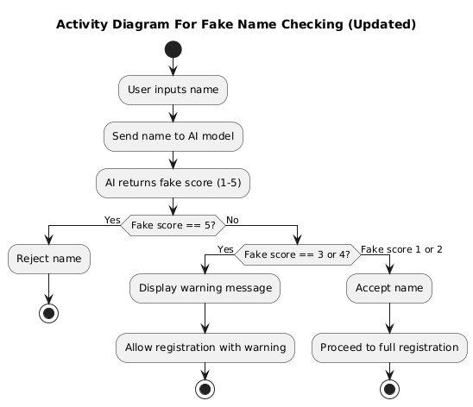
Activity Diagram

Slide 14
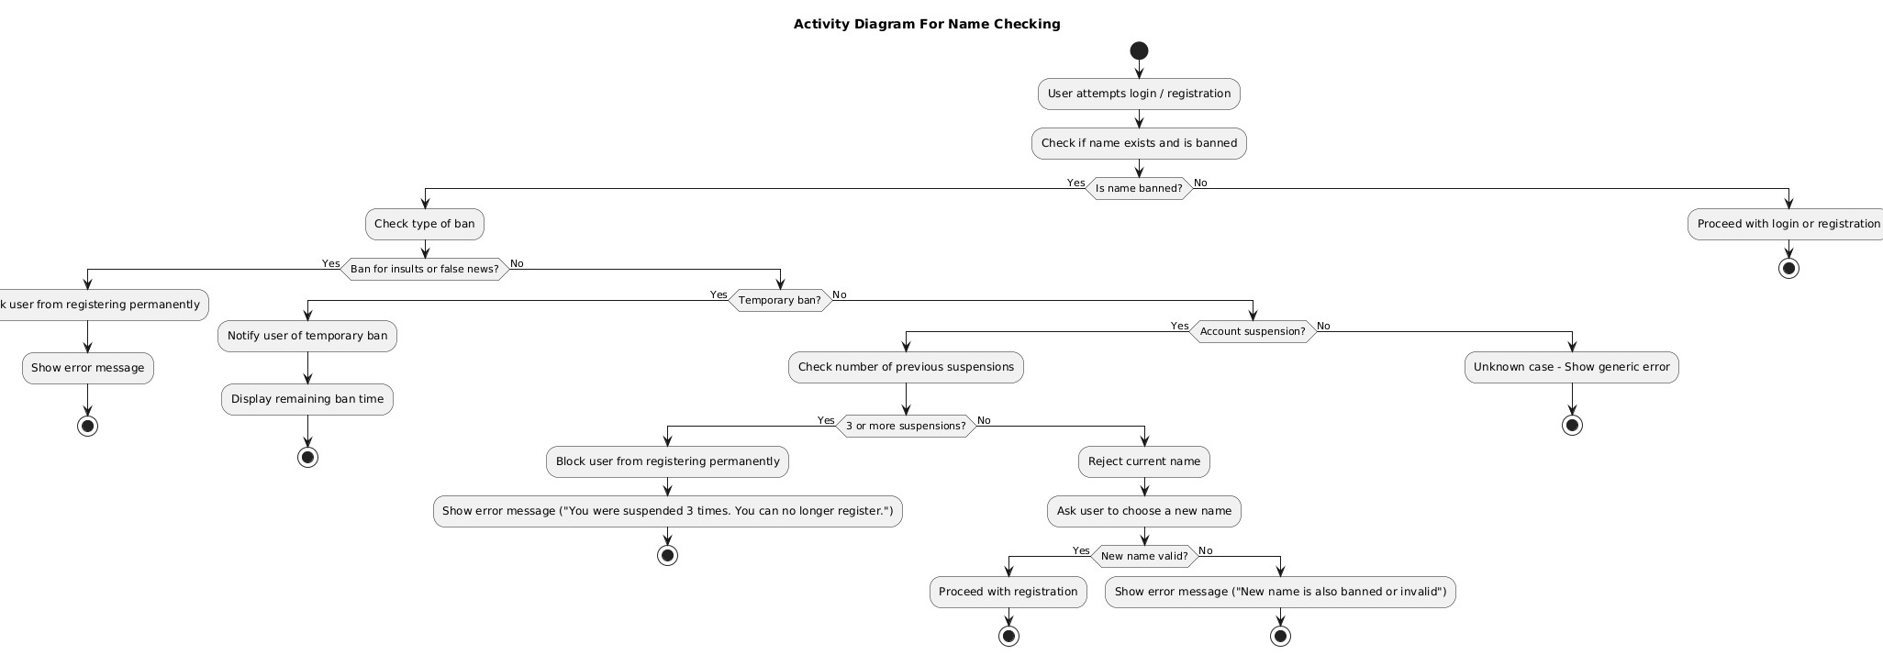

Slide 15
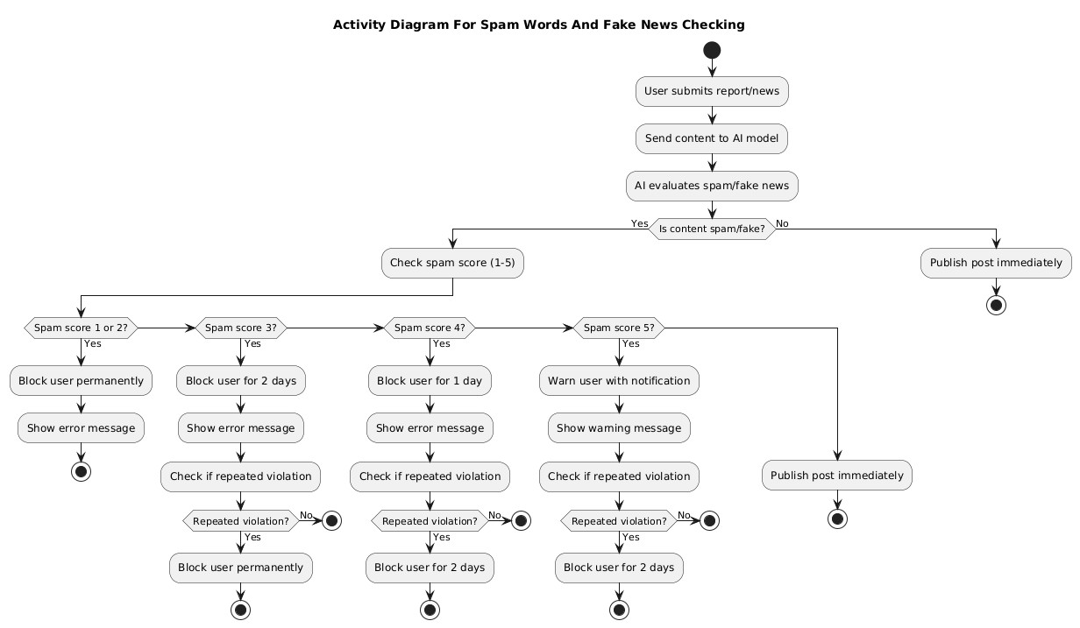

Slide 16
Technologies and Tools Used

Slide 17



Programming languages
Front-end

Slide 18


Programming languages
Back-end

Slide 19




Frameworks and libraries
Front-end
Back-end

Slide 20

Databases

Slide 21

Development tools

Slide 22
Implementation

Slide 23
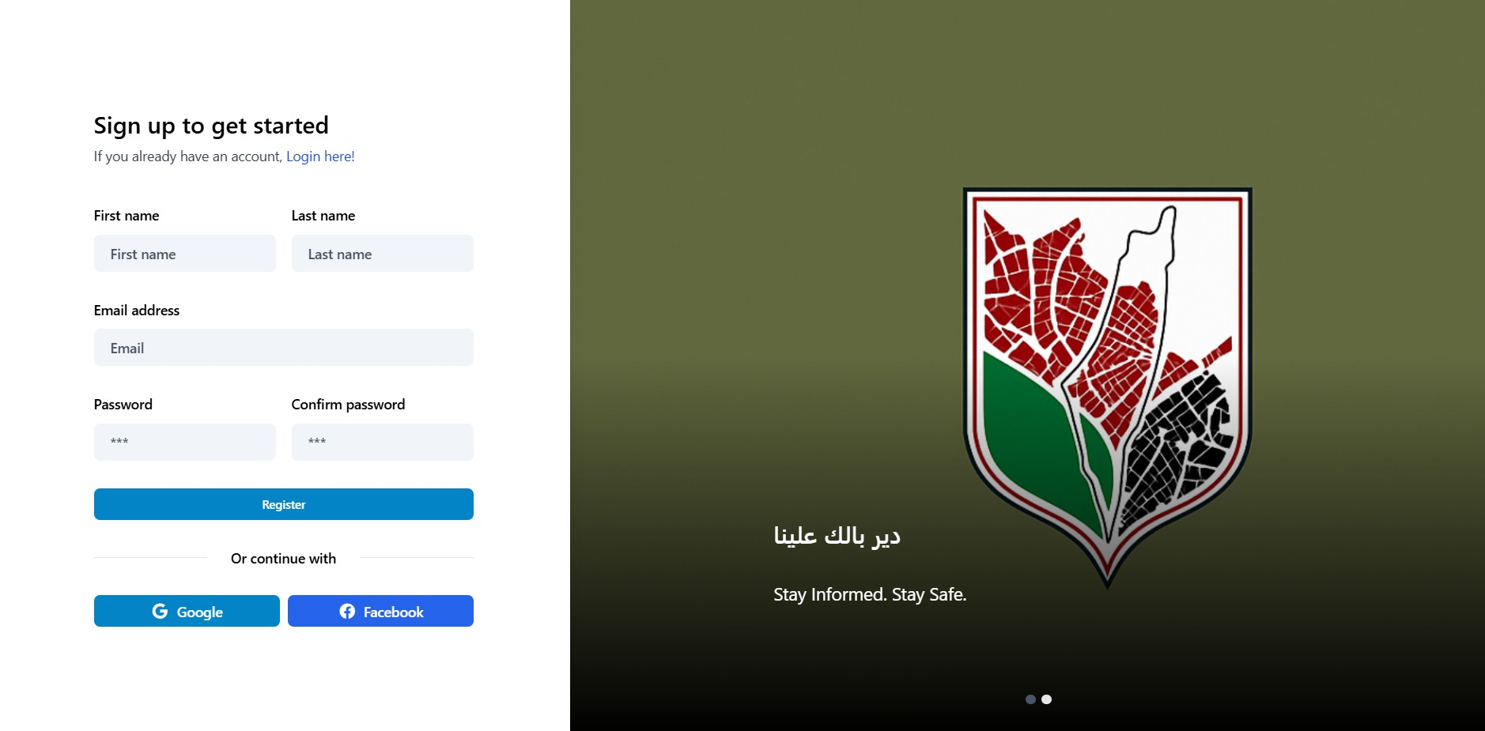
Sign up

Slide 24
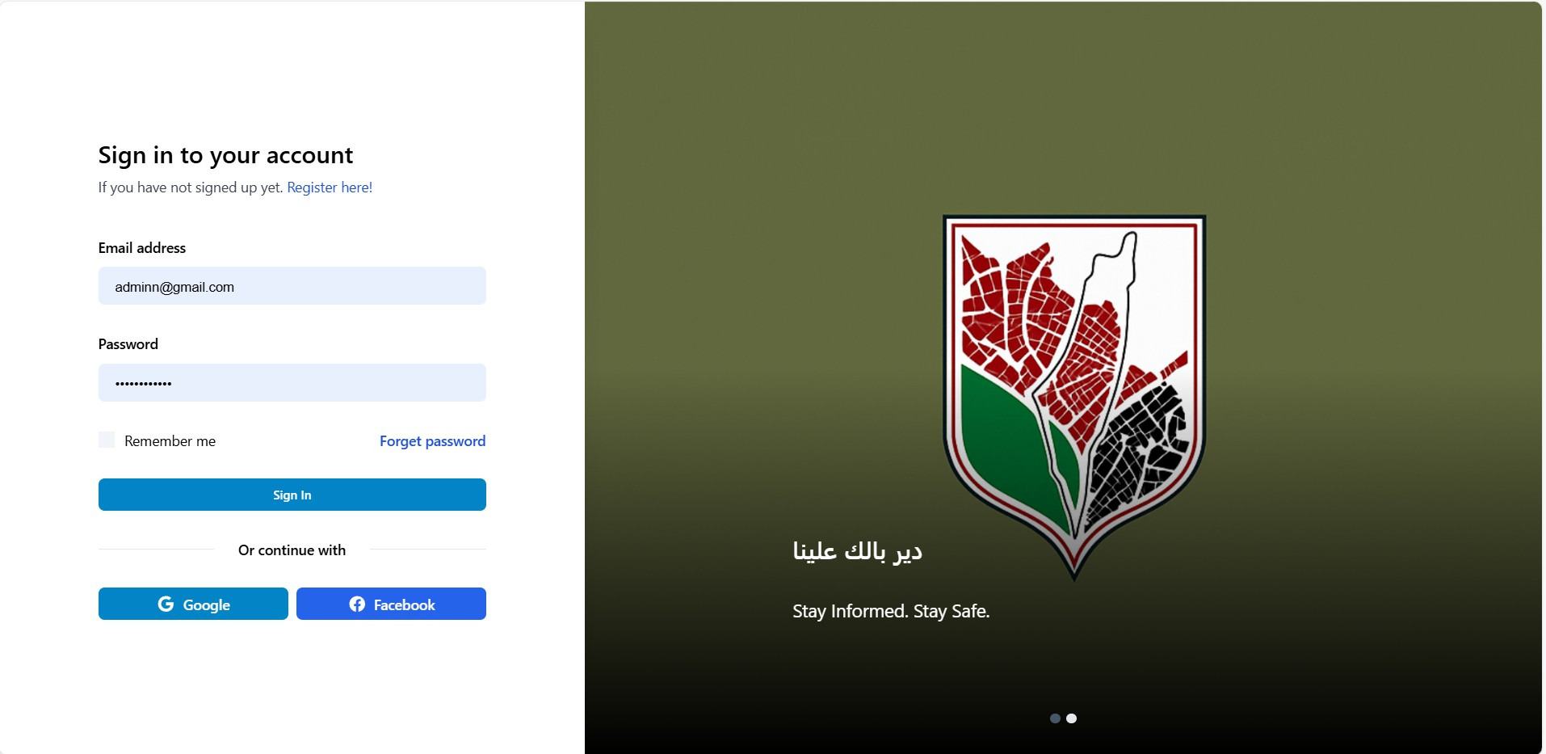
Sign in

Slide 25
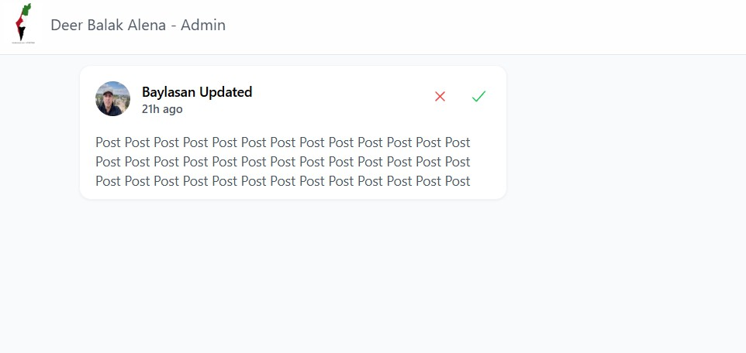
Admin page

Slide 26
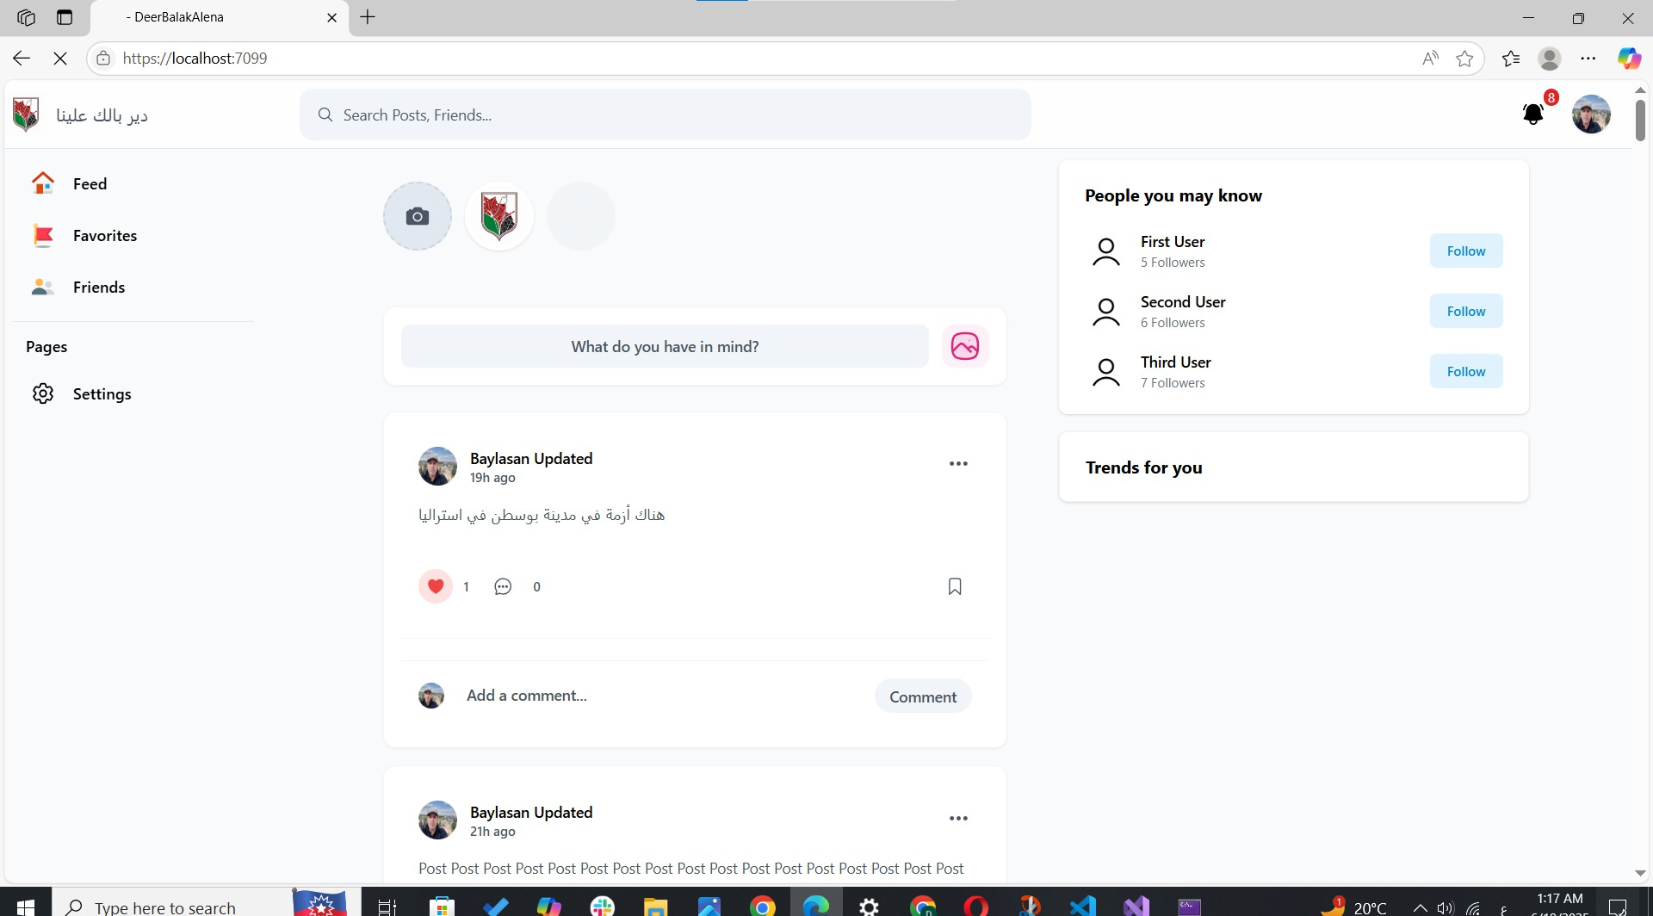
Home page

Slide 27
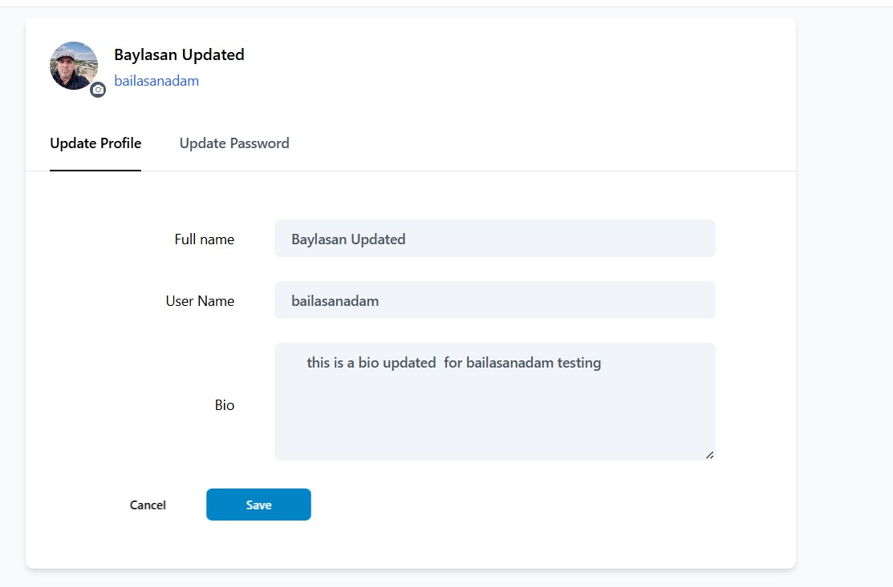
Update profile

Slide 28
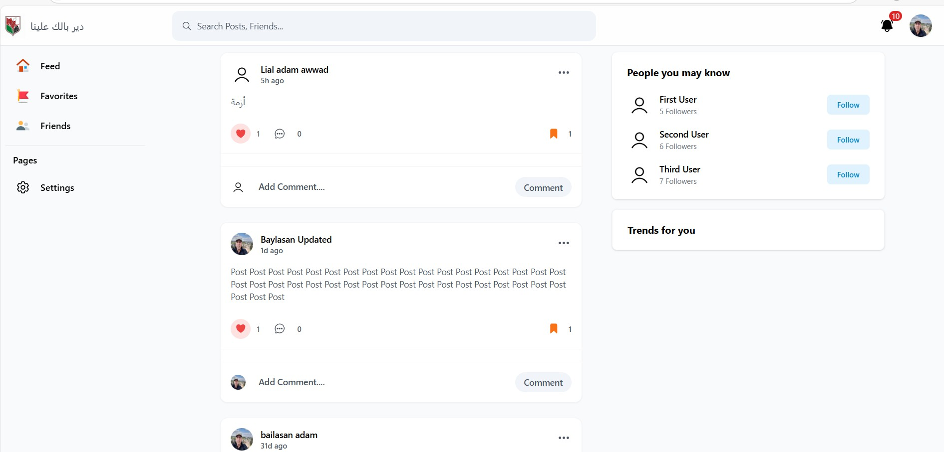
Favorites page

Slide 29
Update profile

Slide 30
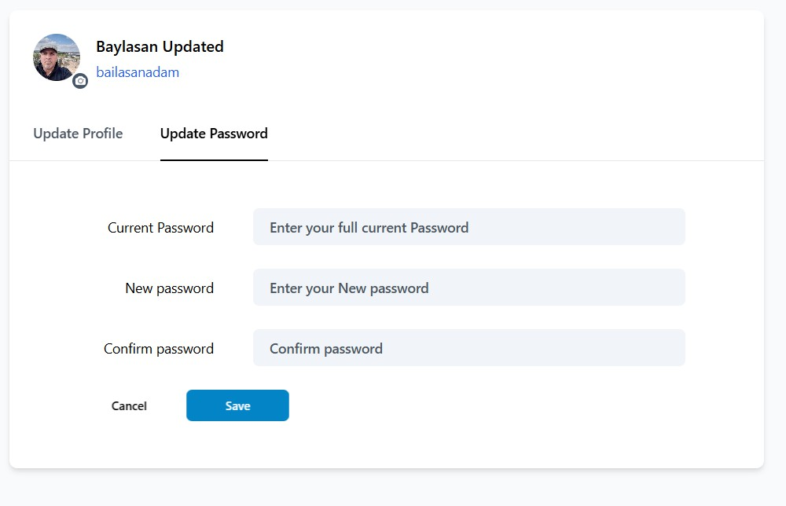
Update Password

Slide 31
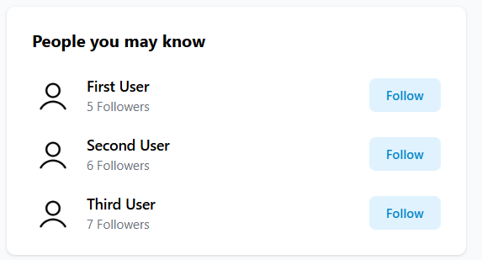

Slide 32
Testing and Evaluation

Slide 33
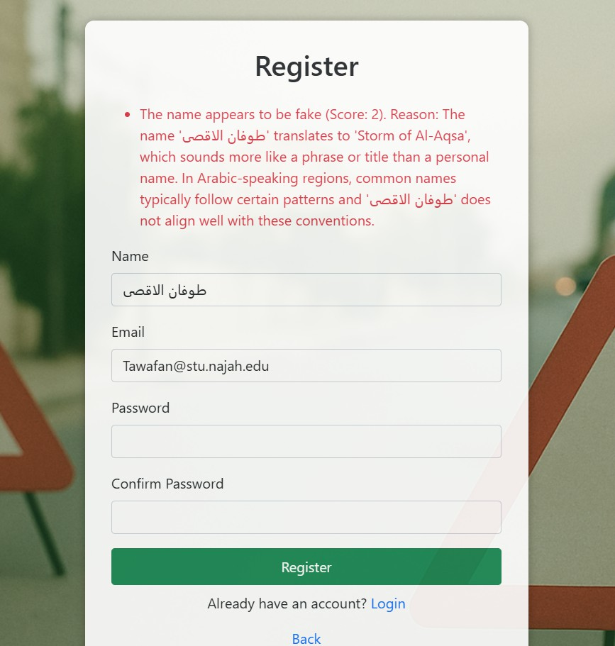

Slide 34
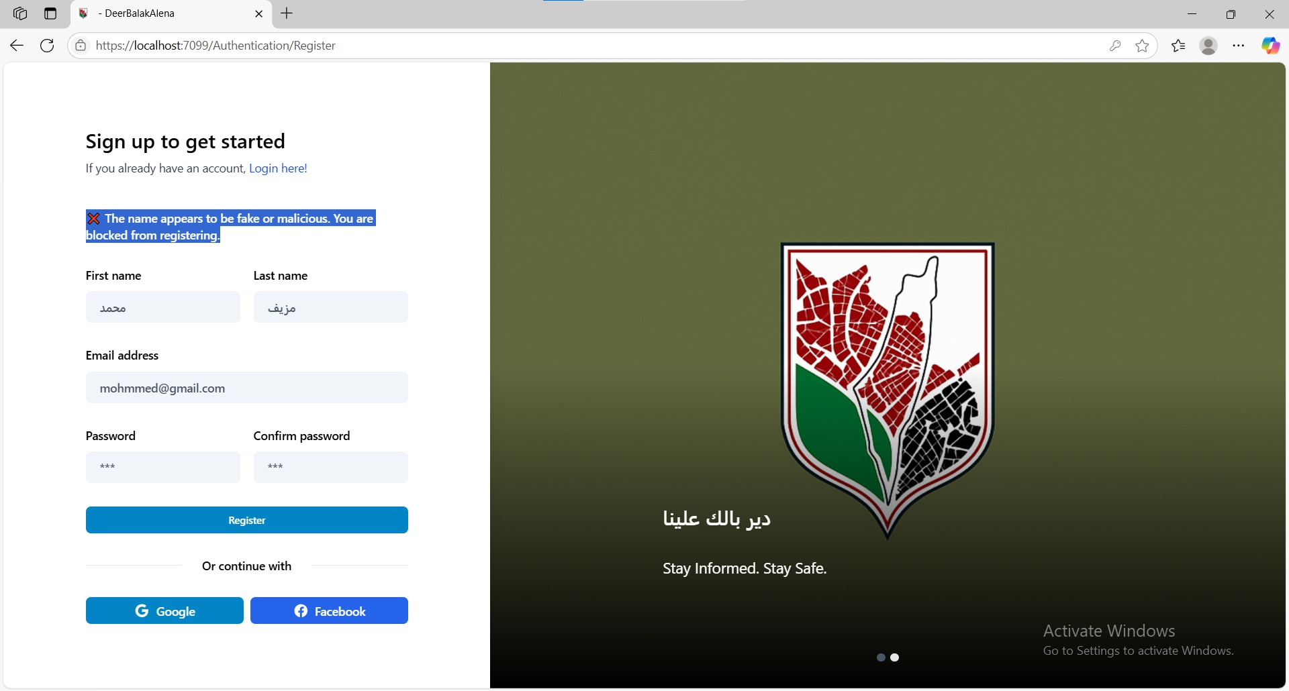

Slide 35
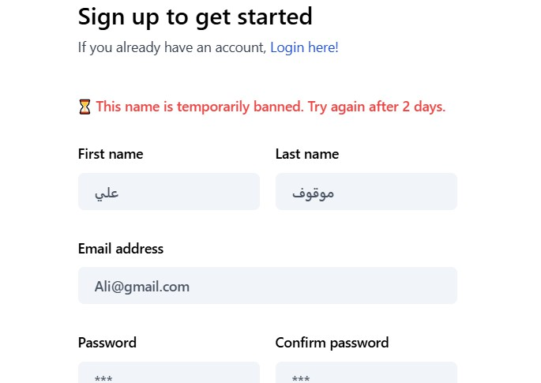
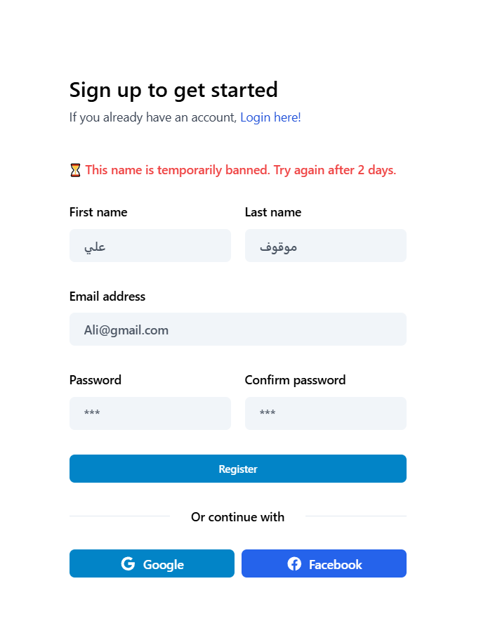

Slide 36
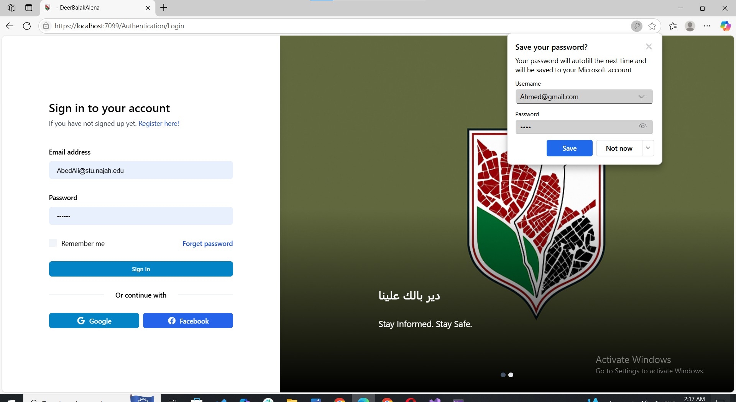

Slide 37
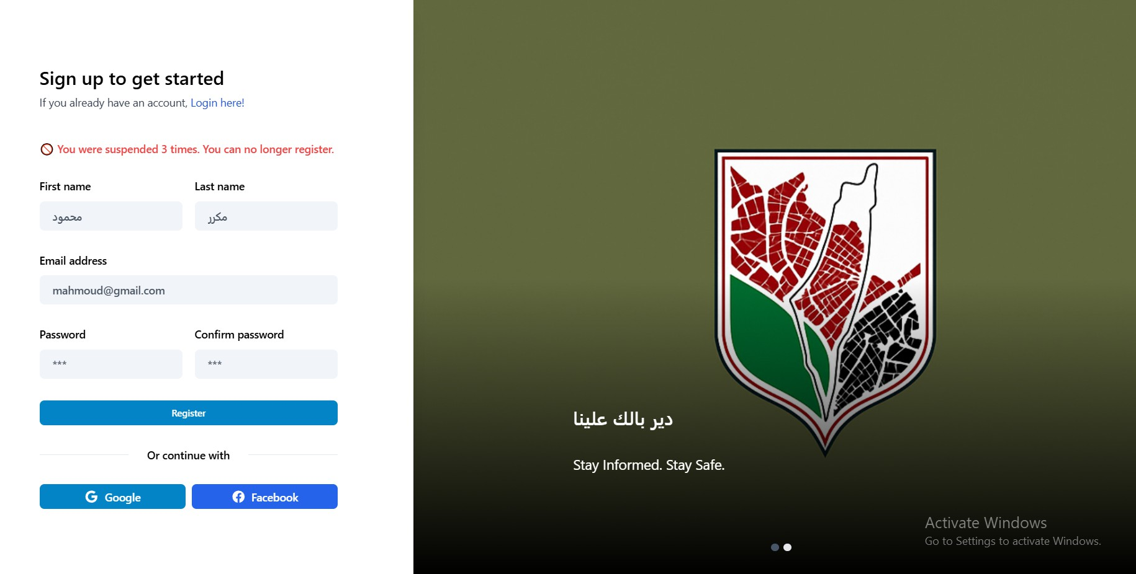

Slide 38
Challenges faced

Slide 39
AI Accuracy and Training Time
The AI model initially gave unreliable results when detecting fake names or spam content.
We refined the dataset, improved labeling, and conducted multiple training cycles to enhance accuracy.
Real-Time Alert Delivery Under Load
Ensuring fast delivery of alerts, especially under heavy usage, was technically challenging.
We optimized backend performance and used prioritization for verified users.

Slide 40
Gaining User Trust in Sharing Personal Data
Users were hesitant to provide ID or contact details for verification.
We introduced transparent messaging and strong data encryption to protect privacy and build trust.
Handling Multilingual Content (Arabic/English)
Language variation in reports created challenges for AI detection.
We trained the AI to understand both languages and included fallback checks for ambiguous content.

Slide 41
Future Work

Slide 42
SMS Alert Integration
Enable offline users to receive alerts via SMS, especially in low-connectivity areas.
Future Integration with Emergency Services:
In future updates, the system could be integrated with official emergency authorities such as ambulance services and civil defense. This integration would enable the platform to automatically notify the relevant agencies in case of reported injuries, assaults, or other critical incidents, ensuring faster response and enhanced public safety.
Face Recognition
Detect users trying to re-register after suspension using facial recognition and ID verification via AWS Rekognition. Data will be encrypted, admin-only, and auto- deleted after 6 months.

Slide 43
Mobile Application Integration
Detect users trying to re-register after suspension using facial recognition and ID verification. Data will be encrypted, admin-only, and auto-deleted after 6 months using AWS Rekognition

Slide 44

THANK YOU
For watching this presentation

