Slide 1
Adding a new smart block production line for a brick factory
Written by
Khalil Hawash
Kareem kalbouneh
Zaid Jrab
Instructor
Dr.Mohammad Othman

Slide 2
OUTLINE :
Results & Analysis
machine criteria
Introduction
Methodology
Objectives
Production process
Constraints
Conclusions

Slide 3
Problem statement
Ordinary Blocks .
the impacts of the effectiveness of smart blocks, on the construction industry.
Conducting a qualitative and multiple case study to collect data from a number of samples of blocks factories.
adding a smart block production line in regular brick factories to introduce a new concept in building construction and improve it in terms of cost, time and performance, as well as to encourage industry in Palestine.

Slide 4
Introduction to smart blocks
What is smart block ?
About adding smart blocks production line. .
The future of the project through the results of the questionnaire .
Benefits of the proposed product line.

Slide 5
Objectives
When looking at the proposed idea, which is to establish a new production line for smart blocks inside the ordinary block factory, the main objective would be providing a high quality product with low cost, reducing the time of construction, achieving a satisfactory financial return and adding such a production line can achieve a set of goals at the national level through:
Increasing the economic growth of the financial resources in the country through the returns to the income tax on the profits of the establishment and the value added tax.
Increasing the consumption of this product by the beneficiaries by providing a strategic commodity for the Palestinian economy.

Slide 6
Methodology
market opportunity .
Market entry time
Market potential .
success factors .
data collection and questionnaire.

Slide 7
Results & Analysis
Customer Requirements
In this industry, the product must be in conformity with the specifications and standards, to reduce defects and ease of work with them, especially to ensure quality for the customer and the safety required for construction.
The criteria of choosing a machine
Automation
Mobility
Production capacity

Slide 8
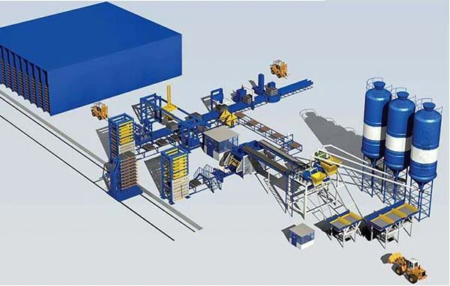
The conception of ideas :
the ability to make different kinds and varieties of blocks in different shapes and forms for different purposes can be achieved by changing the die used in the machine and by having tanks with different mixtures for a multiple choice of blocks.

Slide 9
BMC

Slide 10
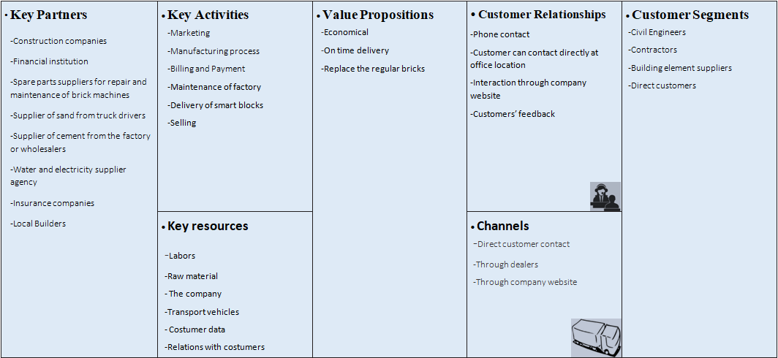
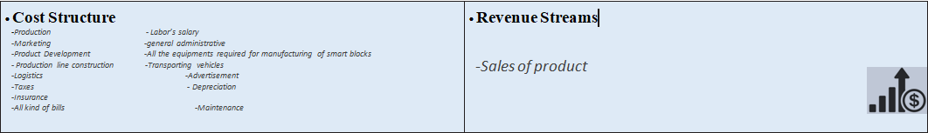

Slide 11
machine VARIANTS
Has easy maintenance
Is Reasonably sized
Is cost-efficient
Has automatic operation
Efficient power consumption
Durable service life
Is Easy to use
Molding time
Is it Safe to use
Is Multi-task function
High production capacity
PLC controls and data collection

Slide 12
machine VARIANTS
 | CLEANER VARIANTS
SELECTION CRITERIA | 1 | 2 | 3 | 4 | 5 | 6 | REF
Has easy maintenance | + | 0 | 0 | 0 | 0 | 0 | 0
Is Reasonably sized | 0 | - | 0 | - | 0 | - | 0
Is cost-efficient | 0 | 0 | + | - | + | 0 | 0
Has automatic operation | 0 | 0 | 0 | 0 | 0 | 0 | 0
Efficient power consumption | - | + | 0 | - | + | + | 0
Durable service life | - | 0 | + | 0 | 0 | + | 0
Is Easy to use | 0 | 0 | - | 0 | 0 | 0 | 0
Molding time | 0 | - | - | 0 | + | 0 | 0
Is it Safe to use | 0 | 0 | 0 | 0 | 0 | 0 | 0
Is Multi-task function | - | - | + | 0 | + | + | 0
High production capacity | 0 | - | + | + | 0 | + | 0
PLC controls and data collection | 0 | 0 | 0 | 0 | 0 | 0 | 0
PLUSES | 1 | 1 | 4 | 1 | 4 | 4
SAMES | 8 | 7 | 6 | 8 | 8 | 7
MINUSES | 3 | 4 | 2 | 3 | 0 | 1
NET | -2 | -3 | +2 | -2 | +4 | 3
RANK | 5 | 6 | 3 | 4 | 1 | 2
CONTINUE? | NO | NO | YES | NO | YES | YES
Screening
Screening is used to limit the alternatives for more comparison using scoring and to make clear the advantages, disadvantages, and the similarity .

Slide 13
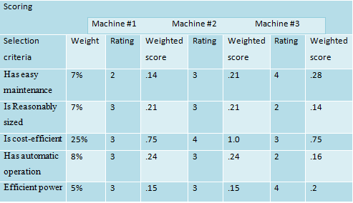
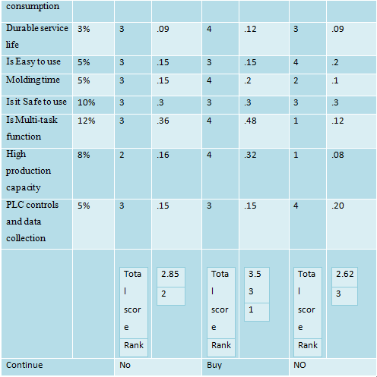
machine VARIANTS
Scoring
is an improved and more detailed version of concept screening. Our group discussed which of the criteria were most important and assigned a value for each. Each design was given a rating for each criteria, which gave a score based on the weighted value of the criteria .

Slide 14
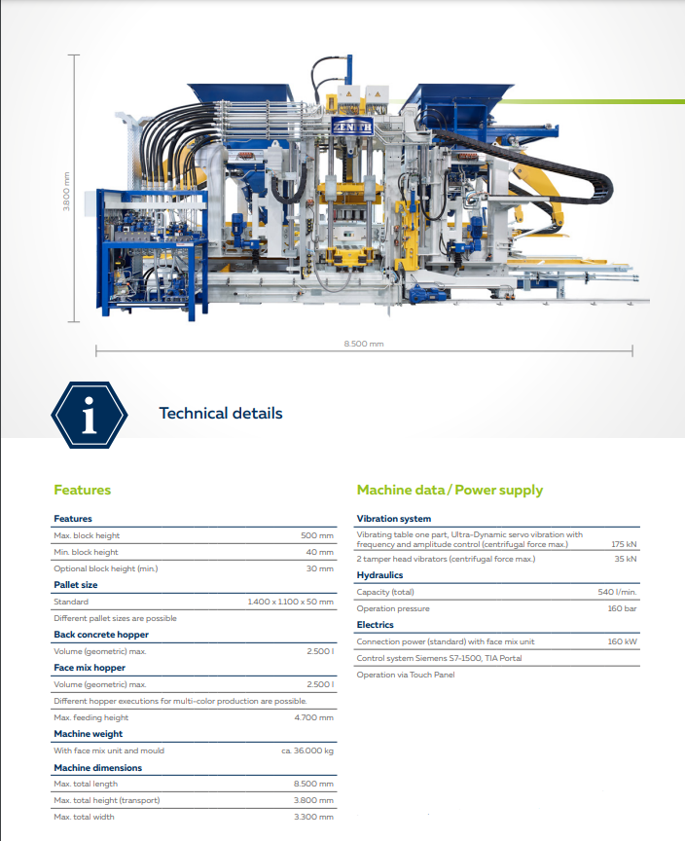
The machine ( ZENITH 1500-2 )
The inventive control framework utilized by the programmed block-creating machine can significantly work on working proficiency and diminish the workforce. The automatic block machine has been a popular product ever since it was released onto the market. The best option for clients is to invest in a self-sufficient brick manufacturing plant when funds permit, enabling you to complete projects quickly.
A lightweight precast machine with the capacity to handle both just-in-time reinforced panel production and high-volume production is the PLC System Fully Automatic Block Making Machine. Products of higher quality are rolled out because there are fewer handlings than in traditional tilt cake processing.

Slide 15
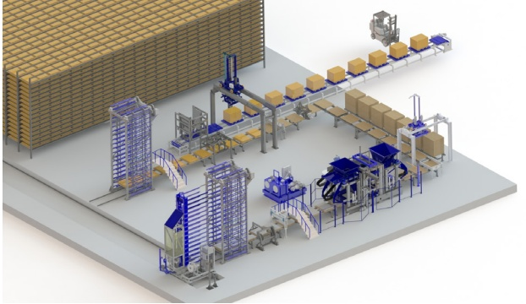
Machine layout

Slide 16
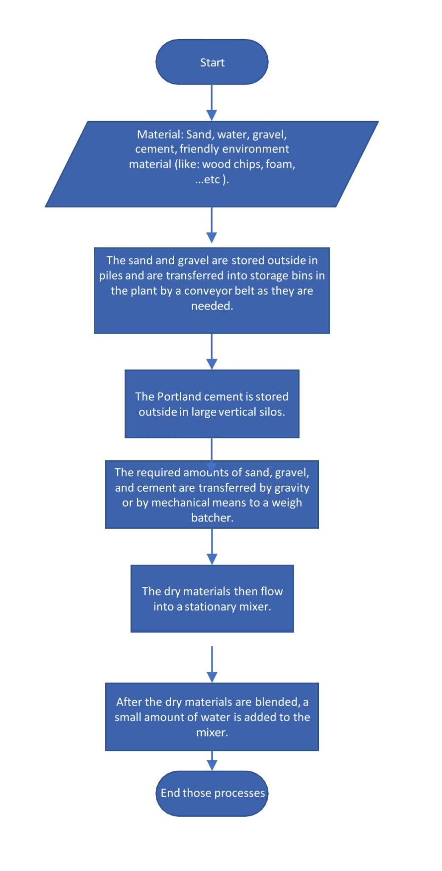
Production process (mixing)
A conveyor belt moves the sand and gravel from piles outside the plant into storage bins inside the plant as needed. The Portland concrete is put away externally in enormous vertical storehouses to safeguard it from dampness.
The required quantities of sand, gravel, and cement are transferred to a weigh batcher, which measures the appropriate amounts of each material by gravity or mechanical means as soon as a production run begins.

Slide 17
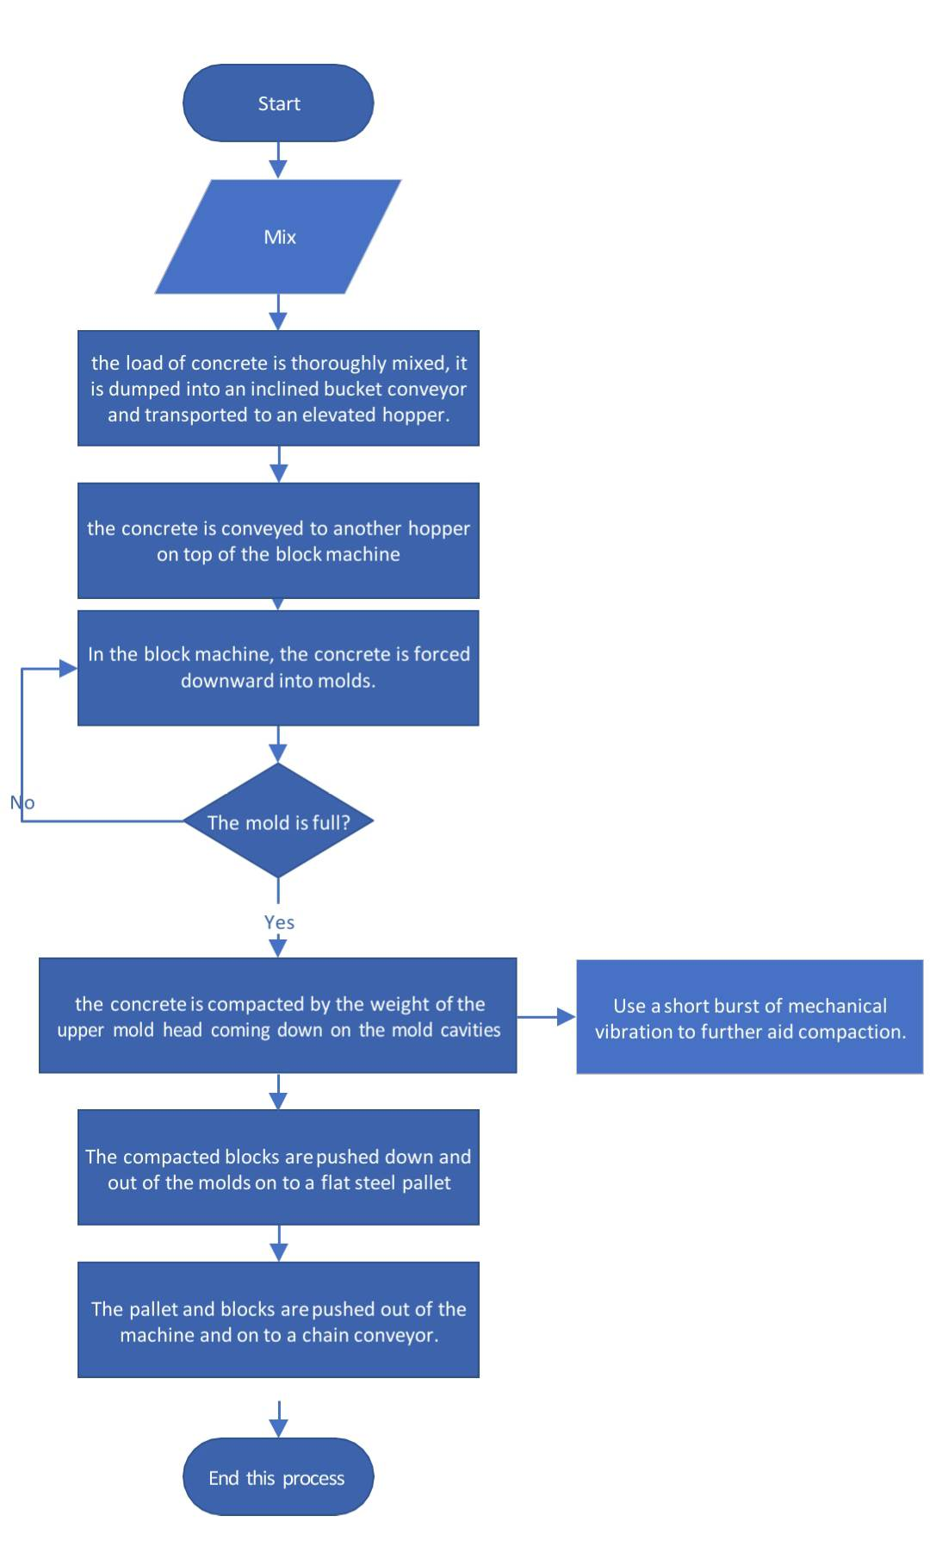
Production process (moulding)
When the heap of cement is thoroughly blended, it is unloaded into a slanted container transport and shipped to a raised container. For the subsequent load, the mixing cycle begins once more.
The concrete is transported from the hopper to another hopper at a measured flow rate on top of the block machine. The concrete is pushed downward into molds by the block machine. An outer mold box contains several mold liners for the molds. The liners determine the inner and outer shapes of the block's cavities. Upwards of 15 blocks might be formed at one time.

Slide 18
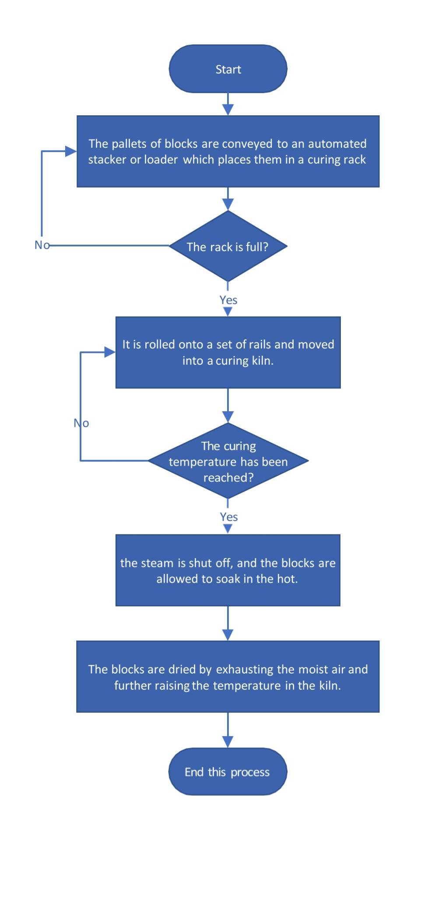
Production process (curing)
An automated stacker or loader moves the block pallets to a curing rack where they are stored. There are several hundred blocks in each rack. When a rack is complete, it is moved into a curing kiln by rolling onto rails.

Slide 19
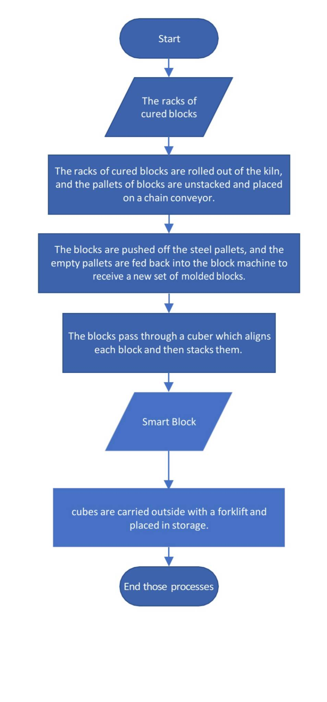
Production process (cubing)
The pallets of cured blocks are unstacked and placed on a chain conveyor after the racks of blocks are rolled out of the kiln. After the blocks are removed from the steel pallets, the empty pallets are brought back into the block machine to produce a new set of molded blocks.

Slide 20
Constraints
Local customs and traditions, non-availability of infrastructure facilities like roads and electricity are the major hurdles in the development of the sector.
• Absence of developed domestic market.
• Non-availability of modern machinery in local market at cheaper rates.
• Lack of investment and government support.

Slide 21
Conclusions
Smart block are competitive with traditional block , based on the analyzes and feasibility study that were conducted in terms of prices , quality and workability, despite the difficulties that we will face in marketing them at the beginning.
implementation of a new production line for the manufacture of smart blocks is a worthwhile investment.
Increased efficiency .
Cost savings .
Improved quality .
Sustainability .
Financial feasibility .

Slide 22
Thank you for listening
Any questions ?

