Slide 1

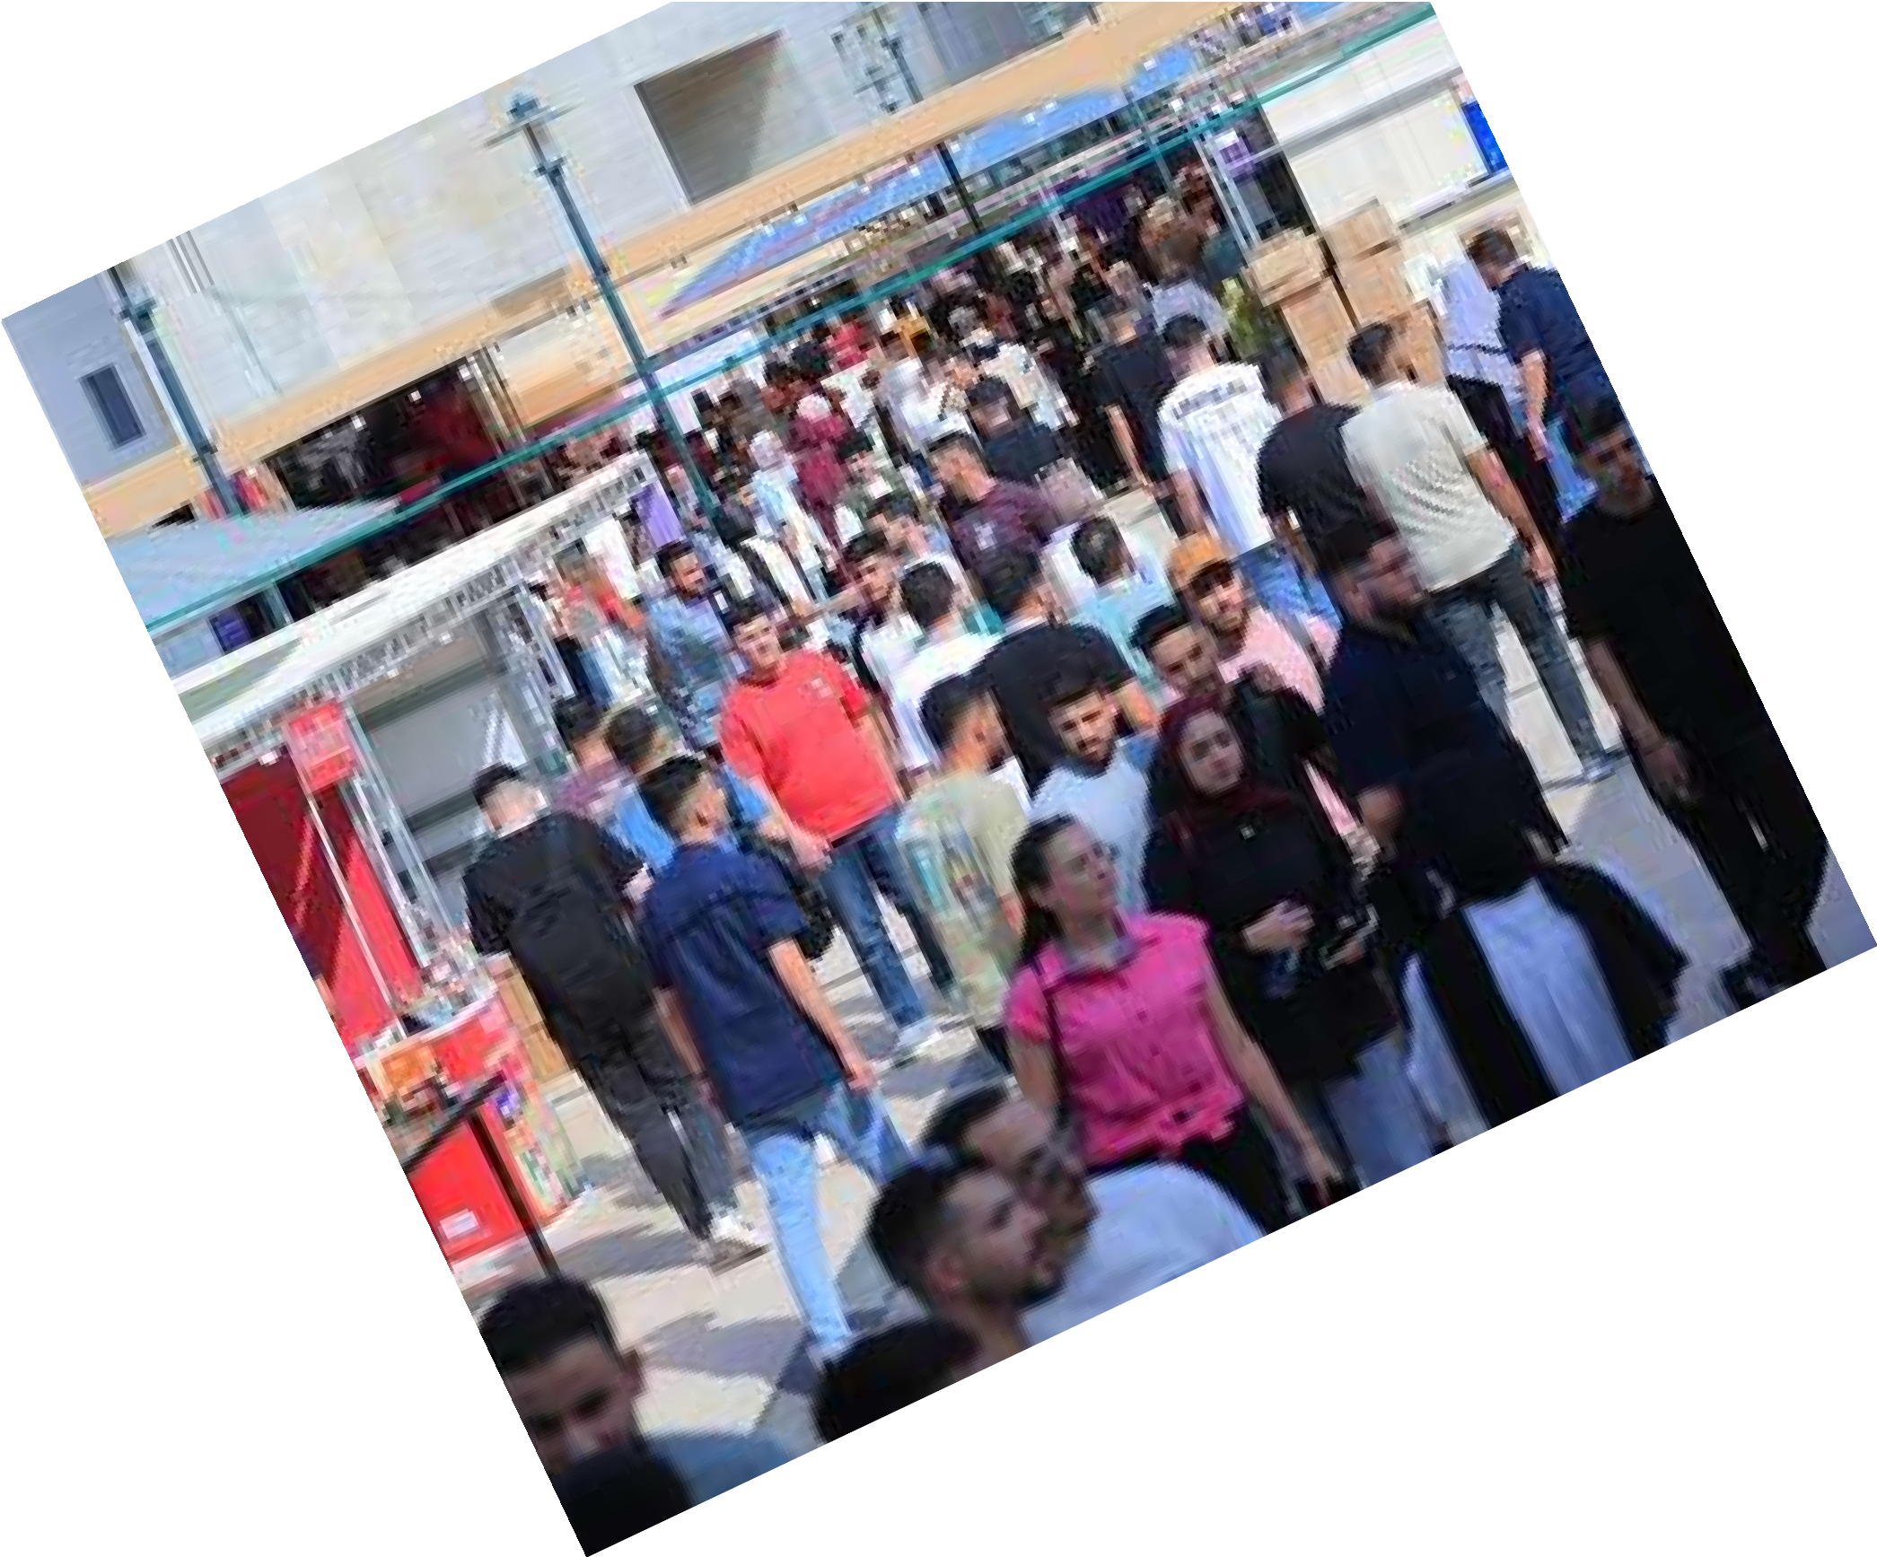


EXPOVERSE
ExpoVerse is a smart digital platform designed to manage and enhance TEDI-Najah Expo, It provides both web and mobile applications that connect students, companies, visitors, and organizers in one unified system.

Slide 2
Meet Our Team
Baha Alawneh
Computer Engineering
Ayman Abu Hijleh
Computer Engineering

Slide 3
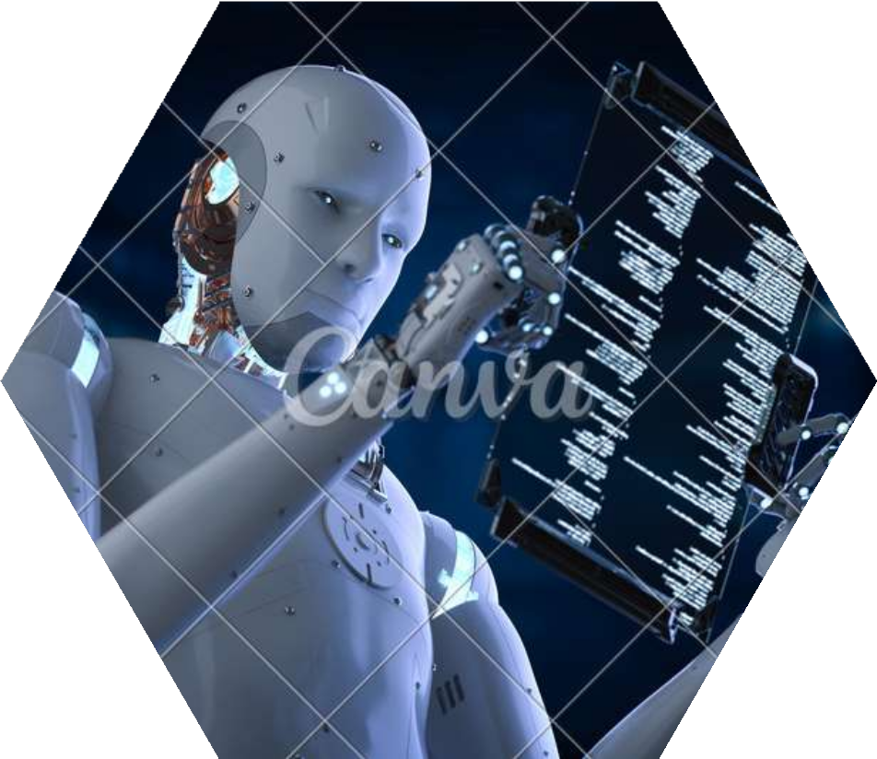
Introduction
Motivation

Slide 4




Automate Expo Organization
Replace manual booth assignment and approvals
Centralize Students, Companies & Visitors
Improve Navigation with a Virtual Map
Motivation
Smart & Interactive Expo Experience

Slide 5
Related
WorK

Slide 6







Aspect | Without ExpoVerse | With ExpoVerse
Expo Organization | Manual coordination, spreadsheets, and physical paperwork | Centralized digital management with automated workflows
Booth Assignment | Manually assigned, error-prone, and difficult to update | Smart booth allocation using an interactive virtual map
Project Exhibition | Physical posters with limited visibility | Digital project profiles accessible before, during, and after the expo
Communication | Face-to-face only, no centralized communication channel | In-app chat, notifications, and AI chatbot assistance

Slide 7
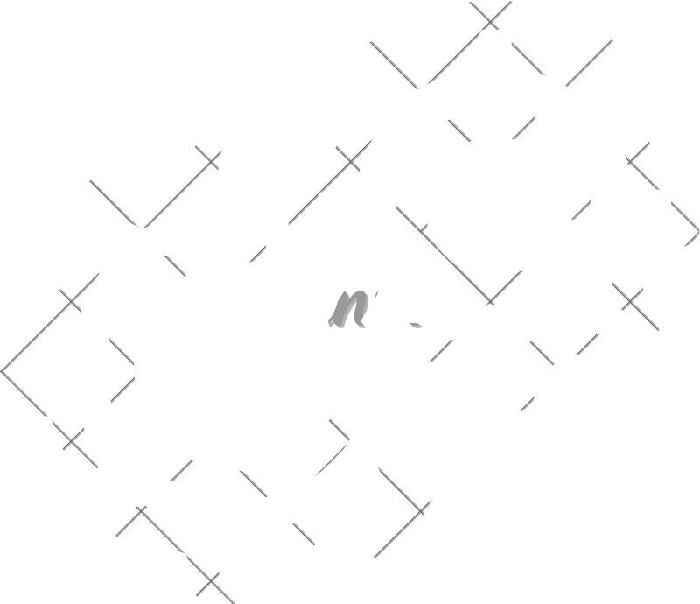
Methodology

Slide 8

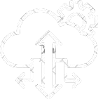

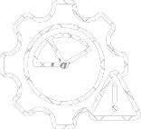
Let’s Talk About
Main Libraries and Frameworks
Cloud Services
Architecture
System Roles
1
2
3
4

Slide 9







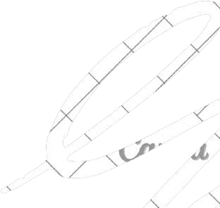
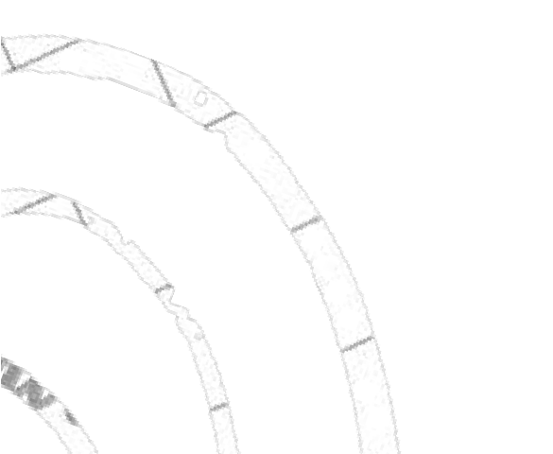

Main Libraries and Frameworks
Front-End
Back-End
React React Native
Express.js

Slide 10





Cloud Services
AWS
RDS (MySQL)
AWS
S3
Nodemailer
Firebase

Slide 11



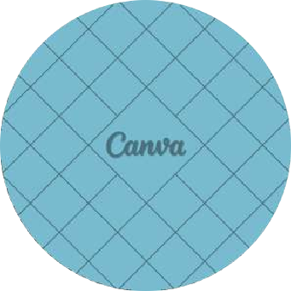

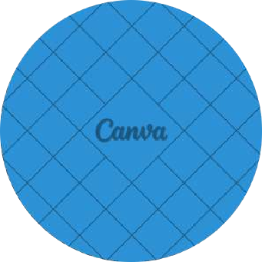



Back-End Architecture
Models
Controllers
Routes
Follows REST standatds Uses a variation of MVC

Slide 12


System Roles
_{adm}ad_{in}min
students
company
visitor

Slide 13
GUI
Discussion

Slide 14



Login AND
Sign Up

Slide 15
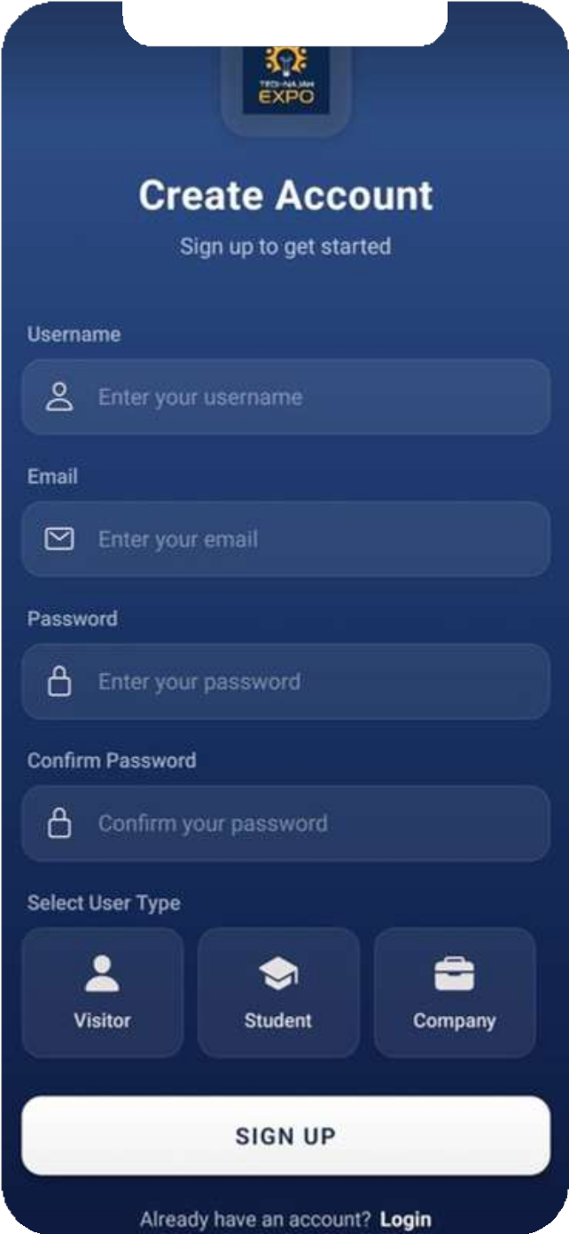
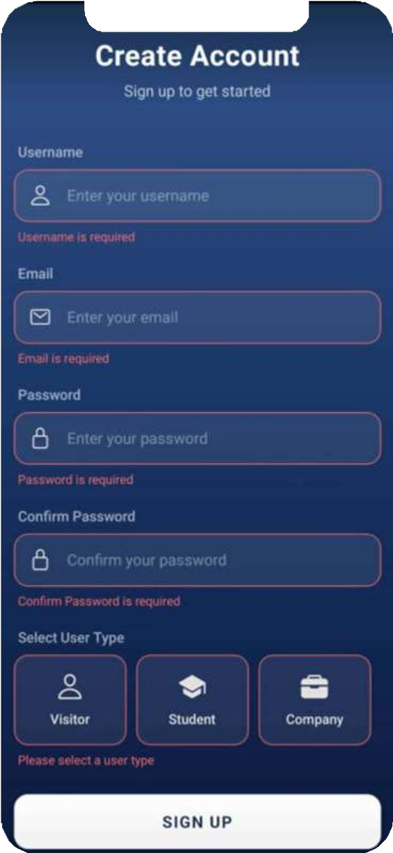
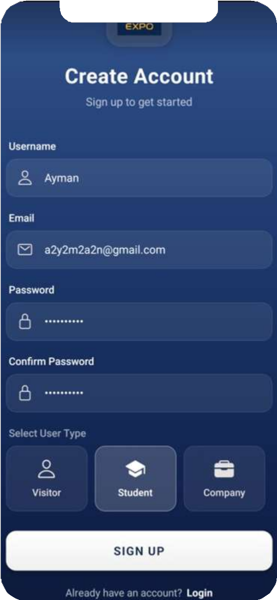
Sign Up

Slide 16
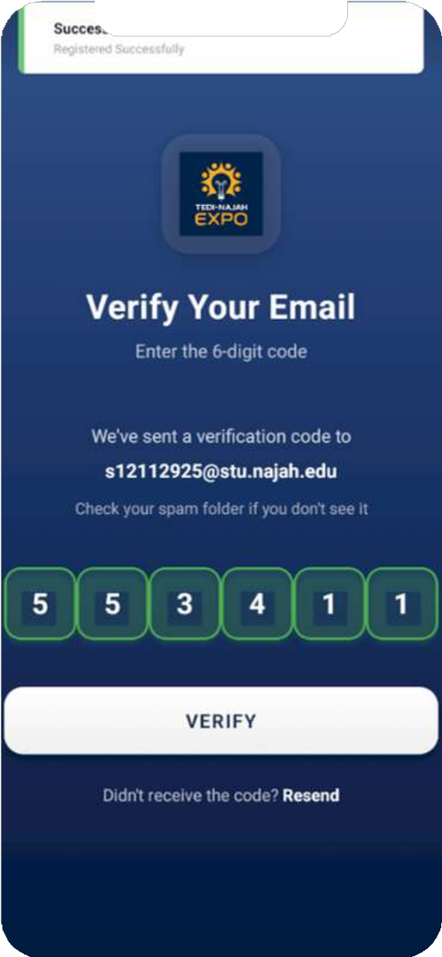
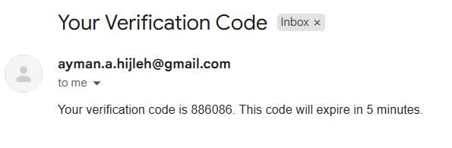
Email Verification

Slide 17
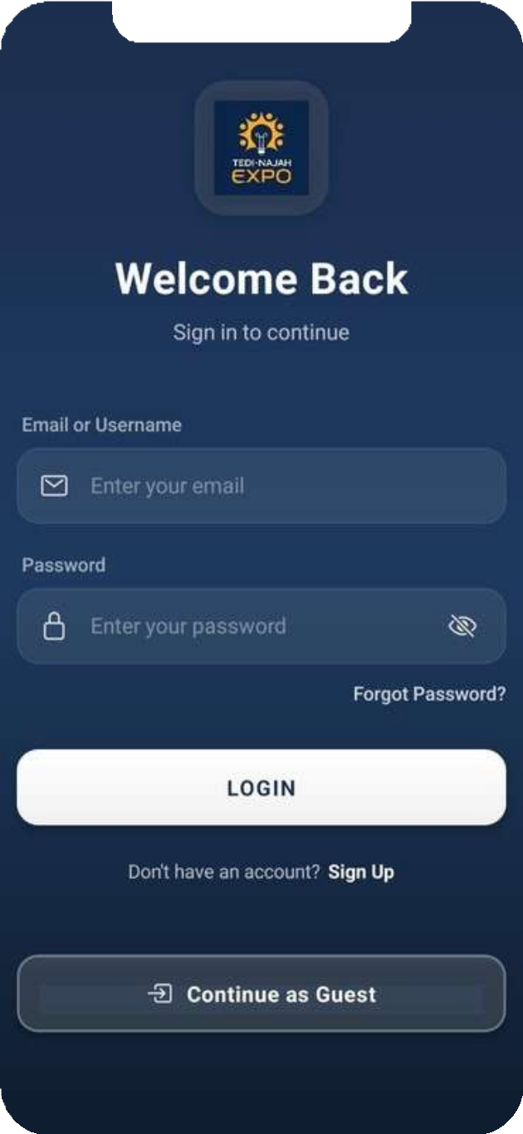
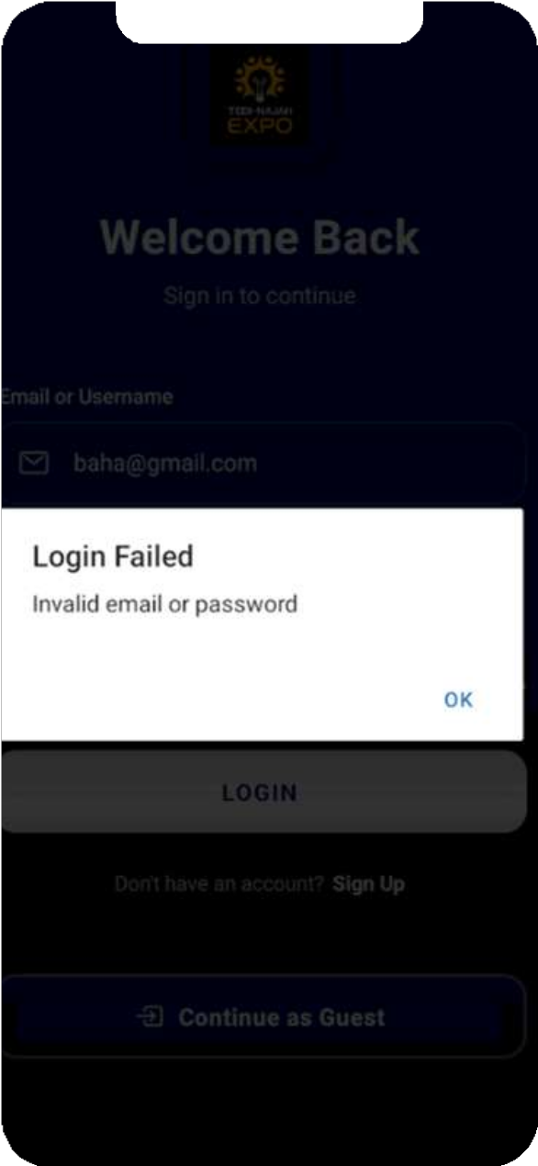
Login

Slide 18
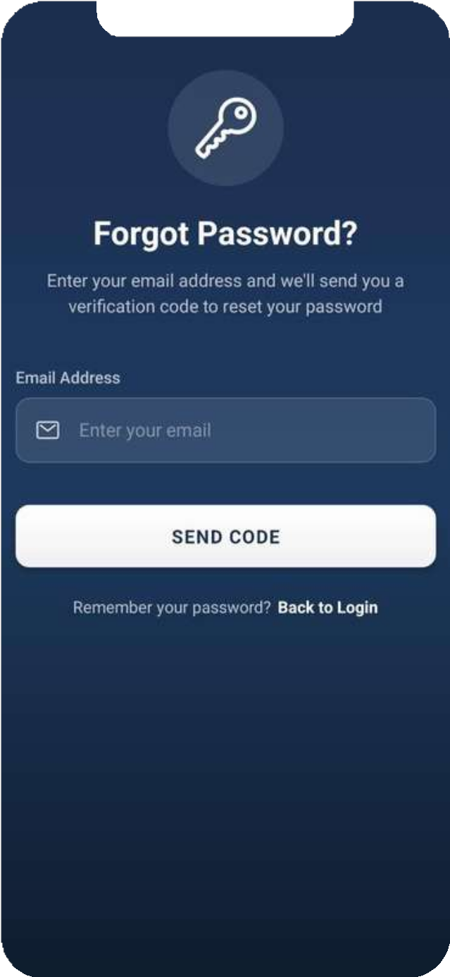
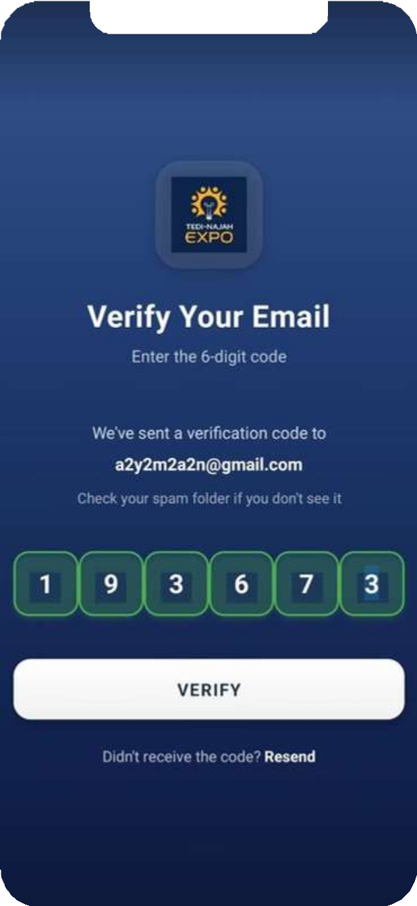
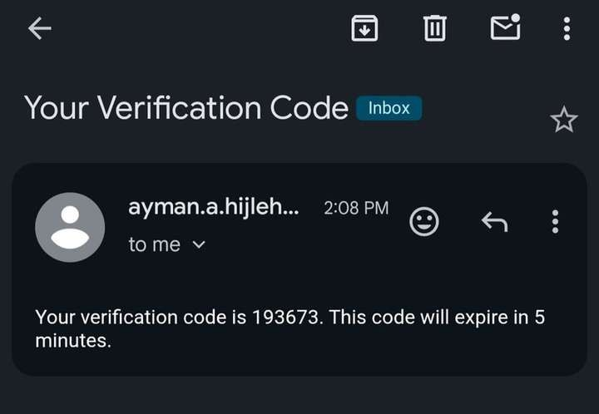
forget password

Slide 19
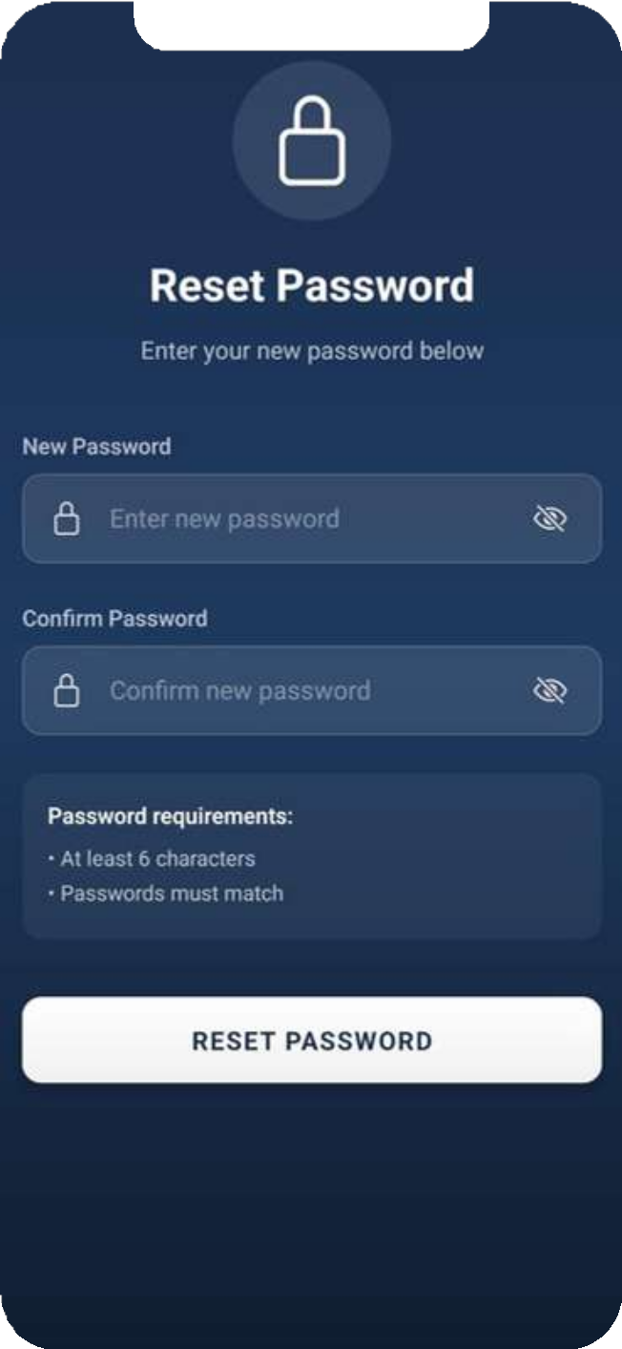
forget password

Slide 20
Home

Slide 21
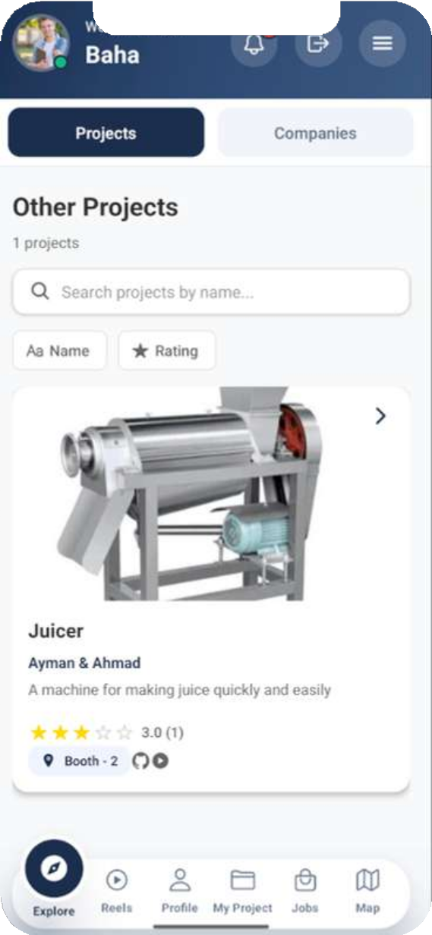
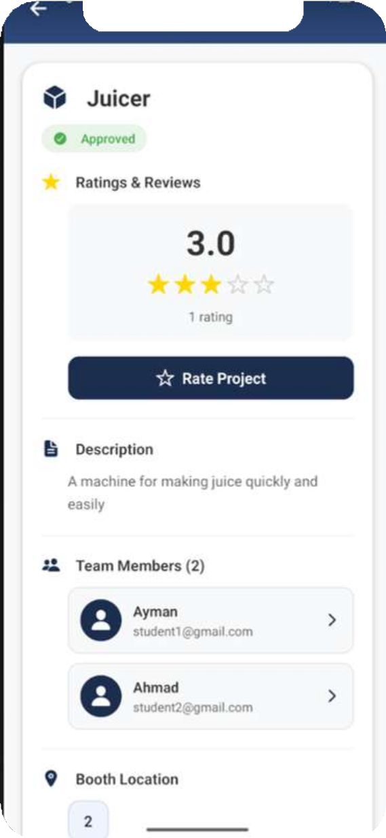
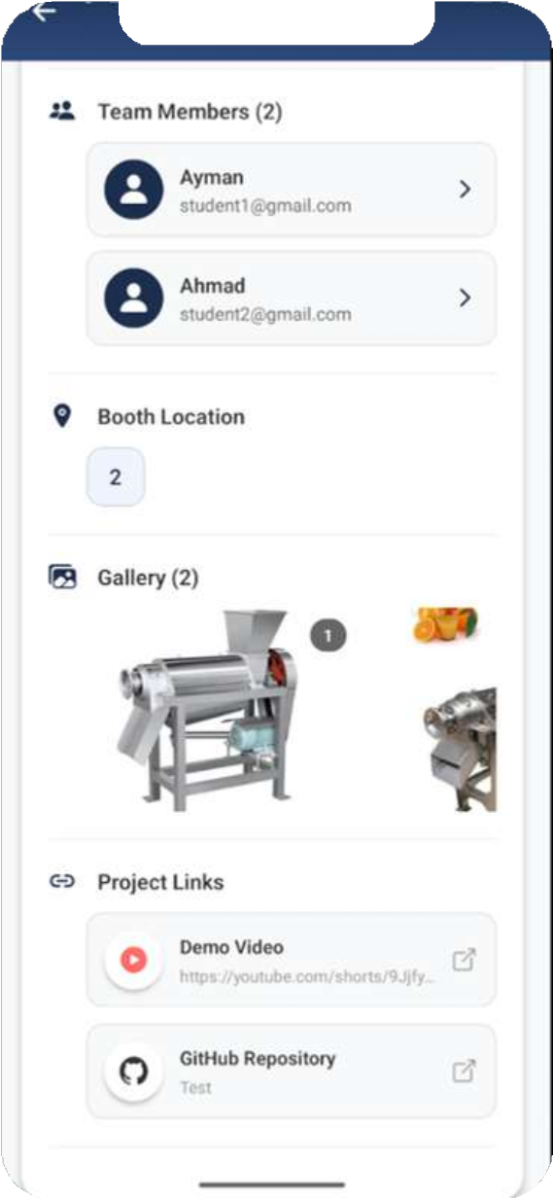
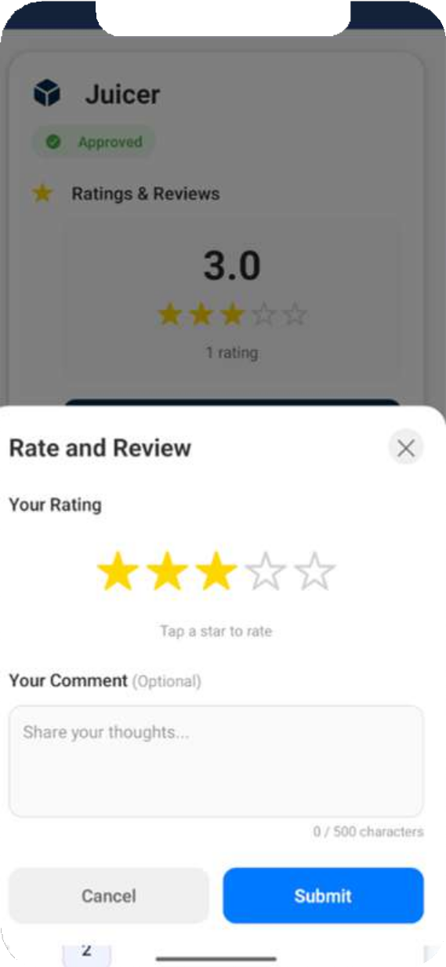
Home

Slide 22
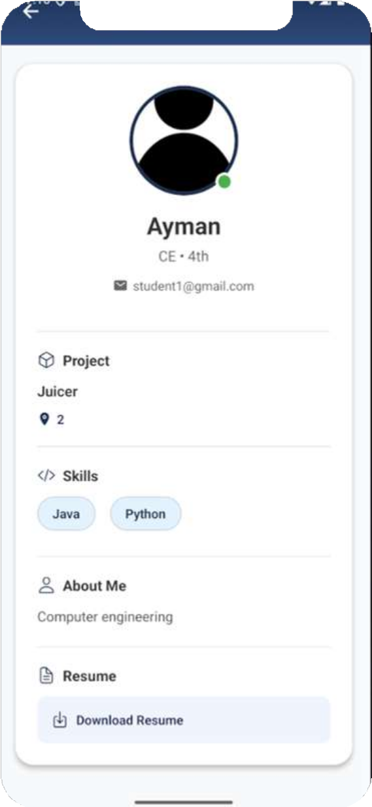
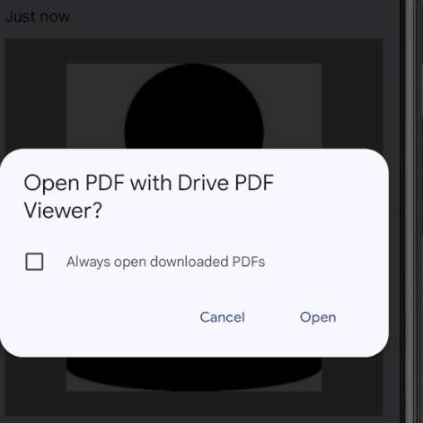
Home

Slide 23
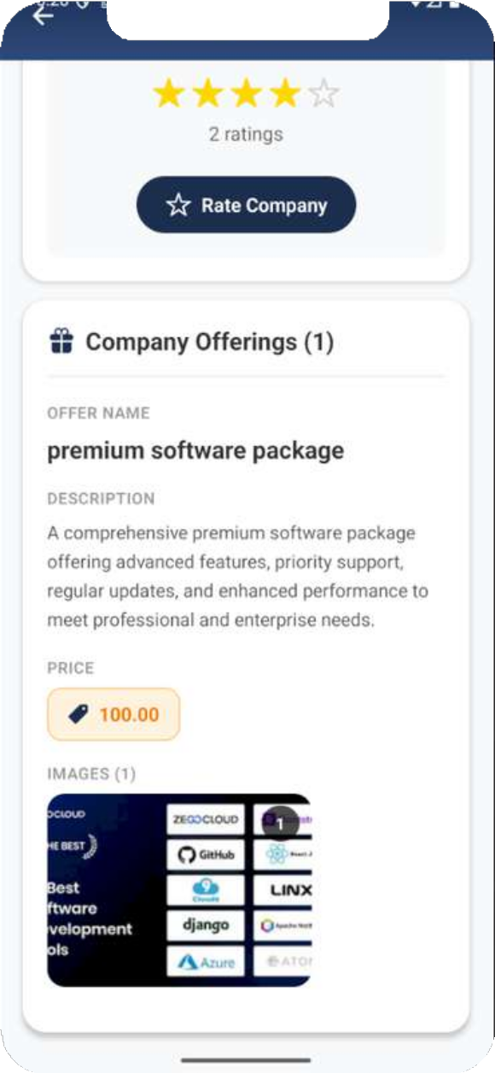
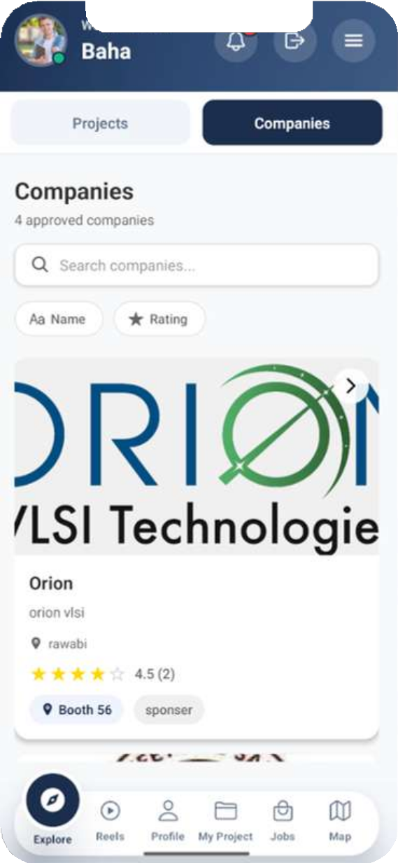
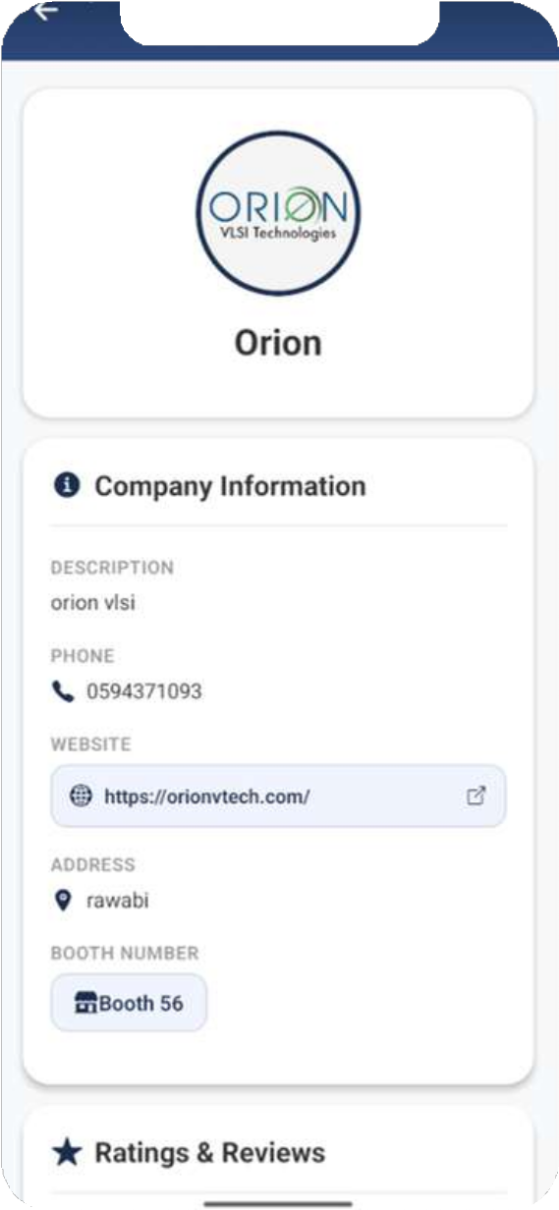
Home

Slide 24
Profile Info

Slide 25
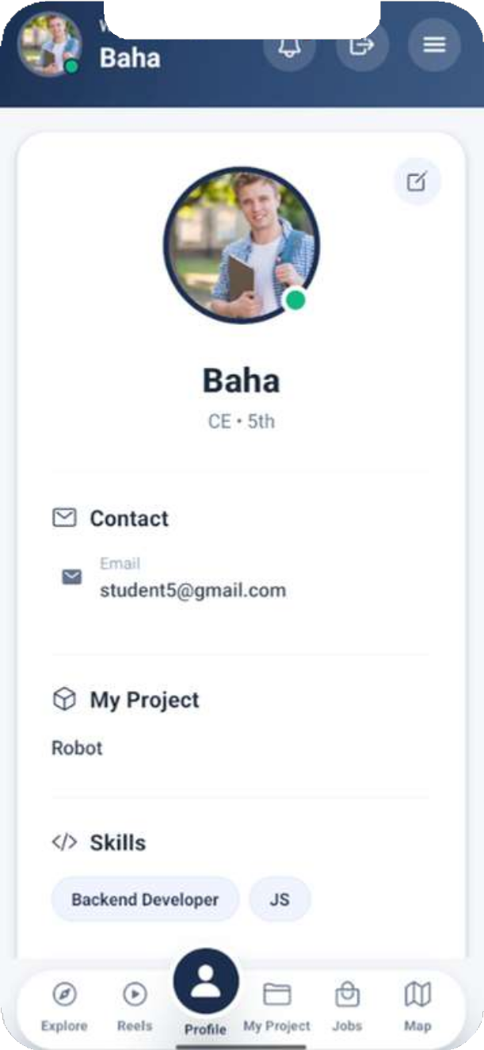
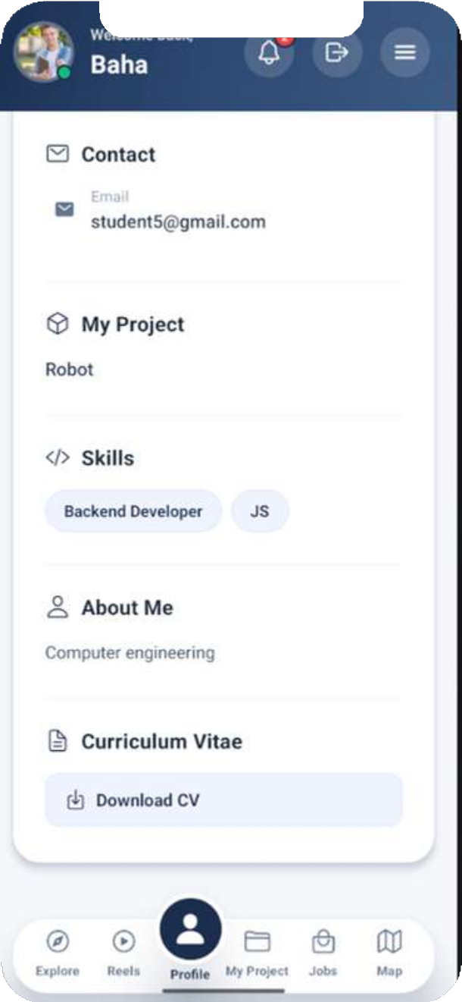
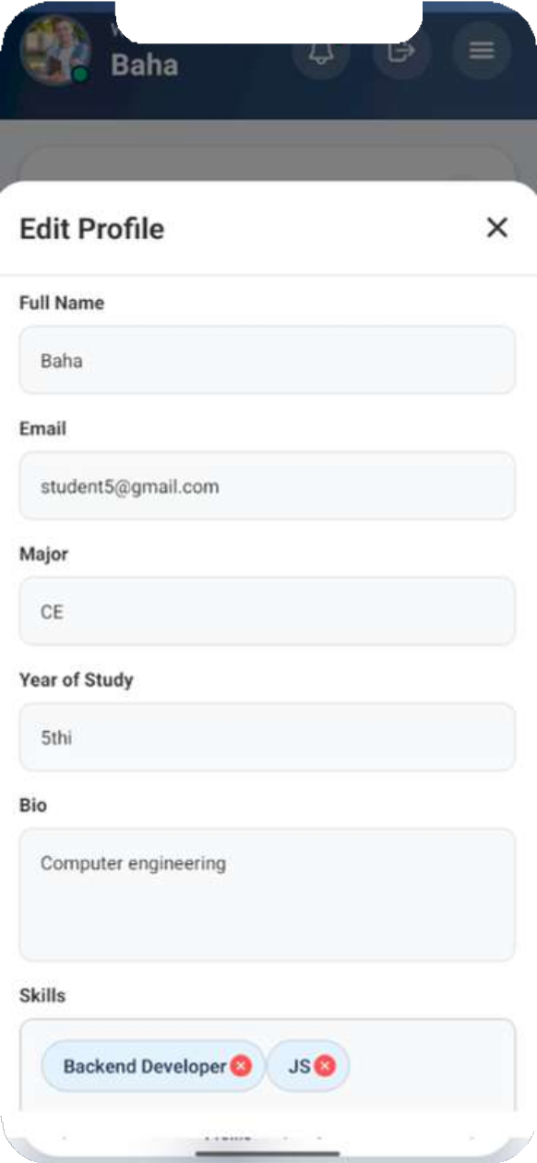
Personal Info

Slide 26
Project Details

Slide 27
add project implementation
fill project data
request go to admin, project is pending
add project
go back to student, edit and request again
admin reject with rejection reason
admin accept, project now in expo

Slide 28
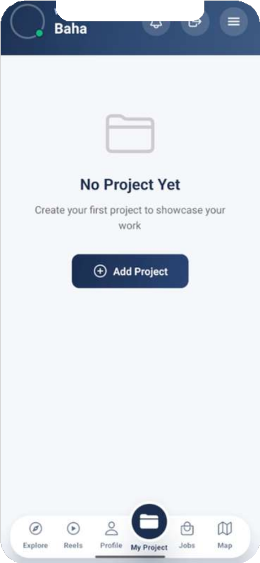
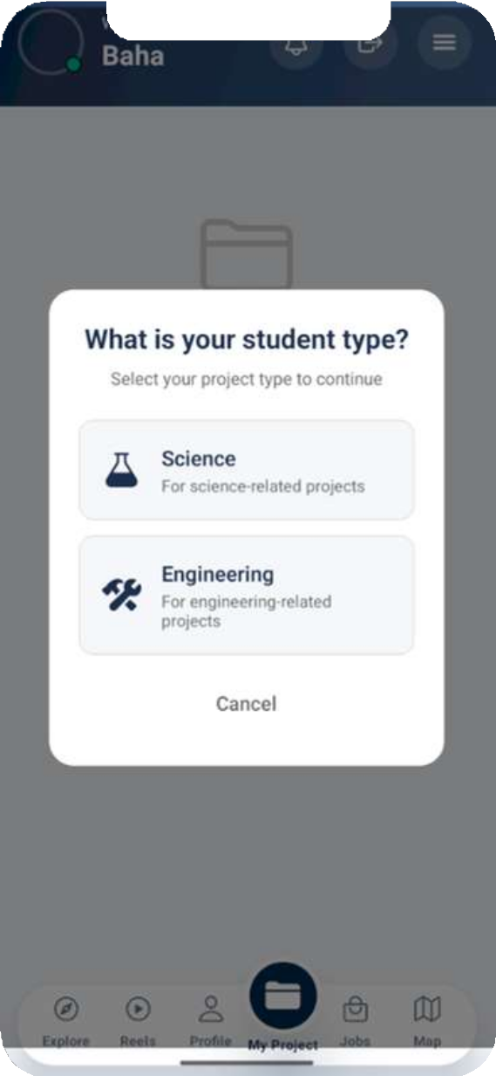
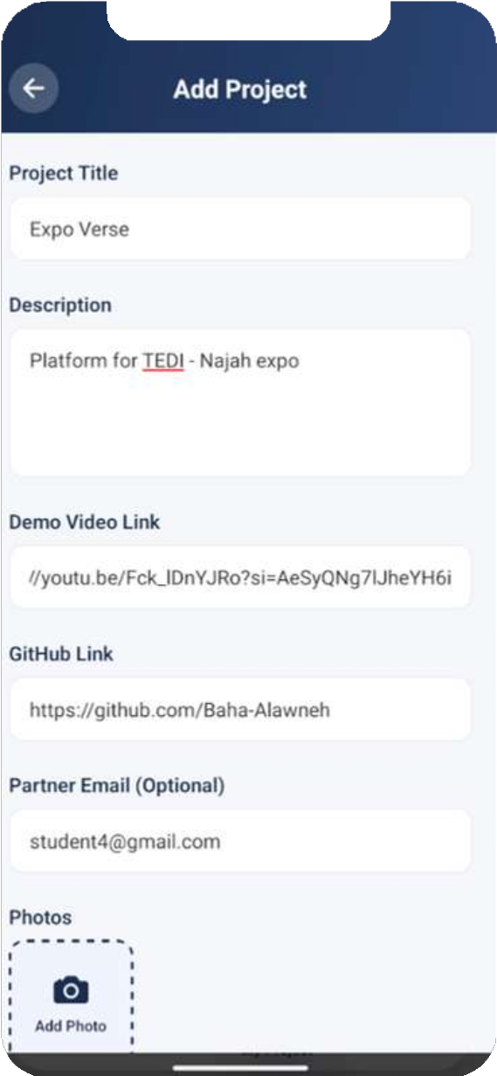
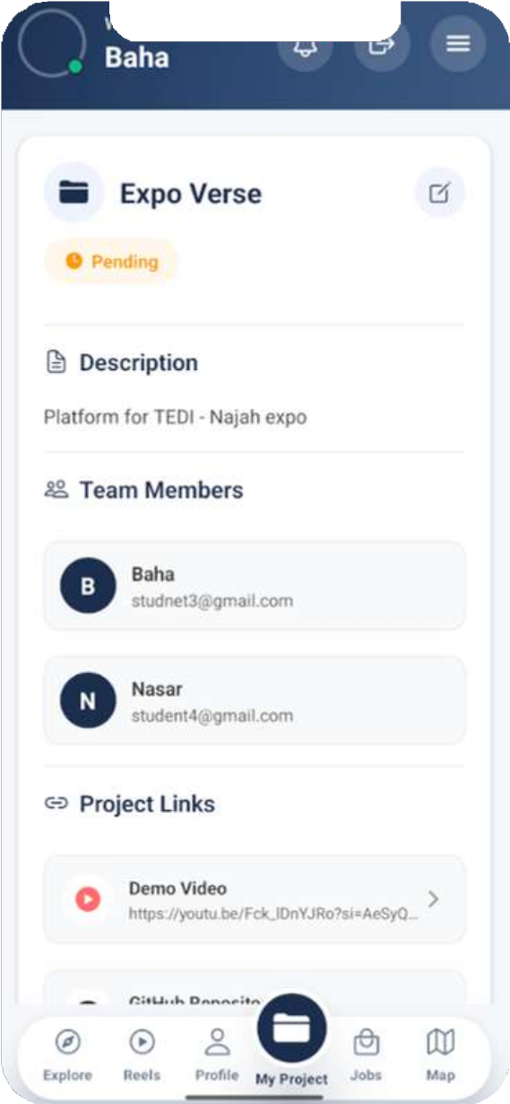
Project Details

Slide 29
Reels

Slide 30
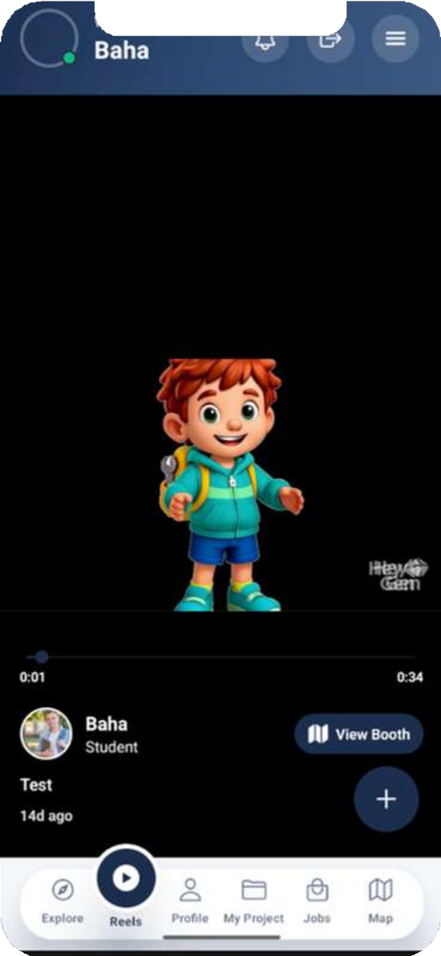
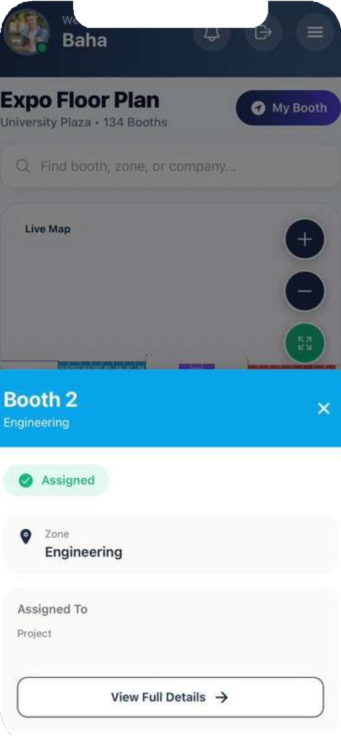
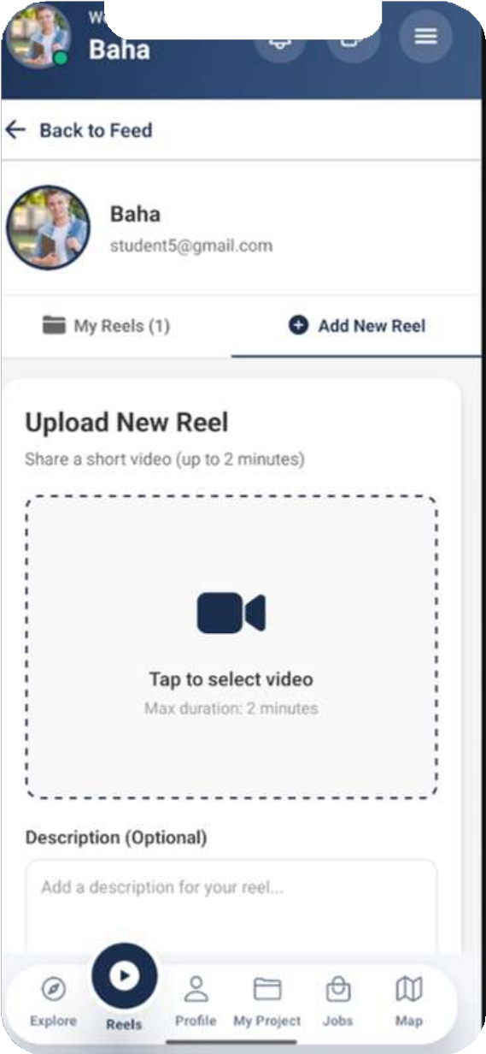
Reels

Slide 31
chatbot

Slide 32
Chatbot implementation
User types a question, and send
go to Google Gemini to analyze it
determine the Intent,
,Category , and Whether database access is needed
system Decide Data Source:Static Data Path, Database Path
Send Response to Frontend to the user
sent back to Google Gemini ,to format it into natural, conversational language
Results retrieved

Slide 33
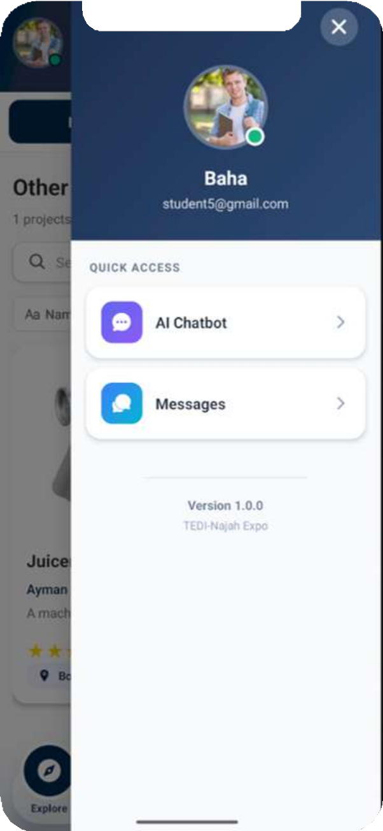
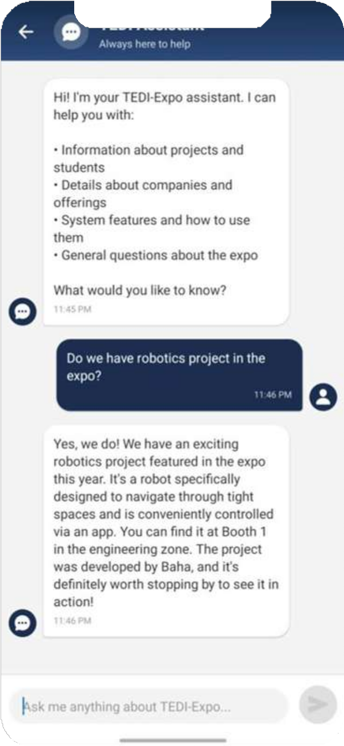
Chatbot

Slide 34
Messages

Slide 35
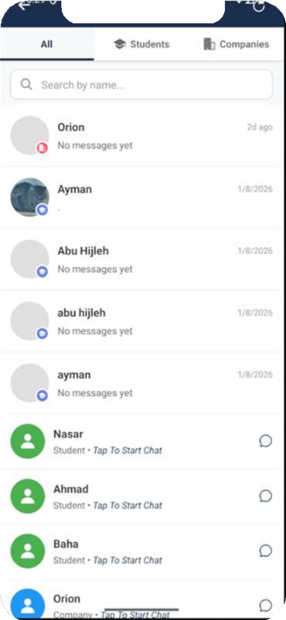
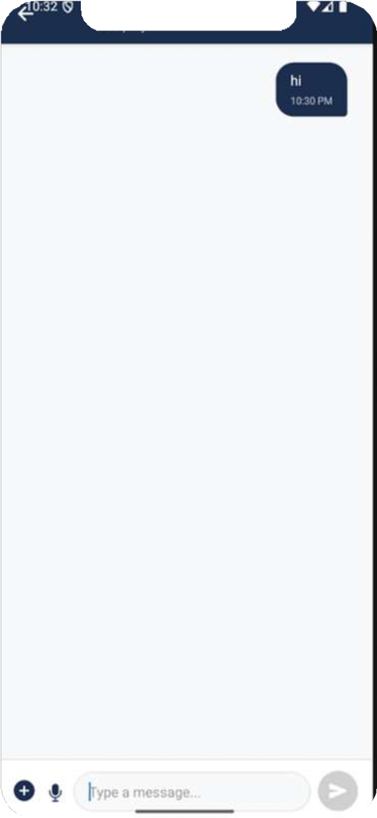
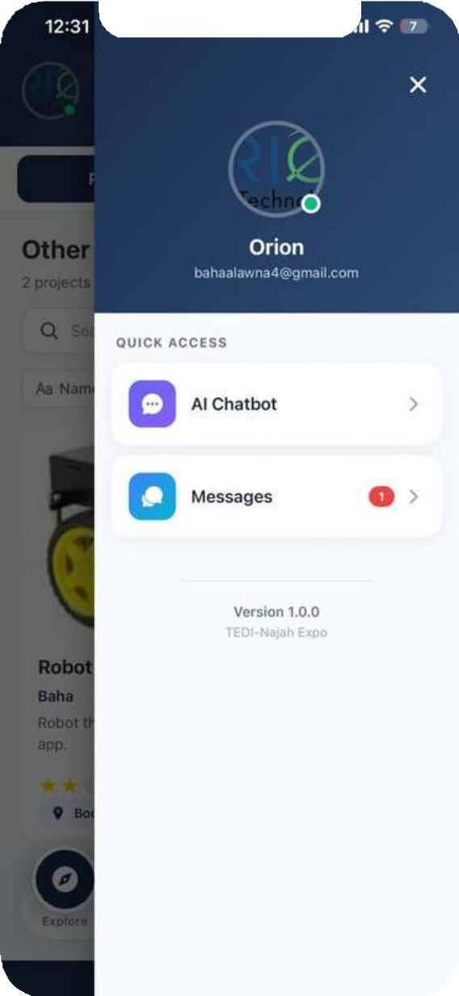
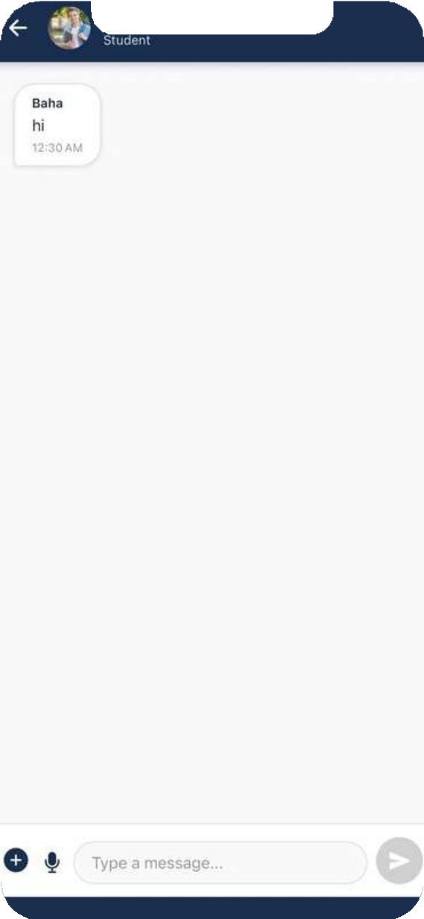
sender
receiver
Messages

Slide 36
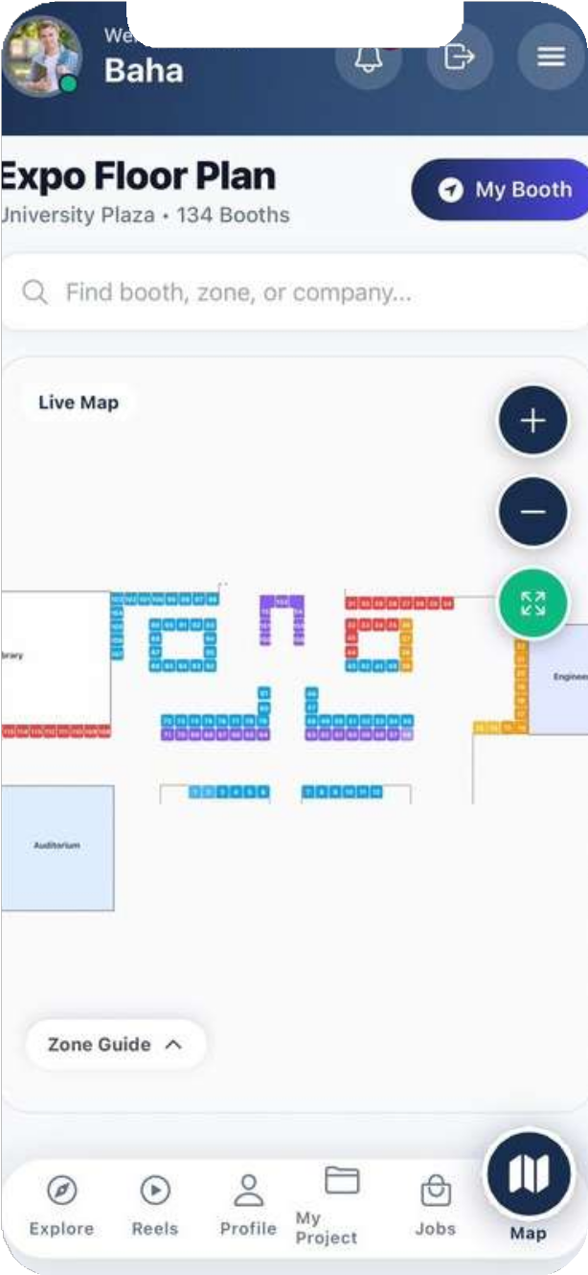
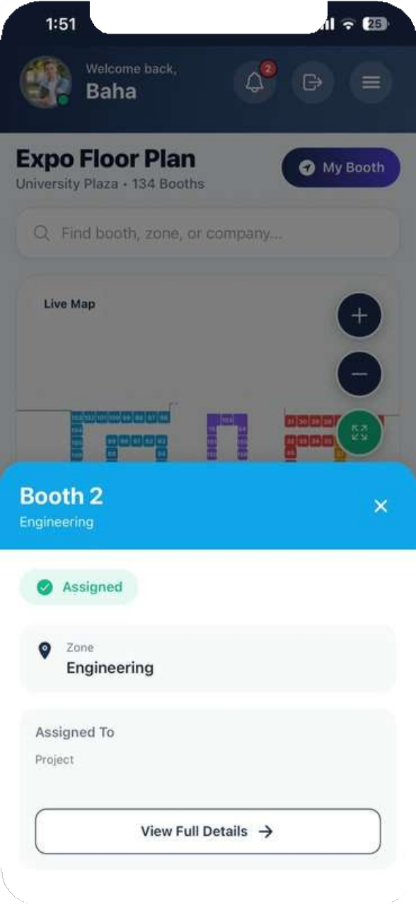
Expo Map

Slide 37
Company Role

Slide 38
company implementation
fill company info
request go to admin, company is pending
company register
company rejected, cant add offers
admin reject with rejection reason
admin accept, company now in expo, and can add offers

Slide 39
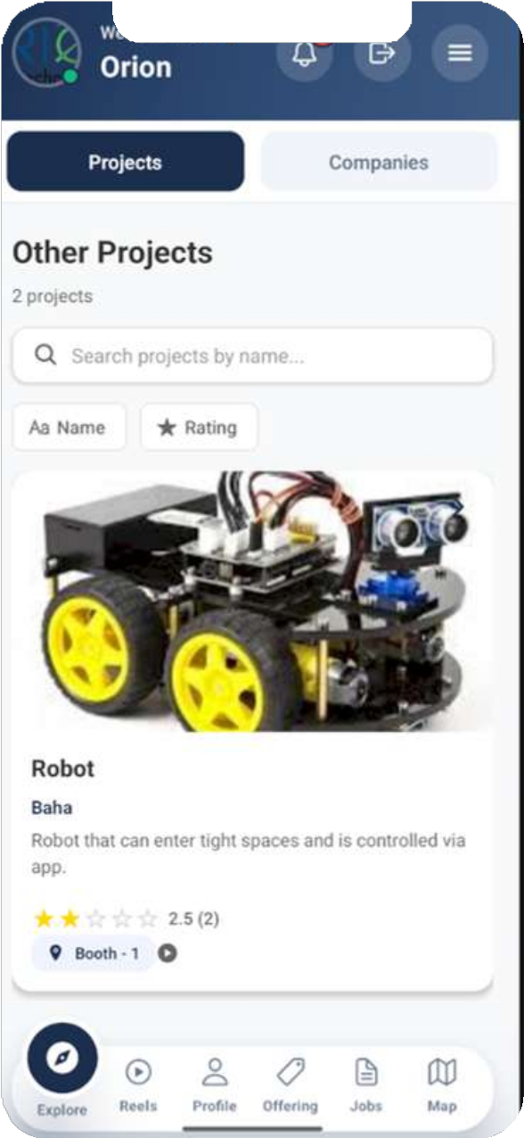
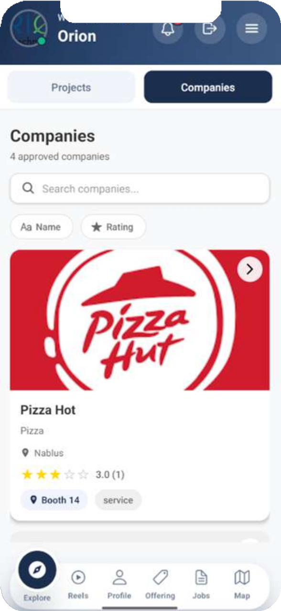
Home

Slide 40
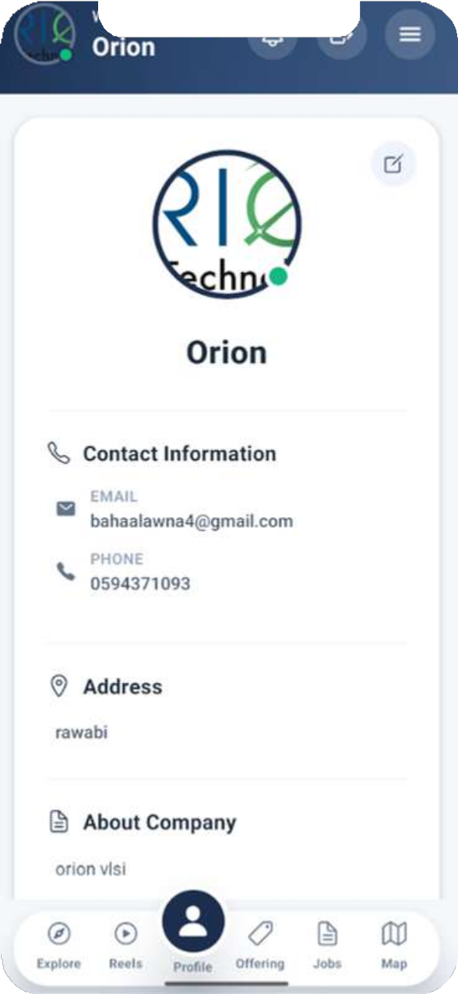

Company profile

Slide 41




Offering

Slide 42


Jobs & internship

Slide 43




Jobs & internships-process

Slide 44
Admin Role

Slide 45


admin-Home page

Slide 46


admin-Home page

Slide 47



Projects
student

Slide 48



companies
student

Slide 49




notification

Slide 50


notification

Slide 51


map

Slide 52
Map

Slide 53

Map

Slide 54

Map

Slide 55
Map
Design the Layout of the Map
Export to production Mode
scratch mode
open in new sheet
become the default map
assign the booths to projects/companies
save everything

Slide 56
Map

Slide 57

Map

Slide 58


Map

Slide 59

Map

Slide 60

Map-New sheet

Slide 61

Map

Slide 62

Map-New sheet

Slide 63



Map

Slide 64


Map

Slide 65



Map-Reset positions
reset

Slide 66





Map implementation
Map technology
1
2
3
map is implemented using SVG, a vector-based graphics technology
SVG represents graphics using mathematical shapes (lines, rectangles) instead of pixels
The SVG root element defines the drawing area and coordinate system,Each booth is implemented as an SVG group
4
5
So Each booth is a real object (clickable, movable)
The GPU handles: Drawing shapes, Scaling and zooming, Smooth interactions, so better performance

Slide 67


Map implementation
Why SVG?
Feature
DOM elements
Booth as object
Click handling, Drag logic
Debugging
SVG
Easy
Easy
Canvas/image
Complex
Hard

Slide 68
Web

Slide 69



login & sign up

Slide 70

Project-Details

Slide 71


other projects

Slide 72


other companies

Slide 73


jobs & internships

Slide 74

jobs & internships

Slide 75

Map

Slide 76

notification

Slide 77


messages

Slide 78

chatbot

Slide 79
company
web

Slide 80

profile

Slide 81



jobs & internships

Slide 82


jobs & internships

Slide 83


notification

Slide 84
admin-web

Slide 85


quick actions

Slide 86


projects

Slide 87


companies

Slide 88


notification

Slide 89

map

Slide 90

Future Work!

Slide 91




Future Work
Enhance the virtual map with live location tracking and path guidance.
Generating QR codes for fast and secure booth access
API Access for Third-Party Tools: Allow integrations with university systems and career platforms.

Slide 92
Questions
thanks for listening..!

