Slide 1
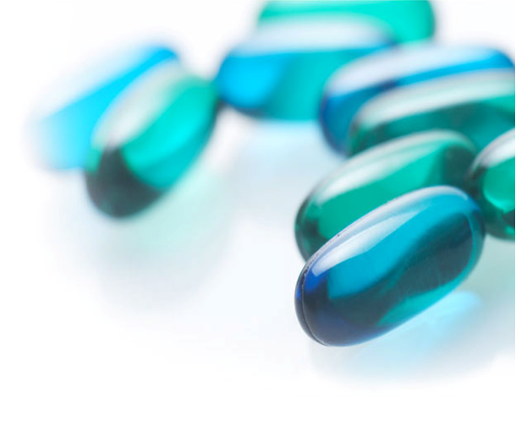
An-Najah National University
Industrial Engineering Department
Graduation project (SIX SIGMA)
Prepared by:
Alaa Alsadi
Ameera Dawoud
Mays Hijjawi
Ons Shawahni
Supervisor:
Dr.Husam Arman

Slide 2
Birziet Pharmaceutical company
BPC was established in 1974 in Birzeit village as a private shareholding company with a total capital Investment of USD 150,000.
BPC combines many factors in order to maintain its success:
Obtaining the latest quality standards certificates such as GMP (Current Good Manufacturing Practices) and ISO quality systems.
Highly educated and well trained staff members distributed among the different departments.

Slide 3
BPC Mission
BPC realizes that the significance of the Palestinian Pharmaceutical Industry extends far beyond the size of the revenues.
BPC Vision
Its vision is to be the backbone of the health care security system in Palestine and the region with superior quality product

Slide 4
Motivation
Pharmaceutical industry is a very sensitive and dangerous industry because it deals with people's life . so we choose to apply six sigma as a disciplined, data driven problem solving approach supported by powerful statistical order to reduce variation and improve quality of products and tools in business processes in the way to achieve perfection.

Slide 5
  Research objectives
Evaluate the current practices in the pharmaceutical companies.
Test and apply the Six Sigma concept in a pharmaceutical company.

Slide 6


Slide 7
Definition
Six Sigma (in statistics) : the definition of outcomes as close as possible to perfection. With six standard deviations, we arrive at 3.4 defects per million opportunities, or 99.9997 percent, so “reaching Six Sigma” means that your process or product will perform with almost no defects.
Six Sigma (as a philosophy) : is a total management commitment and philosophy of excellence, customer focus, process improvement, and the rule of measurement.

Slide 8
Levels of sigma performance per million opportunities

Slide 9
Methodology

Slide 10
Evaluation of current practices in Pharmaceutical company

Slide 11
  Evaluation of current situation in pharmaceutical companies.
Pharmaceutical companies were evaluated by a questionnaire which contains many sections:
Introduction
Management style
Customer satisfaction
Defects
Education of employers

Slide 12
Muda(wastes)
Quality
2. Structured interviews with pharmaceutical companies.
Then structured interviews were held with the pharmaceutical companies
quality managers to answer the questionnaire questions ( companies were given symbols from A to D for confidentially purposes .

Slide 13
    3. Analysis
Analysis Criteria was to give questions rates from four to one , four for best answer and one for worst answer .
Finally rates of every company were summed so that the company with highest rate is the best company.

Slide 14
Company | Rate
A | 107
B | 96
C | 83
D | 67
From Rating it's obvious that company A is the best according to our evaluation so we choose company A to implement our project which is Berzeit Pharmaceutical company.

Slide 15
Case Study
Evaluation of blistering process in Birzeit Pharmaceutical Company

Slide 16
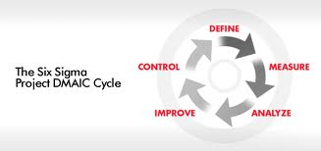
dmaic

Slide 17
DEFINE
This phase includes several steps:
Determine project charter.
Item | Description
Business case | Our project based on evaluation of blistering Process in Birzeit pharmaceutical company, we chose this topic because blistering Process is the most critical Process in the manufacturing process in the company.
Goal statements | We expect to achieve many things such as: • Reducing defects in blistering from 4% to3%. • Reducing customer complaints from 85.7% to 20%.
Scope | The scope of the project is the reducing customer complaints and defects in the blistering Process.
Players | Mays Hijjawi . Alaa Al-sa'adi. Ameera Dawood. Ons Shawahneh.
Preliminary plan | Define Phase: (7-11)/3 Measure phase: (21/2)-(20/3) Analyze phase: (21-25)/3 Improve phase: (26-28)/3 Control phase: (29-30)/3

Slide 18
2. Validate problem and goal statements.
Problem Statement
In the last year we found that 85.7% of customer complaints were because of final packaging (Blistering ) , this is due to: defects in this Process( about 4%) which leading to losing 519,832,891 NIS in the last year(Losses From Time and defects) , and because of blistering is the bottleneck of the processes in the company . so , we need to solve this problem using DMAIC methodology.

Slide 19
Objective Statement
Our Objectives are: first "reduce the defects in blistering Process from 4% to 3% during 3 months (30/4/2011), "second reduce customer complaints to 20%". In order to restore the company image and to save 519,832,891 NIS in a year.

Slide 20
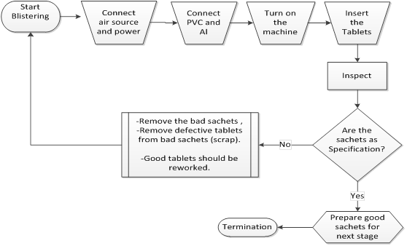
3. Create process map and scope.
UHLMANN UPS 1680

Slide 21
MEASURE
Monitoring and measuring the performance indicators using data collection plan.
Three blistering machines were monitored:
UHLMANN UPS 1680
UHLMANN UPS 300
UHLMANN B 1240
But, here we will talk about the first machine UHLMANN UPS 1680.

Slide 22
Machine breakdowns
Machine Breakdowns. | Total time of machine breakdowns. (min)
Squashing | 150
Sealing | 55
Sealing retest | 75
Unclear number | 60
AL shiftiness | 115

Slide 23
Specifications of process conditions
Batch # | Product | Type of blistering | Mold size | Tablet type | Calculated velocity | Tab. in sachet
110007 | NAPREX 500 MG | PVC-Al | Round | coated | 20 | 10
100155 | ERYTHROTAB | PVC-Al | oblong | coated | 20 | 12
110034 | ORACAL CHEWABLE | PVC-Al | Round | uncoated | 20 | 10
100682 | MOBICOL 200 MG | PVC-Al | Round | coated | 20 | 10
110059 | SEREPAM 5 MG | PVC-Al | Round | uncoated | 20 | 20
100853 | LARICID 500 MG | PVC-Al | oblong | coated | 20 | 7
100721 | ORALUTE | PVC-Al | Round | uncoated | 20 | 20
100517 | SPIRONE | PVC-Al | Round | coated | 20 | 10
100851 | PHENOTAB 15 MG | PVC-Al | Round | uncoated | 20 | 20

Slide 24
Quantities (in, out, Defects) of process inputs
Batch # | Tablet In | Tablet Out | Defects of Product | PVC in (Kg) | PV C out (Kg) | Defects of PVC(Kg) | Al in (Kg) | Al out (Kg) | Defects of Al (Kg)
110007 | 91988 | 91840 | 349 | 49.7 | 16.5 | 14.10 | 9.2 | 3.4 | 2.06
100155 | 142960 | 139836 | 1000 | 89.5 | 20.9 | 26.6 | 30.9 | 4.7 | 12.4
110034 | 155214 | 154360 | 520 | 105.2 | 27.8 | 8.9 | 24.6 | 5.8 | 1.08
100682 | 86041 | 83230 | 2100 | 51.5 | 21.5 | 13.7 | 9 | 3.7 | 2.25
110059 | 294424 | 290380 | 3060 | 51.4 | 29.1 | 21.9 | 12.8 | 5.5 | 3.7
100853 | 37230 | 36001 | 400 | 27.8 | 11.8 | 11 | 8.6 | 2 | 1.67
100721 | 190240 | 186260 | 3756 | 52.5 | 16.8 | 20.5 | 8.1 | 3.7 | 2.38
100517 | 86692 | 85050 | 500 | 26.4 | 15.3 | 8.7 | 9.2 | 3.2 | .95
100873 | 7851 | 7469 | 100 | 26.7 | 1.9 | 11.7 | 4.2 | .4 | 1.85
100851 | 388022 | 383560 | 5352 | 80.1 | 34.5 | 20 | 13 | 6.9 | 3.05

Slide 25
Operations time study
Batch # | Machine Cleaning time (min). | Machine Preparation time (min). | Machine decomposing time (min). | Machine production time (min).
110007 | 15 | 240 | 15 | 330
100155 | 30 | 60 | 15 | 250
110034 | 30 | 45 | 15 | 390
100682 | 45 | 120 | 15 | 780
110059 | 15 | 80 | 15 | 790
100853 | 15 | 180 | 15 | 435
100721 | 15 | 40 | 15 | 755
100517 | 30 | 100 | 15 | 280
100873 | 15 | 50 | 15 | 105
100851 | 25 | 120 | 15 | 745

Slide 26
Analyze
1. Cause and effect diagram.

Slide 27
2. Pareto charts

Slide 28
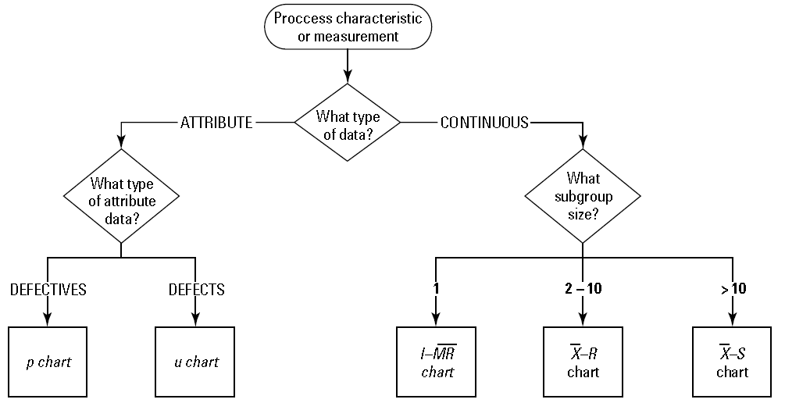
3. Control charts
Why We Choose I-MR?

Slide 29
Control charts were made for these processes:
Tablets Production.
Al .
PVC.
Preparation of Machine.
Cleaning of Machine.
Decomposing of Machine.

Slide 31
Note: All Processes Are in Control.

Slide 32
4. Capability analysis:
We note from figure that capability of the process=0.38<1, so the process is incapable.

Slide 33
We note from figure that capability of the process=-0.75<1, so the process is incapable and all of data points are out of specification limits.

Slide 34
We note from figure that capability =-0.63 <1, so the process is incapable and all of data points are out of specification limits.

Slide 35
5. Study of losses
Losses from time.
 | Lost cost | Cost of one sachet | Lost sachet | #of tablet per sachet | Lost tablet | Lost time | Theoretical productivity in one hour | Tablet Out | Product
 | 76435.2 | 7.2 | 10616 | 10 | 106160 | 2.9 | 36000 | 91840 | NAPREX 500 MG
 | 18138.6 | 5.4 | 3359 | 12 | 40308 | 0.9 | 43200 | 139836 | ERYTHROTAB
 | 14335.2 | 1.8 | 7964 | 10 | 79640 | 2.2 | 36000 | 154360 | ORACAL CHEWABLE
 | 404009 | 10.5 | 38477 | 10 | 384770 | 10.7 | 36000 | 83230 | MOBICOL 200 MG
 | 98679 | 3 | 32893 | 20 | 657860 | 9.1 | 72000 | 290380 | SEREPAM 5 MG
 | 377226 | 18 | 20957 | 7 | 146699 | 5.8 | 25200 | 36001 | LARICID 500 MG
 | 431700 | 12 | 35975 | 20 | 719500 | 10.0 | 72000 | 186260 | ORALUTE
 | 74763 | 9 | 8307 | 10 | 83070 | 2.3 | 36000 | 85050 | SPIRONE
 | 94194 | 18 | 5233 | 7 | 36631 | 1.5 | 25200 | 7469 | LARICID 500 MG
 | 122563 | 4.8 | 25534 | 20 | 510680 | 7.1 | 72000 | 383560 | PHENOTAB 15 MG
Total lost cost (NIS) =1,712,043

Slide 36
Losses from defects (tablets, PVC, AL)
lost cost | cost of one sachet | defect sachet | #of tablet per sachet | Defects of Product (Tablets) | Product
251.28 | 7.2 | 35 | 10 | 349 | NAPREX 500 MG
450 | 5.4 | 83 | 12 | 1000 | ERYTHROTAB
93.6 | 1.8 | 52 | 10 | 520 | ORACAL CHEWABLE
2205 | 10.5 | 210 | 10 | 2100 | MOBICOL 200 MG
459 | 3 | 153 | 20 | 3060 | SEREPAM 5 MG
1028.571 | 18 | 57 | 7 | 400 | LARICID 500 MG
2253.6 | 12 | 188 | 20 | 3756 | ORALUTE
450 | 9 | 50 | 10 | 500 | SPIRONE
257.1429 | 18 | 14 | 7 | 100 | LARICID 500 MG
1284.48 | 4.8 | 268 | 20 | 5352 | PHENOTAB 15 MG
Total lost cost (NIS) =8732.674

Slide 37
Batch # | Product | Defects of Al (Kg) | cost of one KG of AL | Lost cost | Defects of PVC(Kg) | cost of one KG of PVC | Lost cost
110007 | NAPREX 500 MG | 2.06 | 40.18 | 82.77 | 14.1 | 11.9 | 167.79
100155 | ERYTHROTAB | 12.4 | 40.18 | 498.23 | 26.6 | 11.9 | 316.54
110034 | ORACAL CHEWABLE | 1.08 | 40.18 | 43.39 | 8.9 | 11.9 | 105.91
100682 | MOBICOL 200 MG | 2.25 | 40.18 | 90.41 | 13.7 | 11.9 | 163.03
110059 | SEREPAM 5 MG | 3.7 | 40.18 | 148.67 | 21.9 | 11.9 | 260.61
100853 | LARICID 500 MG | 1.67 | 40.18 | 67.10 | 11 | 11.9 | 130.9
100721 | ORALUTE | 2.38 | 40.18 | 95.63 | 20.5 | 11.9 | 243.95
100517 | SPIRONE | 0.95 | 40.18 | 38.17 | 8.7 | 11.9 | 103.53
100873 | LARICID 500 MG | 1.85 | 40.18 | 74.33 | 11.7 | 11.9 | 139.23
100851 | PHENOTAB 15 MG | 3.05 | 40.18 | 122.55 | 20 | 11.9 | 238
Total cost |  |  |  | 1261.25 | Total cost |  | 1869.5

Slide 38
Total cost of all defects=1261.25+1869.5+8732.674=11863.424
Total losses from time and defects=1,712,043+11863.424=1,723,907 NIS.

Slide 39
6. Sigma level calculations
We calculated defects per million and long term sigma level that are followed in the blistering process for three blistering machines
Defects per million=∑Defects/∑Output of tablets*1,000,000
Long term sigma level=NORMSINV {1-(∑Defects/∑Output of tablets)} + 1.5

Slide 40
Defects per million=11753.89
Long term sigma level=3.8

Slide 41
IMPROVE
Because of:
Limited time.
The company is satisfied with current quality level so, it didn't accept applying solutions as design of experiments.
So, we suggest some solutions to improve the process that show in the following table:

Slide 42
Problem | Cause | Suggested Solution
PVC and Al shiftiness | Defective from supplier | Never use defective raw materials
Camera Problems (extra tablets, breaking tablets). | Labor error, excess temperature, hardness of tablet. | Retraining blistering and maintenance employees. Control previous Processs (Mixing and compression).
Unclear batch number. | Labor error. | Retraining blistering employees.
Calibrating Machine problems. | Labor error. | Retraining maintenance employees.
Empty sachets. | Labor error. | Retraining blistering employees,
Sealing Problems. | Mold problems, Excess temperature, Labor error, broken rings. | Retraining blistering and maintenance employees, Replace Local molds with original ones, Replace defective molds, replace rings.
Entering extra tablets under sealing unit. | Labor error. | Retraining blistering employees, put the barrier part to prevent tablet entering.
Forming | Unsuitable temperature with PVC type, worn rings. | New calibration, replace rings.
Squashed( Burning) | Inaccurate calibration, unsuitable temperature, PVC type, labor error. | Retraining blistering and maintenance employees, new calibration.

Slide 43
CONTROL
Specific Control tasks that DMAIC team much complete include:
Implement three levels of retaining (low, medium, high) on three employees with same level of productivity and measure the effect on their performance.
Perform Reliability analysis on all machines in the company.
Perform Design Of Experiments on critical parameters of any process in the company.

Slide 44
Put a good criteria for preventive maintenance for all machines in the company.
Developing a monitoring process to keep track of the changes they have set out.
Creating a response plan for dealing with problems that may arise.
Helping focus management’s attention on a few critical measures that give them current information on the outcomes of the project (the Y) and key process measures, too (the Xs.)

Slide 45
We recommended implementing major concept in control world; this is (Poka-Yoke).
Poka-Yoke is the transliteration of a Japanese phrase meaning “to make mistakes impossible"
Common Poka-Yoke implementations include:
Physical features or geometry.
Automated processing, inspection systems.
Limiting controls that don’t allow the process to be operated at unacceptable levels.

Slide 46
We recommend using simple devices and procedures that prevent mistakes:
  Photo sensors in order to skip the bad sachets.
  Checklists to ensure that everything in good status.
  Trip switches to stop the machine when the workers work on fault setting especially in temperature.
  Control panel in order to set the process easily.
  Fixtures to orient parts.

Slide 47
Conclusion
We can conclude from this project that:
Birzeit Pharmaceutical company took the best rate according to our evaluation so, it was choose for the project.
2. long term sigma level for the machines:
UHLMANN UPS 1680=3.8
UHLMANN B 1240=4.44
UHLMANN UPS 300=3.6

Slide 48
Then, UHLMANN B 1240 has the higher sigma level, so this machine has good quality.
3. The most of lost cost comes from waste time not come from bad quality, in the contract, the quality of process and products were good and not costly as waste time so the company should work on lean manufacturing system.

Slide 49
4. The results from comparison between three machines that the performance of UHLMANN B 1240 machine better than UHLMANN UPS 1680 machine performance which better than UHLMANN UPS 300 machine performance.
5. The total lost cost resulted from all machines production process for tablets during 3 months =58,281,053(NIS)

Slide 50

Alaa Alsadi
Ameera Dawoud
Mays Hijjawi
Ons Shawahni

