Slide 1


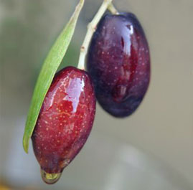
Mechanical Engineering Department
Graduation Project
Home Olive Press
Prepared by
Ahmad N. Kulaib
Rafeeq Daragmeh
Rizq Ararawi
Yousef I. Hussein
Supervisor:
Prof. Dr. M. Abu-Hilal
Thursday 10-5-2012
HOME OLIVE PRESS

Slide 2
Introduction
Methodology
Extraction Methods
Design of Machine
Home Olive Press
Thursday 10-5-2012
HOME OLIVE PRESS

Slide 3
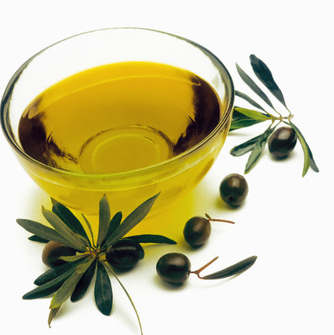

Introduction
Thursday 10-5-2012
HOME OLIVE PRESS

Slide 4
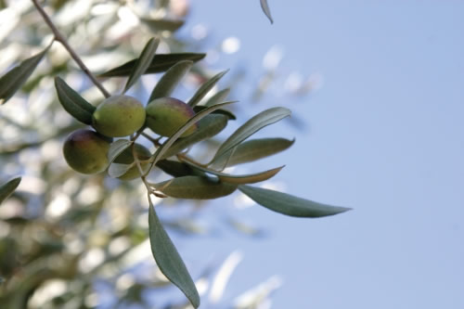
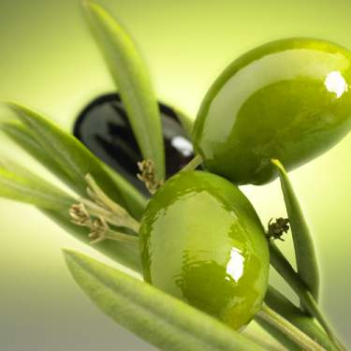
Olive fruit types in Palestine
Nabali
Souri
Balahi
K18
Thursday 10-5-2012
HOME OLIVE PRESS

Slide 5

Olive Oil Production
Thursday 10-5-2012
HOME OLIVE PRESS

Slide 6
Olive Oil Quality
The three main agents that cause the lack of olive oil quality are oxygen ,light and temp.
Once an olive is harvested, it should be pressed within 24 hours. Oxidation begins directly upon harvesting. Therefore oil obtained after a longer wait is of lower quality, presenting higher acidity.
Thursday 10-5-2012
HOME OLIVE PRESS

Slide 7
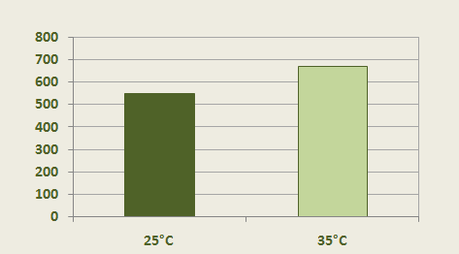
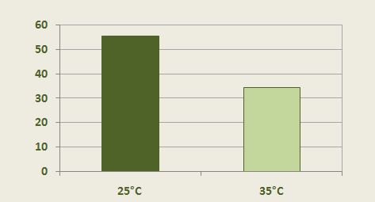
The paste temperature effect on the acidity and perfumery compounds
veynol
perfume compound
Thursday 10-5-2012
7
HOME OLIVE PRESS

Slide 8
Methodology
Thursday 10-5-2012
HOME OLIVE PRESS

Slide 9
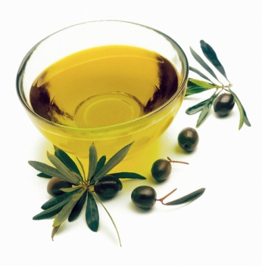
Main objectives
Previous projects studies
Discussing the designs
set up the design
Design output studies
Thursday 10-5-2012
HOME OLIVE PRESS

Slide 10
Extraction methods
Thursday 10-5-2012
HOME OLIVE PRESS

Slide 11
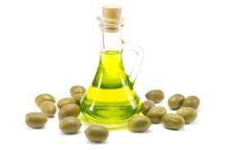
Home Olive Press
Olive Extraction :
Olive oil extraction is the process of separating the oil from the other fruit contents.
Thursday 10-5-2012
HOME OLIVE PRESS

Slide 12
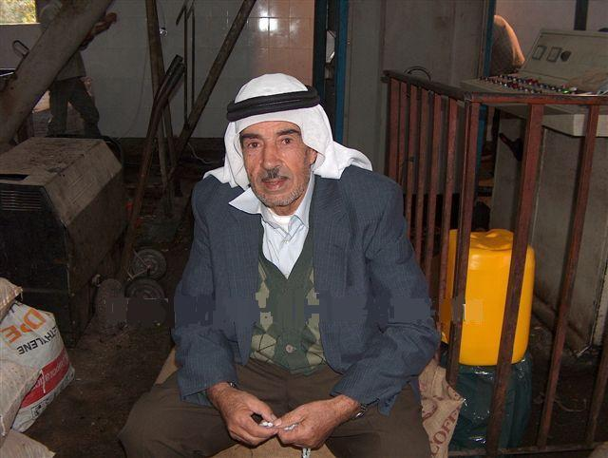
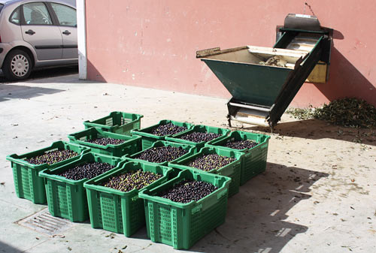
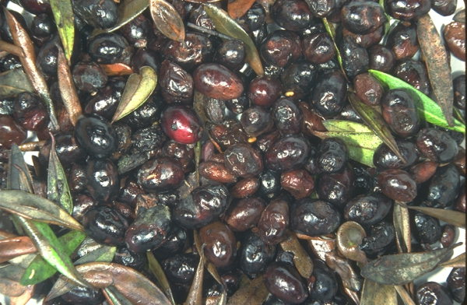
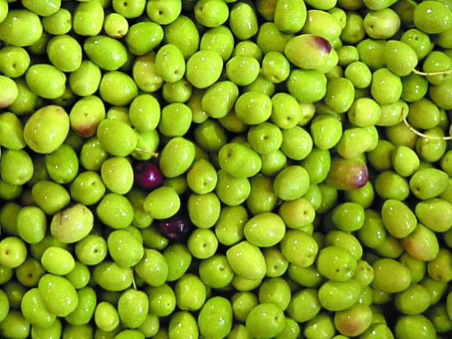
Problems facing the olive extraction process
Waiting
Quality
Cost
waste
Thursday 10-5-2012
HOME OLIVE PRESS

Slide 13
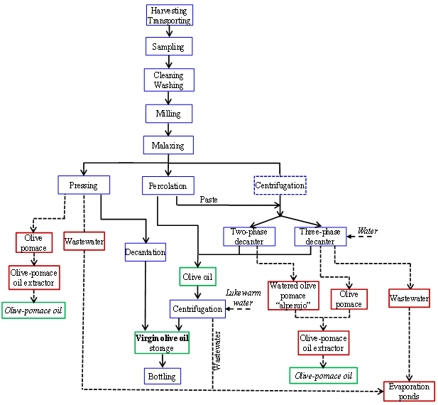

Thursday 10-5-2012
HOME OLIVE PRESS

Slide 14

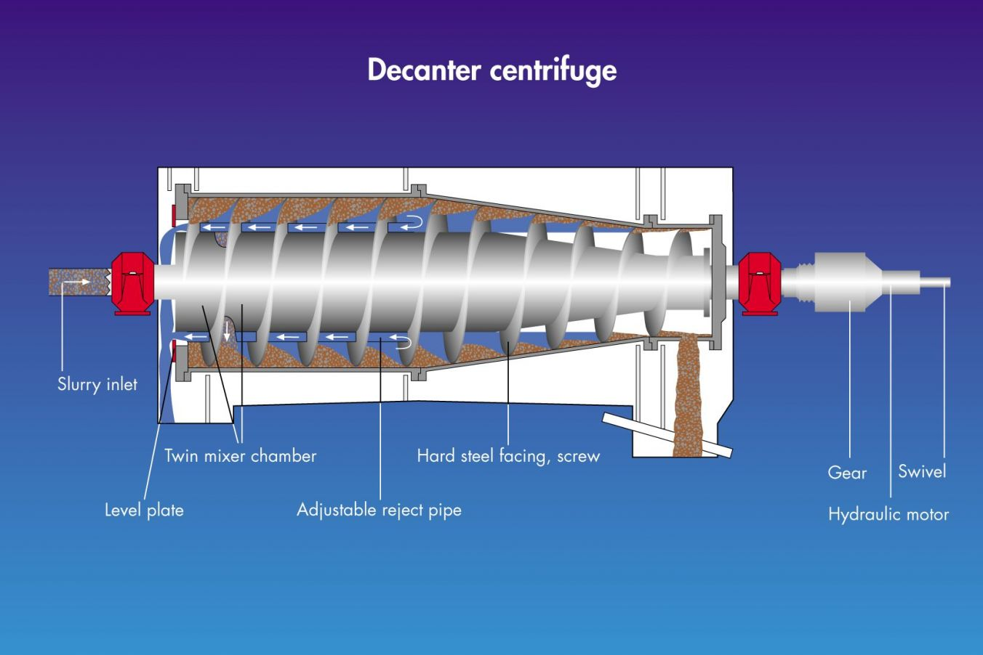
Decanter Centrifuge
Thursday 10-5-2012
HOME OLIVE PRESS

Slide 15
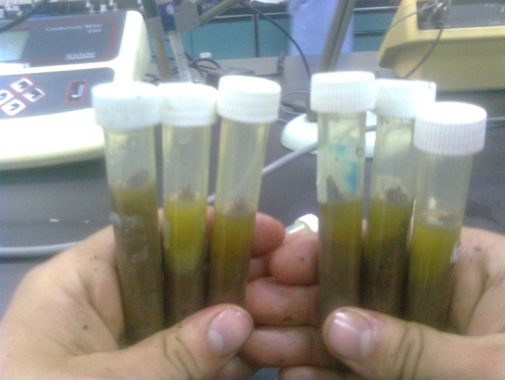
Home Olive Press
Centrifugal Experiments
The effect of centrifugal process was tested experimentally in the university by coordinating with chemical engineering department for using a centrifugal device. The experiment data give information about the rotating velocity, rotating time effect and the oil percentage produced.
Thursday 10-5-2012
HOME OLIVE PRESS

Slide 16
oil percentage & angular velocity within 3 min
oil percentage & angular velocity within 10 min
The best choice is to use 3000 rpm angular velocity of the centrifuge for 6 minutes.
oil percentage & angular velocity within 6 min
Thursday 10-5-2012
HOME OLIVE PRESS

Slide 17
Design of machine
Thursday 10-5-2012
HOME OLIVE PRESS

Slide 18
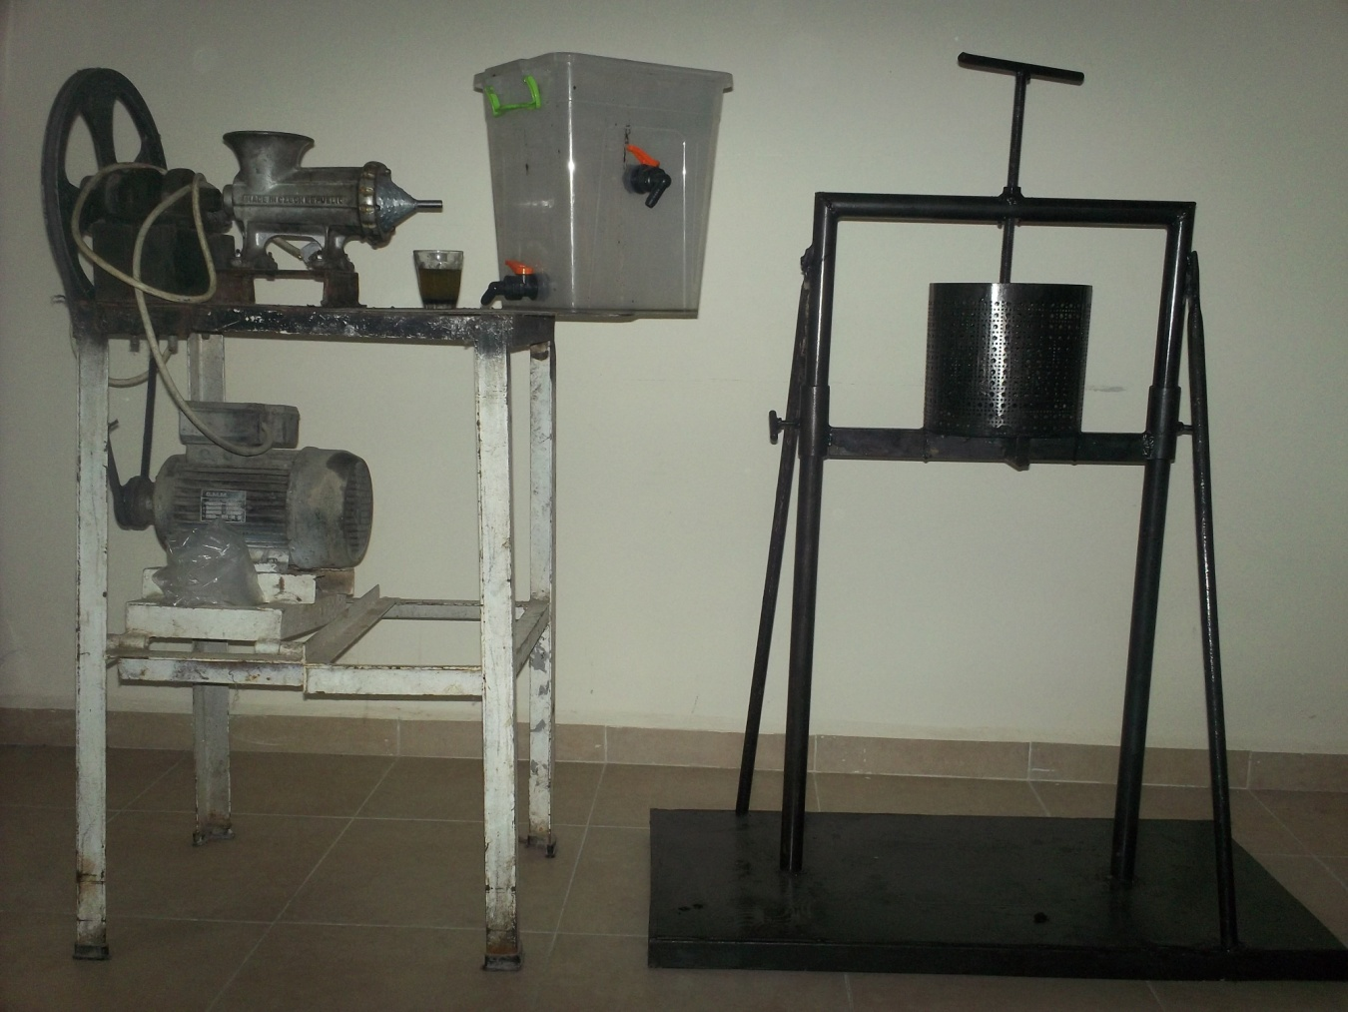
The Designed Parts of Machine
Plastic bowl
Grinding machine
Press
Thursday 10-5-2012
HOME OLIVE PRESS

Slide 19

1-Grinding machine
In order to obtain the mass flow rate we implemented the following experiment
mass(g) | Time(sec) | Flow rate(Q) (Kg/s)
750 | 47 | 0.016
750 | 49 | 0.0153
750 | 45 | 0.0167
Q = mass/time
Q =750 g/47 sec
Q = 57.446 kg/hr
Thursday 10-5-2012
HOME OLIVE PRESS

Slide 20
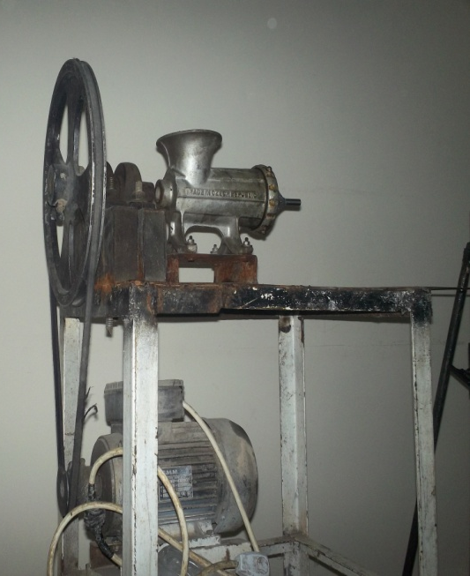
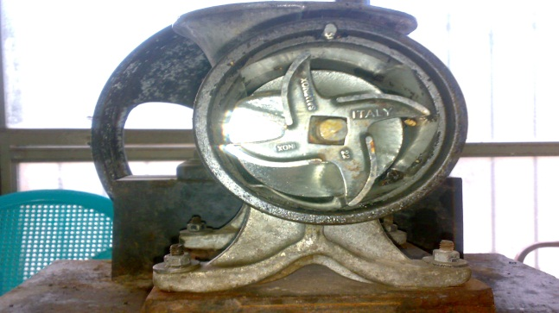
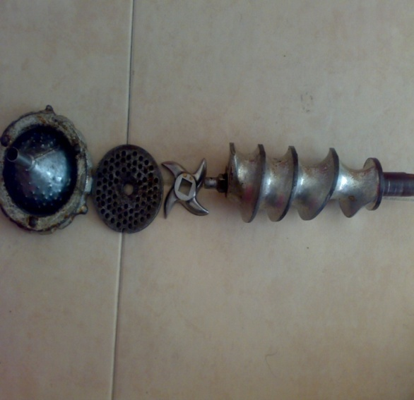
step1
Experimental flow rate
step2
Angular velocity
step3
Applied motor torque(T) = 44.796 N.m
step4
(n) = 33.306 rpm
(Q) = 57.446 kg/hr
motor Power = 2 hp
bore diameter : 40mm,outside diameter : 80mm, width : 18mm
Bearing selection , C₁₀=27.125KN
Thursday 10-5-2012
HOME OLIVE PRESS

Slide 21
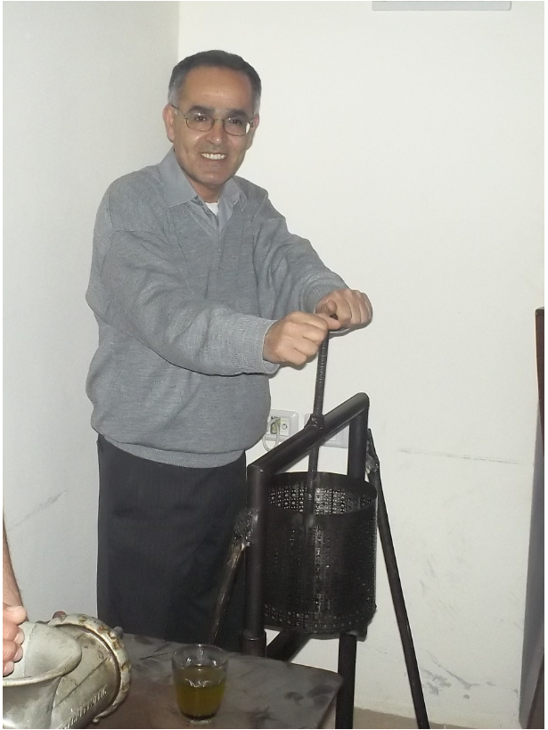
Home Olive Press
Squeezing Process
In order to separate oil from the solid components a manual squeezing method were used, by putting the paste inside a cotton piece and put weight on the content. This pressure forced the oil to flow out through the cotton piece, which produces clean oil in a good quality , the applied weight was 100kg for a specified quantity, the press capacity is 5 times more so we suppose we need 5times weight,500kg
Thursday 10-5-2012
HOME OLIVE PRESS

Slide 22
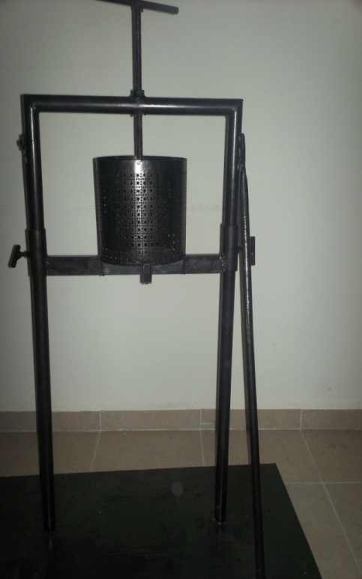
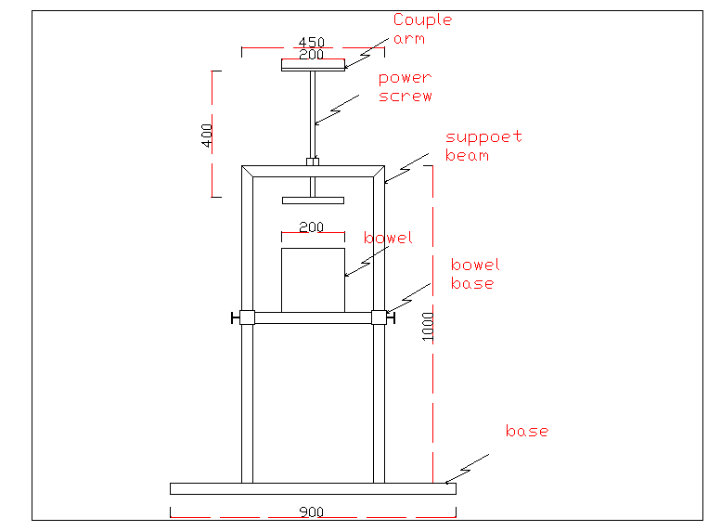
2-press machine :
Used to separate liquid from solid
The applied load is 500 kg
The torque needed to rotate the screw (T_{R})
T_{R} = 4.21416 N.m
A. Stresses on body screw
1. Shear stress = 12.426 MPa
2. Axial nominal stress = 43.391 MPa
Stress on thread of screw
Bearing stress =24.032 MPa
Bending stress =16.250 MPa
Transverse shear stress = 12.015 MPa
Minimum factor of safety = 9
Thursday 10-5-2012
HOME OLIVE PRESS

Slide 23
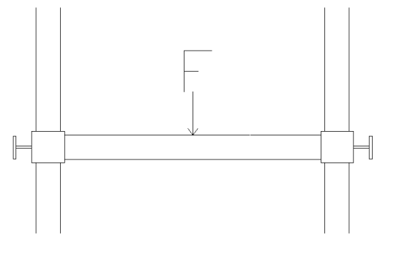
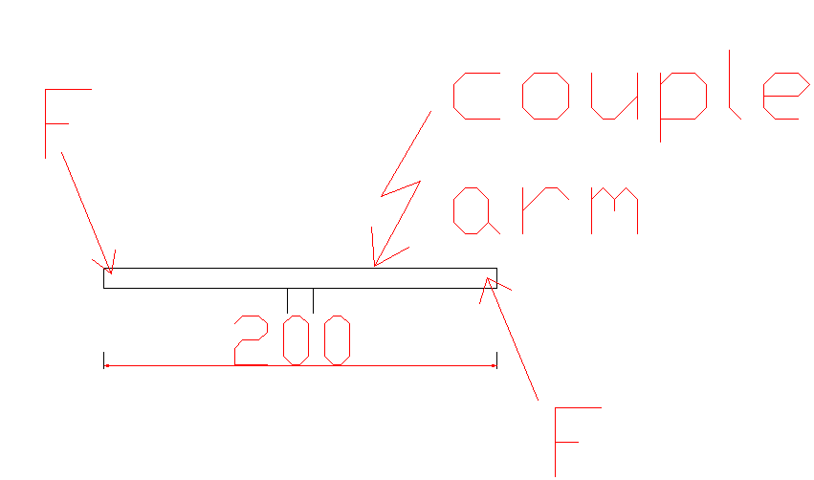
Shear on Screw That Support the Beam
shear stress = 48.82 MPa
F.S = 4.9
Couple Force(F) = 181.5 N
Thursday 10-5-2012
HOME OLIVE PRESS

Slide 24
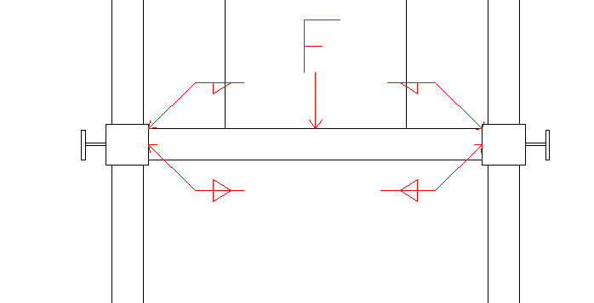
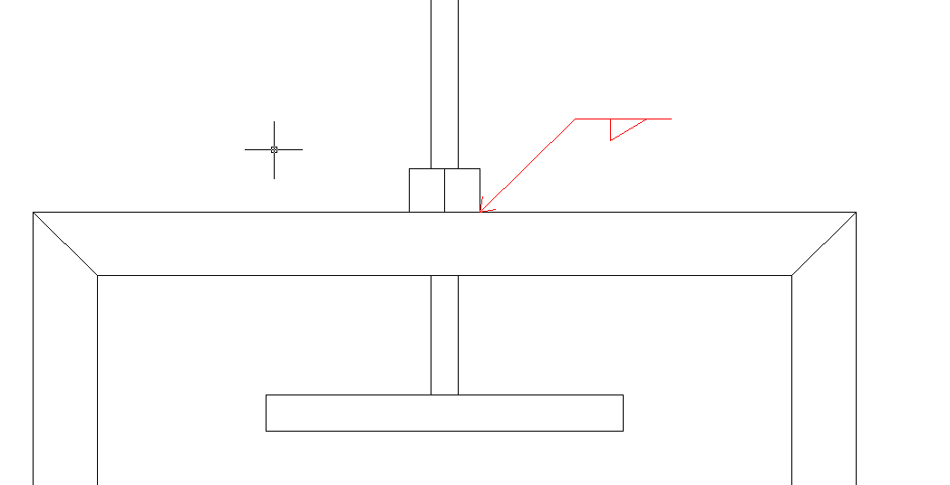
Welding calculation
Welding on Beam
The primary shear stress = 6.937 MPa
Shear stress due to bending moment =109.8 MPa
The overall shear stress = 109.96 MPa
Factor of safety = 1.81
B. Welding on the Nut of the Screw
The primary shear stress = 14.73 MPa
Shear stress due to bending moment =7.365 MPa
The overall shear stress = 16.46 MPa
Factor of safety = 12.1
Thursday 10-5-2012
HOME OLIVE PRESS

Slide 25

Weld on the Arm
The primary shear stress = 4.36 MPa
Factor of safety = 45.6
The minimum factor of safety was 1.81 for the press
Thursday 10-5-2012
HOME OLIVE PRESS

Slide 26
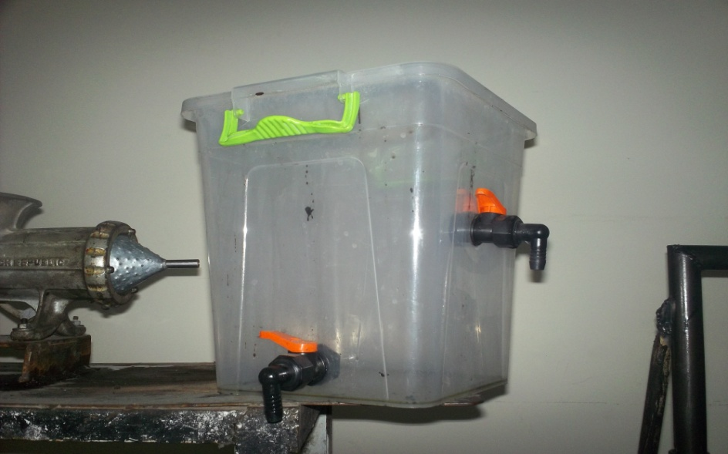
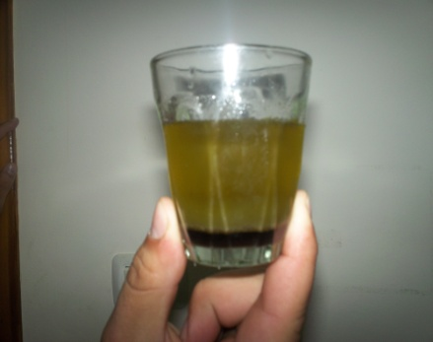
Separating Oil from Water :this process depends on natural separation due to density difference between the components of the liquid and called sedimentation, the obtained liquid from the pressing machine stored in a plastic bucket for period of time to allow the oil to separate from the other components (vegetarian water and small particles)
Pure oil
Mixed oil and water
Solid particles
Thursday 10-5-2012
HOME OLIVE PRESS

Slide 27

THANK YOU
Thursday 10-5-2012
HOME OLIVE PRESS

