Slide 1

Graduation Project
Management Information System Department
E-Commerce Website & Mobile App UI Design
For Abo Zahra Electronic Company
Prepared By: AbdAllah al-sharif
Supervised By: Dr. Maher Arafat

Slide 2
  Introduction
  Objectives of the project
Table Of
Content
  Strategies followed
  Website Features
  AZ-Website :
- User
- Admin
  Analytics
  UI Design for mobile App

Slide 3
Introduction
  Established in 1984 in Nablus, Palestine
  It has several branches in several cities.
  began selling and maintaining electronic spare parts and selling wholesale and retail
  A comprehensive provider of electrical, electronic and cellular devices and accessories

Slide 4



Objectives of the project:
Building and developing an online store for the company
Improve customer experience, showcase company products and expand brand
UI Design for mobile
App

Slide 5




Strategies followed :
Cost Effective Options
Open-Source Technologies
Cloud Based Solutions

Slide 6




Website Features :
Interactive interface
Data Export & Sales Analytics
Chat Direct & WhatsApp
Easy To Use

Slide 7
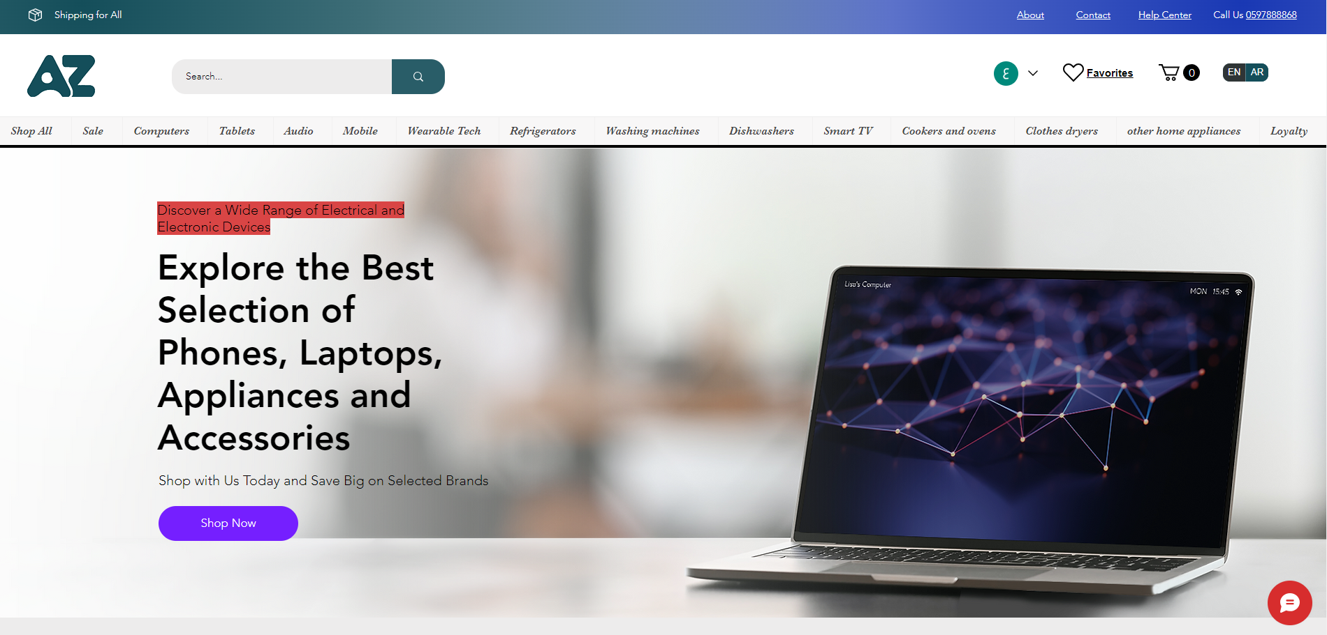
AZ-Website : User Interface

Slide 8
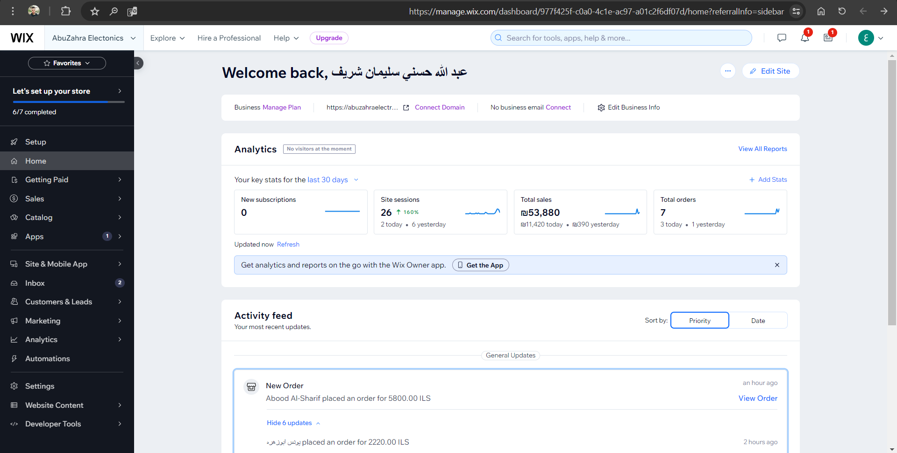
AZ-Website : Administrator

Slide 9
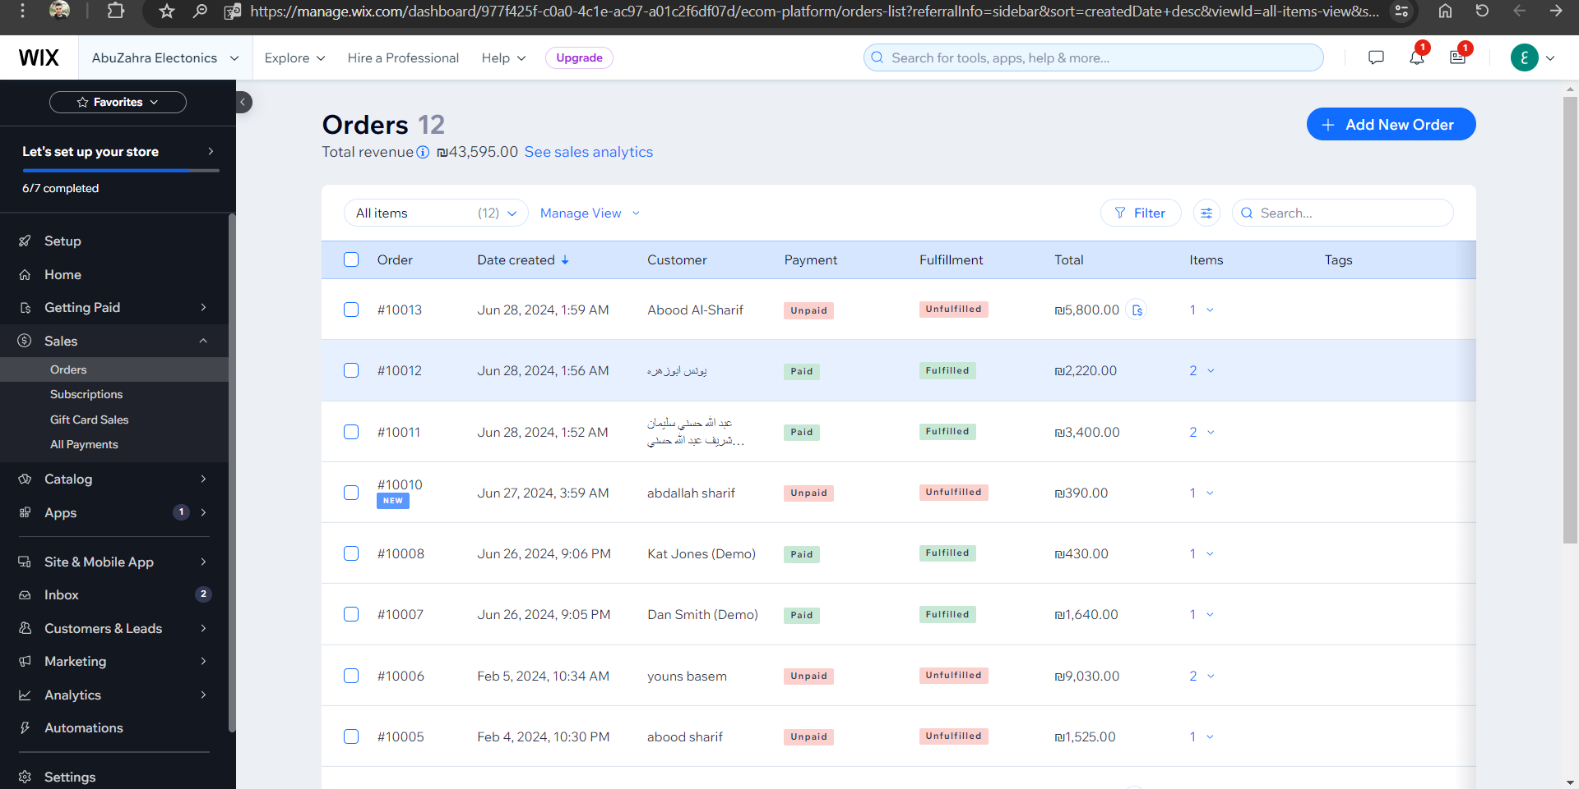

Slide 10
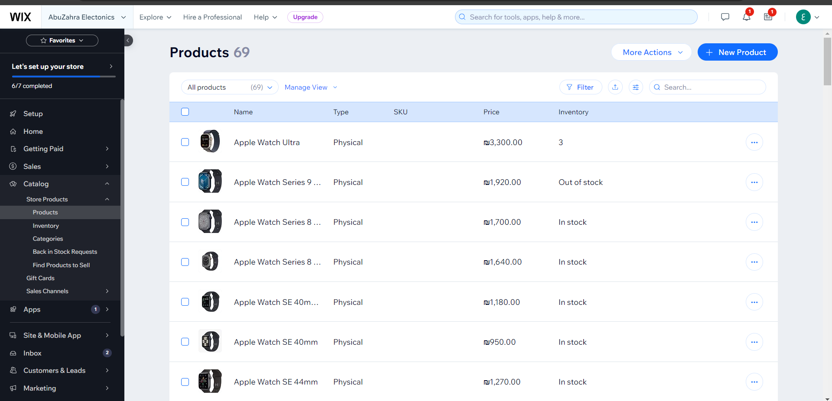

Slide 11
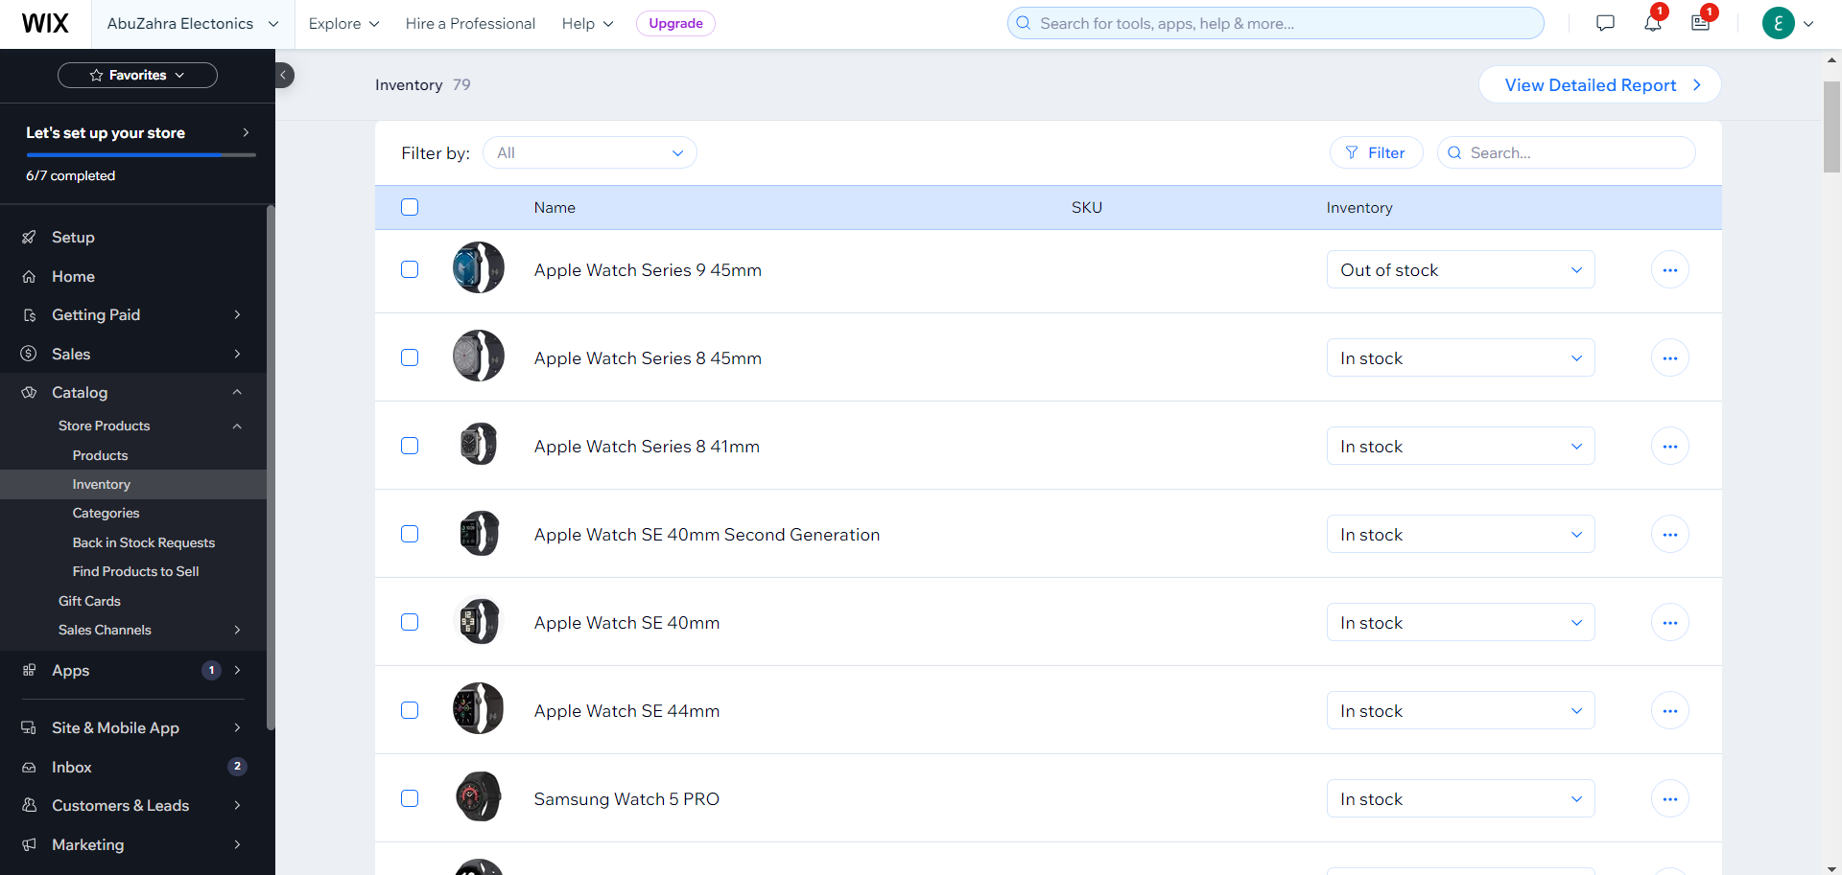

Slide 12
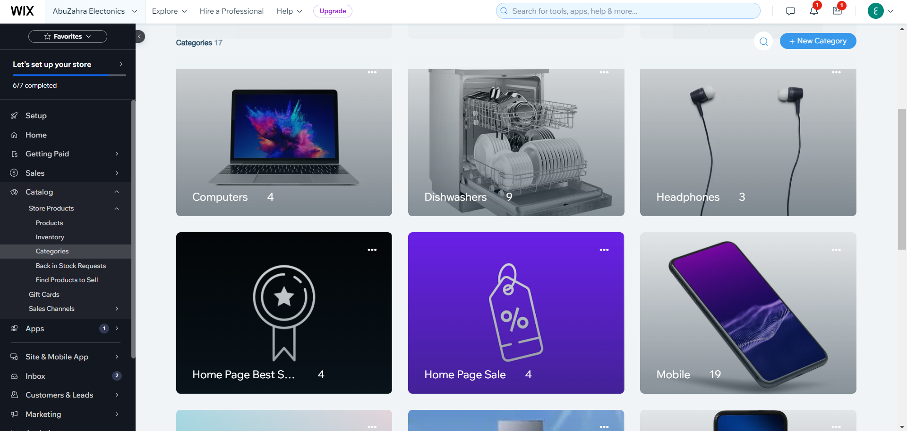

Slide 13
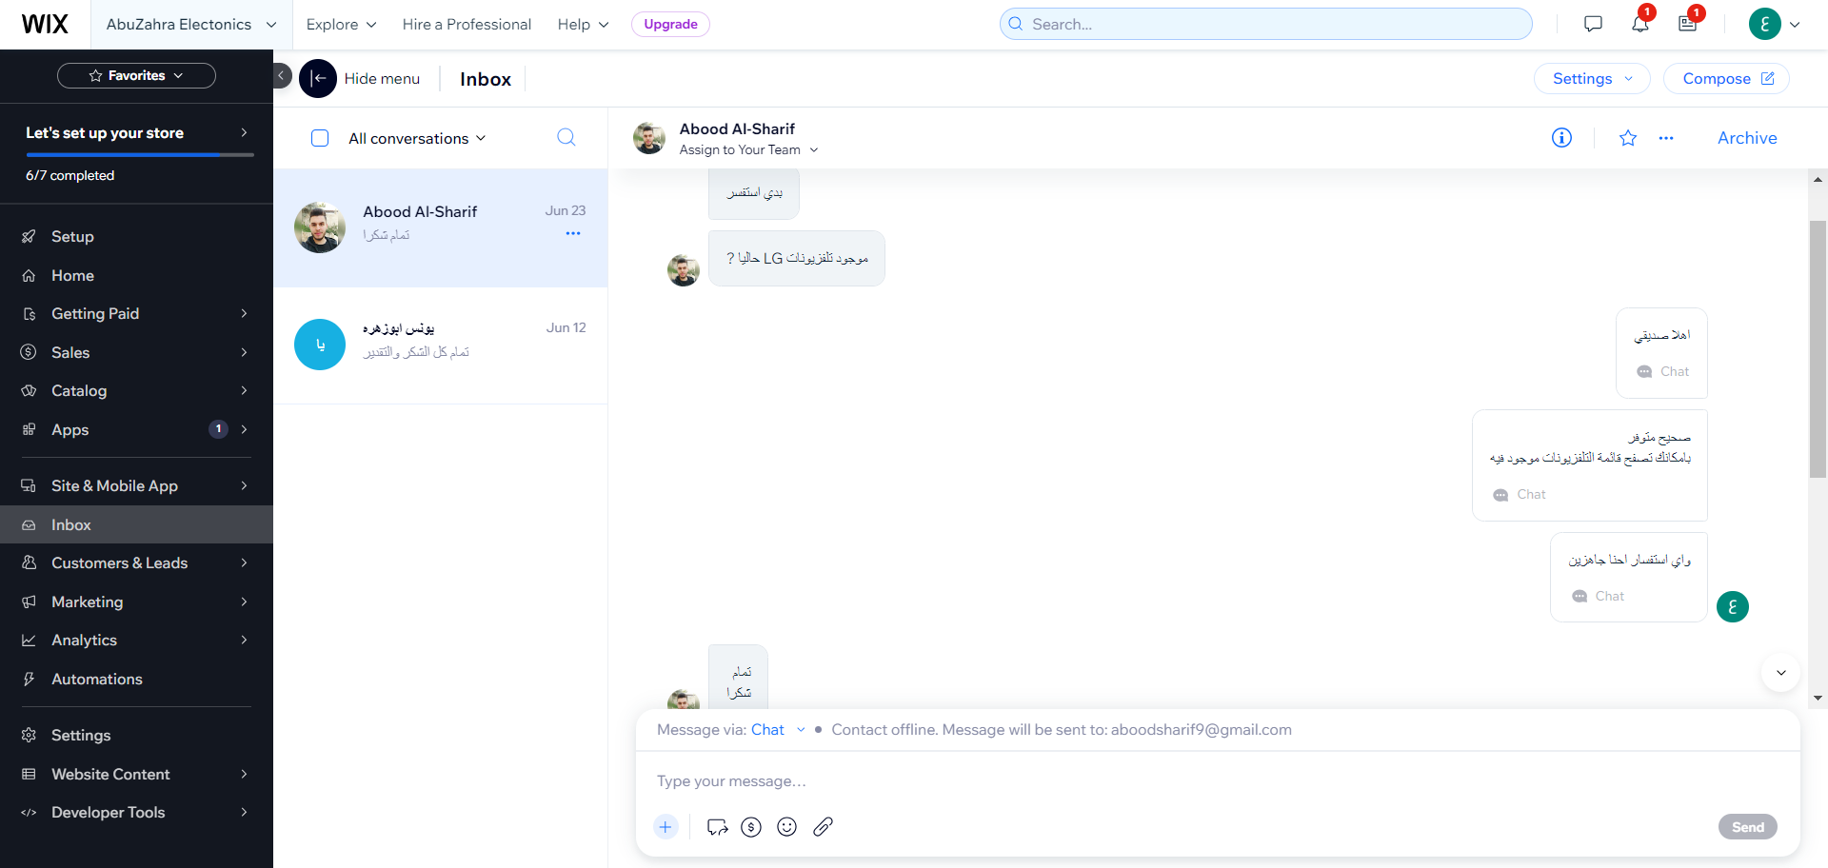

Slide 14
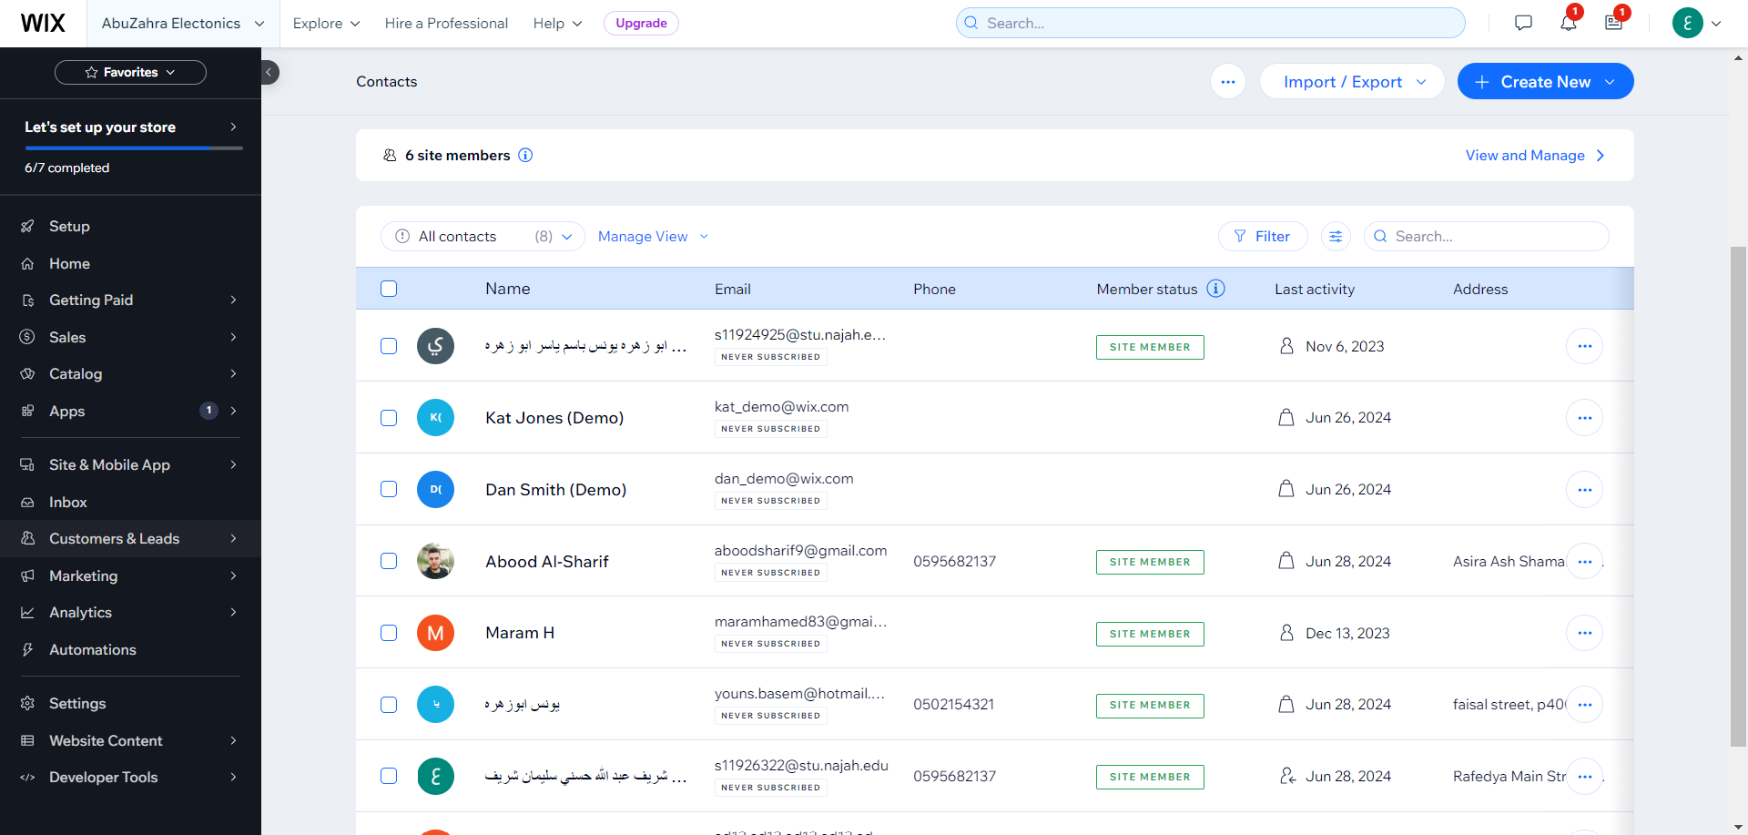


Slide 15
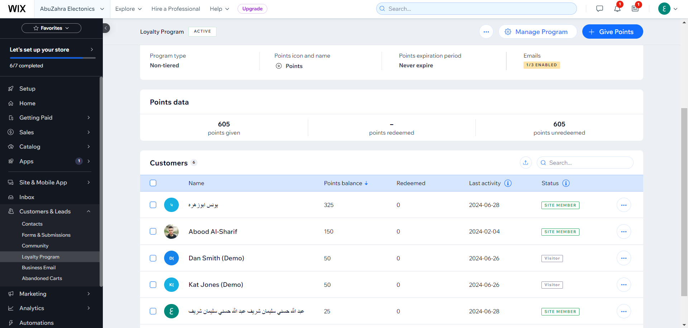

Slide 16
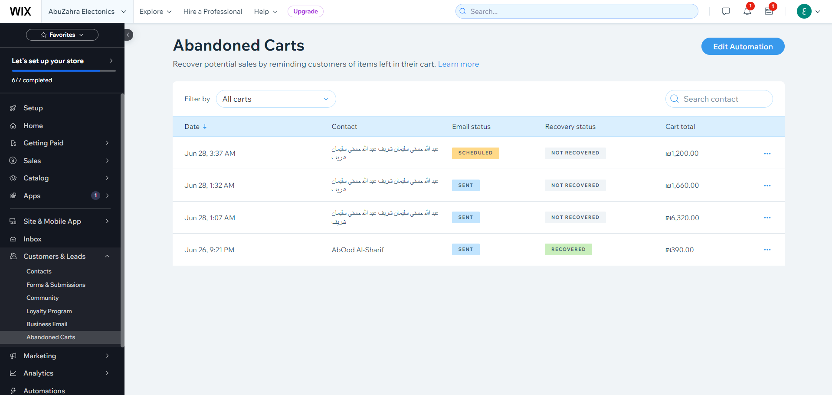

Slide 17
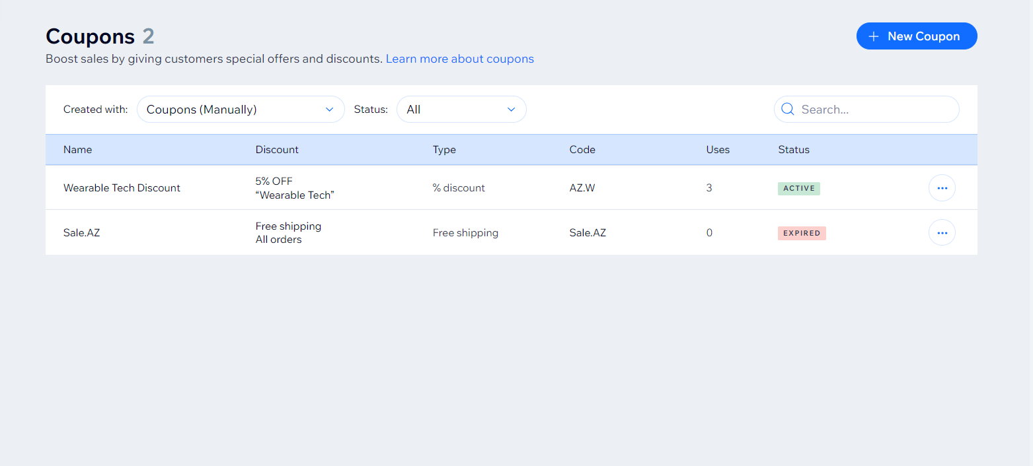

Slide 18
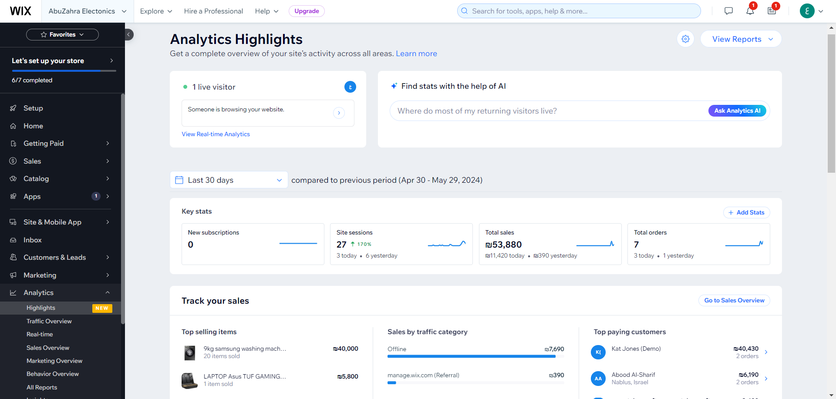

Slide 19
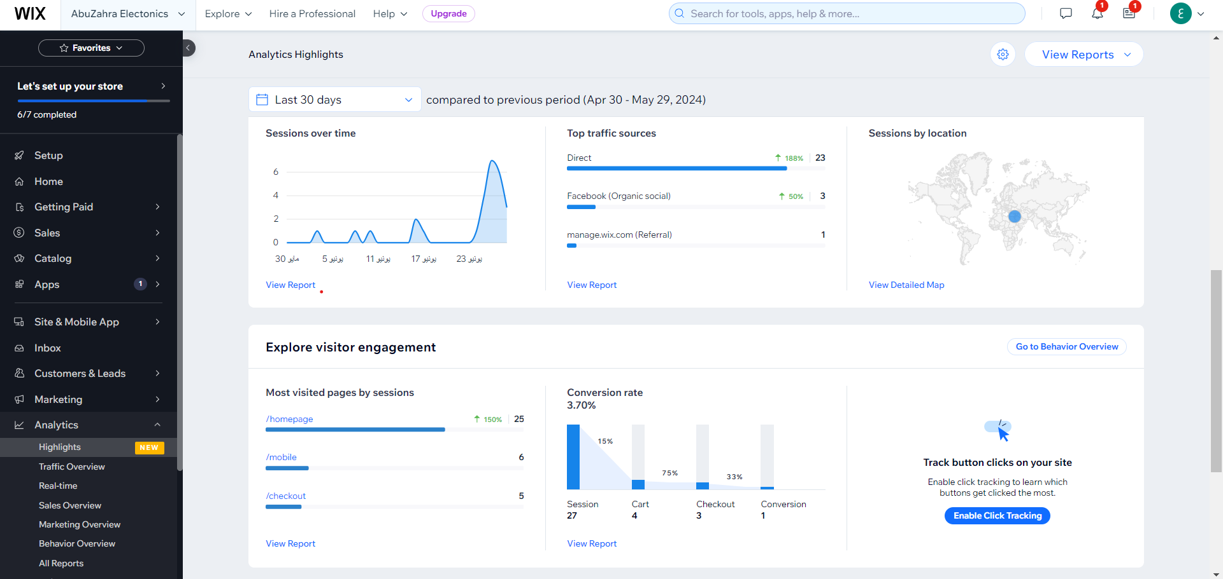

Slide 20
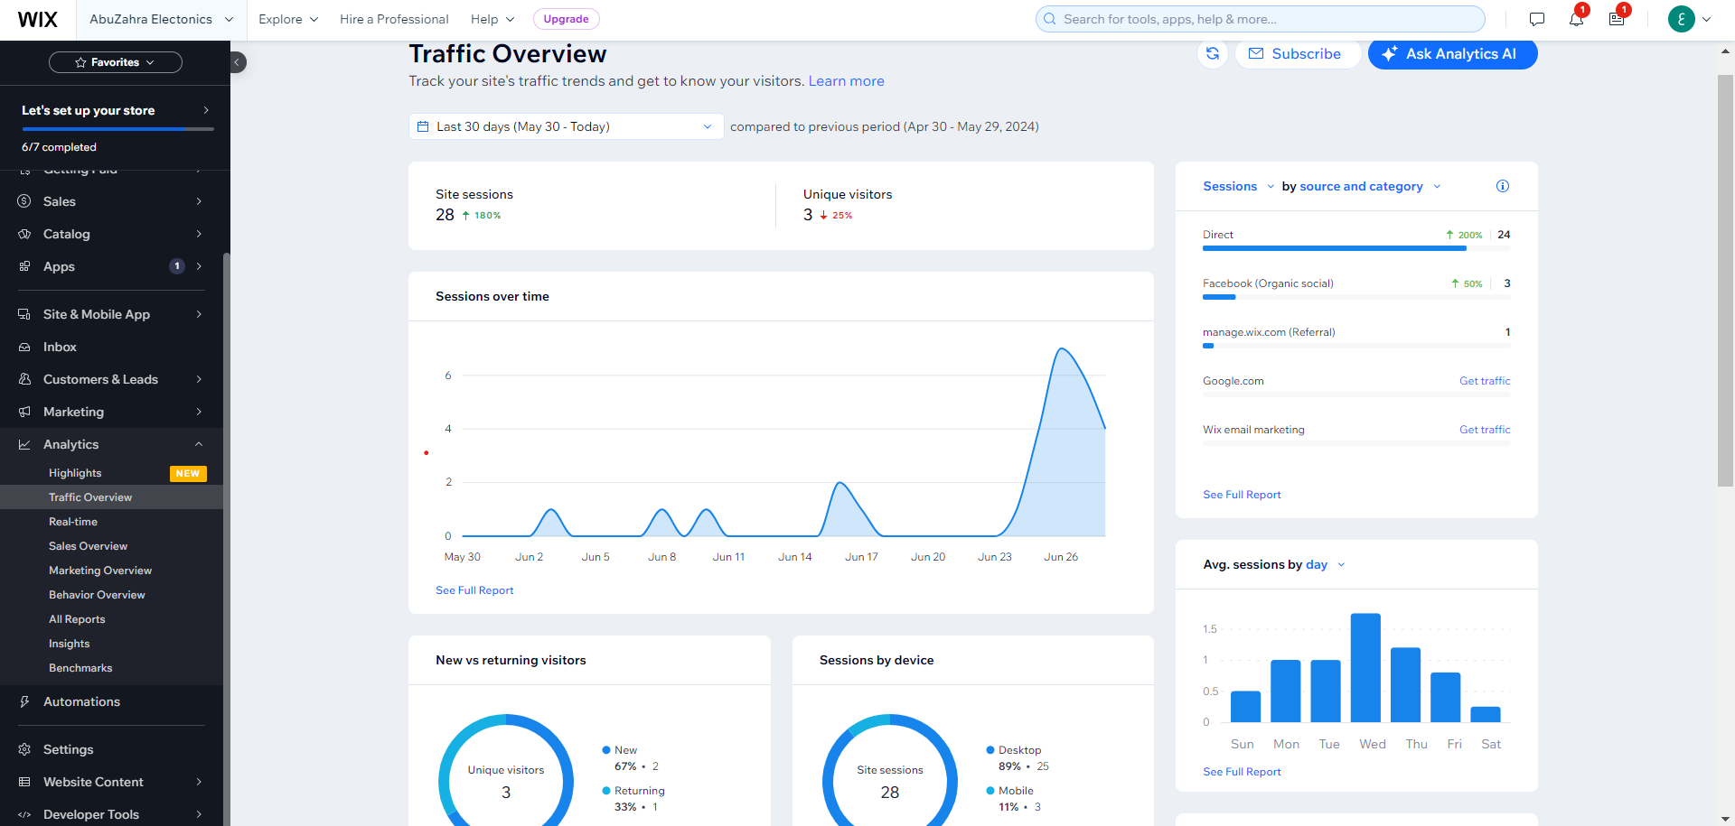

Slide 21
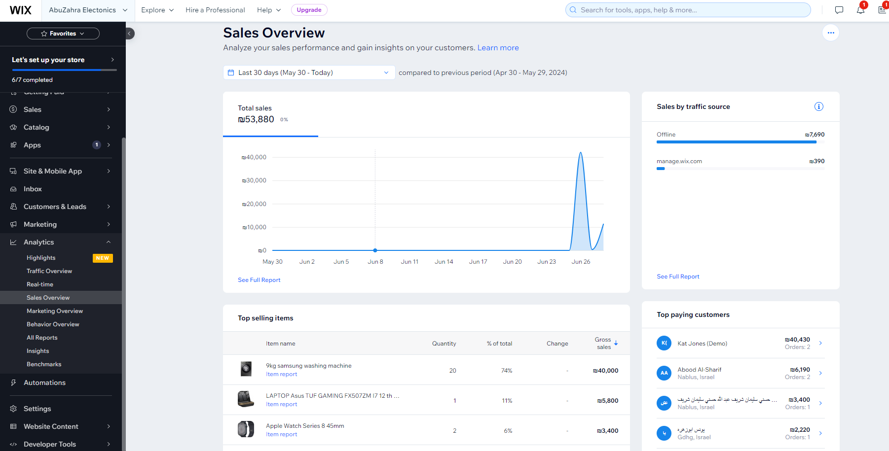

Slide 22
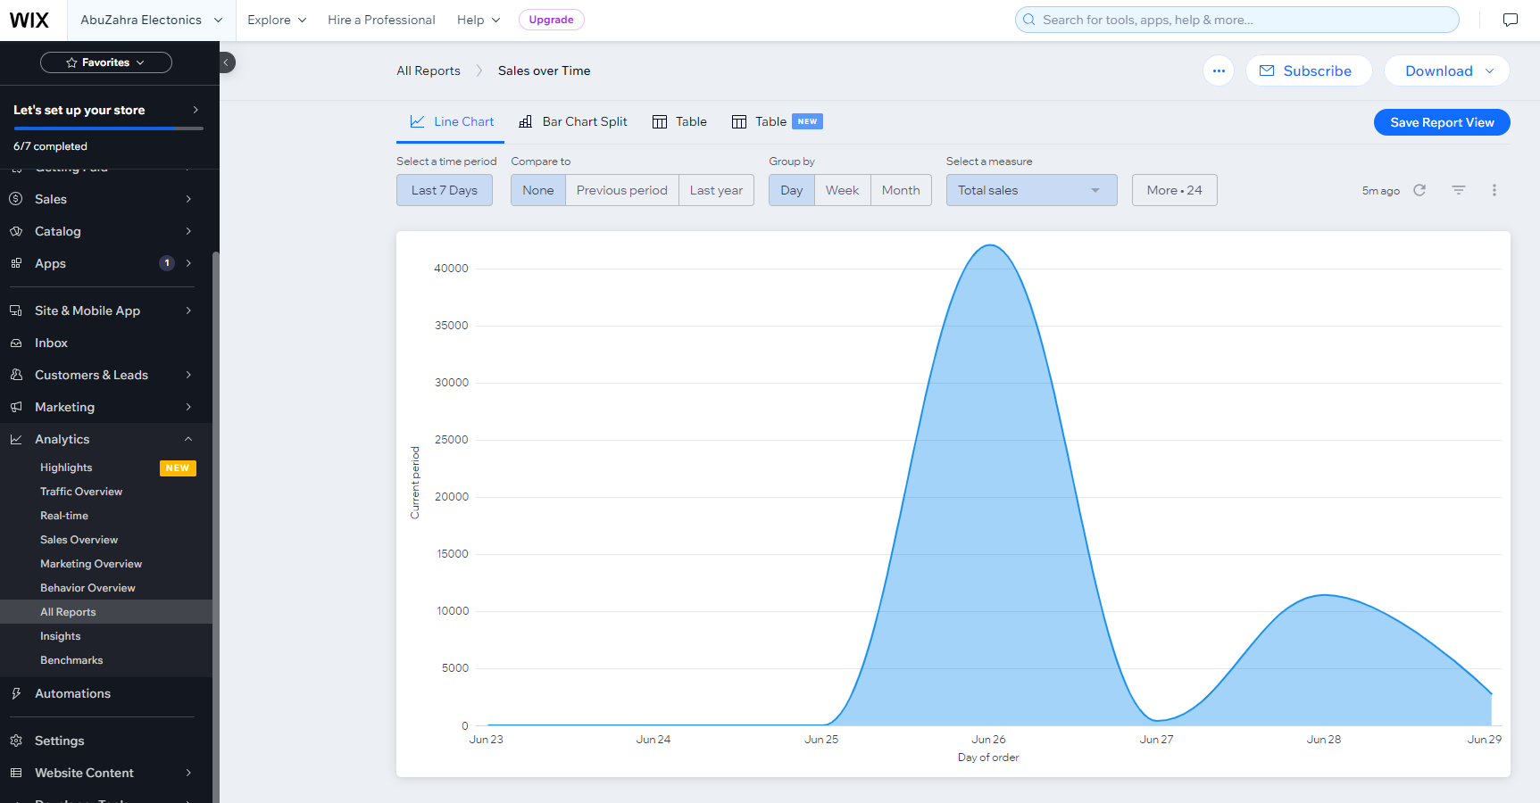

Slide 23
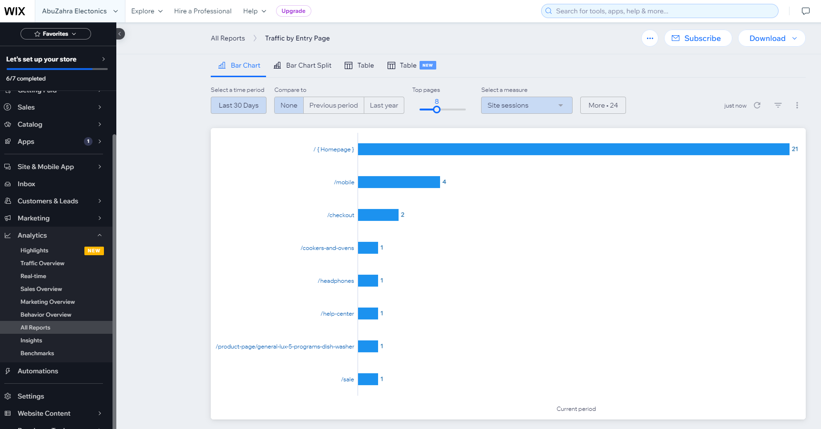

Slide 24
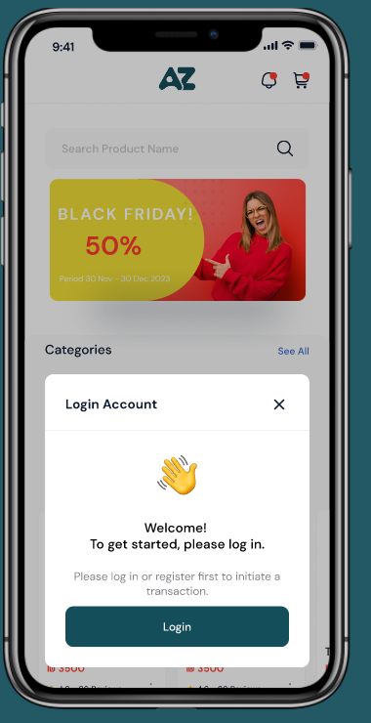
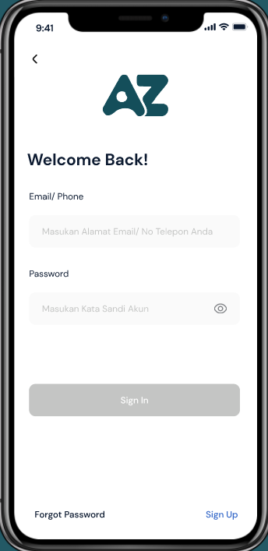
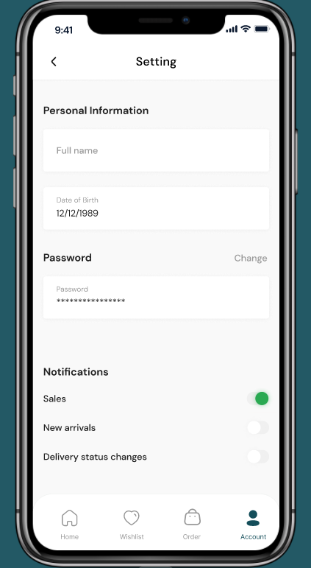
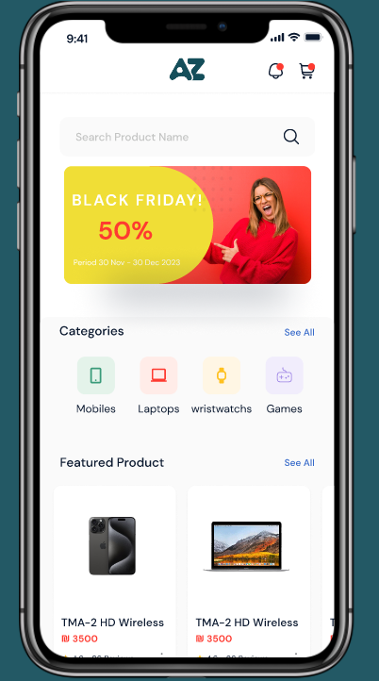
UI desgin for mobile app:

Slide 25
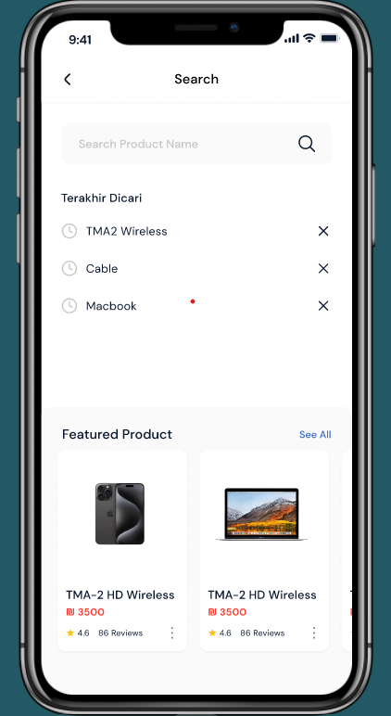
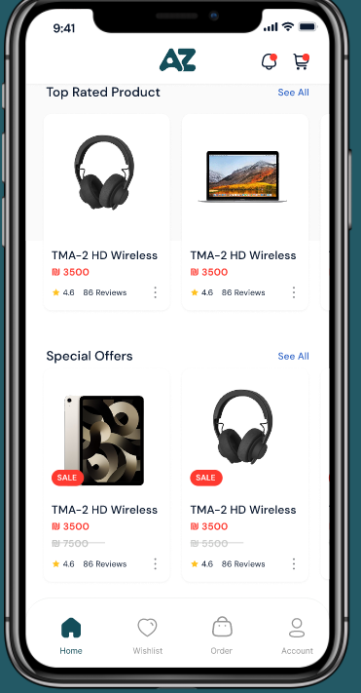
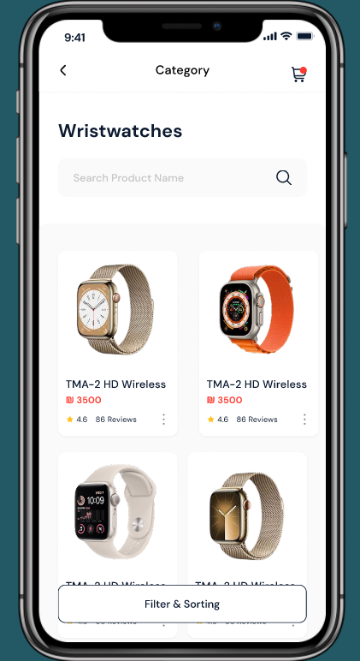
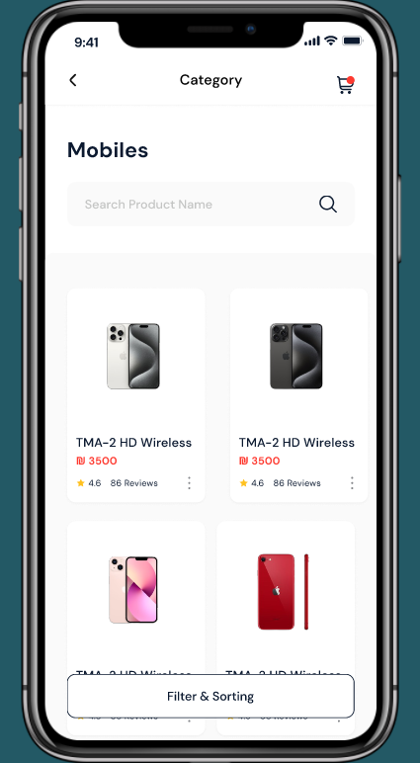
Search and Category :

Slide 26
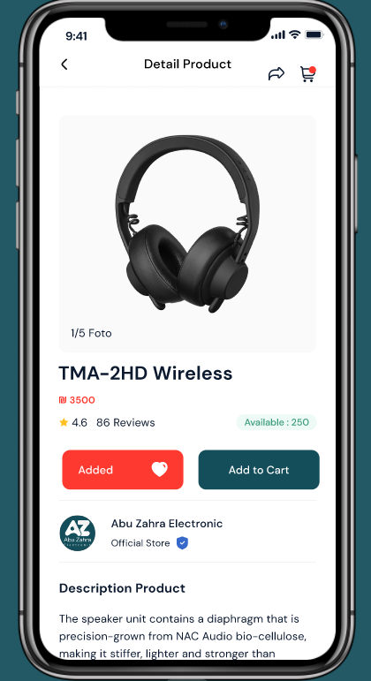
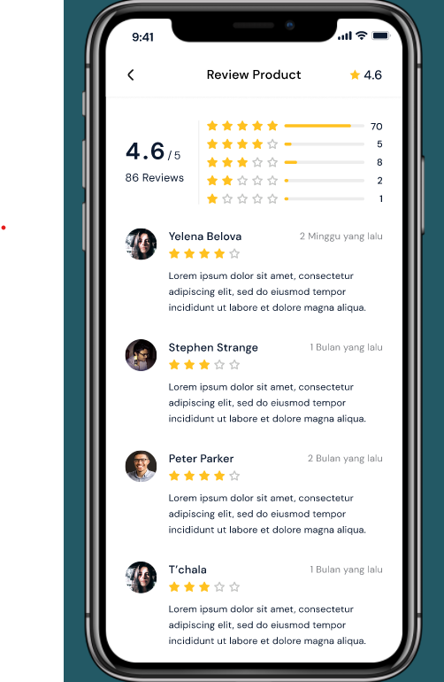
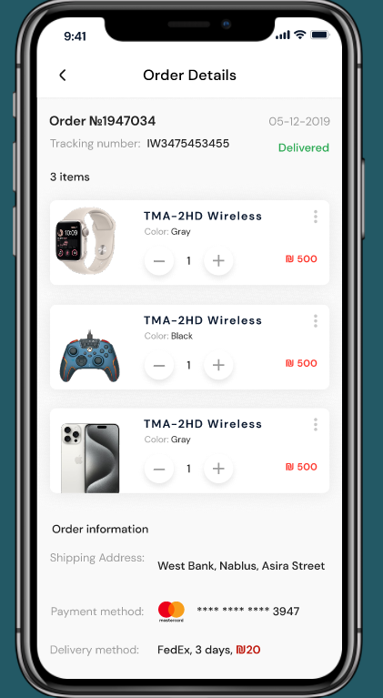
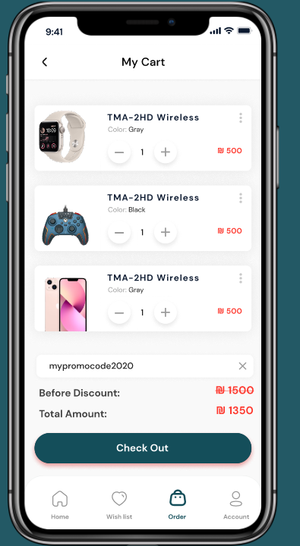
Products & Ordars :

Slide 27

Thank You For Your Attention !

