Slide 1

Faculty of Engineering and Information Technology
Civil Engineering Department
Water and Wastewater Network design for Kherebt Jbarah Village
Prepared By :
Malik Hussain
Khaled Aslan
Under the direction of Dr. Abdelhaleem Khader
April 2014
Nablus – Palestine

Slide 2
Kherebt Jbarah Village
Introduction
Methodology
Reccomendation
Result

Slide 3
General Introduction :
قال رسول الله (ص):
}تخللوا فإنه من النظافة، والنظافة من الإيمان، والإيمان وصاحبه في الجنة{
This project include design water and wastewater network system by using waterCad and sewerCad.
Water is the grace of our god to us , there is no place to go expect there is water in that .
Living without water is unimaginable. The lack of water will lead life to the death . In fact, it is very hard for plants, animals, and especially humans to live without.

Slide 4
There is many historical sources of water in Palestine the Jordan river and surface water and ground water but I say historical because of many problems faces this sources , and these problem are :
There is an errors in saving water that reflect our culture .
Lacks in water in last few years because of greenhouse effect .

Slide 5
Objectives
Our project aims to design water and wastewater distribution system network of Kherbet Jbarah Village in Tulkarem governorate in Palestine. The study will be utilized in designing the water and wastewater distribution network to be able to meet the demand of water and create a healthy environment for Kherbet Jbarah Village people with their available resources .

Slide 6
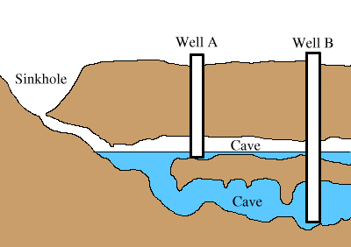
Ground Water :
Groundwater is utilized through wells. Ground water is a very important source of water in Palestine as it represents 100% of the fresh water in the country.

Slide 7
Surface Water
(Rainfall and Jordan River)
The most important source of water is the rain which feeds the other sources and completes it.
In general the amount of rain in Palestine different from one year to another, so rainfall can not be a reliable source for all aspects of our daily life.

Slide 8
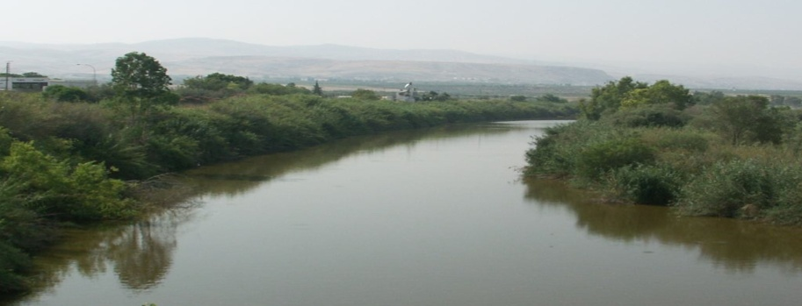
Jordan River :
Only a fraction of this can be used by Palestinians in the especially in West Bank. Israel has remove Palestinians access to the entire Lower Jordan River .

Slide 9
Sources of Wastewater
Domestic Effluents:
The so-called sewage water which is used in domestic units or public buildings.
Industrial Effluents:
The waste resulting from the use of water in the different manufacturing processes, these wastes may contain toxic materials or harmful to plants that are linked to a network of discharge after achieving certain conditions.

Slide 10
Infiltration :
water which enters the sewers from the surface through flaws and defects in the system.
Storm water :
Modern networks are separated rainwater for other residues

Slide 11
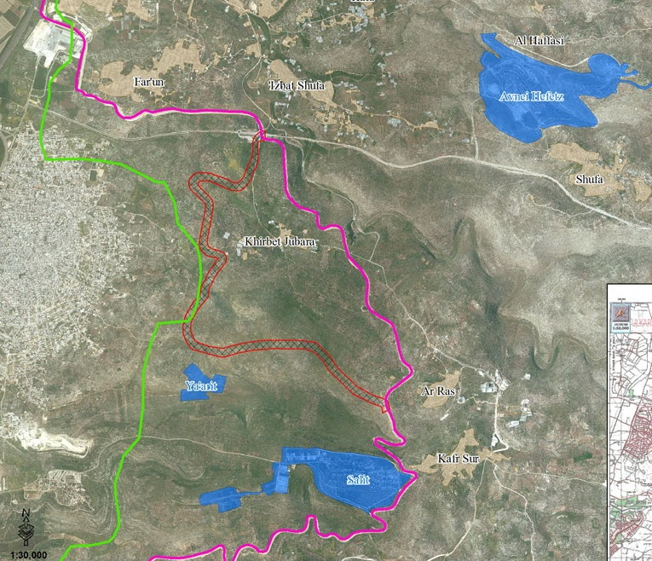
Study Area
Kherebt Jbarah village is located south of the city of Tulkarem after 6 km, inside the barrier. and the population of the village is about 300 capita .
This decision was due to the challenges people from this village are facing, in terms of an old agricultural water network and the lack of a wastewater network .

Slide 12
Data Needed to Design a Network
In order to design a new water and wastewater network system we should have various types of data , and these data include :
Consumption rate,
Plans for new network,
Geographical maps of the area,and
Places of industrial and commercial areas.

Slide 13
Maintenance of Wastewater Conduit
Wastewater networks system need regular maintenance to achieve its goal. Maintenance can be achieved by these ways :
Water pumps
Air pumps
Chemical solutions

Slide 14
Stages of Wastewater Treatment
Mechanical Stage :
Separating the solids from the liquid wastewater
Chemical Stage :
Transformation of dissolved organic matter in the water to solids gradually
Sedimentation Stage :
After the organic matter transform to greater size this will lead these matter to free fall (sedimentation) by slow velocity and without mixing

Slide 15
Uses of Treated Water:
Treated wastewater can be used in several purposes either directly or in-directly. In general, the percentage of re-use of treated water by various sectors represented in the following:
Agricultural purposes 60%
Industrial purposes 30%
Other purposes, e.g. feeding the groundwater 10%

Slide 16
Climate In Tulkarem
The climate is described as hot dry in the summer and moderately warm and rainy in winter.

Slide 17
Rainfall in Tulkarem
The annual mean rainfall is 645 mm. About 80% of the total precipitation falls between December and March while June, July and August are totally dry.

Slide 18
Evaporation In Tulkarem
Potential evaporation rate is particularly high in summer as it can reach about 200mm /month in July. Evaporation in winter is about 45 mm/month in December. During spring and autumn, the potential evaporation reaches about 90-135mm/month.

Slide 19
Humidity In Tulkarem
Relative humidity during May reaches approx 60% and it can reach 35% in Khamaseen period.

Slide 20
Expected Outcome
The expected outcome of this project is a wastewater network system and calculate B.O.Q for this project .

Slide 21
Methodology
To make a project you have to do many steps these steps conclude in five levels :
choosing the study area :
We chose Kherbet Jbarah as our study area to design the water supply and wastewater network. This decision was due to the challenges people from this village are facing, in terms of an old agricultural water network and the lack of a wastewater network.

Slide 22
Data Collection
We collected data that include: the population , growth rate ,water consumption per capita , return wastewater factor , …..etc .

Slide 23
Assumptions
We assumed that in each house we have 4 persons .
Assume that the return flow equal 80% .
the maximum hourly factor equal 3.
Infiltration rate equal 20%

Slide 24
Selection of the software
We selected WaterCAD software to design .There are many available to work on it but we select WaterCad because of its capabilities and because we are more familiar with.
Other options might be :
Pipe Flow Expert v1.08 .
Bentley auto pipe plus .
EPAnet .
WaterCAD :

Slide 25
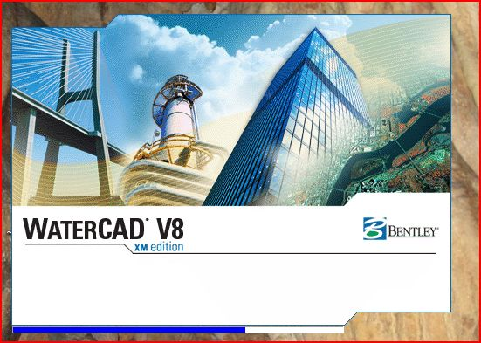
WaterCAD is a software by which we can conduct design and analyze water distribution network and we using the program according to the Palestinian standard and specification.
WaterCAD

Slide 26
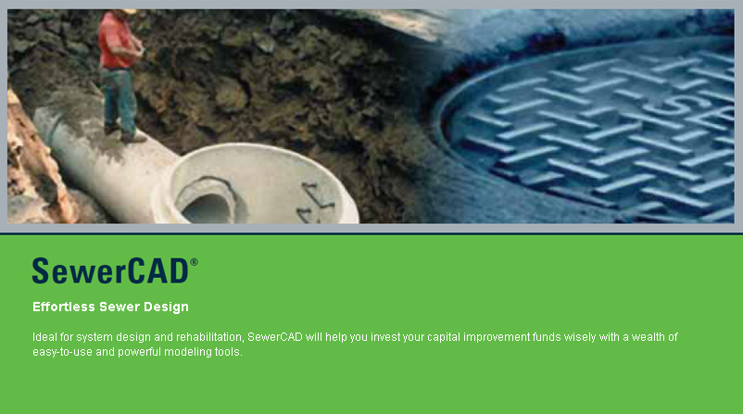
SewerCAD
SewerCAD can be used to model both pressurized force mains and gravity hydraulics with ease, by using steady-state analysis with various standard peaking factors and extended-period simulations.

Slide 27
SewerCAD is an easy-to-use sanitary sewer modeling and design software product that thousands of municipalities, utilities, and engineering firms around the world trust to design, analyze, and plan wastewater collection systems. Engineers can model both pressurized force mains and gravity hydraulics with ease, using steady-state analysis with various standard peaking factors, and extended-period simulations.

Slide 28
Designing the network
Sewer systems shall be designed to convey wastewater discharges from domestic , commercial and industrial premises to the point of treatment without prejudice to health and safety. Such design should also include allowances for future growth and for extraneous discharges up to such flow that will justify rehabilitation.

Slide 29
The following factors inter alia must be taken into consideration in the assessment of the sewerage system most appropriate for a particular area:
The nature of the area and the prevailing climatic conditions
Existing wastewater systems within the defined area
The degree of pollution in the surface water and pipe deposits
The risk of leakage
The nature of the recipient
Geology, ground conditions, topography, etc.
Economic considerations

Slide 30
We have four scenarios :
The scenarios are :
Branch network only
Branch network with EPs
Loop network only
Loop network with EPs

Slide 31
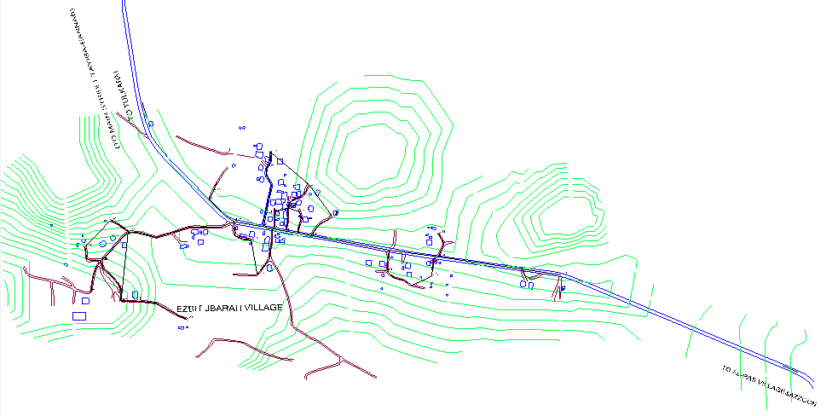
Loops System without EPs

Slide 32
Results
Elevation of reservoir : 146.50 m
Elevation of pump: 146.00 m
Head of pump : 45.44 m
Q design of pump: 359.6 m3/day
 | Max | Min
Pressure | 60.8 m H2O | 38.5 mH2O
Velocity | 1 m /s | 0.02 m/s
Flow | 359.6 m3/day | 0.928 m3/day
Diameter | 3 inch | 0.5 inch

Slide 33
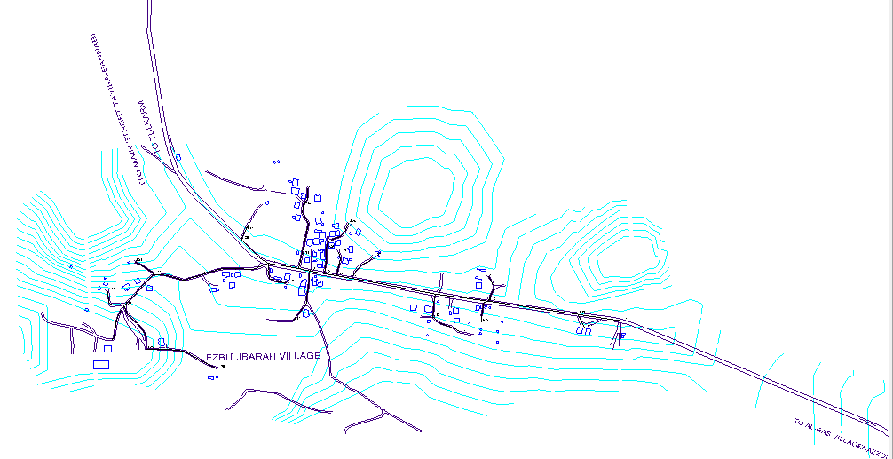
Branch System without EPs

Slide 34
Results
Elevation of reservoir : 146.50 m
Elevation of pump: 146.00 m
Head of pump : 45.44 m
Q design of pump: 359.6 m3/day
 | Max | Min
Pressure | 55.1 m H2O | 32.6 mH2O
Velocity | 1.79 m /s | 0.01 m/s
Flow | 359.59 m3/day | 0.964 m3/day
Diameter | 3 inch | 1 inch

Slide 35
Loops System with EPs

Slide 36
Results
Elevation of reservoir : 146.50 m
Elevation of pump: 146.00 m
Head of pump : 45.44 m
Q design of pump: 359.6 m3/day
 | Max | Min
Pressure | 60.8 m H2O | 38.5 mH2O
Velocity | 1 m /s | 0.01 m/s
Flow | 359.6 m3/day | 0.572 m3/day
Diameter | 3 inch | 0.5 inch

Slide 37
Branch System with EPs

Slide 38
Results
Elevation of reservoir : 146.50 m
Elevation of pump: 146.00 m
Head of pump : 52.36 m
Q design of pump: 161.82 m3/day
 | Max | Min
Pressure | 66.3 m H2O | 46.9 mH2O
Velocity | 0.49 m /s | 0.02 m/s
Flow | 161.82 m3/day | 0.217 m3/day
Diameter | 3 inch | 0.5 inch

Slide 39
Wastewater Network System
In the sewer network we found that all of conduits velocity lie between the design constraints Also we found that all of the conduits have the slope within the design constraints and the conduits have the cover which lie between the minimum and the maximum constraints.

Slide 40
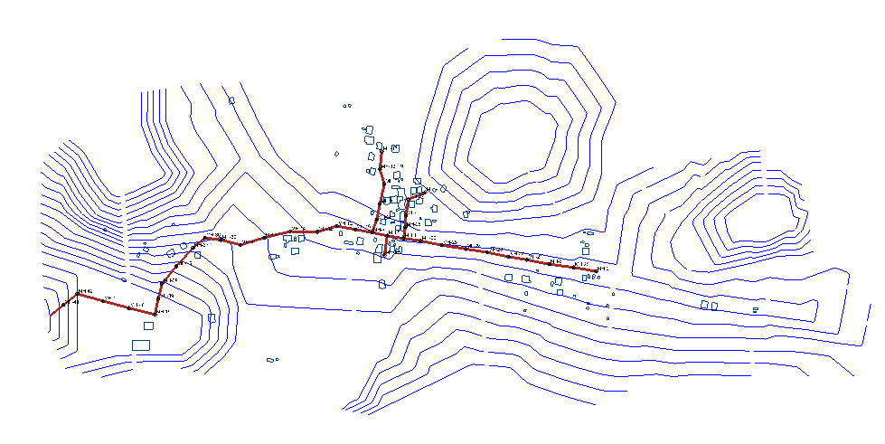

Slide 41
MH-289 | Label | Length (m) | Stop Node | Cover (Start) (m) | Cover (Stop) (m) | coversine | cover+sand | min | first volume(m3) |  | volume 2
MH-140 | CO-59 | 41.1 | MH-20 | 1 | 1.64 | 1.35 | 1.99 | 1.35 | 41.61375 | 0.64 | 9.864
MH-265 | CO-60 | 44.5 | MH-3 | 1.64 | 2.09 | 1.99 | 2.44 | 1.99 | 66.41625 | 0.45 | 7.509375
MH-87 | CO-61 | 40.8 | MH-21 | 2.09 | 2.57 | 2.44 | 2.92 | 2.44 | 74.664 | 0.48 | 7.344
MH-399 | CO-62 | 33.5 | MH-22 | 2.57 | 2.73 | 2.92 | 3.08 | 2.92 | 73.365 | 0.16 | 2.01
MH-484 | CO-63 | 39.3 | MH-23 | 2.73 | 3.18 | 3.08 | 3.53 | 3.08 | 90.783 | 0.45 | 6.631875
MH-86 | CO-64 | 39.3 | MH-24 | 3.18 | 3.48 | 3.53 | 3.83 | 3.53 | 104.04675 | 0.3 | 4.42125
MH-594 | CO-65 | 43.6 | MH-25 | 3.48 | 3.78 | 3.83 | 4.13 | 3.83 | 125.241 | 0.3 | 4.905
MH-1125 | CO-66 | 38.7 | MH-26 | 3.78 | 3.97 | 4.13 | 4.32 | 4.13 | 119.87325 | 0.19 | 2.757375
MH-1075 | CO-67 | 31.1 | MH-4 | 3.97 | 4.34 | 4.32 | 4.69 | 4.32 | 100.764 | 0.37 | 4.315125

Slide 42
MH-1145 | CO-68 | 29.9 | MH-5 | 4.34 | 4.34 | 4.69 | 4.69 | 4.69 | 105.17325 | 0 | 0
MH-266 | CO-69 | 28 | MH-7 | 4.34 | 4.44 | 4.69 | 4.79 | 4.69 | 98.49 | 0.1 | 1.05
MH-397 | CO-71 | 36.9 | MH-32 | 4.66 | 4.33 | 5.01 | 4.68 | 4.68 | 129.519 | 0.33 | 4.566375
MH-458 | CO-72 | 48.8 | MH-14 | 4.33 | 3.37 | 4.68 | 3.72 | 3.72 | 136.152 | 0.96 | 17.568
MH-1165 | CO-73 | 47.9 | MH-33 | 3.37 | 2.41 | 3.72 | 2.76 | 2.76 | 99.153 | 0.96 | 17.244
MH-420 | CO-74 | 45.1 | MH-34 | 2.41 | 1.5 | 2.76 | 1.85 | 1.85 | 62.57625 | 0.91 | 15.39038
MH-419 | CO-75 | 36.6 | MH-35 | 1.5 | 1.22 | 1.85 | 1.57 | 1.57 | 43.0965 | 0.28 | 3.843
MH-1175 | CO-76 | 29 | MH-36 | 1.22 | 2.35 | 1.57 | 2.7 | 1.57 | 34.1475 | 1.13 | 12.28875
MH-1135 | CO-77 | 28.3 | MH-37 | 2.35 | 1 | 2.7 | 1.35 | 1.35 | 28.65375 | 1.35 | 14.32688
MH-401 | CO-78 | 44.5 | MH-15 | 1 | 1 | 1.35 | 1.35 | 1.35 | 45.05625 | 0 | 0
MH-386 | CO-79 | 40.2 | MH-38 | 1 | 1 | 1.35 | 1.35 | 1.35 | 40.7025 | 0 | 0
MH-400 | CO-80 | 28.3 | MH-39 | 1 | 1 | 1.35 | 1.35 | 1.35 | 28.65375 | 0 | 0
MH-402 | CO-81 | 29 | MH-16 | 1 | 1.29 | 1.35 | 1.64 | 1.35 | 29.3625 | 0.29 | 3.15375

Slide 43
MH-1116 | CO-82 | 48.5 | MH-40 | 1.29 | 1.77 | 1.64 | 2.12 | 1.64 | 59.655 | 0.48 | 8.73
MH-382 | CO-83 | 48.5 | MH-41 | 1.77 | 1.31 | 2.12 | 1.66 | 1.66 | 60.3825 | 0.46 | 8.36625
MH-385 | CO-84 | 48.2 | MH-42 | 1.31 | 1 | 1.66 | 1.35 | 1.35 | 48.8025 | 0.31 | 5.60325
MH-94 | CO-85 | 32 | MH-43 | 1 | 1 | 1.35 | 1.35 | 1.35 | 32.4 | 0 | 0
MH-647 | CO-87 | 35.7 | MH-5 | 1 | 4.34 | 1.35 | 4.69 | 1.35 | 36.14625 | 3.34 | 44.71425
MH-393 | CO-88 | 32.9 | MH-27 | 1 | 1.91 | 1.35 | 2.26 | 1.35 | 33.31125 | 0.91 | 11.22713
MH-88 | CO-89 | 29.6 | MH-11 | 1.91 | 1.92 | 2.26 | 2.27 | 2.26 | 50.172 | 0.01 | 0.111
MH-394 | CO-90 | 20.4 | MH-28 | 1.92 | 1.65 | 2.27 | 2 | 2 | 30.6 | 0.27 | 2.0655
MH-91 | CO-91 | 27.7 | MH-29 | 2.26 | 2.83 | 2.61 | 3.18 | 2.61 | 54.22275 | 0.57 | 5.920875
MH-622 | CO-92 | 36.9 | MH-31 | 2.83 | 4.92 | 3.18 | 5.27 | 3.18 | 88.0065 | 2.09 | 28.92038
MH-395 | CO-93 | 29.3 | MH-30 | 4.92 | 4.39 | 5.27 | 4.74 | 4.74 | 104.1615 | 0.53 | 5.823375
MH-85 | CO-94 | 24.1 | MH-7 | 4.39 | 4.44 | 4.74 | 4.79 | 4.74 | 85.6755 | 0.05 | 0.451875
MH-441 | CO-95 | 20.7 | MH-4 | 1.65 | 1 | 2 | 1.35 | 1.35 | 20.95875 | 0.65 | 5.045625
MH-84 | CO-96 | 30.8 | MH-46 | 4.44 | 4.47 | 4.79 | 4.82 | 4.79 | 110.649 | 0.03 | 0.3465
MH-264 | CO-97 | 33.5 | MH-12 | 4.47 | 4.66 | 4.82 | 5.01 | 4.82 | 121.1025 | 0.19 | 2.386875
MH-398 | CO-98 | 32.3 | MH-13 | 1 | 2.26 | 1.35 | 2.61 | 1.35 | 32.70375 | 1.26 | 15.26175
MH-90 | CO-99 | 31.4 | OF-2 | 1 | 1 | 1.35 | 1.35 | 1.35 | 31.7925 | 0 | 0
MH-21 | total | 1387 |  |  |  |  |  |  | 2678.246 | 20.8 | 284.2

Slide 44
item no | description of work | unit | quantity | unit price($) | total price($)
1 | excavation with with average depth 2.5m and width .75m | lm | 1386.9 | 30 | 41607
2 | installation conduit with diameter 8" | lm | 1386.9 | 3 | 4160.7
3 | installation manhole with diameter 1.00m | no | 39 | 90 | 3510
4 | manhole (precast with diameter 1.00m x 1.20m) | no | 39 | 214.2 | 8353.8
5 | conduit pvc (diameter 4") | lm | 1386.9 | 4.5 | 6241
6 | (sand back filling) 0.15m below conduit and 0.10m above conduit with width=.75m | m3 | 364 | 30 | 10920
7 | (base coarse back filling) with compacted layer =0.30m and width=0.75m | m3 | 2030 | 15 | 30450
8 | pavement (asphalt with width=0.75m) | lm | 1386.9 | 18.5 | 25658
 |  |  | total cost |  | 130900
B.O.Q

Slide 45
We recommended going ahead with this project as soon as possible since this village suffers from the sewer problems and suffering from the lack of water, so this village really need to it.
Also we can make combined system ( wastewater and storm water ) but we choose this system because of small area and the slop of this area make two separate system more easily .

Slide 46
Reference
Internet .
Tulkarem Council .

Slide 47
Thank
You
Any Questions

