Slide 1
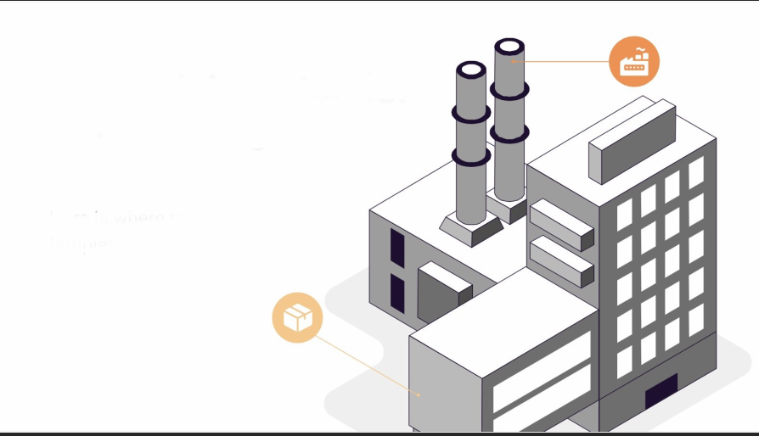
New Layout and Operations
Improvement for
Al-Karawan Factory
Student’s Names:
Noor Zedan
Rawan Abu Alhijaa
Masa Tammam
Ahmad Adnan
Supervised by:
Eng. Suleiman Daifi

Slide 2
Outline
01
05
Introduction
Results
02
06
Problem Statement
Conclusion
03
07
Objectives
Recommendation
04
Literature Review

Slide 3
Introduction
Al-Karawan Factory for Tahina and Halawa was established in 1980.
The second branch is located in Hwarah and produces only Tahina.
The main factory has three production lines:
1- Tahina production line
2- Halawa production line
3- Nigella production line.
The production capacity of this factory is approximately 4 tons per day of tahini

Slide 4
Problem Statement
Increasing demand
High operational cost
Old random layout
Safety problems related to the old layout
The need to better organizational structure.
The need for a better Inventory management system

Slide 5
Objectives
01
02
03
04
Developing New effective layout
Developing Inventory management system
Developing Safety plan
Developing New Organizational Structure

Slide 6
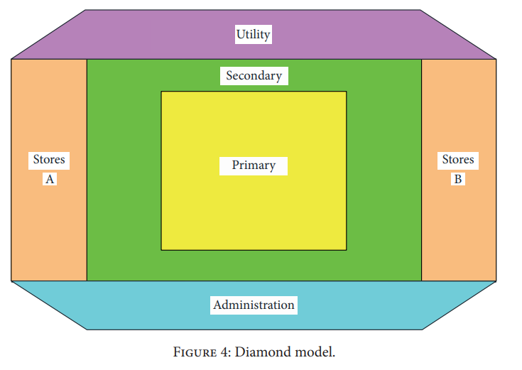
Literature Review
Layout in food industry
The diamond model elements is a layout model for food processing which was formed by progressively placing the five fundamental.
Based on the activities and amount of risk involve in food processing, primary, secondary, utility, warehousing, and administrative are used.
Utility
Secondary
Stores A
Stores B
Primary
Administrative

Slide 7
New effective Layout for Al-karawan Factory
Design New Layout
Design New Rack system
Design Silo System
Comparing between Flow Processes Charts

Slide 8



After analyzing the current layout and discussing the problems associated with it while considering the managerial requirements a new layout was developed.
The layout is based on the diamond model which divides the layout into five main areas:
Primary
Secondary
Utility
Stores
Administration

Slide 9
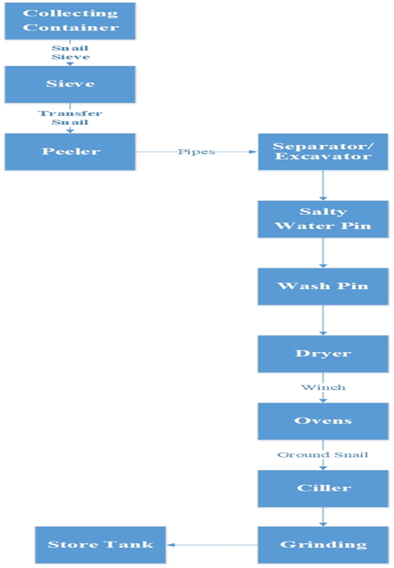

Slide 10
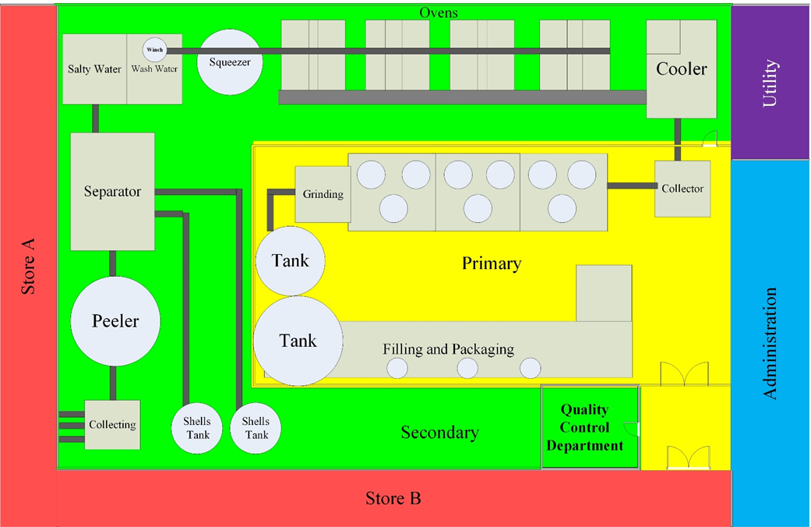

Slide 11

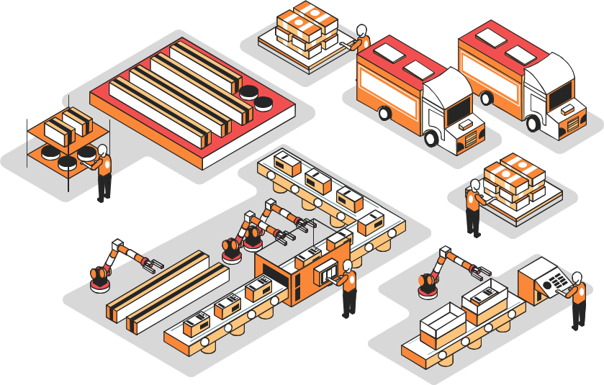
Design New Rack system
A rack system will be designed for storing sesame bags.
The bags are arranged in pallets,
Each pallet contain one ton.
The rack system must allow for a total capacity of 400 tons.
The height of the system should not exceed 7m.
There will be an extra 0.25m above the floor.

Slide 12
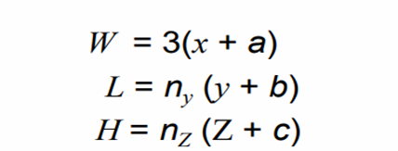
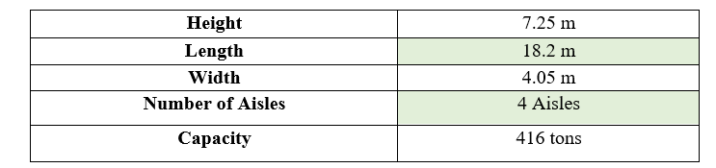
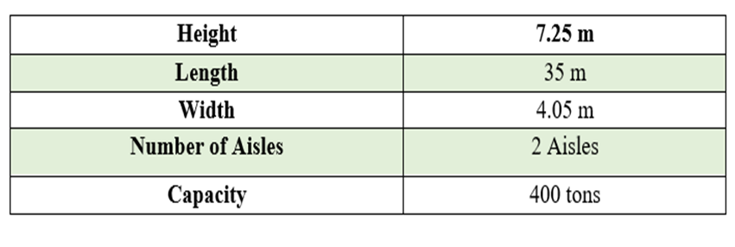
The dimensions of the rack system will be calculated Based on the following formulas:
Rack System design for alternative 1
Rack System design for alternative 2

Slide 13

Design Silo System
The silo system will be designed holed a total amount of 600 ton of sesame this amount will be held in three silos each one of them will have a capacity of 200 ton.
The Silos Design:
Diameter = 4.35 m
Height = 10.5 m
Hopper = 4 m
Total height = 14.5 m
Capacity: 200 ton
Volume = 328,6 m3

Slide 14
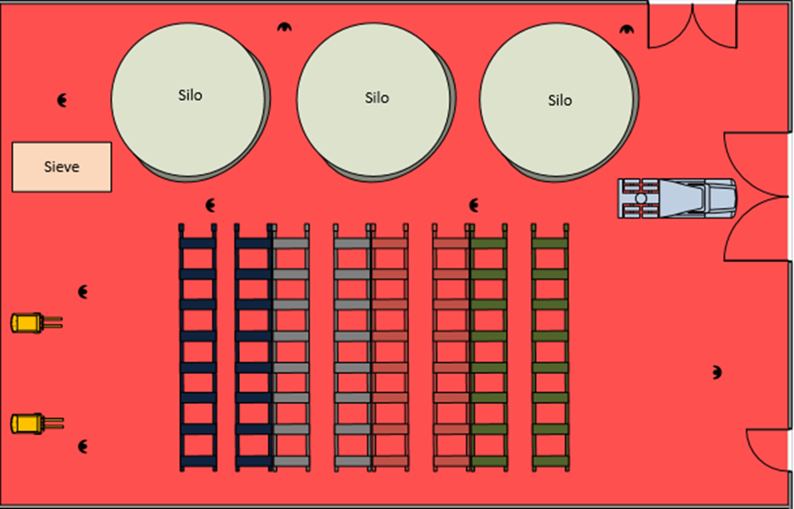
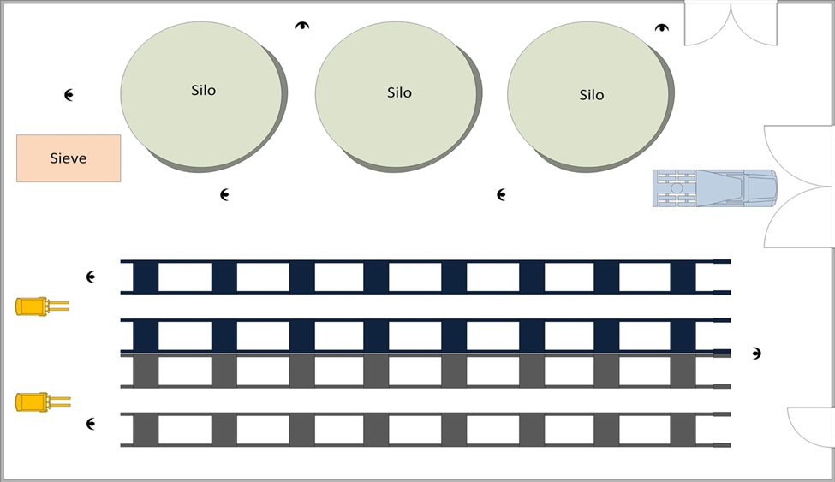
Store design using 4 aisles
Store design using 2 aisles

Slide 15
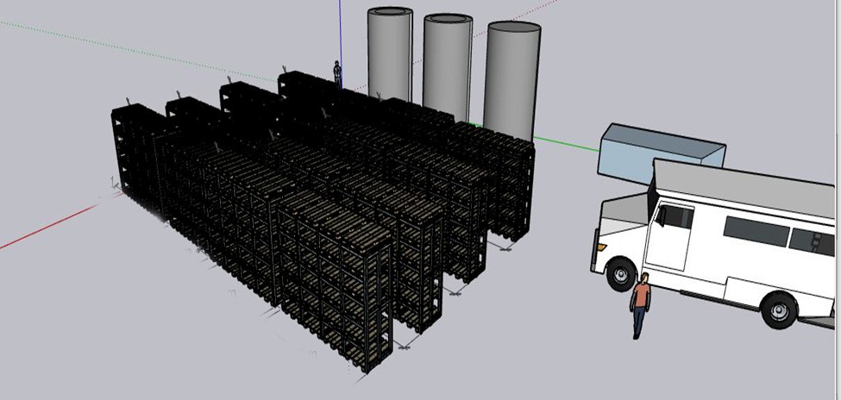
3D store design

Slide 16

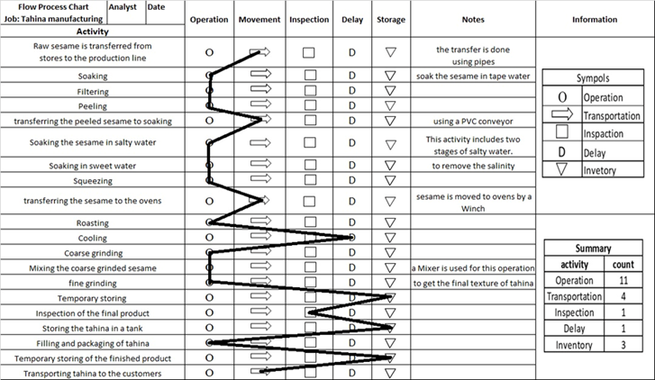
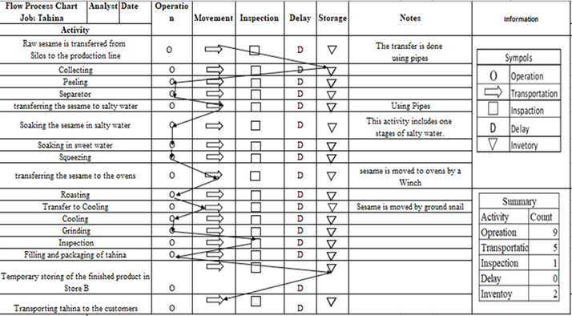
Comparing between Flow Processes Charts
Flow Process Chart for the Old Factory
Flow Process Chart for the New Factory

Slide 17
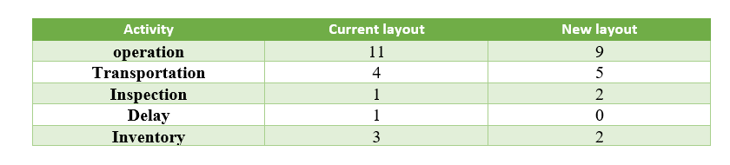
The number of operations decrease in the new layout to nine operations, while the transportation increased to five, the inspection increased to two inspections during the production, the delay was eliminated and the inventory was reduced to two.

Slide 18
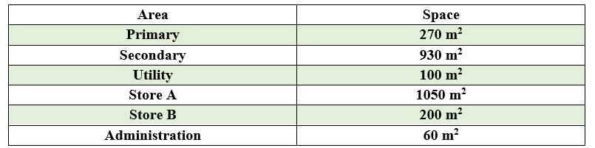
Space Requirement
The space required for each department of the previous five area is shown in the following table and that’s suitable for the available area:
Total Area =1560 m²

Slide 19
Organizational Structure
In order to develop the organizational structure a list of all the required departments was established based on the managerial requirements.

Slide 20
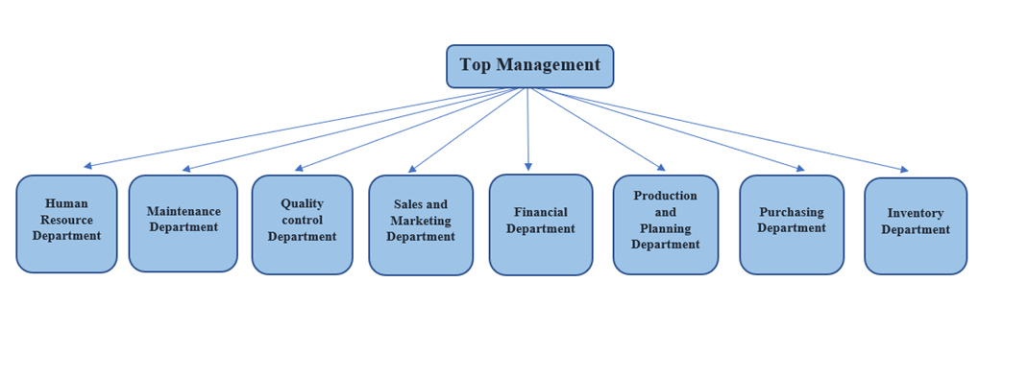
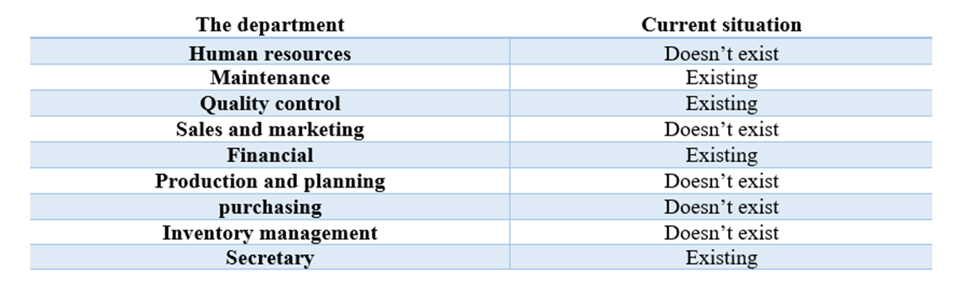

Slide 21
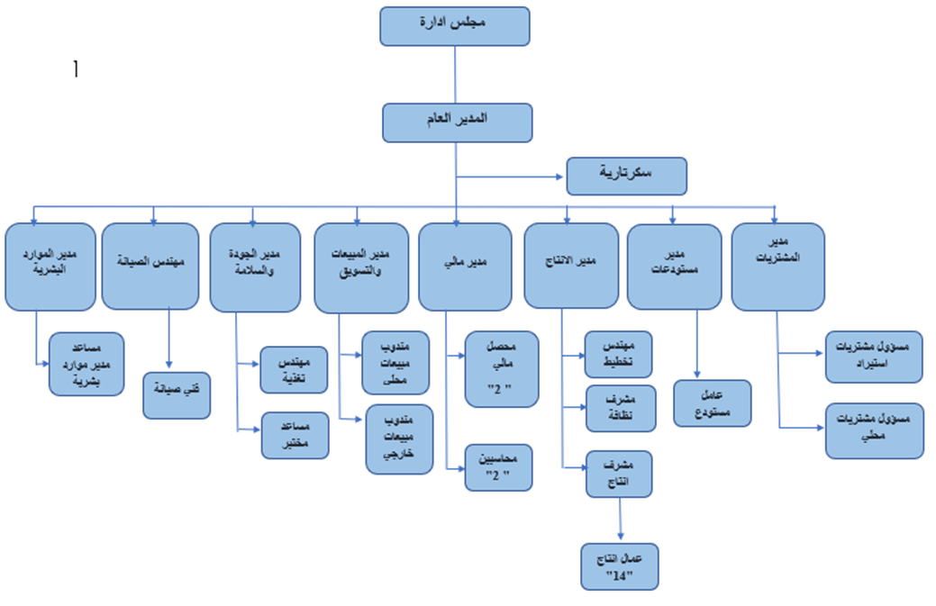


Slide 22
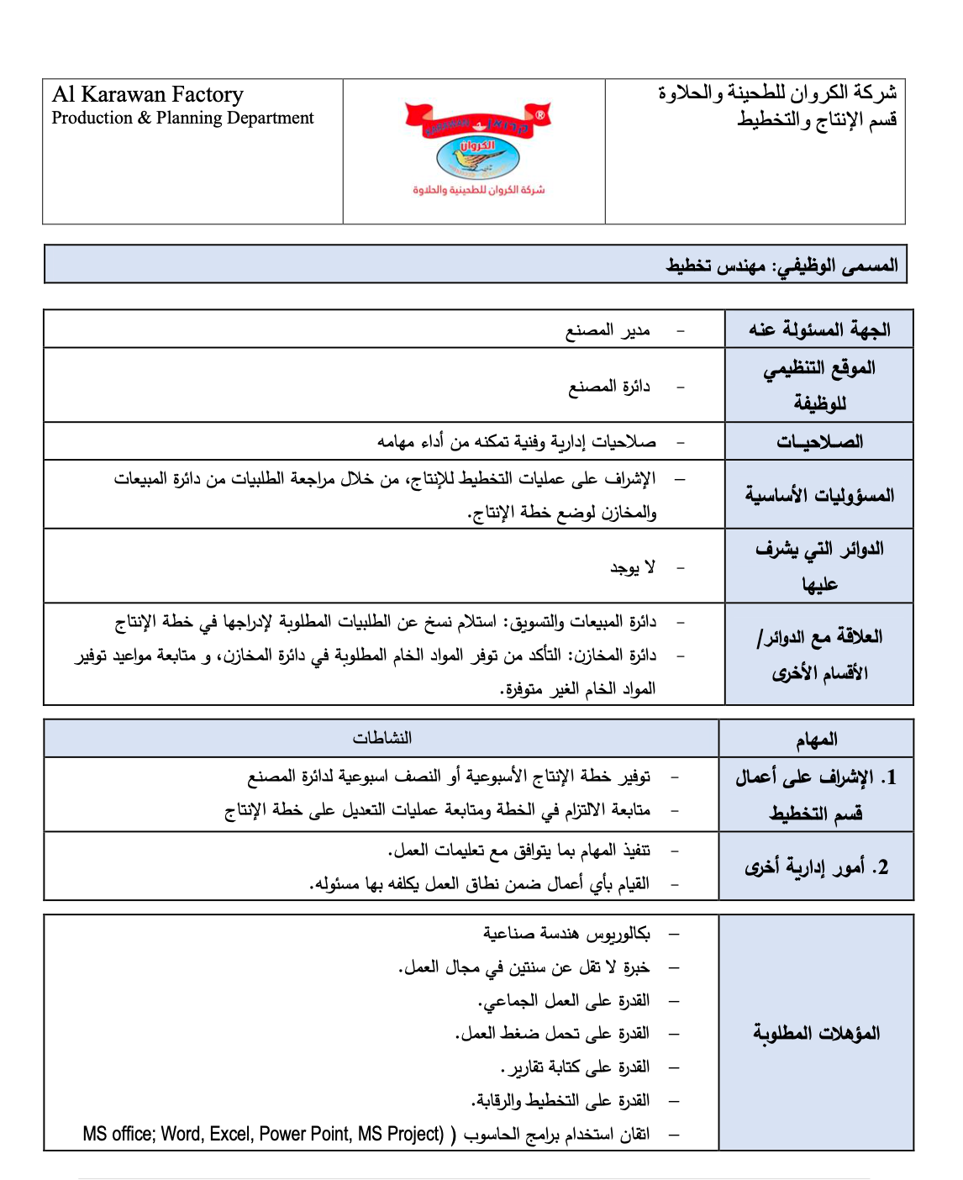

Slide 23
Safety Management
01
Loud noise
02
Vibration
The physical and ergonomic part to ensure a safe work place for the workers this category will include five elements.
03
Slipping floor
04
Boiler Hazards
05
Electric shock

Slide 24
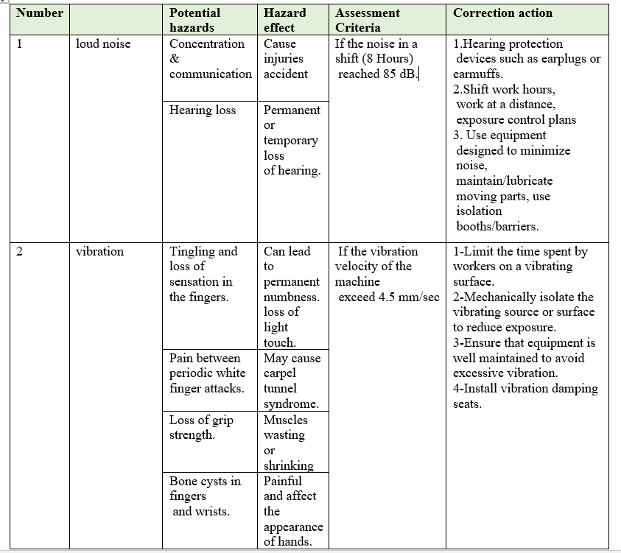

Slide 25
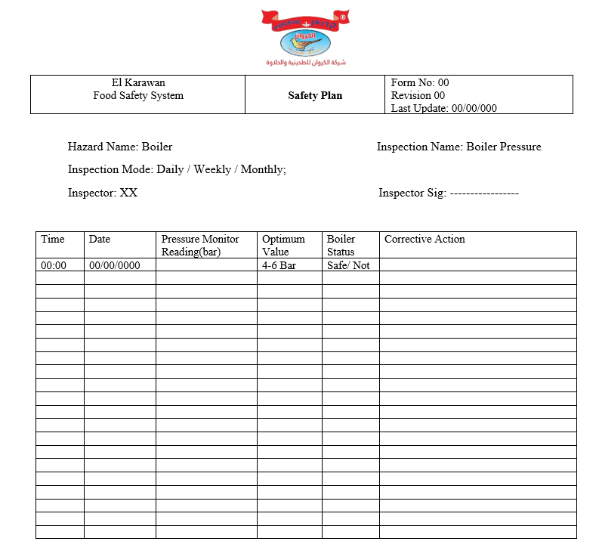

Slide 26
Safety Management
01
Considering each step in the production process of tahini
02
The hazards that could happen in each step were identified and a control measures established.
03
This category includes 21 elements.
04
Each element represent a step in the manufacturing process of tahini.

Slide 27
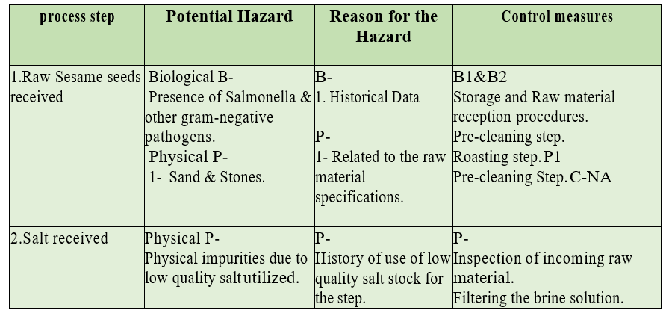
Hazard Analysis for Tahina

Slide 28
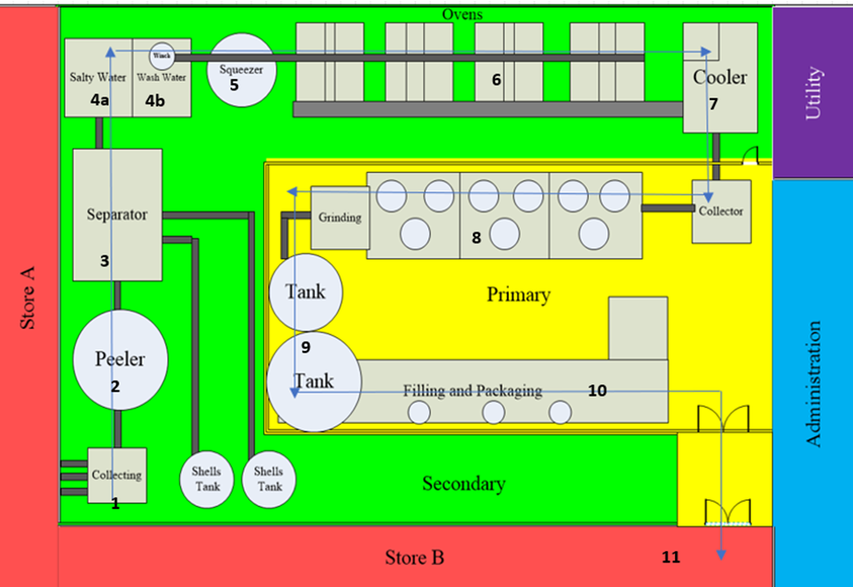
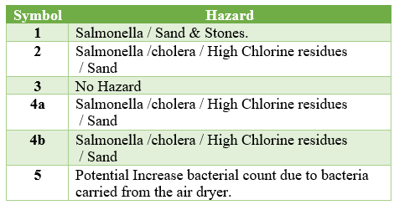

Slide 29
Inventory Management
Determining the Holding Cost
EOQ and Re-order point
Forecasting
MPS and MRP

Slide 30
Determining the Holding Cost
Holding cost for items stored in the rack system.
Holding cost for items stored in the silos.
Operation cost for storing in silos.
The warehouse labor salaries.

Slide 31
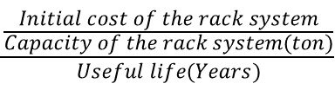
Rack System Holding Cost
Initial Cost
01
02
The useful life
48,800 JD
30 Years
$$\frac{\frac{Initial cost of the rack system}{Capacity of the rack system(ton)}}{Useful life(Years)}$$
The capacity
03
04
Annual holding cost
416 Ton
3.9 JD/ton

Slide 32
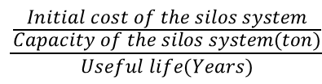
Silo System Holding Cost
Initial Cost
01
02
The useful life
85,500 JD
25 Years
$$\frac{\frac{Initial cost of the silos system}{Capacity of the silos system(ton)}}{Useful life(Years)}$$
The capacity
03
04
Annual holding cost
600 Ton
5.7 JD/ton

Slide 33
Holding Cost
01
The annual operational cost for the silos=5 JD/ton.
02
Holding Cost from warehouse labor salaries =10 JD/ton
03
The total annual holding cost = 24.6 JD/Ton

Slide 34
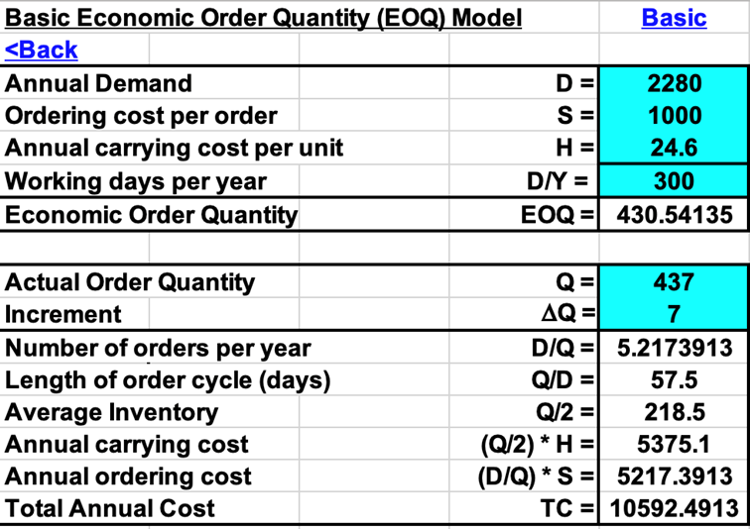
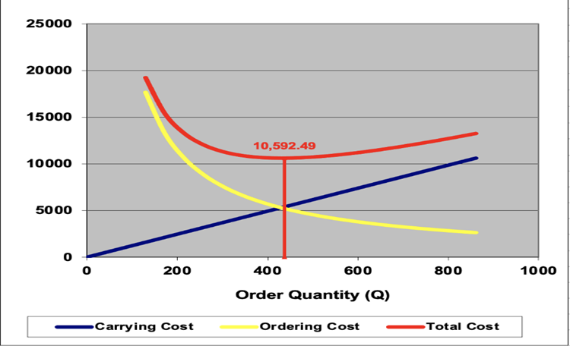
Economic Order Quantity(EOQ)

Slide 35
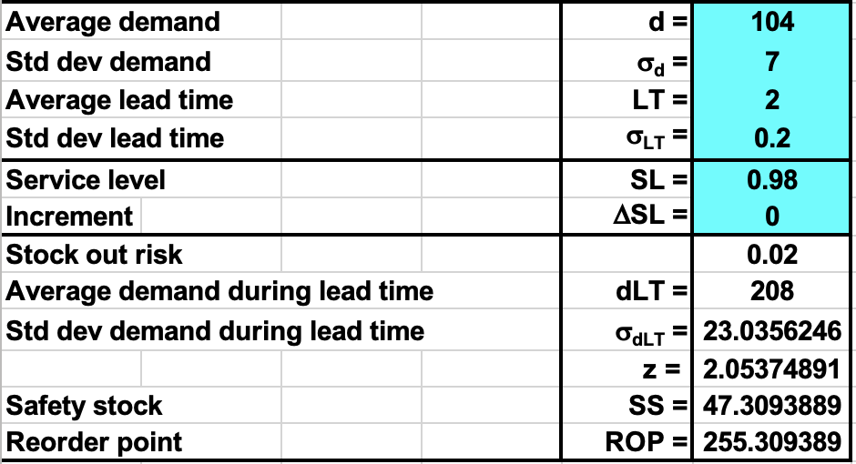
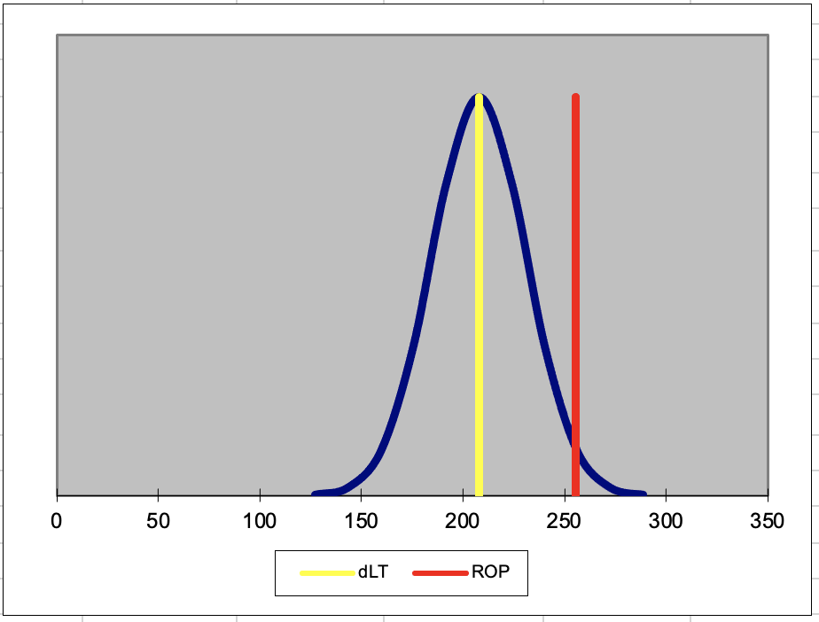
Reorder point (ROP)
The reorder point amount is determined by four factors:
The average demand.
The duration of the lead time.
The degree to which demand and/or lead times are variable.
The level of stock out risk that management is willing to take.

Slide 36
Forecasting
The data in the years from 2018-2021 were used in this project.
01
02
The data of years 2018-2020 will be used to develop the model.
The data of the year 2021 as a
hold set.
05
03
Graphical representation of the data.
04
Several models were compared based on MSE and MAPE.

Slide 37
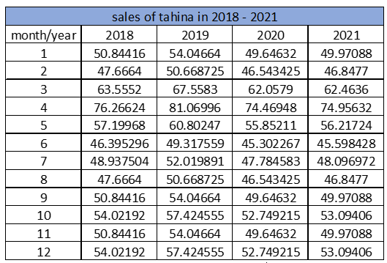
Tahina Sales in 2018-2021

Slide 38
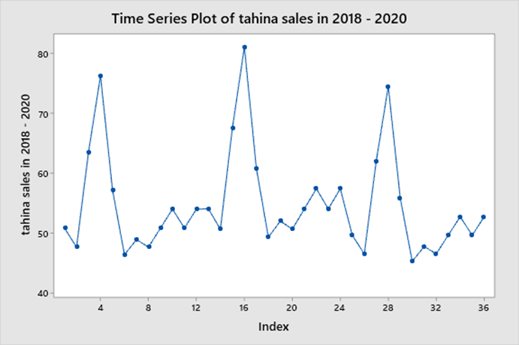
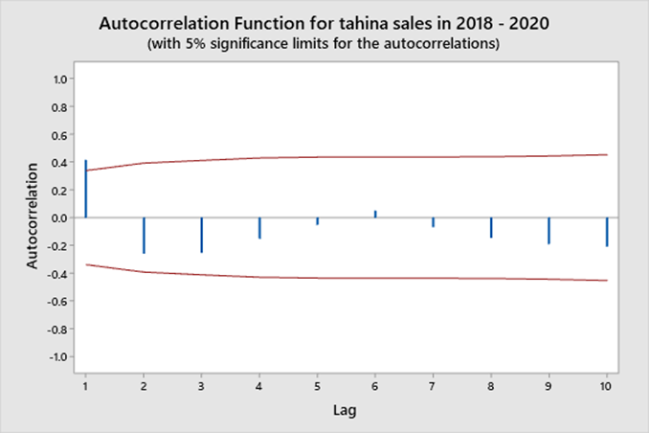
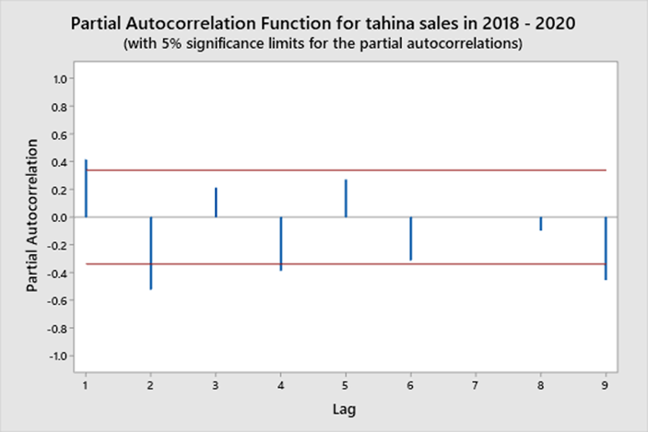

Slide 39
Forecasting Models
01
Linear Trend model
Holt’s linear method (double exponential smoothing)
02
Holt’s linear method (double exponential smoothing)
02
Holt’s winter method (triple exponential smoothing)
03
Holt’s winter method (triple exponential smoothing)
03

Slide 40
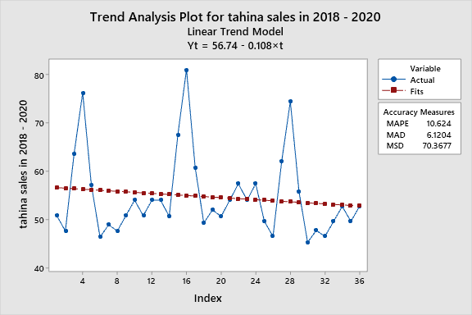
01
Fitted Trend Equation
Yt = 56.74 - 0.108×t
02
MSD = 70.3677
03
MAPE = 10.6245
04
MAD = 6.1204

Slide 41
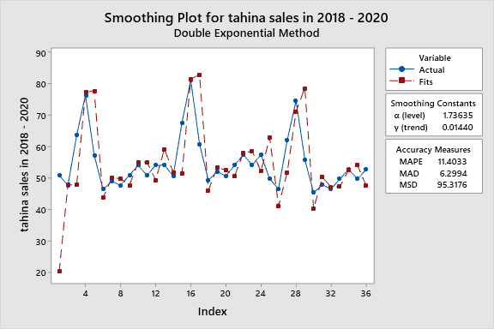
02
Holt’s linear method (double exponential smoothing)
Smoothing Constants
α (level) 1.73635
γ (trend) 0.01440
MSD
95.3176
MAPE
11.4033
MAD
6.2994

Slide 42
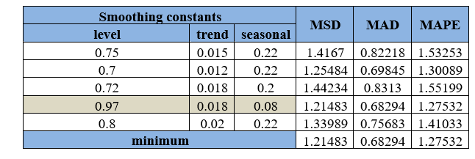

Slide 43
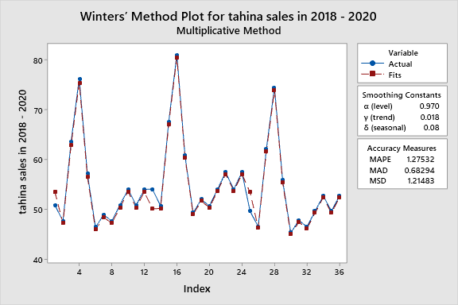
Smoothing Constants
α (level) 0.970
γ (trend) 0.018
δ (seasonal) 0.080
MSD
1.21483
MAPE
1.27532
MAD
0.668294

Slide 44
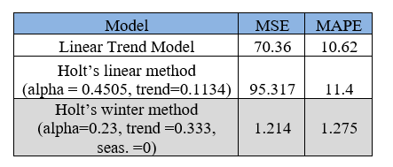

Slide 45
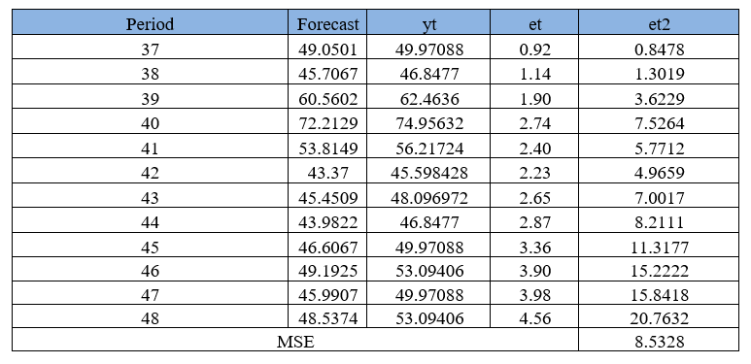
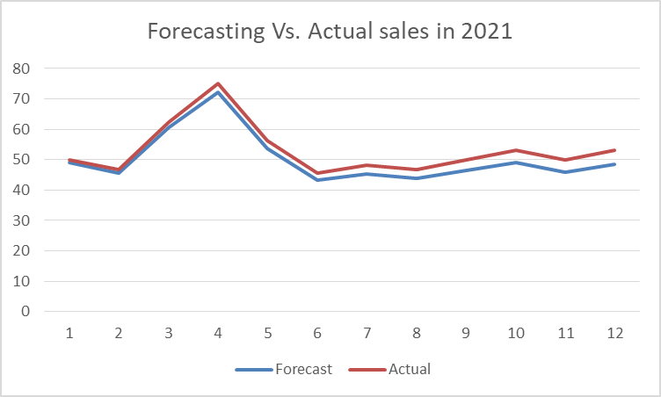
Testing The Model Adequacy

Slide 46
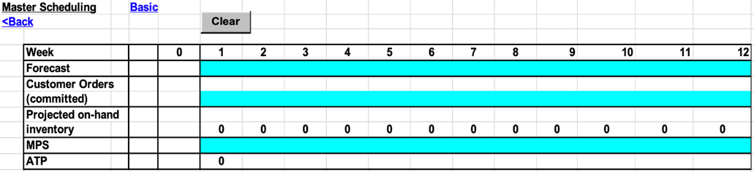
Master Production scheduling (MPS)

Slide 47
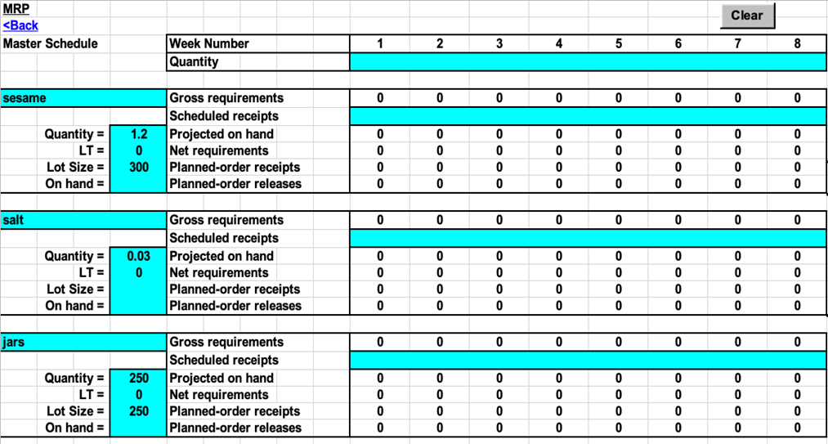
Material Requirements Planning (MRP)

Slide 48
Conclusion
A new layout that facilitated the flow of operations was developed
01
02
A clear organization structure was established
Inventory management system was developed
04
03
Safety plan was developed

Slide 49
Main Recommendations
Applying the proposed layout in this project which will increase the efficiency of the factory.
Implementing the inventory management system discuss previously in this project.
Investing in an inventory management software.
The forecasting method should be chosen as suggested according to the calculations of each item.

Slide 50
Main Recommendations
Developing maintenance scheduling and planning for the factory periodically.
Establishing the organizational structure proposed in this project with the established job
description.
Applying the safety plan.

Slide 51
Thank You

