Slide 1
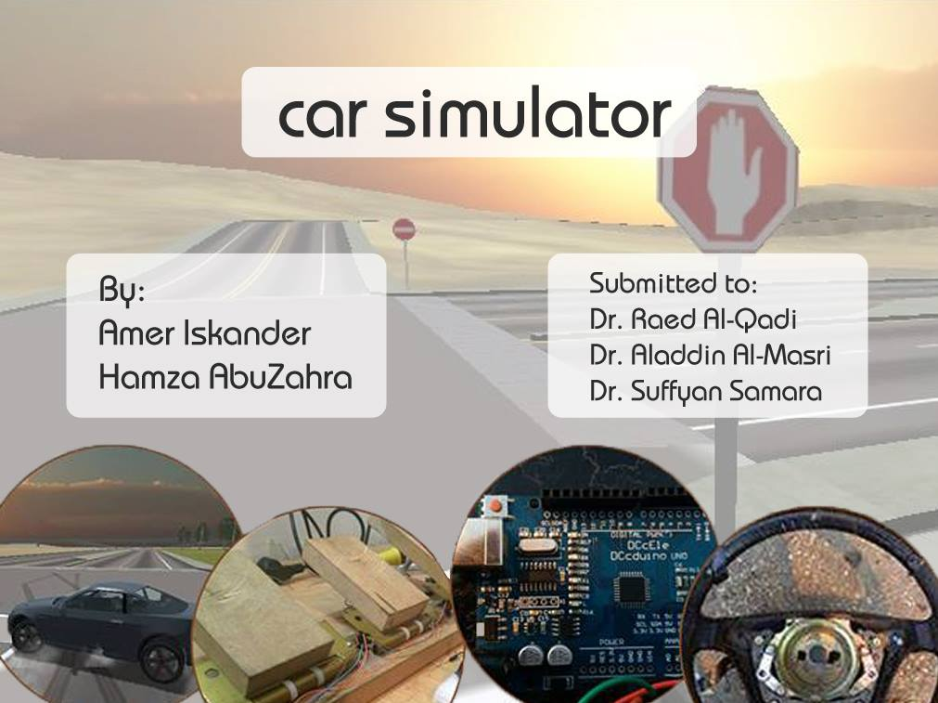
`
Car Simulator
Prepared by:
Amer Iskander
Hamza Abuzahra
Submitted to:
Dr. Raed Al-Qadi
Dr. Aladdin Al-Masri
Dr. Suffyan Samara

Slide 2
Outline
Introduction
Technologies
Map
Our Simple Vehicle
Car
Hardware
Mini map
Traffic System
Results

Slide 3
Introduction
Our project is a desktop 3D Car simulator.
  Hardware: Steering, Gear, Pedals.
  Acceptable software with two modes.
    The software can be played using the hardware.
    It also may be played

Slide 4



Technologies
Unity 3D ( 3D Graphic design, texturing )
C#, JS( Game logic, physics, network )
Blender ( Map Design, Simple Car design )

Slide 5
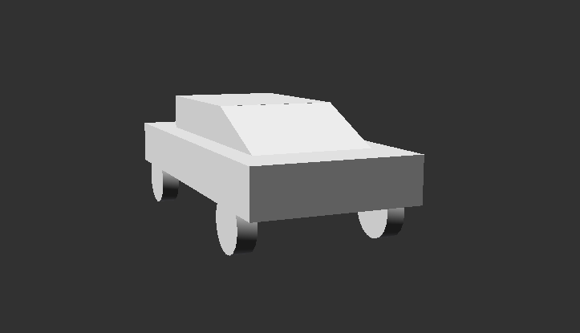
Our Start With A Simple Car
Our aim was made this simple car to move forward, backward, left and right.

Slide 6
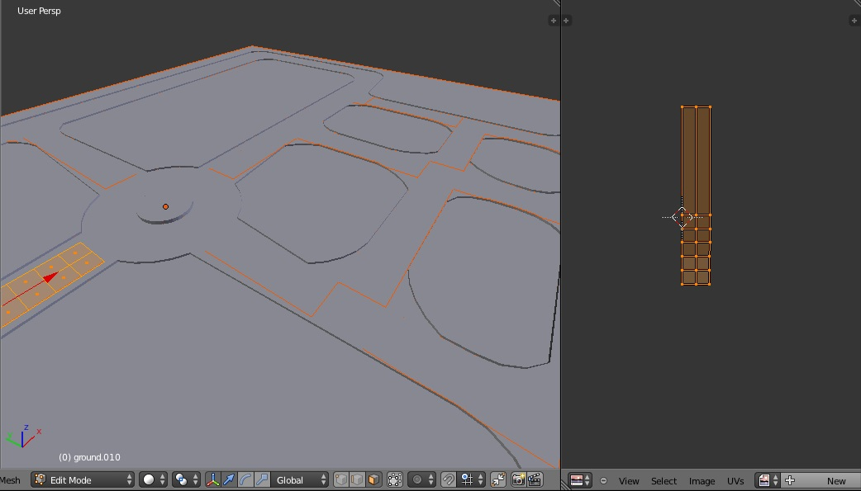
Map
We designed our own map using blender
The map is the environment where the car will stand over it.

Slide 7
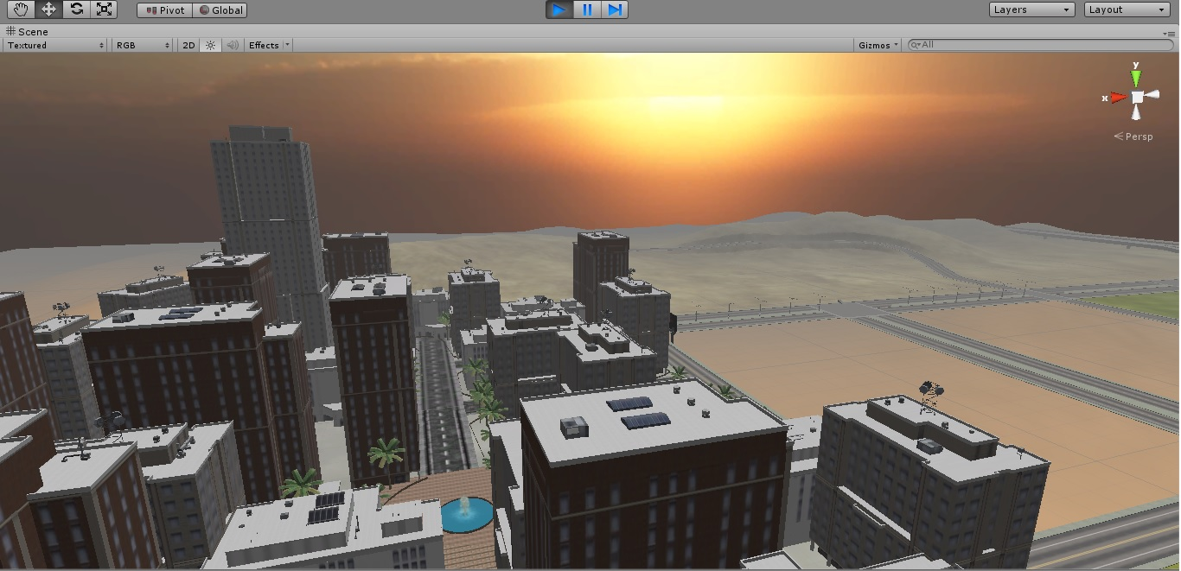
The Same Map After Texturing

Slide 8
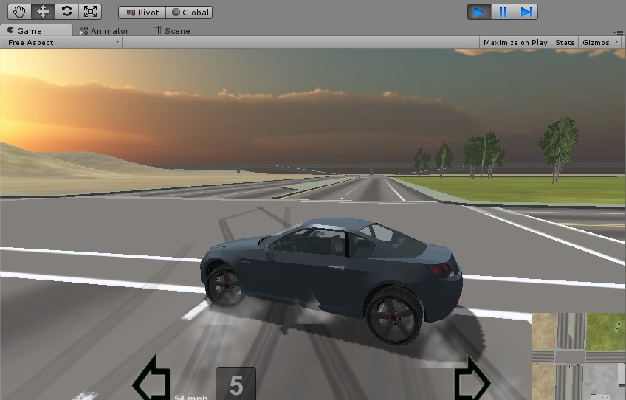
Car
This is the car which we used in our game.

Slide 9
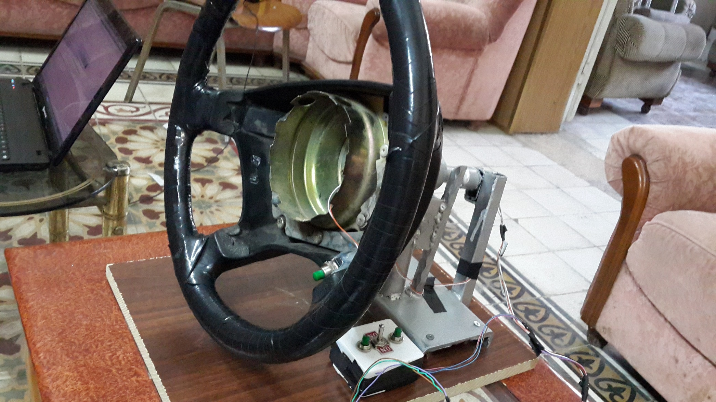
Hardware
Steering

Slide 10
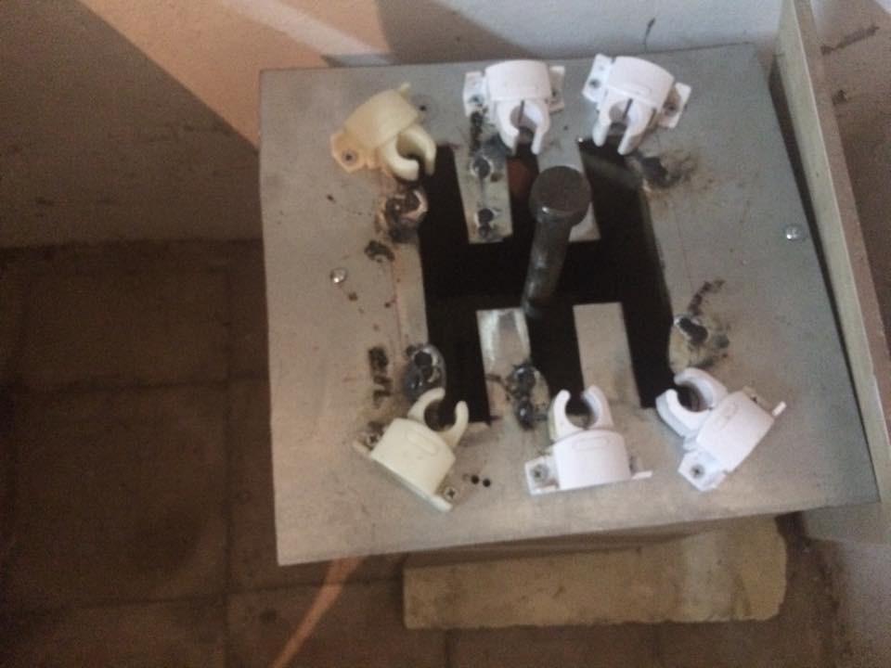
Hardware
Gear

Slide 11
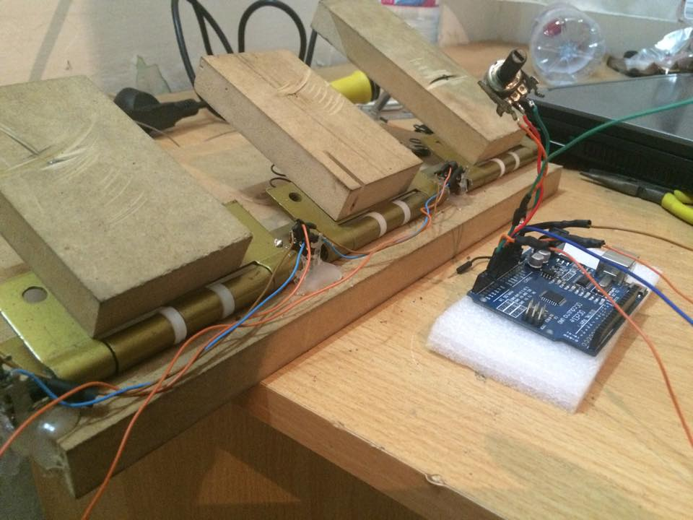
Hardware
Pedals

Slide 12
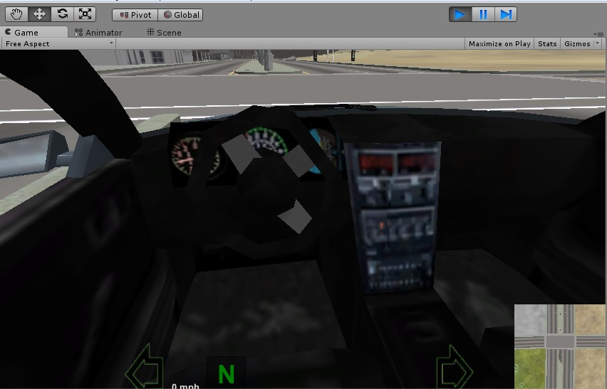
Mini Map

Slide 13
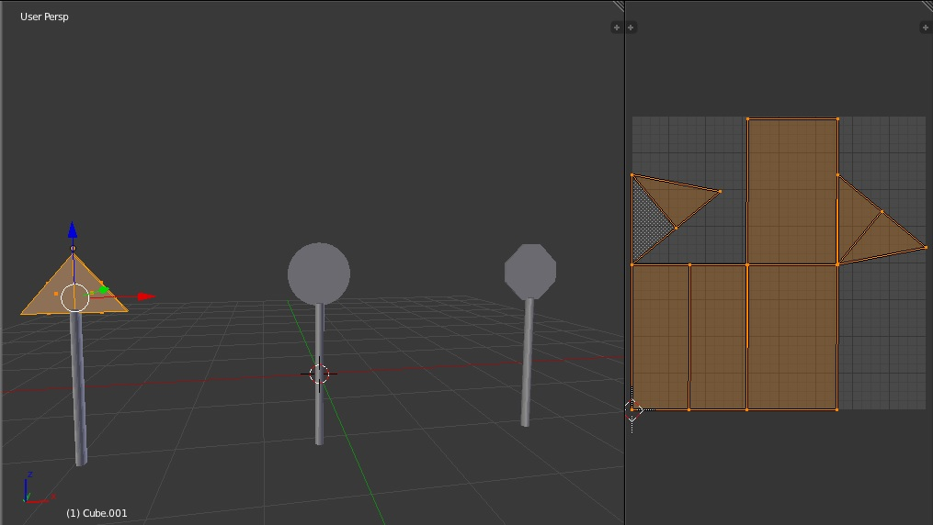
Traffic system
Traffic signs before texturing

Slide 14
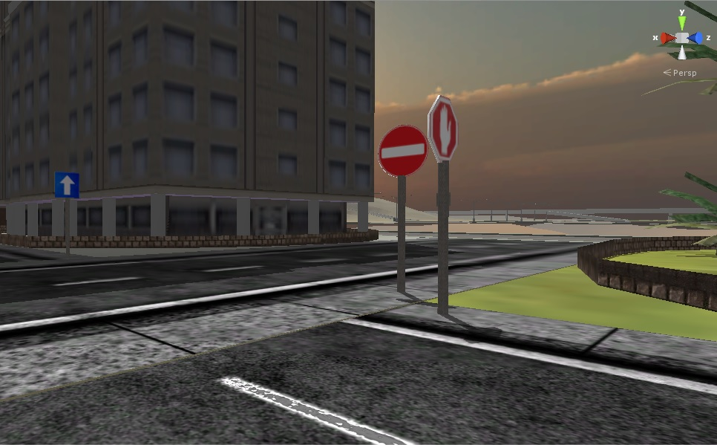
Traffic system
Traffic signs after texturing

Slide 15
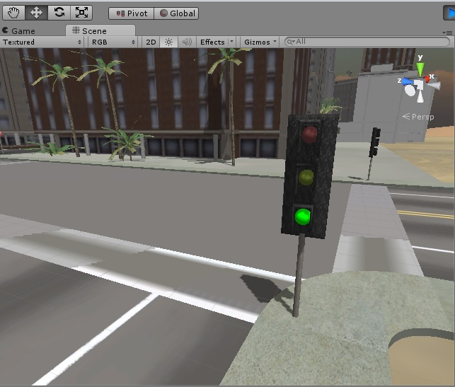
Traffic system
Traffic Lights

Slide 16
Results
Simulator
  We got a very good results in the car simulator, we got a very sensitive car.
The Game Size
  The game size is 64 MB.
  The needed run time memory (RAM) is approximately 174 MB
  10% of CPU time.

Slide 17
Enough Talking !!
Lets Drive

