Slide 1



Medical
Training
Matching
Program

Slide 2




IDEA

Slide 3







Why?
Handy
Mistake
Repetition
Tired

Slide 4



Solution
Algorithm that receives students and distributes them according to criteria determined by the university

Slide 5






Features
Access to Zajel
CRUD operation
Admen authentication ​
Easy to use

Slide 6




Technology
Front-End
Back-End
Caching​
Devops

Slide 7






Technology
(Design patterns : mvvm, Dependency Injections)
Front-End
Typescript
Alertfyjs
ngx bootstrap
Angular Jwt
rxjs

Slide 8




Technology
(Design patterns: Unit of work, Dependency Injection, code-first approach , observer)
Back-End
C#
Asp.net core
Entity framework
Sql server

Slide 9


Technology
Elastic search.(Json document)
Caching​

Slide 10



Technology
Git
Github
Devops

Slide 11



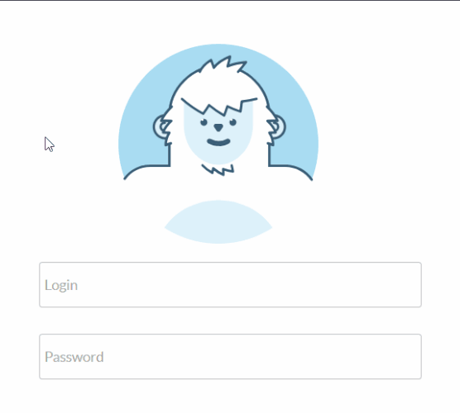



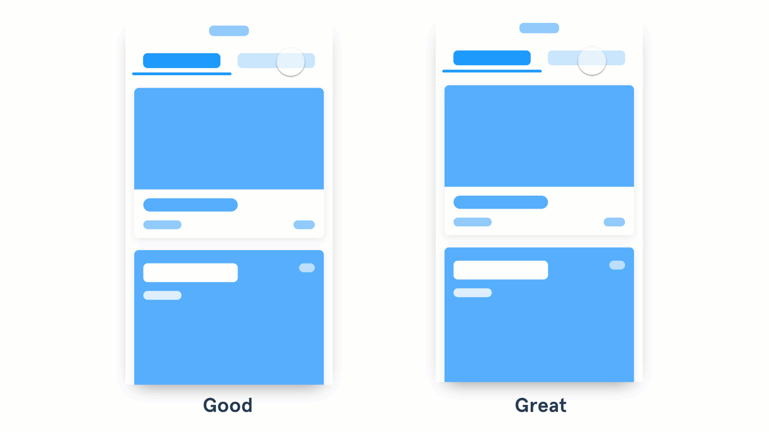

Workflow
Building skeleton application
Security
Clinet side login (for admin)
Error handling
Adding 3rd libraries packages
Routing in angular
Extending the API
Enhance the User interface
Update sources

Slide 12



Future
Adding Bus Services, will be a connection(Http) between our application and zajel.

Slide 13
Medical
Training
Matching
Program

