Slide 1


An-Najah National University
Telecommunication Engineering Department
" Women Safety Android Application"
Prepared by:
Rahaf Khalil
Renad Takrouri
Lama Zubidi
Supervisor:
Dr. Saed Tarapiah

Slide 2
Introduction
Problem Statement
System
Software
System Flowchart
The
Results
SWOT Analysis
Conclusion and Recommendations

Slide 3
Introduction
Globally, violence against women and girls has increased noticeably in recent years. According to UNWOMEN,35 per cent of women have experienced violence, with spread COVID-19 recently calls to help lines have increased from women have experienced a violence. But not all cases are Reported, statistics showed that less than 40 per cent of the women who experience violence seek help of any sort.

Slide 4
Introduction
Therefore, women’s security is an important and global issue which that very necessary to deal with, don't ignore it and find solution to help women when exposed violence. Therefore, this project show an Android application called "Women Safety" build by Android Studio platform based on Global System for Mobile (GSM) & Global Positioning System (GPS).

Slide 5
Problem Statement
Recent years experienced increasing of the women violence such as harassments, beating and others.So the issue of protecting women has become one of the most important issues in the world. Therefore, a solution must be found which can help her when exposed to violence.

Slide 6

System Software
Android Studio :
Android Studio is the official Integrated Development Environment (IDE) for Android app development, based on IntelliJ IDEA a Java integrated development environment for software,
There are many languages for Android development, this project use the official language for Android development Java.

Slide 7
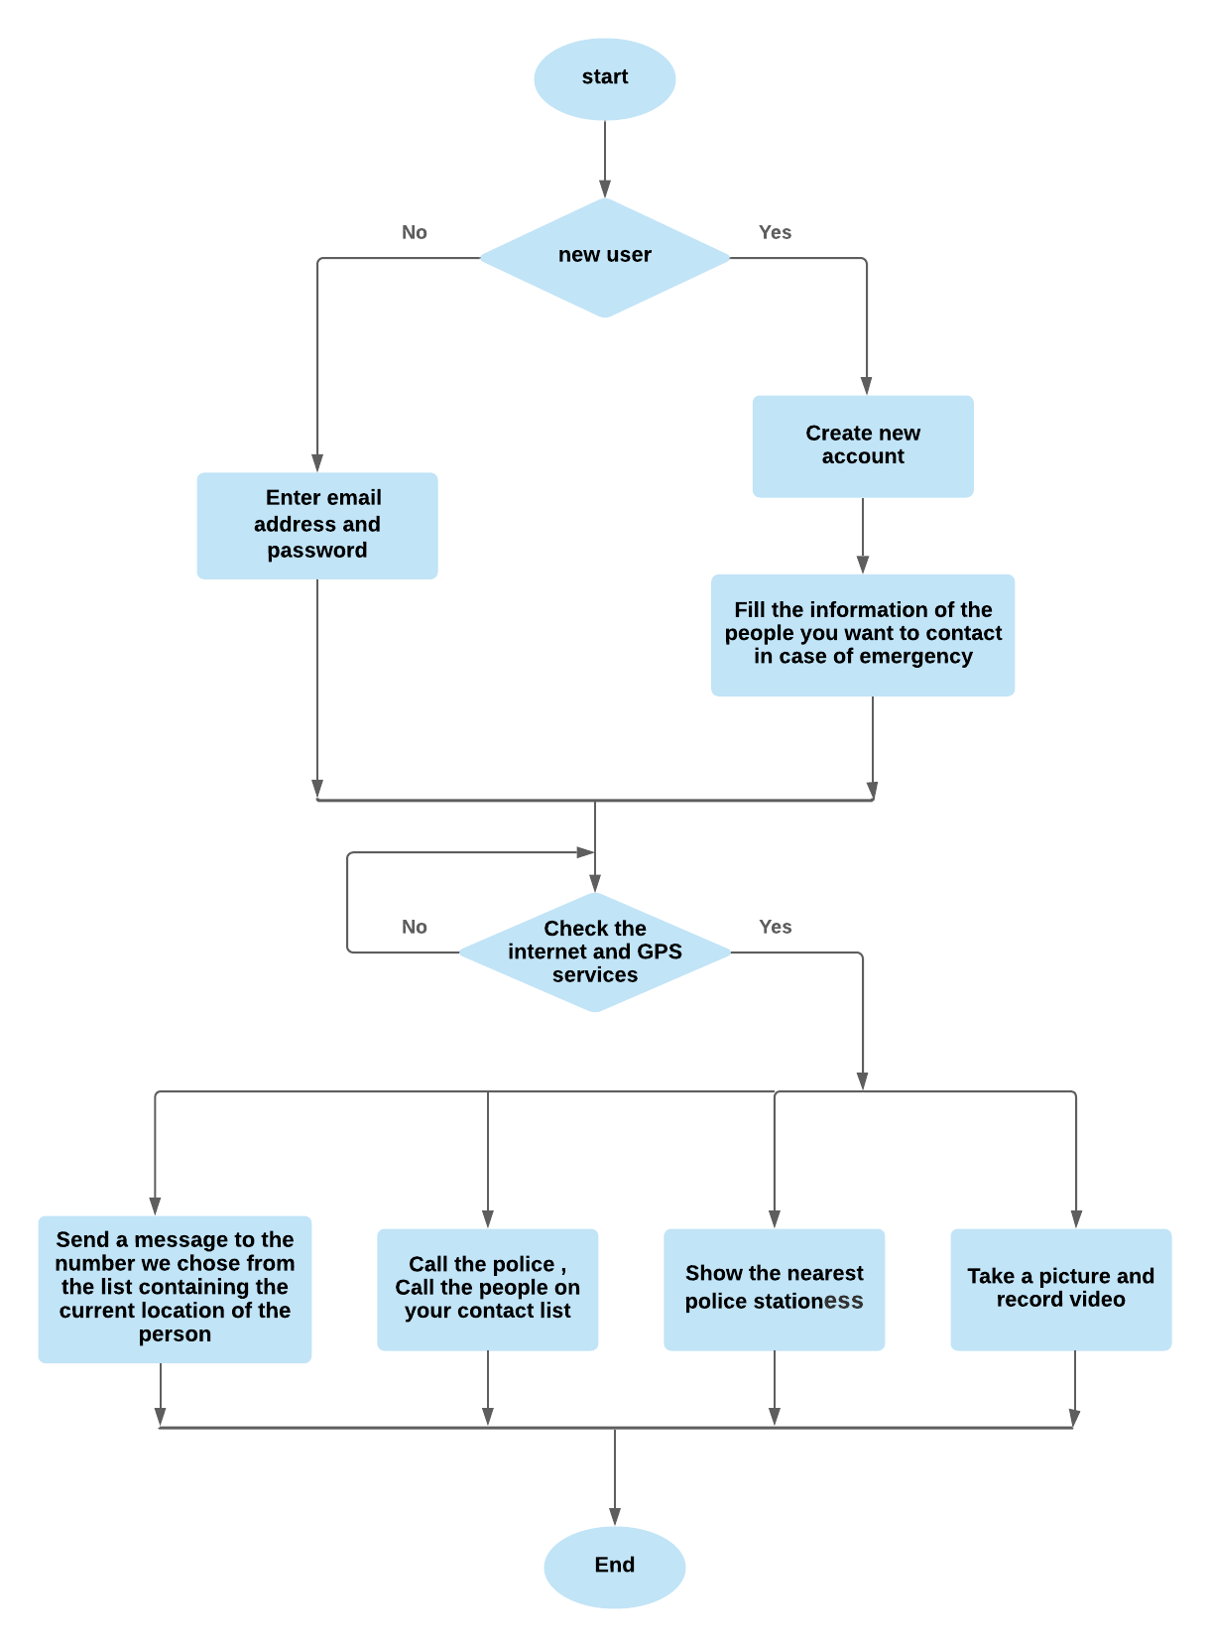
System Flowchart

Slide 9
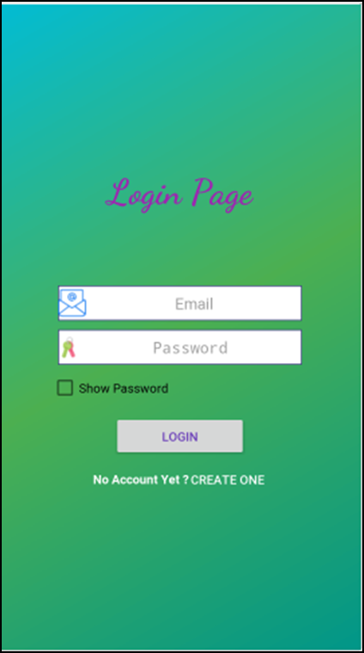
The results
Figure 1: Application interface

Slide 10
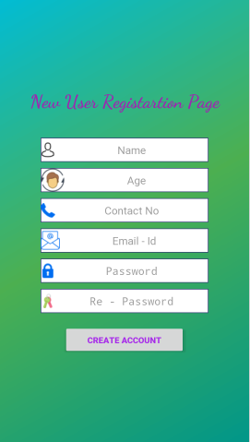
Figure 2: Registration page

Slide 11
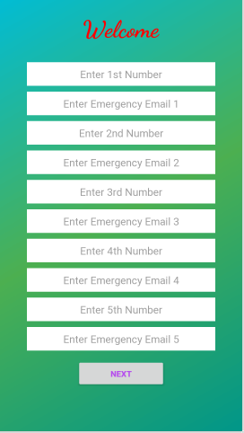
Figure 3: Registration numbers and emails page

Slide 12
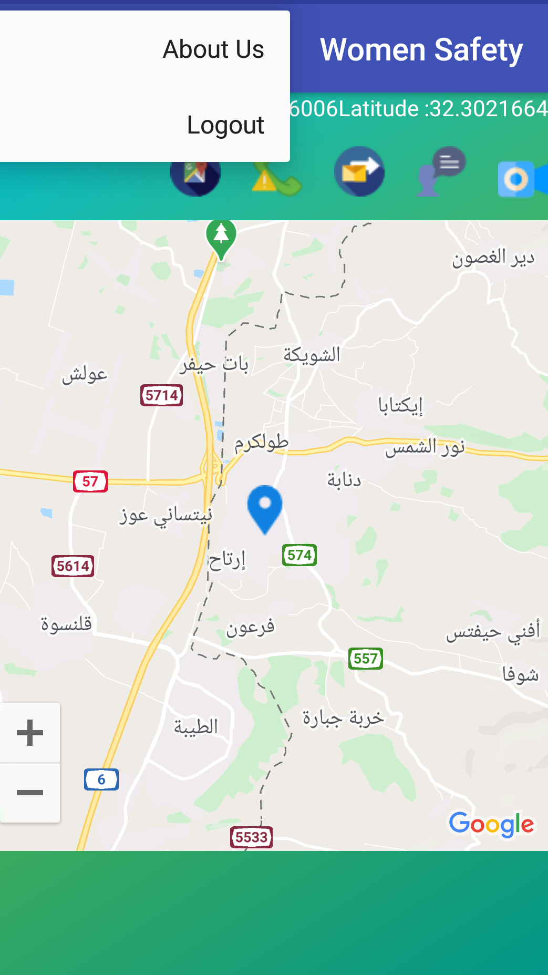
Figure 4: Home page of application

Slide 13
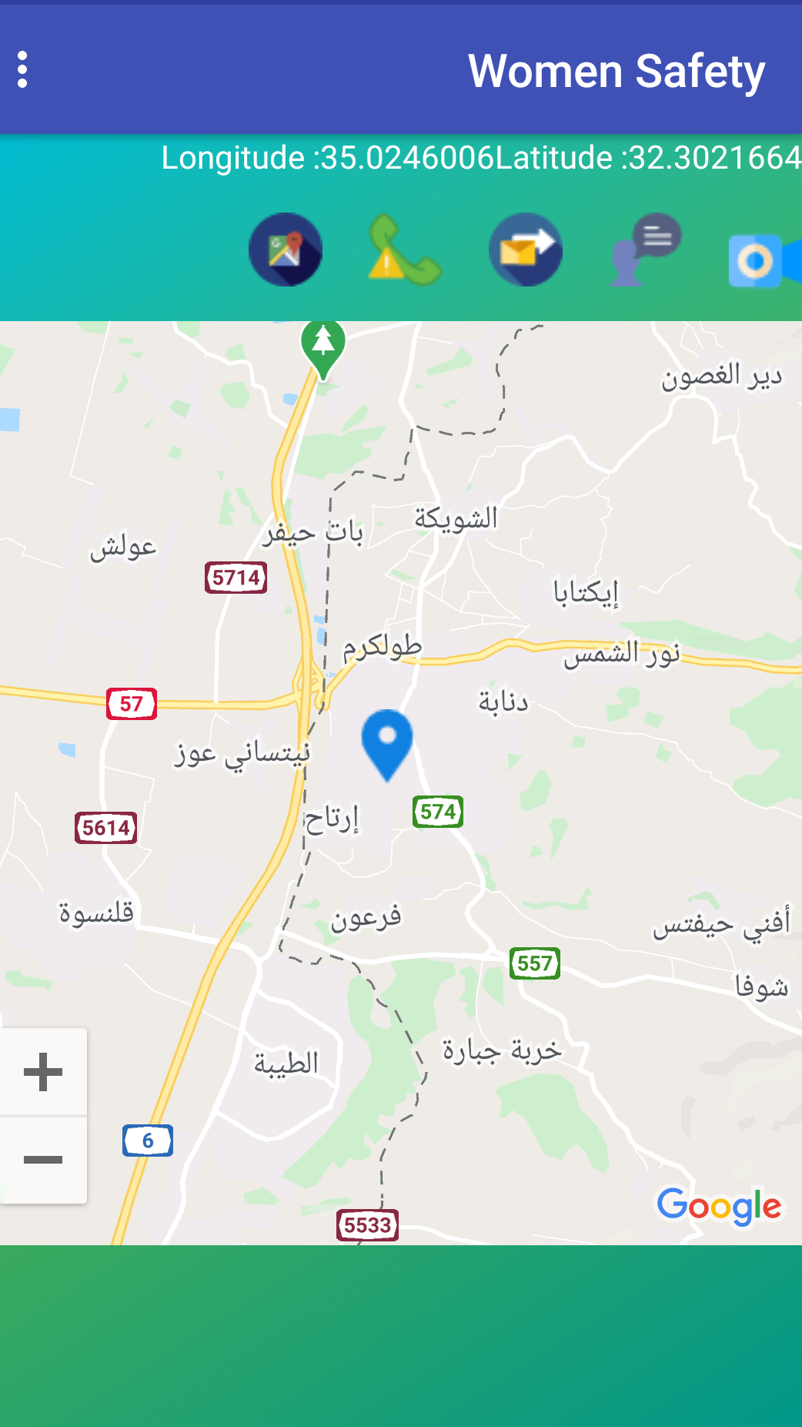
Figure 5: The current location to the user

Slide 14
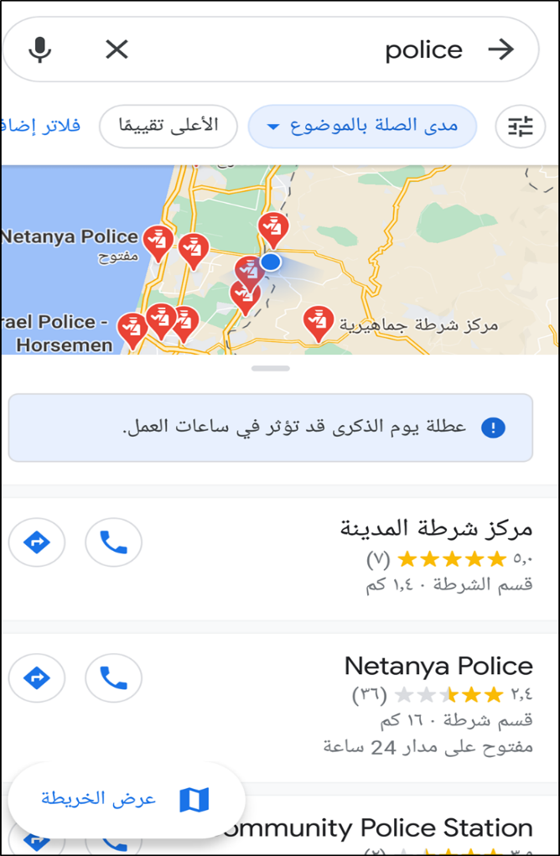
Figure 6: Nearest police station

Slide 15
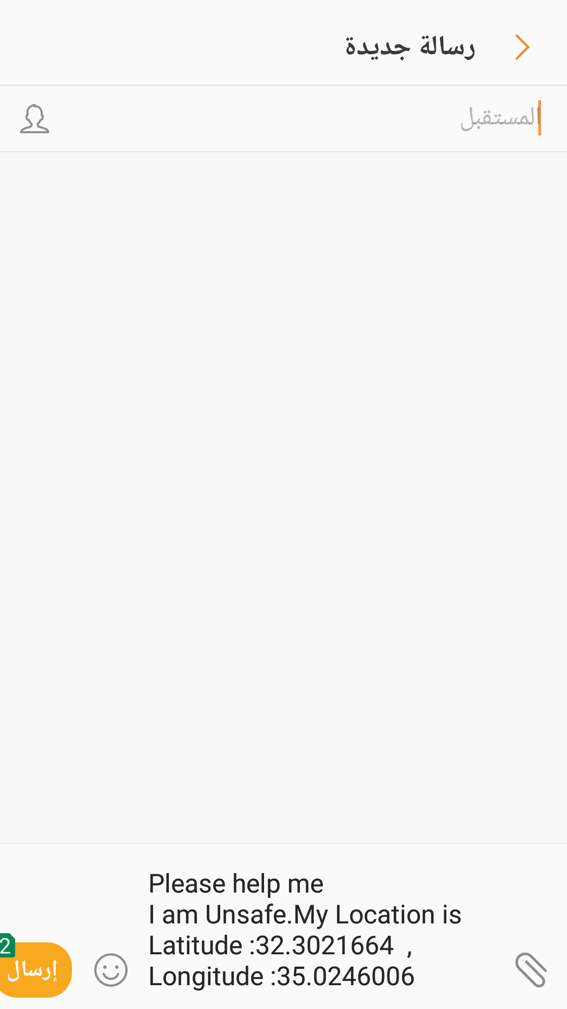
Figure 7: Message interface in application

Slide 16

Figure 8: Picture and video interface

Slide 17
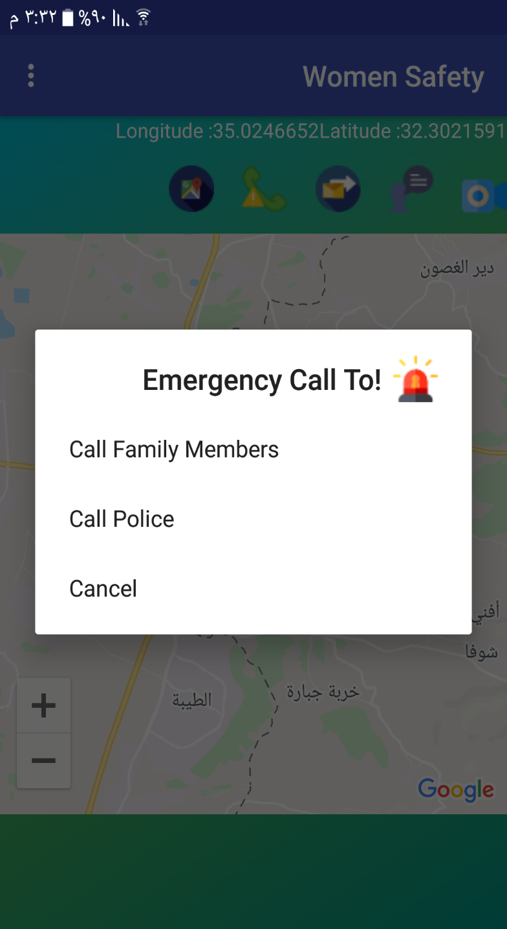
Figure 10: Call to police and family members

Slide 18
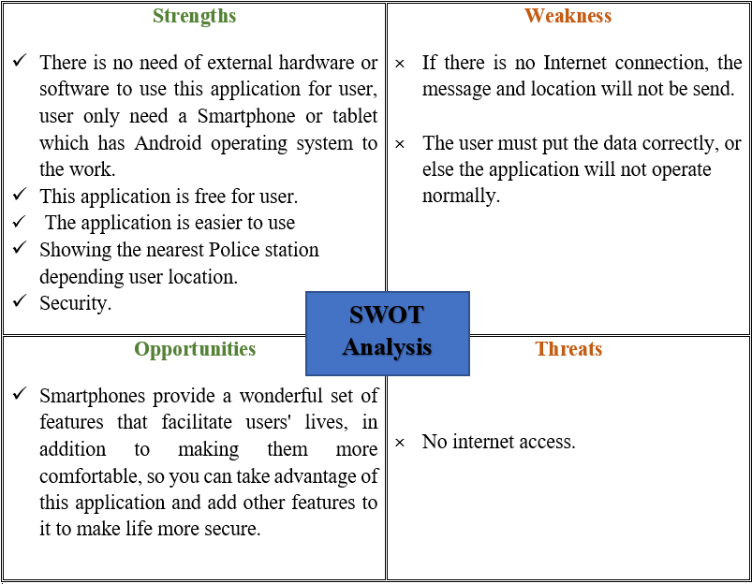
SWOT Analysis

Slide 19
Conclusion
To achieve our goals, Security for women has become a major issue as the number of crimes over women increasing day-by-day and with the increasing number of people using smart phones, they can be used for protection and personal safety purposes. This project proposed a Women Safety Android Application that ensures the safety of women, reduce the risk and help to identifying the location of person who is in danger.

Slide 20
Recommendations
The project is flexible and can be improved at anytime with more progressive features, for instance shake the smartphone to send SMS with location in case of emergency.

Slide 21
Thank you!
Any Question?

