Slide 1

Smart Bin
Prepared by:
Laila Abdallah
Mariam Abu-Doleh
Supervisor:
Dr. Mohannad Al-jabi

Slide 2
Outline
Motivation
Overview
Hardware part
Flow chart
Constraints
Future Work
Demo

Slide 3

Motivation
For a cleaner environment.
Encourage people to be more environmentally friendly.
Reduce time and effort.

Slide 4

Smart Bin

Slide 5
Overview
User identifier.
Classification of waste depending on material.
Detect the level of rubbish.

Slide 6
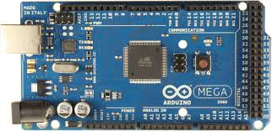
Hardware part
Arduino mega Microcontroller

Slide 7
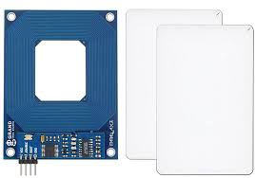
RFID

Slide 8
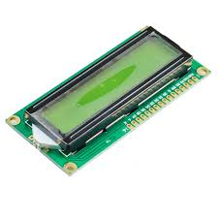
LCD

Slide 9
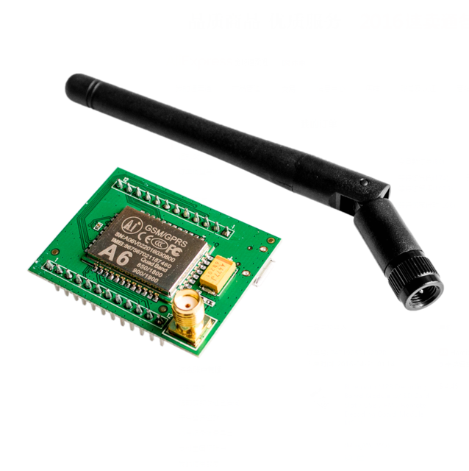
GSM GPRS A6 Module

Slide 10
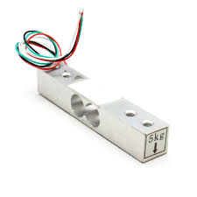
load cell sensor
& Amplifier

Slide 11
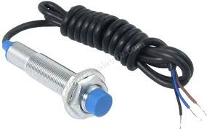
Inductive proximity sensor

Slide 12
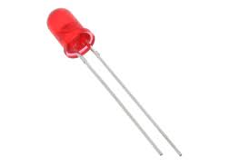
LED

Slide 13
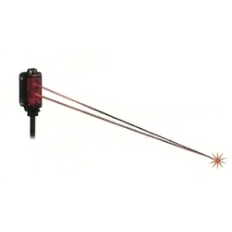
Laser sensor

Slide 14
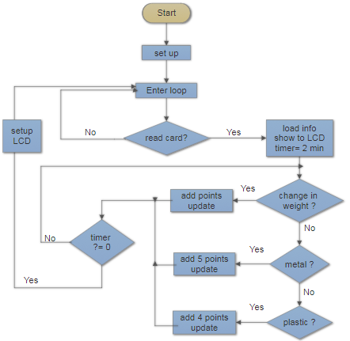
Flow chart

Slide 15
Constraints
Some sensors are not available.
Problems with ultrasonic→ laser.
Load cell sensor is inaccurate.

Slide 16
Future work
Separate waste automatically.
Fire extinguishing \ Report a fire.

Slide 17
Demo

Slide 18
Thank you

