Slide 1

DotSense: An Intelligent Braille Conversion and Printing System
Ala'a Abdelrahim & Abdullah Shabib
Supervisor: Dr. Anas Toma
An-Najah National University – September 2025

Slide 2

What is Braille?
Braille is a way of reading and writing for blind people using raised dots.

Slide 3
Why DotSense?
Millions lack access to braille
Printers are very expensive
Visual impairment affects millions worldwide, yet many don't have access to essential braille materials for daily life.
Commercial braille printers can cost thousands of dollars, making them inaccessible for many individuals and organizations.
Limited connectivity & usability
Need affordable, inclusive solution
Existing solutions often have restricted input methods and connectivity options, limiting their practical application.
There's a critical gap for cost-effective, user-friendly braille printing technology that promotes inclusivity.

Slide 4
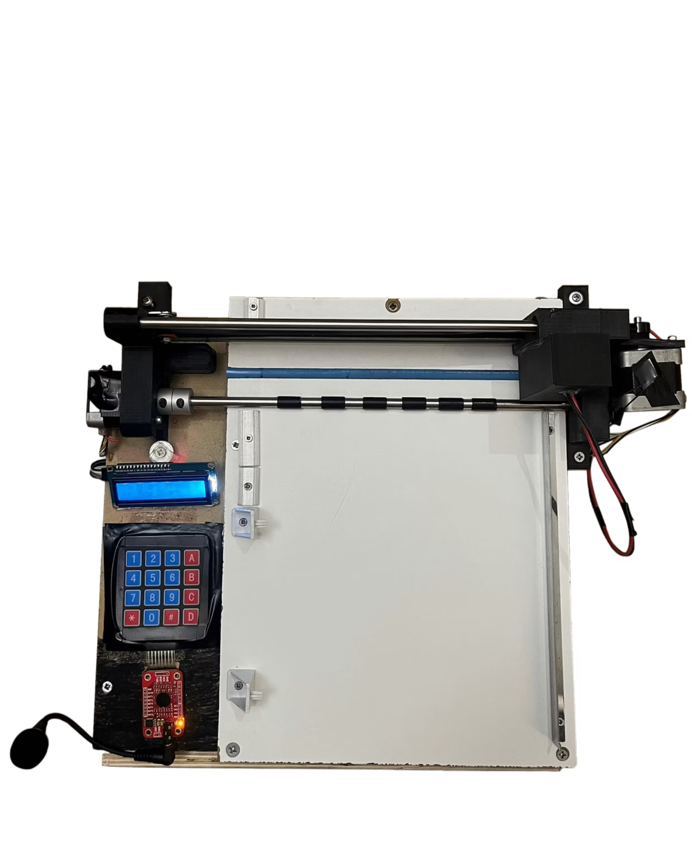
What is DotSense?
Affordable, user-friendly printer
Converts text/PDF → braille
Seamlessly transforming digital content into tactile braille format for visually impaired users.
Creating a cost-effective braille printing solution that anyone can use regardless of technical expertise.
Multi-modal: keypad , voice, web
Offering multiple input methods to ensure accessibility for diverse user needs and preferences.

Slide 5
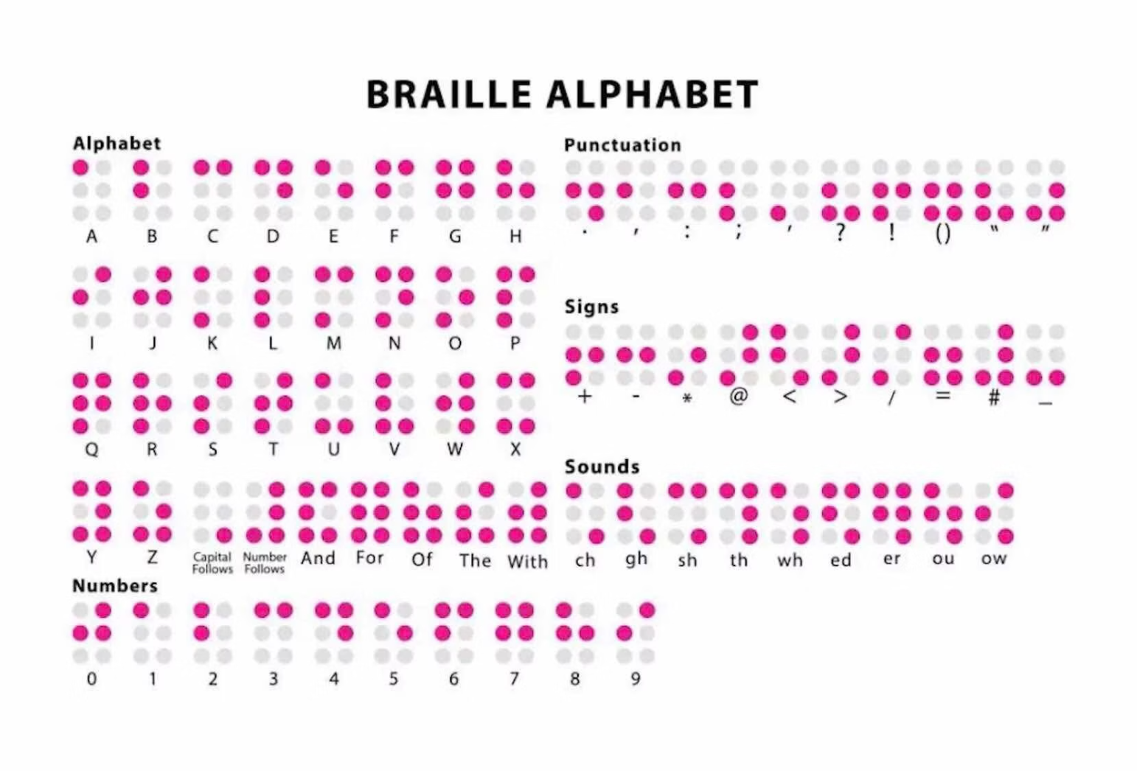
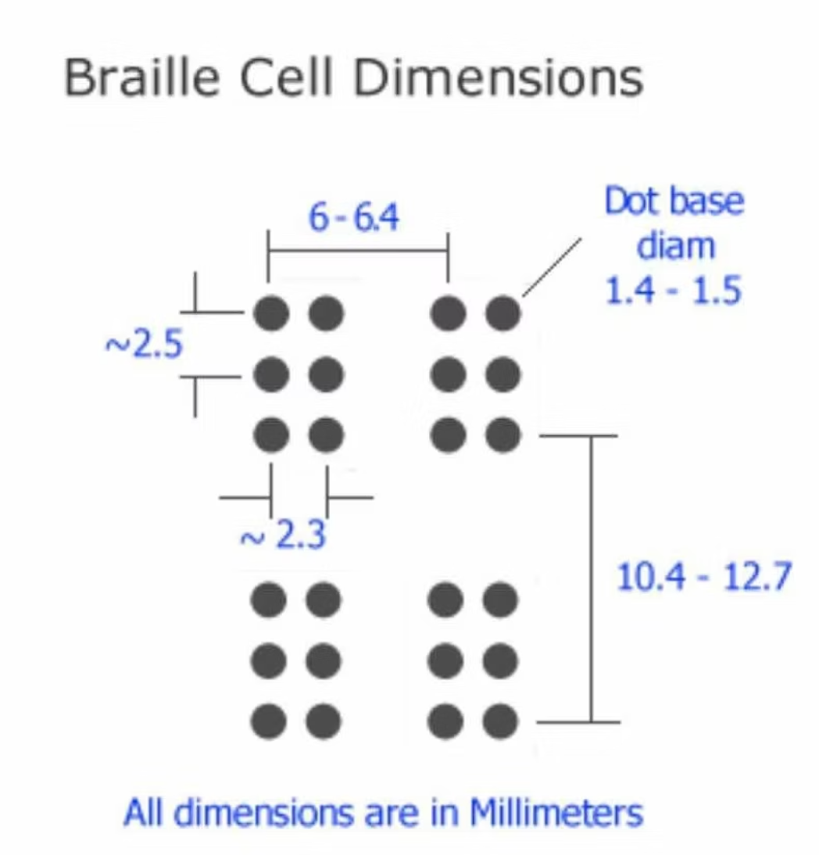
World Braille Usage Specifications

Slide 6





Key Features
Multi-modal input
Real-time braille embossing
PDF/text support
Multiple input methods ensure accessibility for all users regardless of their technical abilities or preferences.
Immediate conversion and printing of braille content as soon as input is received and processed.
Compatibility with common document formats to maximize usability with existing content.
Audio & LCD feedback
Wireless connectivity
Clear system status updates through both audio and visual channels for enhanced user experience.
Connect from any device on the network to send content for braille conversion and printing.

Slide 7
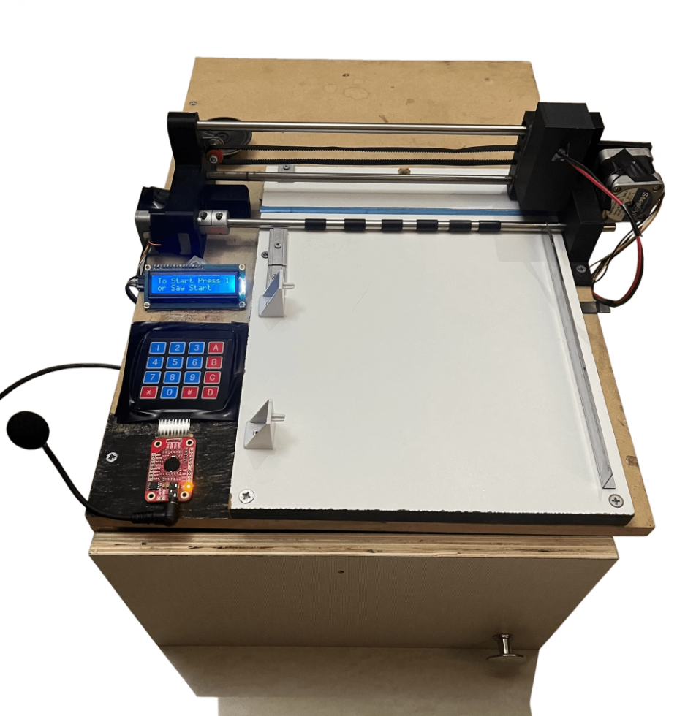
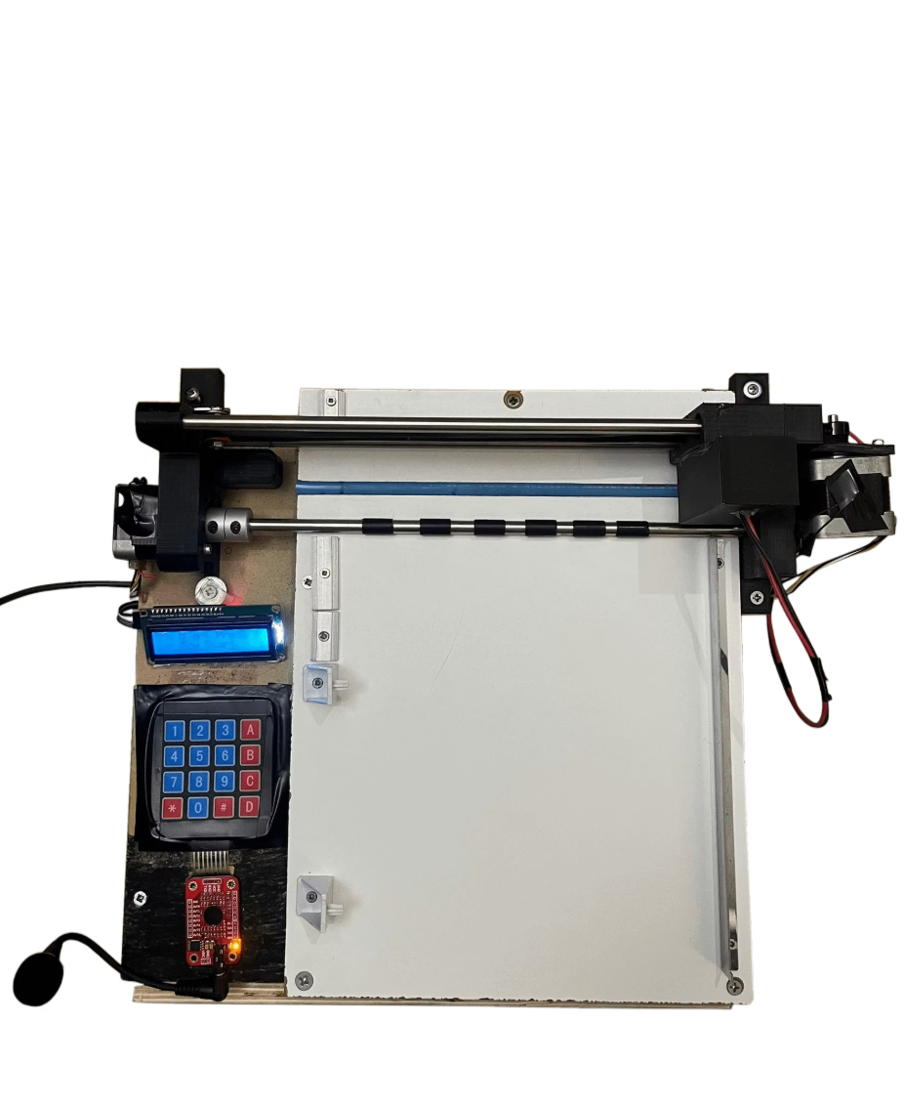
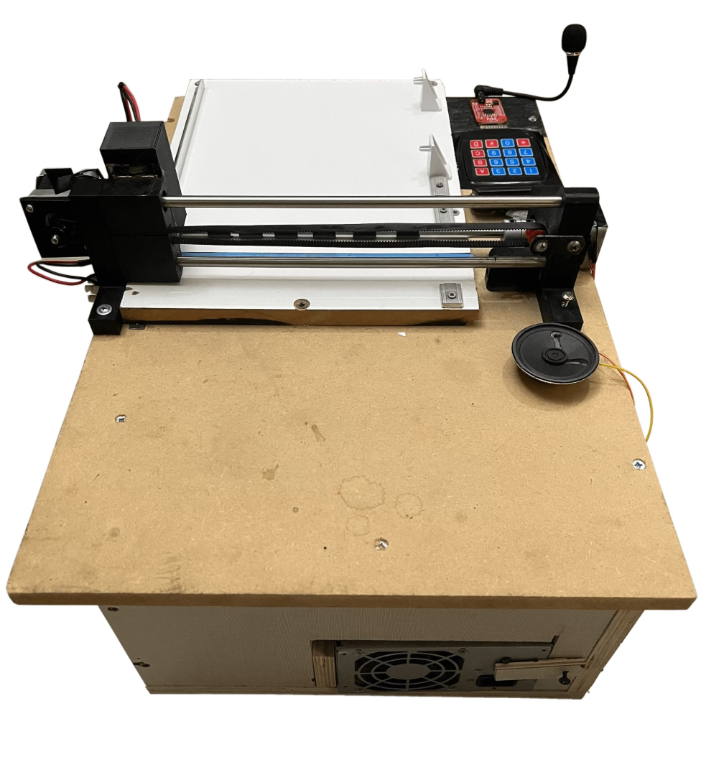
DotSense Components

Slide 8
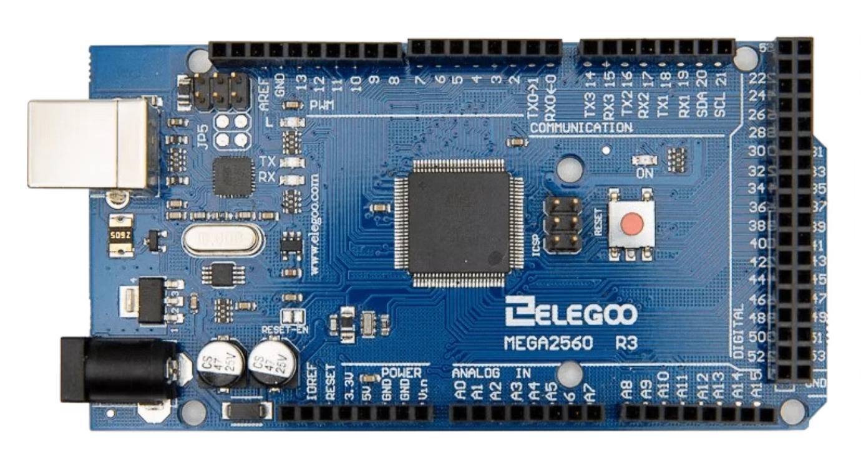
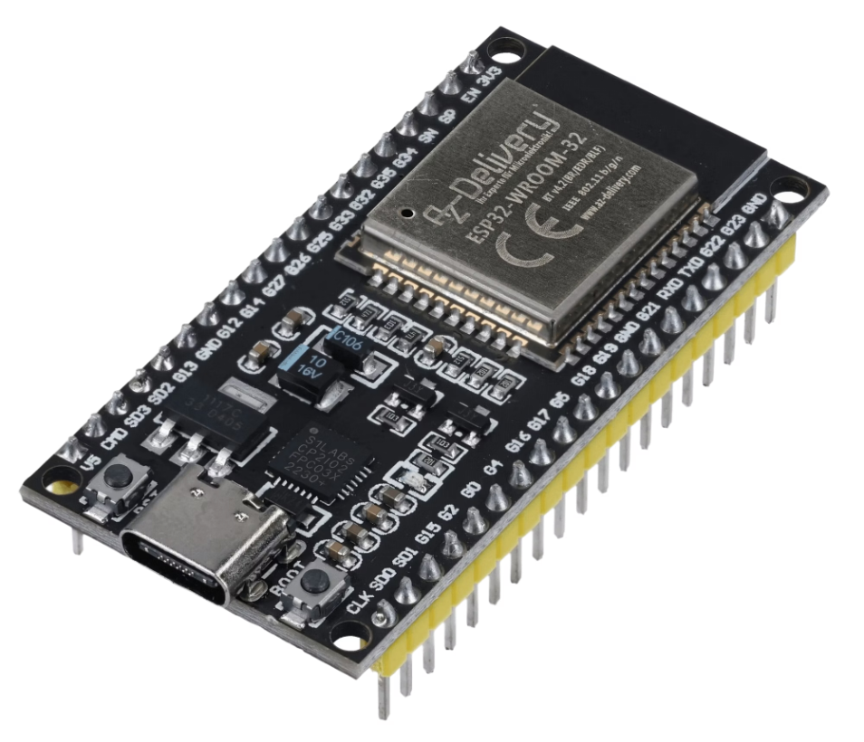
Control & Processing Set
This set is the brain of the system, where Arduino manages real-time printing and ESP32 manages connectivity and web input.
Arduino Mega 2560
ESP-WROOM-32

Slide 9
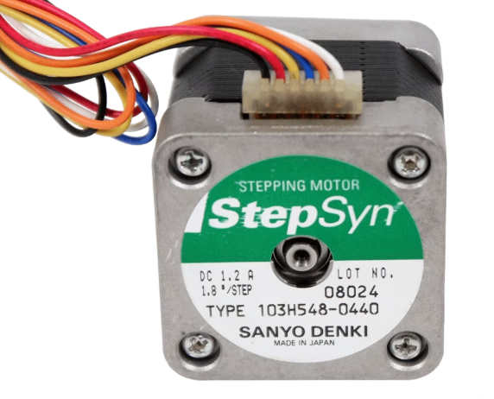
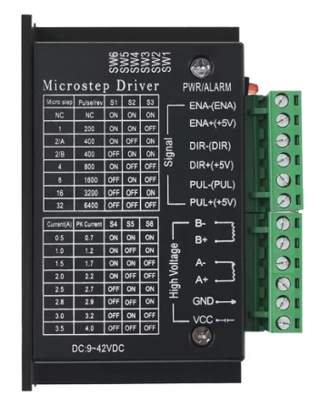
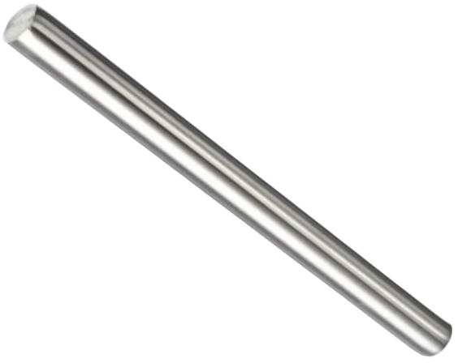
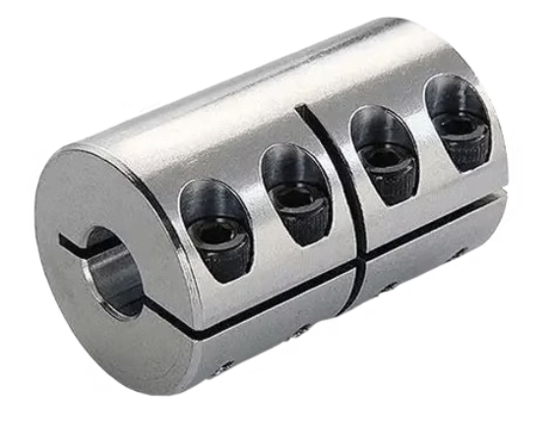
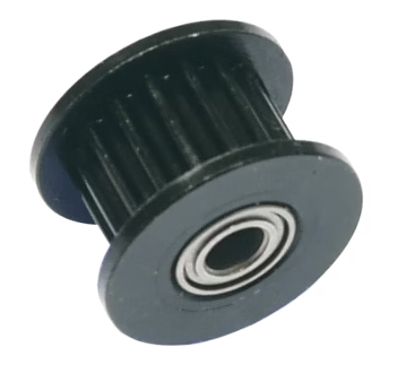
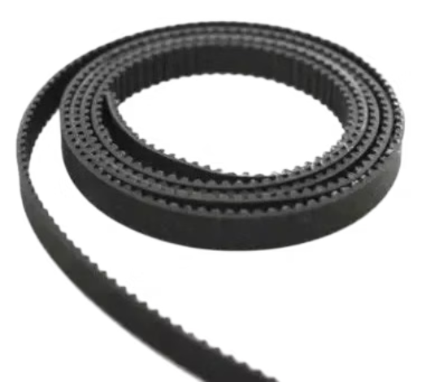
Motion Set
This set is responsible for moving the paper and positioning the embossing head.
Stepper Motors NEMA 23
Stepper Motor Drivers TB6600
Stainless Steel Carbide Metal Rods
Rigid Coupling
GT2 16-Teeth Idler Pulley
Timing Belt GT2 (1m)

Slide 10
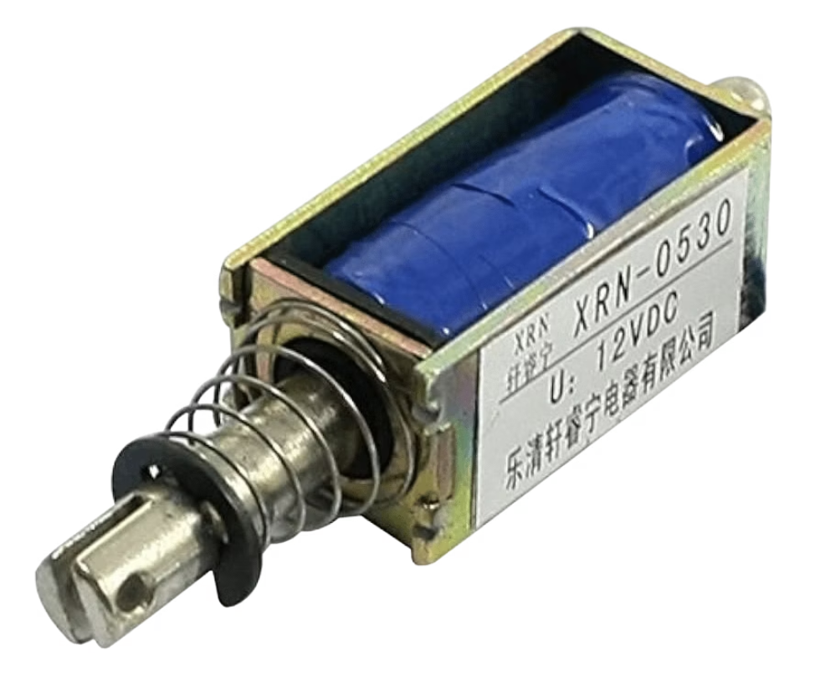
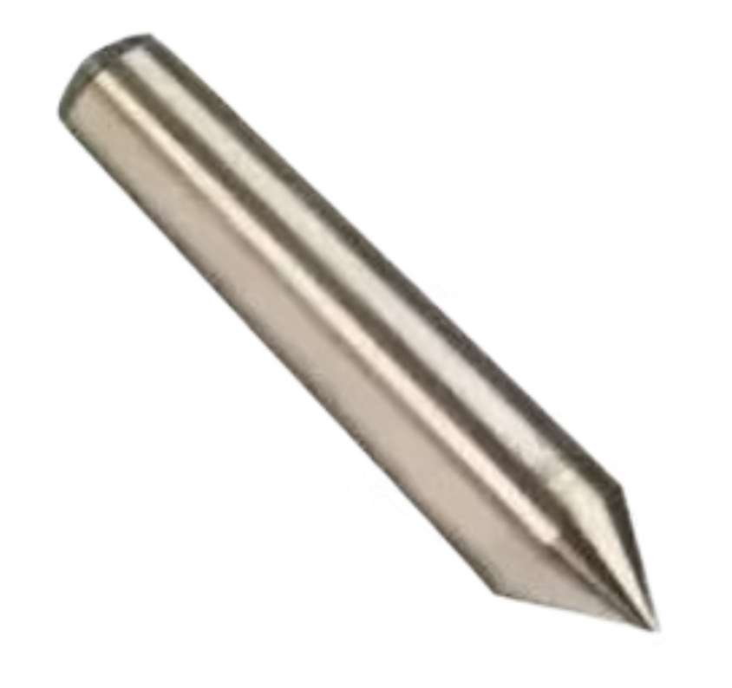
Embossing Set
This set is the actual printing unit that embosses dots according to the braille pattern.
Linear Actuator
Braille Pen

Slide 11
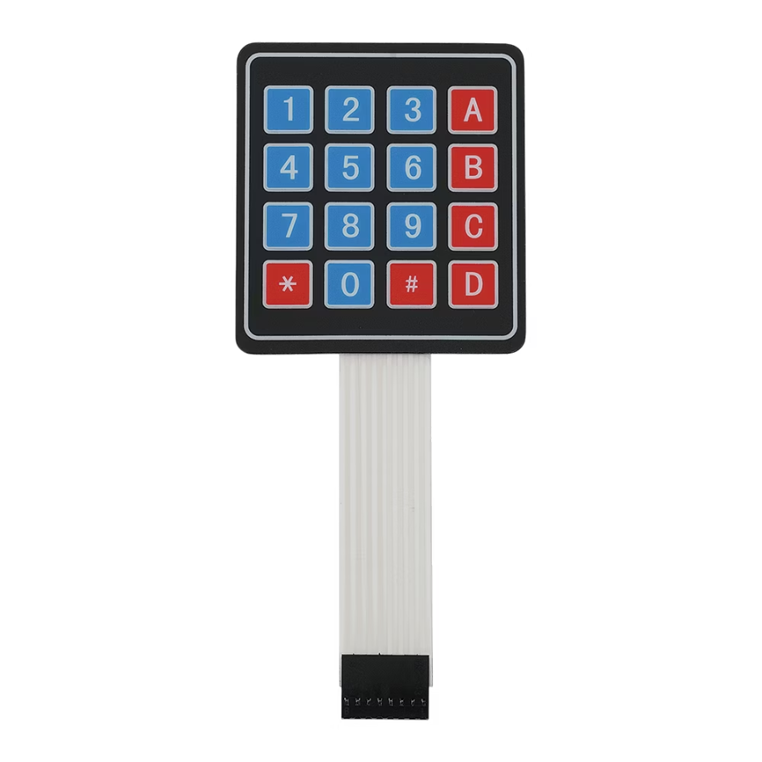
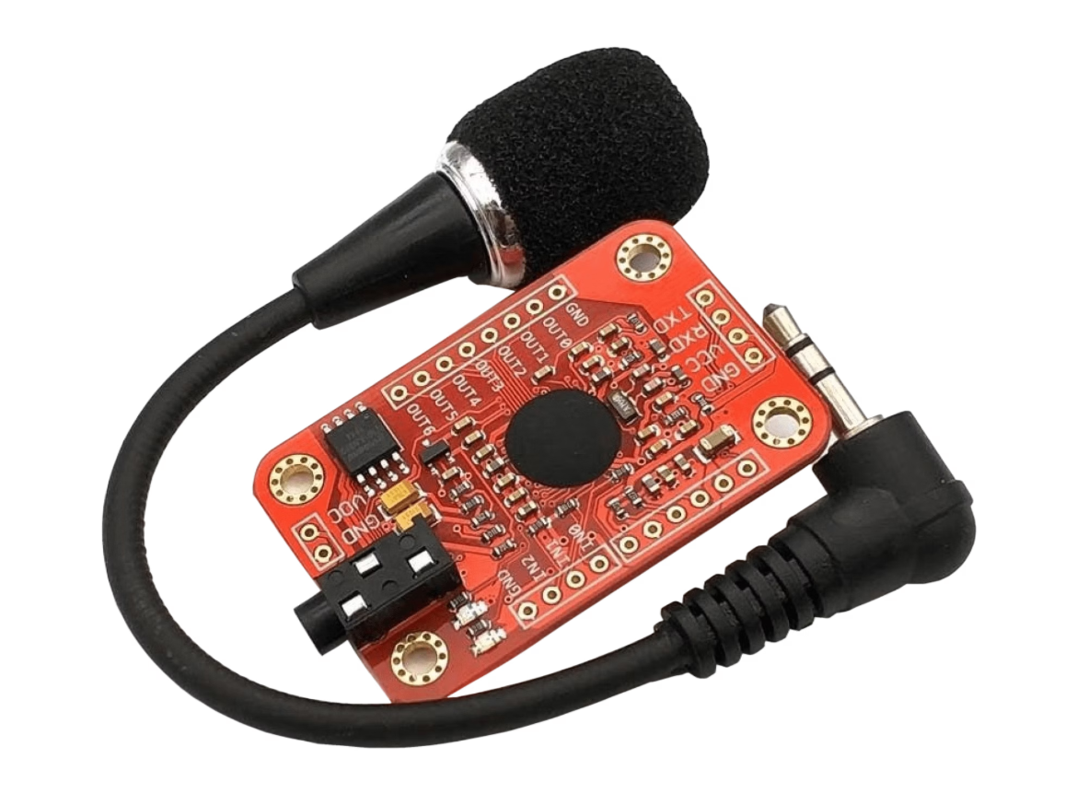
User Interface Set
This set provides multiple ways for users to interact with the printer
Keypad 4x4
Voice Recognition Module V3

Slide 12
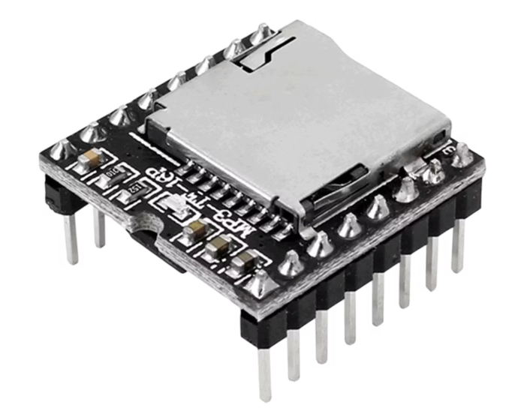
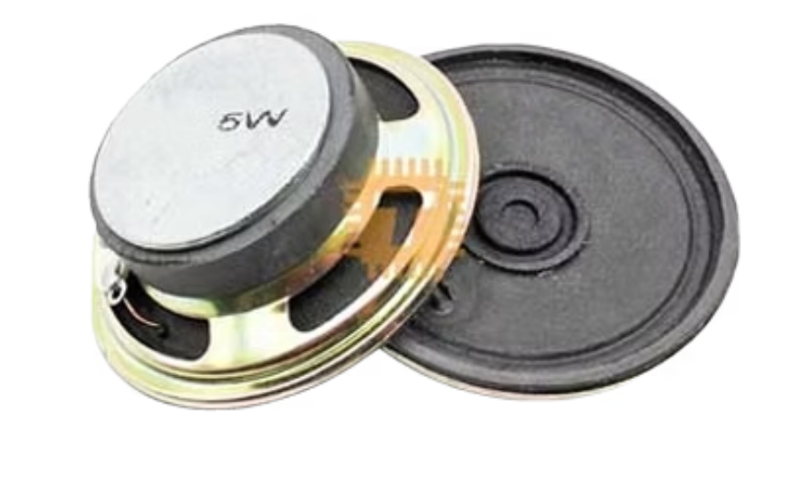
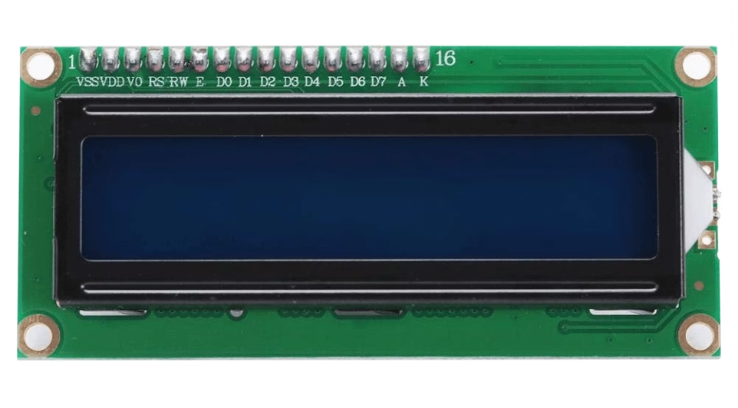
Audio & Feedback Set
This set ensures audio guidance and feedback for accessibility.
DFPlayer Mini MP3 Module
Speaker
LCD 16x2 with I2C Module

Slide 13
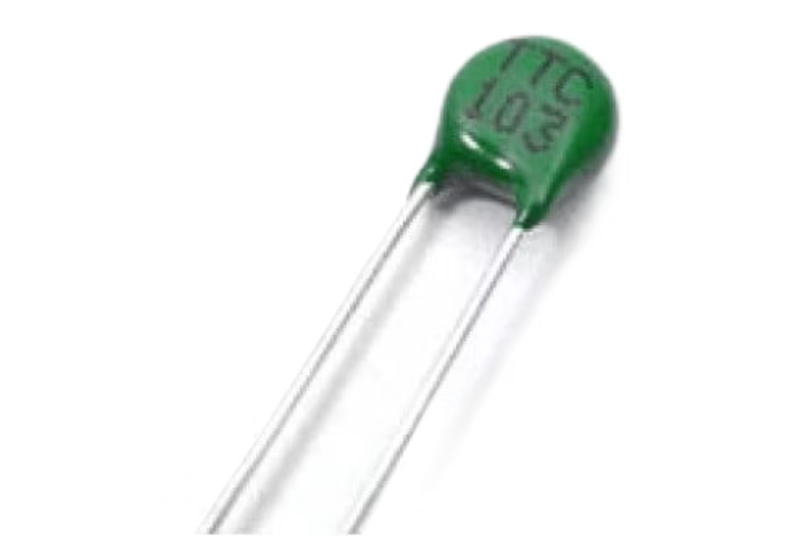
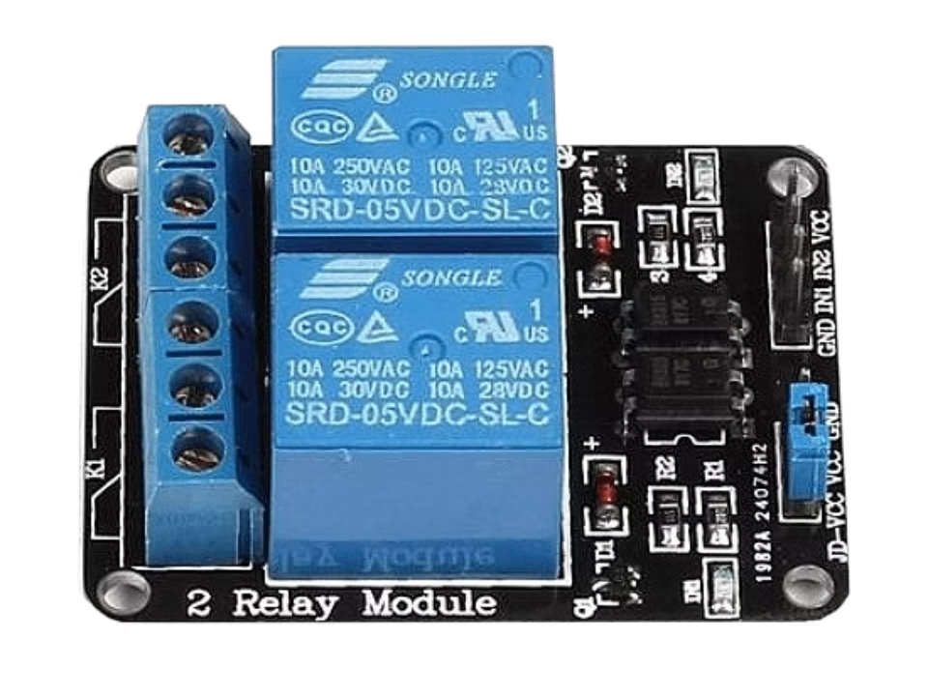
Safety & Monitoring Set
This set protects the hardware and ensures safe operation.
10K Ohm NTC Thermistors
5V 2-Channel Relay Module

Slide 14
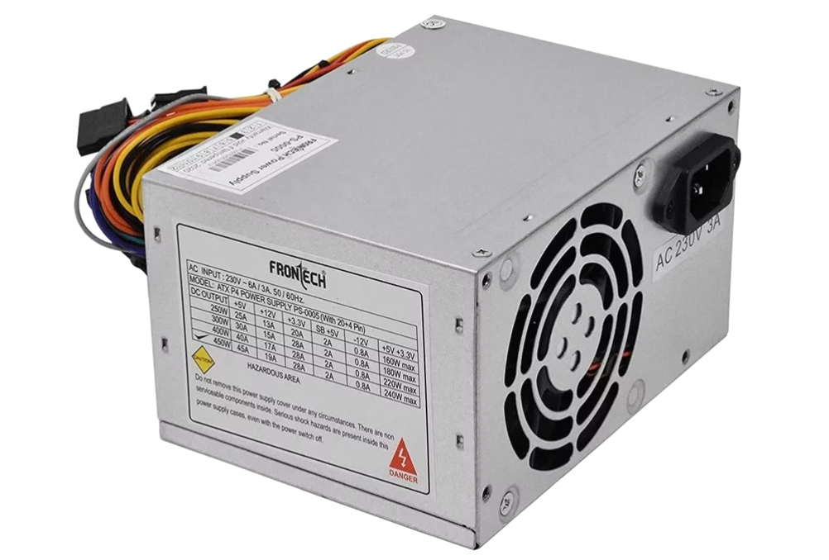
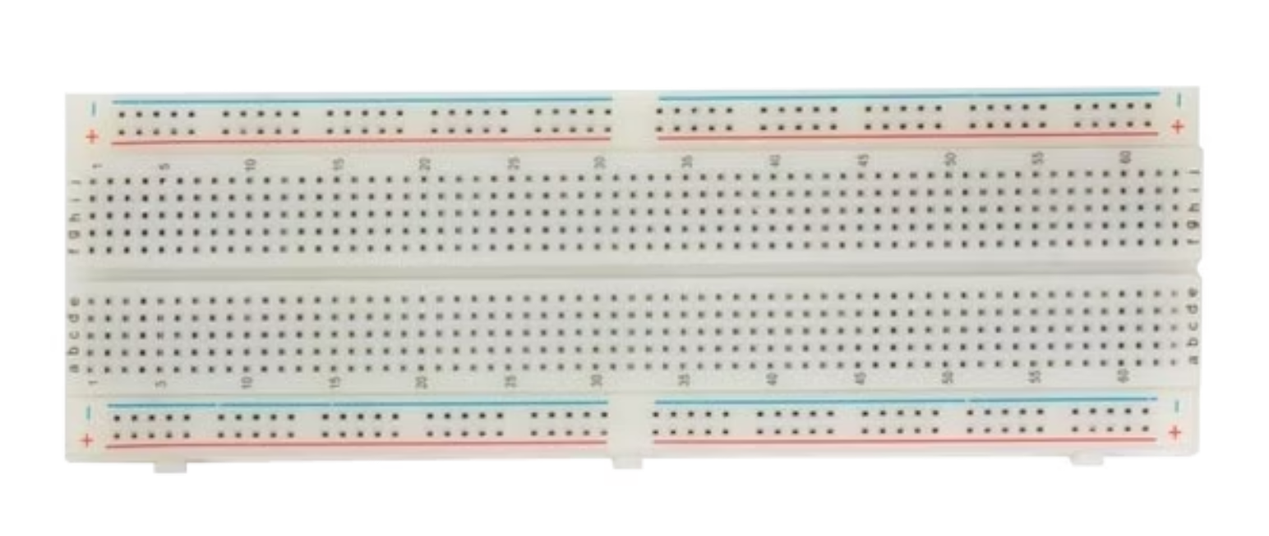
Power & Prototyping Set
This set supplies and organizes the energy distribution.
Power Supply
Breadboards

Slide 15








Software & Technology
Arduino & ESP32 firmware
Python PDF → text
Custom embedded software that controls hardware components and manages the printing process.
Document processing algorithms that extract text content from PDF files for braille conversion.
Open-source libraries
Web: HTML, CSS, JavaScript
Leveraging community-developed resources to enhance functionality and reliability.
User-friendly web interface that allows remote document submission and printer control.

Slide 16
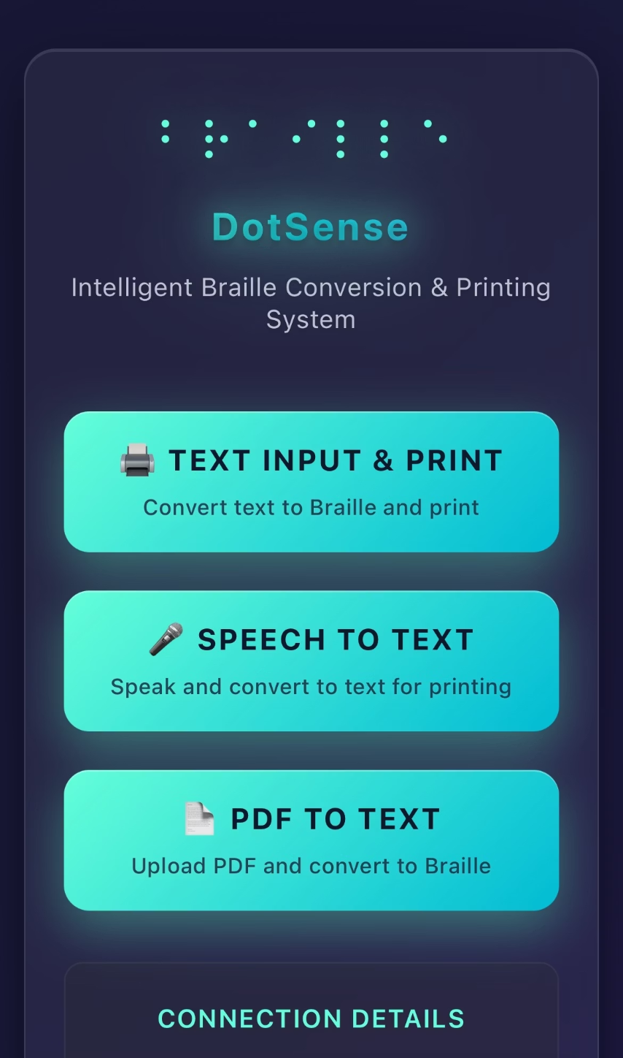
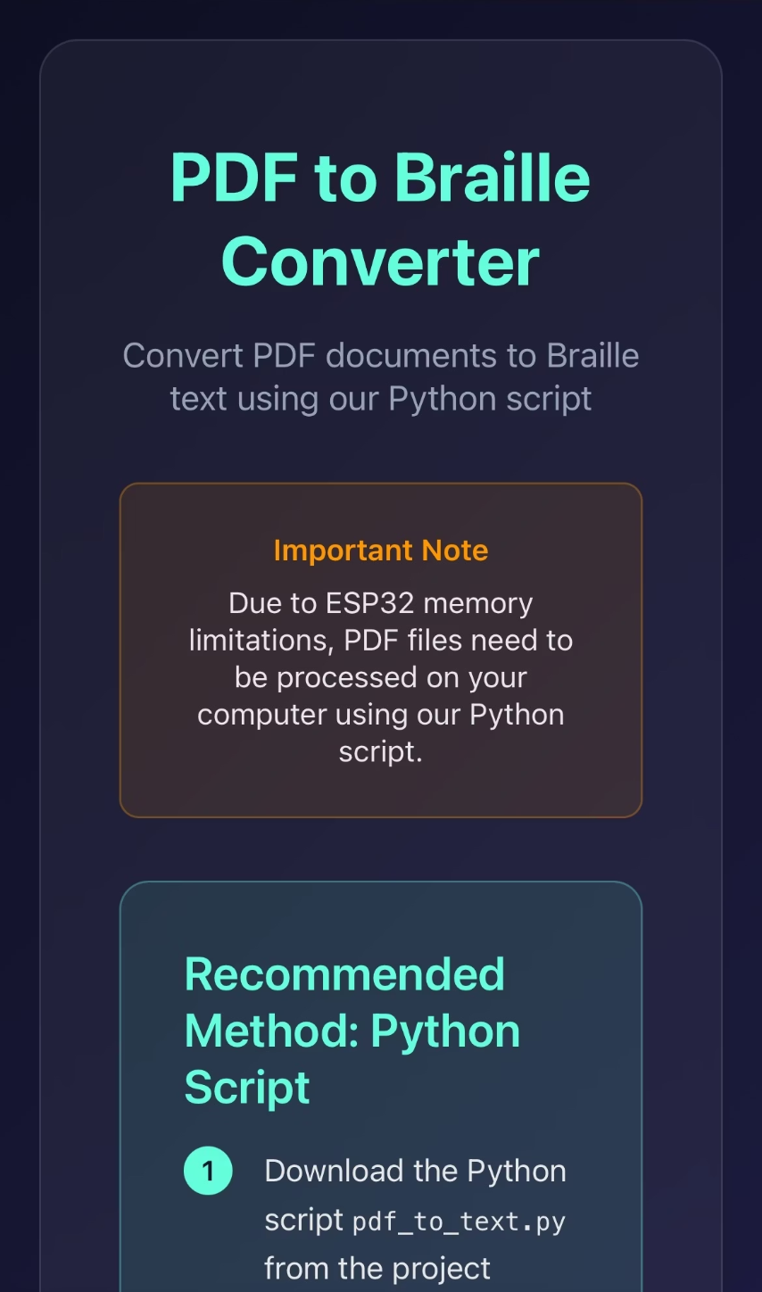
Web Application
Main Page
PDF Instructions

Slide 17
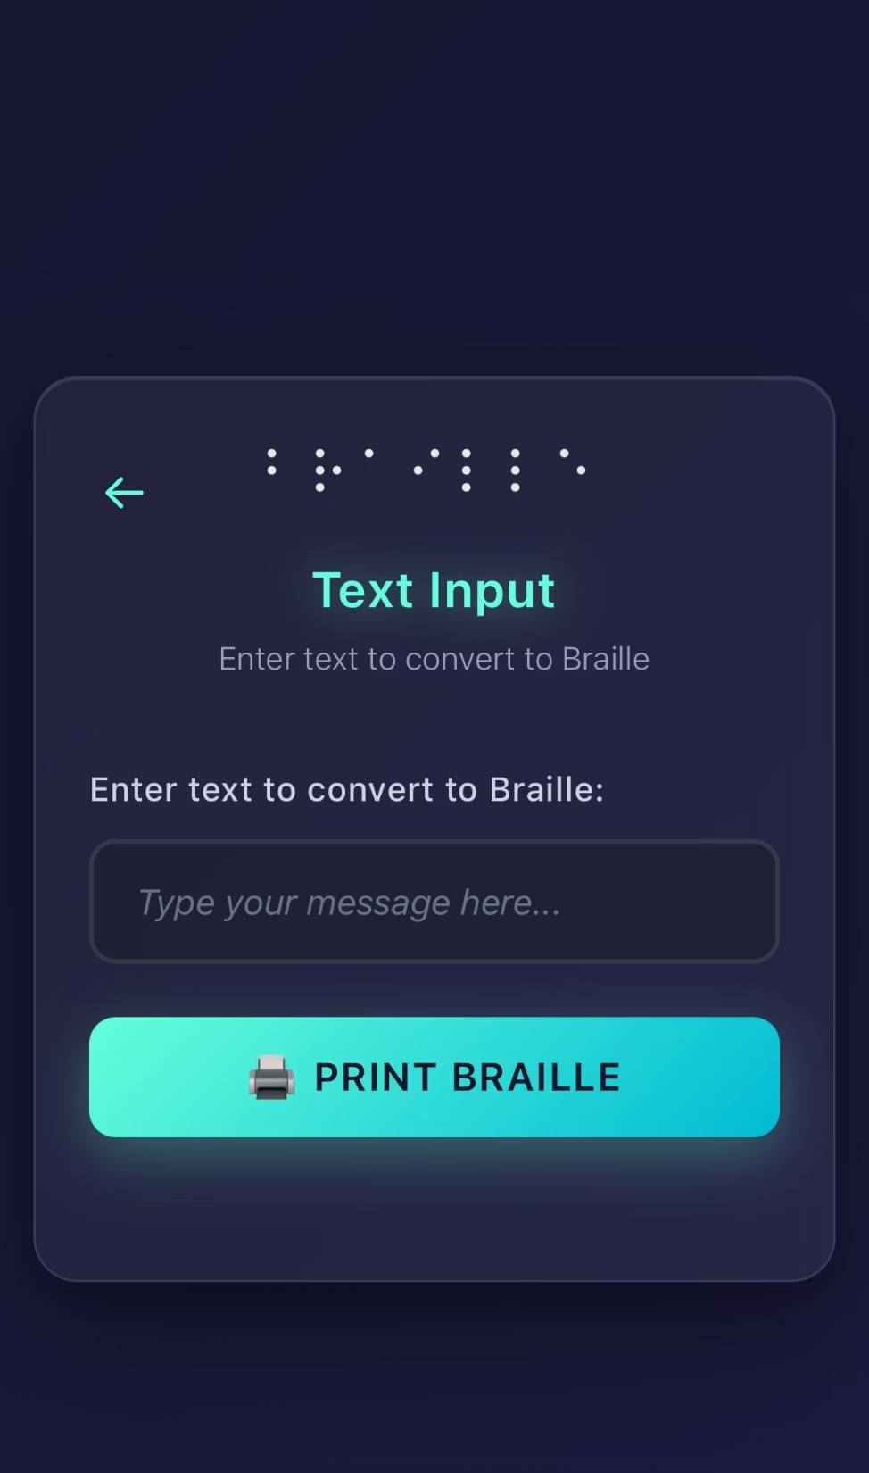
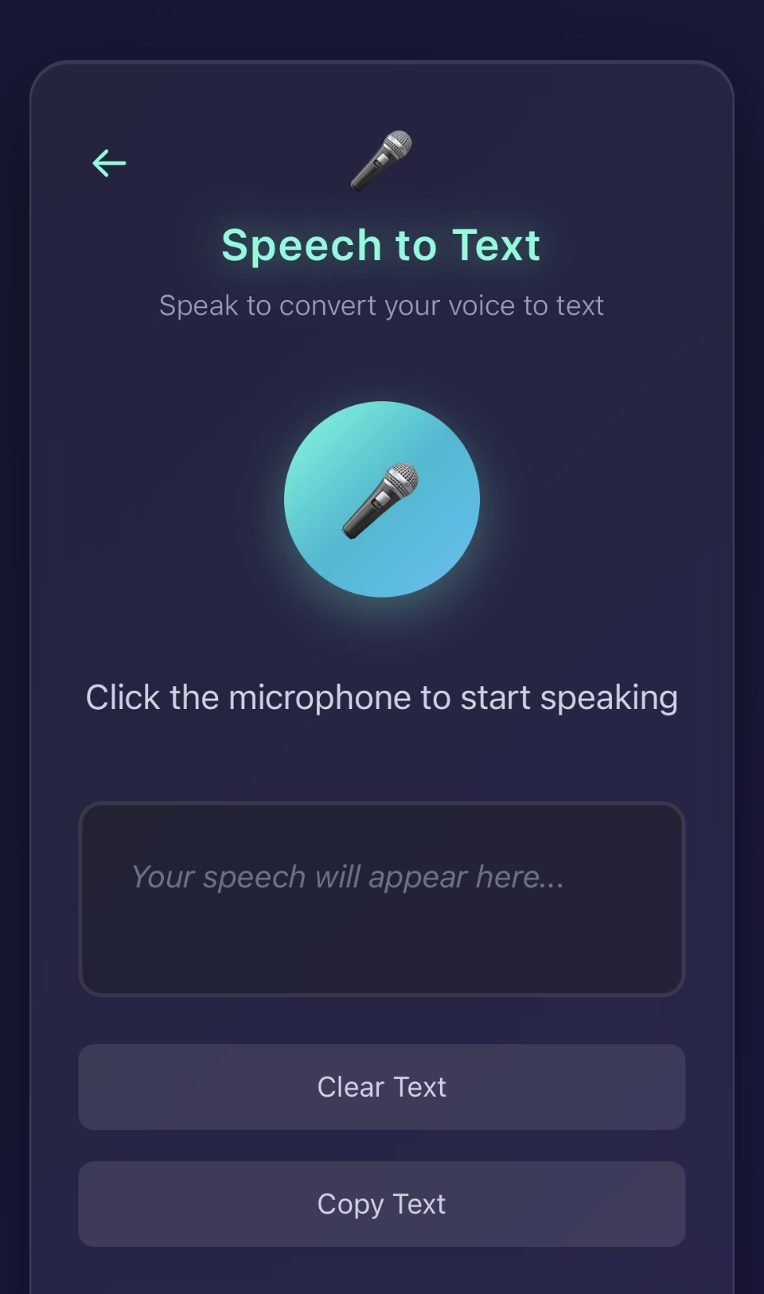
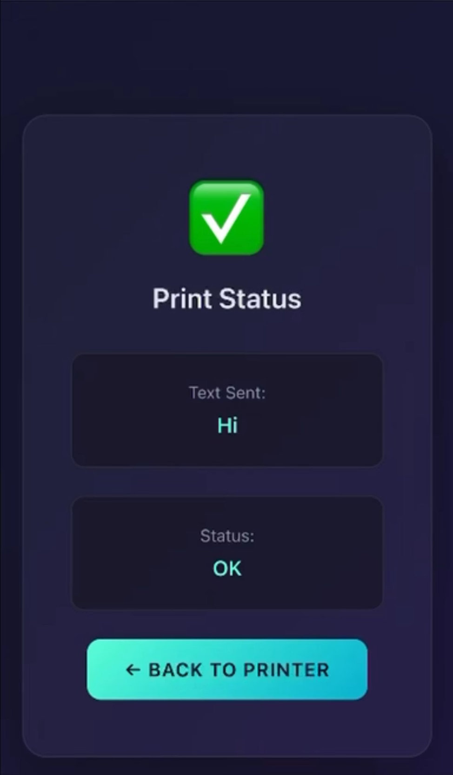
User Input Text
Speech to Text Page
Status Page

Slide 18


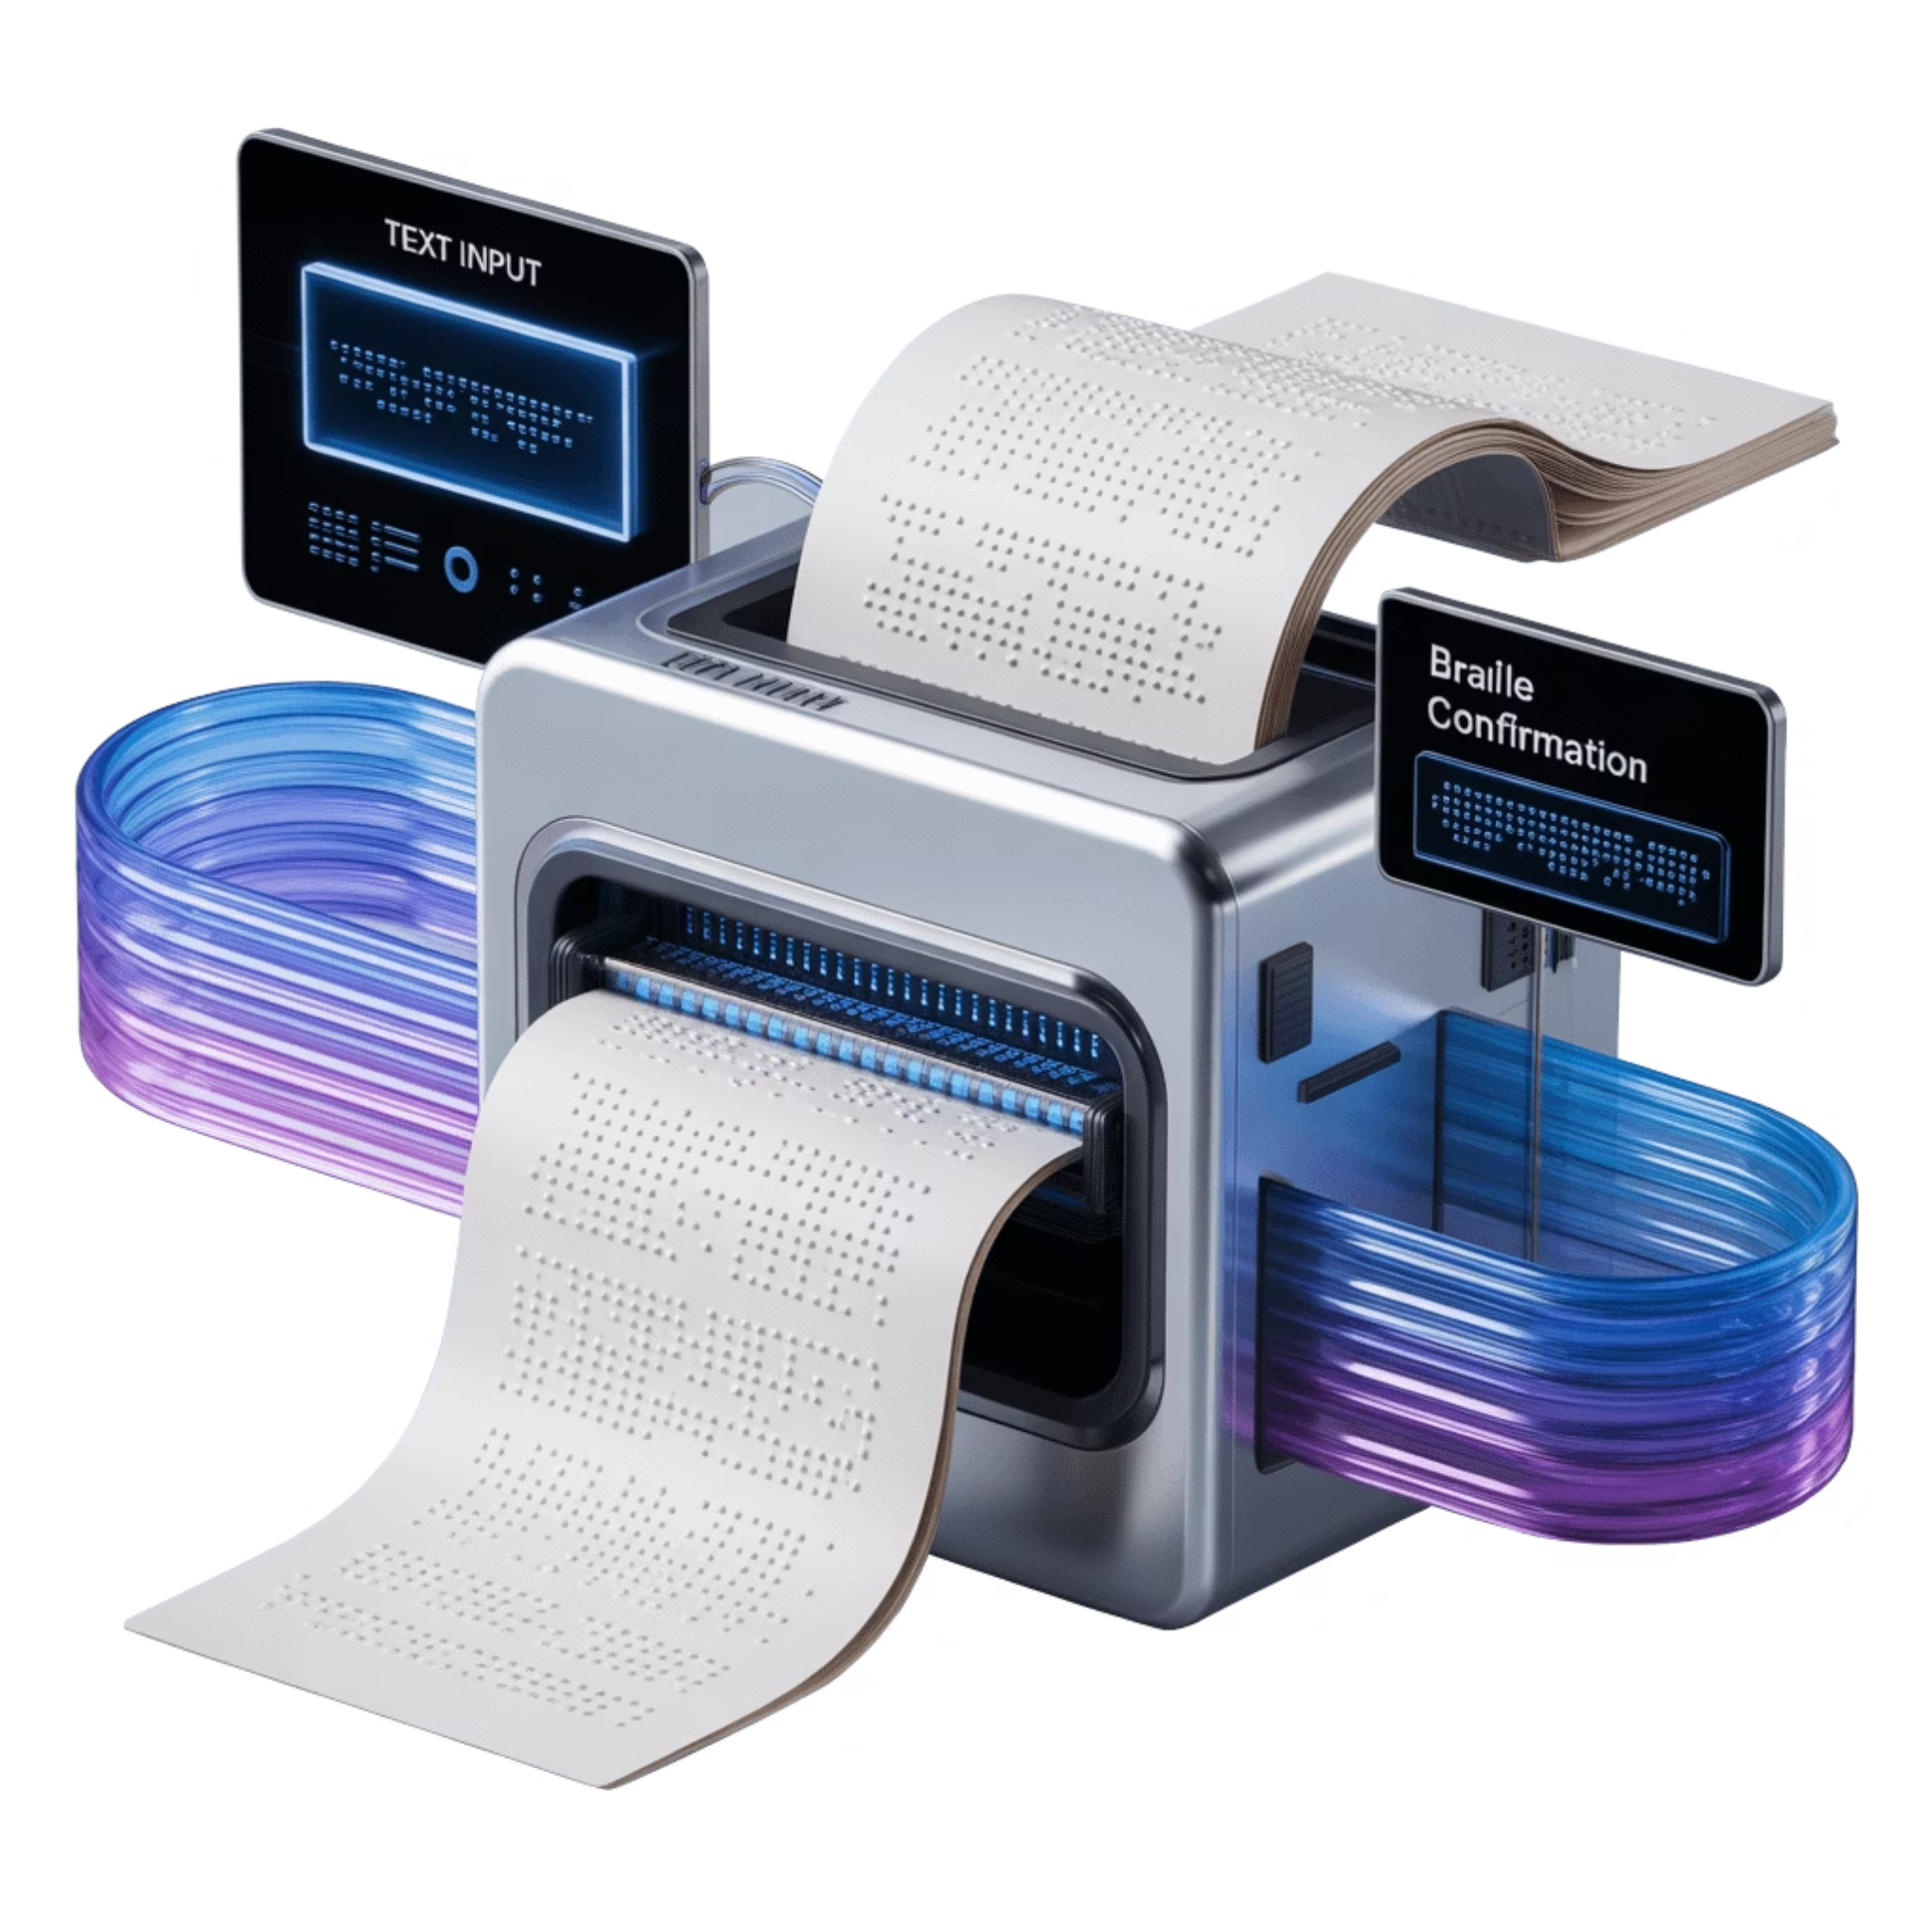



Workflow
1. Input: voice, keypad, or web
2. Process: convert text → braille
the user provides text through voice, keypad, or web
the system converts text into braille patterns using built-in translation
algorithms.
3. Emboss: motors + actuator
4. Feedback: LCD + audio
stepper motors move the paper, and the actuator makes the dots
LCD and audio give real-time updates
5. Output: braille page
a properly formatted braille page ready for tactile reading.

Slide 19

Results
Ala'a Abdelrahim 5
Abdullah Shabib 7

Slide 20

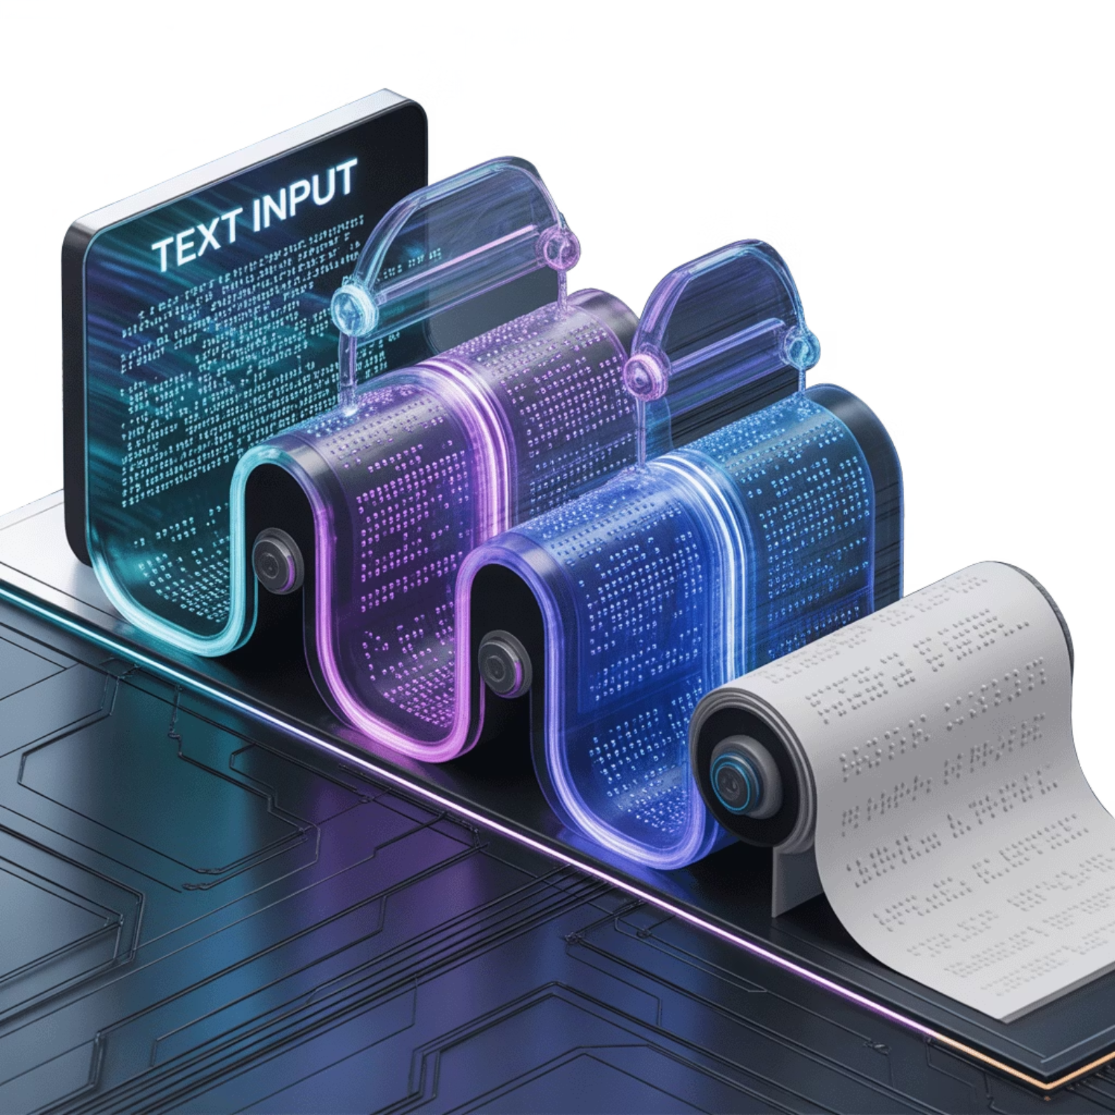



Future Work
Make printing faster
Optimizing the mechanical system and algorithms to increase printing speed without sacrificing dot quality.
Add an auto paper feeder
Developing an automatic paper feeding mechanism to improve accessibility and convenience.
Support more languages
Expanding translation capabilities to support braille in multiple languages and specialized formats.
Improve safety features
Implement additional safety mechanisms.

Slide 21



Conclusion
Cost-effective & modern solution
Combines IoT and assistive design
Bridges the gap in accessibility
DotSense is designed to be cost-effective and modern, making braille printing more accessible for individuals, schools, and organizations
By combining IoT connectivity with assistive design, we created a system that bridges the digital divide for visually impaired users
Our solution bridges the gap between expensive printers and the real need for affordable braille access

Slide 22

Thank You
⠠⠁⠝⠽⠀⠠⠟⠥⠑⠎⠞⠊⠕⠝⠎?

